Slide 1


National Aeronautics and
Space Administration
Let’s Talk:
Opportunities at NASA
Karen Bradford
Director of Strategic Partnerships
https://www.nasa.gov/careers
“We Are NASA”

Slide 2
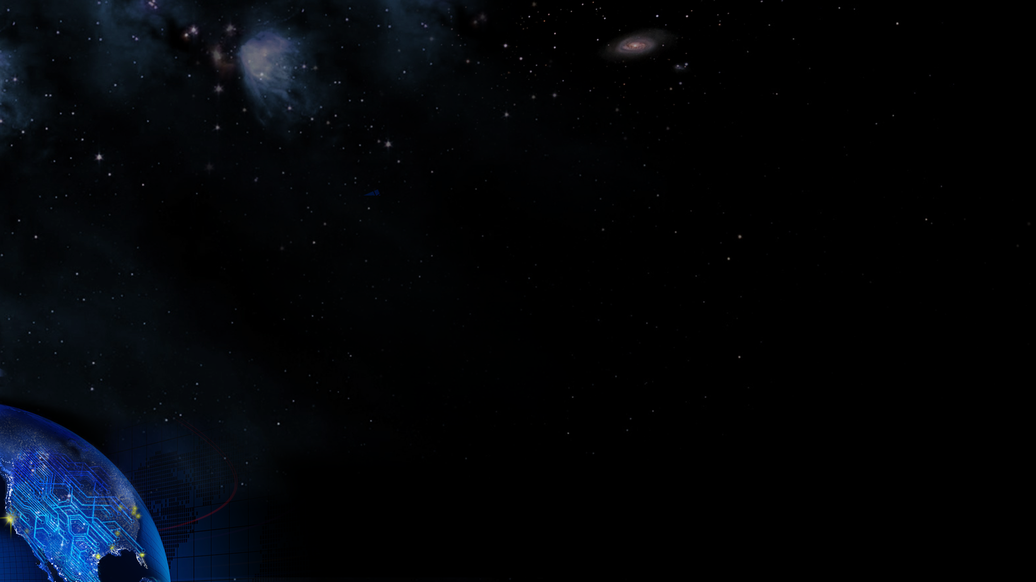


Is there space for me on the meatball?
NASA Ames Research Center Partnerships with NASA in Silicon Valley
National Aeronautics and
Space Administration
All together
We Go as the Artemis Generation! https://www.youtube.com/watch?v=dOKKkV-30dE
For Internal Use Only

Slide 3
Engage and take opportunities
NASA Ames Research Center Partnerships with NASA in Silicon Valley
National Aeronautics and
Space Administration
“Look for and/or create your own opportunity and don’t forget to take them. If it’s not obvious, if it’s not knocking on your door then go find it.”
– Mamta Patel Nagaraja – MissionStem
How are we going to the moon (1 minute)
https://www.youtube.com/watch?v=7Lol3lumMTo
Students 5th-8th Grade information/opportunities
https://www.nasa.gov/audience/forstudents/5-8/career/index.html
Students 9th-12th Grade information/opportunities
https://www.nasa.gov/stem/forstudents/9-12/index.html
STEM Opportunities at NASA HS-College (Note Pathways and Internships)
https://www.nasa.gov/centers/johnson/stem/student-activities/index.html
Videos of various information areas for students/educators
https://gpm.nasa.gov/education/subtopics/stem-careers
For Internal Use Only

Slide 4
Who is on the Enterprise?
NASA Ames Research Center Partnerships with NASA in Silicon Valley
National Aeronautics and
Space Administration
In addition to traditional STEM path careers, there are a plethora of what we call Mission Enabling careers (STEAM) as well that are vital to the success of a mission/goal. Here are just a few!
Logistics
  Launch prep
  Cargo lift/movement
  Travel (Prior to and on planet)
  Conference/workshop planning
  Project managers
  Procurement
Nutrition
  Nutritionists
  Chefs
  Botanist
  Farmers
Environment
  Artists
  Journalists
  Musicians
    https://www.clickorlando.com/news/local/2020/05/27/what-did-spacex-astronauts-listen-to-on-their-way-to-the-lanchpad/
  Organization Space Designers
  Clothing design and function (wearables)
  Event management
Law
  International Law
  Space Law (emerging field)
  Community Laws/Guidance for social constructs
  Agreements/Treaties
Theological/Counselors
  Faith support
  Psychiatric and Social Development Counselors
  Guiding Principles of Engagement
For Internal Use Only

Slide 5

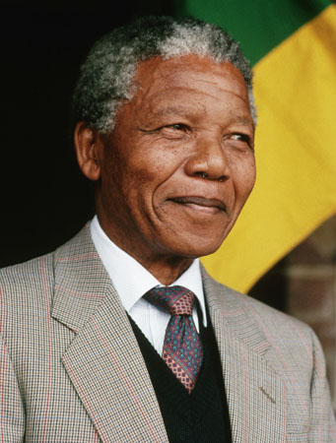
NASA Ames Research Center Partnerships with NASA in Silicon Valley
National Aeronautics and
Space Administration
“...Our deepest fear is not that we are inadequate. Our deepest fear is that we are powerful beyond measure. It is our light, not our darkness that most frightens us. We ask ourselves, Who am I to be brilliant, gorgeous, talented, fabulous? Actually, who are you not to be? You are a child of God.Your playing small does not serve the world. There is nothing enlightened about shrinking so that other people won't feel insecure around you. We are all meant to shine, as children do. We were born to make manifest the glory of God that is within us. It's not just in some of us; it's in everyone. And as we let our own light shine,
we unconsciously give other people permission to
do the same. As we are liberated from our own fear,
our presence automatically liberates others."
For Internal Use Only
Notes:
”

Slide 6
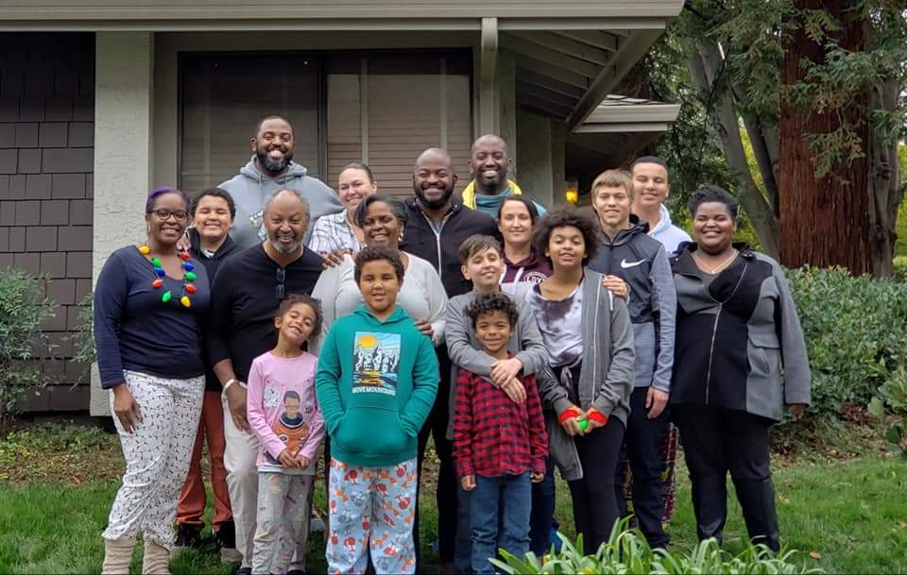
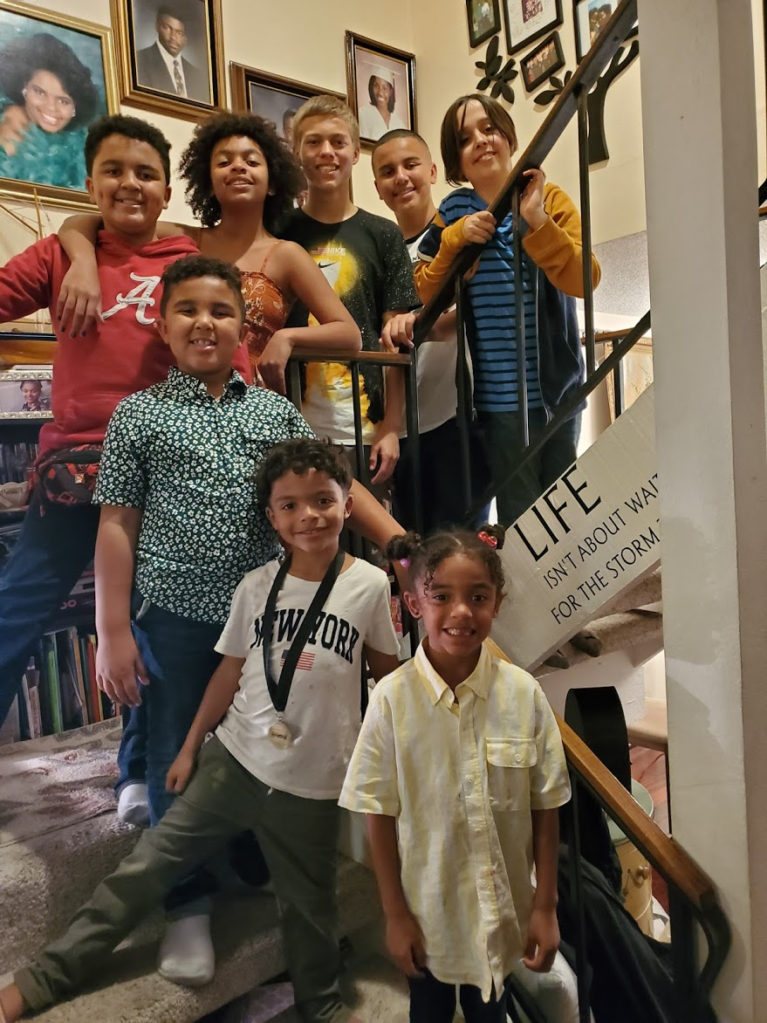
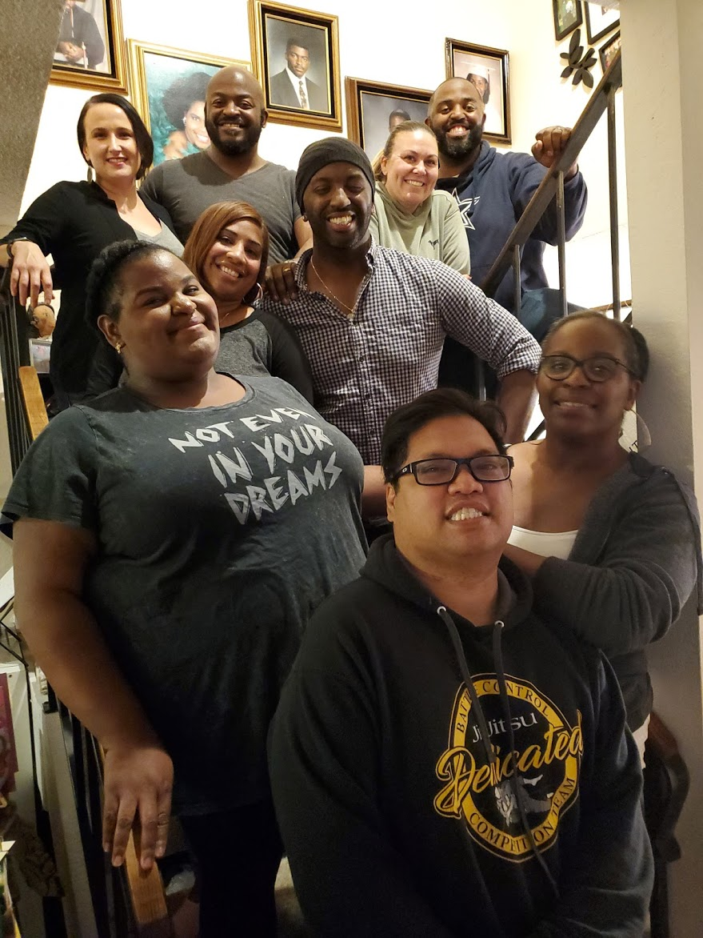
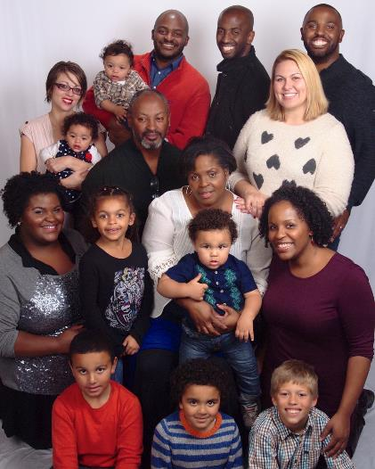
Thank You! Any Questions?
NASA Ames Research Center Partnerships with NASA in Silicon Valley
National Aeronautics and
Space Administration
For Internal Use Only

