Slide 1
Designing validation experiments: combining modeler and experimentalist perspectives
Presenter: Jacob Hochhalter, University of Utah
Team Members: David Dawicke, Analytical Services & Materials
Patrick Leser and Paul Leser, NASA Langley
Rick Russell, NASA Kennedy
Heather Hickmann, NASA Glenn
TMS Verification & Validation Seminar, October 20, 2020

Slide 2
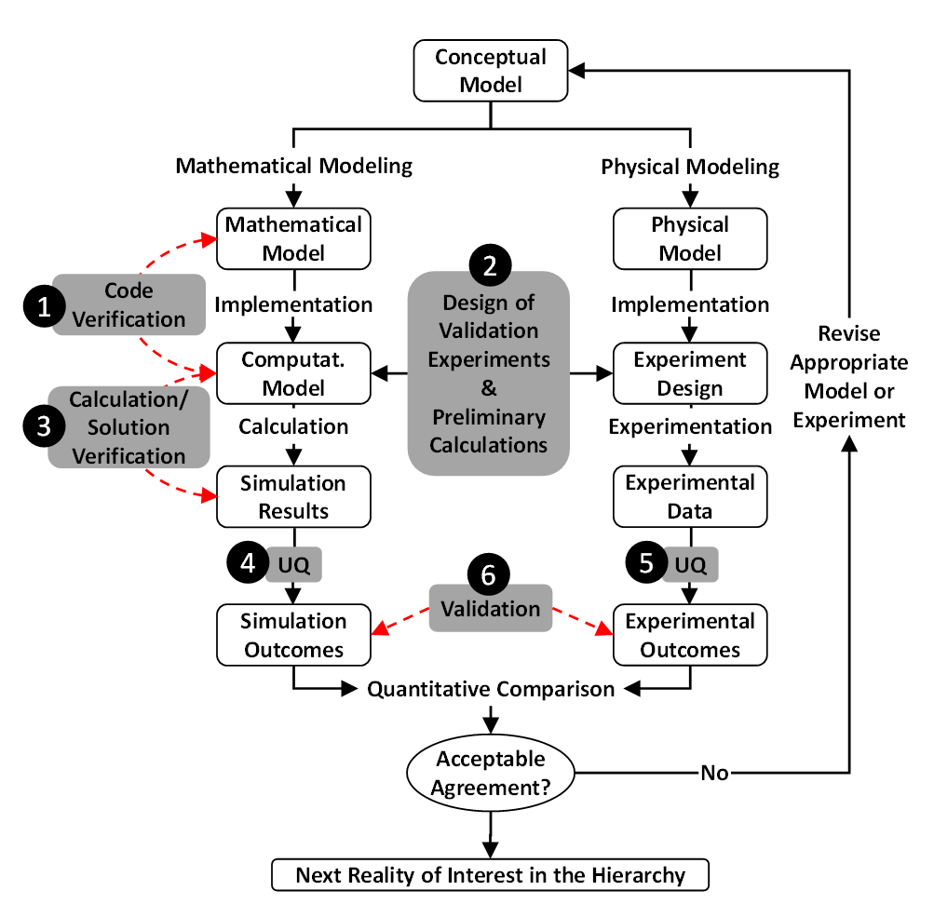
Topic Overview
“Step 2” in flowchart: experiment-design stage comes early in the V&V process and requires a close collaboration between modelers and experimentalists.
Objectives:
design an experiment wherein the quantities of interest (QoIs) to serve as a validation basis are defined.
provide effective assessment of computational-model accuracy.
Modeler: specify those QoIs along with all model-prediction assumptions and physical limitations to their validity.
Experimentalist: design an experiment in which those QoIs can be reliably measured and compared directly with the model predictions.
Following discussions of the main tasks are complemented with a few examples from practice to provide context.

Slide 3
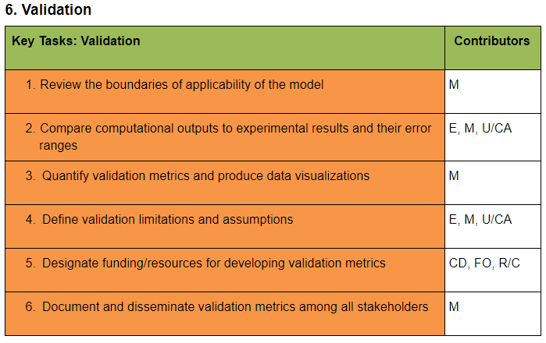
Validation is the Goal
Definition
“In the broadest sense, validation of a computational model refers to the process of determining the degree to which the computational model is an accurate representation of physical reality from the perspective of the intended uses of the model”
There are no universally validated models: comparison of the model to empirical data is assessed for particular use cases.
Robust Recommended Practices
rigorous numerical testing to confirm whether the model represents the intended physics and physical space/domain;
quantification agreement of model with tests results, includes UQ
use of data in validation as similar as possible to the real-world application of the computational model,
ensure the data used for validation has not been previously used in the development or execution of the computational model;
ensure that the model and experiments should have similar error tolerance, standard deviation, and confidence levels;

Slide 4
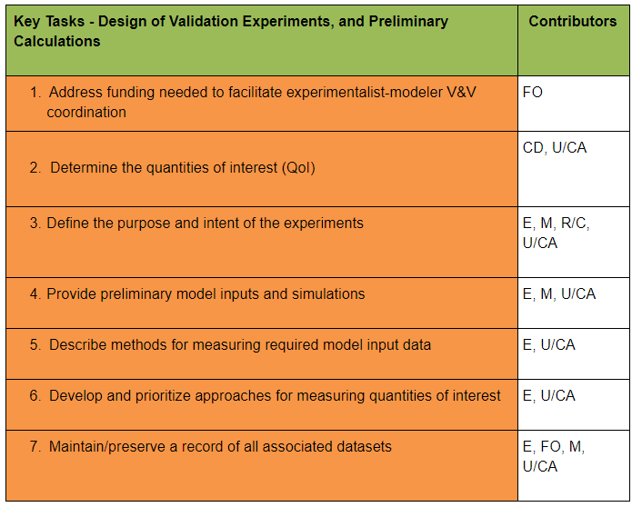
Current and Recommended Practice
Current Shortcomings:
Insufficient communication between modeler/analyst and experimentalist
Measurement uncertainties and/or input data uncertainties not rigorously investigated or reported
Detailed mathematical model idealizations of the experiment are commonly not reported
Lacking rigor (accuracy and UQ) in preliminary calculations
Recommended Practices:
Modeler/analyst inform experimentalist in advance the pertinent model assumptions, approximations, and requisite input data
  assessment of QoIs for expected numerical behavior
Experimentalist inform the modeler/analyst of the planned test procedures, data acquisition, diagnostics, range of possible conditions, and pertinent uncertainties
Modeler/analyst and experimentalist agree on the following:
  model-input parameters that will be directly measured and others that will require calibration
  identification and documentation of uncertainties in the experimental and preliminary calculations
  initial and boundary conditions in the experimental configuration, should be measured, understood, and incorporated

Slide 5
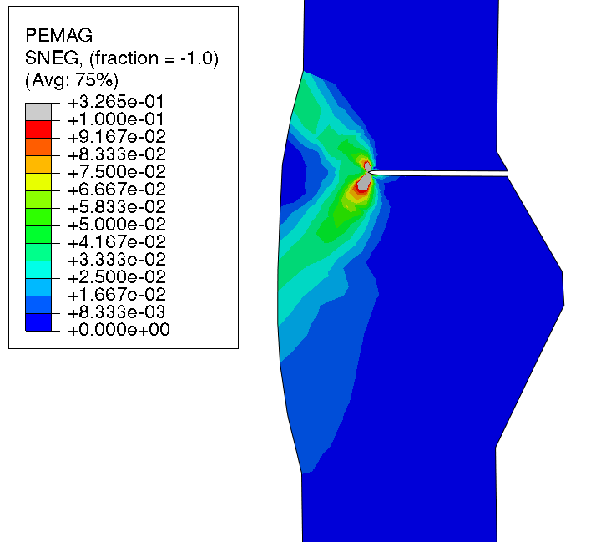
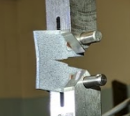
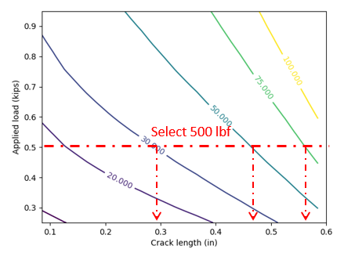
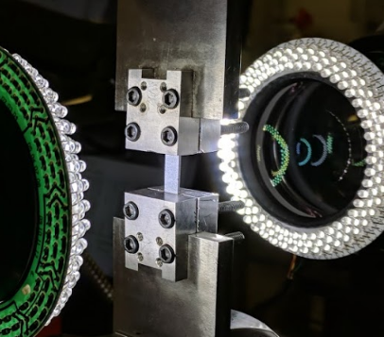
Design of Validation Experiments, and Preliminary Calculations
Determine QoIs
Accomplish early in the V&V process
Define intent of experiments
Experimentalists, modeler/analysts, and customer/regulator
Preliminary model inputs and results
Experimentalists, modeler/analysts
User, modeler/analyst, and code developer.
Identify the QoIs to be studied and/or predicted by the computational model
Describe the expected behaviors of these QoI
Assess test facility, funding, time, schedule
Define the physical phenomena of interest
List assumptions in the formulation of the model
Preliminary simulations for design of the validation experiments
Initial model calibration, boundary conditions, the sensor details
List trade-offs and outputs of the preliminary simulations
Design validation experiments based on analyst description of requisite model inputs
Quantify material state
Ensure experiment does not violate model assumptions
List potential experiments and measurements of QoIs
Prioritize methods for QoI data acquisition
Experimentalists and analysts confer on approaches for measuring QoIs
List potential experiments and methods for measuring the QoI to be measured and predicted.
List capabilities and limitations of the test facility(ies) and viable options of the proposed experiments
In practice, the experimentalist and modeler must agree on beneficial values that can be measured, if QoIs can not
List tradeoffs to the potential methods
Data acquisition plan for model input data
Experimentalists, users and analysts prioritize methods of measuring and calibrating model input data, such as material properties, and/or boundary conditions
In practice, experimentalist and analyst must often agree on a method to calibrate input data using inverse solutions of the model
Estimate experiment uncertainties. This encompasses gage repeatability and reproducibility
Output: Maintain/preserve a record of all associated datasets
Notes:
It is essential that all datasets associated with the validation experiments and preliminary calculations be captured, archived, and maintained over time, with proper version control and metadata. This requires some financial commitment to maintain the proper data registry in a sustainable fashion, and thus would involve funding organizations and/or other resource gatekeepers coordinating with the modelers and experimentalists in support of such data infrastructure. In cases where a sufficient data platform was not already in place or available to the user, this could also involve the initial development of such a platform.

Slide 6
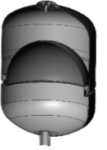
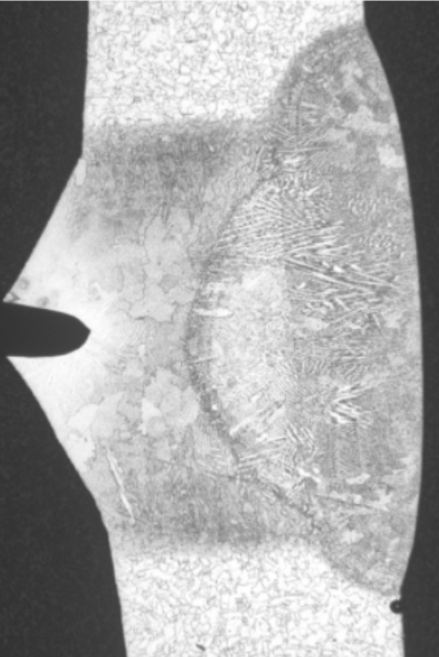
Pressure Vessel Use Case
Determine QoIs: Unstable crack growth in welded pressure vessel Define Intent: EAC* under elastic-plastic conditions
Tank
Gas
Diaphragm
Weld
Diaphragm
Hypergolic Propellant
(MMH and MON-3)
Characteristic fracture site
*EAC = Environmentally-assisted cracking

Slide 7
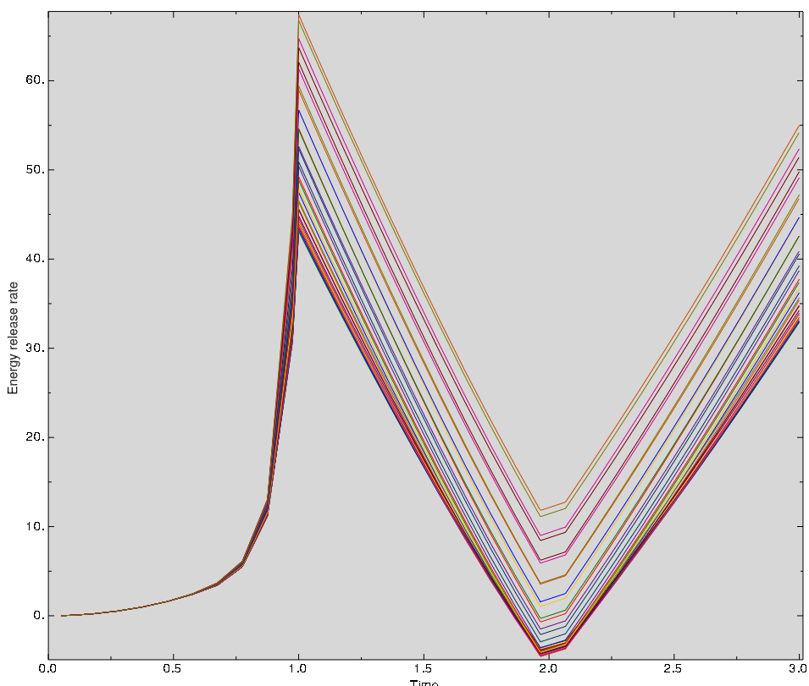
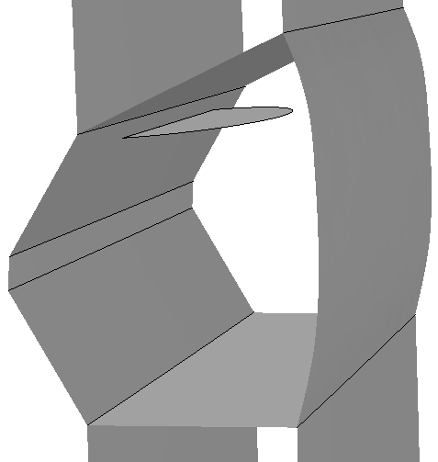
Pressure Vessel Use Case
Preliminary model inputs and results
Plastic Strain Mag.
J-Integral Results along crack front
Energy Release Rate
Side view of semi-circular surface crack near HAZ interface
Time
For c:a = 1, max(J) where crack front daylights (ID)
For c:a = 5, J nearly constant along crack front
Proof
MDP
3D view of crack

Slide 8
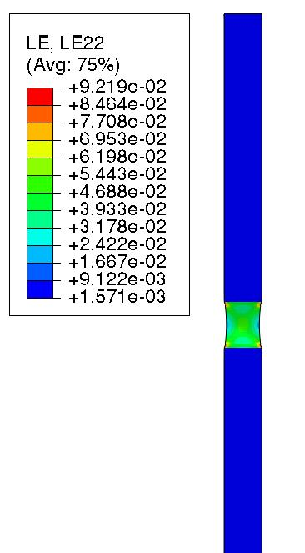
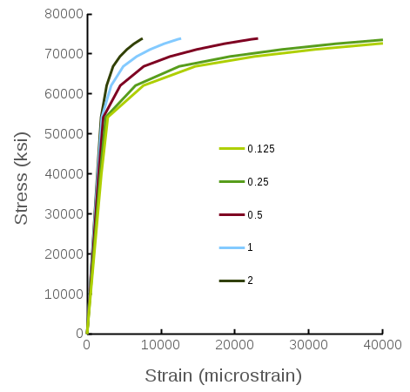
Pressure Vessel Use Case
Preliminary model inputs and results
Data acquisition plan for model input data
1” gauge length commonly used to measure elongation – assumes homogeneous material
Weld modulus and yield calculated in this way represent a mixture of parent and weld materials
Stereo DIC
Increase in apparent yield and modulus by increasing gauge length in FE model
Gauge length
0.25” gauge
1” gauge

Slide 9
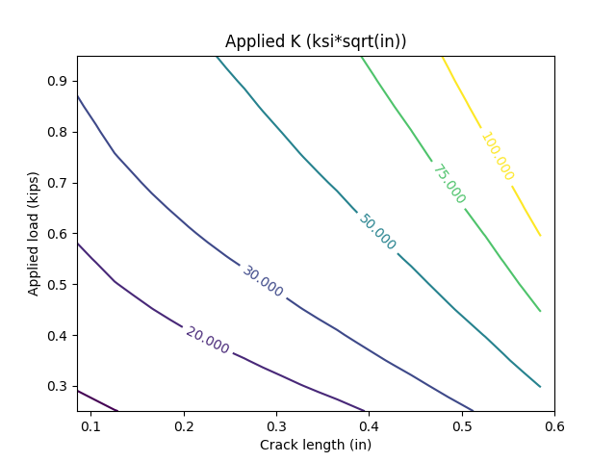
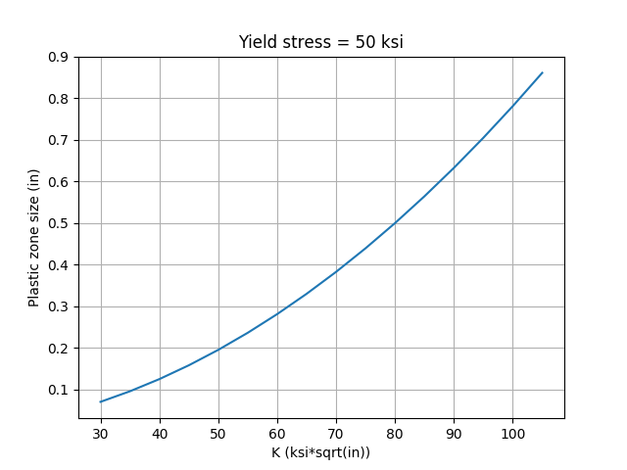
Pressure Vessel Use Case
Prioritize methods for QoI data acquisition
Yield Stress = Lower bound estimate
Surface cracked, M(T), specimens:
About 5 kips would be required to produce desired K.
There would be net section yielding at a load much lower than that which would produce the desired K.
ESET (or CT) specimens:
Provides increased K at practical loads
Load being applied manually as hanging weight
Lacks similarity to surface crack in tank
Select 500 lbf
Design steps:
select desired load (500 lbf used as an example)
select desired applied K (30, 50, and 75 ksi*sqrt(in) used as arbitrary examples here)
determine required crack length that satisfies above conditions
crack length + plastic zone size (using desired K and chart on right) estimates width lower bound

Slide 10
Takeaway Points
Main Tasks:
Input: Funding and motivation
Determine QoIs
Define intent of experiments
Preliminary model inputs and results
Data acquisition plan for model input data
Prioritize methods for QoI data acquisition
Output: Maintain and preserve a record of all associated datasets
In practice, these steps are not always chronological nor monotonic. Iterations that incorporate
lessons learned can be expected, especially in complex scenarios.

Slide 11
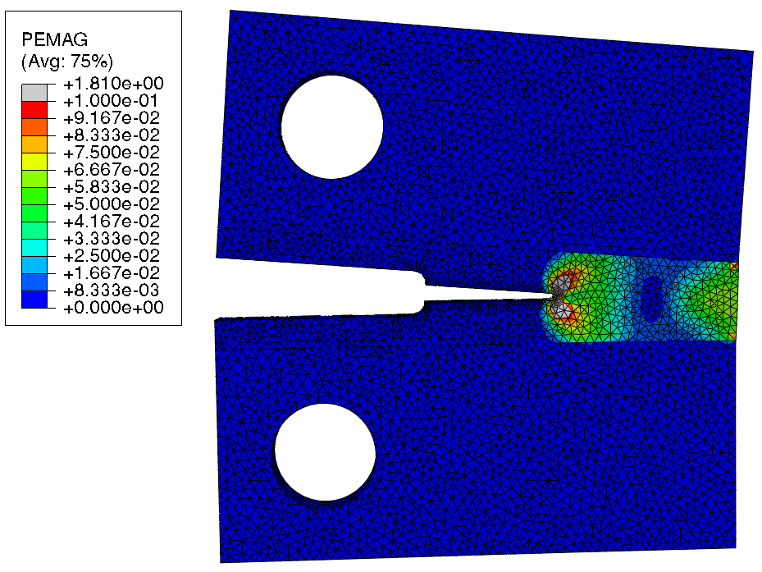
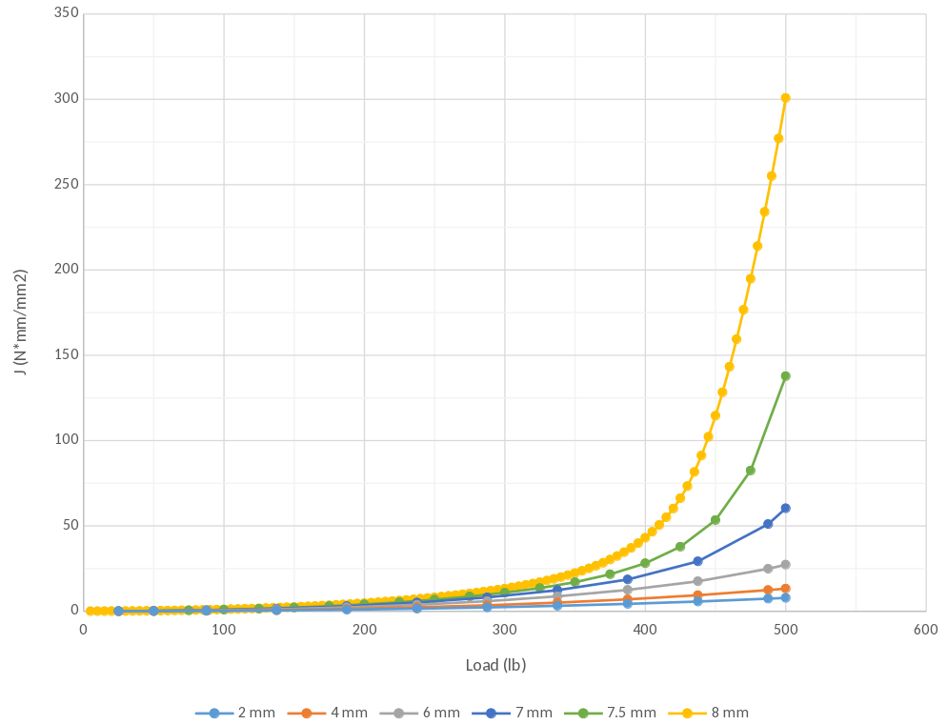
Pressure Vessel Use Case
Weld toughness
c:a = 1:5
c:a = 1:4
c:a = 1:1

Slide 12
Validation
Task 1. Review the boundaries of applicability of the model
Predominantly, it is the responsibility of the modeler to review the boundaries of applicability of the model, and conduct an assessment of model inaccuracies as a function of individual experiments. Any given model has physical limits of applicability where the modeling is valid and accurate. An example would be elasticity, which loses applicability when plastic deformation begins. The same is true for modeling assumptions such as boundary conditions.
Task 2. Compare computational outputs to the experimental results and their error ranges
This task would be performed by some combination of the computational modeler, the experimentalist, the user of the model, and/or a computational/simulation analyst. In this effort, the computational outputs would be directly compared to experimental results (and their error ranges) in a quantitative fashion. To whatever extent possible, consideration can be given to the distribution metrics (e.g., mean, standard deviation, kurtosis, skewness) and other direct distribution-based metrics of both the computational and the experimental results, using UQ methodologies and their error ranges (see also the tasks for process steps 4 and 5 above) [$UQ-Wang&McDowell]. In this step consideration should be given to the relationship between model fidelity and error levels, and it should be recognized that outputs are stochastic, as opposed to discrete values. The practitioner should in advance review applicable rules/guidelines for quantifying measurements (e.g., measurement of dimensions) and associated errors pertaining to the experiment(s) at hand. Sources of uncertainty should be reviewed and confirmed to satisfy the validation requirements.
Task 3. Quantify validation metrics and produce data visualizations
In this task the modeler should aggregate the quantitative validation metrics, and produce graphs and other data visualizations that help illustrate any divergence or disparities between the simulation results and the experiments. This can be applied to either discrete data groups and/or to more qualitative trends.
Task 4. Define validation limitations and assumptions
This task would again involve a coordinated effort between some combination of the computational modeler, the experimentalist, the user of the model, and/or a computational/simulation analyst. The validation limits imposed by the model itself would be outlined and assumptions about model accuracy or acceptability for applications of interest would be described. In similar fashion, the experimental validation limits need to be outlined as well, and any limits of the conclusions and outcomes from the entire validation exercise should be defined (for instance via a parametric description of the physical regime under examination).
Task 5. Designate funding/resources for developing validation metrics
To engage in a robust validation effort, it is important to ensure that funding/resources are specifically designated to support these efforts (i.e., for developing the validation metrics, which includes metrics that are both closely and poorly matched.) The modelers, users of the models, and/or experimentalists involved in the validation effort need to engage the customer or regulator to define the threshold or extent of validation required, in support of approaching the funding organization or other allocator of resources in their organization.
Task 6. Document and disseminate validation metrics among all stakeholders
It is imperative that the validation metrics that resulted from the validation tasks outlined above be fully documented and disseminated to all parties that have an interest or stake in the computational modeling effort. The computational modeler should take the lead responsibility in ensuring that this is done.

Slide 13
Connecting Modelers and Experimentalists
Strategy #1: Provide Incentive Mechanisms that Motivate V&V Contributions
  Multidisciplinary V&V funding streams and requirements
  Publication venues that reinforce joint experimental-computational V&V efforts
  Robust experimentation requirements for challenge problems
  Strategy #2: Build Awareness of the Value of V&V/UQ
  Value-driven collaborative V&V partnerships for decision making
  Professional society V&V committees/working groups
  Recognition and achievement awards for V&V efforts
  Advertisements for shared V&V resources
Strategy #3: Reduce the Entry Barrier for New V&V Practitioners
  Networking events for V&V team matchmaking
  Joint educational opportunities for experimentalist modeler teams

