Slide 1






Alternating Between Software Models and Real Hardware in the System Integration Lab for the Incremental Development of the Space Launch System Program Avionics
Matthew Pickard
Aaron Itzkovitz
10-23-2020

Slide 2
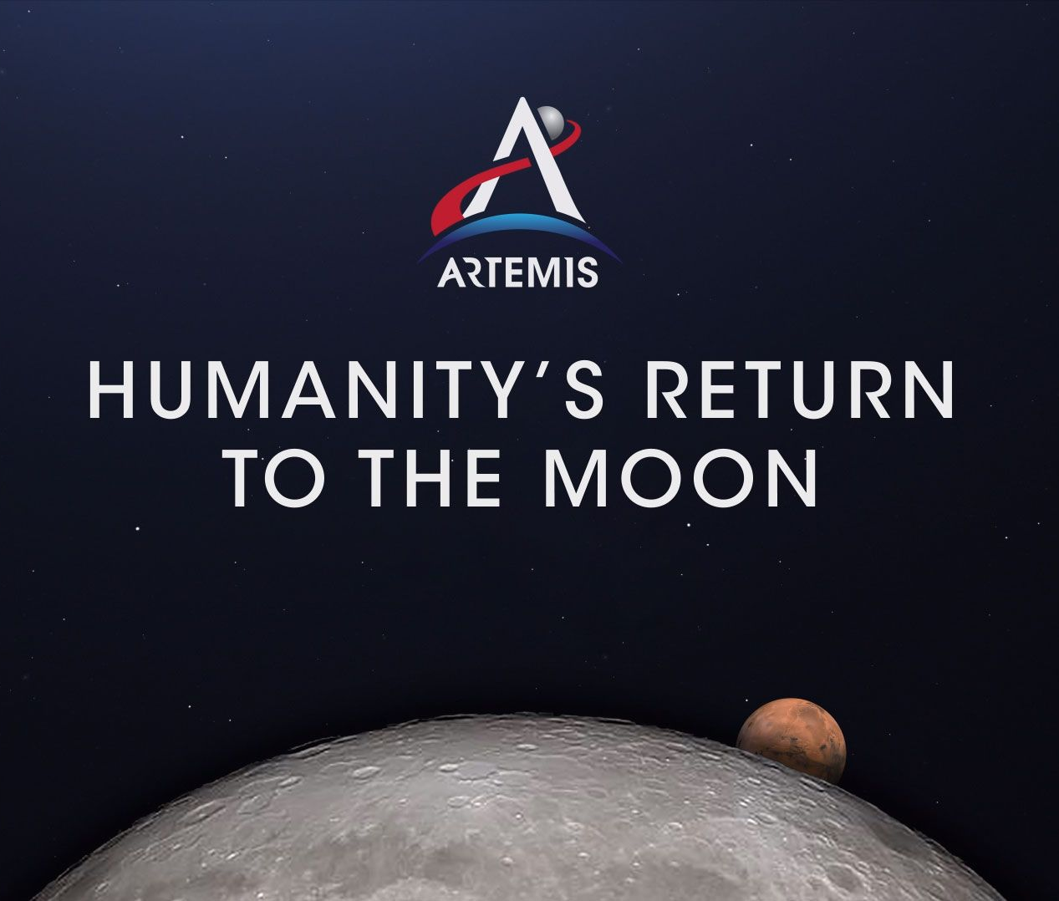
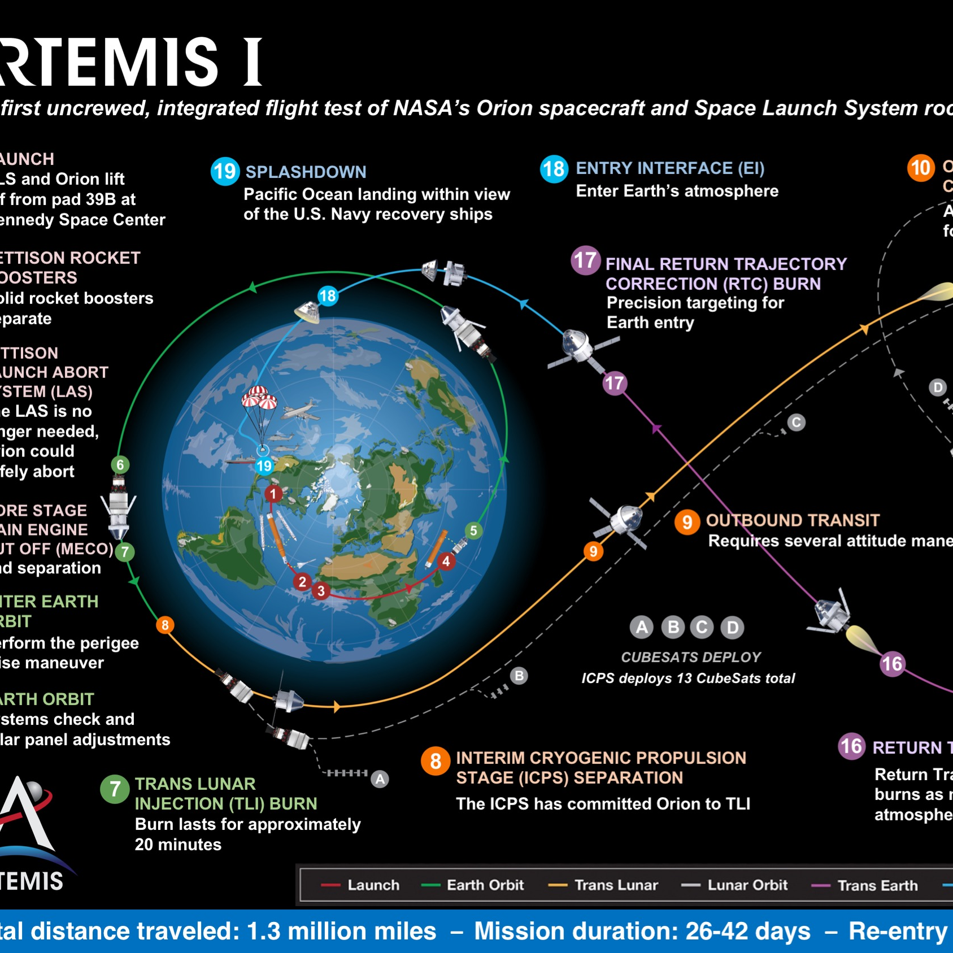
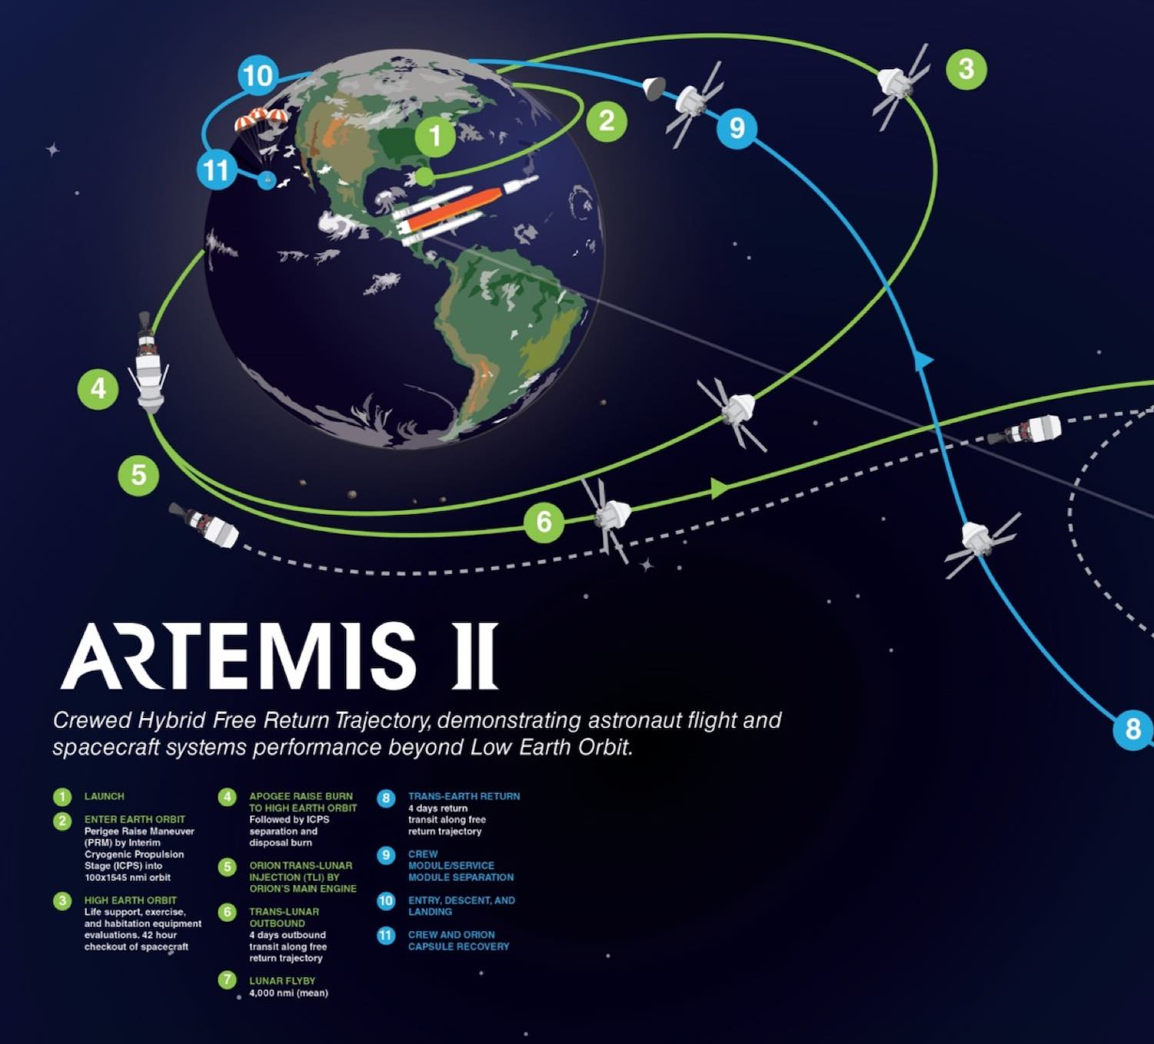
ARTEMIS
The Artemis program is a US government-funded crewed spaceflight program that has the goal of landing "the first woman and the next man" on the Moon, specifically at the lunar south pole region by 2024.
Launch vehicles planned to be used will include the NASA Space Launch System

Slide 3

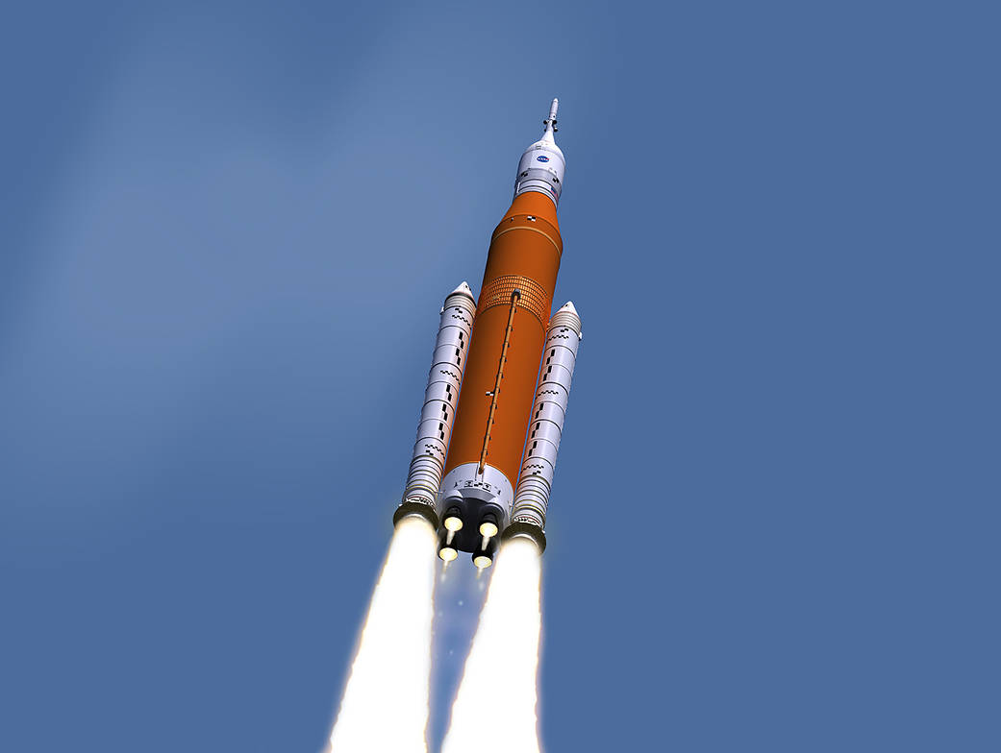
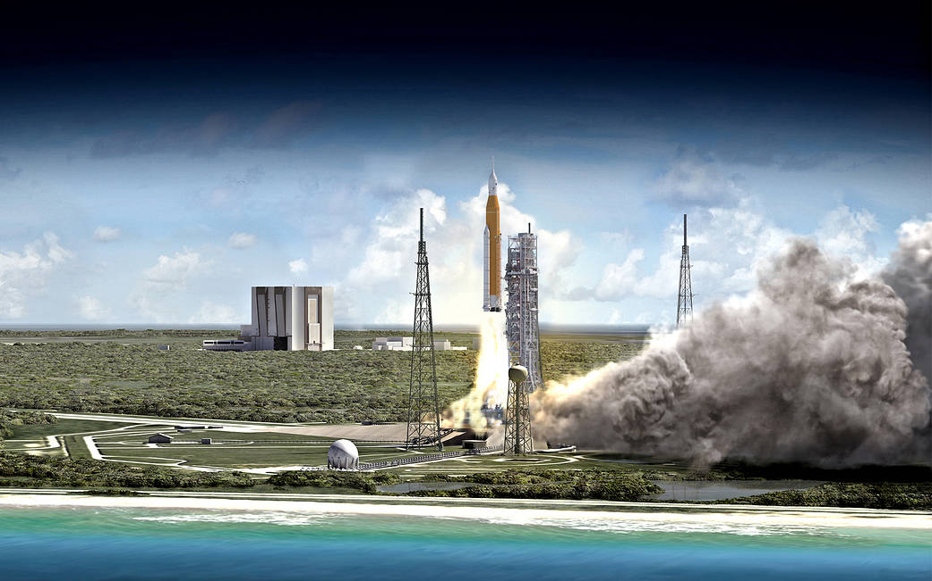
What is the Space Launch System (SLS)?
NASA’s new heavy-lift launch vehicle for the next generation of human space exploration beyond low-Earth Orbit

Slide 4
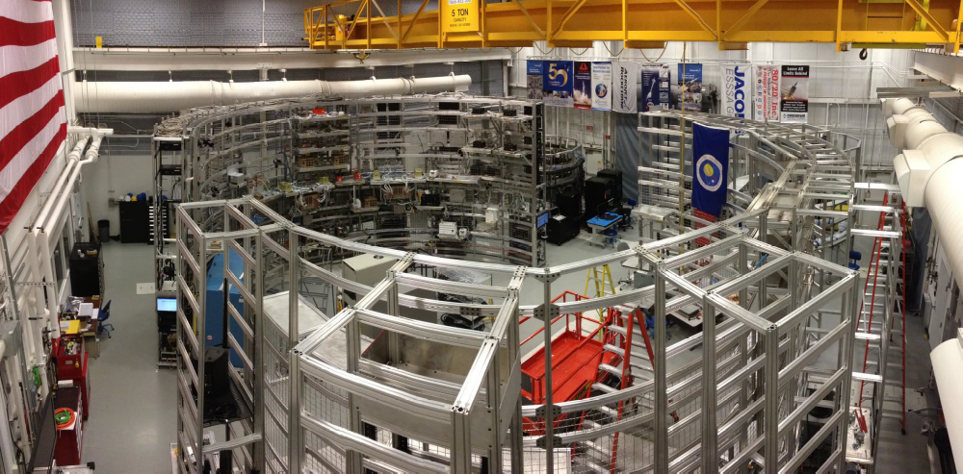
MSFC SLS Testing Facilities:
System Integration Lab (SIL)
System Integration Testing
Facility (SITF)
Real Hardware
Flight
Computer
Engine
Controller
Global Positioning Sensors
Fuel Tank Level
Sensors
Radio Transmitter
https://blogs.nasa.gov/Rocketology/2016/07/01/sls-avionics-the-brain-without-a-body/

Slide 5
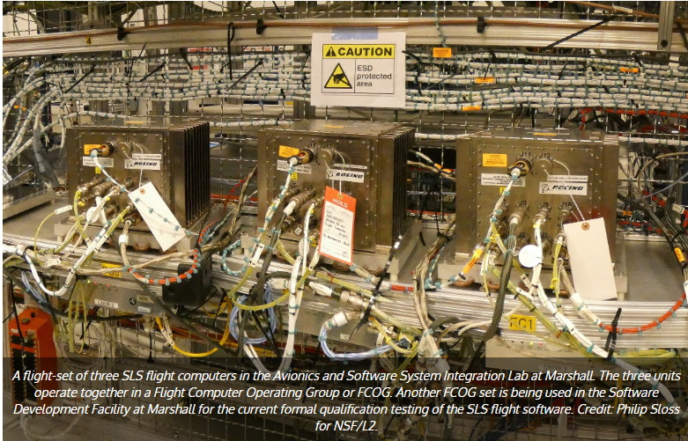
Testing Facility
Real Hardware
Flight
Computer
https://www.nasaspaceflight.com/2019/04/sls-flight-software-avionics-run-record-testing/
Engine
Controller
ARTEMIS Simulation
Global Positioning Sensors
Fuel Tank Level
Sensors
Radio Transmitter

Slide 6
Swapping out hardware for a model
Engine
Controller
Unit returned to
vendor
Real Hardware
Flight
Computer
SW Model of
Engine Controller
ARTEMIS Simulation
Engine
Controller
Global Positioning Sensors
Fuel Tank Level
Sensors
Radio Transmitter

Slide 7
Advantages of Hardware in the Loop (HWIL) Integrated Testing
Perform early hardware/software integration as components are developed and built
Risk Mitigation:
  Potential architecture and interface problems can be addressed
  Reduce risk as early in the design cycle as possible when problems are the least expensive to resolve while also improving the design and requirements.
Avionics components can be tested and integrated as they are developed and built
Example:
  Problems detected with fuel tank sensor hardware
  This HW can be removed and returned to vendor/manufacturer
  Testing can continue of the integrated system using software model surrogates

Slide 8
References
https://www.nasa.gov/exploration/systems/sls/multimedia/images.html
https://www.spaceflightinsider.com/organizations/nasa/nasa-administrator-bolden-visits-msfc-reviews-progress-sls/
https://www.nasaspaceflight.com/2019/04/sls-flight-software-avionics-run-record-testing/
https://www.google.com/search?q=sls+system+integration+lab&tbm=isch&source=hp&sa=X&ved=2ahUKEwjn2LLthorjAhUJhOAKHQkzDPMQsAR6BAgGEAE&biw=1790&bih=941&dpr=1
https://blogs.nasa.gov/Rocketology/2016/07/01/sls-avionics-the-brain-without-a-body/

