Slide 1
Advanced Microwave Precipitation Radiometer (AMPR) observations during IMPACTS 2020
Timothy J. Lang
NASA Marshall Space Flight Center

Slide 2
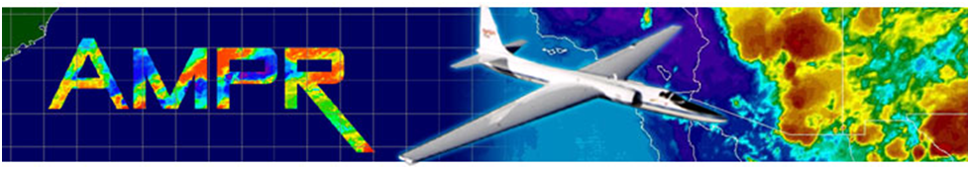
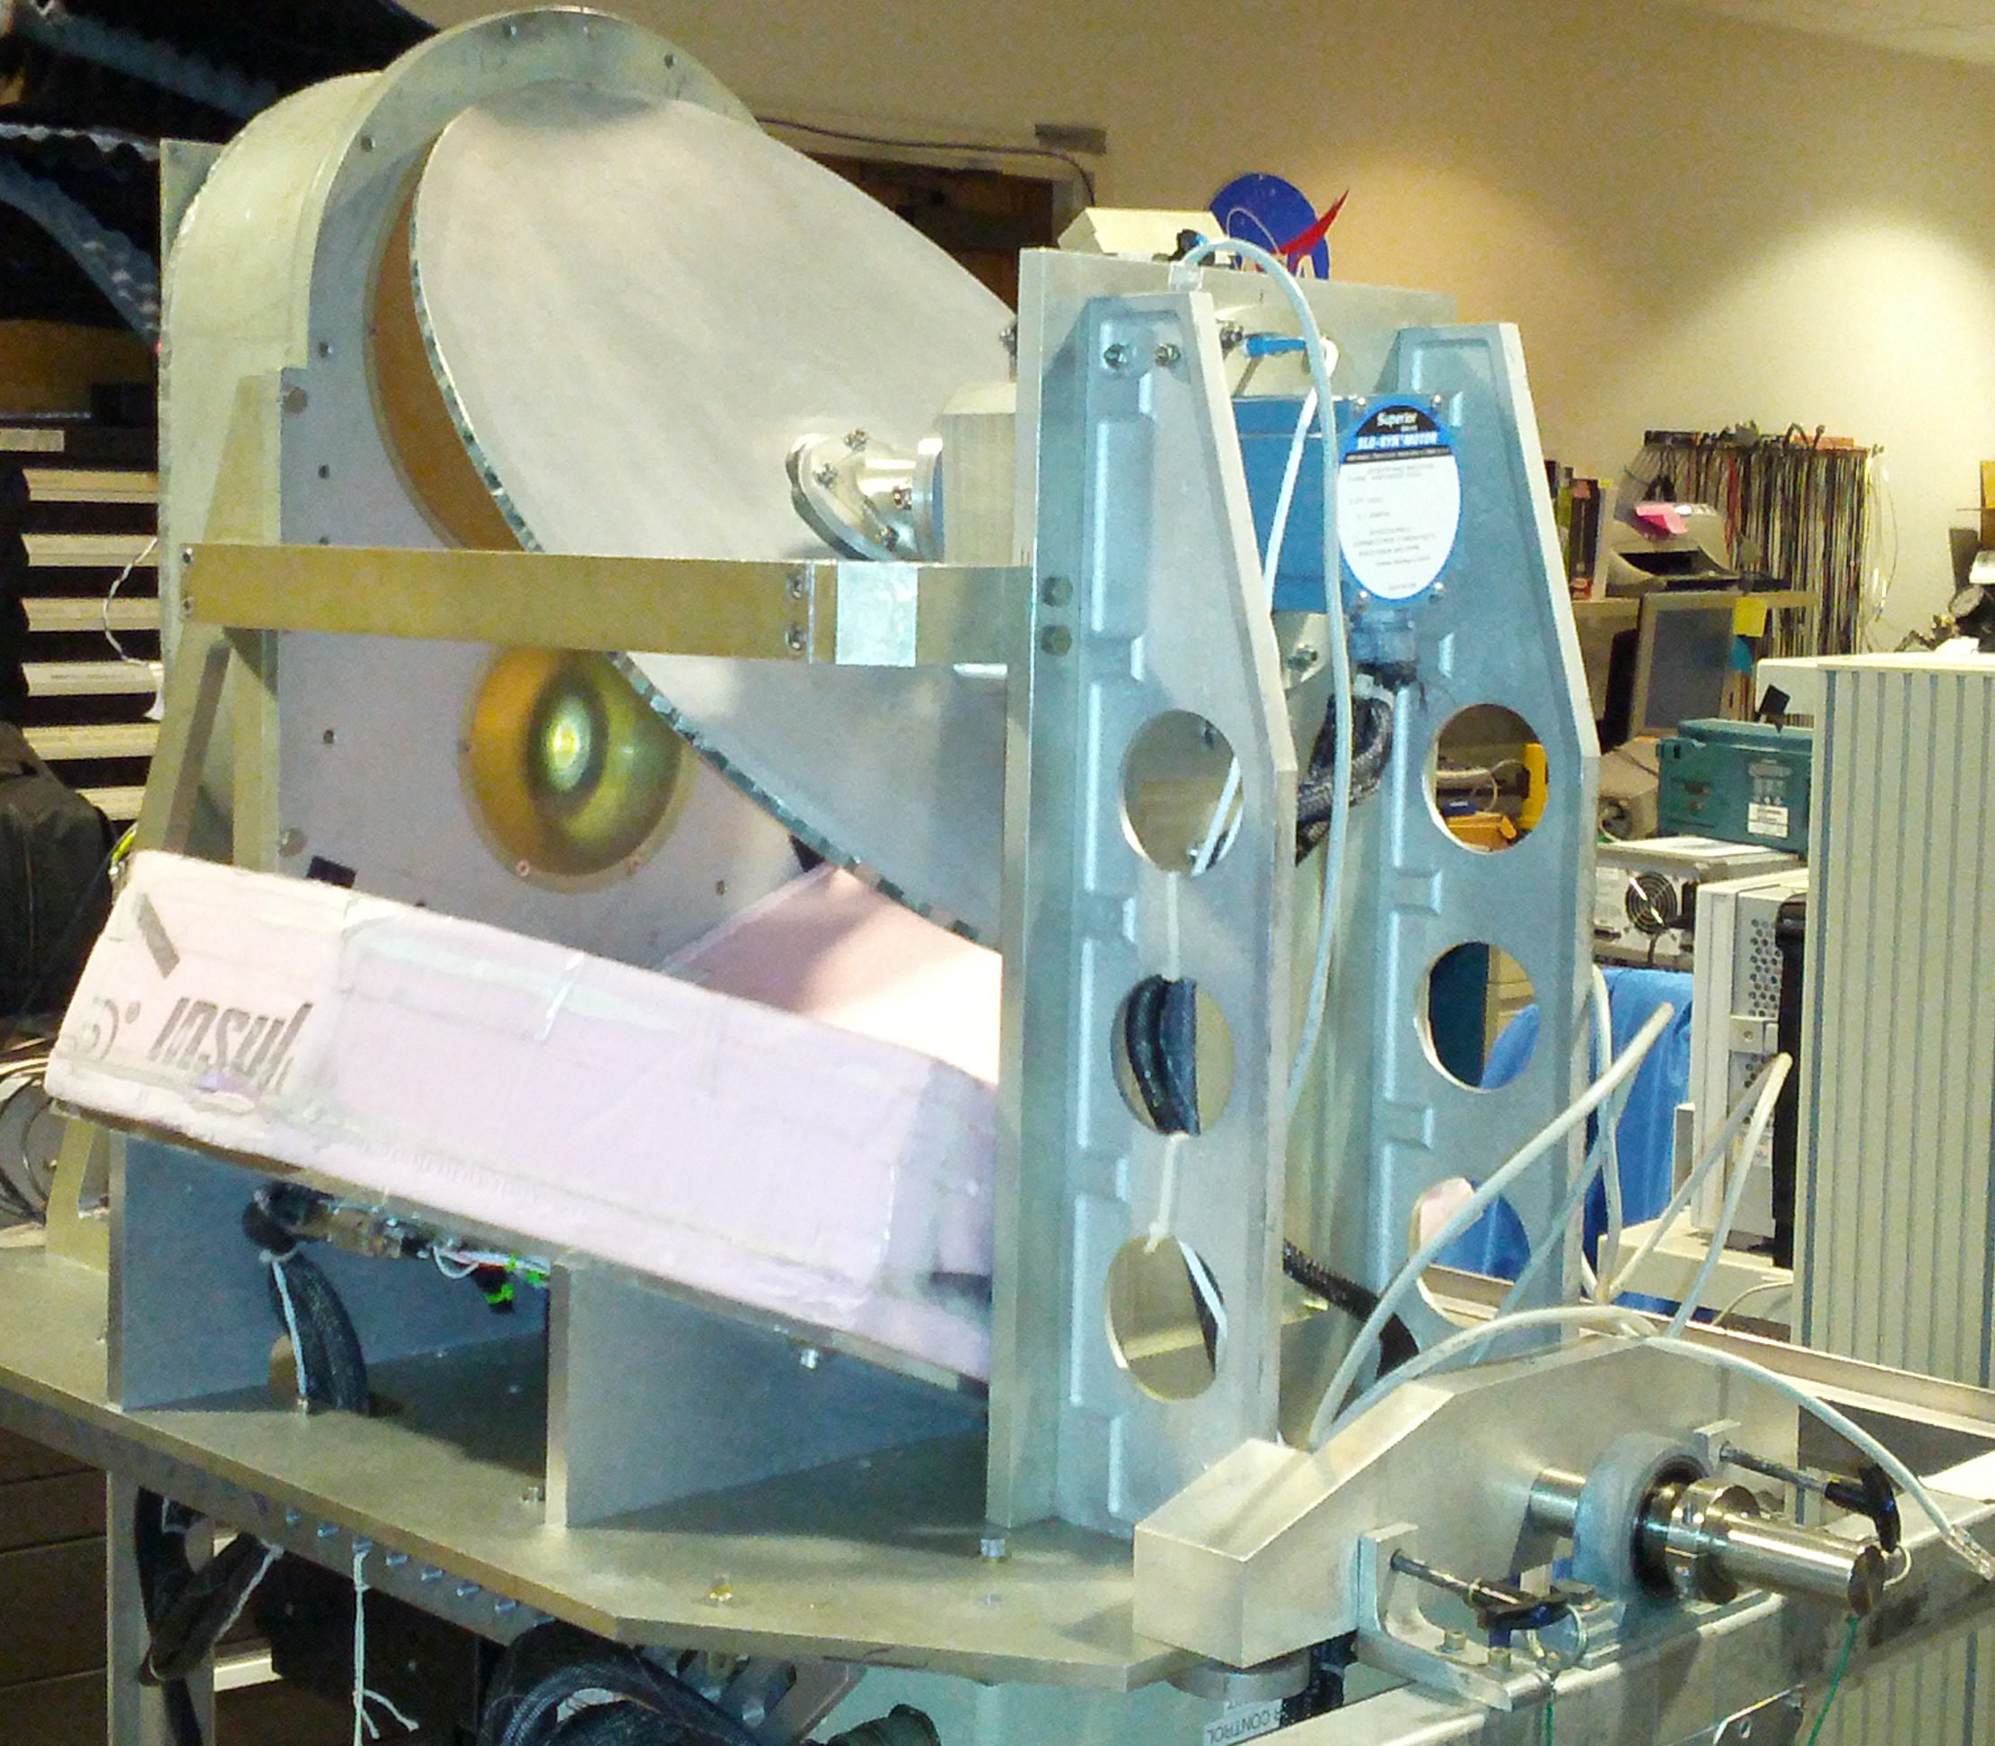
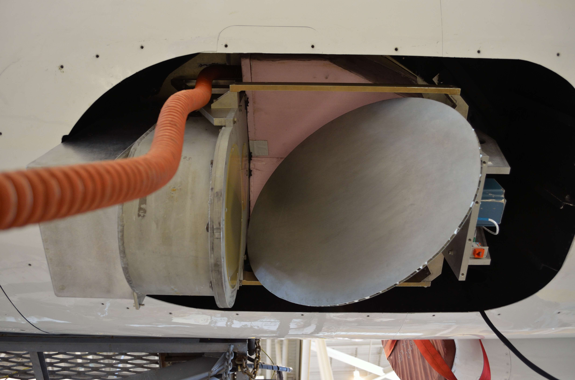
IMPACTS ER-2 Payload
Instrument name /team:
AMPR (Advanced Microwave Precipitation Radiometer)
Team: Timothy Lang (PI), Paul Meyer (PM), Eric Cantrell, Max Vankeuren, Doug Huie, Amanda Richter, Corey Amiot, Sayak Biswas, Sue O’Brien, Tom Phillips, Mark James, Chris Anthony
1) What does AMPR measure?
Passive microwave radiometer – Retrieve surface emission, cloud liquid water, ice water path, water vapor, ocean wind speeds, etc.
Four frequencies - 10.7, 19.35, 37.1, 85.5 GHz, with 2 variable polarization channels apiece (Channel A: V -> H and Channel B: H -> V)
Cross-track scanning (can also do nadir staring)
2) What science role is AMPR playing in IMPACTS?
Objective 1: Characterize the spatial/temporal scales/structures of snowbands - Precipitation horizontal structure
Together with CoSMIR, provide coverage of 10-183 GHz microwave channel range
Low frequencies provided by AMPR especially valuable over water

Slide 3
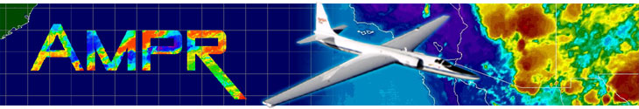
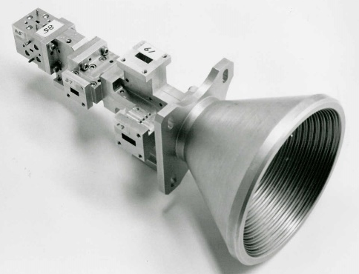
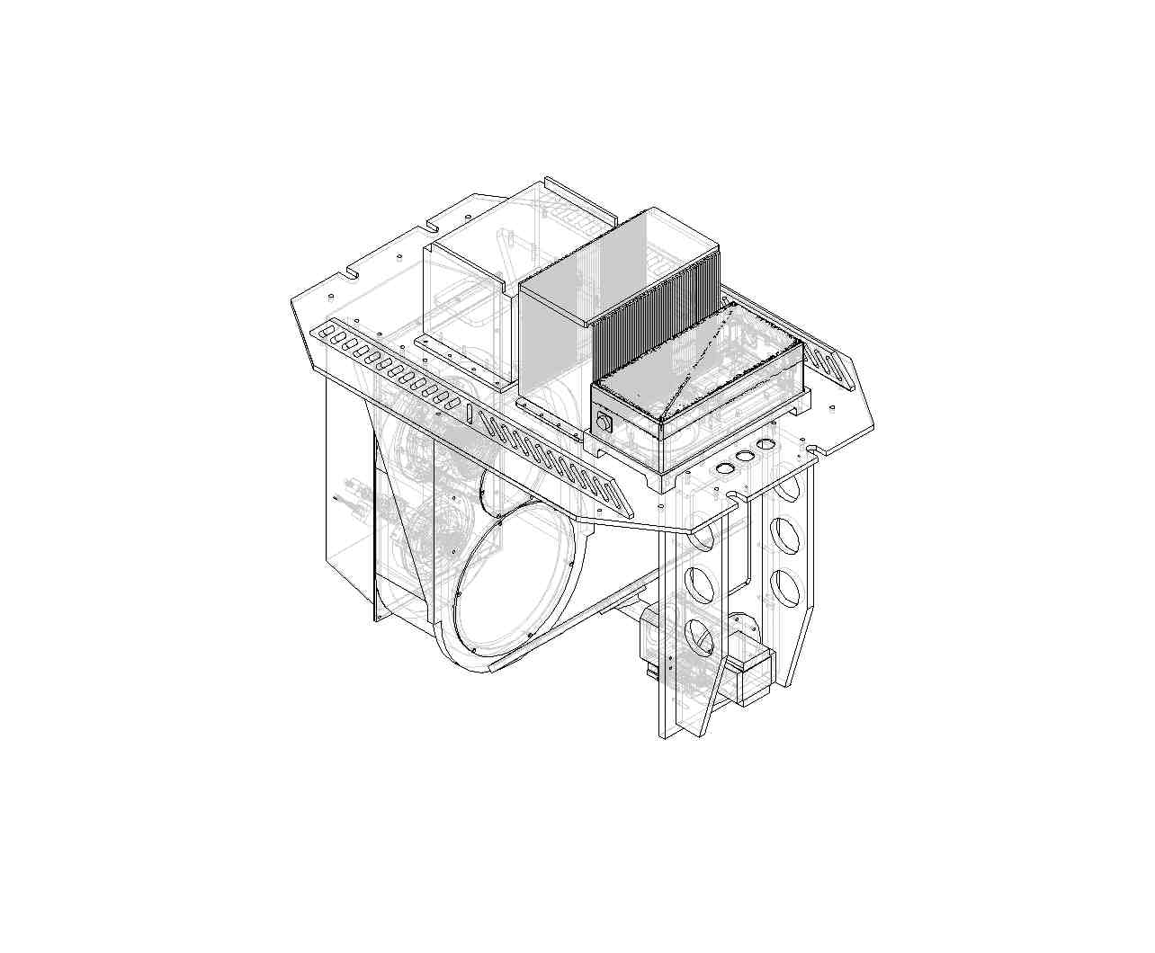
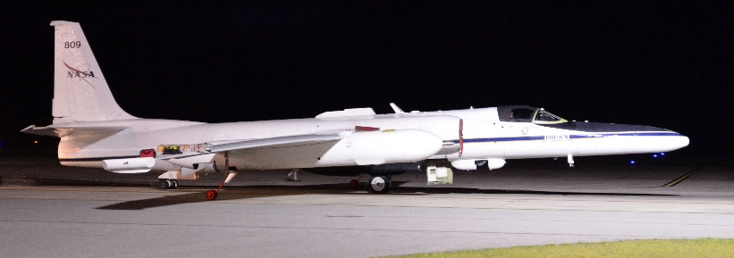
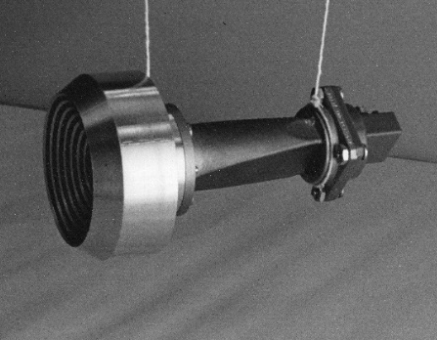
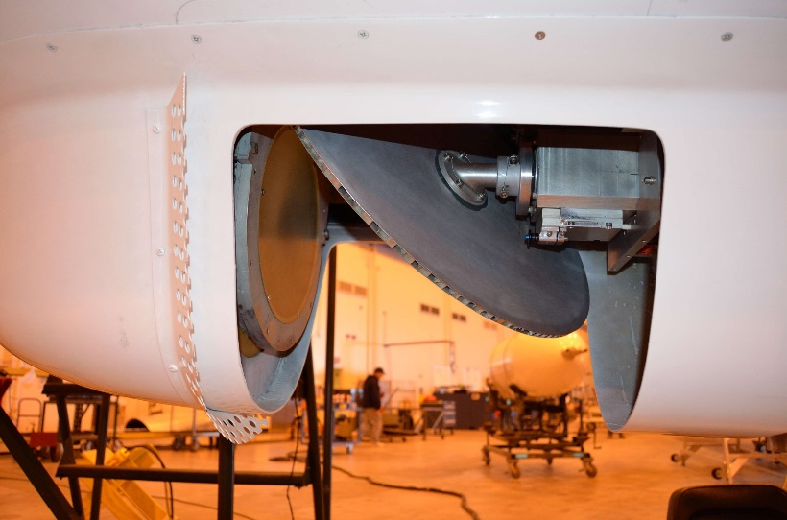
NASA ER-2
NASA ER-2
SSMI MFFH
Mirror reflector
GTRI 10.7 GHz horn
Channel Center Frequency | 85.5GHz | 37.1GHz | 19.35GHz | 10.7GHz
Polarization | A/B | A/B | A/B | A/B
Pre-Detection Bandwidth (MHz) | 1400 | 900 | 240 | 100
Integration Time (ms) | 50 | 50 | 50 | 50
Horn Type | SSM/I | SSM/I | SSM/I | GTRI
Lens Diameter (inches) | 5.3 | 5.3 | 5.3 | 9.7
Beam width (degrees) | 1.8 | 4.2 | 8.0 | 8.0
Footprint (km) [@20 km ER-2 alt. 500kts] | 0.64 | 1.48 | 2.78 | 2.78

Slide 4
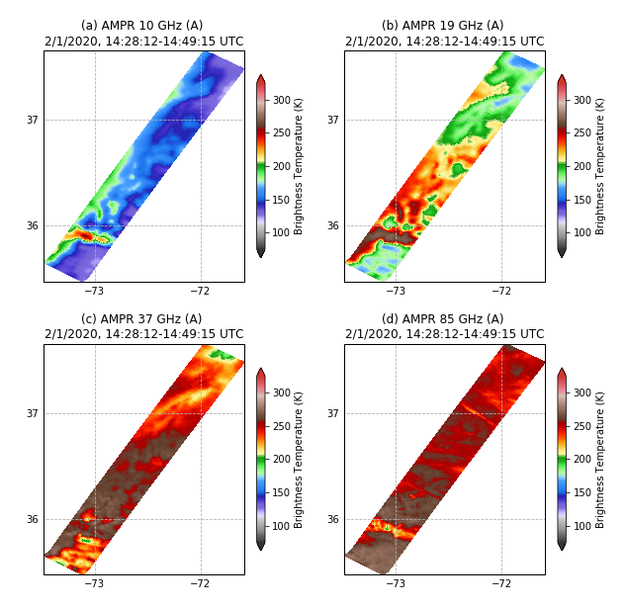
AMPR Overview – IMPACTS 2020
AMPR flew on 10 IMPACTS 2020 transit and science flights (~61 hours of observations)
While AMPR’s primary science role in IMPACTS is for over-water flights, 37- & 85-GHz channels also provided useful precipitation observations over land.
AMPR supported a Global Precipitation Measurement (GPM) underflight on 2/1/2020

Slide 5
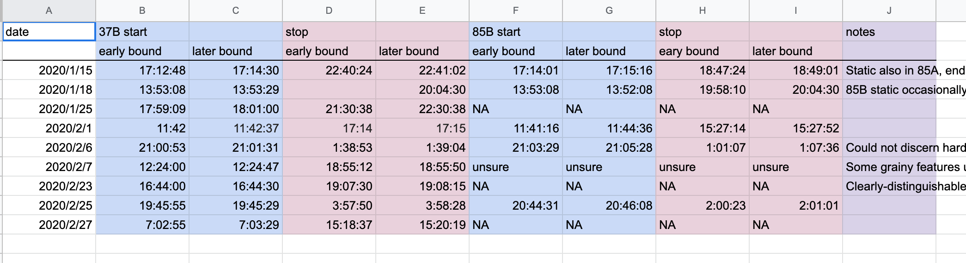
AMPR Issues During IMPACTS 2021
Partial data loss occurred on two flights (1/18 & 1/25) due to likely failure of Compact Flash (CF) card reader at altitude. Successfully mitigated afterward by switching to internal hard drive and archiving realtime data feed.
Significant noise occurred on the 37-GHz (B) channel, and minor noise was observed on the 85-GHz (B) channel. Noise is being mitigated during IMPACTS 2021 preparations. Both A channels for these frequencies were nominal.

Slide 6
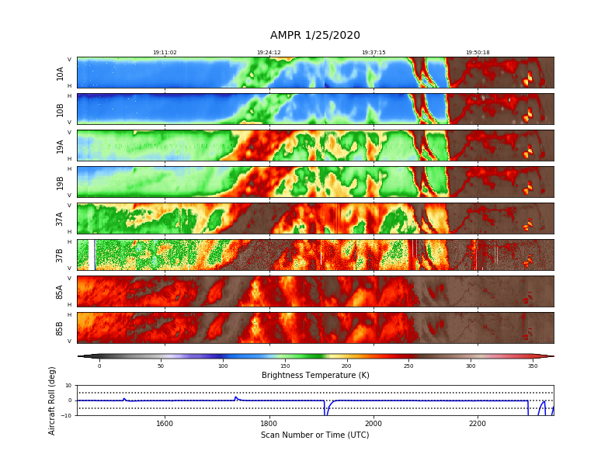
AMPR Highlights – 25 January 2020

Slide 7
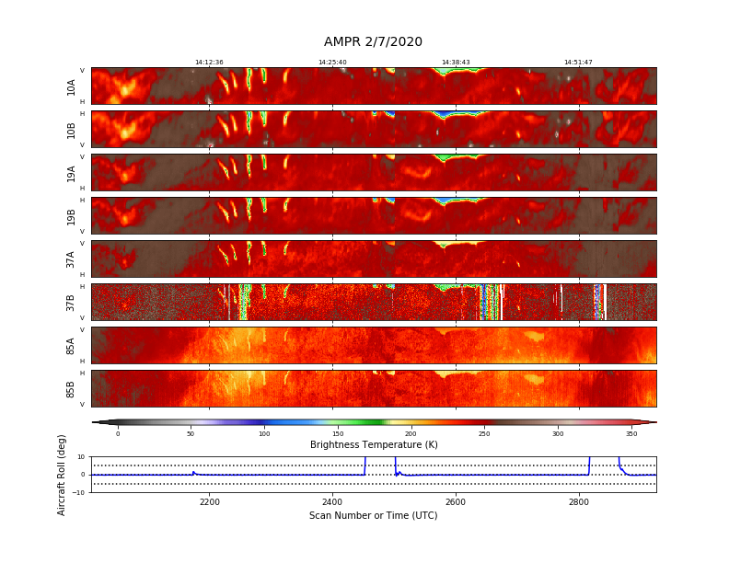
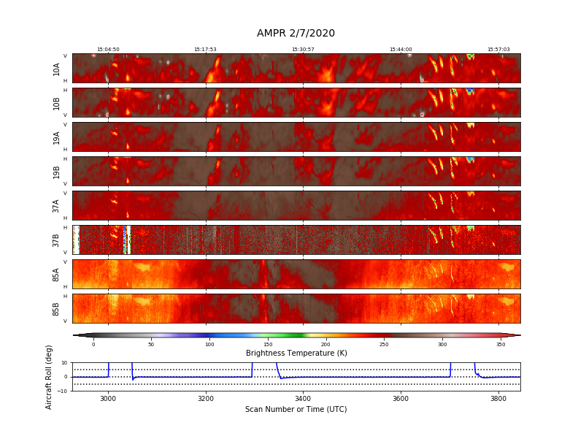
AMPR Highlights – 7 February 2020

Slide 8
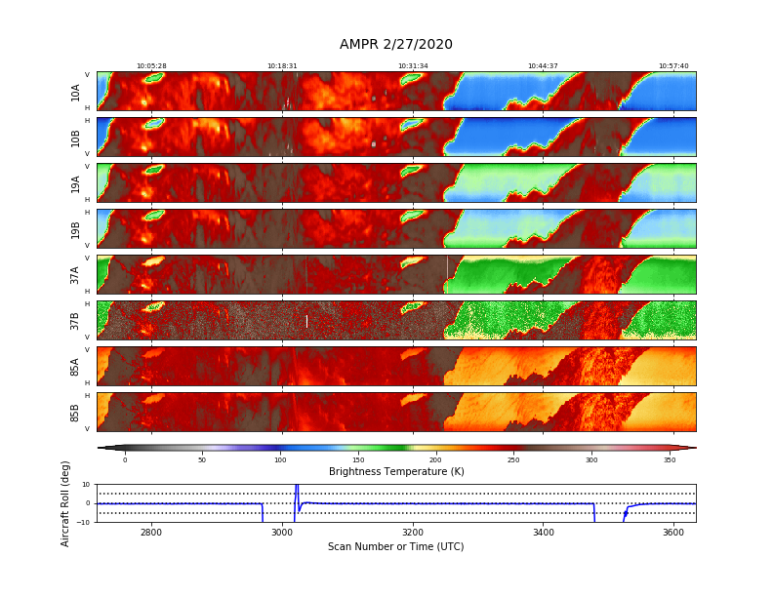
AMPR Highlights – 27 February 2020

Slide 9
AMPR Summary
AMPR observed precipitation signals on all nearly all IMPACTS 2020 flights
85 GHz and some 37 GHz overflights were useful for precip over land; lower frequencies indicate enhanced soil moisture or snow cover
All frequencies useful over water
Don’t use 37B or 85B channels without consulting MSFC first
AMPR self-describing, CF-compliant netCDF4 data available from GHRC DAAC:
https://ghrc.nsstc.nasa.gov/home/
AMPR software here:
https://github.com/nasa/PyAMPR/
PI contact:
timothy.j.lang@nasa.gov

