Slide 1
CCSDS BP V7 Bluebook Recommendation
“Approved for Public Release; Distribution is Unlimited”
Sponsoring Org/Office Code: HP27
Stakeholders: Rodney Grubbs
Name of Forum: CCSDS Fall Virtual Technical Meeting
Date: 10/28/2020
Presenter Name
Robert Lee Pitts

Slide 2
Outline
Purpose
Description
Discussion
Summary

Slide 3
Purpose
This briefing outlines what is required to support a CCSDS blue book for Bundle Protocol v7
Based on BPBIS v26 or later
Consistent with CCSDS 734x2b1
Reflects the lessons learned of long term on-orbit operations
Anticipates future needs based on mission networking.
The CCSDS Bundle Protocol is a specification for space applications
Out of necessity it interacts with the terrestrial internet
By the same necessity, it will in some instances be used in a terrestrial fashion on large network implementations on the extra-terrestrial side of the space network; e.g. Lunar, Mars ground networks
Usage in this briefing of the term exploration is based on the international effort

Slide 4
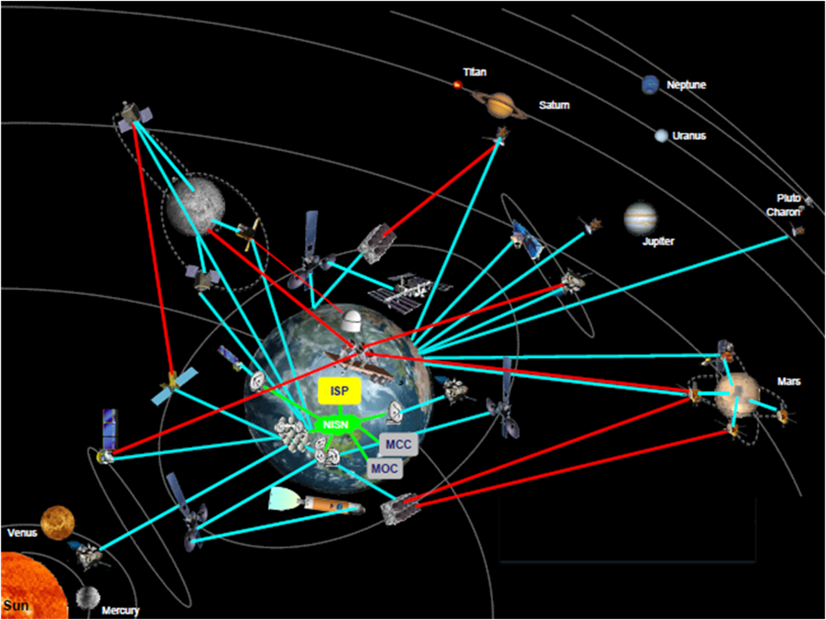
Description
The CCSDS bundle protocol is a specification for use with space applications that:
Intersects with the terrestrial internet
Utilizes space links
Will create extra-terrestrial networks
Courtesy of AJH

Slide 5
Description
In an “ideal DTN” model, an entire network is DTN and the endpoints are (or host) DTN nodes to handle the translation of bundle data to communications for their internal subsystems
Experience has shown that this approach is an idealized model
Users do not want the overhead or the need to integrate a new network regimen.
Payload developers want to be in their lab
Spacecraft designers want well defined options for critical services
Communications providers want deterministic communications
Payload developers, spacecraft builders and communication providers prefer a more traditional model
They want the capabilities and benefits of DTN

Slide 6
Description
Last Hop implementation
If BP v7 is to be the backbone of space networking, the end to end model must be supportable and clients can be at the
Node A endpoint
Communication Node
Gateway D endpoint
Last hop endpoint

Slide 7
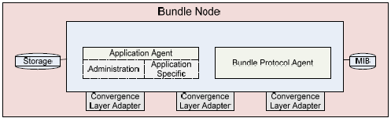
Description
In general the language and graphic representations need adjusting to move the specification forward.
These revisions will ensure there is no transference of concepts between V6 and V7 unless intended.
For example, the old bundle node representation of Figure 3 shown below is from RFC 5050 and the CCSDS blue book.

Slide 8
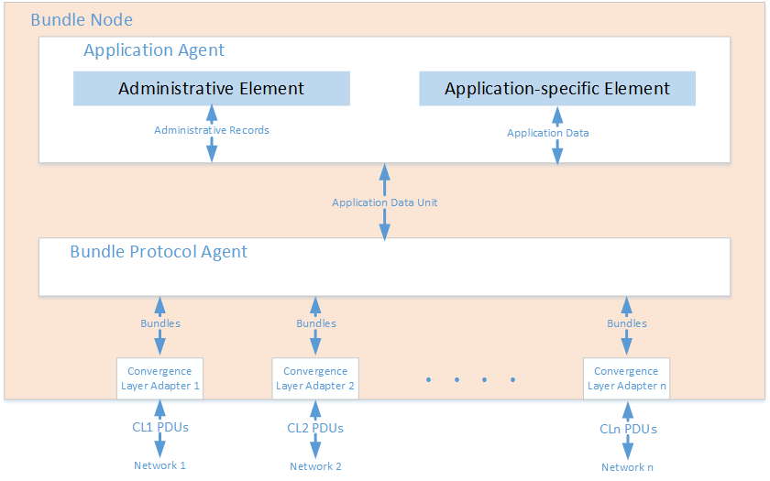
Description
The new representation in Figure 4 is more mature, evolved, and consistent with the BPBIS RFC. This is typical and illustrates why items like this require modernization throughout.

Slide 9
Discussion
Following are the specification sections and associated areas of change. Appendices are not discussed since they are subject to the items in the main body of the specification.
Section 1: This section includes the purpose, scope, organization, definitions, and references. These need to be modernized for V7 with the appropriate items. Specifically:
Update to include new RFC and the addition of “ability to use available bandwidth for a wide variety of services and functions”
Modernize wording where required.
General updates to reference the BPBIS RFC are required. Updates to the document sections should include removal of Aggregate Custody Signal (ACS) since it will be subsumed under the Bundle-in-Bundle Encapsulation (BIBE) RFC.
General updates to capture the latest RFC language and tone. Includes update to the Figure 1-1 and terminology updates to align them with BPBIS and BIBE language where applicable.
Update references.

Slide 10
Discussion
Section 2: This section is the overview section that explains supported and unsupported features in the specification. The amount of detail is flexible as long as it discusses all the reasonable limitations and services. This should probably be a more detailed section since there are more RFCs and history to consider.
2.1 Generally needs an update based on the BPBIS RFC and defining terms such as routing, scheduling, etc. However, it should also specify that this specification is more compatible and scalable than RFC 5050. Since V6 will not be extended further, the expectation is that V7 will be widely be supported.
2.2 Details the infrastructure options and defines implementation boundaries. (Note: This section provides high-level guidelines and does not specify implementation details.)
2.3 Services to include are BIBE as well as BP services. BIBE is a major item to support V7 that was inherent in BP with RFC 5050 and several other draft RFCs to include “Custody Transfer Enhancement Block” and “Aggregate Custody Signals” by A. Jenkins S. Kuzminsky.
2.4 Add any additional capabilities and details to enable compatibility with the overall infrastructure.

Slide 11
Discussion
Section 3: This is a very important section of the document. It describes the actual boundaries of CCSDS use. It requires an update for the new RFCs and any direction CCSDS wants to take.
3.1 Sets the stage and should be updated accordingly.
3.2 BPBIS, BIBE, CBHE
a. BIBE explicitly calls for support of encapsulation. In addition, custody transfer support to include ACS is included. Normal custody transfer under RFC 5050 is functionally a subset of ACS.
b. The original CBHE RFC is not required. The IPN scheme as outlined in the BPBIS (Section 4.1.5.1.2), should explicitly be identified as required, versus the DTN scheme.
3.3 ECOS may be required. Though it is not yet significantly used, it is anticipated as necessary in a multi-mission exploration environment.
a. ECOS original inclusion was due to the CCSDS working group deciding it was important to support more than three levels of priority.
b. In BPv6, ECOS was used to trigger Licklider Transmission Protocol (LTP) green versus red.

Slide 12
Discussion
Section 3: This is a very important section of the document. It describes the actual boundaries of CCSDS use. It requires an update for the new RFCs and any direction CCSDS wants to take.
3.4 Emphasize Time and reinforce language.
a. Explore and define conditions with ground lunar and planetary bodies need to be explored/nailed down to include correlation/synchronization to UTC.
b. Define how the addition of the Bundle Age extension blocks that tracks accumulated time is used. Additionally, describe the basic unit of time.
3.5 Asynchronous Management Protocol (AMP) – Like BPSEC, this is beyond the scope of this specification. It is included here to highlight that management is a critical issue. As number of nodes requiring oversight and physical dispersal of nodes increases, management becomes exponentially important. See Section 4 below.

Slide 13
Discussion
Section 3: This is a very important section of the document. It describes the actual boundaries of CCSDS use. It requires an update for the new RFCs and any direction CCSDS wants to take.
3.7 Supported CLAs;
a. More detail in the appendices.
b LTP, Nack Oriented Reliable Multicast (NORM), User Datagram Protocol (UDP), Transmission Control Protocol (TCP) (what color)
c. Identify link utilization, IP Encapsulation (IPENCAP), Space Packet, and any other methods and implemented in relation to current specifications.
3.8 Describe the role of the Space Assigned Numbers Authority (SANA) and which of its registries are important?

Slide 14
Discussion
Section 4: Service Description will require a careful detailed analysis of the BIBE and BPBIS RFCs.
Specific block types and endpoints:
Multicast
The ISS program or any of its sundry endeavors do not currently use Bundle Multicast.
All bundle traffic is point to point.
Exploration has discussed in detail the need to send bundles to multiple diverse locations.
Methods discussed are multiple sends and BP multicast.
Example1: Multiple endpoints on Earth
Example2: Multiple endpoints on Earth and Moon
Network loading is different for each method

Slide 15
Discussion
Section 4: Service Description will require a careful detailed analysis of the BIBE and BPBIS RFCs.
Specific block types and endpoints:
Bundle Protocol Security (BPSec)
BPSec is well beyond the scope for inclusion in the bundle specification.
Update is required for the security section of ANNEX G
Should explicitly add that all non-compliant nodes act as a pass-through
Custody transfer
Included in IRTF RFC 5050, however BPBIS does not directly support
An additional IETF RFC is being generated called BIBE (https://datatracker.ietf.org/doc/draft-ietf-dtn-bibect ).
Prior to completion, it is probably necessary to rewrite the ACS appendix D to accommodate.

Slide 16
Discussion
Section 4: Service Description will require a careful detailed analysis of the BIBE and BPBIS RFCs.
Specific block types and endpoints:
Compressed Bundle Header Encoding (CBHE) - RFC 6260 (https://www.rfc-editor.org/rfc/pdfrfc/rfc6260.txt.pdf ). As previously stated, it is subsumed by BPBIS section 4.1.5.1.2.
ACS – specification as defined in Annex D of CCSDS BUNDLE PROTOCOL SPECIFICATION. To be deleted. (https://public.ccsds.org/Pubs/734x2b1.pdf) see BIBE in item 4c above.
LTP - as defined by https://public.ccsds.org/Pubs/734x1b1.pdf . This was extended by RFC 7122 to support LTP using UDP/DCCP. Candidate for inclusion.

Slide 17
Discussion
Section 4: Service Description will require a careful detailed analysis of the BIBE and BPBIS RFCs.
Specific block types and endpoints:
Specific Convergence Layer Adapters (CLAs) –LTP, NORM over UDP, UDP, TCP (RFC 7242) as candidates.
The ISS implementation was deployed with the limited set of convergence layers of TCP, LTP over UDP for spacelink, UDP, and sTCP.
IETF RFCs have provide additional CLAs. Following are a list of those that require consideration.
Minimal TCP to replace sTCP – incorporates reduced overhead and increased security (optional). Experience with it has indicated that the use of Transport Layer Security (TLS) in the security option has an excessive performance hit.
Delay-Tolerant Networking TCP Convergence Layer Protocol Version 4 to replace TCP – supports Bundle protocol V7.
LTP over UDP/DCCP – RFC supporting congestion control of LTP over networks
DTN over NORM – Efficient replacement for LTP over limited distances such as Earth to the Moon
AMP – In the ISS environment, management has become a growing concern. As distance increases in exploration activities, AMP becomes a necessity. Somewhere in the specification, it should highlight the need and recommend a minimum set of Application Data Models (ADMs). The actual standard should be a standalone book.

Slide 18
Discussion
Section 5: Services required includes on orbit and ground instances. However, our experiences should color this based on ISS. Items in this section should remain and another service requires consideration: Bundle replay.
5.1 Reliable storage requirement - Is an important consideration based on mission requirements
5.2 Underlying communication service requirement - section is still required and is unique to the node situation/environment.
5.n Bundle replay is the capability to replay “lost” bundles. Ground systems often have queued data pending a replay. For DTN bundles, the data may expire. Bundle replay allows a user to recover this lost data and replay it into a bundle node. Originally developed as an engineering capability, it has been useful in recovering data that would otherwise be lost due to misadventure, failure, or incompetence.

Slide 19
Summary
This presentation and supporting white paper has two goals:
Identify BP V7 needs based on the V6 experience.
The BP V7 needs identified in this paper resulted from discussions within various DTN forums and ISS experience.
Describe minimum needs for a new blue book.
Exploration activities, experience with DTN, and conduct of operations informed the minimum needs for a new blue book.
In no way is this to limit DTN capabilities but only to establish a solid, ground floor baseline for adding new capabilities for long term deployment. Therefore, it will act as a platform for AMP, new CLAs, and unique implementations.

