Slide 1
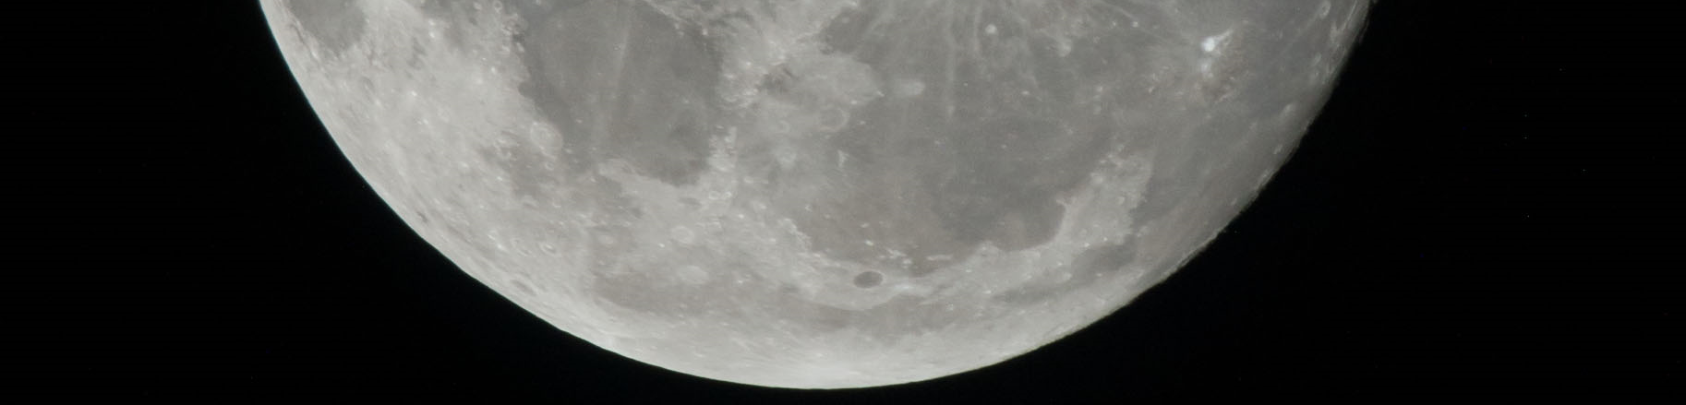

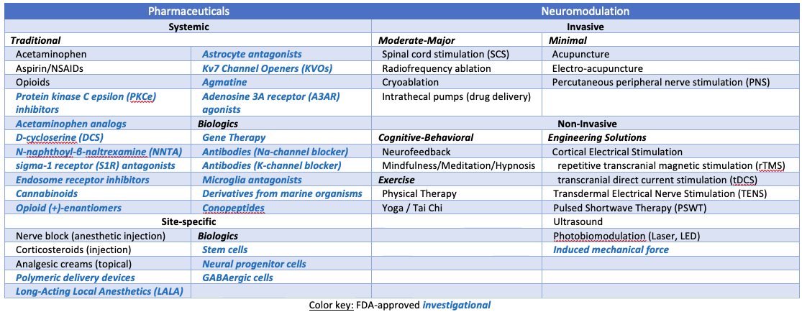
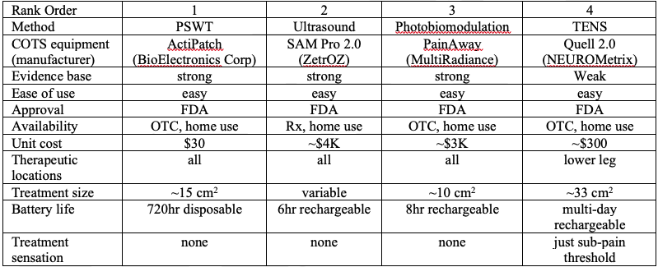
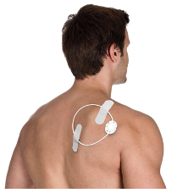
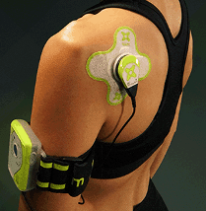
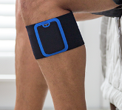
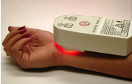
Electromagnetic Pain Relief/Blocking
National Aeronautics and Space Administration
Johnson Space Center (JSC) / White Sands Test Facility (WSTF) 2020 JSC Technology Showcase: FY20 ICA
Carol A. Mullenax, PhD, PE, PMP / carol.a.mullenax@nasa.gov
Technology Area (TA): 6.3.1 - Medical Diagnosis and Prognosis
TRL: start 1 / current 2
FY20 ICA PROJECT Overview
Astronauts use pharmaceuticals during spaceflight to manage acute and chronic pain, but use of analgesics will have drawbacks for exploration-class missions because the shelf life of these medications is limited, resupply will be curtailed, astronauts may develop tolerance and/or addiction to these medications, and side effects can include impairment of cognitive abilities. Electromagnetic devices have been developed that treat pain terrestrially by affecting neuromodulation – dubbed “electroceuticals”, these devices have varied mechanisms of action that either stimulate or suppress neural activity in the central nervous system or peripheral nerves. The available literature was reviewed and FDA-approved pain treatments (both pharmacological and non-pharmacological), as well as those currently under development, were assessed for their suitability for use in exploration-class spaceflight missions.
INNOVATION
Due to the COVID-19 pandemic and the resulting closure of libraries, data sources were restricted to those available digitally. Online database searches included PubMed, U.S. Patent and Trademark Office, federal grant award databases (NASA, DoD, NIH), and general internet searches. More than 1,600 records were reviewed in this effort. Targeted searches included different aspects of pain management. Priority was given to review studies, to cover as much of the available literature as possible in this limited effort. The titles of the studies and the awards that were obtained by searching online databases were reviewed and further information was sought for the relevant titles. Abstracts or award summaries were generally available online; for journal abstracts, full text articles were either available online or were requested via interlibrary loan.
OUTCOME
An overwhelming majority of the literature focuses on the treatment of chronic rather than acute pain because it is assumed that acute pain only rarely fails to resolve and instead transitions into chronic pain when the central nervous system becomes hypersensitized. The available electromagnetic devices marketed for pain treatment have varying levels of invasiveness, use different mechanisms of action, and have demonstrated varying efficacy when evaluated scientifically. A truly noninvasive, highly efficient device is desired for use during spaceflight. One portable, self-contained, FDA-approved device was identified that, from preliminarily assessment, best met these criteria; the device noninvasively applies pulsed shortwave therapy (PSWT) to modify pain signals from peripheral nerves, however, the device has limited battery life and the effects are relatively non-selective in type of neural signal modified.
Future Work
The ideal electromagnetic pain treatment device for use on exploration-class spaceflight missions does not yet exist, but it may be available soon. It is not feasible for NASA to develop medical devices due to the schedule constraints for pending exploration-class missions, but adapting a promising device that is already FDA-approved might be an option. Monitoring research that is ongoing at other federal agencies is recommended, and further review of the candidate PSWT device identified in this current effort may be warranted.
26973-1

