Slide 1
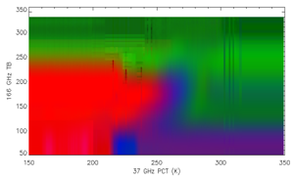
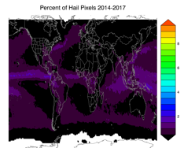
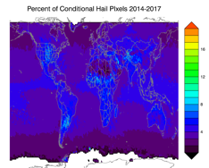
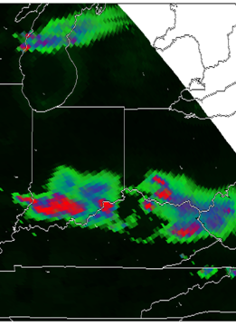
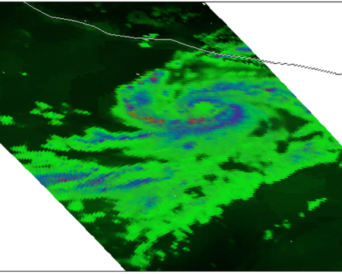
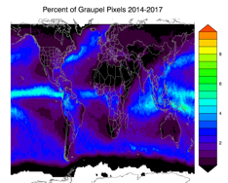
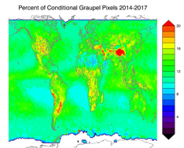
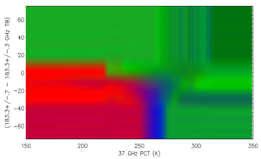
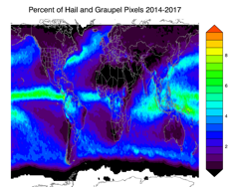
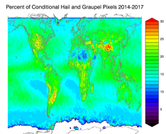
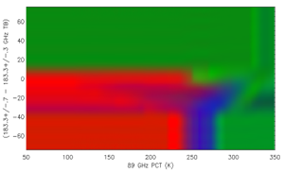
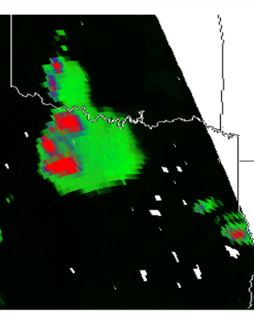
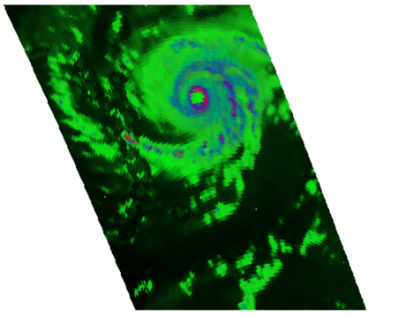
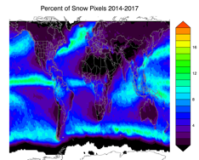
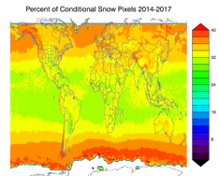
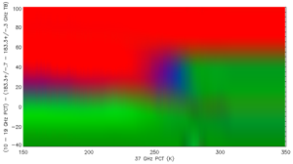
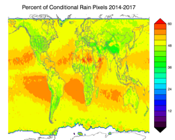
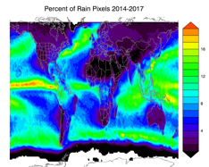
Diagnosing Dominant Hydrometeor Type from GMI Measurements
Daniel J. Cecil (NASA MSFC; Daniel.J.Cecil@nasa.gov)
Michael Solomon (University of Alabama – Huntsville)
Empirical matchups (left) between GMI brightness temperature combinations and dual-pol radar hydrometeor IDs.
We extrapolate the empirical data to fill out lookup tables (right) of the most likely particle type
Percentage of GMI pixels assigned to each HID, April 2014 – March 2017
Conditional Probability of each HID (normalized by precipitation occurrence), April 2014 – March 2017
Red = Hail
Blue = Graupel
Green = Other Precip
(intermediate shades like purple are a mix of probabilities)
Using these lookup tables, we can map hydrometeor types for storms in individual orbits (below) or accumulate global statistics about how often the different hydrometeor types are found (maps at right). In all cases, we normalize the lookup table output by the GPROF Probability Of Precipitation.
2-m temperature > 5° C is used to screen out snow/ice covered surfaces
OTHER
Hail
HAIL
GRAUPEL
Examples
MIX
For each TB combination, we assign a % likelihood of hail, graupel, other ice, rain
Color shading is the % of matchups with HAIL
OTHER
Graupel
MIX
HAIL
GRAUPEL
White dashes are the % of matchups with GRAUPEL
Hierarchical approach checks for hail first, then graupel, then others
Hail or Graupel
Severe Thunderstorms in:
(top) Ohio Valley
(bottom) Texas
(top) Hurricane Patricia
(bottom) Hurricane Irma
OTHER
HAIL
MIX
GRAUPEL
A “HAIL” pixel usually includes graupel and other particle types in the same vertical column, but we assume the dominant signal comes from hail.
Snow / Other Ice
Purple contours are the % of matchups with OTHER precip types
HAIL
MIX
OTHER
Rain
A “GRAUPEL” pixel may include snow / ice crystals / rain, but no hail. “MIX” (the purple shades) really means a mix of chances between the graupel and hail categories.

Slide 2
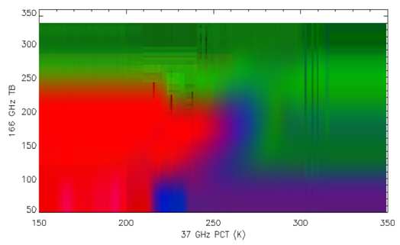
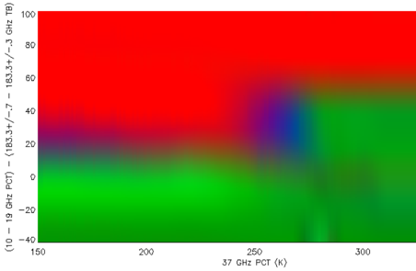
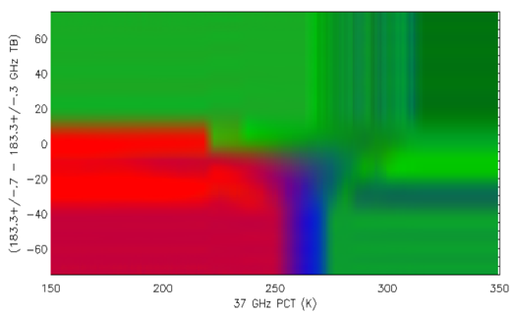
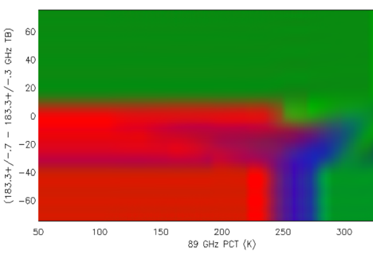
Diagnosing Dominant Hydrometeor Type from GMI Measurements
Daniel J. Cecil (NASA MSFC; Daniel.J.Cecil@nasa.gov)
Michael Solomon (University of Alabama – Huntsville)
Hierarchical approach checks for hail first, then graupel, then others. A “HAIL” pixel can also include graupel and the others. A “GRAUPEL” pixel can include snow and rain, but cannot include hail. A pixel labeled “SNOW” or “RAIN” cannot include graupel or hail.
Empirical matchups between GMI brightness temperature combinations and dual-pol radar hydrometeor IDs, from GPM Validation Network.
We extrapolate the empirical data to fill out lookup tables of the most likely dominant particle type.
For each TB combination, we assign a % likelihood of hail, graupel, other ice, rain
Color shading is the % of matchups with HAIL
OTHER
10, 19, 183 GHz combo
HAIL
MIX
166 GHz (V)
OTHER
GRAUPEL
MIX
HAIL
MIX
MIX
37 GHz PCT
89 GHz PCT
“MIX” (the purple shades) really means a mix of chances between the graupel and hail categories… the brightness temperature combination likely includes graupel, and may also include hail.
The lookup tables assign an HID type to all possible TB combinations, even if parts of the parameter space are non-physical or rarely observed.
Gray portions of these plots represent a lack of observational data for a given TB combination. Some combinations are non-physical.
White dashes are the % of matchups with GRAUPEL
OTHER
(183.3+/-.7)-(183.3+/-.3) GHz
OTHER
(183.3+/-.7)-(183.3+/-.3) GHz
HAIL
MIX
HAIL
MIX
GRAUPEL
GRAUPEL
Purple contours are the % of matchups with OTHER precip types
Red = Hail
Blue = Graupel
Green = Other Precip
(intermediate shades like purple are a mix of probabilities)
37 GHz PCT
89 GHz PCT

Slide 3

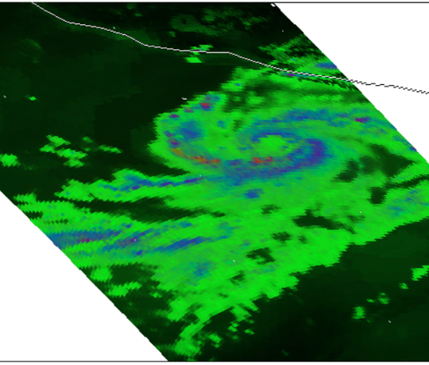
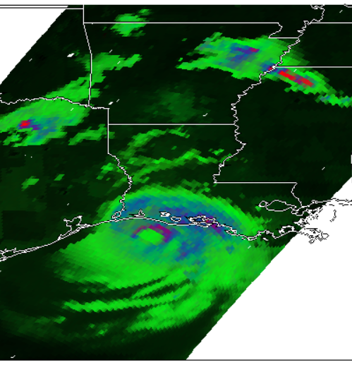


Diagnosing Dominant Hydrometeor Type from GMI Measurements
Daniel J. Cecil (NASA MSFC; Daniel.J.Cecil@nasa.gov)
Michael Solomon (University of Alabama – Huntsville)
Red = Hail
Blue = Graupel
Green = Other Precip
(intermediate shades like purple are a mix of probabilities)
Using our new lookup tables, we can map hydrometeor types for individual storms. The assigned hydrometeor type is interpreted as the largest / most dense ice particle type present in the vertical column, or otherwise as liquid rain.
In all cases, we normalize the lookup table output by the GPROF Probability Of Precipitation.
A dark shade represents a very low Probability of Precipitation from GPROF.
Note the contrast between purple shades in Hurricane Laura, and red shades (hail) in thunderstorms hundreds of km away
Severe Thunderstorms in:
(top) Ohio Valley
(bottom) Texas
(top) Hurricane Patricia
(bottom) Hurricane Irma
Hurricane Laura
Strong / severe thunderstorms tend to have solid red for hail (although this may indicate small hail aloft, that melts on its way to surface).
MCS usually has large area with shades of blue, for mix of chances between graupel and hail or between graupel and less dense ice types.
Hurricane eyewalls and strong parts of deep convective rainbands tend to have purple shades, for a mix of chances between hail and graupel. This indicates that graupel is highly likely, and there may also be some hail aloft.
More extensive hurricane rainshield mostly has green and blue-green shades, for a mix of probabilities between snow, rain, and graupel.

Slide 4
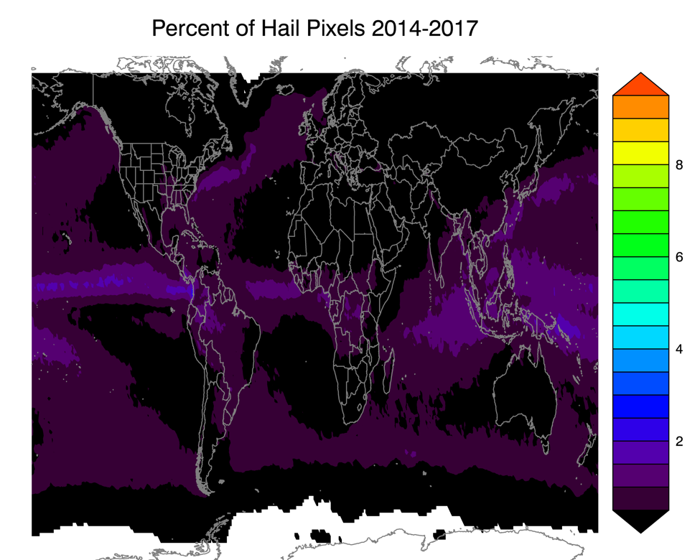

Diagnosing Dominant Hydrometeor Type from GMI Measurements
Daniel J. Cecil (NASA MSFC; Daniel.J.Cecil@nasa.gov)
Michael Solomon (University of Alabama – Huntsville)
Using our new lookup tables, we can accumulate global statistics about how often the different hydrometeor types are found. In all cases, we normalize the lookup table output by the GPROF Probability Of Precipitation and eliminate any pixels with 2-m surface temperature below 5° C (to screen out surface snow/ice artifacts).
HAIL
%age of all pixels, Apr 2014-Mar 2017
Conditional %age of precip pixels, Apr 2014-Mar 2017

Slide 5
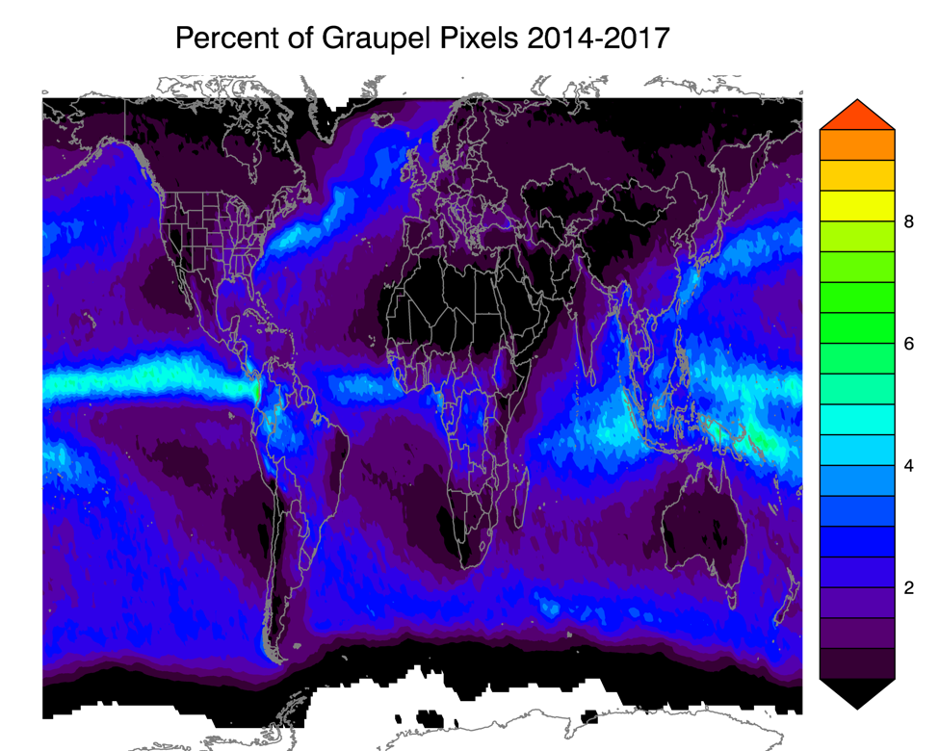
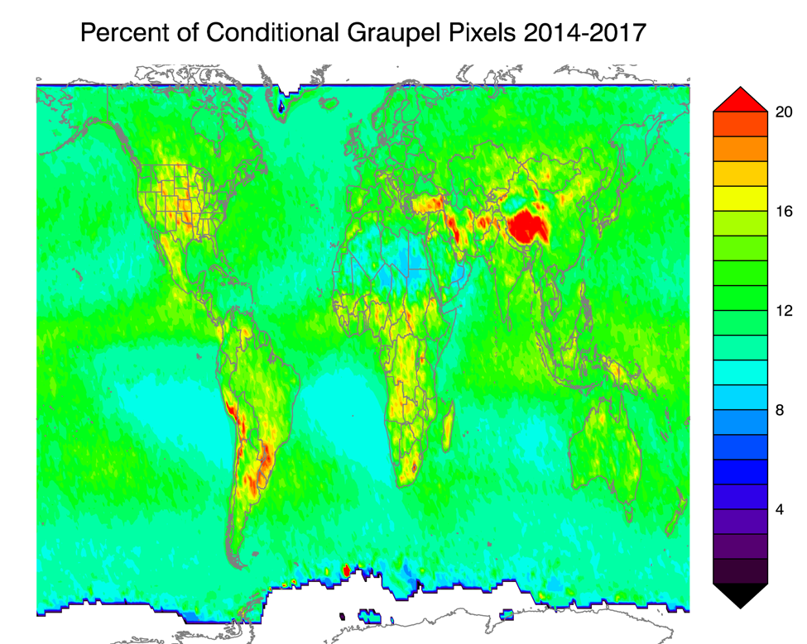
Diagnosing Dominant Hydrometeor Type from GMI Measurements
Daniel J. Cecil (NASA MSFC; Daniel.J.Cecil@nasa.gov)
Michael Solomon (University of Alabama – Huntsville)
Using our new lookup tables, we can accumulate global statistics about how often the different hydrometeor types are found. In all cases, we normalize the lookup table output by the GPROF Probability Of Precipitation and eliminate any pixels with 2-m surface temperature below 5° C (to screen out surface snow/ice artifacts).
GRAUPEL
%age of all pixels, Apr 2014-Mar 2017
Conditional %age of precip pixels, Apr 2014-Mar 2017

Slide 6


Diagnosing Dominant Hydrometeor Type from GMI Measurements
Daniel J. Cecil (NASA MSFC; Daniel.J.Cecil@nasa.gov)
Michael Solomon (University of Alabama – Huntsville)
Using our new lookup tables, we can accumulate global statistics about how often the different hydrometeor types are found. In all cases, we normalize the lookup table output by the GPROF Probability Of Precipitation and eliminate any pixels with 2-m surface temperature below 5° C (to screen out surface snow/ice artifacts).
HAIL OR GRAUPEL
%age of all pixels, Apr 2014-Mar 2017
Conditional %age of precip pixels, Apr 2014-Mar 2017

Slide 7
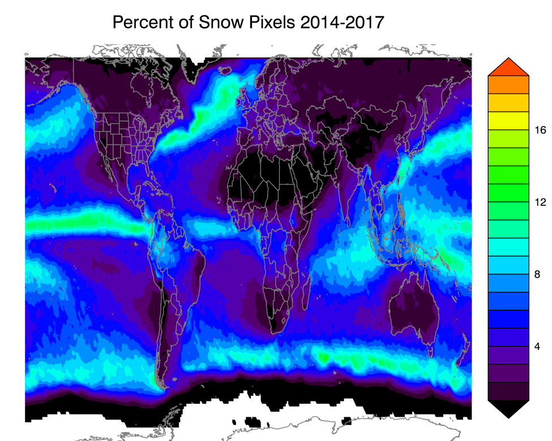

Diagnosing Dominant Hydrometeor Type from GMI Measurements
Daniel J. Cecil (NASA MSFC; Daniel.J.Cecil@nasa.gov)
Michael Solomon (University of Alabama – Huntsville)
Using our new lookup tables, we can accumulate global statistics about how often the different hydrometeor types are found. In all cases, we normalize the lookup table output by the GPROF Probability Of Precipitation and eliminate any pixels with 2-m surface temperature below 5° C (to screen out surface snow/ice artifacts).
SNOW / OTHER ICE (precipitation ice signature, but too weak for hail or graupel)
%age of all pixels, Apr 2014-Mar 2017
Conditional %age of precip pixels, Apr 2014-Mar 2017
Color scale goes to higher values than on previous slides

Slide 8
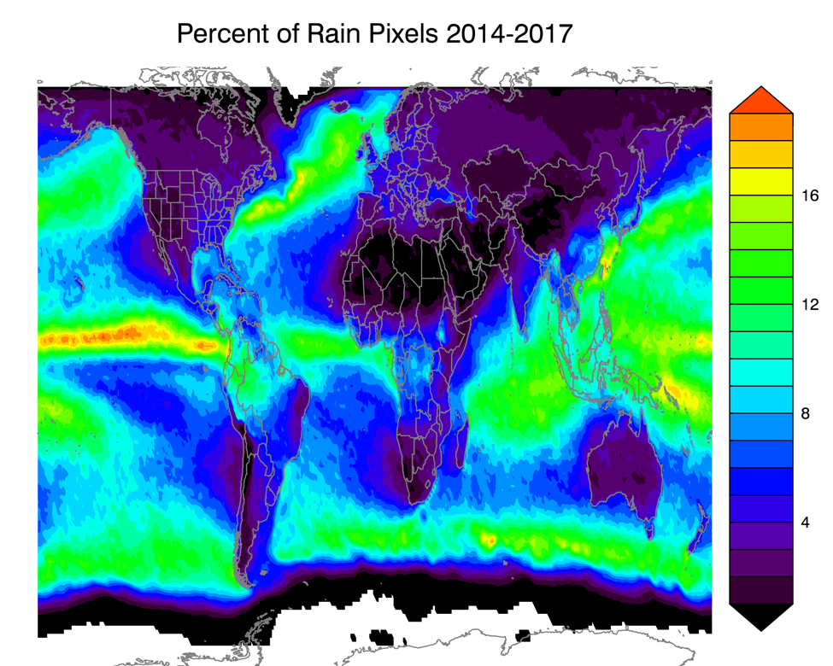
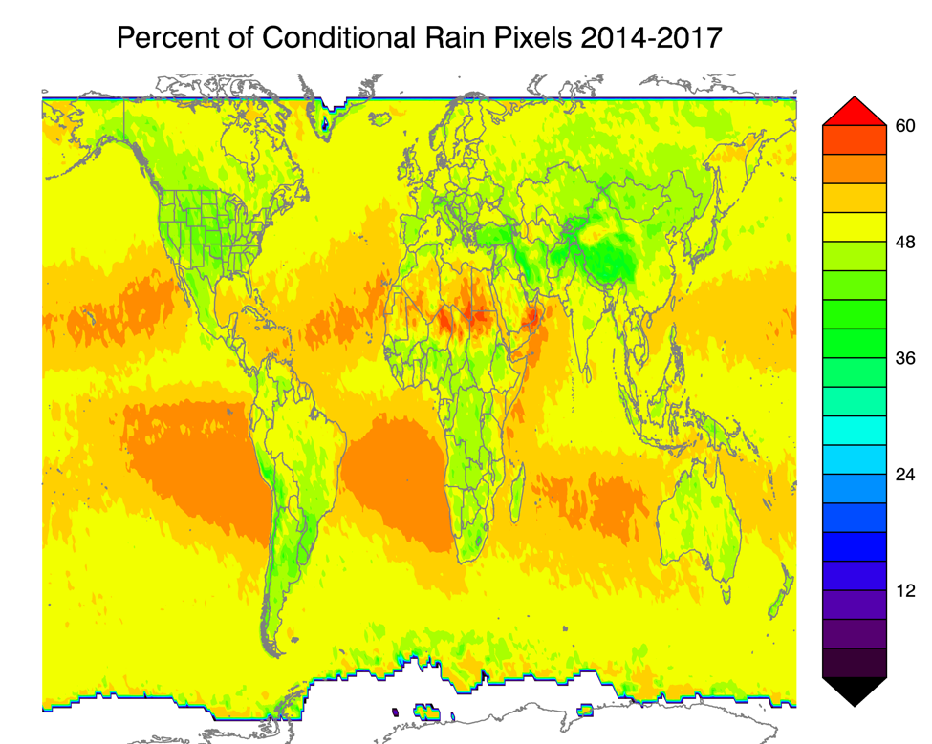
Diagnosing Dominant Hydrometeor Type from GMI Measurements
Daniel J. Cecil (NASA MSFC; Daniel.J.Cecil@nasa.gov)
Michael Solomon (University of Alabama – Huntsville)
Using our new lookup tables, we can accumulate global statistics about how often the different hydrometeor types are found. In all cases, we normalize the lookup table output by the GPROF Probability Of Precipitation and eliminate any pixels with 2-m surface temperature below 5° C (to screen out surface snow/ice artifacts).
Liquid rain (no clear precipitation ice signature)
%age of all pixels, Apr 2014-Mar 2017
Conditional %age of precip pixels, Apr 2014-Mar 2017
Color scale goes to higher values than on previous slides

Slide 9
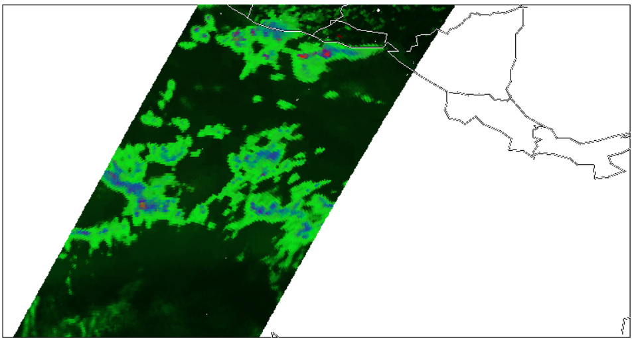
Diagnosing Dominant Hydrometeor Type from GMI Measurements
Daniel J. Cecil (NASA MSFC; Daniel.J.Cecil@nasa.gov)
Michael Solomon (University of Alabama – Huntsville)
Red = Hail
Blue = Graupel
Green = Other Precip
(intermediate shades like purple are a mix of probabilities)
More examples from individual cases
Using our new lookup tables, we can map hydrometeor types for individual storms. The assigned hydrometeor type is interpreted as the largest / most dense ice particle type present in the vertical column, or otherwise as liquid rain.
In all cases, we normalize the lookup table output by the GPROF Probability Of Precipitation.
A dark shade represents a very low Probability of Precipitation from GPROF.
East Pacific ITCZ
Precip is very frequent here
Mostly identified as Graupel, Snow / Other Ice, and Liquid Rain
Low probabilities of Hail in the convective cores, but repeated non-zero probabilities in the frequent precip events add up when accumulating all orbits

Slide 10
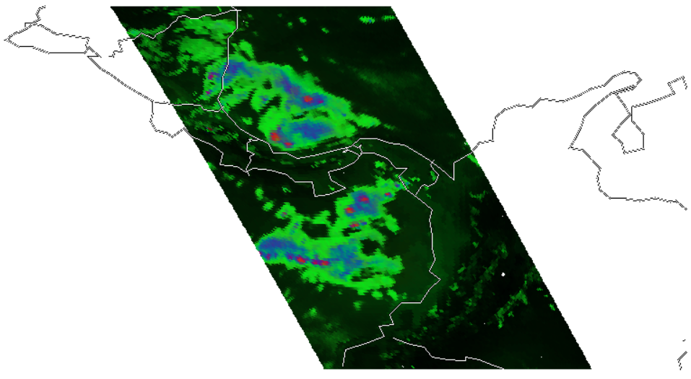
Diagnosing Dominant Hydrometeor Type from GMI Measurements
Daniel J. Cecil (NASA MSFC; Daniel.J.Cecil@nasa.gov)
Michael Solomon (University of Alabama – Huntsville)
Red = Hail
Blue = Graupel
Green = Other Precip
(intermediate shades like purple are a mix of probabilities)
More examples from individual cases
Using our new lookup tables, we can map hydrometeor types for individual storms. The assigned hydrometeor type is interpreted as the largest / most dense ice particle type present in the vertical column, or otherwise as liquid rain.
In all cases, we normalize the lookup table output by the GPROF Probability Of Precipitation.
A dark shade represents a very low Probability of Precipitation from GPROF.
Gulf of Panama / Panama Bight
Stronger convection here gives more robust hail signature
This does not mean hail reaching the surface, but likely small hail aloft that melts while falling

Slide 11
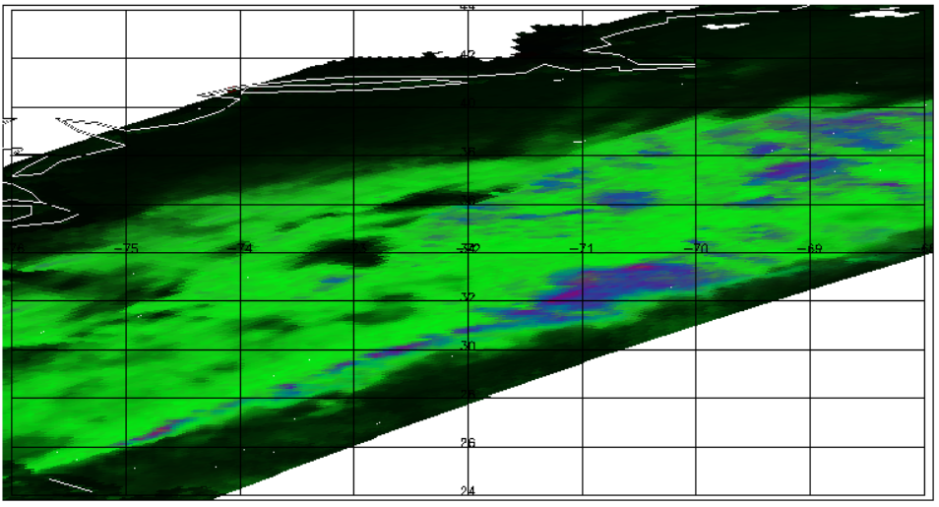
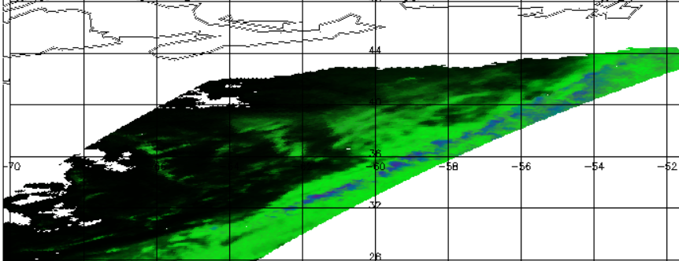
Diagnosing Dominant Hydrometeor Type from GMI Measurements
Daniel J. Cecil (NASA MSFC; Daniel.J.Cecil@nasa.gov)
Michael Solomon (University of Alabama – Huntsville)
Red = Hail
Blue = Graupel
Green = Other Precip
(intermediate shades like purple are a mix of probabilities)
More examples from individual cases
Using our new lookup tables, we can map hydrometeor types for individual storms. The assigned hydrometeor type is interpreted as the largest / most dense ice particle type present in the vertical column, or otherwise as liquid rain.
In all cases, we normalize the lookup table output by the GPROF Probability Of Precipitation.
A dark shade represents a very low Probability of Precipitation from GPROF.
Gulf Stream / NW Atlantic Ocean
Frontal systems with embedded convection are frequent here
Mostly identified as Graupel, Snow / Other Ice, and Liquid Rain
Low probabilities of Hail in the convective cores, but repeated non-zero probabilities in the frequent frontal precip events add up when accumulating all orbits

Slide 12
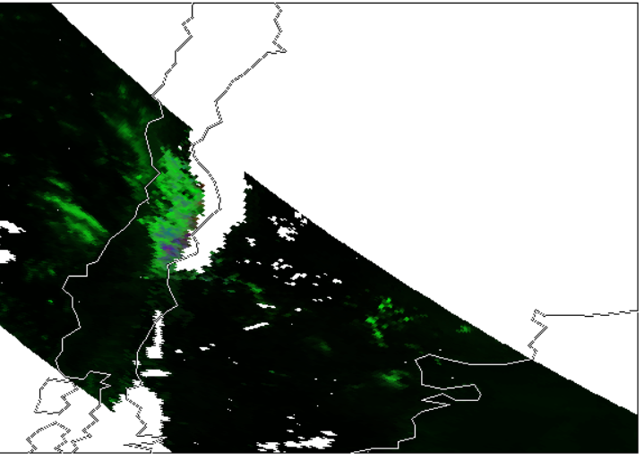
Diagnosing Dominant Hydrometeor Type from GMI Measurements
Daniel J. Cecil (NASA MSFC; Daniel.J.Cecil@nasa.gov)
Michael Solomon (University of Alabama – Huntsville)
Red = Hail
Blue = Graupel
Green = Other Precip
(intermediate shades like purple are a mix of probabilities)
More examples from individual cases
Using our new lookup tables, we can map hydrometeor types for individual storms. The assigned hydrometeor type is interpreted as the largest / most dense ice particle type present in the vertical column, or otherwise as liquid rain.
In all cases, we normalize the lookup table output by the GPROF Probability Of Precipitation.
A dark shade represents a very low Probability of Precipitation from GPROF.
Surface Snow Contamination – Example from Andes Mountains
We use 2-m Temperature field from GPROF files to screen out regions of potential surface snow / ice contamination
5° C threshold applied
This eliminates many of the problematic pixels, but sometimes leaves false signatures in adjacent regions
Want to apply tools developed by team members working on land surface

