Slide 1

MSFC Natural Environments Tower QC, Verification GUI, and Future Work
James Brenton, Maggie Fielder
Jacobs Space Exploration Group
NASA Marshall Space Flight Center
10/27/2020

Slide 2


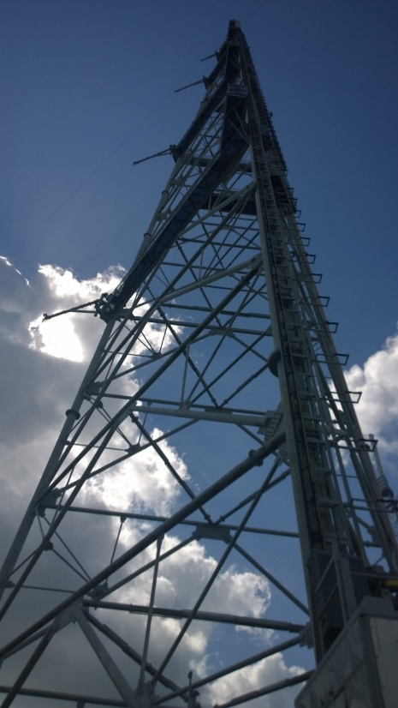






Meteorological tower data has supported numerous space programs; both commercial and government.
Notes:
Tower data has proven extremely valuable to numerous programs that have launched vehicles and hardware from KSC/ER.
Tower data can provide long periods of record (some towers have almost 30 years of archived data), which is useful in assessing extreme events and climatic “norms” for vehicle design and operation.
Example: Orion needed tower data to analyze the likelihood of cool, moist ambient air blowing back into the vehicle through a vent, and introducing condensation. Only tower data could give a long period of data to meet this need.

Slide 3
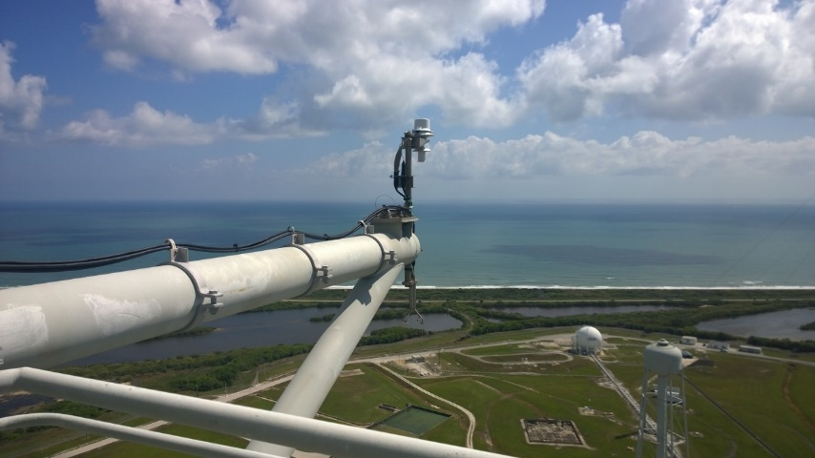
Quality analysis requires quality data. What can weaken the quality of data and how to do we mitigate it?
?
Notes:
Operational weather data is not always “clean”.
Sensors break and degrade over time, which is only accelerated by the corrosive nature of the sea salt found in the air.
Other external and logistical factors can lead to long periods of time where a sensor is offline, such as a broken elevator.
The Wind Towers can provide valuable data, but how do you determine what’s “good” data and how do you prepare that data?

Slide 4
EV44 has developed a method to perform Quality Control (QC) on Tower data from Towers 313 and 397.
GUI
Automated QC Checks
Data
Data
Data ✓
Data
Monthly Data
Notes:
Operational weather data is not always “clean”.
Sensors break and degrade over time, which is only accelerated by the corrosive nature of the sea salt found in the air.
Other external and logistical factors can lead to long periods of time where a sensor is offline, such as a broken elevator.
The Wind Towers can provide valuable data, but how do you determine what’s “good” data and how do you prepare that data?

Slide 5
The data are evaluated against a series of QC checks in an automated process that produces QC flags.
Automated QC Checks
GUI
Data
Data
Data ✓
Data
Climatological
Hourly
Daily
U/V Components
Vertical/Horizontal
Tower Obstruction
Hang Up
Mean vs. Peak Wind Speed
Monthly Data
Notes:
These checks each have their own purpose and help protect against various ways errors could arise in the data
*Briefly go through list*
More detail for the specific checks and how the thresholds for each check can be found in old presentations which can be provided on request

Slide 6
The largest development since the last NEDOLWG was the implementation of a GUI to manually review the data.
GUI
Automated QC Checks
Data
Data
Data ✓
Data
Monthly Data
Notes:
The new daily files include binary flags showing which data has failed the QC checks.
These daily files provide a QC’ed data set but the data and QC flags need to be verified.

Slide 7
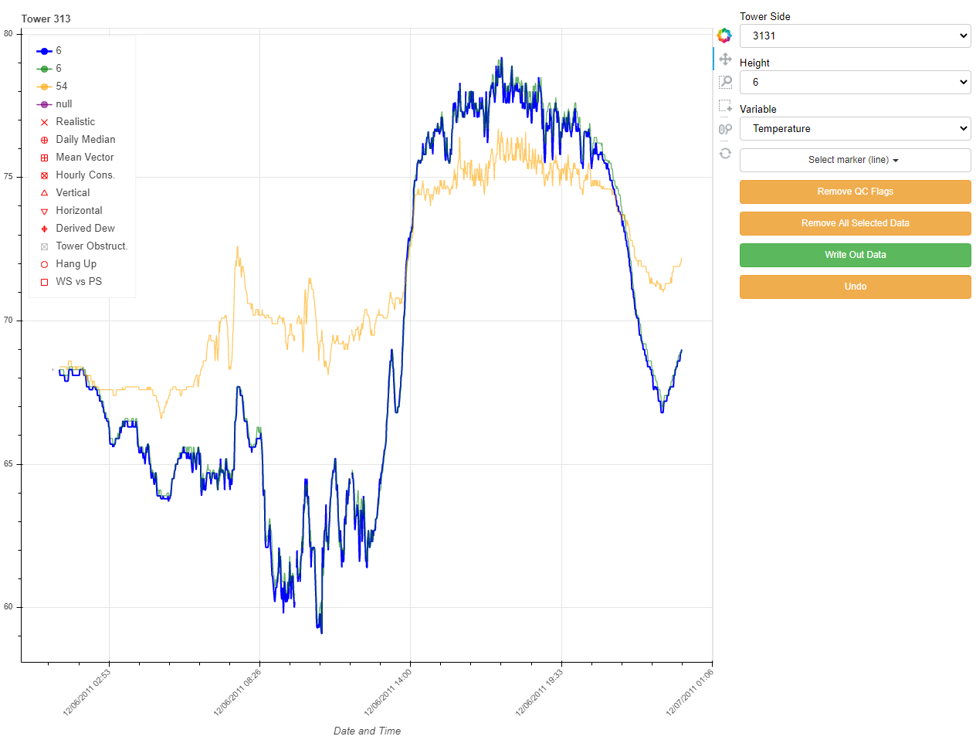
Example of the GUI and its functionality
Drop down menus to select side/towers, heights, and variables to display. Line style can also be changed from “line” to “scatter”.

Slide 8
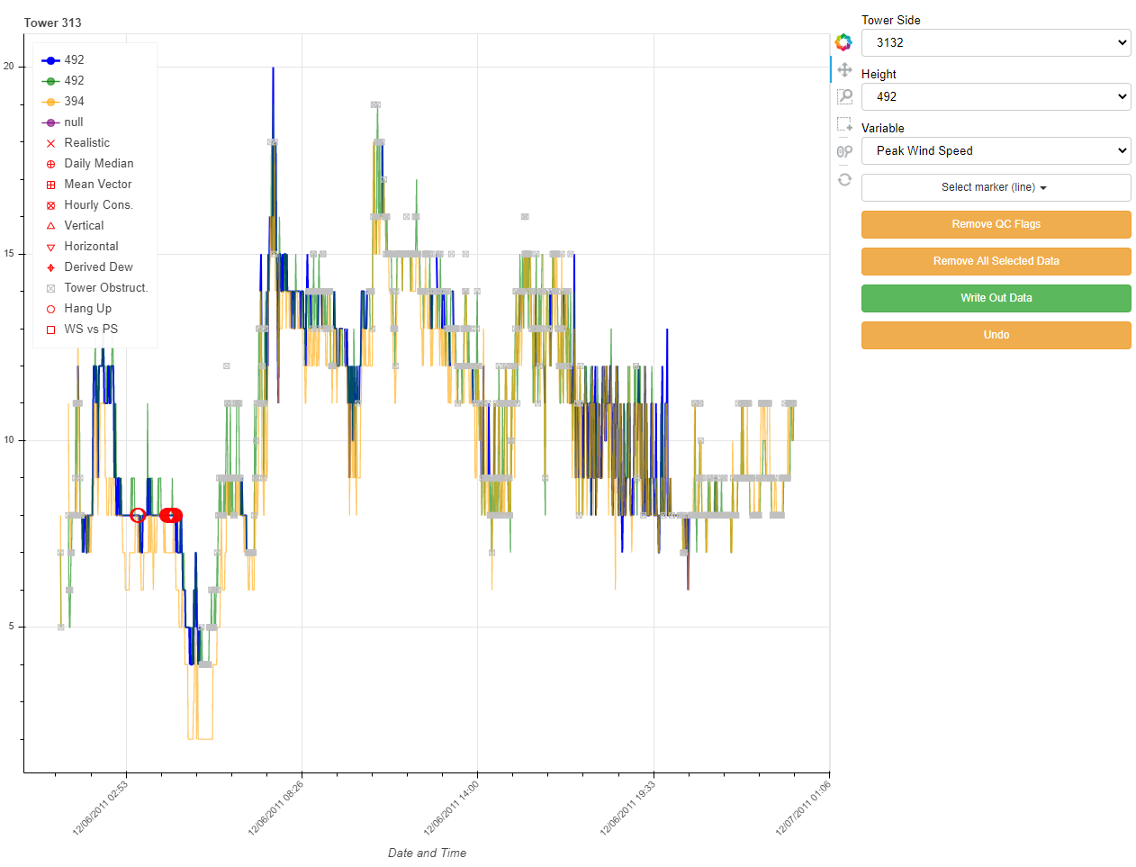
Example of the GUI and its functionality
The GUI will display flags based on their symbols in the legend. The user review flags to determine if the automated flags correctly identified “bad” data. Tower Obstruction flags will automatically flag all wind values.

Slide 9
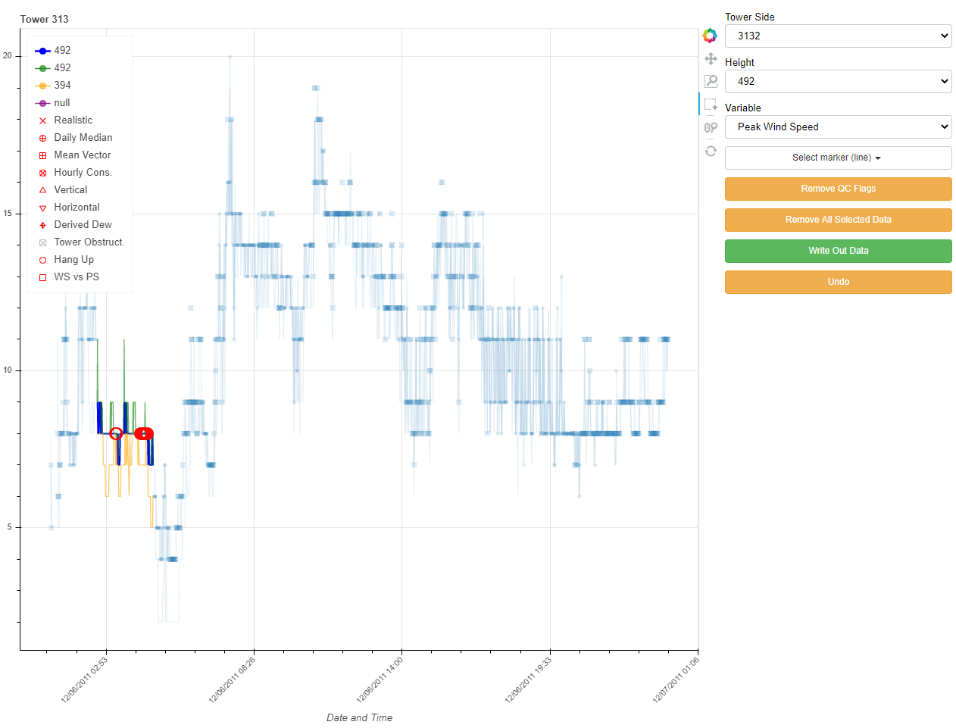
Example of the GUI and its functionality
Using the Box Selector tool, the user can highlight a region of data to manually verify.

Slide 10

Example of the GUI and its functionality
Using the “Remove QC Flags” button will verify that the flags correctly identified erroneous data. The “Remove All Selected Data” button can be used to manually reject data regardless if the data has passed or failed the QC checks.

Slide 11
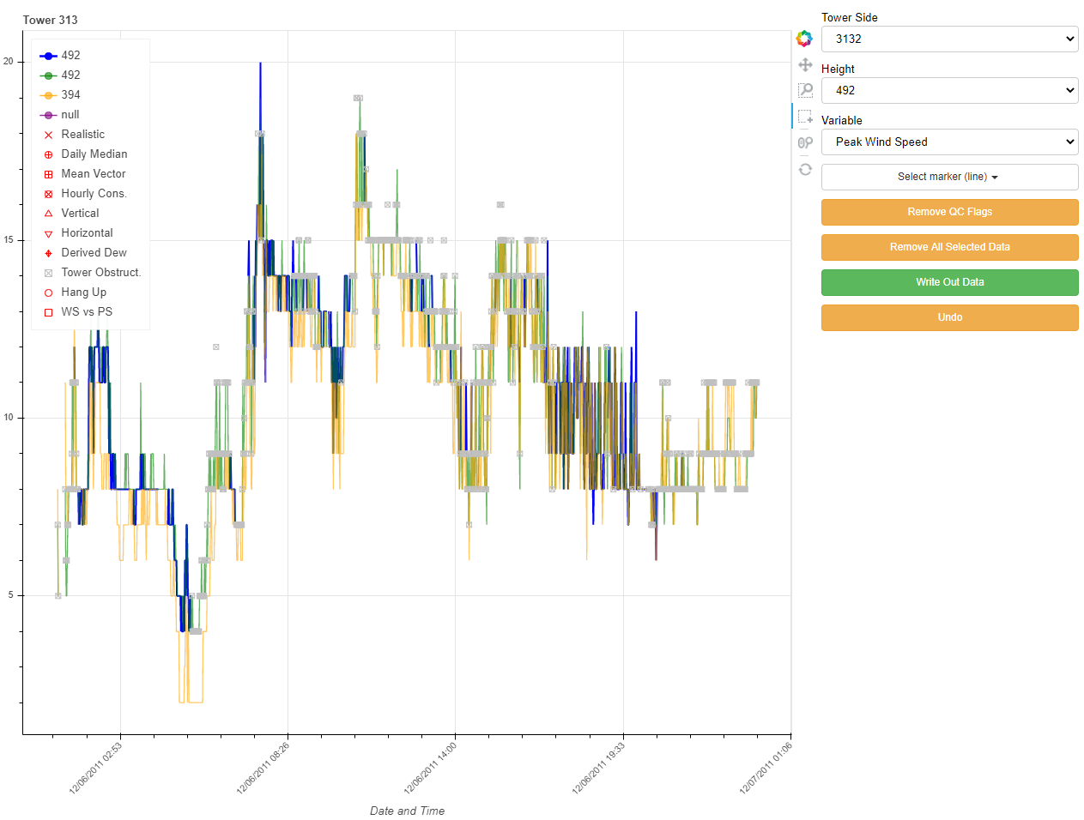
Example of the GUI and its functionality
The “Reset” button will un-select any highlighted portions of data, letting the user view the approved and verified data. The “Write Out Data” button will write the new daily file out, which includes the manual verification flags.

Slide 12
After verifying the data and QC flags, the new daily files are compiled into monthly NetCDF files.
GUI
Automated QC Checks
Data
Data
Data ✓
Data
Monthly Data
Notes:
This is where we are currently.
Two types of monthly NetCDFs will be available: a “clean” monthly file and a “flagged” monthly file
The “clean” monthly files will have all manually rejected data removed and no flags will be in the file. This data is intended for “plug and play”.
The “flagged” monthly files will have all original, “as received” data along with all flags. This will provide an option for end users needing more control over their data.

Slide 13
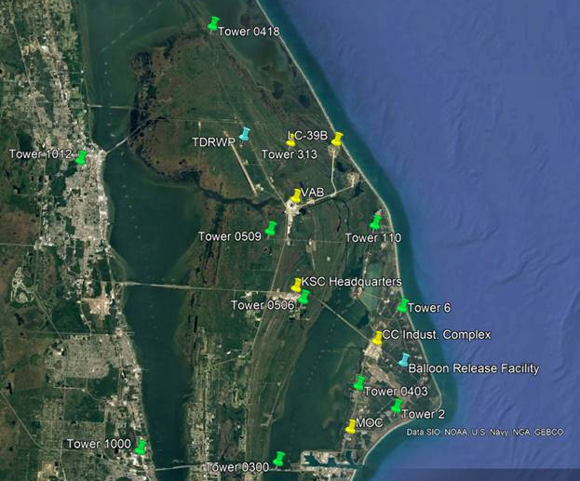
Additional Towers will be QC’ed.
Tower | Height
Tower 2 | 200
Tower 6 | 200
Tower 110 | 200
Tower 300 | 60
Tower 403 | 60
Tower 418 | 60
Tower 506 | 60
Tower 509 | 60
Tower 1000 | 60
Tower 1012 | 60
Notes:
EV44 came up with a list of towers to include in future QC efforts.
These towers provide data from locations spanning from the mainland to the coast, with heights from 60 ft to 200ft.
These efforts are still very earlier and have just begun.

Slide 14
Future Work
Finish developing Monthly NetCDF Files. ETC: Winter 2020/2021
Complete QC work on additional towers
Incorporate this methodology to manually verify files once a week and compile NetCDFS once a month.

