Slide 1
Metallic Powder Core Tubular Wire (PCTW) Development for Additive Manufacturing
Marcia Domack
NASA Langley Research Center
AWS Professional Program
Honorary Symposium for Prof. Stephen Liu
November 19, 2020

Slide 2
Applications and Goals for Aerospace Structures
Capitalize on the flexibility of additive manufacturing to produce aerospace structures optimized for minimum weight with improved performance.
Emphasis on high value aerospace titanium and aluminum parts
  Properties comparable to or exceeding conventionally manufactured parts
  Reduced cost through efficient material usage
Develop new materials to enable novel structural designs
  Locally tailor material properties to meet specific requirements
  Create functionally graded structures
Metallic airframe structural concepts; (a) conventional built-up, (b) unitized, and
(c) functionally graded, curvilinear stiffened

Slide 3
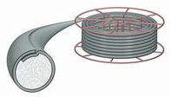
Attributes of Powder Core Tubular Wire (PCTW) for Additive Manufacturing
Powder core tubular wire technology enables rapid production of custom alloy composition feedstock
    Nearly unlimited flexibility in material composition
    Tailor sheath and powder fill for target product compositions
    Eliminates need for specialty ingot casting of each target composition
    Reduced cost and lead time compared with conventional casting and drawing to produce feedstock wire
    Efficient production of experimental materials for R&D projects
Advantages
Flexibility · Targeting · Cost Efficiency

Slide 4
Metallic Powder Core Tubular (PCTW) Wire Development for Additive Manufacturing
Objective
  Develop powder core tubular wire (PCTW) technology for metal additive manufacturing using electron beam directed energy deposition
Approach
  Collaborate with the Colorado School of Mines (CSM), Center for Welding, Joining, and Coatings Research
    Fabricate PCTW at CSM
    Perform deposition in the NASA Langley Research Center (LaRC) electron beam freeform fabrication (EBF³) system
    Jointly characterize fabricated materials
History and students
  10+ year collaboration with CSM
  Dr. Stephen Liu, Professor, Metallurgical and Materials Engineering
  Four students (3 MS and one PhD)
    Christine Hillier, Scott Mitzner, Devon Gonzales, Ethan Sullivan

Slide 5
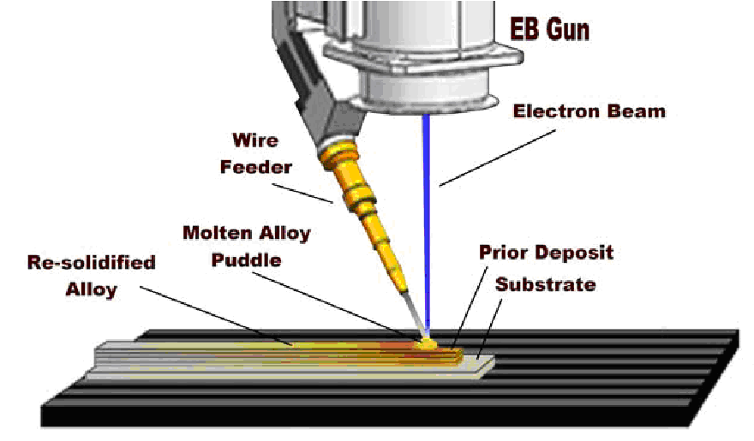
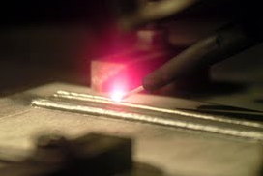
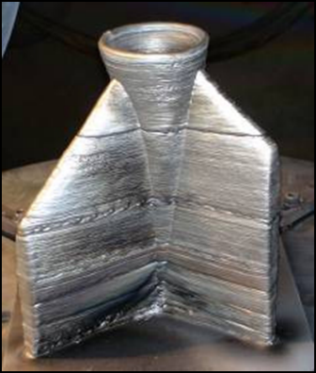
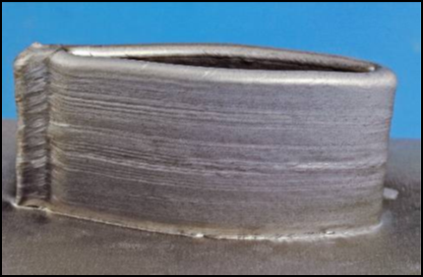
NASA LaRC Electron Beam Freeform Fabrication (EBF³) Capability
Directed energy deposition (DED) process with electron beam energy source
Layer-additive deposition using CNC control and wire feedstock
  Vacuum based process
  42 kW electron beam gun
  72” x 24” x 24” build envelope
  Six-axis positioning
CAD to part with minimal external processing
~100% dense, structural metallic parts

Slide 6
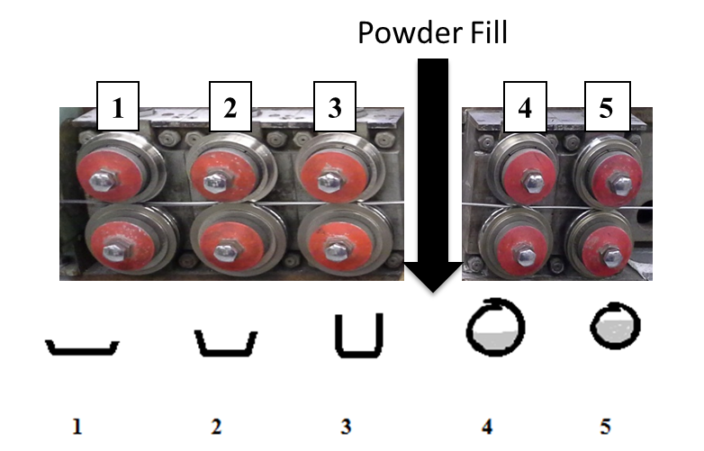
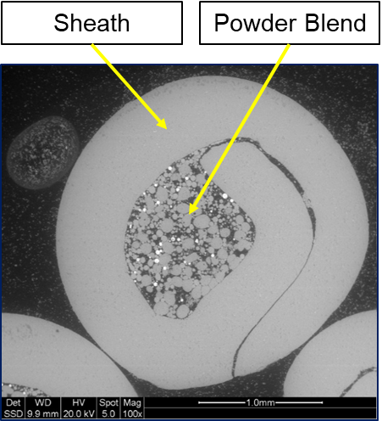
CSM PCTW Fabrication Capability
PCTW consists of a metal sheath and metallic powder fill selected to achieve a target post-deposition material composition
The powder blend is pre-mixed to account for elemental loss due to selective vaporization and sheath composition
A flat strip is shaped by the tubular mill rollers to form the outer sheath
Powder fill is added with the fill ratio determined by the targeted final composition.
The filled sheath is closed and drawn through a series of dies to the final wire diameter
_{Tubular Wire Mill}
Cross-section of a Powder Cored Wire
Flat
Filled
Strip
Wire

Slide 7
Metallic PCTW Wire Development for Additive Manufacturing – Research Focus
  Compositions optimized to offset elemental losses during EBF³ deposition – Christine Hillier:
    Process development and mass balance equations
    Ti-6Al-4V with enhanced aluminum
    Aluminum alloy 6061 with enhanced magnesium
Microstructure control – Scott Mitzner:
  Microstructure refinement in Ti-6Al-4V
  FeB additions
  Beam modulation
Aluminum Metal Matrix Composite (MMC) – Devon Gonzales, Ethan Sullivan:
  2219 and 6061 matrix alloys
  Direct addition of SiC, TiC, and TiSi₂ particulate reinforcements
  In-situ formation of TiC reinforcement

Slide 8
Metallic PCTW Wire Development for Additive Manufacturing – Elemental Losses
Developed process for manufacturing PCTW at CSM
Tubular mill forming dies and process parameters
Powder blending and feed systems
Wire drawing parameters
Wire design strategy
Analytical method to predict deposit composition
Account for estimated elemental loss due to vaporization
Account for sheath composition and thinning during wire drawing
Compositions tailored through sheath and powder fill compositions
Iterative fabrication / analysis
Deposit Analysis
Button melter and GTA melting systems at CSM
EBF3 system at NASA LaRC
Demonstrated feasibility of PCTW and EBF³ for fabrication of materials that meet required composition specifications
Ti-6Al-4V and Al 6061

Slide 9
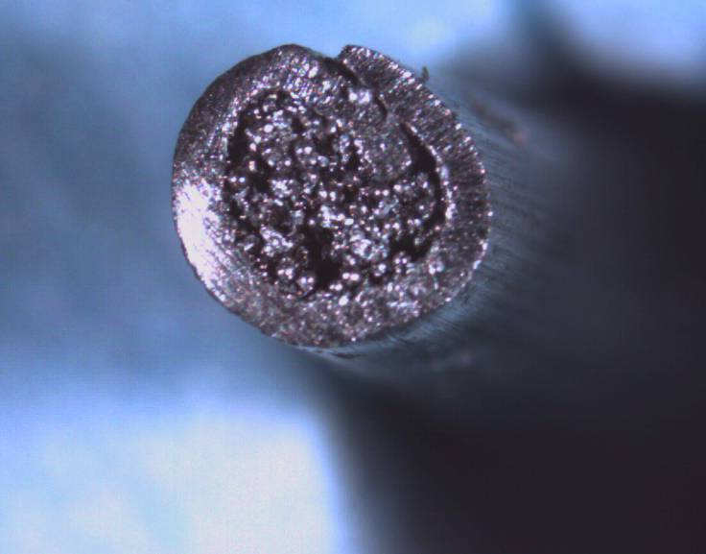

Metallic PCTW Wire Development for Additive Manufacturing – Tailored Powder Fill – Ti-6Al-4V
Ti-6Al-4V PCTW
  CP Ti sheath
  Powder fill
    Ti-6Al-4V + 19.5 Al + 12.5 V (wt %)
    Al addition to account for losses due to vaporization during deposition
    Al and V additions to account for CP Ti sheath
Composition of PCTW Designed for Ti-6Al-4V with Monolithic Ti-6Al-4V and Ti-7Al-4V Wires
8
Aluminum
7
Vanadium
Al range in Ti-6-4 per Specification AMS4911
6
5
Composition (wt. %)
4
3
2
1
0
Ti-6-4 Monolithic
Ti-7-4 Monolithic
PCTW
Ti-6Al-4V composition demonstrated in resulting deposits
Composition control through tailored powder blend

Slide 10
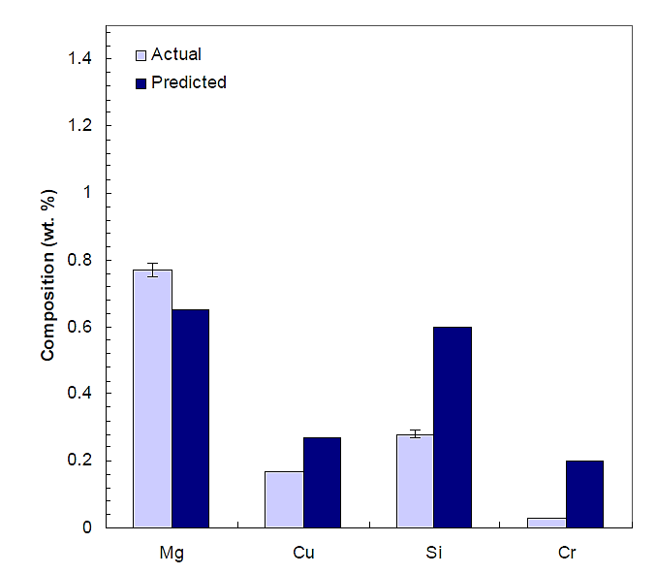
Metallic PCTW Wire Development for Additive Manufacturing – Tailored Sheath Selection – Al 6061
Composition of Al 6061 PCTW Deposit
Al 6061 PCTW
  Al 5052 sheath
    Mg enhancement
    1 wt% higher Mg than Al 6061
  Powder fill
    Pre-alloyed Al 6061
Mg range in Al 6061 per Specification
AMS4025
Al 6061 and Al 5052 Composition Specifications
Demonstrated composition control through sheath selection
Al 6061 composition possible with concurrent tailoring of powder fill

Slide 11
Metallic PCTW Wire Development for Additive Manufacturing – Microstructure Control
Identified grain refinement benefits for property improvements in Ti-6Al-4V AM materials
FeB additions
Beam and arc modulation in both EBF³ and GTAW systems; frequency and amplitude
Promote grain refinement
Disrupt interlayer epitaxial growth
Expanded the GTAW system at CSM to enable additive manufacturing
Wire fed system; argon atmosphere
Single axis automated stage manipulation
Supported up to 8” long deposits
Microstructure Refinement
Both FeB inclusion and beam/arc frequency modulation produced refined microstructures
Reductions in β grain size, α colony size and lath spacing
Increase in β volume fraction
Demonstrated trend of progressive refinement with modulation frequency

Slide 12
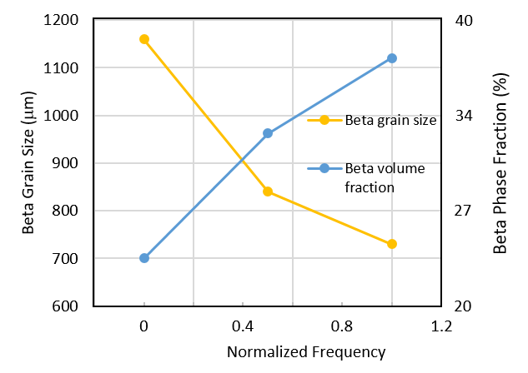
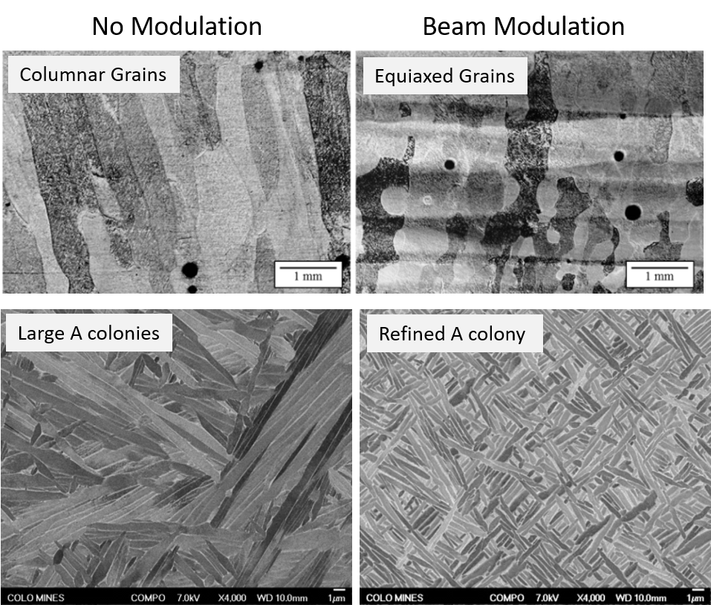
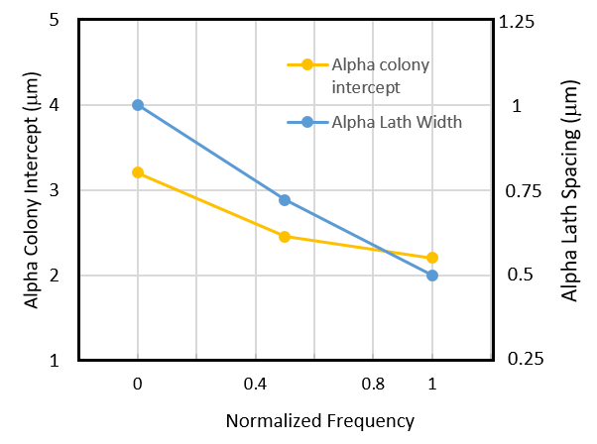
Powder Core Tubular (PCTW) Wire Development for Additive Manufacturing – Beam Modulation
Microstructure of Ti-6Al-4V PCTW Deposit
Large α colonies
Refined α colonies
Demonstrated grain refinement through beam and arc modulation
Noted reductions in β grain size, α colony features, and increase in β volume fraction

Slide 13
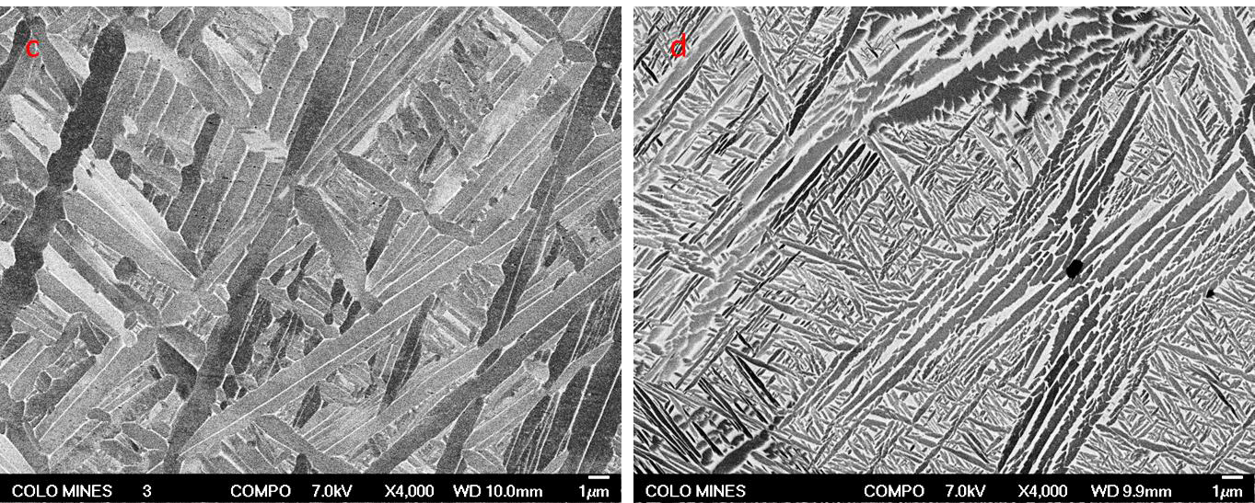
Metallic PCTW Wire Development for Additive Manufacturing – FeB Particulate Additions
Microstructure of PCTW Deposits
_{Ti-6Al-4V Wire}
_{FeB enhanced Ti-6Al-4V Wire}
Boron precipitates TiB which acts as a pinning point for α-lath colonies
Reduced α-colony intercept length by 35% and α-lath width by 40%

Slide 14
Metallic PCTW Wire Development for Additive Manufacturing – MMC Materials
Evaluated fabrication of MMC materials using PCTW and EBF³ technologies
Goal is to capitalize in AM processed materials on the demonstrated stiffness and strength improvements of MMCs
Direct additions of SiC to Al 6061
In-situ fabrication of reinforcements via reactive precursors
Direct Addition of SiC
Matrix alloys Al 6061 and Al 2219
SiC, uncoated, Ni- and Cu coated SiC
Deposition conditions: Focused, circular raster defocused, non-rastered beam conditions
In-situ reinforcement fabrication
Matrix alloy Al 6061
Powder blends target 2% and 10% nanoscale reinforcements via reaction synthesis of precursor powders
Material deposition: PCTW via EBF³ and powder via laser powder bed fusion

Slide 15
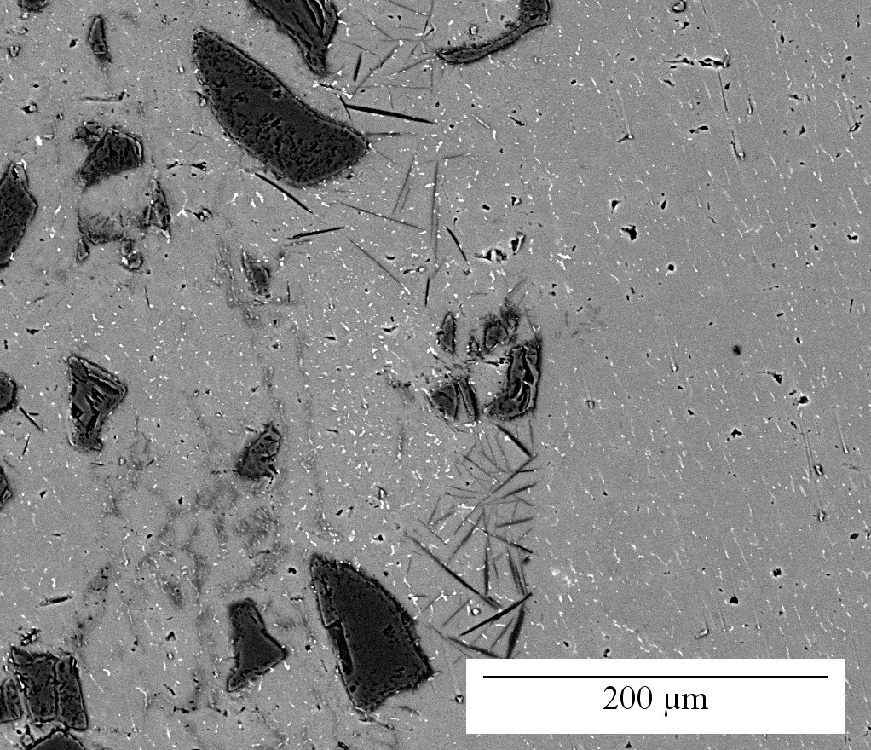
Metallic PCTW Wire Development for Additive Manufacturing – Direct SiC Addition
Al 6061 – SiC Metal Matrix Composite
SiC
Particle clusters
Al₄C₃
Challenges
  Clustering of SiC creates non-uniform distribution of reinforcement
  Reaction of SiC with Al matrix to form aluminum carbides

Slide 16
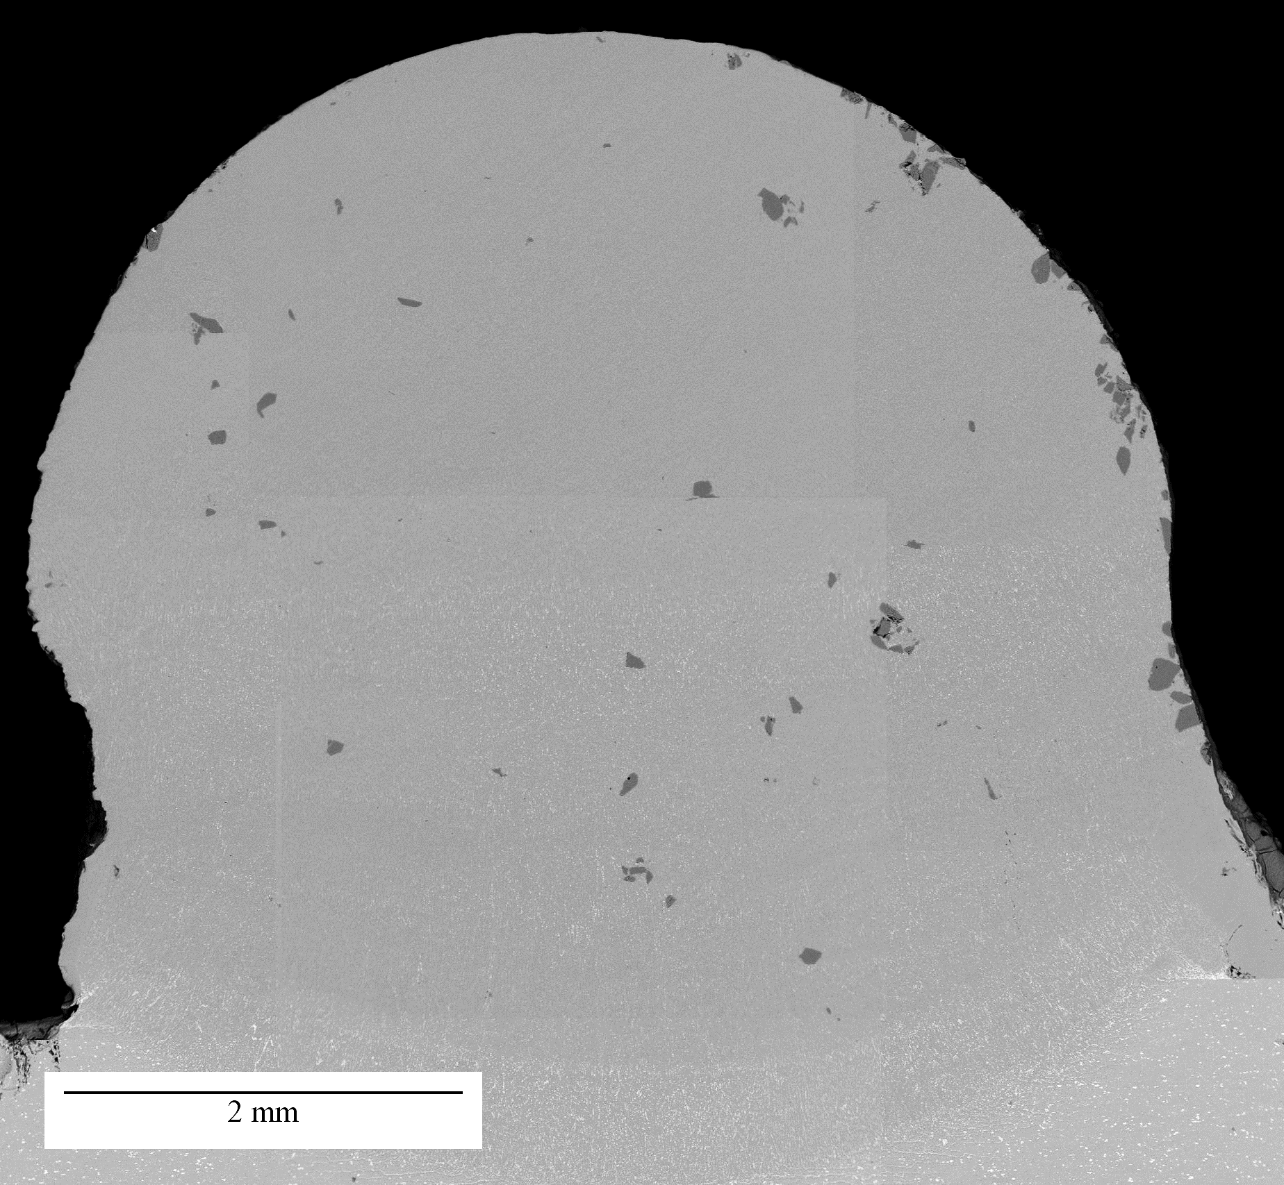
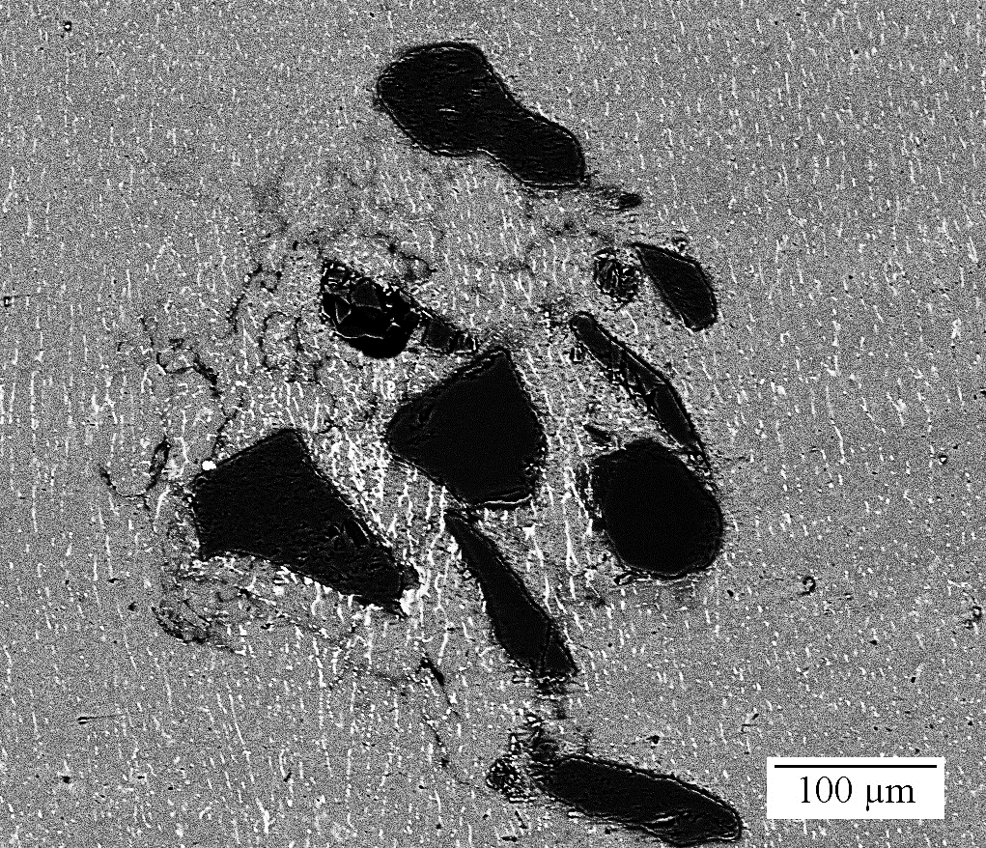
Metallic PCTW Wire Development for Additive Manufacturing – Coated SiC Additions
Al 6061 – Ni Coated SiC Metal Matrix Composite
SiC
SiC
Particle clusters
Al₄C₃
Ni-rich
Phase
Ni coating on SiC eliminated aluminum carbide formation and reduced particle clustering
Noted reduced number and size of particle clusters

Slide 17
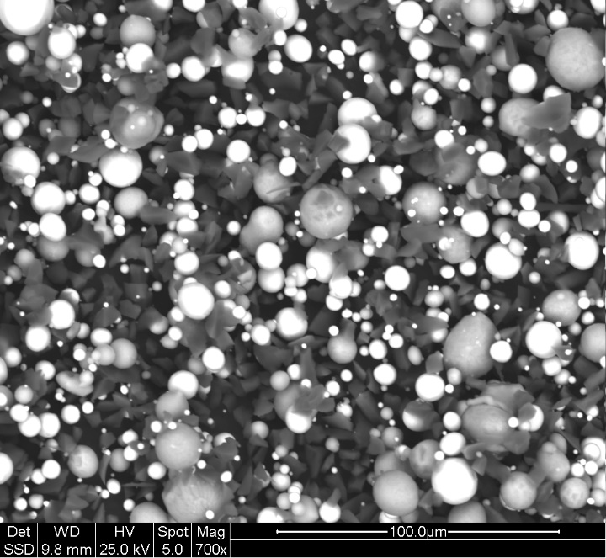
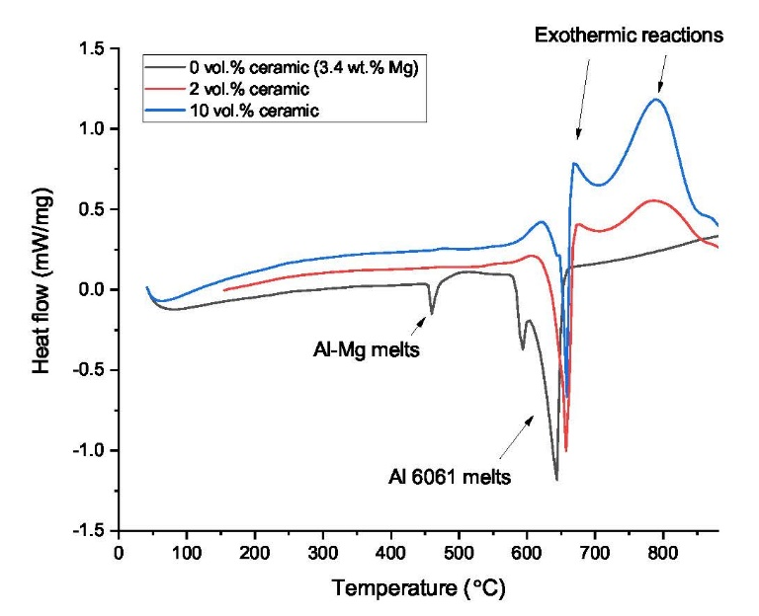
Metallic PCTW Wire Development for Additive Manufacturing – In-situ Reinforcement Formation
Powder Morphology
Thermal Signature of Powder Fill
Ceramic precursors
Al 6061
Al 6061 powder with reactive precursors
Designed to create 10 vol.% ceramic reinforcement during deposition
Exothermic reaction of precursor materials
DSC provides guidance for deposition conditions

Slide 18
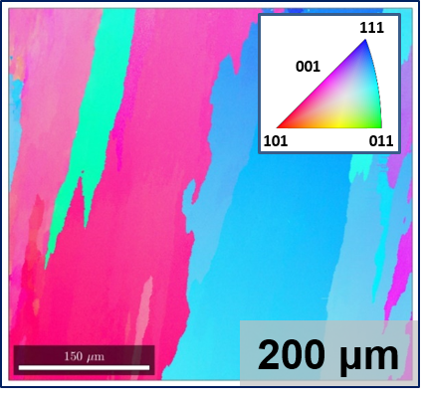
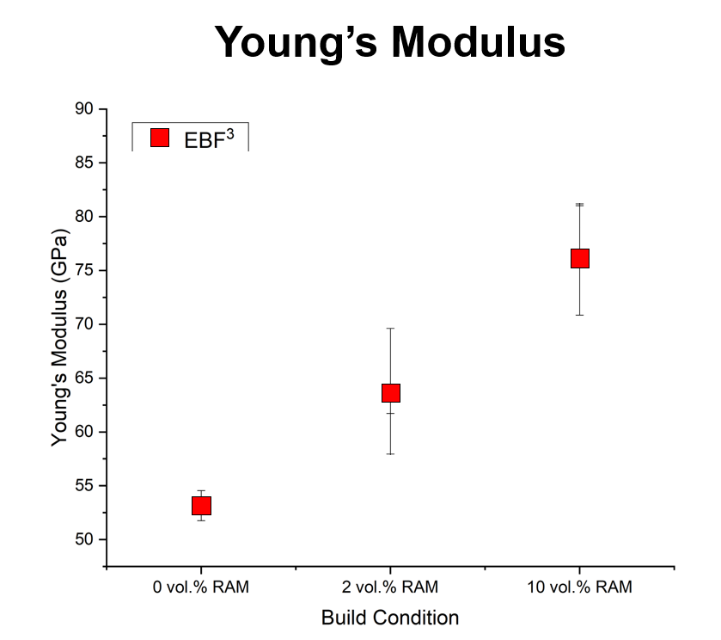
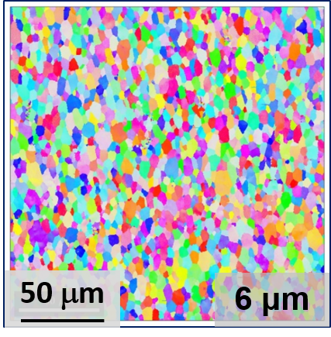
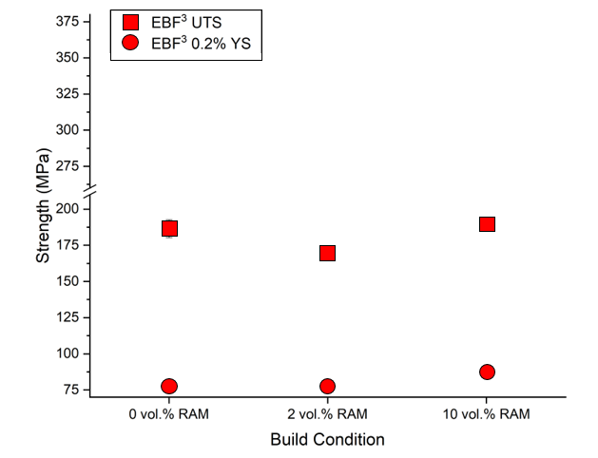
Metallic PCTW Wire Development for Additive Manufacturing – In-situ Reinforcement Formation
Effect of Nanoscale Reinforcements on EBF³ Deposits of Al 6061-based MMC
0 vol.%
Avg grain size 200μm
0 vol%
2 vol%
10 vol%
2 vol.%
Avg grain size 6μm
0 vol%
2 vol%
10 vol%
Significant grain refinement achieved
Demonstrated Modulus benefit and comparable strength with reinforcement

Slide 19
Metallic PCTW Wire Development for Additive Manufacturing – Conclusions
The potential of PCTW technology for customizing alloy composition and controlling microstructure wa successfully demonstrated
A manufacturing process was developed for titanium- and aluminum-based PCTW
Powder fill and sheath design methodology for target deposit composition
Wire fabrication though sheath formation, powder fill, and wire drawing
Deposited materials met compositional specifications for wrought materials
Composition control through tailored powder fill and sheath selection
Iterative design of powder fill using theoretical calculations and empirical data
Mitigated Al loss from Ti-6Al-4V and Mg loss from Al 6061
Microstructure refinement and property improvements demonstrated in Ti-6-4
Epitaxial grain growth mitigated through beam modulation and FeB additions
Significant grain refinement achieved
Demonstrated viability of MMC fabrication using PCTW and AM deposition
Direct additions and in-situ forming of reinforcements

