Slide 1
Evaluation of correction methods for NASA GeneLab transcriptomic datasets
Finsam Samson
Mentor: Amanda Saravia-Butler, Ph.D., NASA GeneLab
Notes:
Overall:
Avoid diving into details

Slide 2

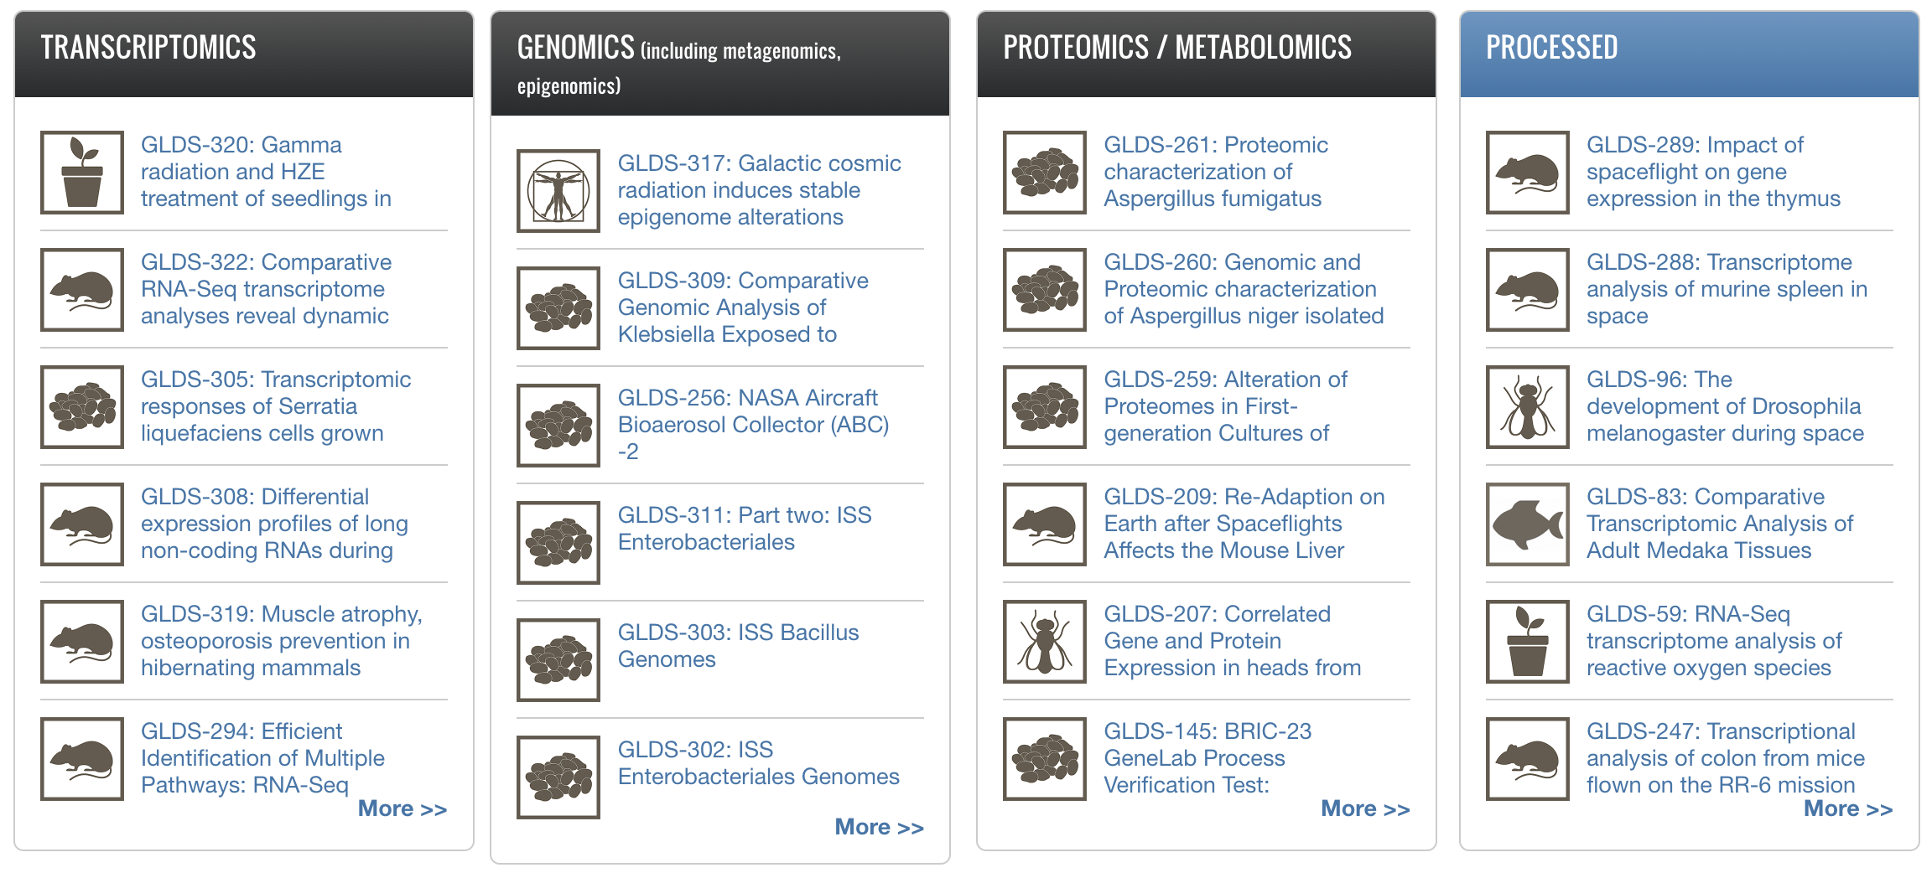
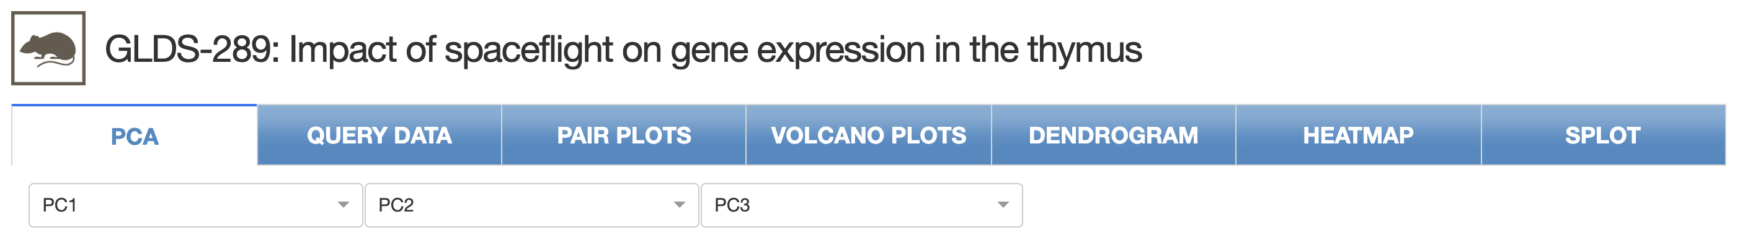
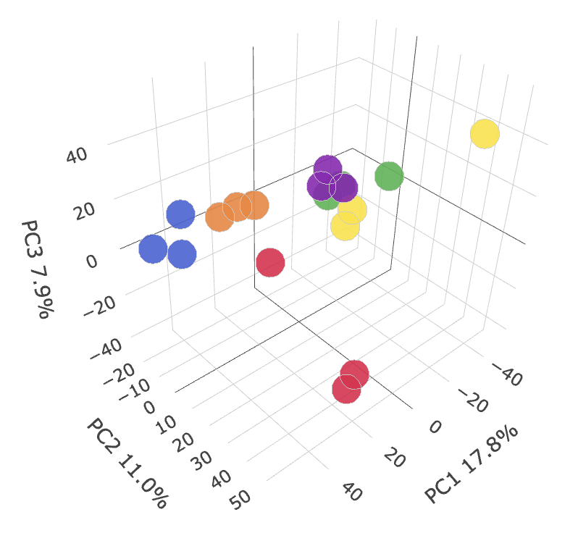
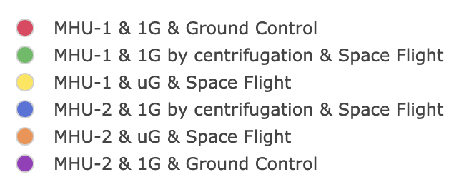
NASA GeneLab – genelab.nasa.gov
Open Source
Space Biosciences ‘Omics Repository
Visualization Suite
Notes:
Point to tube
Mention that datasets generated in house use UR samples to account for tech. variation
Majority of datasets (from outside of GeneLab) don’t have this
Can only be applied to a subset
Standard correction
Doesn’t take into account any universal reference
Set up the more technical parts
Table:
Mention the different types of variation (experimental design, technical, maybe more)
Tools can’t distinguish between them
If datasets processed in house, then it could be distinguished, reference RNA
Table:
Project 1: Technical variation (can tease it out with universal references)
Project 2: Standard correction methods, for everything, majority of GLDS
Explain the datasets
Could show the chart
Explain UMRR

Slide 3
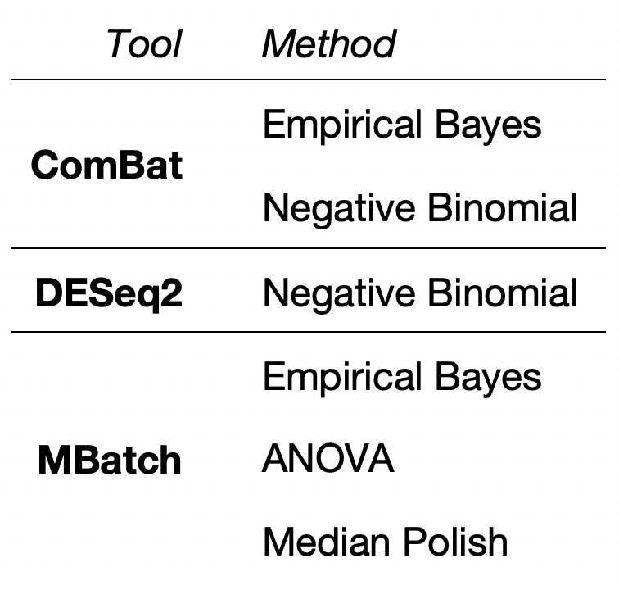
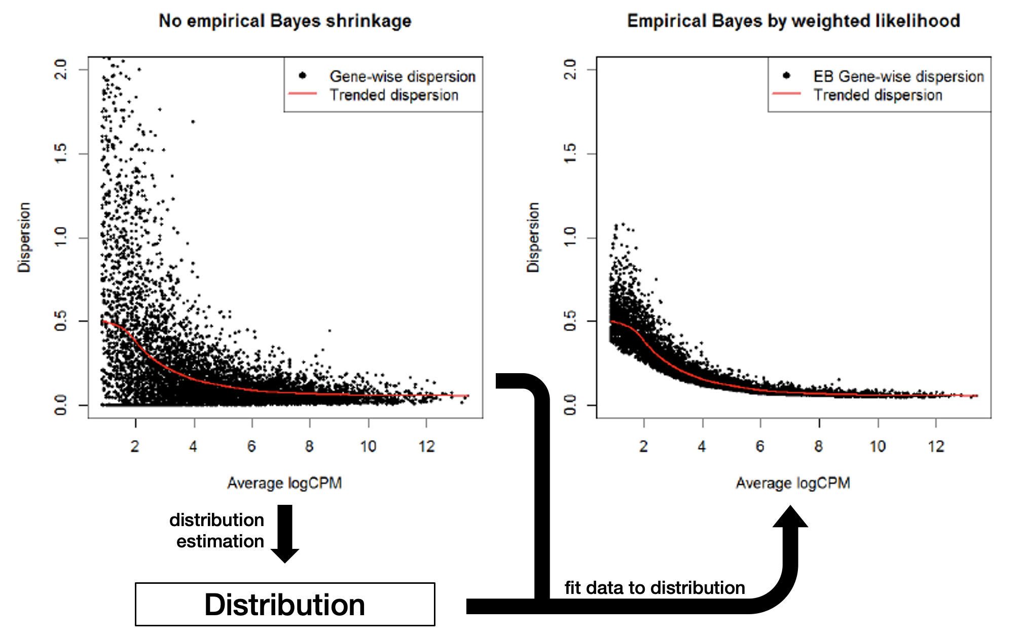

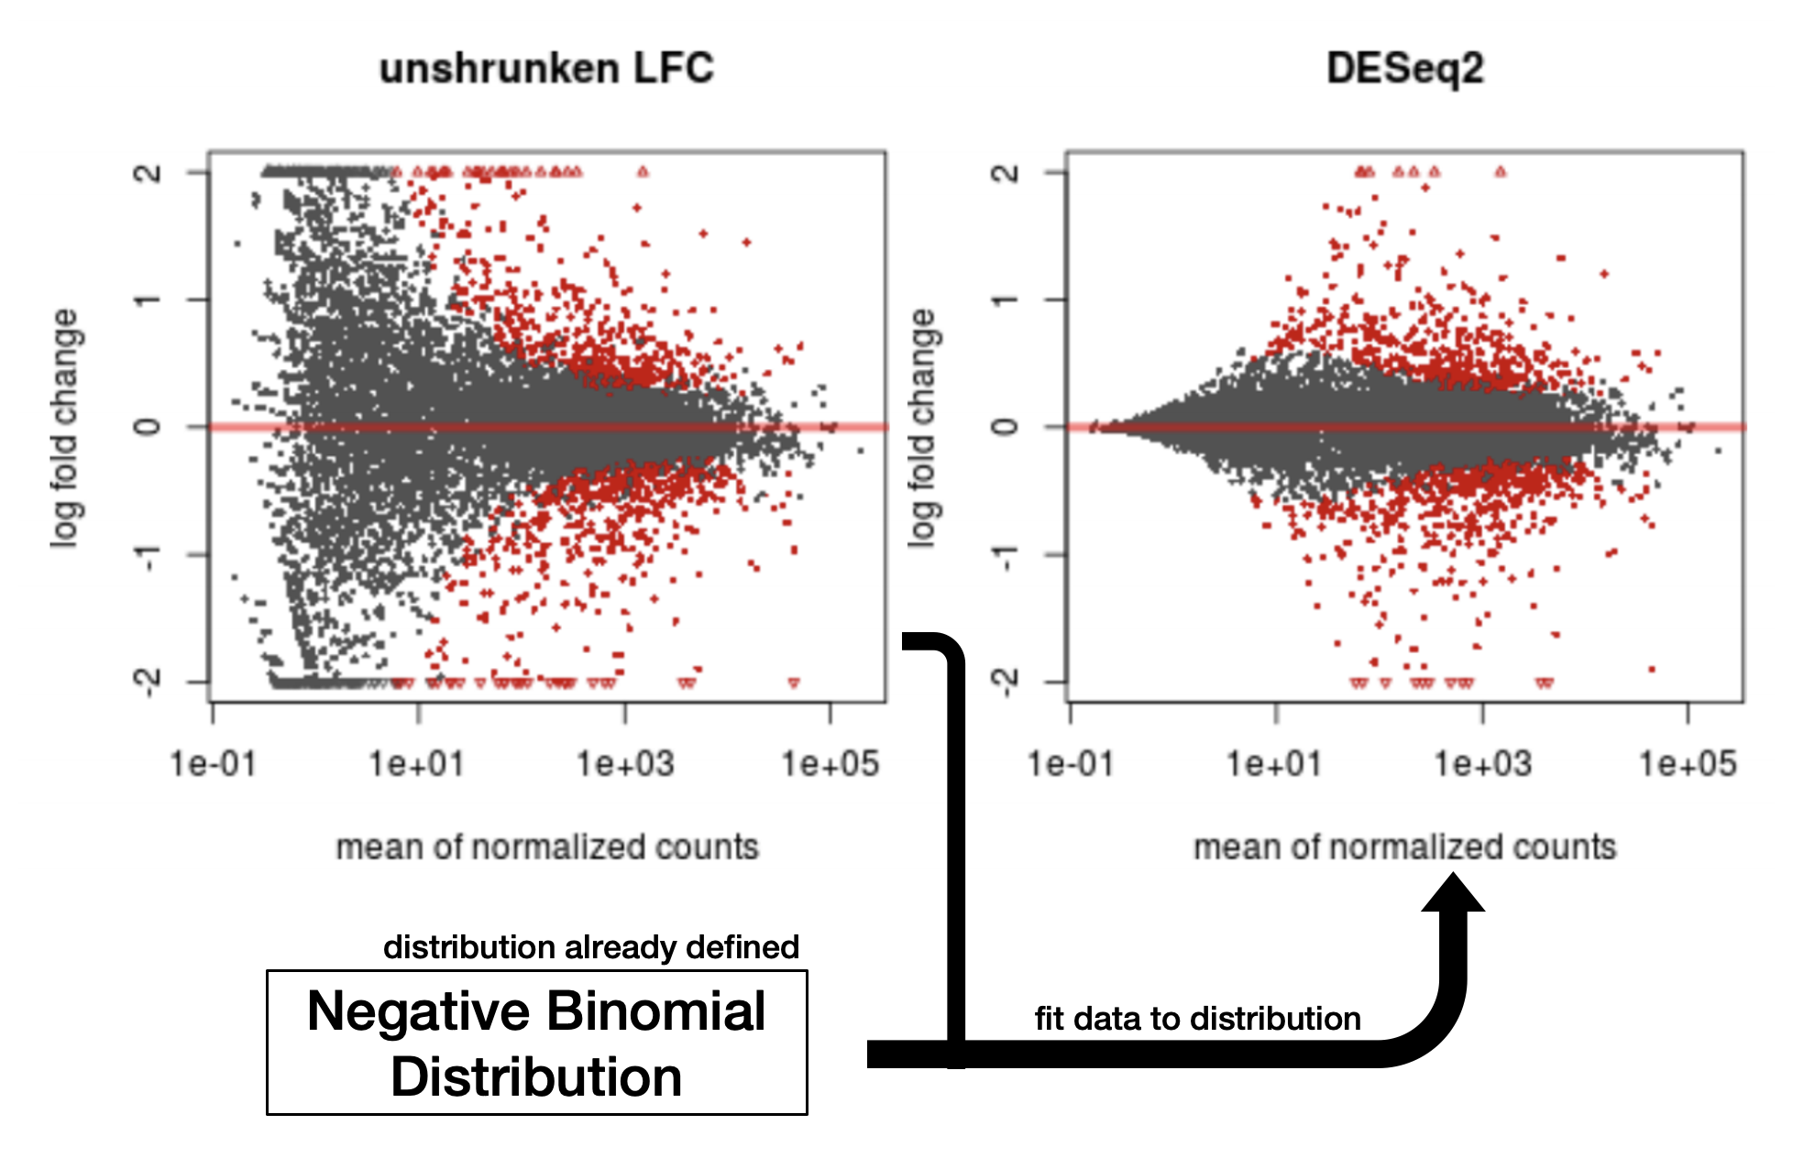
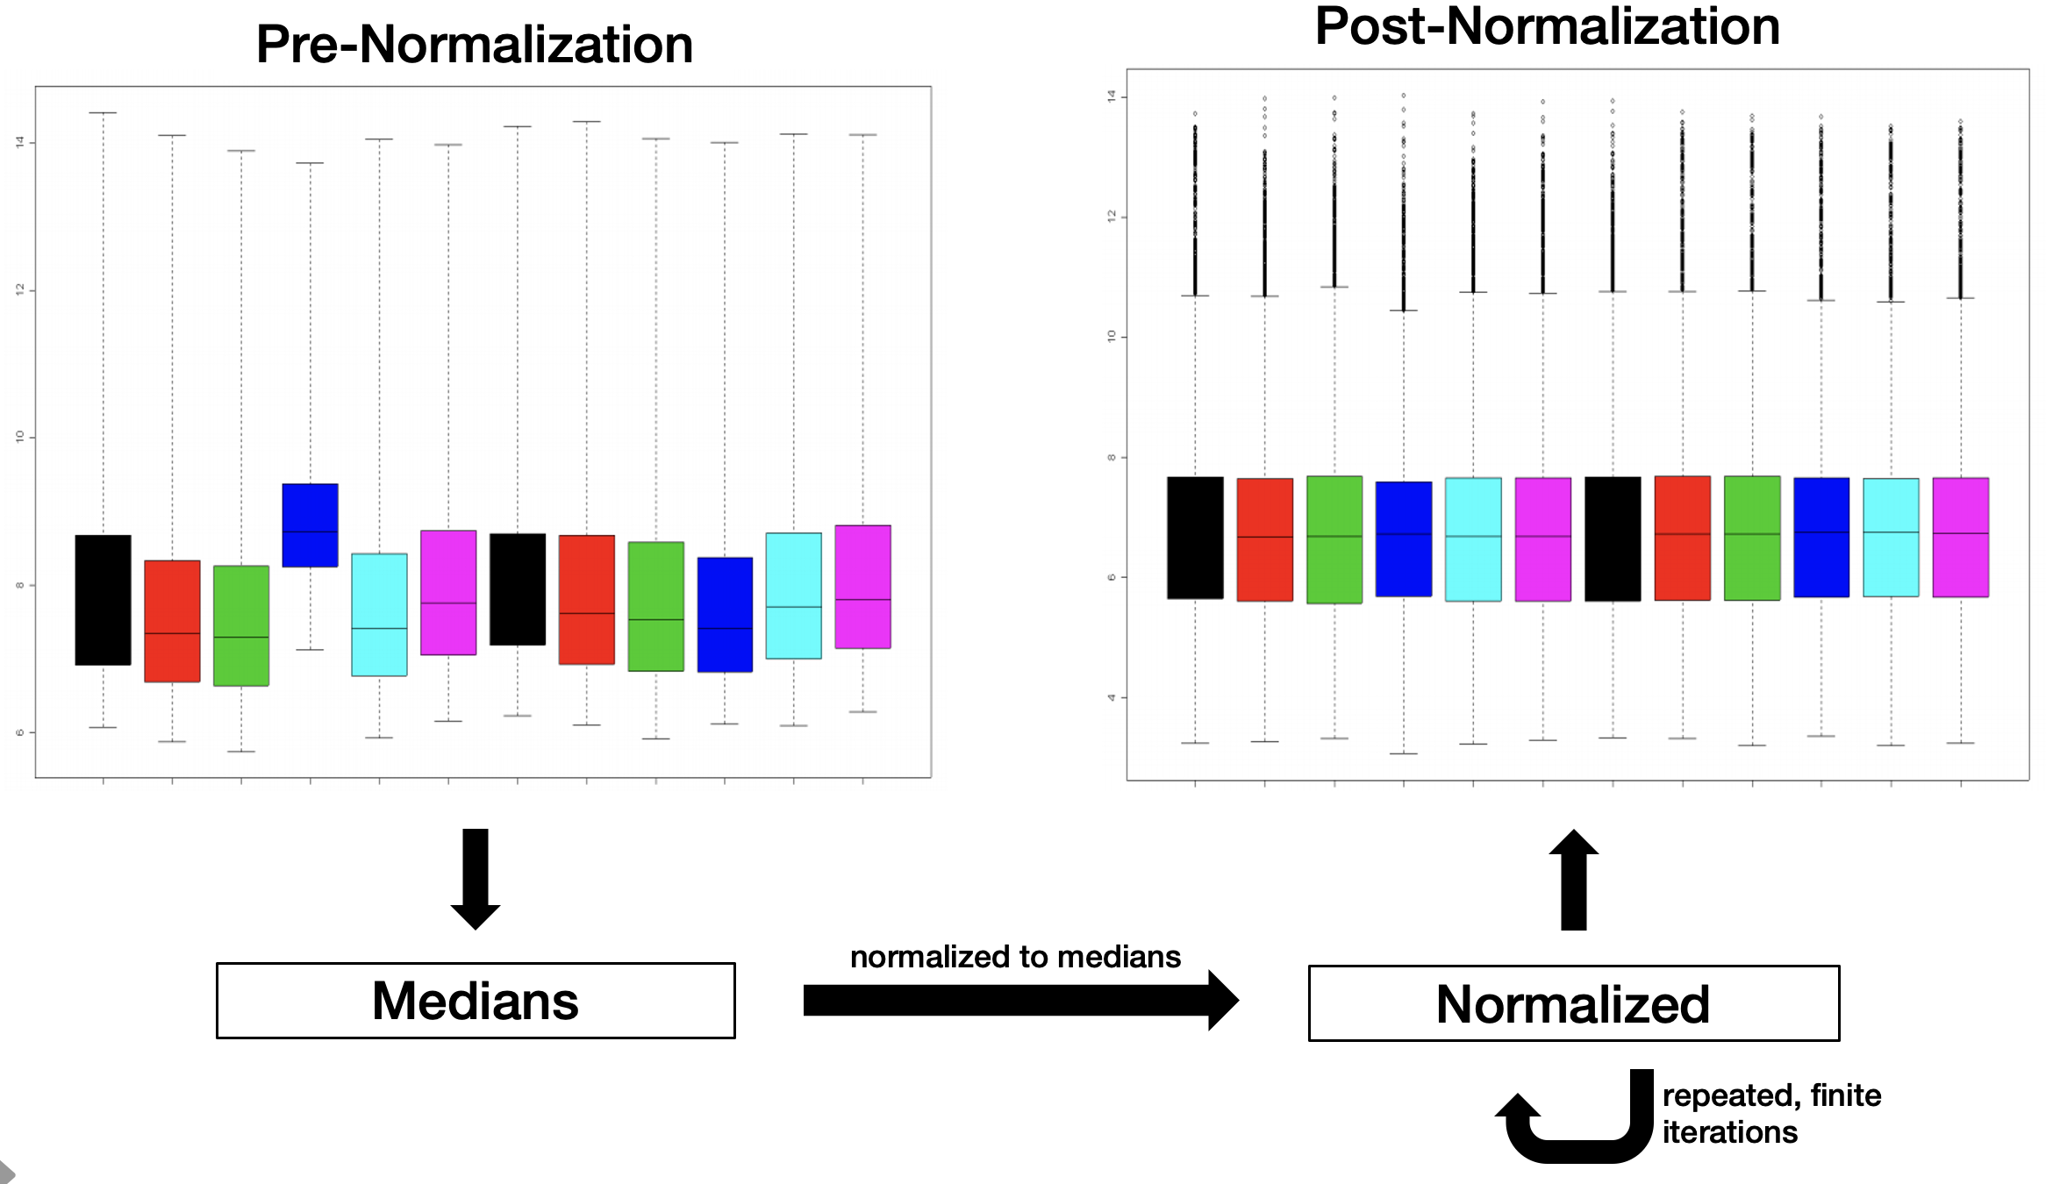
Correction Tools
Empirical Bayes Method
Negative Binomial Regression
Median Polish
Notes:
Mention each name
First column: tool name (emphasize it)
Each row: each tool
Other columns: mathematical models used
Explain the mathematical models
DSeq2 models based on the batch

Slide 4
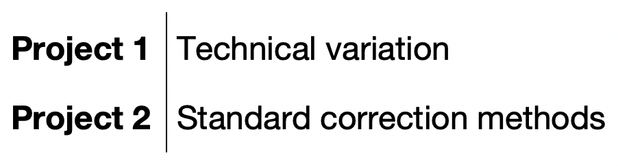

Two Projects
Notes:
Point to tube
Mention that datasets generated in house use UR samples to account for tech. variation
Majority of datasets (from outside of GeneLab) don’t have this
Can only be applied to a subset
Standard correction
Doesn’t take into account any universal reference
Set up the more technical parts
Table:
Mention the different types of variation (experimental design, technical, maybe more)
Tools can’t distinguish between them
If datasets processed in house, then it could be distinguished, reference RNA
Table:
Project 1: Technical variation (can tease it out with universal references)
Project 2: Standard correction methods, for everything, majority of GLDS
Explain the datasets
Could show the chart
Explain UMRR

Slide 5
Reference-based Correction – Project 1
Use BatchQC to identify differences
Run correction on reference samples
Extract correction factors
Apply correction to FLT/GC samples
Evaluate robustness of correction approach
Notes:
Use BatchQC to identify differences in samples between datasets
Apply correction methods to UMRR samples
Extract correction factors from UMRR correction
Apply UMRR correction factors to FLT/GC samples from respective datasets
4. Evaluate robustness of this correction approach

Slide 6
Standard Correction Methods – Project 2
Use BatchQC to identify differences
Apply correction to FLT/GC samples
Evaluate robustness of correction approach
Notes:
Flowchart decision tree (part one)
Use animations
Do one tool at a time
Look at project document (and screenshot)
BatchQC
Batch effect? Y/N
Correction tool
Batch effect?
- Could show step in decision tree where I am

Slide 7
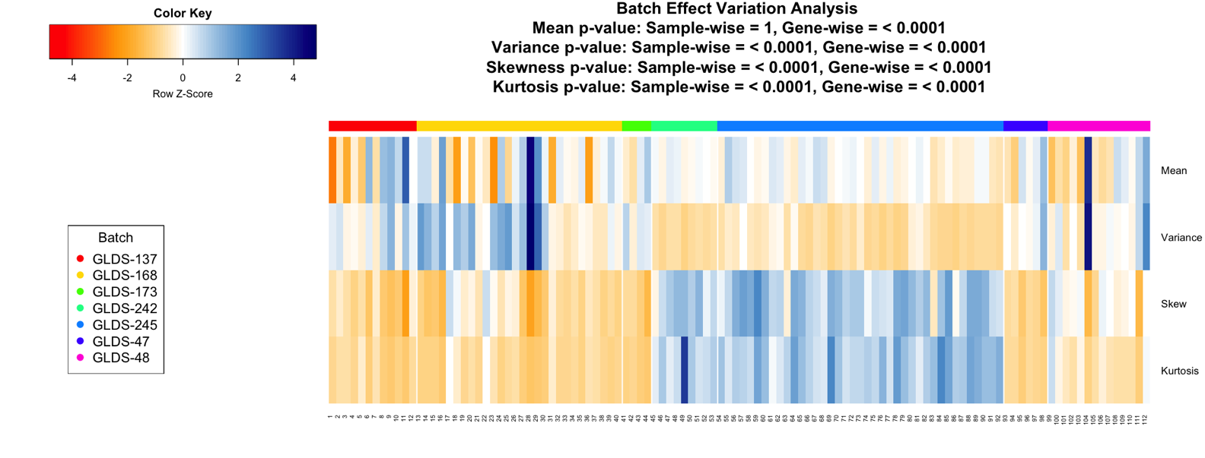
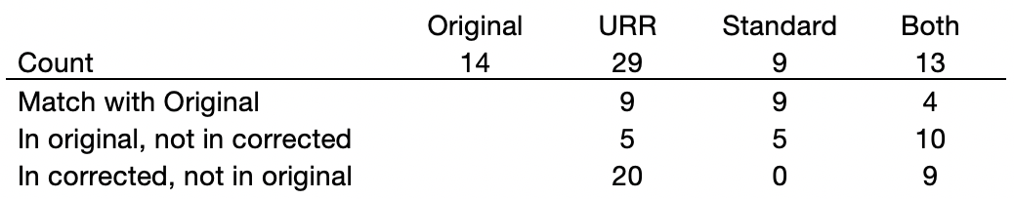
Correction Method Evaluations
Evaluate robustness of correction approach
BatchQC
PCA
Differential Gene Expression Analysis
Adj. p < 0.05, |log2fc| < 1.5
Notes:
Three methods for evaluation
BatchQC
Stat. dif
PCA
Global gene expression
DEA
Before/after correction

Slide 8
Refernce-based Correction – PCA
ComBat
Uncorrected
Reference RNA correction
Standard correction
Reference RNA + standard correction
Notes:
Say standard correction “that doesn’t consider universal references”
Be clear that we are not looking at the reference samples now, only FLT and GC samples from these two datasets
Applied correction factors
Could use animations to walk through the PCAs
Could have bulleted points in the process
Show two together
Increase size of dots, flip size of FLT/GC, increase size of labels, have something for ISST/LAR
Identified difference in reference samples, then extracted out correction factors, applies correction factors to flt and gc
Reran PCA plots and BatchQC (have ready)
Flip flight and GC shapes
Label ISST and LAR, this might be it
Explain ISST/LAR
Walk through the PCAs again
Script it again, to be concise

Slide 9
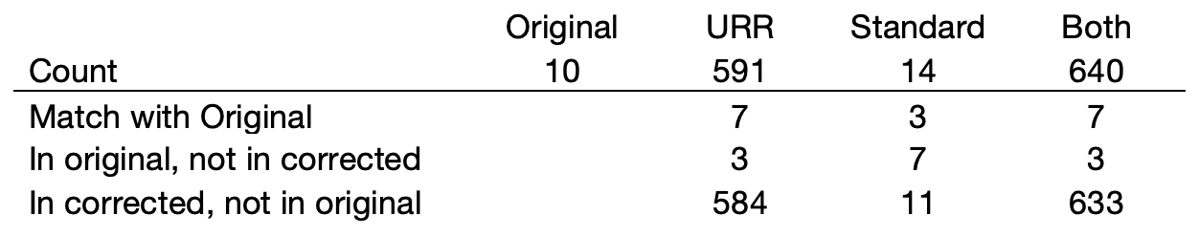
Reference-based Corrections – DGE
ComBat_seq
Differentially Expressed Genes for Uncorrected Dataset
Differentially Expressed Genes for Corrected Dataset
GLDS-242
Adj. p < 0.05
Notes:
Bring the circle/animation up earlier
Same thing as slide 18
At the end of this slide
Because we noted such a big difference in applying URR, decided to move onto everything
Do ISST vs. LAR

Slide 10
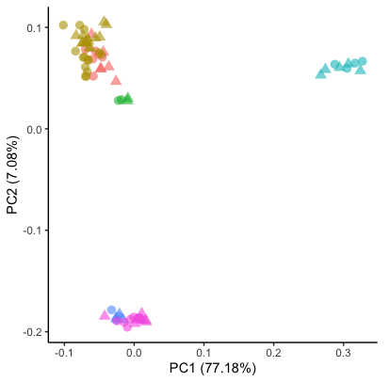
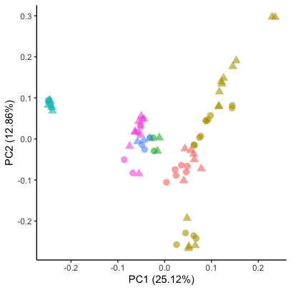
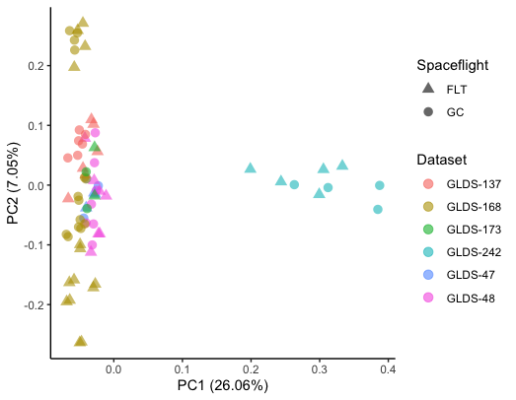
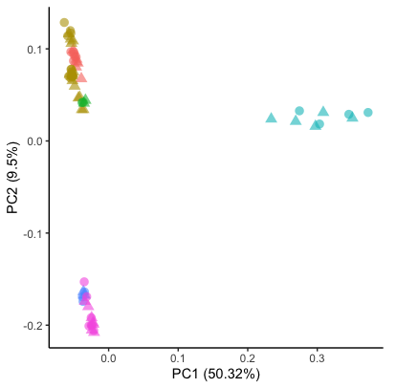
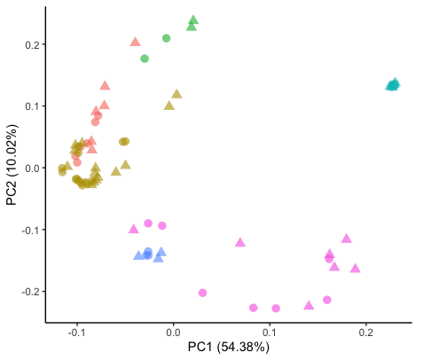
Standard Corrections – PCA
Raw
ComBat
ComBat_seq
DESeq2
MBatch – MP

Slide 11
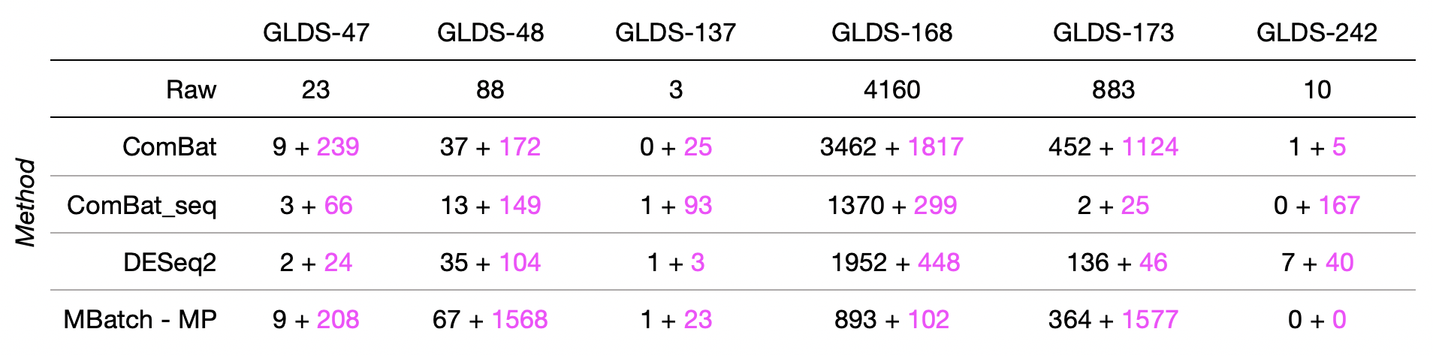
Standard Corrections – DGE
– Matching
– Additional Differentially Expressed Genes
Notes:
Spend a bit more time on this
State that these comparisons are to evaluate datasets
All the numbers in black are total dif exp genes that were the same as those in original
All in pink are additional DGE identified after combining and correcting datasets
Point out that ComBat and ComBat_seq maintain most genes as found in original dataset before combining
Introduces fewest potential false positive genes

Slide 12
Acknowledgements
Mentor
Amanda Saravia-Butler, Ph.D.
GeneLab Team
SLSTP Management
Sigrid Reinsch, Ph.D.
Desi Bridges
Hami Ray, Ph.D.
SLSTP Staffers
Elizabeth Hawkins
Jerika Christman
Notes:
Acknowledgements
All the SLSTP management, staffers, everyone in the program, GeneLab

