Slide 1
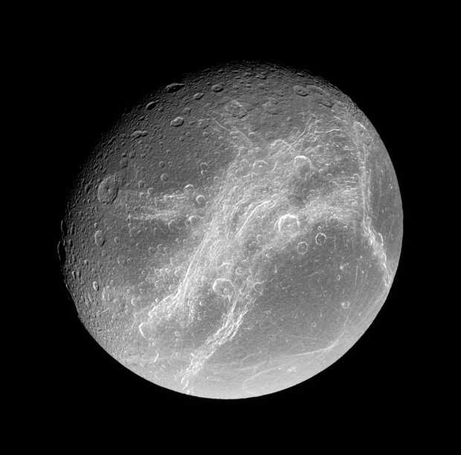

Electron bombardment on Dione: surface compositional effects and temperature anomalies
C. L. Young¹, M. S. Grant¹, C. A. Nixon², F. Scipioni³,
T. A. Nordheim⁴, J. C. Cook⁵, T. W. Hayes²;
¹NASA Langley Research Center, Hampton Virginia, VA, ²GSFC, Greenbelt, MD,
³SETI Institute, Mountain View, CA, ⁴JPL, Pasadena, CA, ⁵Pinhead Institute, Telluride, CO
Notes:
Thanks so much for coming to my talk today. In conjunction with my collaborators, I have been working on further constraining the surface compositions of icy moons using mid-infrared spectroscopy.
Surface compositions bear on three cross-cutting themes of the Planetary Science Decadal Survey: understanding solar system beginnings, revealing planetary processes through time, and searching for the requirements of life.
Determining surface compositions for icy moons was one of the original goals of Cassini’s Composite Infrared Spectrometer (CIRS), but there are few studies on this to date bc of the challenges of mid-IR remote sensing on these bodies. I’m going to talk about some of the those challenges to determine if mid-IR spectrometers are suitable instruments to study surface compositions of icy satellites.

Slide 2
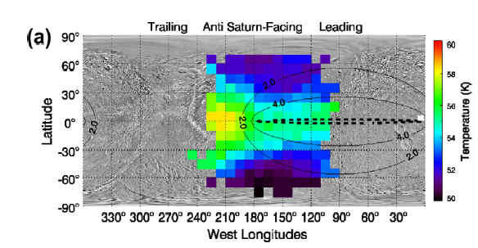
Motivation
Electron bombardment is expected to be particularly important on the surfaces of Saturn’s inner moons
Terrains exhibiting thermal anomalies correspond to regions of high energy electron bombardment
[Nordheim et al., 2017; Howett et al., 2020;
Paranicas et al., 2012; 2014]
Modeling has shown that electron bombardment sinters the ice grains [Schaible et al., 2017], but this is yet to be observed in Visual and Infrared Mapping Spectrometer (VIMS) spectra
Dione’s nighttime temperature anomaly; Contours show electron power deposited into the surface per unit area [Howett et al., 2014].

Slide 3
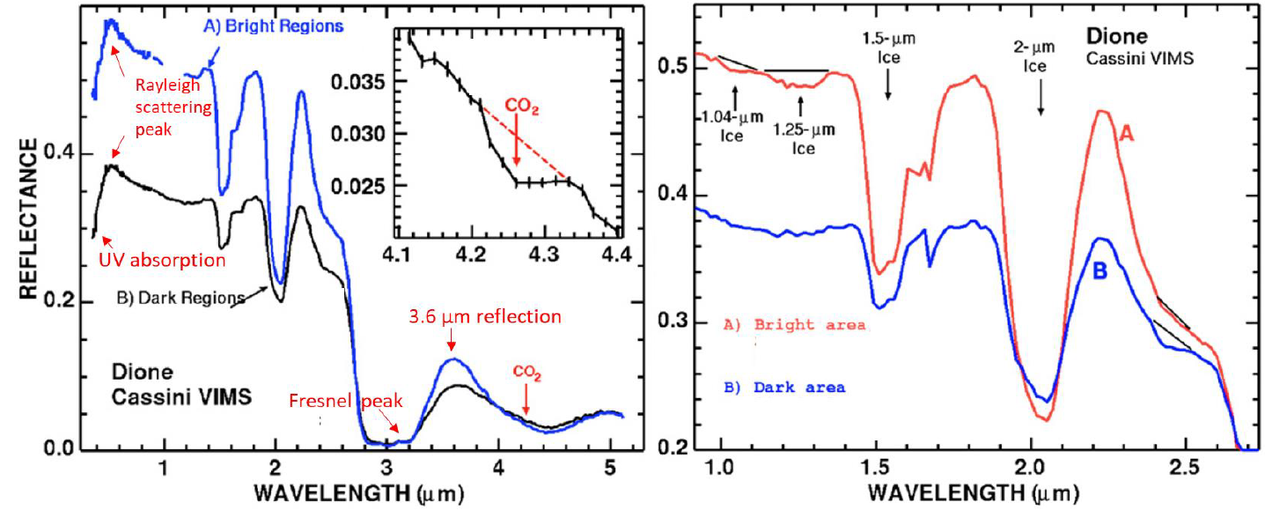
Figures from Clark et al. [2008]
There are several VIMS spectral regions that can yield information about the surface interaction with the space environment

Slide 4
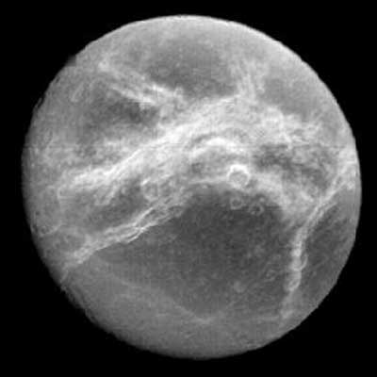
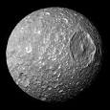
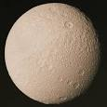
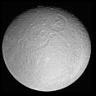
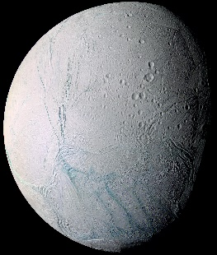
Goal: to study the effects of electron bombardment on NIR spectral features (i.e., do VIMS spectra support the sintering hypothesis?)
Approach:
  Clustering to reveal subtle differences/similarities in spectral bands
  Mapping NIR spectral properties (e.g., band depth or height)
    The band depth/height is controlled by abundance and grain size
  Understanding variations in spectral properties with Temperature
    How do Temperatures derived from the Composite Infrared Spectrometer (CIRS) correlate with spectral properties?
Focus on Dione and its water ice bands
Notes:
Of the very few previous studies that have attempted to find mid-IR features on icy moons, some have focused on colder bodies in the Saturn System (such as Rhea’s poles) where signal would be low. Others have tried to average spectra to reduce the signal to noise and tease out spectral features, but did so using disk averages, which likely removed any features.
Our goal is the average CIRS FP3 spectra to increase the signal to noise ratio and use emissivity spectra to constrain the composition of the dark material on Iapetus.

Slide 5
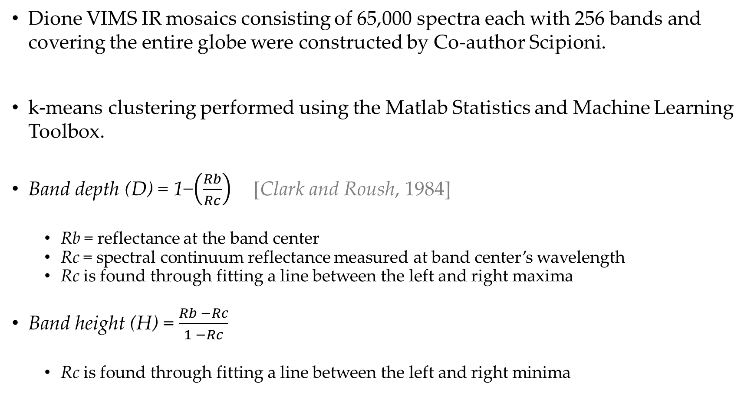
Methods: clustering & band depth/height
Dione VIMS IR mosaics consisting of 65,000 spectra each with 256 bands and covering the entire globe were constructed by Co-author Scipioni.
k-means clustering performed using the Matlab Statistics and Machine Learning Toolbox.
Band depth (D) = 1−$\left(\frac{Rb}{Rc}\right)$ [Clark and Roush, 1984]
  Rb = reflectance at the band center
  Rc = spectral continuum reflectance measured at band center’s wavelength
  Rc is found through fitting a line between the left and right maxima
Band height (H) = $\frac{Rb −Rc}{1 −Rc}$
  Rc is found through fitting a line between the left and right minima

Slide 6
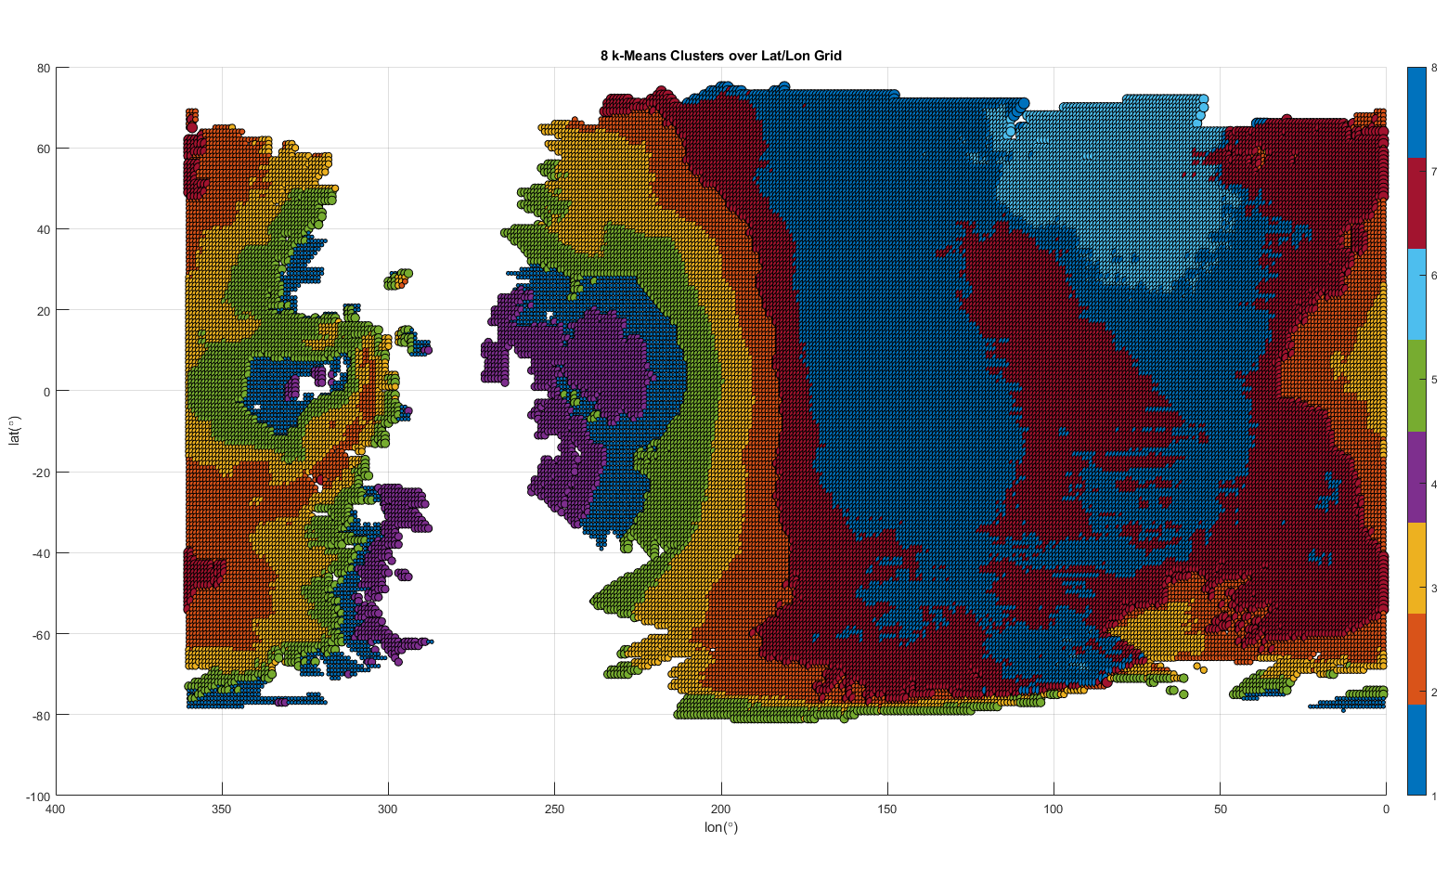
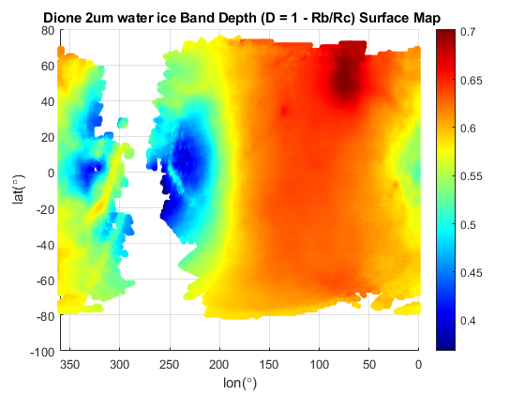
Global 2 µm band maps
2 µm band k-means clusters
80
80
8
60
7
40
6
20
0
5
lat (º)
-20
4
-40
3
-60
-80
2
0
1
400 350 300 250 200 150 100 50 0
lon(º)
Globally, clusters appear highly correlated with band depth variations

Slide 7
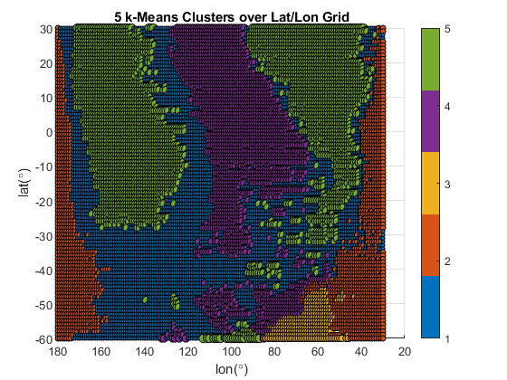
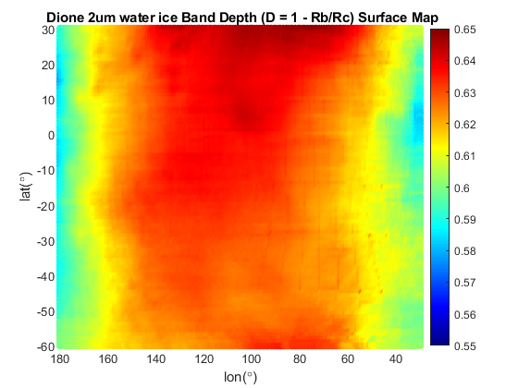
Leading hemisphere 2 µm band maps
On the leading hemisphere, regional clusters show moderate correlation with band depth
Further spectral evaluation is needed to describe the clusters

Slide 8
Qualitative indicators of sub-micron grains:
e.g., Scipioni et al. [2017]
1.5 µm / 2 µm band depth ratio is decreased
3.1 µm Fresnel peak is suppressed
3.6 µm reflection is muted
Notes:
From a literature search of spectra for silicates, we see that the best match to the feature at 855 cm-1 at ambient T and P is magnesium-rich phyllosilicates, in particular serpentines, such as lizardite and antigorite.
Large dip in noisy part of spectrum is consistent with restrahlen bands of the serpentines near 1045 cm-1.
Serpentines also match the 660 cm-1 part of the doublet observed from CIRS. Although doublet not observed here, lower T’s can often resolve fine structure within bands that appear broad and merged at room T.
Another possible explanation of the doublet is CO2 ice, which should have a singlet or doublet there due to the O-C-O bending mode.

Slide 9
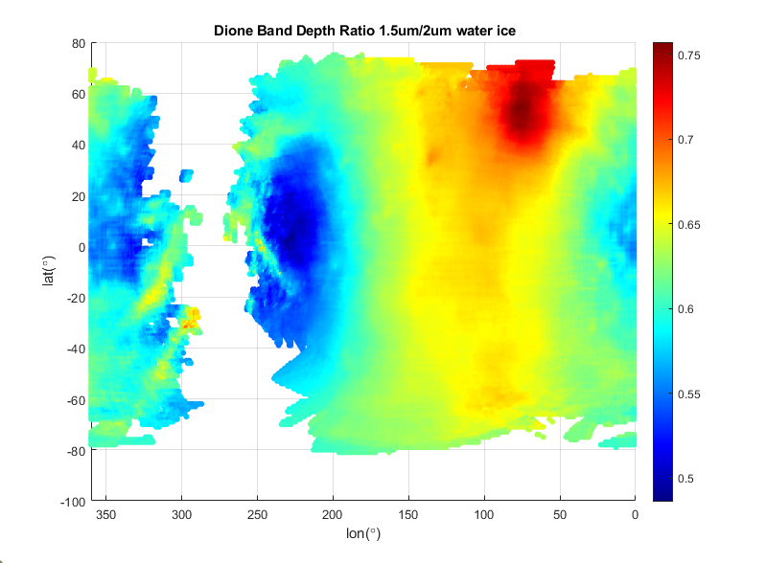
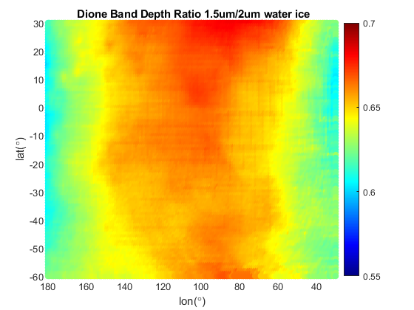
Qualitative indicators of sub-micron grains:
Scipioni et al. [2017]
1.5 µm / 2 µm band depth ratio is decreased X
3.1 µm Fresnel peak is suppressed
3.6 µm reflection is muted
1.5 / 2 µm band depth ratios are elevated on leading hemisphere
Notes:
From a literature search of spectra for silicates, we see that the best match to the feature at 855 cm-1 at ambient T and P is magnesium-rich phyllosilicates, in particular serpentines, such as lizardite and antigorite.
Large dip in noisy part of spectrum is consistent with restrahlen bands of the serpentines near 1045 cm-1.
Serpentines also match the 660 cm-1 part of the doublet observed from CIRS. Although doublet not observed here, lower T’s can often resolve fine structure within bands that appear broad and merged at room T.
Another possible explanation of the doublet is CO2 ice, which should have a singlet or doublet there due to the O-C-O bending mode.

Slide 10
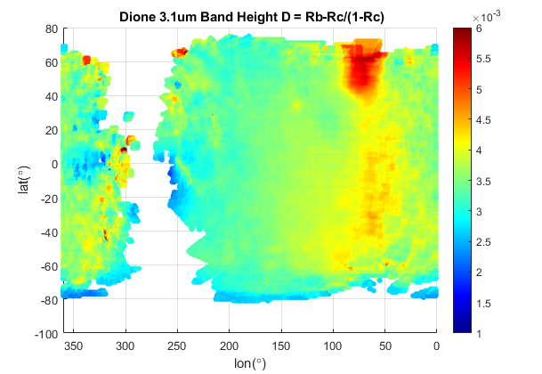
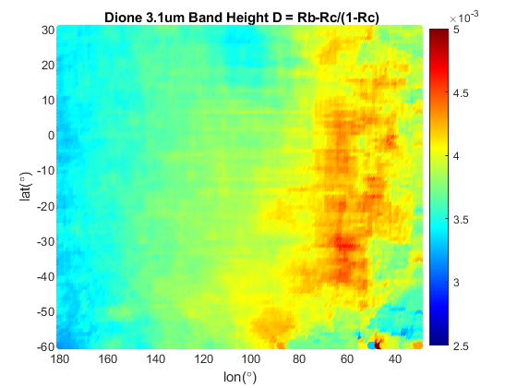
Qualitative indicators of sub-micron grains:
e.g., Scipioni et al. [2017]
1.5 µm / 2 µm band depth ratio is decreased X
3.1 µm Fresnel peak is suppressed X
3.6 µm reflection is muted
3.1 µm Fresnel peak is not suppressed on the leading hemisphere
Notes:
From a literature search of spectra for silicates, we see that the best match to the feature at 855 cm-1 at ambient T and P is magnesium-rich phyllosilicates, in particular serpentines, such as lizardite and antigorite.
Large dip in noisy part of spectrum is consistent with restrahlen bands of the serpentines near 1045 cm-1.
Serpentines also match the 660 cm-1 part of the doublet observed from CIRS. Although doublet not observed here, lower T’s can often resolve fine structure within bands that appear broad and merged at room T.
Another possible explanation of the doublet is CO2 ice, which should have a singlet or doublet there due to the O-C-O bending mode.

Slide 11
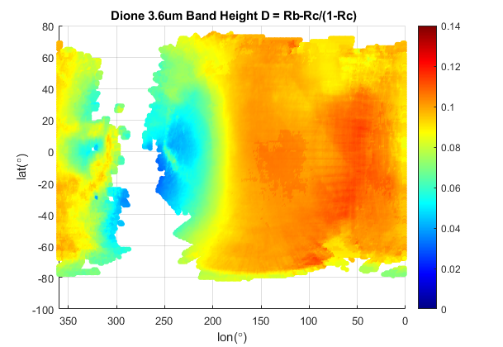
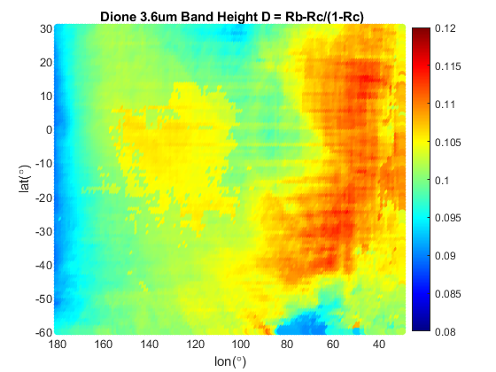
Qualitative indicators of sub-micron grains:
e.g., Scipioni et al. [2017]
1.5 µm / 2 µm band depth ratio is decreased X
3.1 µm Fresnel peak is suppressed X
3.6 µm reflection is muted X
3.6 µm reflection is not muted on leading hemisphere
Notes:
From a literature search of spectra for silicates, we see that the best match to the feature at 855 cm-1 at ambient T and P is magnesium-rich phyllosilicates, in particular serpentines, such as lizardite and antigorite.
Large dip in noisy part of spectrum is consistent with restrahlen bands of the serpentines near 1045 cm-1.
Serpentines also match the 660 cm-1 part of the doublet observed from CIRS. Although doublet not observed here, lower T’s can often resolve fine structure within bands that appear broad and merged at room T.
Another possible explanation of the doublet is CO2 ice, which should have a singlet or doublet there due to the O-C-O bending mode.

Slide 12
Qualitative indicators of sub-micron grains:
e.g., Scipioni et al. [2017]
1.5 µm / 2 µm band depth ratio is decreased X (not on leading hemisphere)
3.1 µm Fresnel peak is suppressed X (not on leading hemisphere)
3.6 µm reflection is muted X (not on leading hemisphere)
Is there a relationship between band depth (or height) and temperature?
Is the relationship different on the leading vs. trailing hemisphere?
Temperature dependency?
Notes:
From a literature search of spectra for silicates, we see that the best match to the feature at 855 cm-1 at ambient T and P is magnesium-rich phyllosilicates, in particular serpentines, such as lizardite and antigorite.
Large dip in noisy part of spectrum is consistent with restrahlen bands of the serpentines near 1045 cm-1.
Serpentines also match the 660 cm-1 part of the doublet observed from CIRS. Although doublet not observed here, lower T’s can often resolve fine structure within bands that appear broad and merged at room T.
Another possible explanation of the doublet is CO2 ice, which should have a singlet or doublet there due to the O-C-O bending mode.

Slide 13
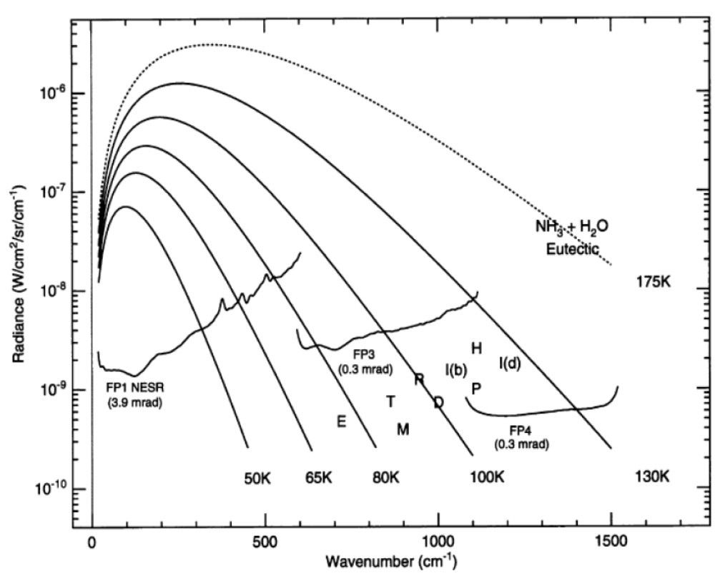
Methods: T calculation
CIRS Focal Plane 4 (FP4) is only useful for the very warmest surfaces, so data from FP4 are excluded
FP3 is only sensitive to daytime temperatures on most moons, while FP1 is sensitive to both day and nighttime temperatures.
We use FP3 for day and FP1 for night.
T calculation uses the method of Howett et al [2020]:
  CIRS spectra binned into 10º x 10º bins and averaged
  A blackbody was fit to each bin
  A two-step Monte Carlo technique was used to generate 1-sigma T error estimates
Expected radiance compared to CIRS noise-equivalent spectral radiance. E=Enceladus, T=Tethys, M=Mimas, R=Rhea, D=Dione, I=Iapetus(bright/dark), P=Phoebe, H=Hyperion. From Flasar et al.[2004].

Slide 14
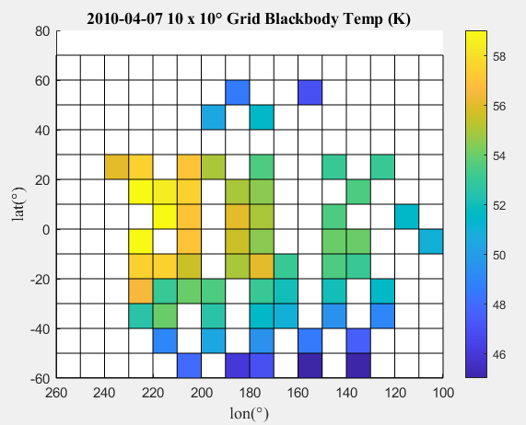
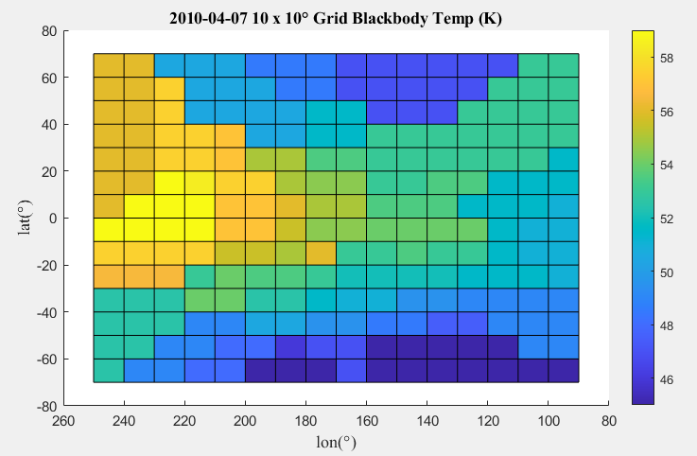
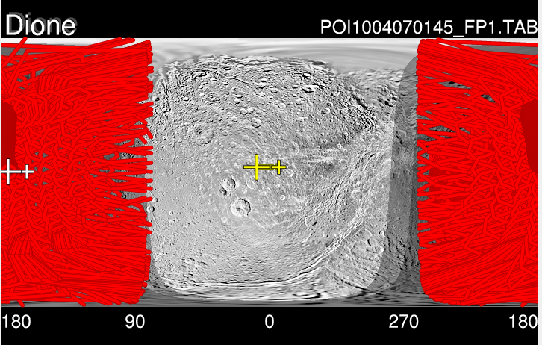
Temperature from one observation
b)
(a) Dione’s nighttime temperature anomaly; Contours show electron power deposited into the surface per unit area [Howett et al., 2014].
c)
Dione FP1, 2010-04-07 Matlab gridded 10x10°, (white squares, no spectra available); solar Φ-angle: 90 - 180°;
b) Original, c) Interpolated
Dione FP1, 2010-04-07 .TAB image FOV coverage

Slide 15
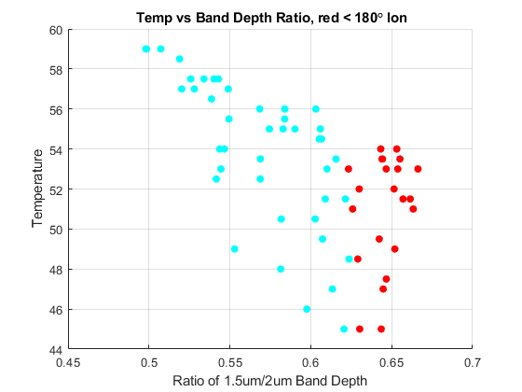
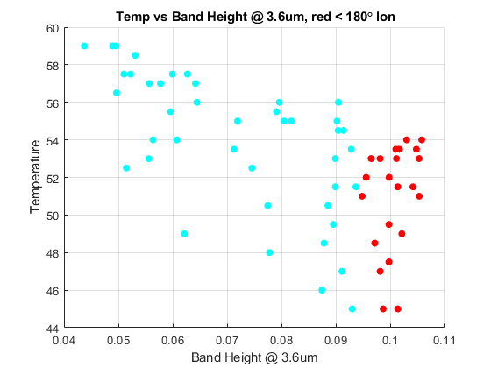
Temperature vs. spectral properties
Trailing hemisphere
Leading hemisphere
The relationship for Temperature vs. spectral properties differs depending on hemisphere

Slide 16

Conclusions
Work in progress
Other spectral properties are being calculated (e.g., asymmetry)
Conducting a more quantitative investigation of grain size via Hapke modeling
T relationships in additional CIRS observations are being analyzed
Preliminary results do not refute the sintering hypothesis
Notes:
To summarize this section, the mid-IR features found by observing Iapetus’ dark material were good matches with serpentines– which may point to a meteoritic origin.
We could also make a comparison to the radiative impacts of volcanic ash deposits on Earth (with Iapetus’ dark material shown on top and ash from Augustine Volcano shown on the bottom). The dark material on Iapetus would alter the radiation balance similar to ash deposited on snow. This absorbing surface combined with Iapetus’ slow rotation can cause the ice to heat, sublime and to migrate.
Additionally, Earth’s volcanoes and hydrothermal systems have been credited with providing the early planet with the materials needed for life. Although chemical composition of Enceladus’ plumes is yet to be fully characterized, a volcanic source for the dark material would hint that bio-essential nutrients may have been delivered to the surfaces of darkened Saturnian bodies, and potentially beyond– as silica particles were observed leaving the Saturn system.
We’ll come back to Enceladus in a bit, but first I’ll talk about coming up with a more exact identification for Iapetus’ silicates in the lab to help establish their origin and implications.

Slide 17
References
Clark, R. N., & Roush, T. L. (1984) Journal of Geophysical Research: Solid Earth, 89(B7), 6329-6340.
Clark, R. N., et al. (2008) Icarus, 193, 372–386
Flasar, F. M., et al. (2004) Space Sci. Rev., 115, 169–297.
Howett, C. J. A., et al. (2014) Icarus, 241, 239-247
Howett, C. J. A., et al. (2020) Icarus, 113745
Nordheim, T. A., et al. (2017) Icarus, 286, 56-68
Paranicas, C., et al. (2012) Planetary and Space Science, 61, 60–65
Paranicas, C., et al. (2014) Icarus, 234, 155–161
Schaible, M. J., et al. (2017) Icarus, 285, 211–223
Scipioni, F., et al. (2017) Icarus, 290, 183-200

Slide 18
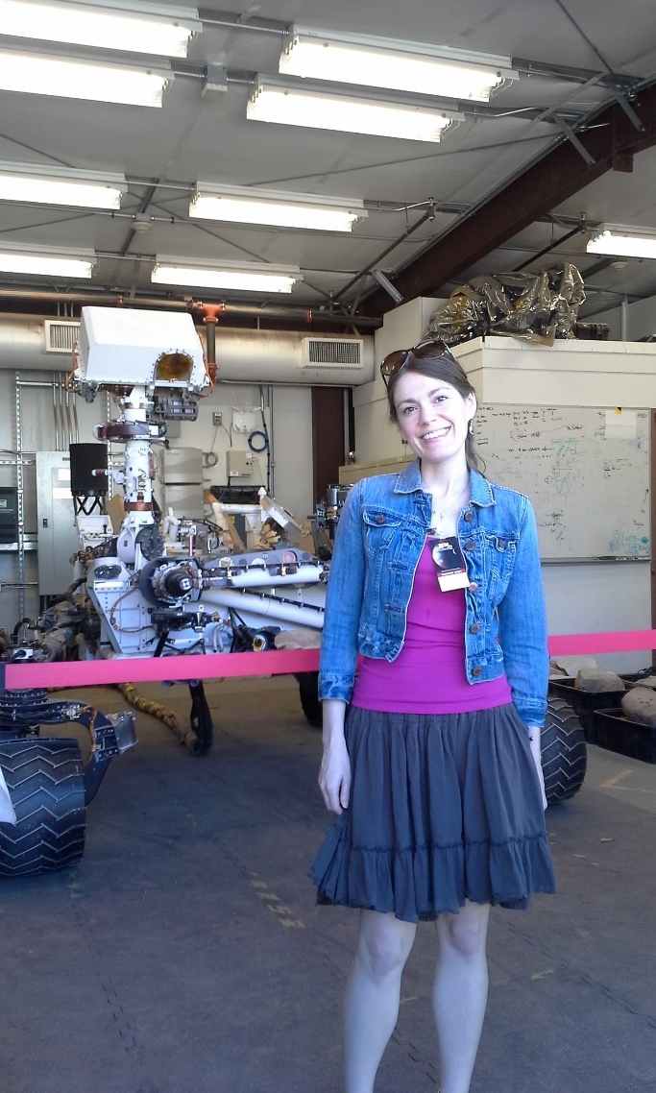
Thank You, and stay safe!
Notes:
Me at the Mars yard– a place to test and troubleshoot problems with rovers in an analog environment

