Slide 1
Observing the Sun
and,
How Do We Know What We Know?
Mitzi Adams
Solar Scientist
NASA/MSFC ST13
October 24, 2020

Slide 2
The Sun and Solar Activity

Slide 3
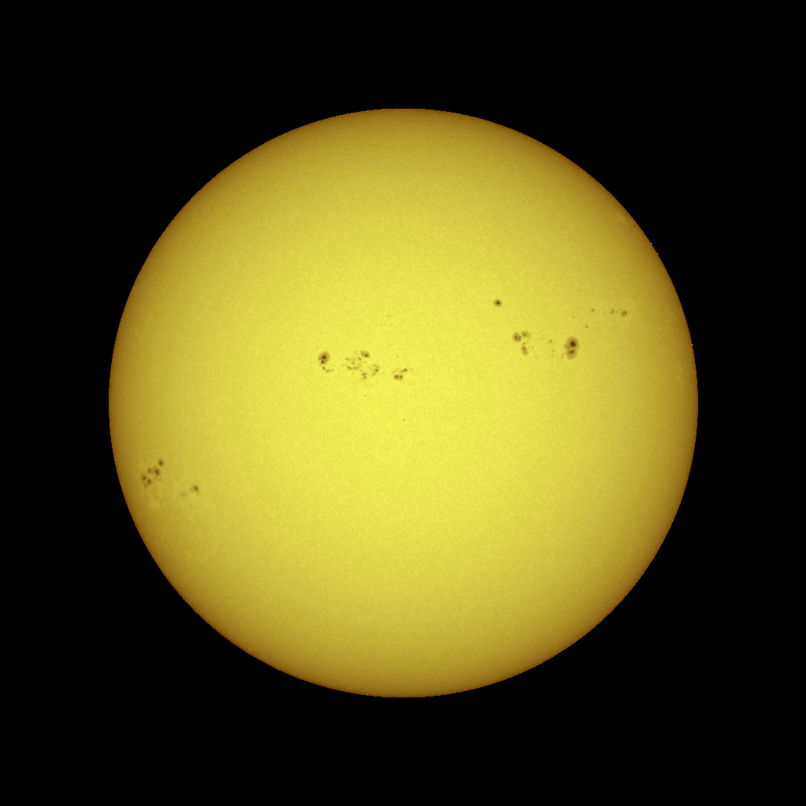
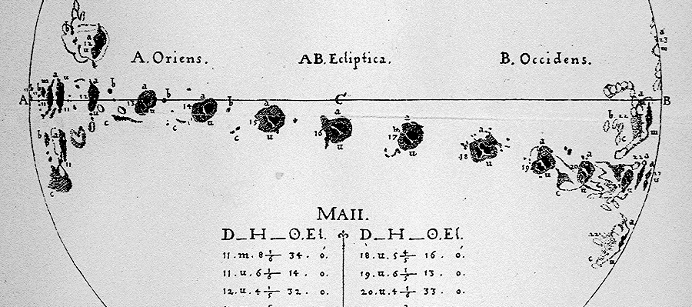

Sunspots
Sunspots are dark (and cooler) regions on the surface of the Sun. They have a darker inner region (the Umbra) surrounded by a lighter ring (the Penumbra).
Sunspots usually appear in groups that form over hours or days and last for days or weeks.
The earliest sunspot observations
(c. 1609) indicated that the Sun rotates once in about 27 days.

Slide 4
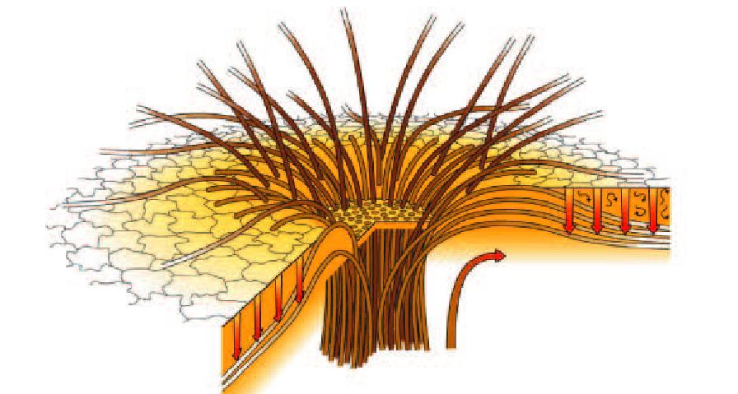
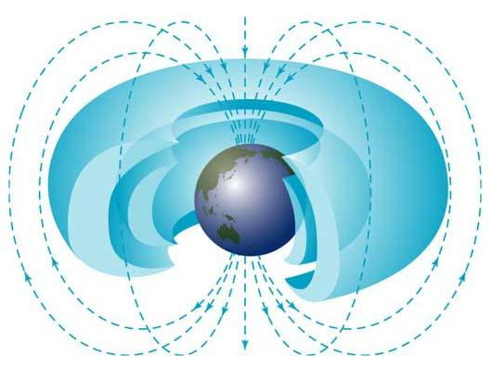
Sunspot Structure
Sunspots are regions where intense magnetic fields break through the surface of the Sun. The magnetic field strengths are typically about 6000 times stronger than the Earth’s magnetic field.
Magnetic fields and the ionized gases within the Sun are intimately tied together. Where magnetic pressure dominates – the gas follows the magnetic field. Where gas pressure dominates – the magnetic field follows the gas. In sunspots the magnetic pressure dominates – this inhibits the convective transport of heat and makes sunspots cooler.

Slide 5
The Solar Cycle

Slide 6
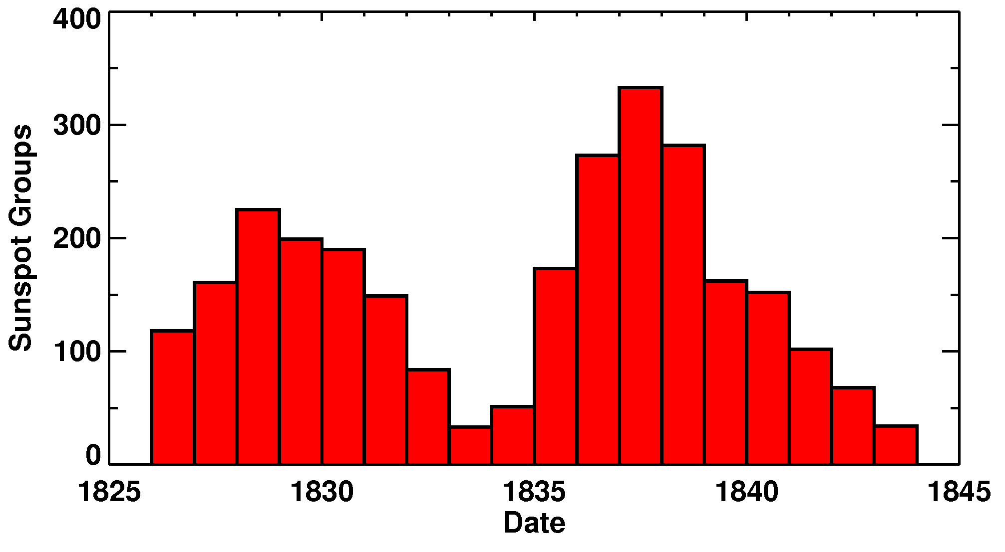
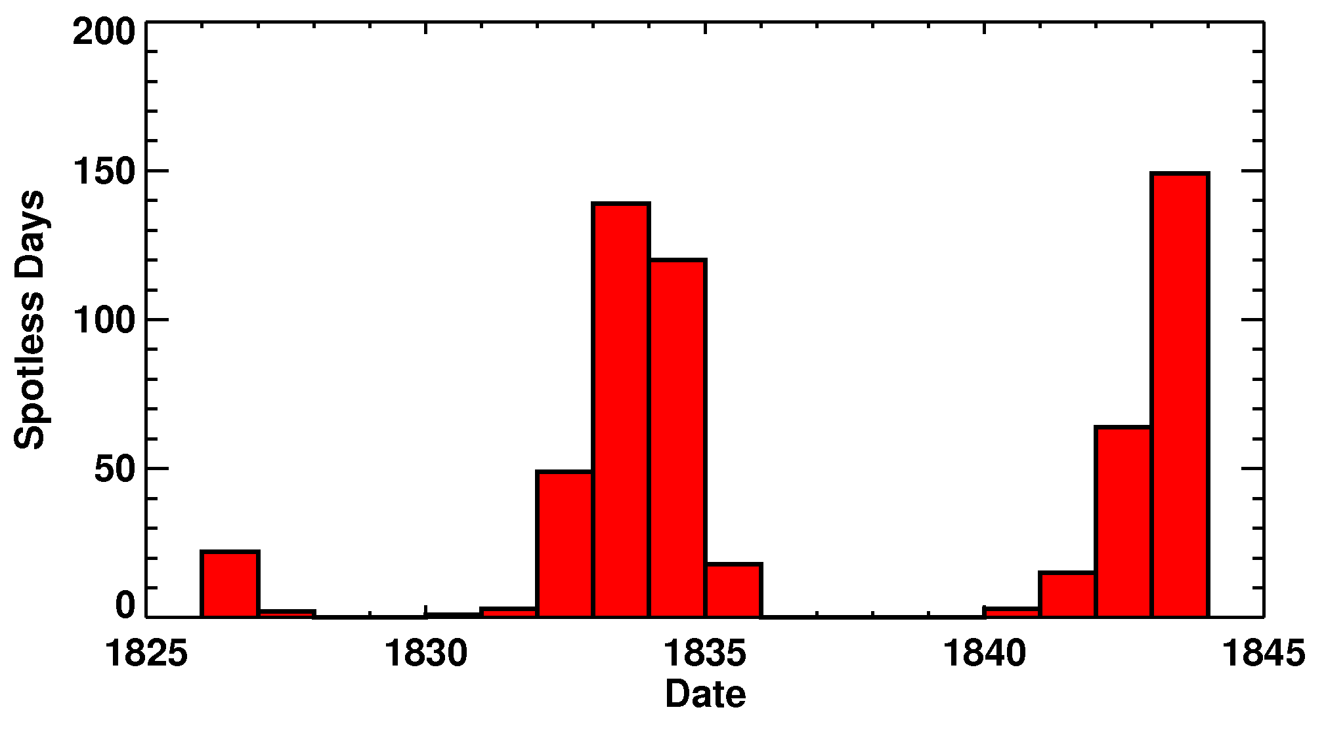
Sunspot Cycle Discovery
Astronomers had been observing sunspots for over 230 years before Heinrich Schwabe, an amateur astronomer in Dessau, Germany, discovered in 1844 that the number of sunspot groups and the number of days without sunspots increased and decreased in cycles of about 10-years.
Schwabe’s data for 1826 to 1843
Number of Sunspot Groups per Year
Number of Spotless Days

Slide 7
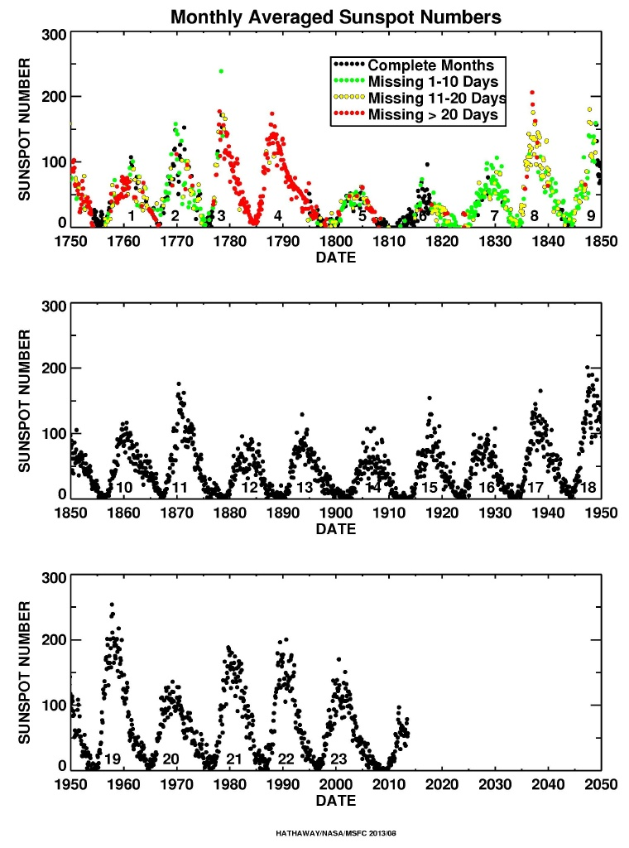
23 Full Cycles
Shortly after Schawbe discovery Rudolf Wolf proposed using a “Relative” Sunspot Number count. While there were many days without observations prior to 1849, sunspots have been counted on every day since. To this day we continue to use Wolf’s Relative Sunspot Number and his cycle numbering.
The average cycle lasts about 11 years, but with a range from 9 to 14.
The average amplitude is about 100, but with a range from 50 to 200.

Slide 8
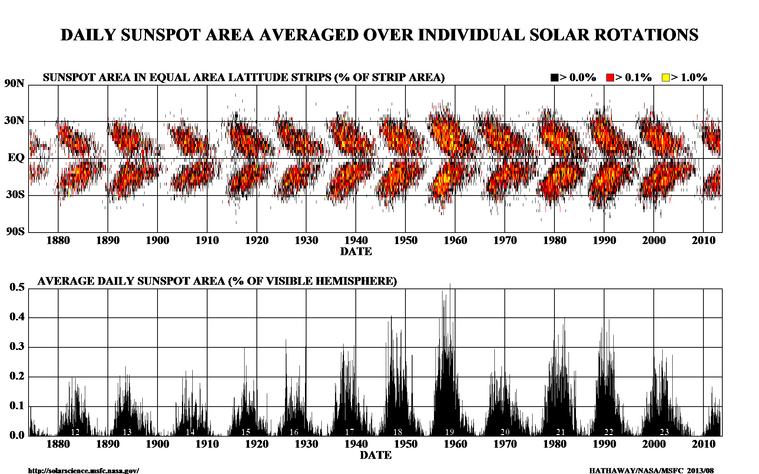
Sunspot Latitudes
Sunspots appear in two bands on either side of the equator. These bands drift toward the equator as the cycle progresses. Big cycles have wider bands that extend to higher latitudes. Cycles overlap by 2-3 years.

Slide 9
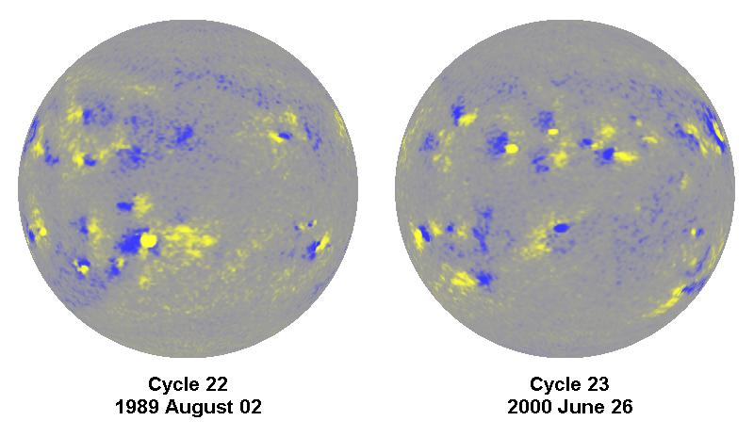
Hale’s Magnetic Polarity Law
In 1919 Hale (along with Ellerman, Nicholson, and Joy) found that the magnetic field in sunspots followed a definite law, “Hale’s Law” such that: “…the preceding and following spots … are of opposite polarity, and that the corresponding spots of such groups in the Northern and Southern hemispheres are also opposite in sign. Furthermore, the spots of the present cycle are opposite in polarity to those of the last cycle”.

Slide 10
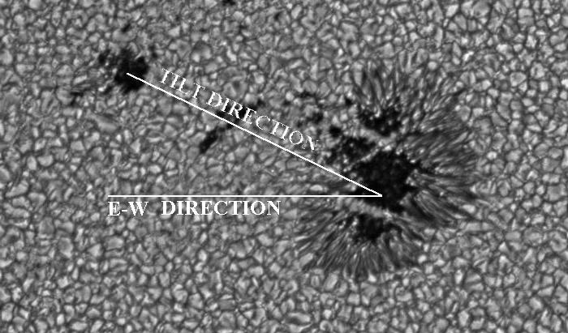
Active Region Tilt- Joy’s Law
In that same 1919 paper Joy noted that sunspot groups are tilted with the leading spots closer to the equator than the following spots. This tilt increases with latitude.

Slide 11
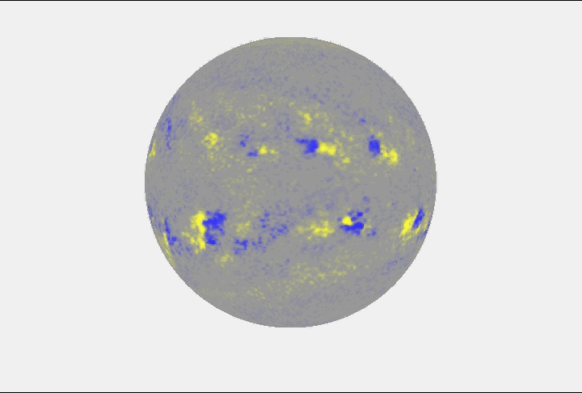
Three Solar Cycles in 3D
In addition to these magnetic polarity changes and the equatorward drift of the sunspot latitudes, there are important flows on the surface and within the Sun: Differential Rotation – faster at the equator, slower near the poles; and Meridional Flow – flow from the equator toward the poles along the surface.

Slide 12
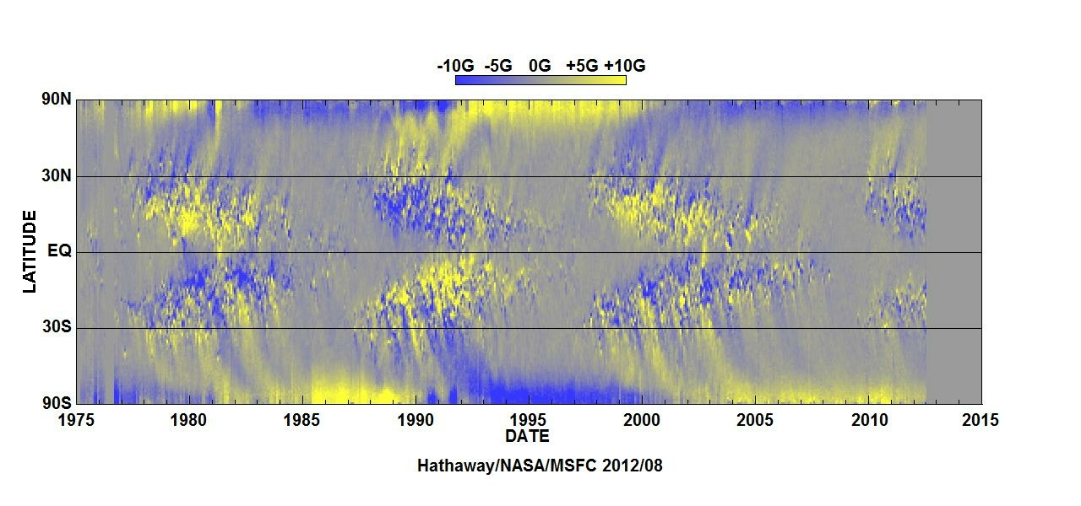
Polar Field Reversals
In 1959 Babcock noted that the magnetic polarities of the Sun’s weak polar fields also reverse from one cycle to the next, and that this reversal happens at about the time of sunspot cycle maximum.
– About a week ago, solar scientist Todd Hoeksema announced that the Sun's magnetic
field is three to four months away from field reversal.

Slide 13
Effects of the Sunspot Cycle

Slide 14
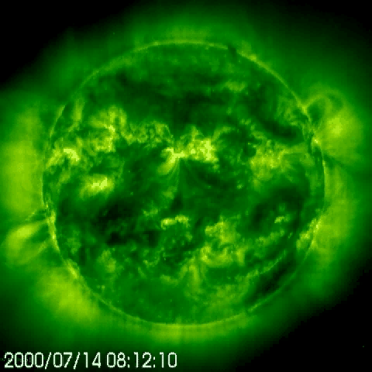
Explosive Events
Solar flares – 10-1000X excess in X-rays and Extreme Ultraviolet (EUV)
Coronal Mass Ejections (CMEs) – magnetic clouds blasted off the Sun
Solar Energetic Particles – relativistic particles from flares and CMEs

Slide 15
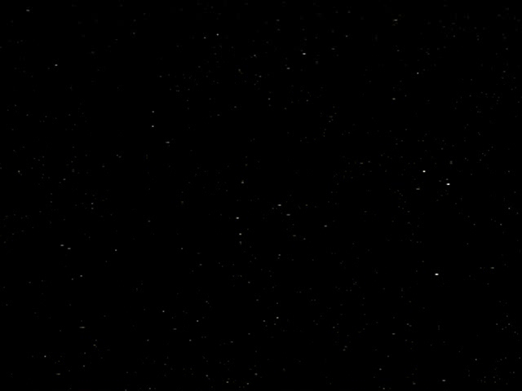
CME Impact on Earth
Magnetized clouds of plasma blasted off of the Sun as CMEs can impact the Earth’s environment – distorting the magnetic field surrounding the Earth and producing energetic particles that stream into the Earth’s atmosphere to create aurorae.

Slide 16
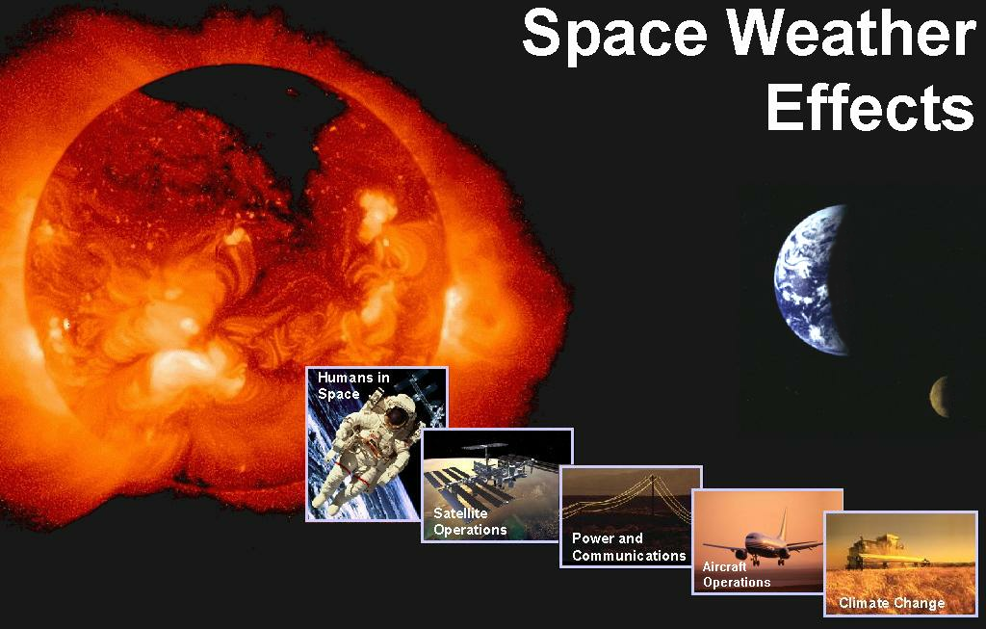
Space Weather
Space weather refers to conditions on the Sun and in the space environment that can influence the performance and reliability of space-borne and ground-based technological systems, and can endanger human life or health.

Slide 17
Solar Cycle Predictions

Slide 18
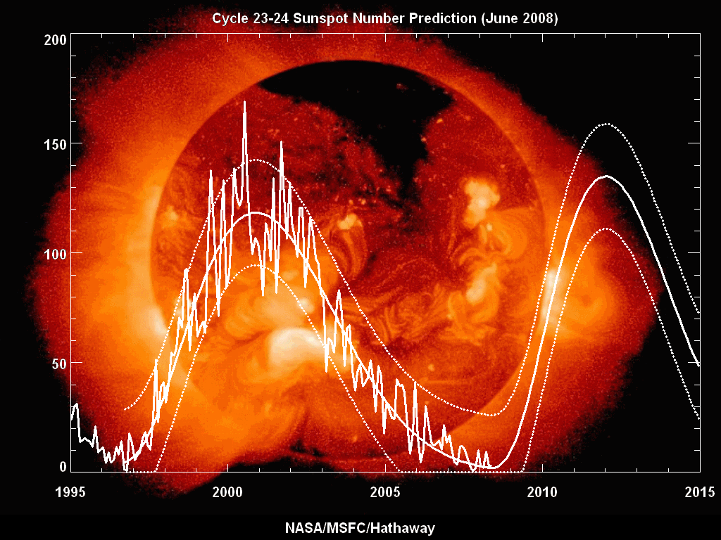
The Deep Solar Minimum Following Cycle 23
Spotless Days:
311 in 1913
250 in 1912
274 in 2009
266 In 2008
Length of cycle:
Cycle 23 – 12.6 yrs
Cycle 22 – 9.7 yrs
Cycle 21 – 10.3 yrs
Cycle 20 --11.7 yrs
Cycle 13 – 11.9 yrs
1890-1902
Cycle 14 --11.5 yrs
1902-1913
Cycle 15 – 10 yrs
1913-1923

Slide 19
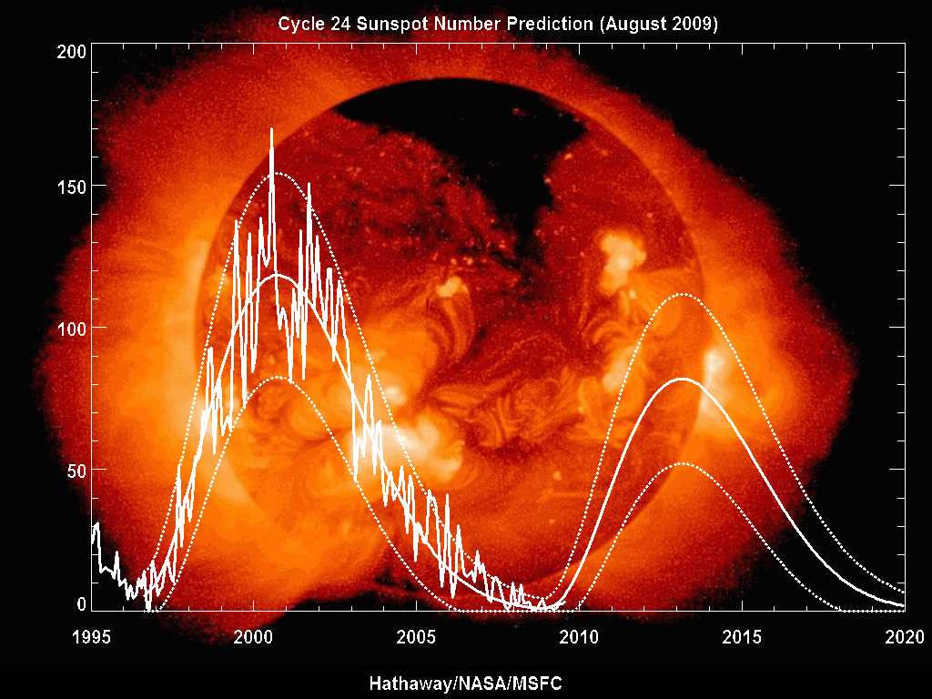
Four Years Ago
Small cycle predicted based on Polar Fields and Geomagnetism

Slide 20
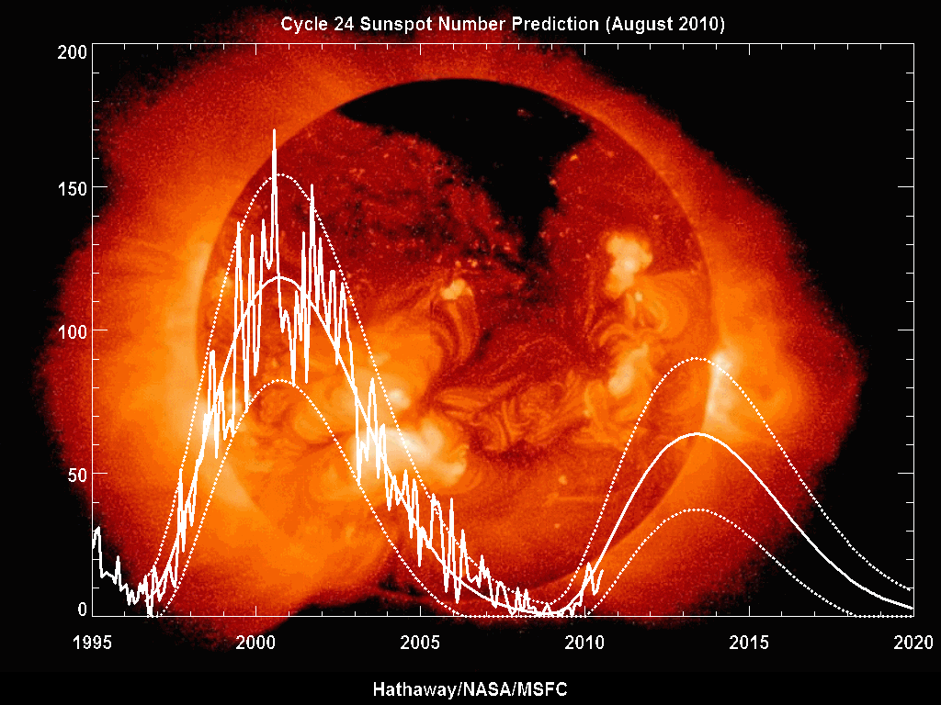
Three Years Ago
Including recent activity indicated an even smaller cycle.

Slide 21

Last Year
In spite of a flurry of activity late last year, the prediction dropped slightly – still indicating the smallest cycle in 100 years.

Slide 22
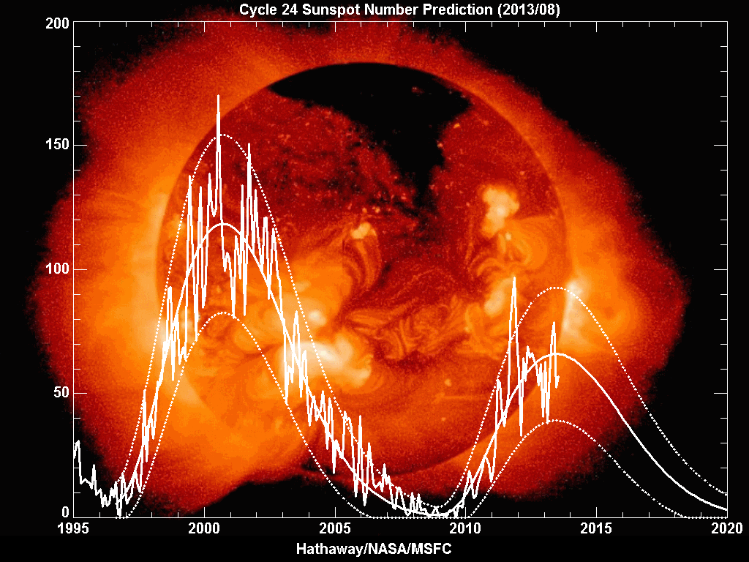
2010 Compared to This Year

Slide 23
Conclusions
Through the use of observations, mathematics,mathematical tools
(such as graphs), inference, testing, and prediction we have gathered
evidence that there are sunspots, a solar cycle, and have begun to
understand more about our star, the Sun.
We are making progress in understanding the cause of the solar cycle.
We expect solar cycle 24 to peak soon
Cycle 24 will be the smallest cycle in 100 years.

Slide 24
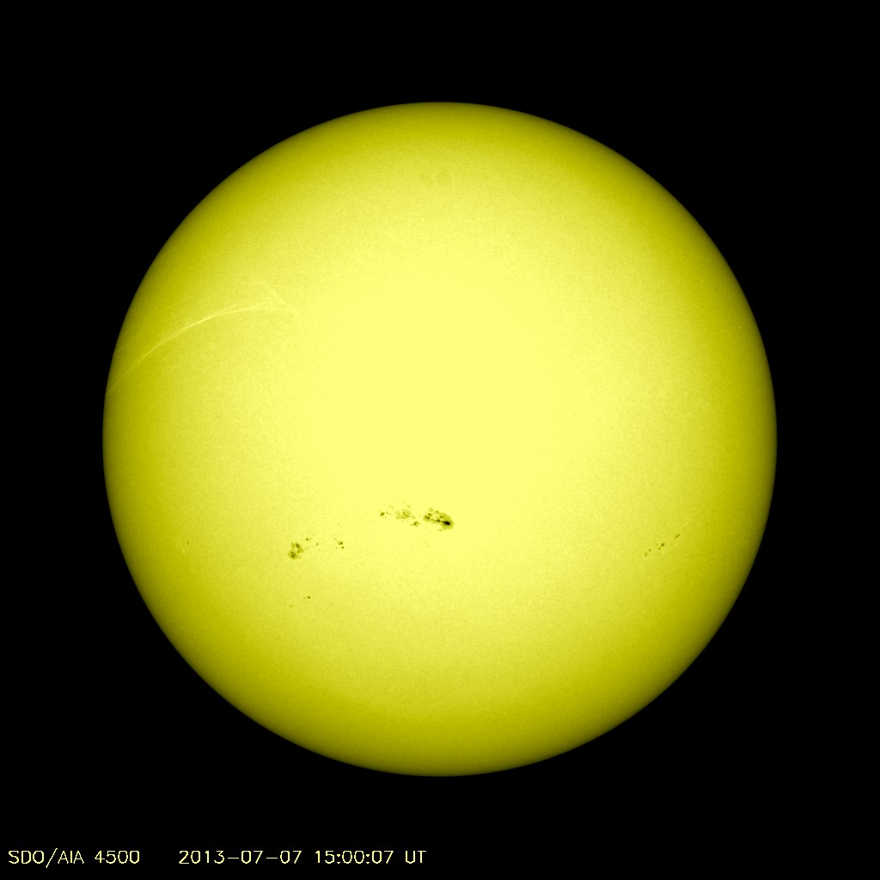
The Sun
Radius = 109 R_{Earth}
Mass = 333,000 M_{Earth}
Surface Temp = 9,930 °F
Surface Density = Air/5000
Core Temp = 28 million °F
Core Density = Gold × 8
Composition: 70% H
28 % He
2% (C, N, O…)

