Slide 1
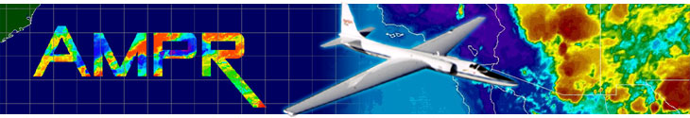


Advanced Microwave Precipitation Radiometer (AMPR)
CAMP²Ex Science Team Meeting
Corey Amiot and Timothy Lang

Slide 2
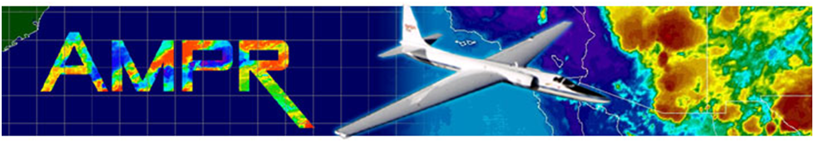
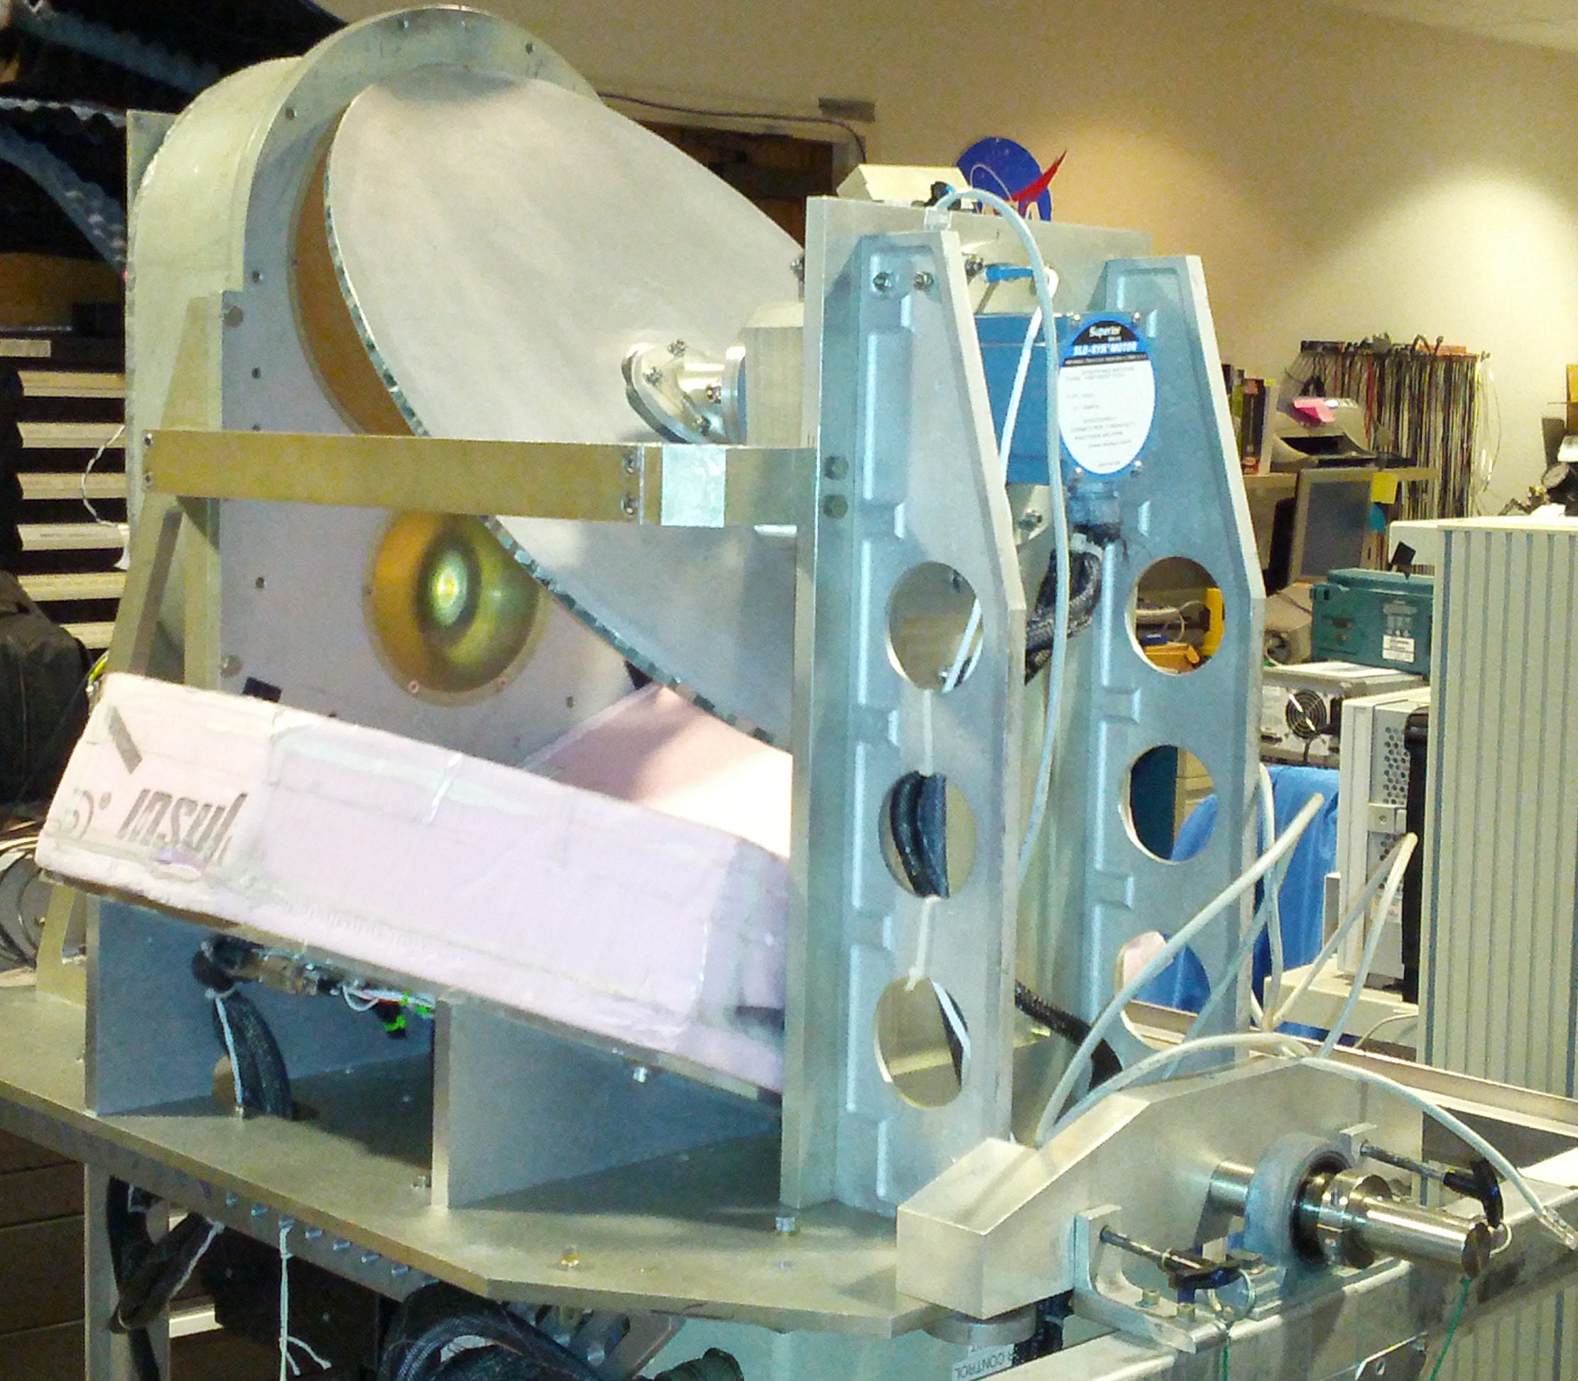
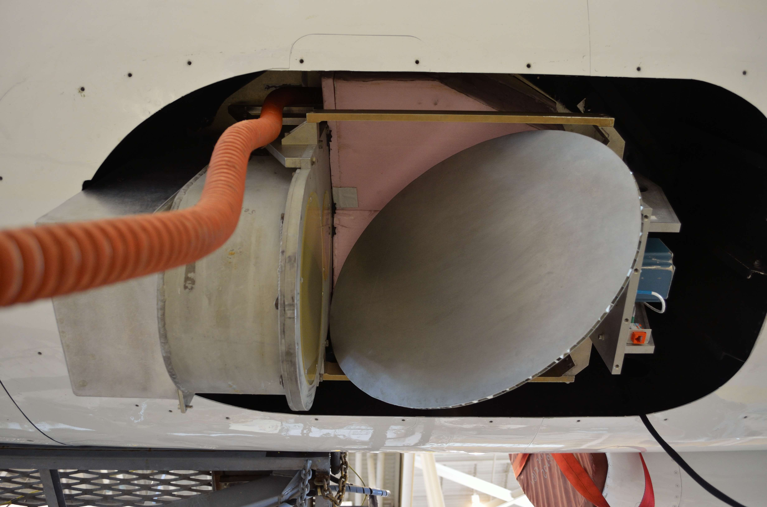
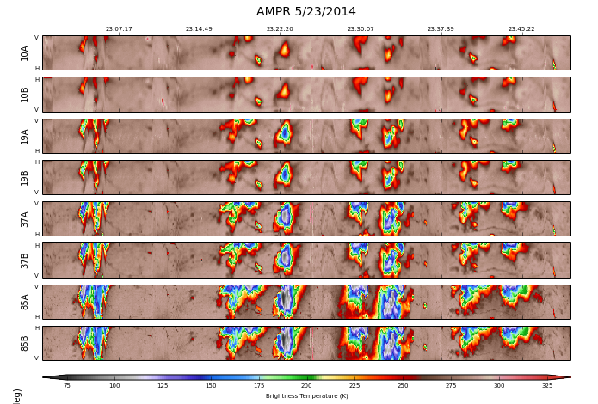
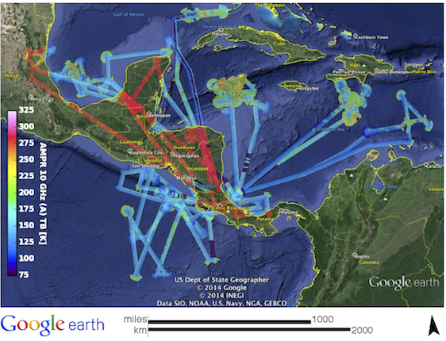
CAMP²Ex Cloud Physics
Instrument name / PI:
AMPR (Advanced Microwave Precipitation Radiometer)
Timothy Lang, NASA MSFC
Instrument Description
Passive microwave radiometer – Retrieve surface emission, cloud liquid water, precipitation rate, water vapor, etc.
Cross-track scanning or nadir staring
Four frequencies - 10.7, 19.35, 37.1, 85.5 GHz, with 2 variable polarization channels apiece (Channel A: V -> H and Channel B: H -> V)
Science topics: Aerosol impacts on precipitation, cloud physics, and cloud structure; Aerosol impacts on cold pool strength
Left: Strip chart time series of T_{B} from 5/23/14 IPHEx flight.
Right: 10 GHz (A) T_{B} for every TCSP (2005) flight.

Slide 3
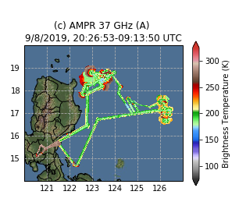
AMPR Data Processing Progress
AMPR operated on 18 of the 19 CAMP²Ex science flights (missed SF #1 on 8/24)
Gathered ~140 hours of science data at a variety of aircraft altitudes
R0 initial calibrated data delivered (CF-compliant, self-describing netCDF4)
  Mixed-pol TBs as well as deconvolved H and V polarizations at 10, 19, 37, and 85 GHz
  Initial retrievals of wind speed, atmospheric water vapor, and cloud liquid water over the ocean
  Deconvolution/retrievals best during level flight legs at altitude (~10+ kft)
  Nadir staring – times identified; only mixed-pol TBs available
  Data during maneuvers, spirals, and low-altitude legs are not calibrated in R0
  Includes detailed README document

Slide 4
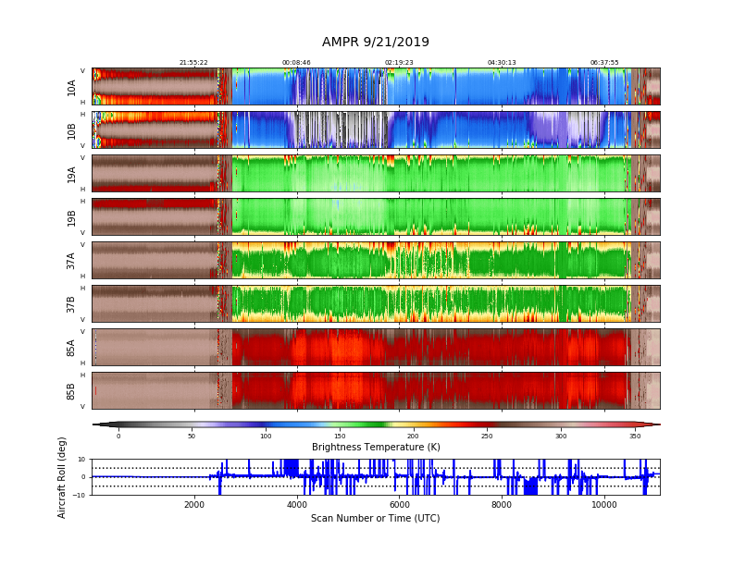
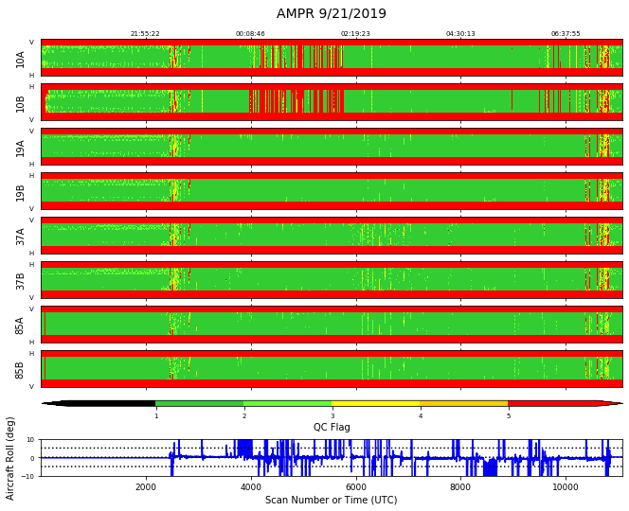
AMPR Data Quality Control
Rule of Thumb for Highest Quality Data
QC incidence angle = 1
Pixel FOV < 0.1 or pixel FOV > 0.9 (i.e., mostly land or mostly water)
QC flag value <= 4
Allow for exceptions!

Slide 5
Nadir Staring
AMPR normally samples a pixel every 50 ms, completes 50-pixel scan in 2.5 seconds
During nadir staring, made mirror stare downward and sampled the nadir pixel every 50 ms
Performed multiple times per flight, during select cloud overflights
When coupled with APR-3, provide ultra-high-resolution microphysical retrievals along a nadir curtain in clouds
Nadir staring flag provided in files (NadirFlag)

Slide 6
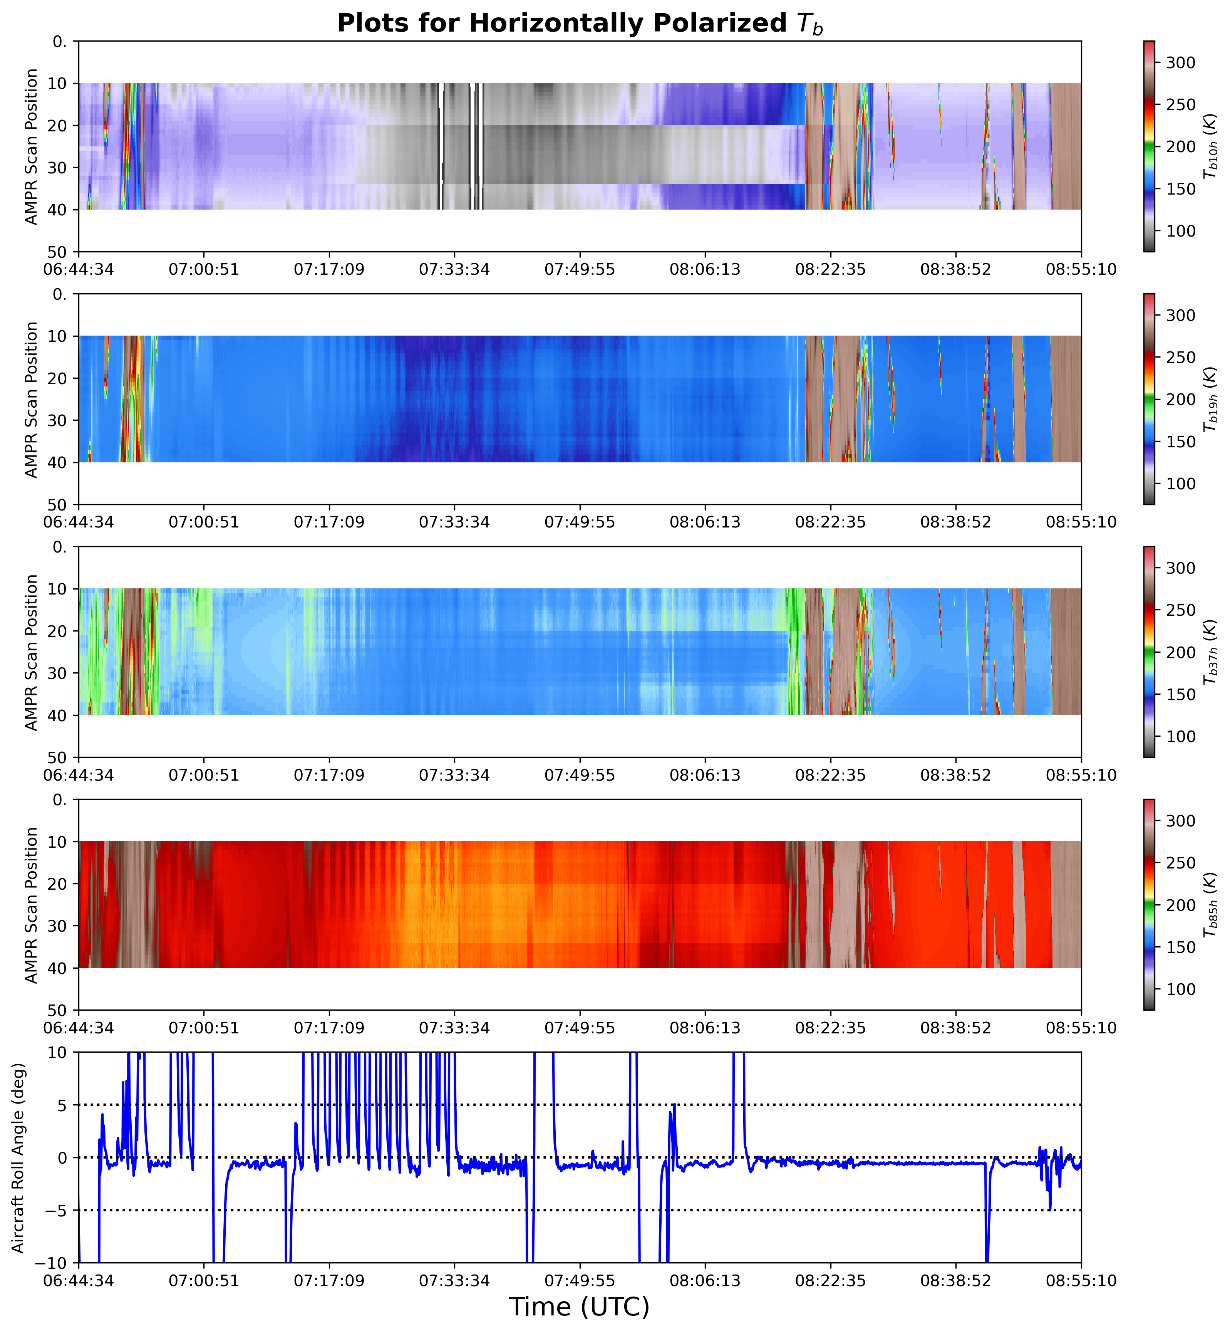
High-Altitude, Level-Flight (HALF) Flags
CORRECTED
UNCORRECTED
CORRECTED
AMPR data & retrievals are of highest quality at sufficiently high altitude (i.e., above 3 km or ~10 kft) and when P-3 pitch/roll angle is near 0°
Applied HALF flags to flight segments where:
  P-3 GPS altitude ≥ 3,000 m
  P-3 pitch and roll angles < 2° for R1 dataset (stricter 1° threshold used for R0 dataset)
  Land fraction in AMPR’s nadir pixel < 1%
Exceptions allowed for:
  Brief aircraft maneuvers (e.g., turbulence or P-3 heading adjustment lasting < ~25 AMPR scans)
  Altitude < 3,000 m if P-3 was flying over clouds (added for R1 dataset; not considered in R0)
T_{B} corrections and geophysical retrievals only performed where HALF flag = 1 for each flight
20190925 example: T_{B} corrected (uncorrected) outside (between) the two black lines, based on HALF flags

Slide 7
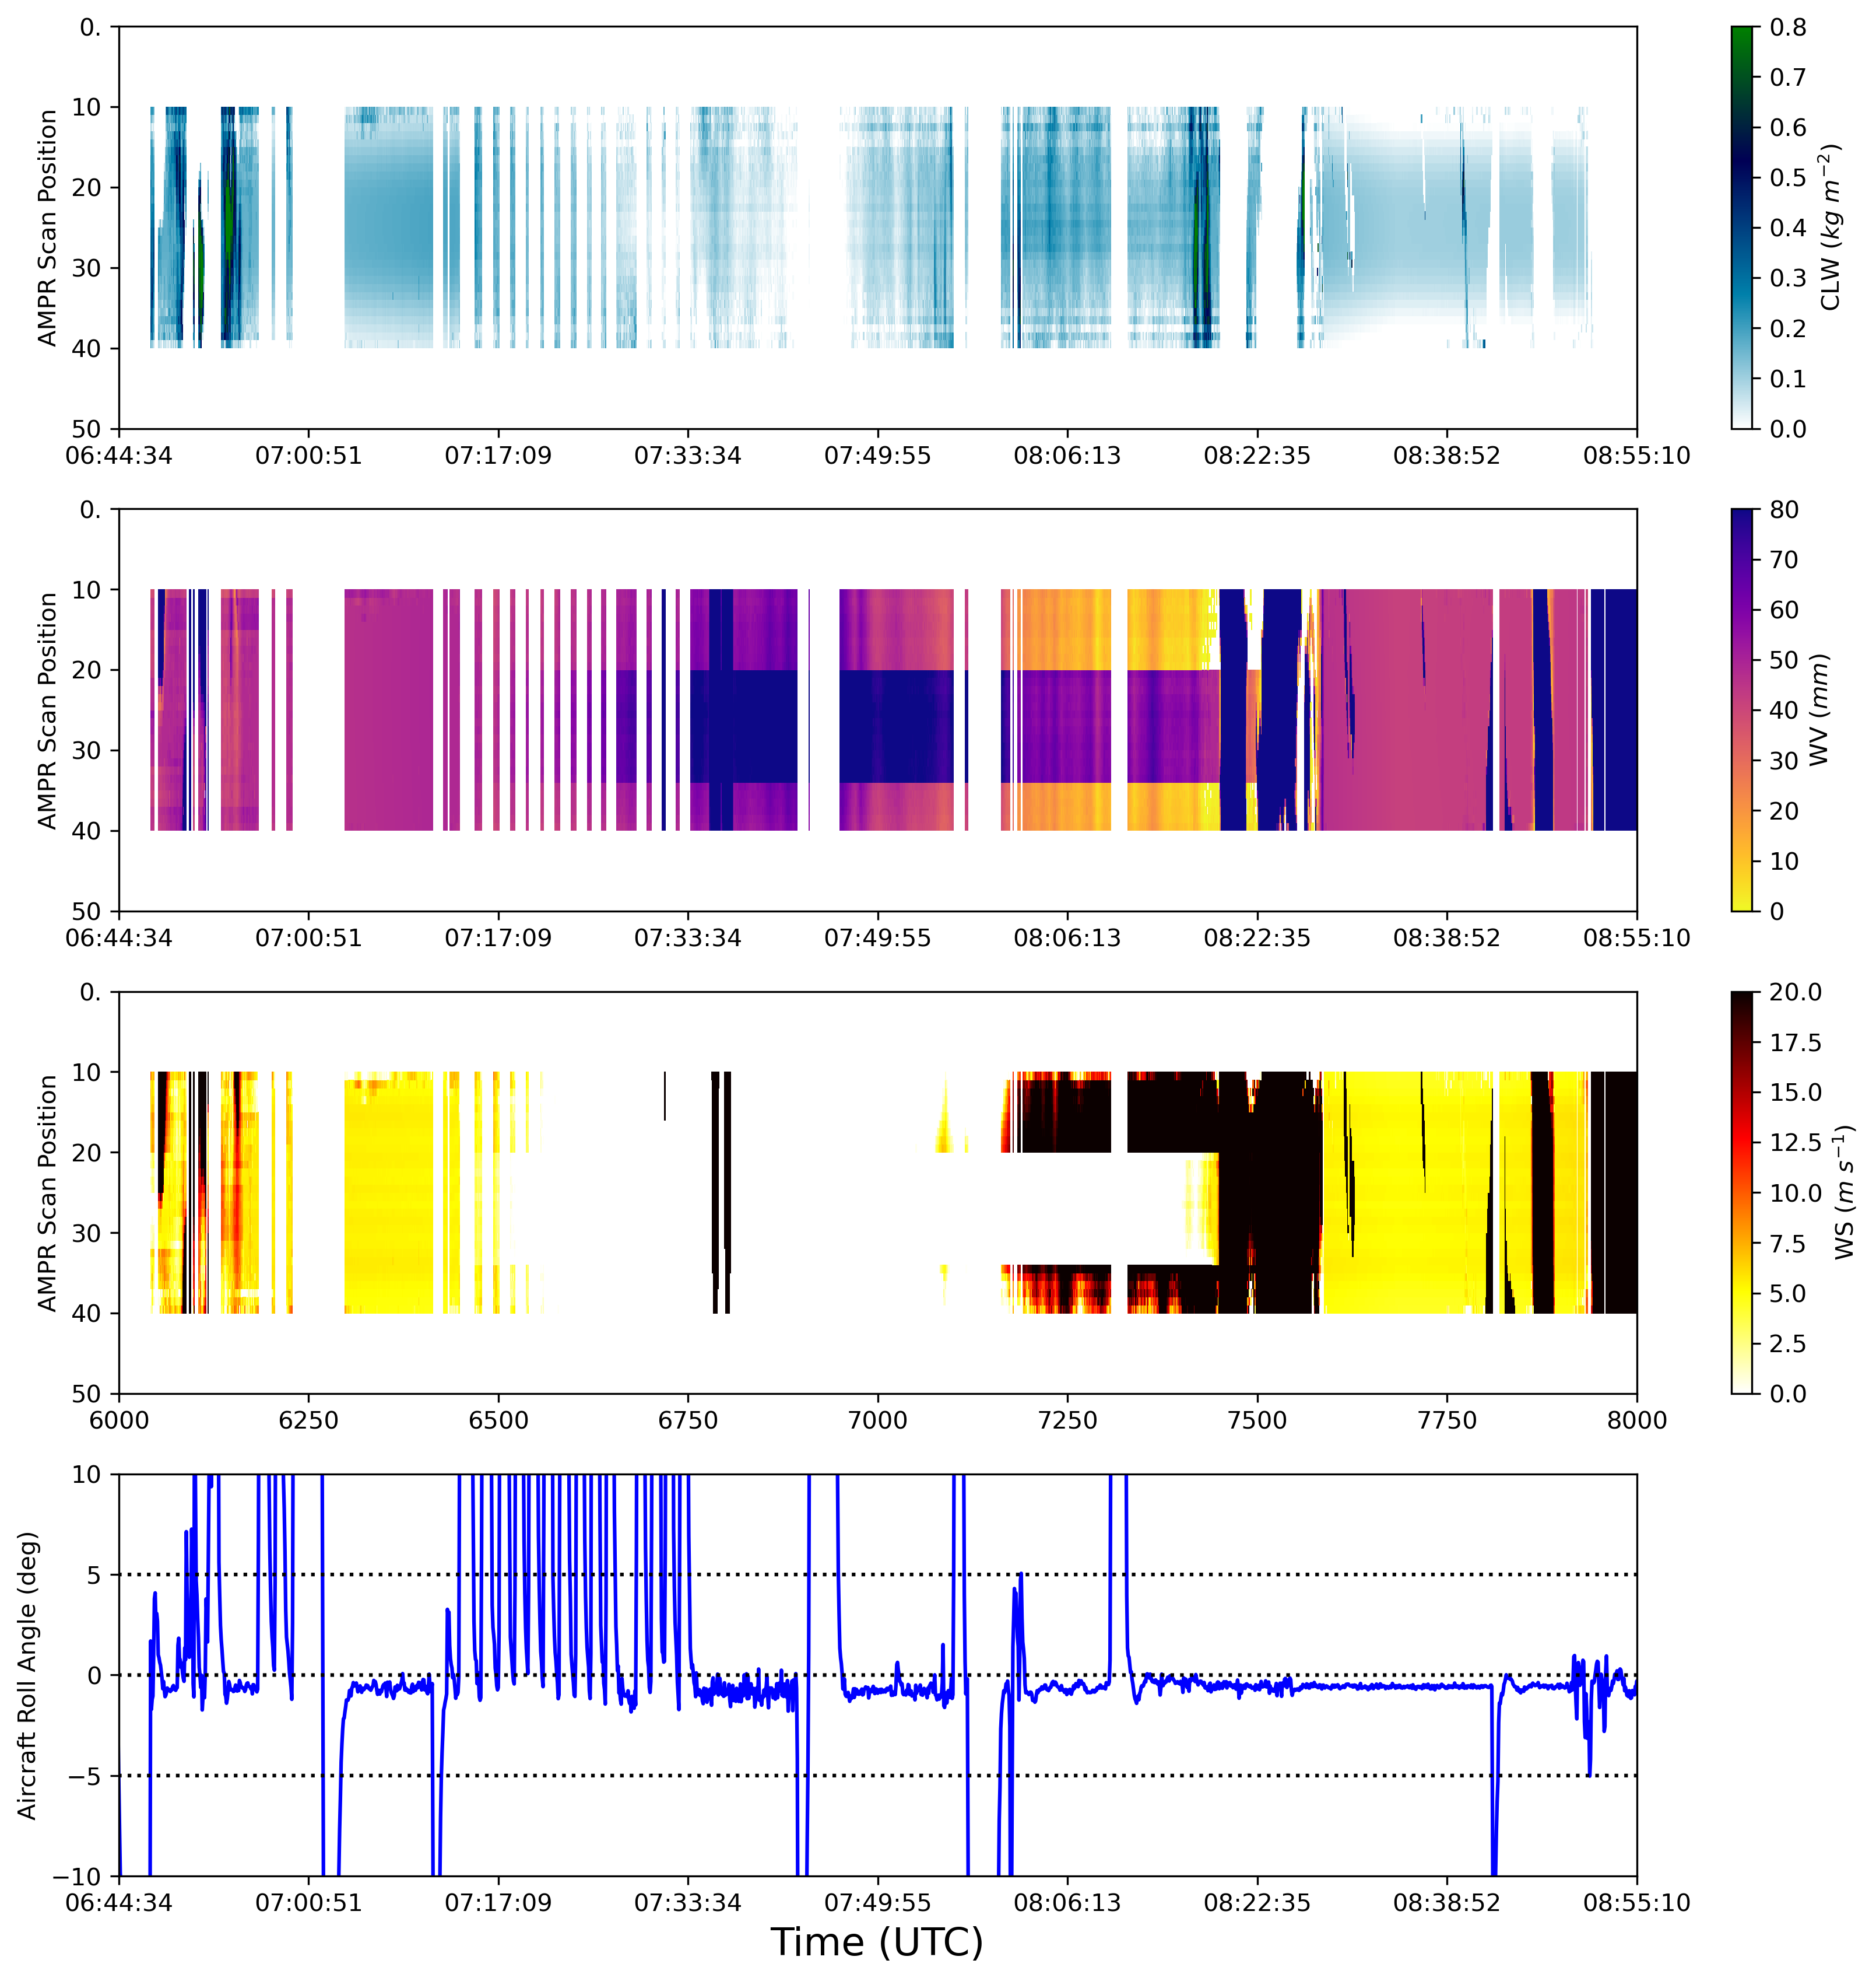

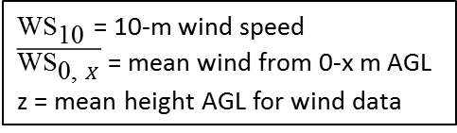
Retrieval Validations using AVAPS
CORRECTED
UNCORRECTED
CORRECTED
CLW
144 AVAPS dropsondes analyzed between 20190904 and 20191005
Masked AMPR data where: 1) HALF conditions not met, 2) in nadir-stare mode, 3) scan position < 10 or > 39, and/or 4) retrieved CLW > 0.15 mm
Calculated AVAPS WV and WS using same equations as Amiot et al. (2020):
WV
WS
$\text{WV}\text{ = }{\text{1}}/{\text{ρ}\text{g}}\int_{{\text{p}}_{1}}^{{\text{p}}_{2}}{\text{r}\left(\text{p}\right) \text{dp}}$ ≈ ${\text{1}}/{\text{ρ}\text{g}}\left({\text{r}\left({\text{p}}_{2}\right)\text{ + }\text{r}\left({\text{p}}_{1}\right)}/{\text{2}}\right)\left({\text{p}}_{2} − {\text{p}}_{1}\right)$
WV = total precipitable water p₁ = pressure at lower altitude
ρ = density of liquid water p₂ = pressure at higher altitude
g = gravitational acceleration r = mixing ratio
$${\text{WS}}_{\text{10}} \text{= 0.8 }\text{∙ }\overline{{\text{WS}}_{\text{0, 500}}}$$
If wind data below 500 m AGL (left) or below 150 m AGL (below):
${\text{WS}}_{\text{10}}$ = 10-m wind speed
$\overline{{\text{WS}}_{\text{0, }X}}$ = mean wind from 0-x m AGL
z = mean height AGL for wind data
$${\text{WS}}_{\text{10}}\text{ = }\overline{{\text{WS}}_{\text{0, 150}}} \text{∙ }\left[\text{1.0314 }− {\text{4.071 }\text{x}\text{ 10}}^{\text{−3}}\left(z\right)+{\text{2.465} \text{x}\text{ 10}}^{\text{−}\text{5}}\left(z^{2}\right)−{\text{5.445} \text{x}\text{ 10}}^{\text{−}\text{8}}\left(z^{3}\right)\right]$$

Slide 8
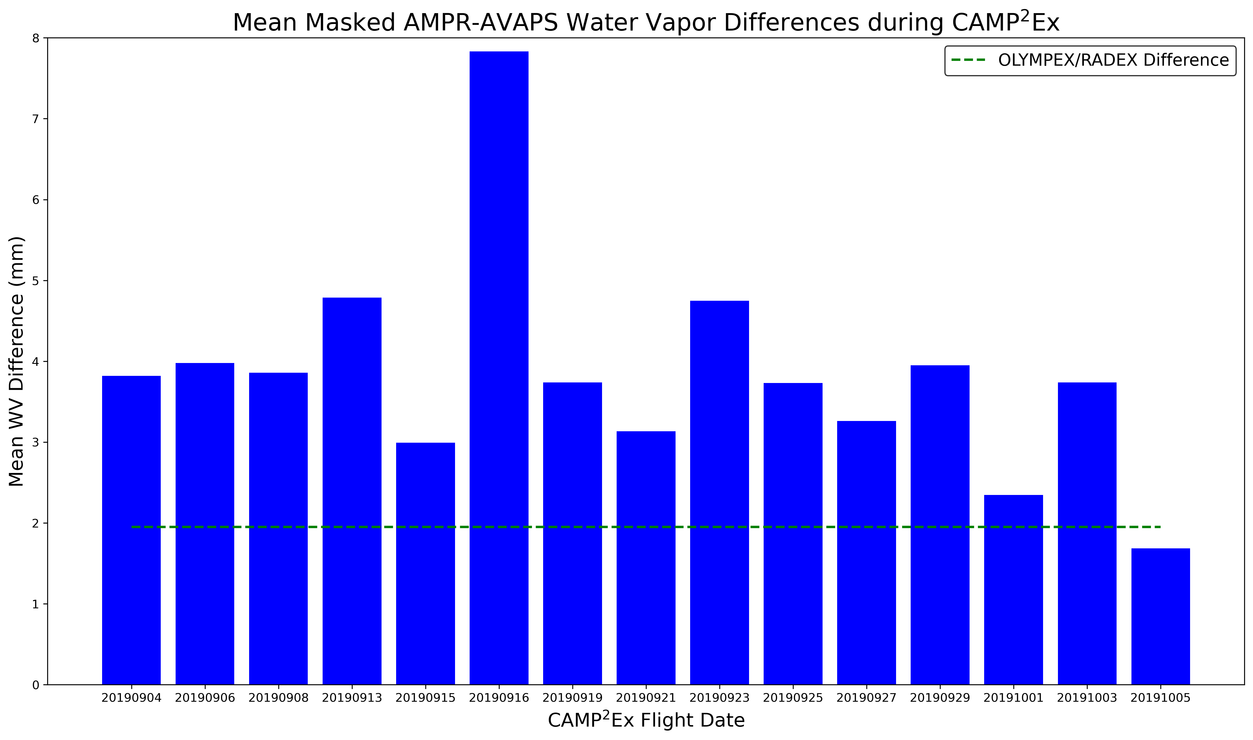
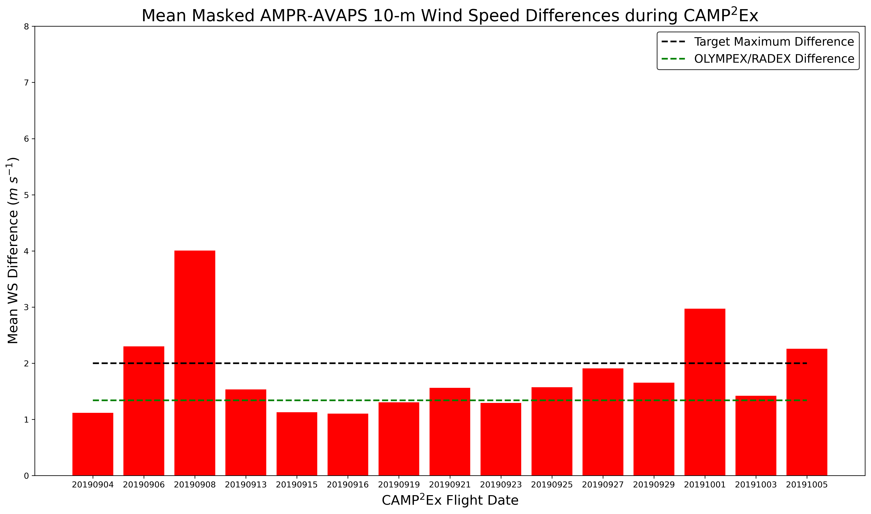
AMPR-AVAPS – WV & 10-m WS
WV (top; blue) and WS (bottom; red)
WV differences in CAMP²Ex higher than OLYMPEX/RADEX (Midlatitude winter)
  Need to examine WV error as a function of percent, given the higher water vapor in the summertime Tropics
Most WS differences less than 2 m s⁻¹ target uncertainty and similar to differences from OLYMPEX/RADEX
Ongoing analysis; updated results soon
Will compare CLW with University of Utah’s combined radar-radiometer cloud retrievals
Overall Mean AMPR-AVAPS Differences:
WV: 3.84 mm WS: 1.81 m s⁻¹

Slide 9
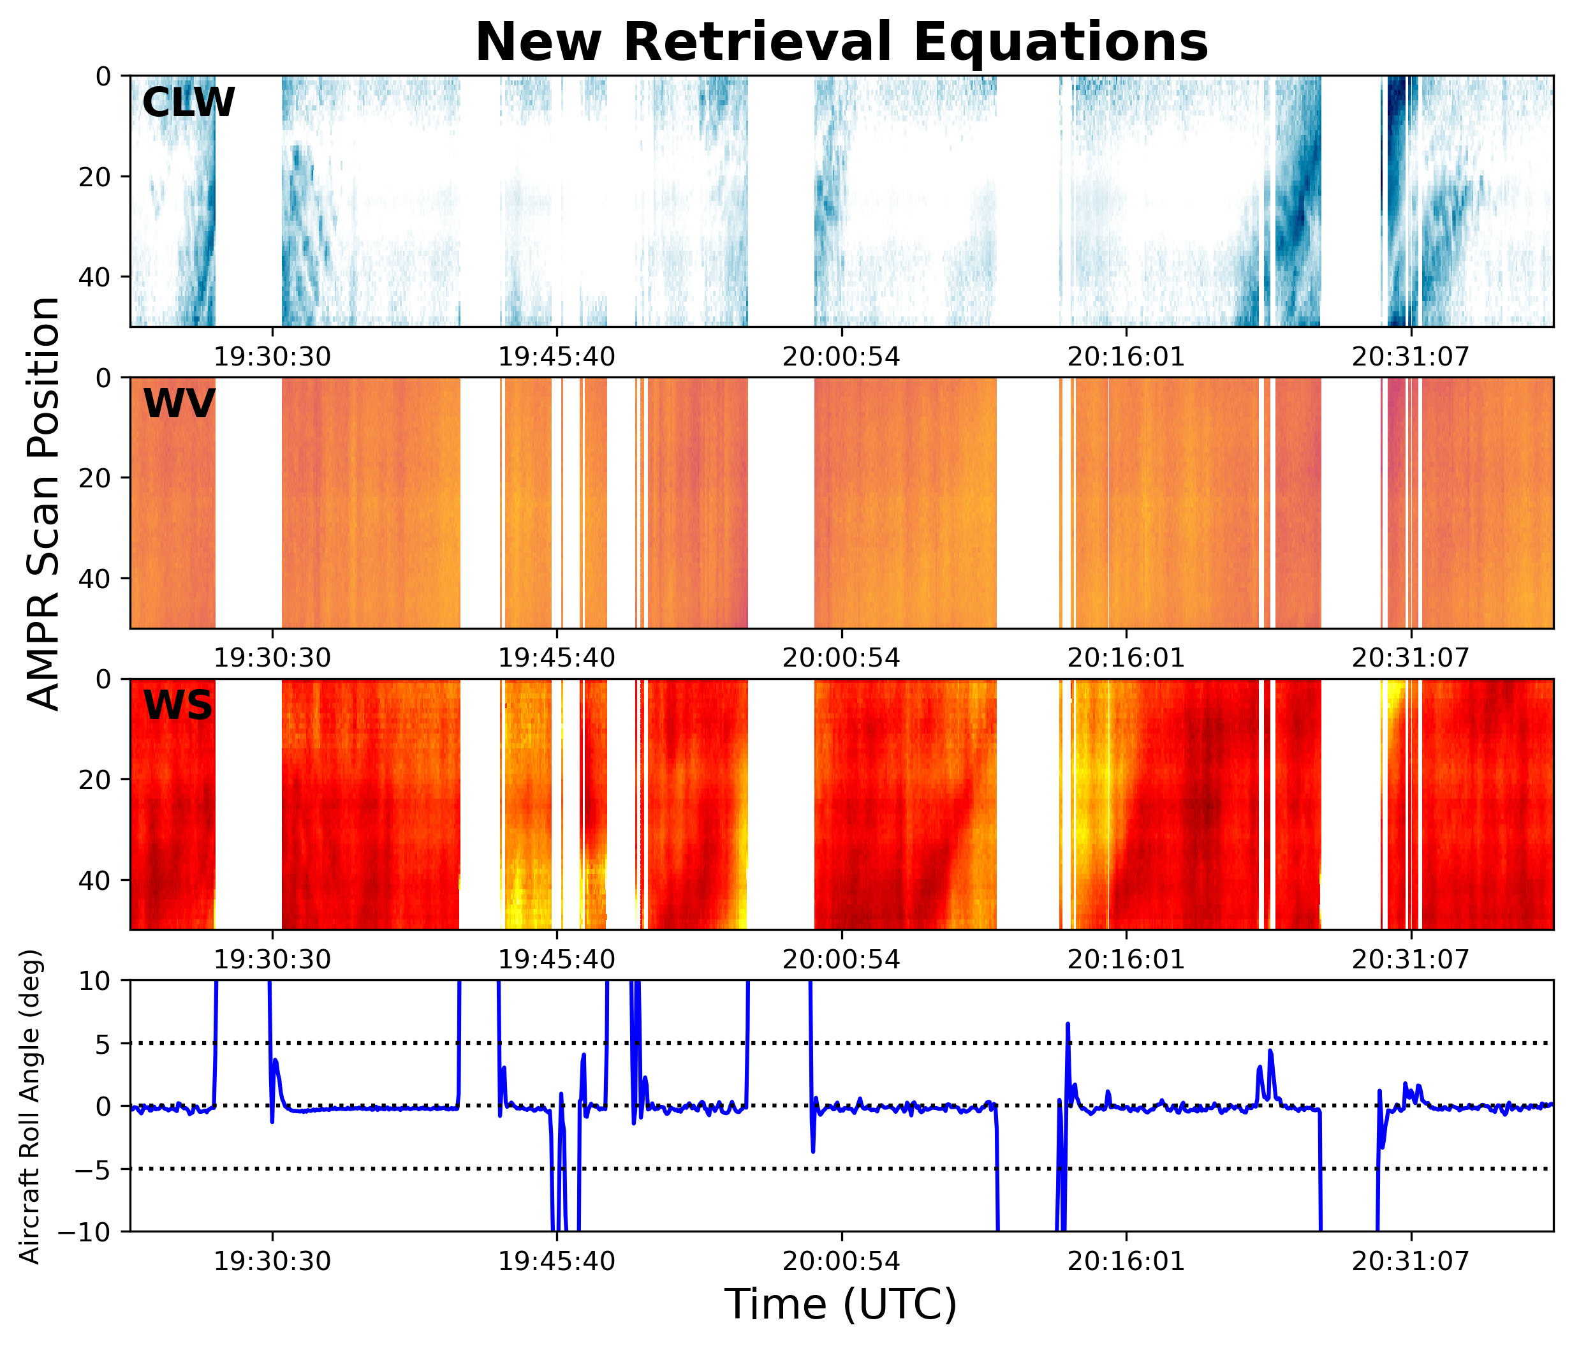
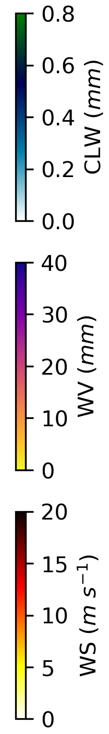
Proposed AMPR Ocean Wind Speed Product
Assumptions
Geolocated ocean wind speed (wind_speed_near_surface) already provided in every AMPR L2 file
Empirically derived retrieval algorithm based on long-term heritage (e.g., Meissner papers, etc.)
Limited additional utility to just pulling this variable out and providing standalone as separate file per flight
Proposal
Provide standalone ocean wind product once current validation against AVAPS is complete and wind speed retrievals are updated
Provide single file that includes all flights (i.e., datetime, lat, lon, ocean wind speed)
Pre-filtered for data quality (e.g., QC, level flight, etc. already accounted for)
Some smoothing may be done if required
Example retrievals from OLYMPEX/RADEX – 24 Nov 2015 (Amiot et al. 2020)

Slide 10
Summary
AMPR R0 data delivered; includes detailed README, calibrated H/V TBs, unvalidated geophysical retrievals
Updated R1 dataset to be delivered this fall, will include improved flagging and validated geophysical retrievals (particularly WV & WS)
Standalone AMPR ocean wind speed dataset will be delivered with R1
University of Utah producing separate combined radar/radiometer microphysical retrieval dataset

Slide 11
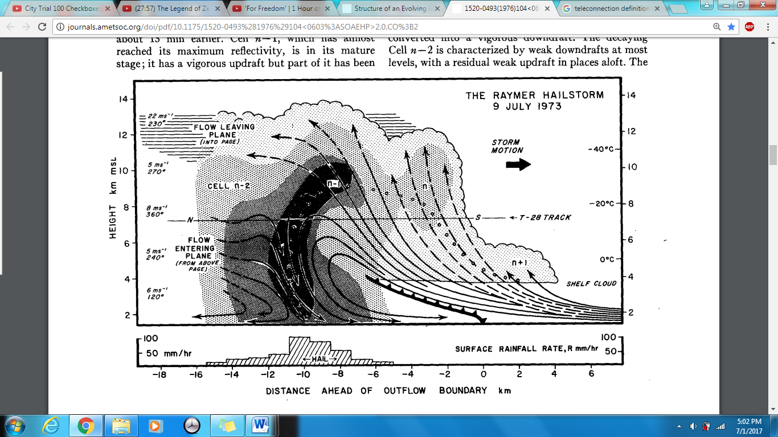
Future/Dissertation Work
Examine variations in storm properties under different aerosol conditions
  Longevity, ice and liquid hydrometeor particle size distributions, peak height, etc.
  Single-cell and multicell storms
Multiple remote-sensing instruments, cloud probes, and dropsondes
  AMPR, APR-3, HSRL2
  Possible modeling work
Particular interest in multicell storm characteristics, including gust front magnitude and differences in updraft-downdraft cycle observations over time
  Multicell storm example shown on right
Figure source: Browning, K. A., and Coauthors, 1976: Structure of an Evolving Hailstorm Part V: Synthesis and Implications for Hail Growth and Hail Suppression. Mon. Wea. Rev., 104, 603 – 610, https://doi.org/10.1175/1520-0493(1976)104<0603:SOAEHP>2.0.CO;2.

Slide 12
Backup Slides

Slide 13
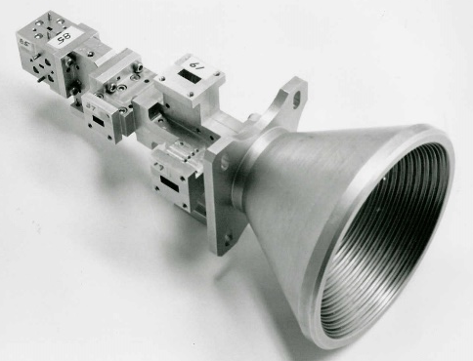
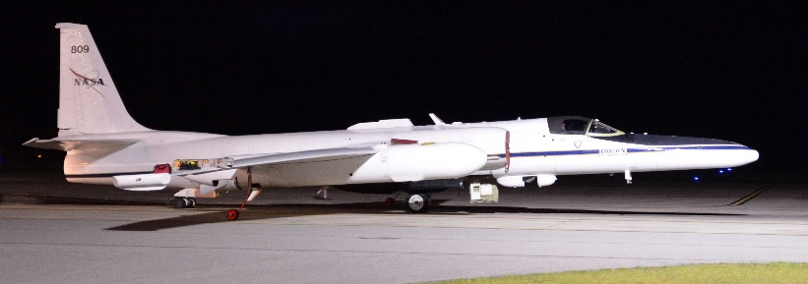
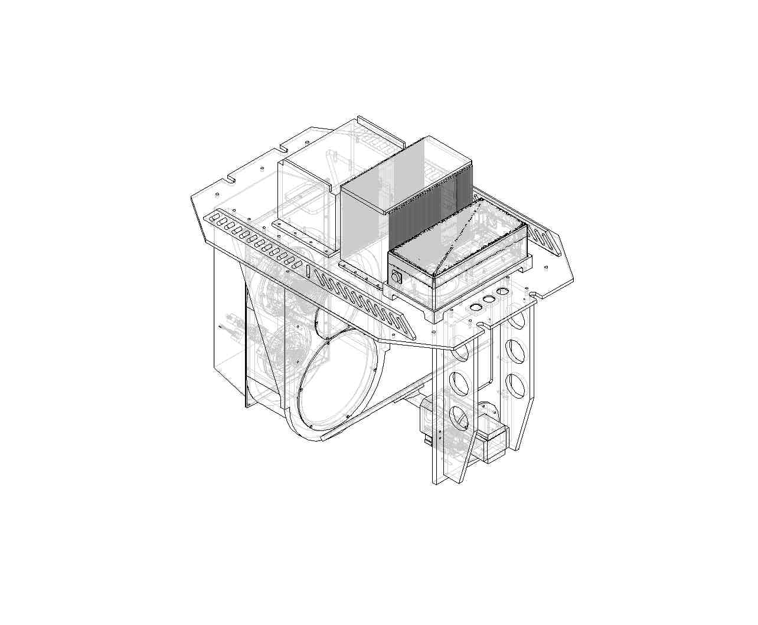
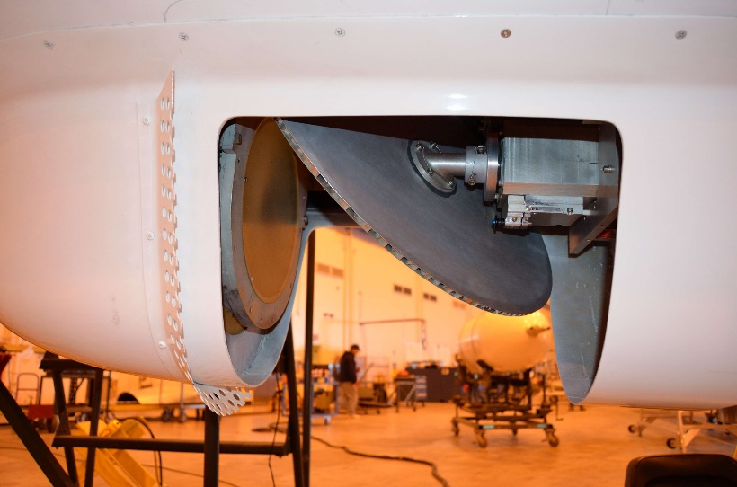
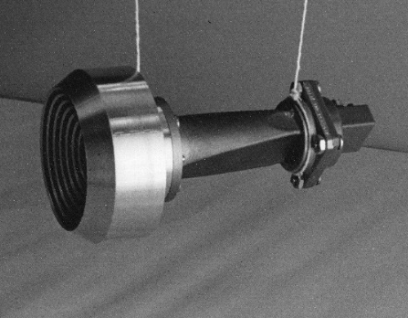
NASA ER-2
NASA ER-2
Four frequencies: 10.7, 19.35, 37.1, & 85.5 GHz
Sensitive to cloud liquid water (CLW), water vapor (WV), wind speed over ocean (WS), precipitation
SSMI MFFH
Mirror reflector
GTRI 10.7 GHz horn
Channel Center Frequency | 85.5GHz | 37.1GHz | 19.35GHz | 10.7GHz
Polarization | A/B | A/B | A/B | A/B
Pre Detection Bandwidth (MHz) | 1400 | 900 | 240 | 100
Integration Time (ms) | 50 | 50 | 50 | 50
Horn Type | SSM/I | SSM/I | SSM/I | GTRI
Lens Diameter (inches) | 5.3 | 5.3 | 5.3 | 9.7
Beam width (degrees) | 1.8 | 4.2 | 8.0 | 8.0
Footprint (km) [@20 km ER-2 alt. 500kts] | 0.64 | 1.48 | 2.78 | 2.78
Feed horn polarization basis (A/B) rotates with respect to the scene polarization basis (V/H) as a function of scan angle.

Slide 14
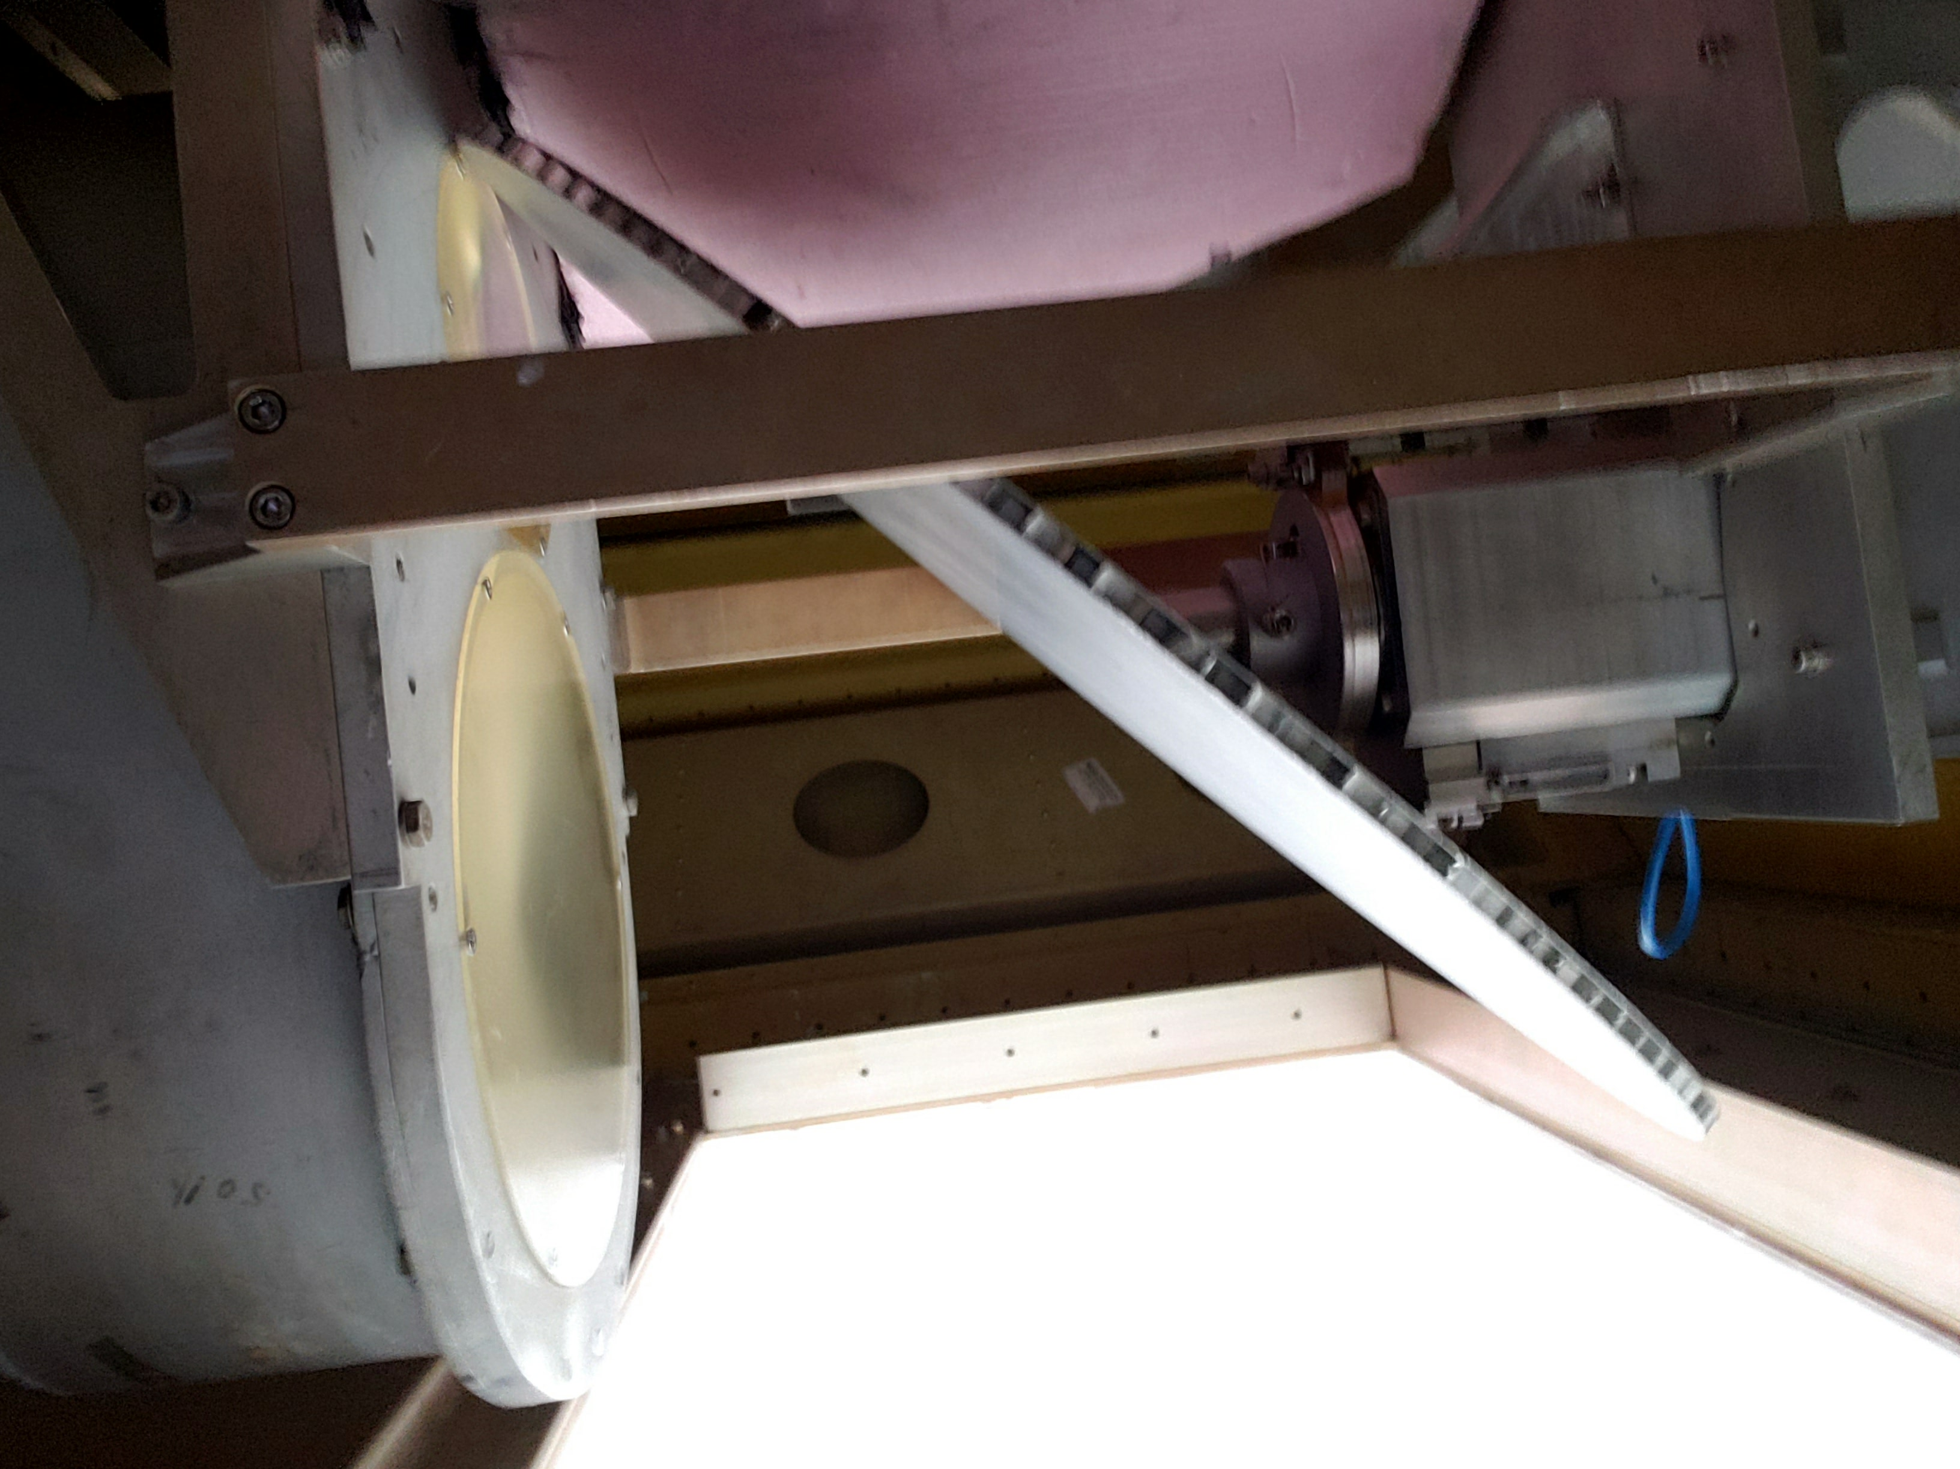
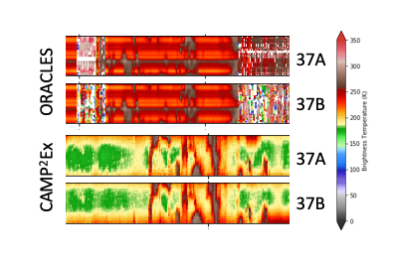
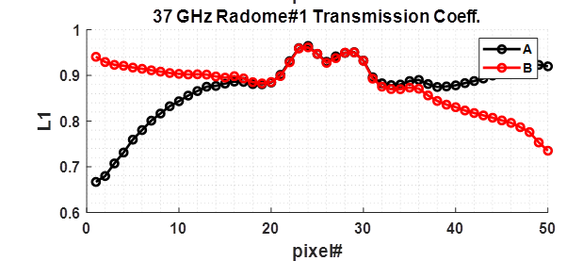
New Custom Multifrequency Radome
Built and tested for flight by ProSensing
Sky tests determined transmissivity as function of scan angle
Coupled with new filters for APR-3 Ka-band, initial data quality vastly improved from ORACLES 2016 deployment

Slide 15
AMPR Data Format
Level 2 data
Self-describing netCDF4
Compliant with CF-1.6 data conventions
One file per flight
Geolocated, UTC timestamped
Uses corrected P-3 MetNav data
Includes QC and other flags relevant to data quality/use

Slide 16
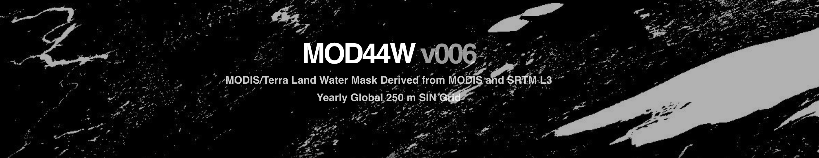
Field of view land/water fractions
Pixel field of view (FOV) land fractions are included (LandFraction)
A 1-km gridded land/water fraction dataset constructed from 250-m Moderate Resolution Imaging Spectroradiometer (MODIS) land/water mask (https://lpdaac.usgs.gov/products/mod44wv006/)
Together with the instrument FOV beamwidths to estimate the percent FOV that contains surface-water (or land) features
These data can be used to quickly identify (and eliminate if desired) those pixels originating from a mixed-surface (land and water) scene
The 250-m MODIS land/water mask includes water flagging for inland water bodies

Slide 17
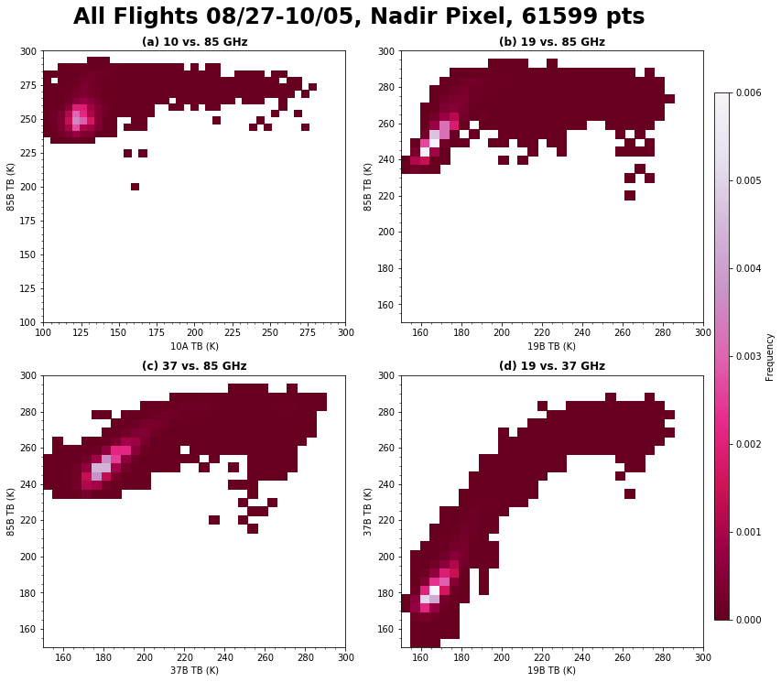
Precipitation and Ice Scattering Flags
Precip Flag
T_{B} thresholds used were 220 K for 37.1 GHz and 250 K for 85.5 GHz
Any pixels where the T_{B} values in AMPR’s mixed-pol 37.1/85.5-GHz A/B channels were greater than the threshold T_{B} values for both frequencies were flagged as likely precipitation
Ignore during overland, maneuvers, low-altitude, etc.
Ice Scattering Flags
Based on T_{B} behavior between 37.1 and 85.5 GHz channels
Any pixels where T_{B} values were unusually low relative to previous scans & clear-air baseline were flagged as likely ice scattering
Ignore during overland, maneuvers, low-altitude, etc.
Ice Scattering Signatures

Slide 18
Geophysical Retrievals
Coefficient Derivation & Testing
Environmental Scenes
523,176 Globally Distributed Atmospheric Profiles from NCEP
Cloud top/bottom from climatology
SST Randomly Varied from 0 to 30 C
WS Randomly Varied from 0 to 20 m/s
(wind direction signal is ignored)
Truth: WS,V,L,SST
Radiative Transfer Model
Atmospheric absorption from GPM XCAL models
Surface Emissivity from Meissner & Wentz [2012]
Simulated AMPR TBs for EIA = 0⁰ to 50⁰ in 0.2⁰ steps
Gaussian Noise
Withheld Data Set
Derive Coefficients for each EIA
Algorithm Coefficients
Run Algorithm
Retrieved values for WS, V, L
Evaluate Algorithm Performance
Performance and cross Talk Statistics

Slide 19
Geophysical Retrieval Equations
Cloud Liquid Water
CLW (mm) = a₀ + [a₁*ln(290-T_{B19v}) + a₂*ln(290-T_{B19h})] + [a₃*ln(295-T_{B85v}) + a₄*ln(295-T_{B85h})]
WV (mm) = a₀ + [a₁*T_{B10v} + a₂*T_{B10h}] + [a₃*ln(290-T_{B19v}) + a₄*ln(290-T_{B19h})] + [a₅*ln(290-T_{B37v}) + a₆*ln(290-T_{B37h})] + a₇*(SST)
Water Vapor
WS (m s⁻¹) = a₀ + [a₁*ln(285-T_{B10v}) + a₂*ln(285-T_{B10h}) + a₃*T_{B10v}² + a₄*T_{B10h}² + a₅*(T_{B10v}* T_{B10h})] + [a₆*T_{B19v} + a₇*T_{B19h} + a₈*T_{B19v}² + a₉*T_{B19h}² + a₁₀*(T_{B19v}* T_{B19h})] + [a₁₁*T_{B37v} + a₁₂*T_{B37h} + a₁₃*T_{B37v}² + a₁₄*T_{B37h}² + a₁₅*(T_{B37v}* T_{B37h})] + a₁₆*(SST)
Ocean-surface Wind Speed
(at 10 m AGL)
T_{Bxxh,v} = deconvolved T_{b} for xx-GHz channel at h,v polarization, SST is sea-surface temperature in Kelvin, and a_{n} values are regression coefficients as a function of AMPR EIA (Amiot et al. 2020)
SST used in the WV and WS equations is the median SST observed during the CAMP²Ex flight being analyzed
  Sensitivity test (not shown herein) indicated slightly lower error/deviation when using median SST compared to mean SST or a single assumed SST value

