Slide 1
Digital Engineering Panel
5th Annual CTO Summit
Aerospace Corporation
November 10, 2020
Jon Holladay
Technical Fellow, NASA Systems Engineering

Slide 2
Contents
culture change and Workforce priority
trusted, accountable Leadership
NASA MBSE Infusion Lessons Learned
valley of Death or moat of Protection

Slide 3
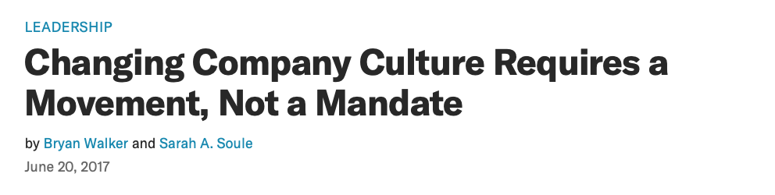
the big C’s …
Culture
Change
Confidence
Conviction
Commitment
Creativity…
Culture is like the wind. It is invisible, yet its effect can be seen and felt. When it is blowing in your direction, it makes for smooth sailing. When it is blowing against you, everything is more difficult.
For organizations seeking to become more adaptive and innovative, culture change is often the most challenging part of the transformation. Innovation demands new behaviors from leaders and employees that are often antithetical to corporate cultures, which are historically focused on operational excellence and efficiency.
But culture change can’t be achieved through top-down mandate. It lives in the collective hearts and habits of people and their shared perception of “how things are done around here.” Someone with authority can demand compliance, but they can’t dictate optimism, trust, conviction, or creativity.
https://hbr.org/2017/06/changing-company-culture-requires-a-movement-not-a-mandate

Slide 4
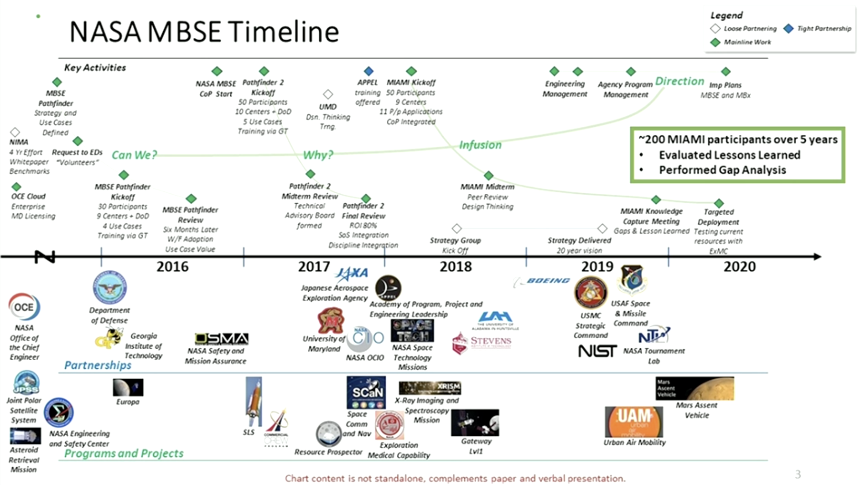
Accountability …
MBSE Infusion Life-Cycle at NASA

Slide 5
NASA lessons learned …
Models should have a purpose
Slow and steady wins the race
Bold, committed leadership, with authority and resources
Modelers & innovators benefit from lots of stakeholder engagement
New technology aligns with new ways of thinking
Resource requirements are hard to estimate
Streamline license and modeling infrastructure
Training is continuously needed
Don’t reinvent the wheel
A model management plan can help with CM/DM

Slide 6
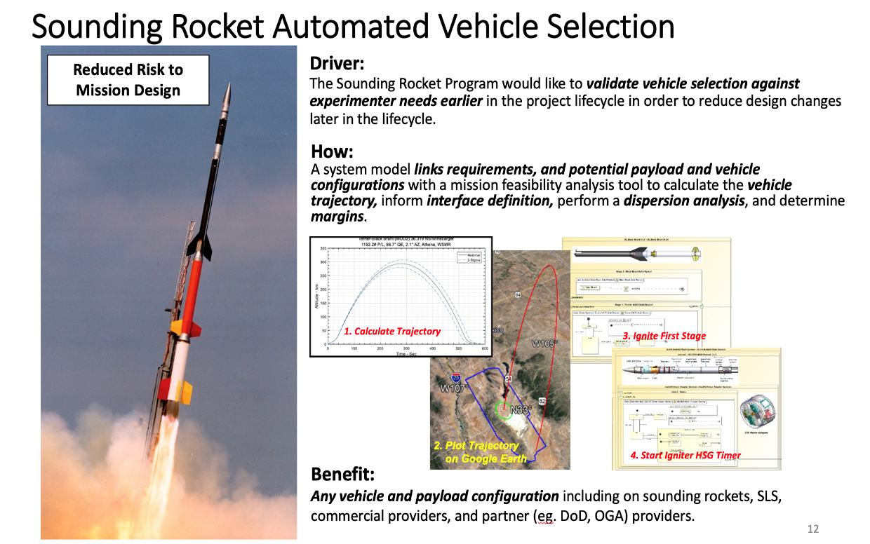
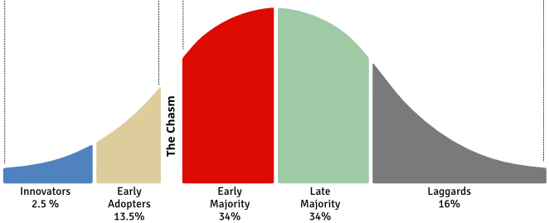
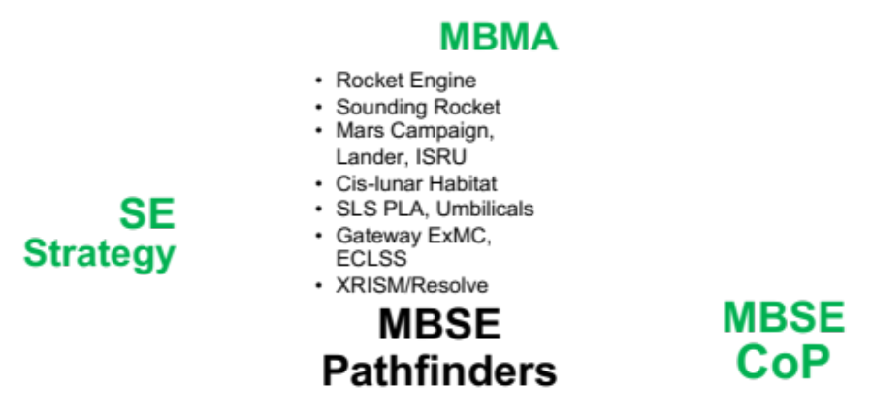

Credibility …
MBSE Infusion Life-Cycle at NASA

Slide 7
SE&I Innovation at NASA …
MBSE at NASA is focused on reducing risk (technical, cost and schedule) within our programs and missions.
It is engaged to allow the SE better systems understanding and improve the ability of the SE to integrate across both engineering discipline and program domains.
Numerous other digital innovations to improve the way SE enables engineering the system are also in play!

