Slide 1
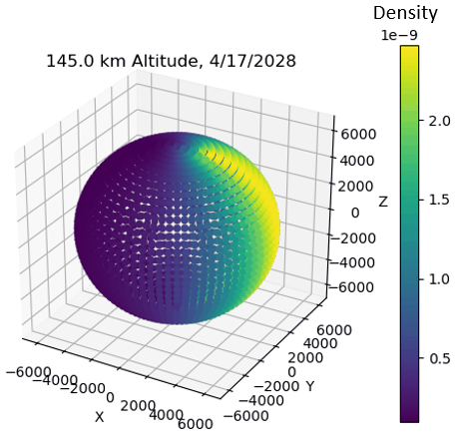
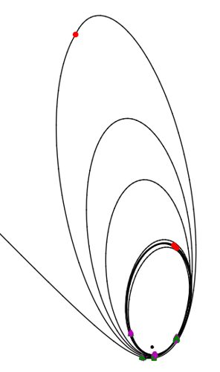
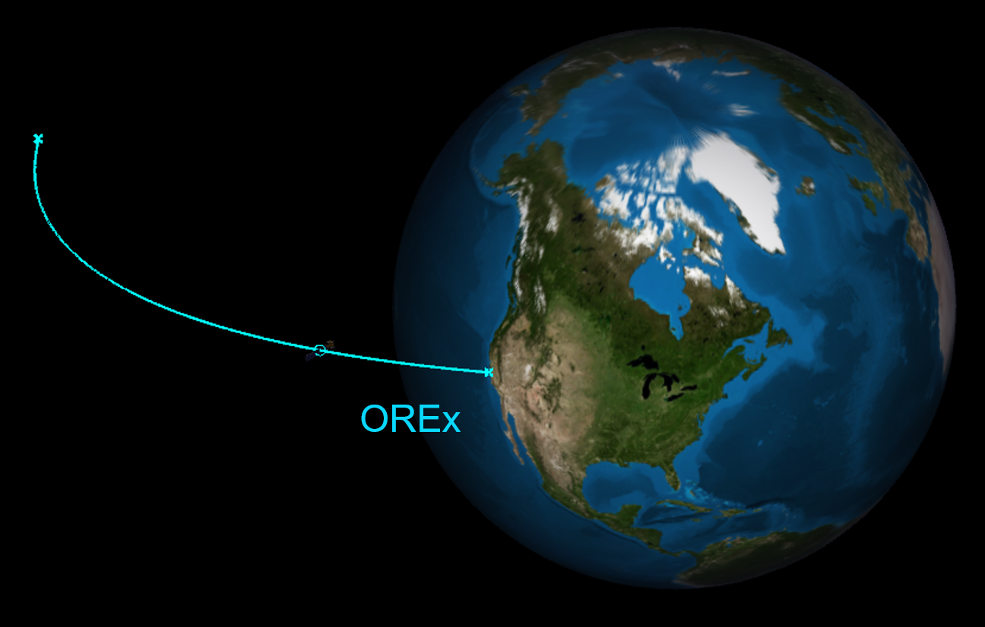
Medium-Fidelity Optimization of Planetary Science Missions
PI: Noble Hatten, 595
Starting TRL: 2 , Ending TRL: 3-6
Additional Team Members: 595: Donald Ellison, Jacob Englander, Kyle Hughes, Alec Mudek
Motivation/Problem Statement:
Planetary science missions involving atmospheric probes and moon tours are scientifically compelling,
but pose serious challenges for mission designers.
Reducing these challenges improves GSFC’s ability to propose and execute exciting planetary science missions.
Project Summary:
This IRAD developed improvements to GSFC’s Evolutionary Mission Trajectory Generator (EMTG), a variable-fidelity interplanetary trajectory optimization software.
New features specifically address capability gaps related to designing atmospheric probe missions and moon tours.
Work related to atmospheric density modeling can easily be adapted for use in tools other than EMTG.
Challenges Encountered / Lessons Learned:
Primary challenge was prioritizing work given limited funding of IRAD and limited availability of team members
Tasks were discretized as much as possible such that individual tasks could be accomplished in nearly any order.
Highest priority was given to tasks that would most directly and meaningfully benefit current or near-future missions and proposals
Project Objectives:
Implement a fast, smooth
atmosphere model in EMTG
Implement a fast drag force model
in EMTG
Derive analytic expressions for
heat flux on an entry probe
Other proposed objectives were superceded by EMTG development objectives based on the needs of specific missions/proposals that arose during FY20.
Refactor EMTG’s numerical integrator
Density globe
Results:
Accomplishment of all items listed under
Project Objectives, plus:
Implementation of fast approximation of
third-body perturbations to increase fidelity
of early designs
Addition of new state representations
in EMTG
Moon tour optimized using EMTG’s refactored integrator
Future Plans /
Next Steps:
Propose, win, and fly challenging planetary science missions to compelling targets
Continue to develop mission design and trajectory optimization capabilities to fill gaps and anticipate needs
Process/Materials/Methodology:
Derived mathematical necessities by hand and/or symbolic manipulator
Verified analytic Jacobians used in gradient-based optimization against algorithmic differentiation
Allowed talented engineers the freedom to adapt high-level IRAD goals to meet mission/proposal-driven needs as they arose
Conclusions:
Features developed by this IRAD have already been used in practice, including to optimize OSIRIS-REx Earth return.
GSFC is better prepared to rapidly
design moon tours and atmospheric
probe missions, improving our
ability to place mission design
“in the loop” when developing these
missions.
OSIRIS-REx Earth return optimized using EMTG’s new drag capabilities

