Slide 1
Urban Air Mobility Noise Working Group Human Response Study, Progress Update
Siddhartha Krishnamurthy
Structural Acoustics Branch
NASA Langley Research Center
Urban Air Mobility Noise Working Group, November 5, 2020

Slide 2
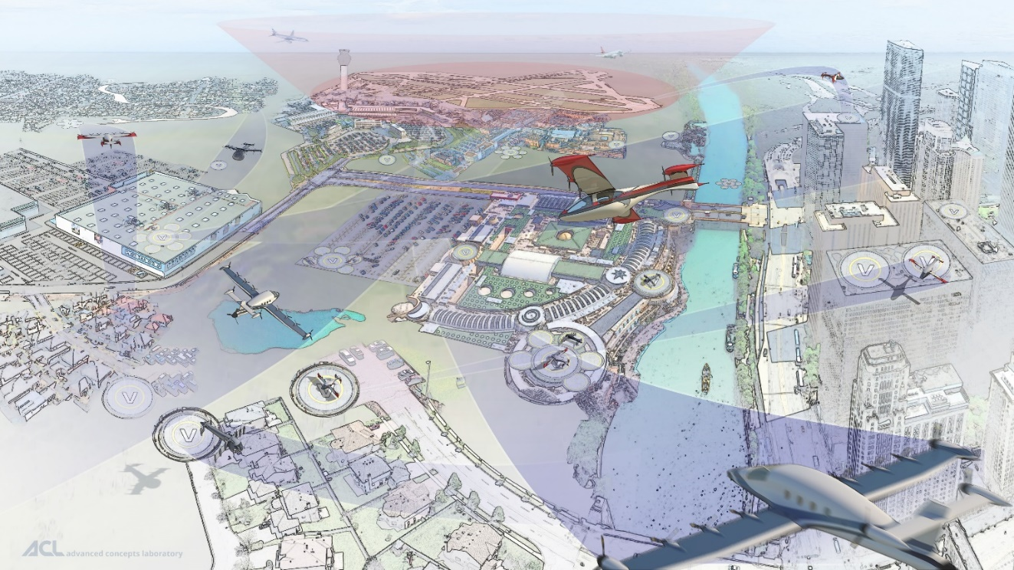
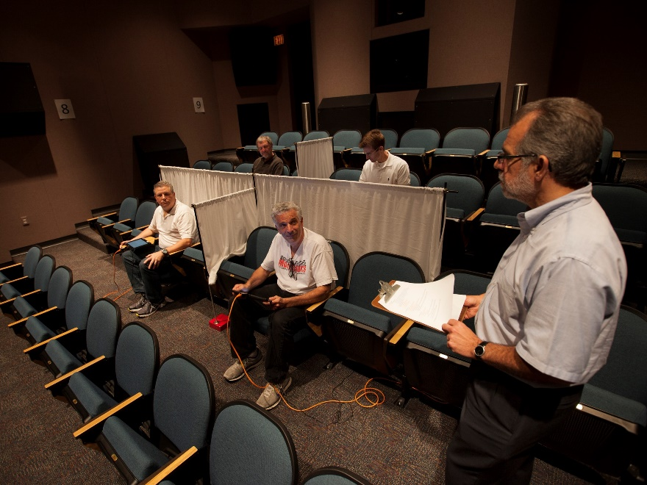
Advanced and Urban Air Mobility Vehicle (UAM) Noise Psychoacoustic Testing
NASA has facilities to conduct psychoacoustic testing, but there are many questions on human response to UAM vehicle noise that we would like to answer.
Exterior Effects Room, NASA Langley Research Center
From NASA Advanced Air Mobility National Campaign Overview website

Slide 3
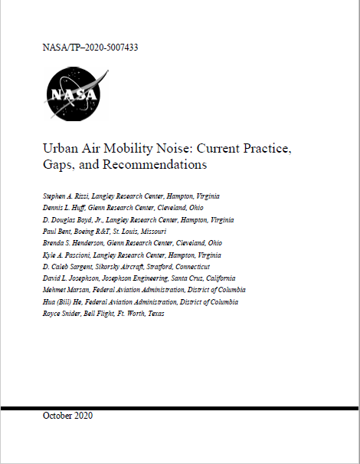
Human Response Study, Initial Motivation
Consensus in UNWG white paper that there is insufficient data on UAM vehicle noise human response.
  From white paper: “At this time, there have been no published reports of psychoacoustic tests conducted to understand human response to UAM vehicle noise.”
Steve Rizzi’s proposal: conduct large psychoacoustic test on UAM vehicle noise using testing facilities from around the world.
  Minimally provide relative annoyance ratings between different vehicles.
Key benefits:
  International collaboration can help obtain sounds from different locations.
  Provide incentive for OEMS to provide UAM vehicle sounds.
  Help with community outreach.

Slide 4
Human Response Study, Overarching Goals
Through cooperation with multiple agencies and organizations, obtain a wide range of recorded and auralized UAM vehicle sounds for use in human response studies.
Provide insights into community response of UAM vehicle noise that will collectively be challenging for any single agency or organization to acquire.
Create a database of community response to UAM vehicle noise that can be analyzed at later times to answer questions that were not originally asked as part of test goals.

Slide 5
Human Response Study, Execution Plan
Execute study in phases.
Timeframe: at least 2-3 years.
Phase 1
Phase 2
Phase 3
. . .

Slide 6
Human Response Study, Phase 2
UNWG White Paper recommendation:
  “A laboratory test campaign be used to explore differences in perception of UAM vehicle noise between communities, so that future policy decisions are based on data representing a wide range of environments.”
Proposed Phase 2 research goal: Evaluate differences in perception of UAM vehicle noise operating in a wide range of environments.
  Need vehicle and ambient sounds.
Phase 1
Phase 2

Slide 7
Human Response Study, Phase 1
UNWG White Paper recommendation:
  “It is recommended that laboratory studies be performed to help inform how different the annoyance to short-term exposure of UAM vehicle noise is from that of existing aircraft noise sources.”
Proposed Phase 1 research goal: conduct laboratory study to help inform how different the annoyance to short-term exposure is among different aircraft noise sources which include aircraft noise in different urban environments.
Take place within USA.
Phase 1 can provide valuable knowledge by itself.
Phase 1
(Feasibility Study)
Phase 2
(Focus on UAM Vehicle Noise)

Slide 8
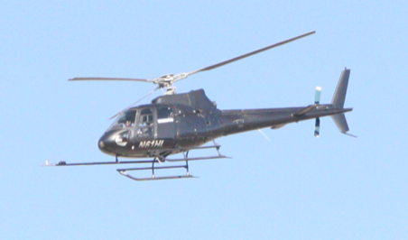
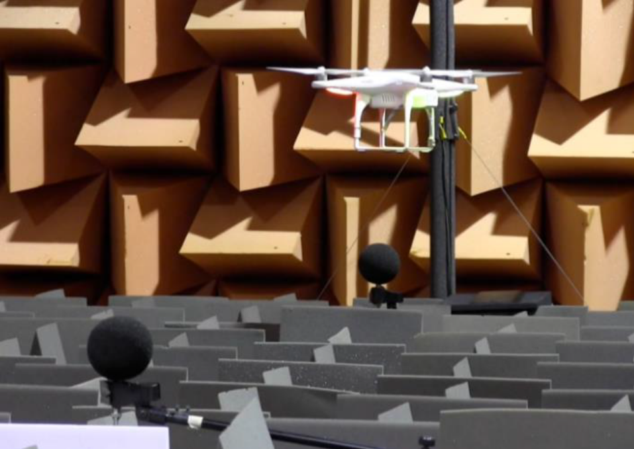
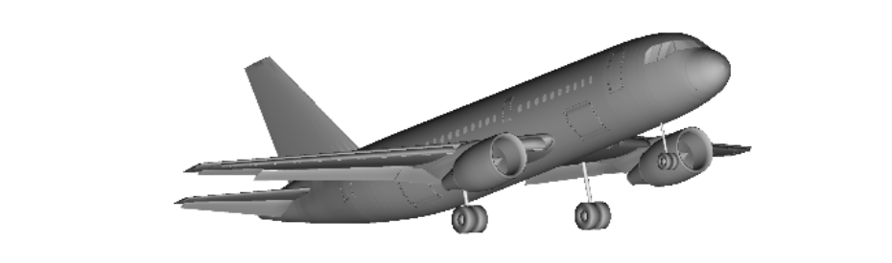
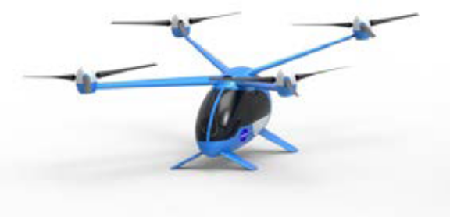
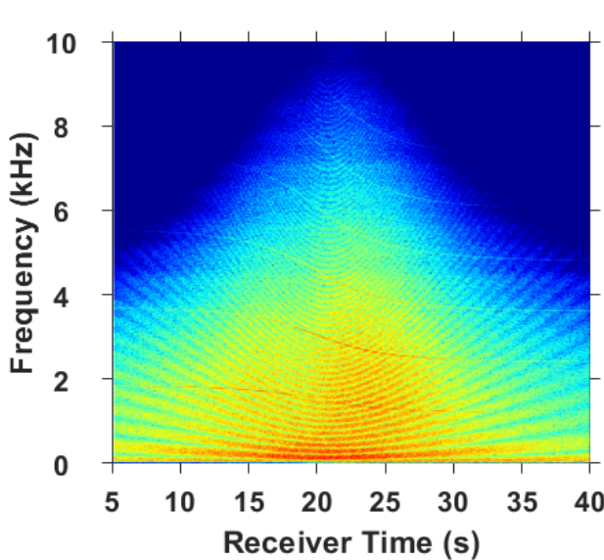
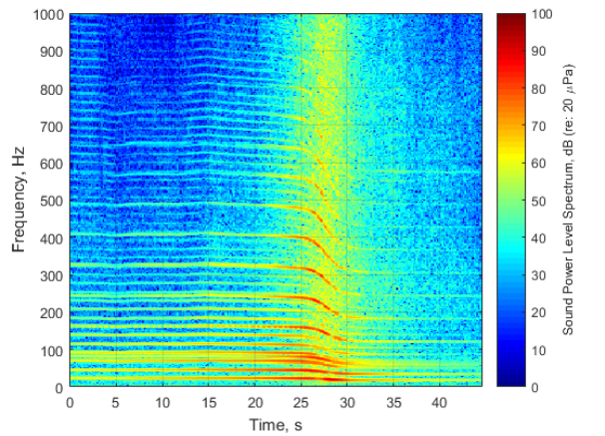
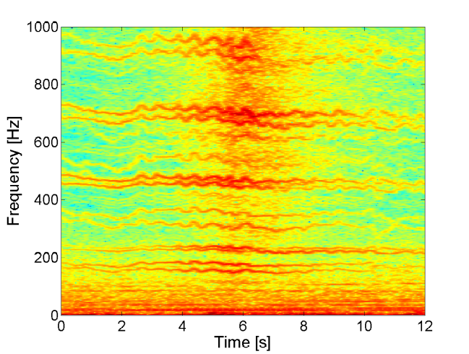
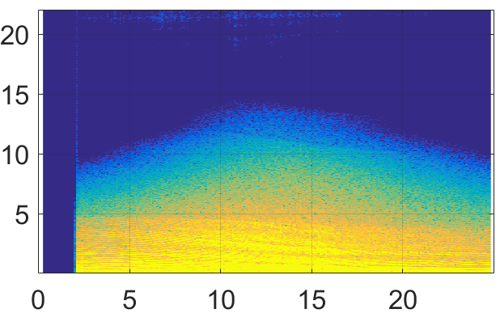
Feasibility Study, Aircraft Sound Stimuli
Sound stimuli will be single-event recordings or auralizations of aircraft flyovers.
Demonstrate ranking of sound annoyance to OEMs.
Frequency [kHz]
Frequency [kHz]
Frequency [Hz]
Frequency [Hz]
Time [s]
Time [s]
Time [s]
Time [s]

Slide 9
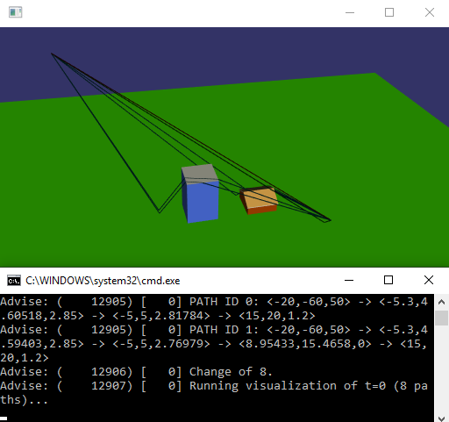
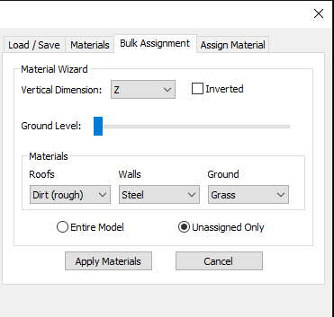
Feasibility Study, Ambient Sound Stimuli
Urban ambient sounds will need to provided.
Great Lakes Sound & Vibration (GLSV) developing urban scene propagation plugin for NASA Auralization Framework which may be part of stimuli generation.
  Completion by June 2021.
  GLSV is looking for commercial partners for NASA SBIR contract Phase II-E to further enhance propagation tool.
    Please contact Kevin Nelson at kevinn@glsv.com if you are interested.

Slide 10
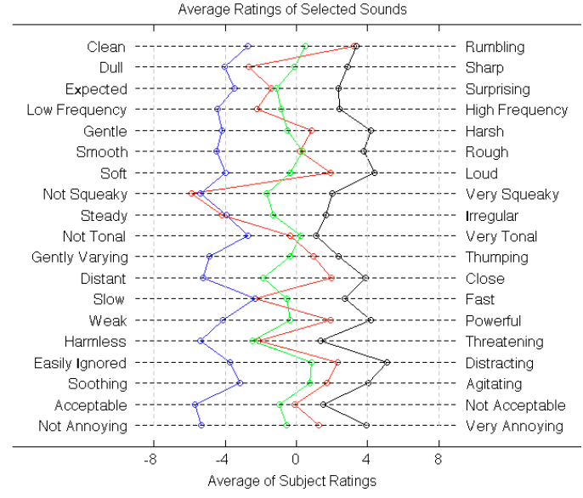
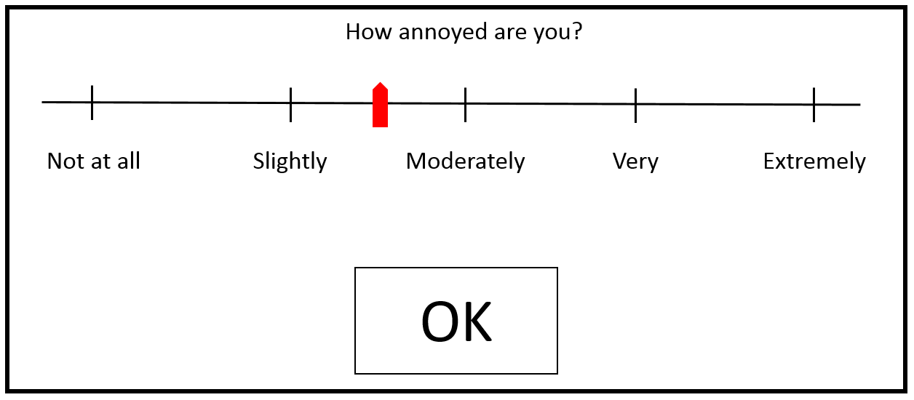
Conducting the Feasibility Study
Remote testing likely due to COVID-19.
Test subjects can be from UNWG organizations.
Two potential types of test questions shown below:
  Other types of questions possible
Testing Annoyance
Semantic Differential Test
Right picture from McMullen, A., Davies, P., and Okcu, S. “A preliminary test conducted to understand perceptual characteristics of rotorcraft noise.” Noise-Con 2013.

Slide 11
Link to Community Engagement
Use test taking equipment from feasibility and phase 2 tests for community engagement.
Apply knowledge gained on UAM vehicle noise human response in community engagement.
Keep UNWG SG4 (Regulation and Policy) up to date on Human Response Study progress.
Community Engagement
Phase 1
(Feasibility Study)
Phase 2
(Focus on UAM Vehicle Noise)

Slide 12
Feasibility Study, Jumpstart Activity
NASA Revolutionary Vertical Lift Technology project has provided the UNWG Human Response Study funding for FY 2021.
NASA contracted HMMH and Arup to jumpstart activity.
HMMH
Provide roadmap for design and execution.
The roadmap should address:
  Estimated level of effort for each phase of test.
  Test Design
  Test Methodology
  Pre-Test Activities
  Post-Test Activities

Slide 13
Feasibility Study, Jumpstart Activity
NASA Revolutionary Vertical Lift Technology project has provided the UNWG Human Response Study funding for FY 2021.
NASA contracted HMMH and Arup to jumpstart activity.
HMMH
Arup
Provide roadmap for design and execution.
The roadmap should address:
  Estimated level of effort for each phase of test.
  Test Design
  Test Methodology
  Pre-Test Activities
  Post-Test Activities
Provide data and test hardware/software standards.
Provide alternative options for conducting the test via remote means and estimated cost and level of effort for each option.
Also address:
  Requirements for test stimuli.
  Facility or test taking equipment requirements.
  Engaging with subjects.

Slide 14
Feasibility Study, Jumpstart Activity
NASA Revolutionary Vertical Lift Technology project has provided the UNWG Human Response Study funding for FY 2021.
NASA contracted HMMH and Arup to jumpstart activity.
HMMH
Arup
NASA and UNWG
Provide roadmap for design and execution.
The roadmap should address:
  Estimated level of effort for each phase of test.
  Test Design
  Test Methodology
  Pre-Test Activities
  Post-Test Activities
Provide data and test hardware/software standards.
Provide alternative options for conducting the test via remote means and estimated cost and level of effort for each option.
Also address:
  Requirements for test stimuli.
  Facility or test taking equipment requirements.
  Engaging with subjects.
Provide HMMH and Arup with example IRB and test instructions.
Following completion of phase 1, NASA will archive/create database for test stimuli and responses for public access.
Provide feedback to HMMH and Arup reports.

Slide 15
Connectivity of Activities Leading to Phase 1 Execution
Next steps for UNWG: Review, discuss, and offer feedback on HMMH and Arup reports to help with develop test methodology (red) and yellow colored blocks.
  Technical
  Business
  Legal
Develop Research Goals
Attract OEM
Participation
Institutional
Review Board(s)
Develop Test Methodology
Modeling & Analysis
OMB – Paperwork
reduction act
Evaluate Psycho
Test Facilities
Cost Estimate
Develop/Prepare
Content
Funding
Model
Agreements
& IP
Publication
requirements

Slide 16
Image References
Slide 2:
  Urban Air Mobility artwork is from NASA Advanced Air Mobility National Campaign Overview website, https://www.nasa.gov/aeroresearch/aam/description/.
  Picture of Exterior Effects room provided by Steve Rizzi, NASA Langley Research Center.
Slide 8:
  AS350 Helicopter picture is from Watts, M.E., Greenwood, E., Sim, B., Stephenson, J.H., and Smith, C.D., "Helicopter acoustic flight test with altitude variation and maneuvers," NASA TM-2016-219354, 2016.
  AS350 Helicopter flyover spectrogram from Krishnamurthy, S. and Rizzi, S.A., “Auralization of Amplitude Modulated Helicopter Flyover Noise.” Paper 6.2019-2087, SciTech 2019, San Diego, CA, 2019.
  DJI Quadcopter picture and sound recording spectrogram from Christian, A., et al., “Auralization of tonal rotor noise components of a quadcopter flyover.” InterNoise 2015, San Francisco, CA, 2015.
  Fixed wing aircraft picture and flyover spectrogram from Rizzi, S.A, et al., “A Comparison of Aircraft Flyover Auralizations by the Aircraft Noise Simulation Working Group.” 6.2020-2582, AIAA Aviation 2020, Virtual Event, 2020.
  NASA Quadrotor concept picture from Gorton, S. “RVLT FY21 Planning Kickoff.” May 12 and 15, 2020.
  NASA Quadrotor flyover spectrogram generated by presenter (Siddhartha Krishnamurthy).
Slide 9:
  Urban scene propagation plugin pictures generated by presenter (Siddhartha Krishnamurthy).
Slide 10:
  Test question prompt provided by Andy Christian, NASA Langley Research Center.
  Semantic differential test pictures from McMullen, A., Davies P., and Okcu, Selen, “A preliminary test conducted to understand perceptual characteristics of rotorcraft noise.” Noise-Con, Denver, CO, Aug 26-28, 2013. Funding provided under NASA Cooperative Agreement NNX12AP13A as part of Subsonic Rotary Wing project of the NASA Fundamental Aeronautics Program.

Slide 17
Backup Slides

Slide 18
Known Efforts on UAM Vehicle Noise Similar to Human Response Study
NASA (USA)
  Develop annoyance model for UAM vehicle noise.
  Improve veracity of electric vertical takeoff and landing (eVTOL) aircraft auralizations.
University of Salford, Manchester (England)
  Development of psychoacoustic models to inform designs and operation of UAV/UAM
  Assessment of human response (annoyance, audibility and acceptance) to noise generated by UAV operations in diverse soundscapes.
NLR (Netherlands)
  Pilot study on UAM human perception in different environments (urban, rural).
  Compare recorded UAM fly-over procedures with other known sounds.
Other efforts by Uber, HMMH, ATAC, FAA, CAMI, LADOT.
  Most efforts documented in prior AWTG/UNWG presentations.
Other UAM vehicle noise human response research could potentially provide sounds for UNWG Human Response Study.

