Slide 1
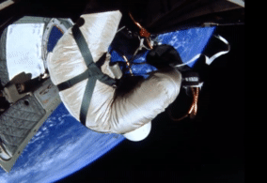
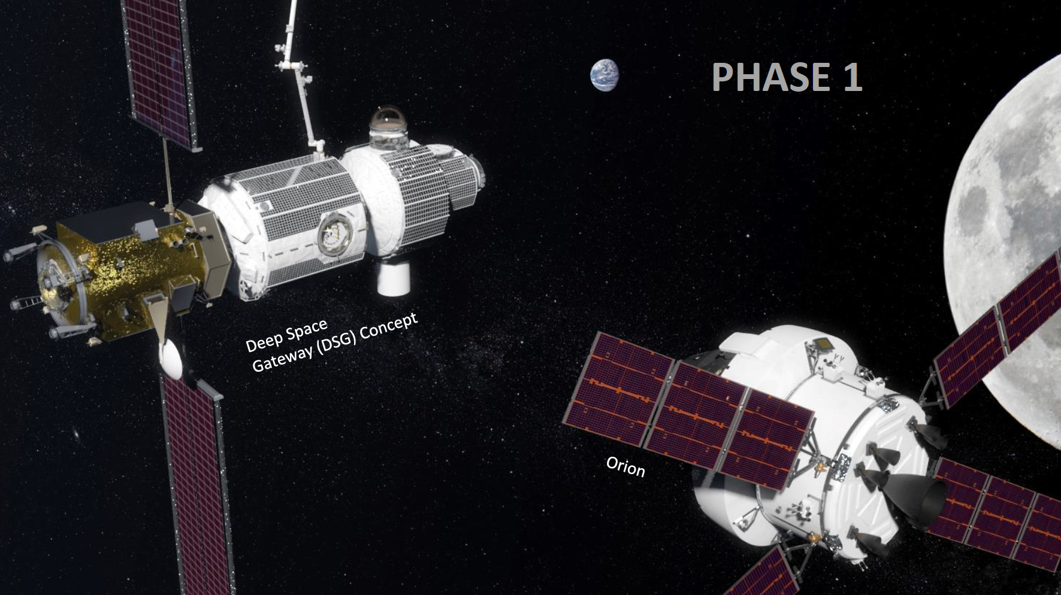
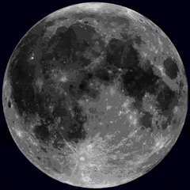
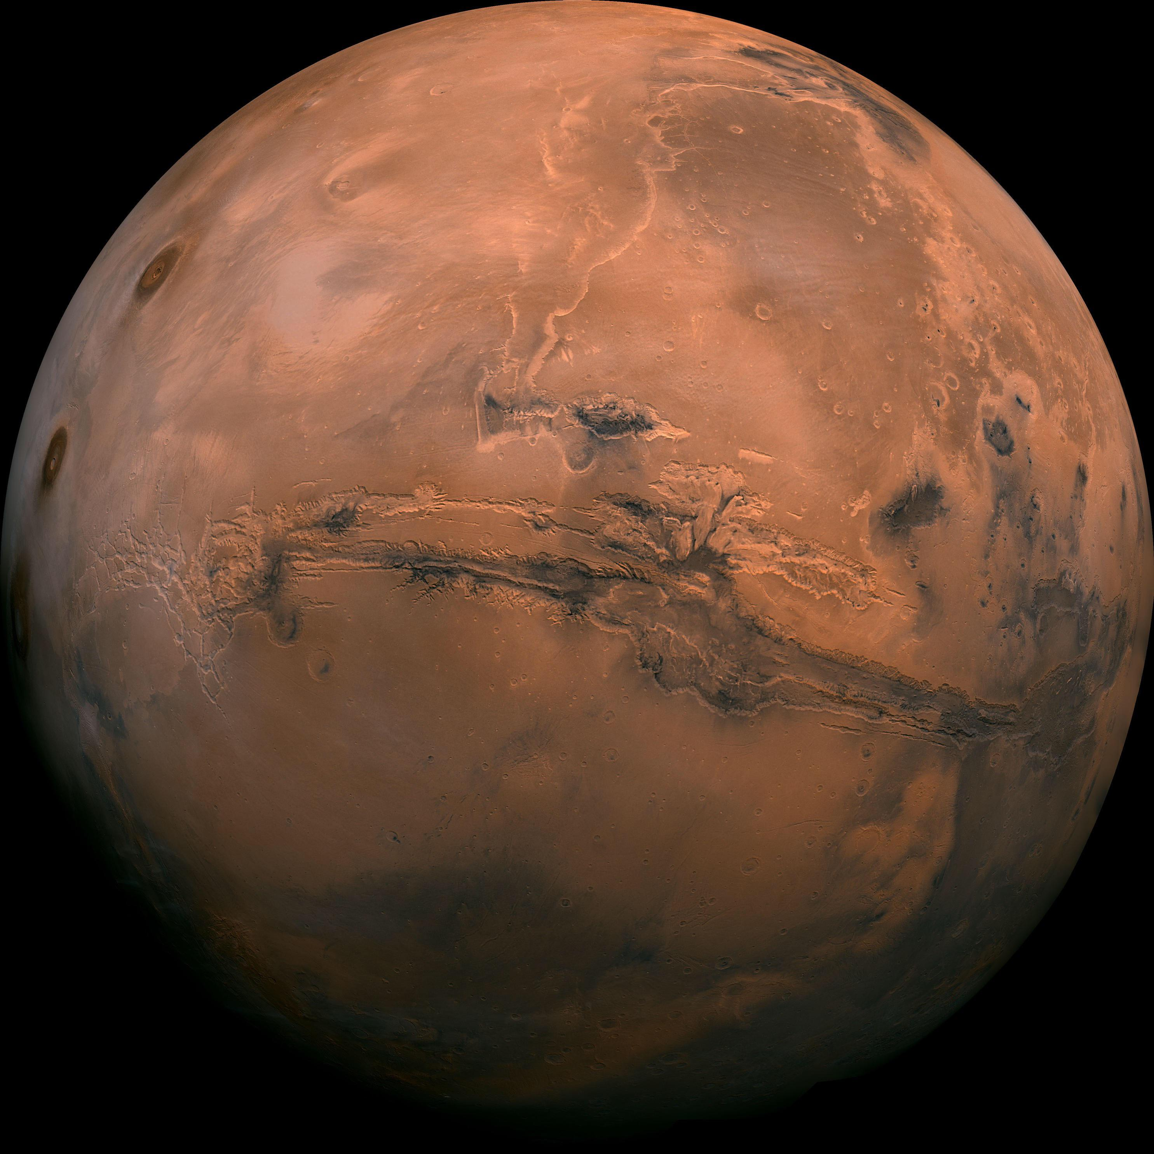
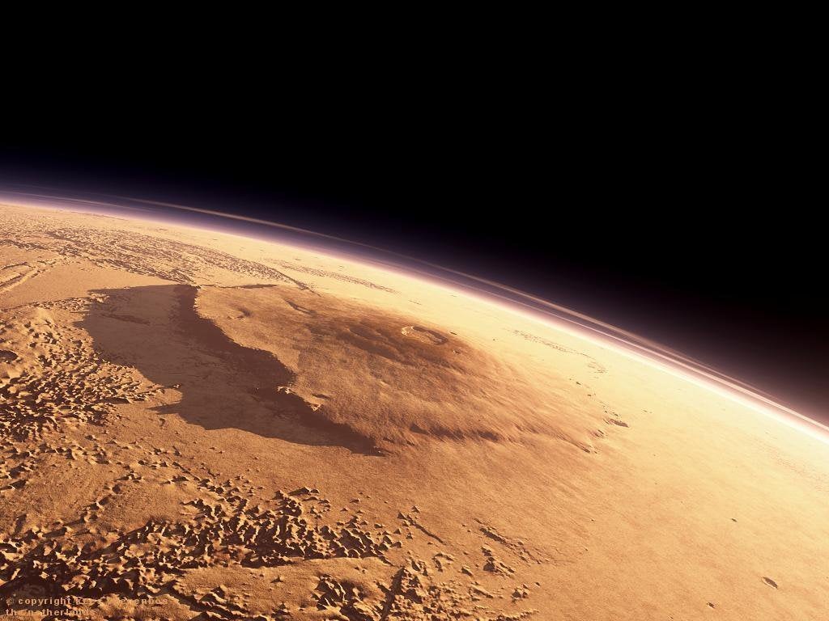
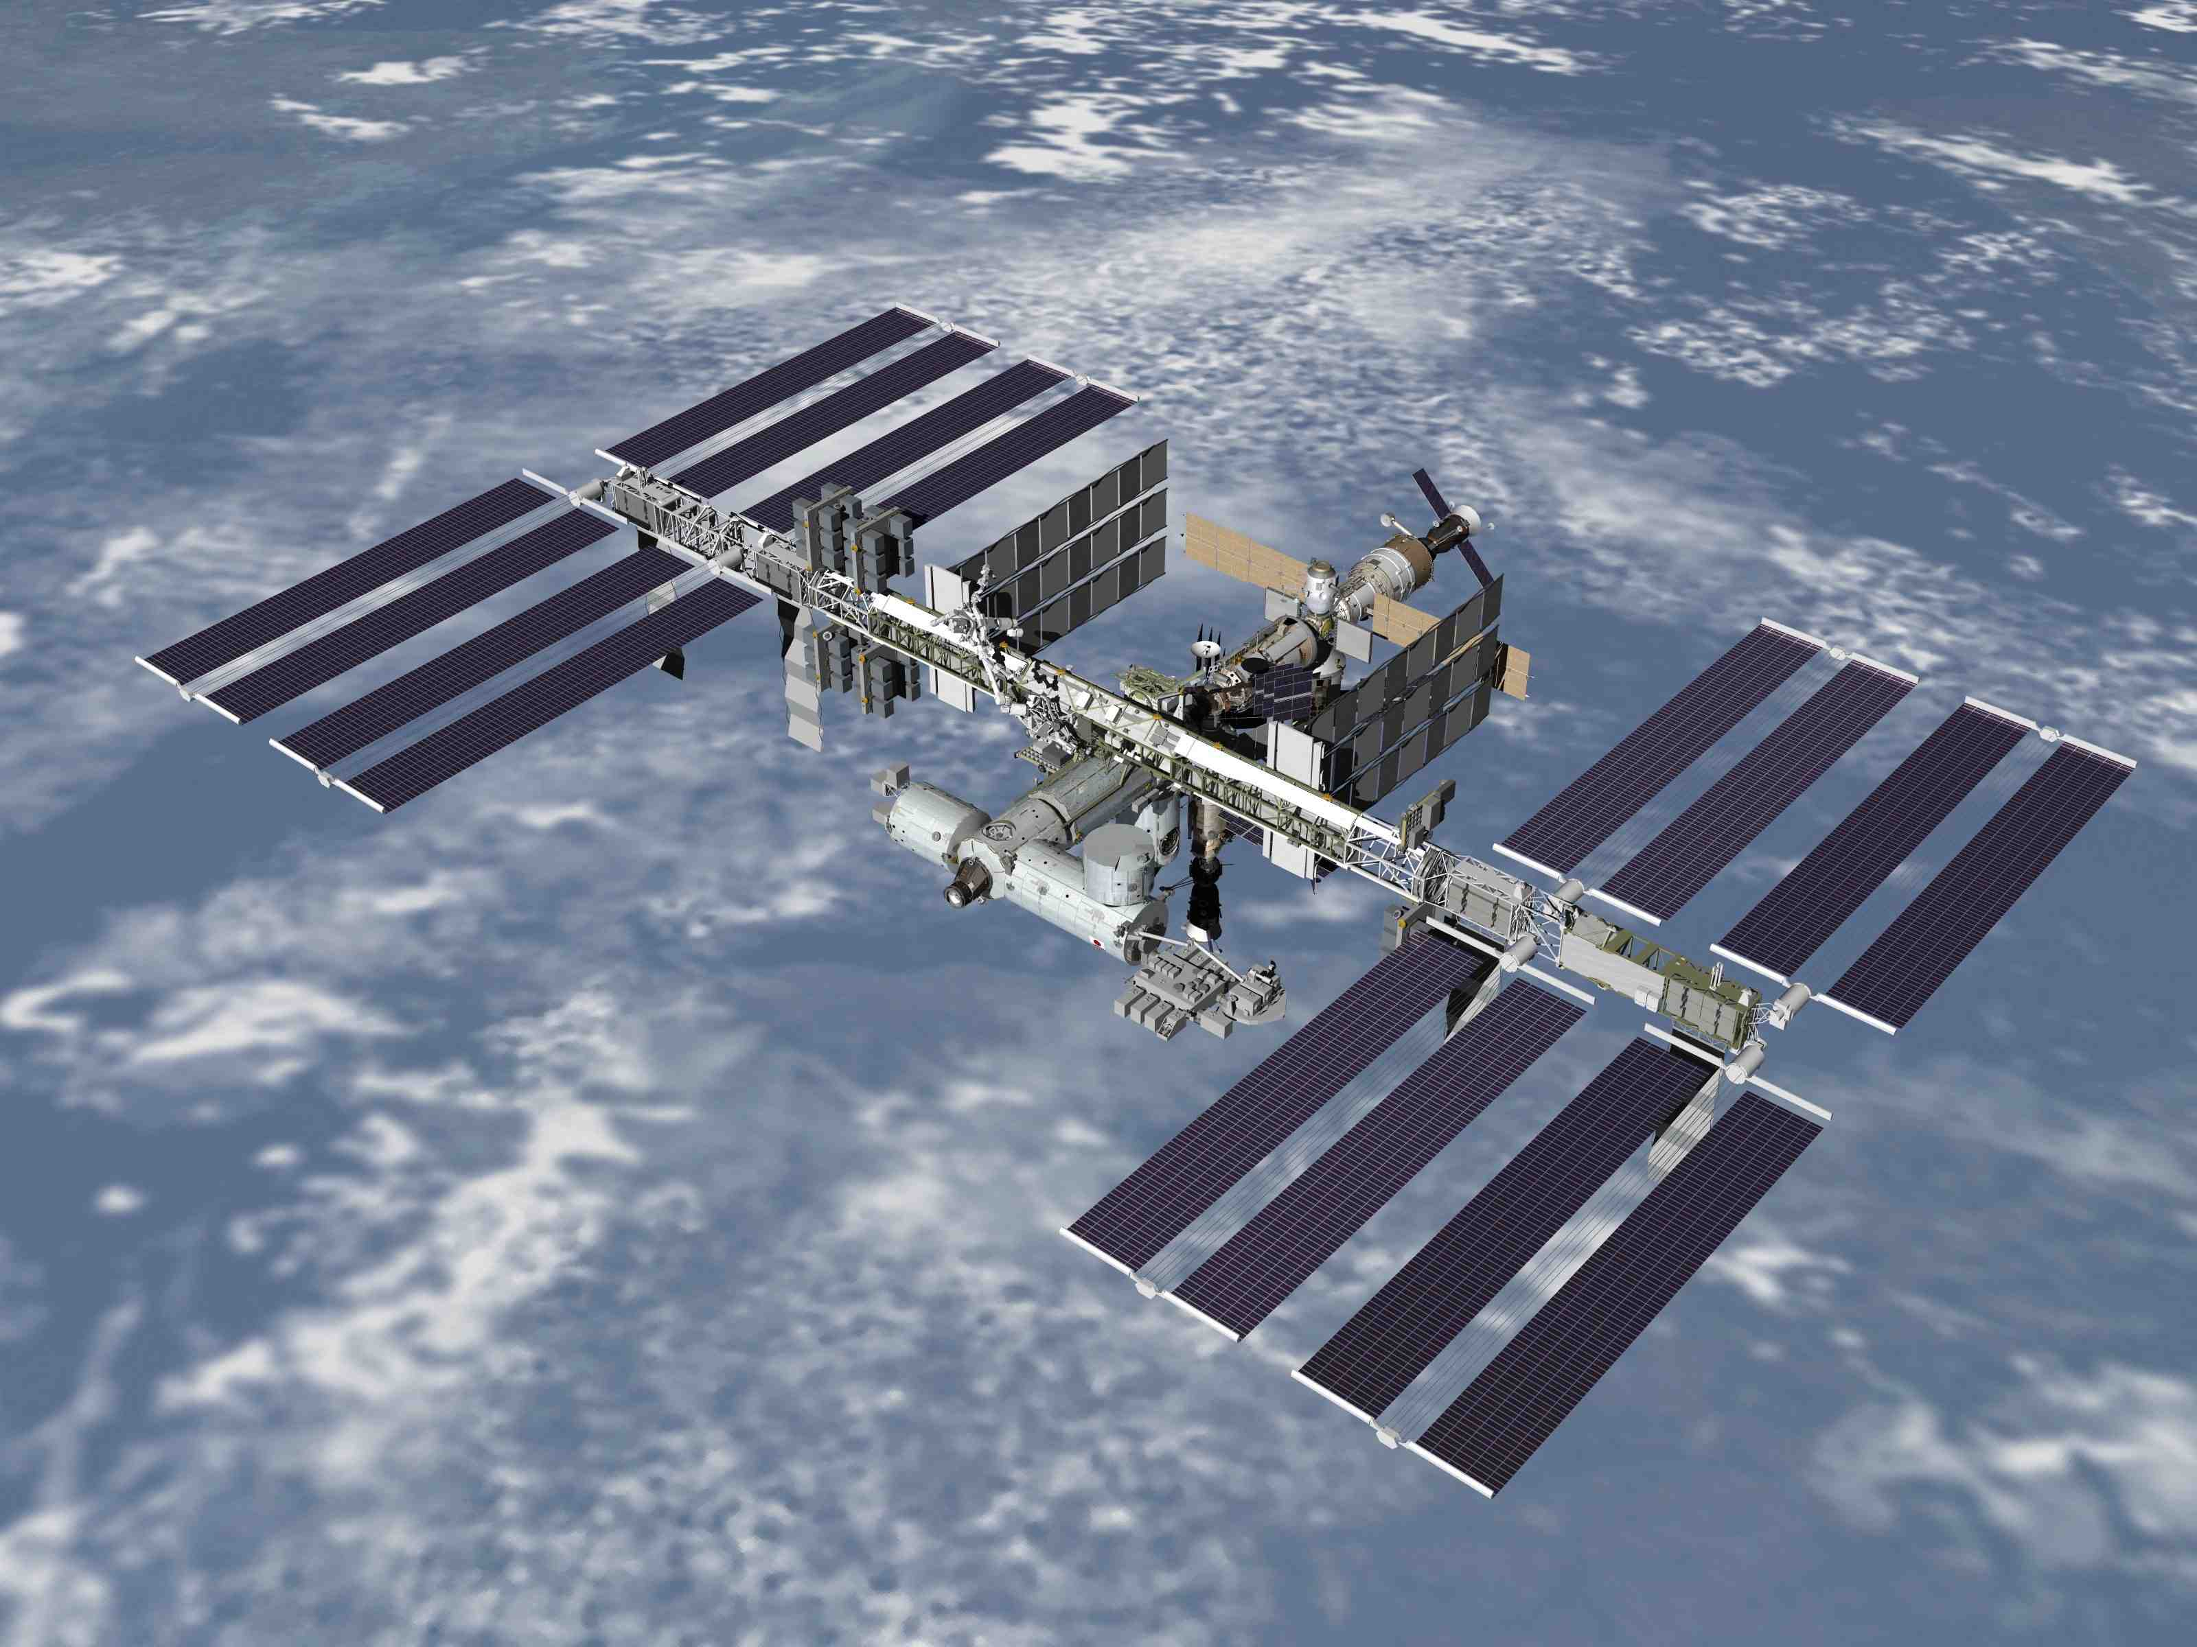
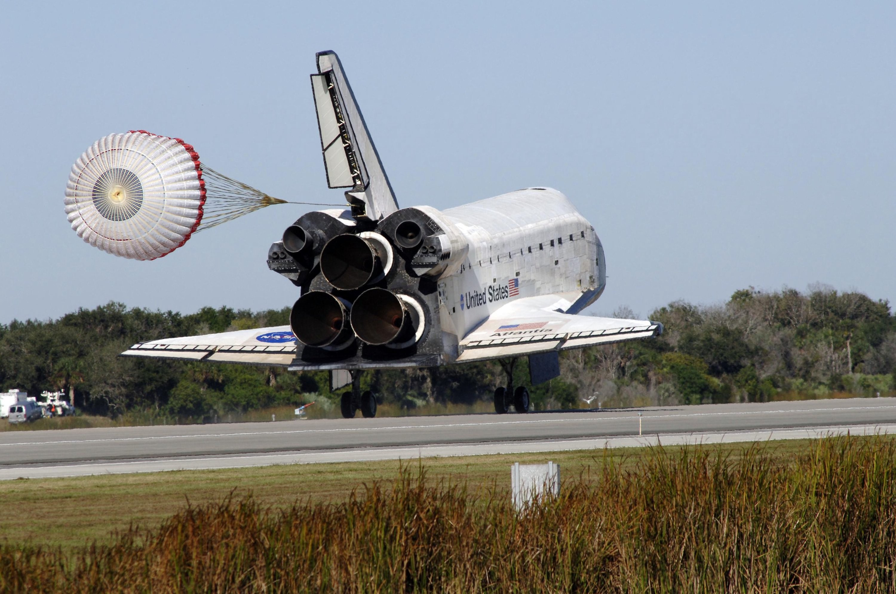



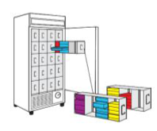



Biospecimen and Data Sharing:
NASA Institutional Scientific Collection at Ames Research Center (ISC-ARC), and the Ames Life Sciences Data Archive (ALSDA)
Missions and Experiments
ISC-ARC & ALSDA
Researchers, Publications
Data and Biospecimens
Data Submitters, Data Archive, Data Consumers
Ryan Scott, ALSDA Project Scientist
#ASGSR2020 – Enabling Technologies
November 5-6, 2020 – ryan.t.scott@nasa.gov

Slide 2
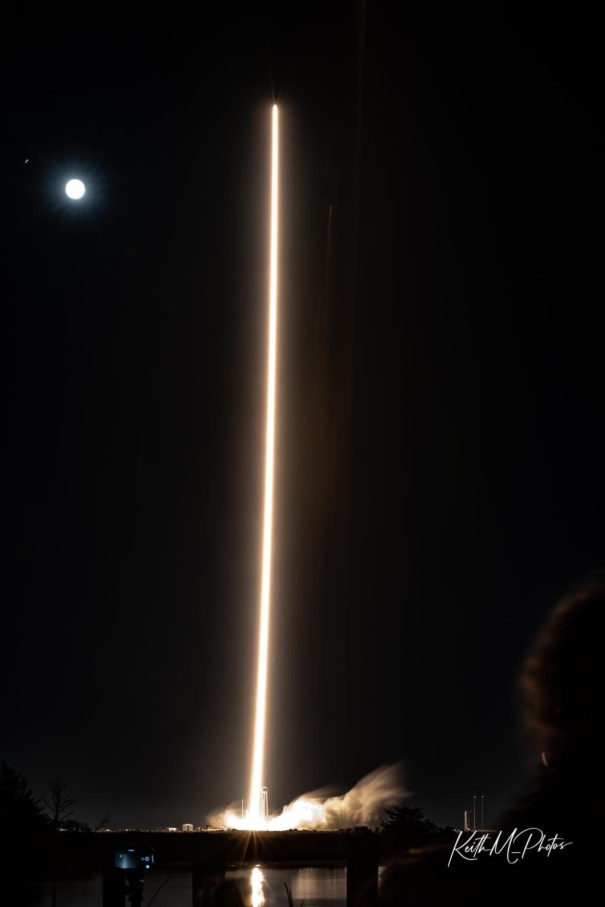
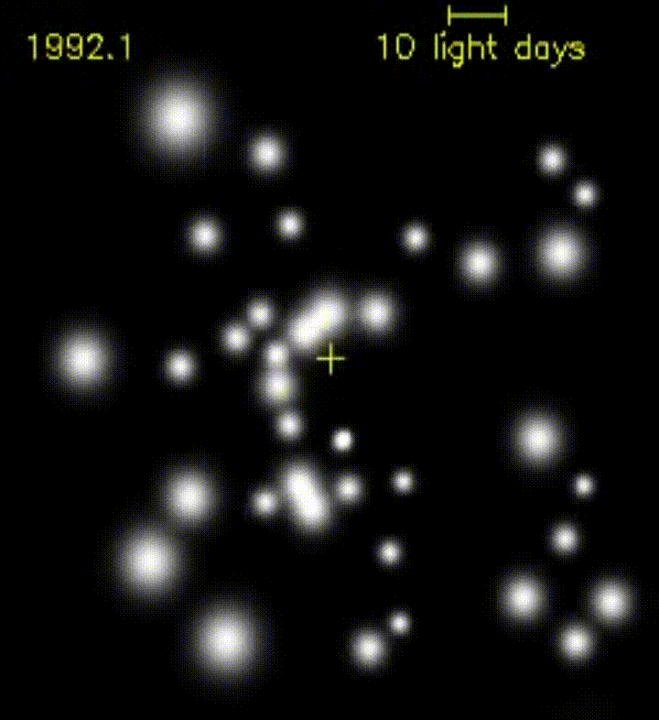
Central Parsec, Milky Way Galaxy
Ever ”Seen” a Black Hole? See that star’s oval-shaped orbit?
(Ghez et al., 2016; W.M. Keck Telescopes, UCLA Galactic Center)
(KeithM Photos; Lewes, DE; Cygnus NG Launch 10.02.2020)

Slide 3
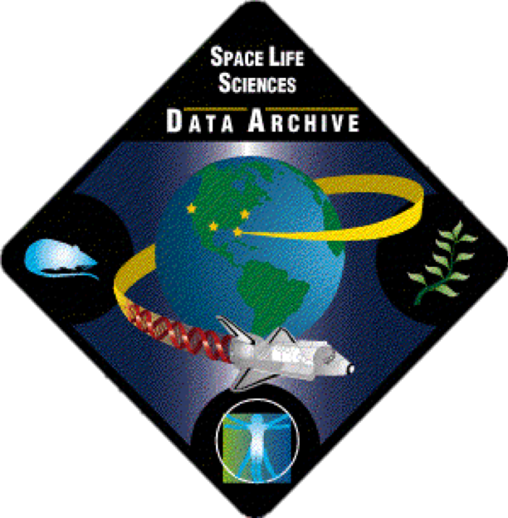


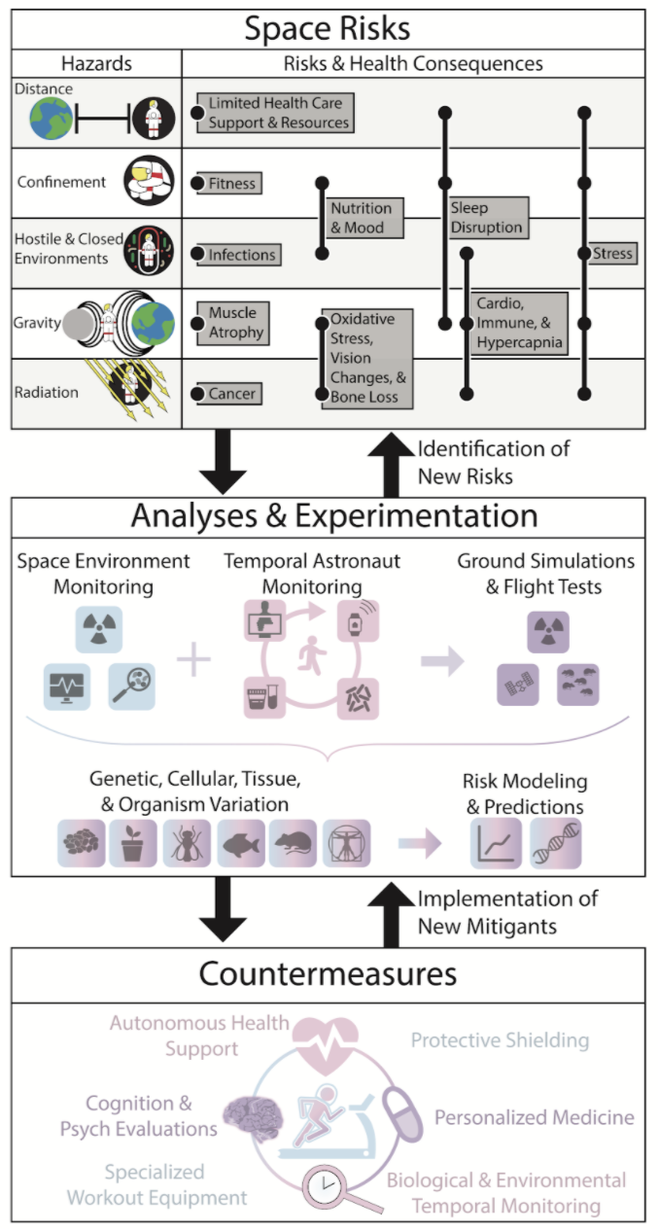
Information Flow from the Space Environment
(Submitted to Cell; Afshinekoo et al., 2020)
Iterative Learning and Development Process
Closed Looped Feedback of Evidence and Information Throughout Levels
New Experiments, New Designs, New Hardware, New Missions, More Monitoring, More Data, More Biospecimens
Use of Biospecimens and Data for new insights
Notes:
Changed Imagery to Photographs – photographs and video are imagery so use one or the other
Changed Experimental to Experiment

Slide 4
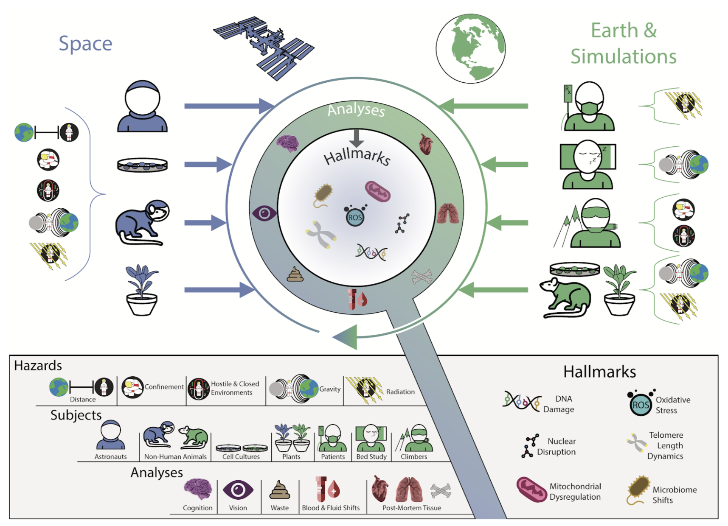
Features of Biology in Spaceflight
Evidence Spanning Multiple Systems
DNA Damage
Oxidative Stress
Mitochondrial Dysregulation
Microbiome Shift
Nuclear Disruption
Telomere Length Dynamics
(Submitted to Cell; Afshinekoo et al., 2020)
Notes:
Changed Imagery to Photographs – photographs and video are imagery so use one or the other
Changed Experimental to Experiment

Slide 5
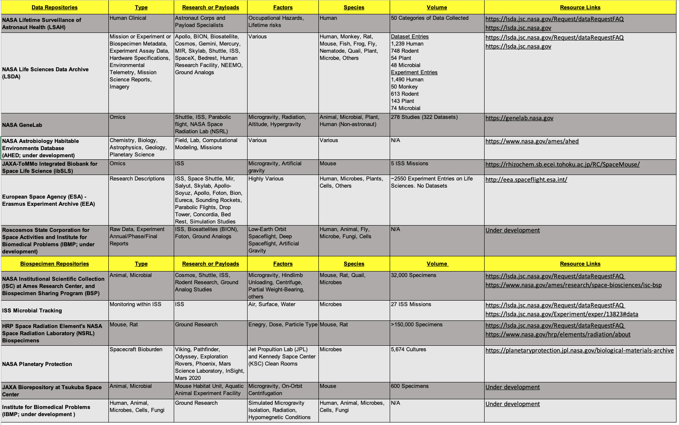
Space Biology Data and Biospecimen Resources
Available
(Submitted to Cell; Afshinekoo et al., 2020)
(Submitted to Cell; Afshinekoo et al., 2020)
Notes:
Changed Imagery to Photographs – photographs and video are imagery so use one or the other
Changed Experimental to Experiment

Slide 6
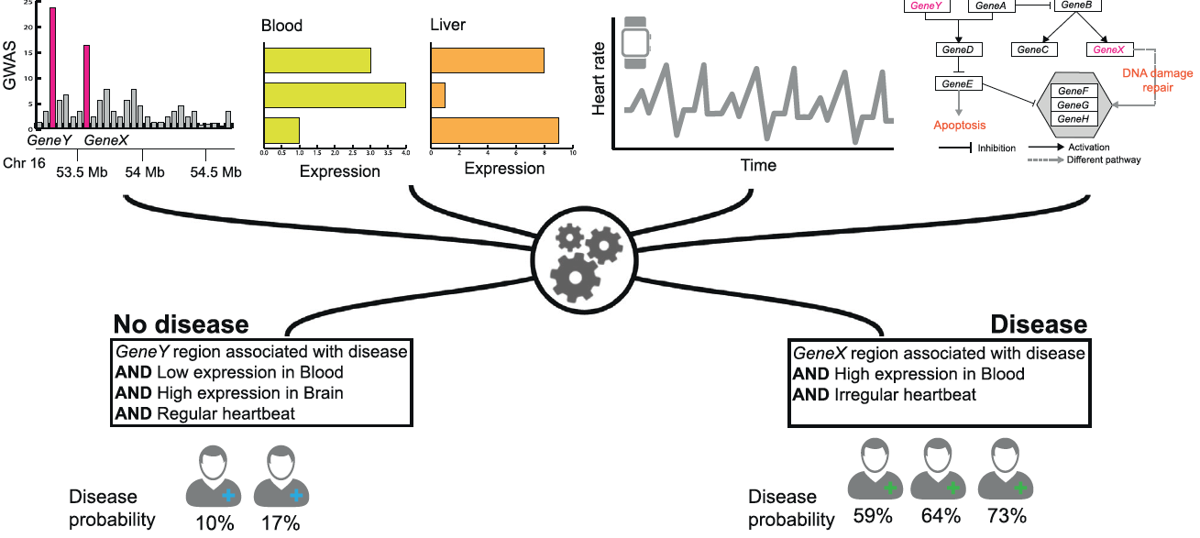
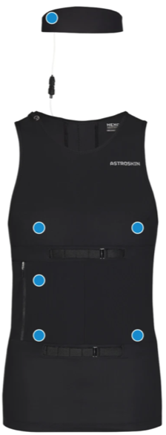
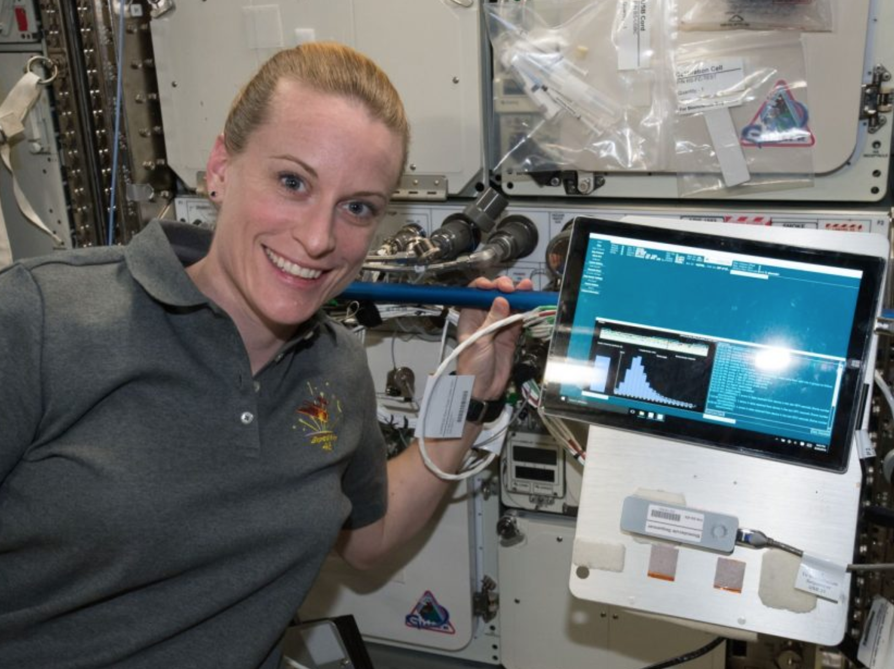
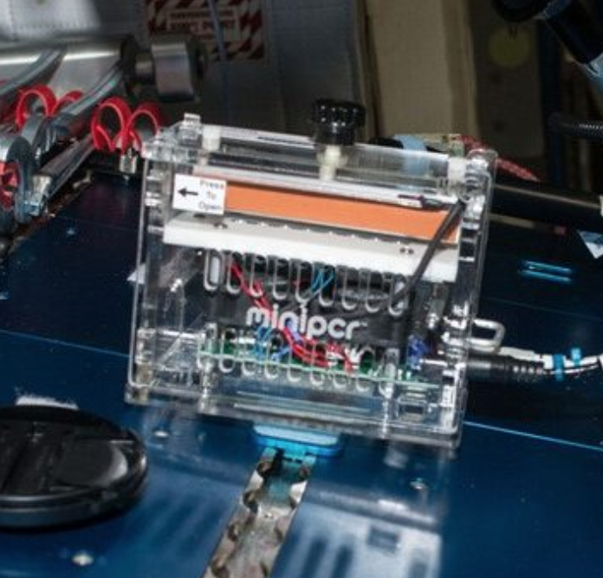
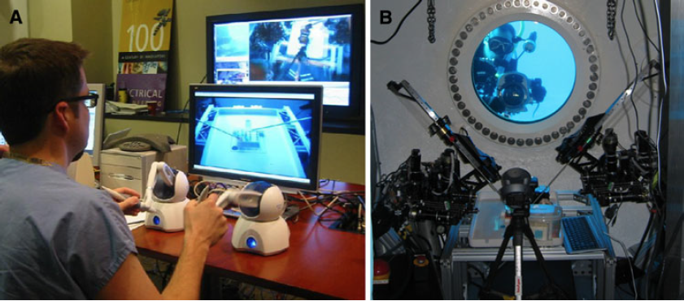
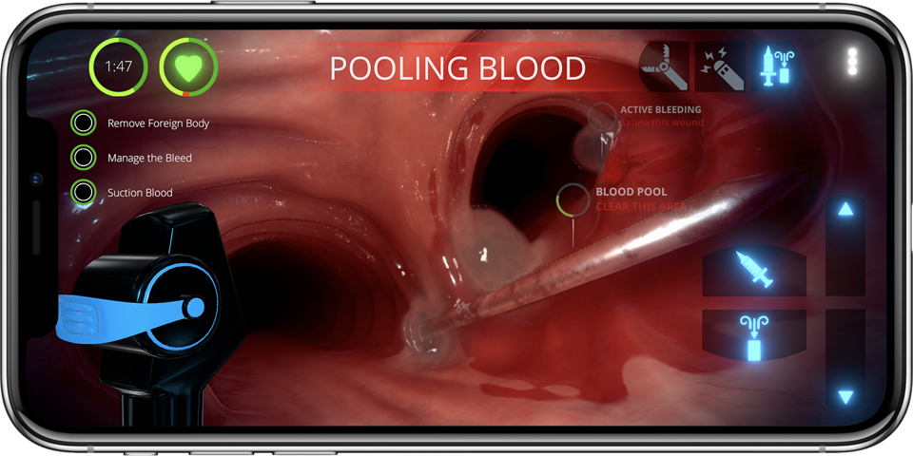
Data and Biospecimens: Discovery and Support for Spaceflight
Enables New Scientific Discoveries
  Basic, Fundamental (science exploring the unknown) and Applied (science addressing the known risks)
  Systems Biology (science simultaneously examining complexities re: DNA, mRNA, miRNA, proteins, metabolites, methylation)
Translational Research and Countermeasure Development (Alwood et al., 2017)
Analysis of Adverse Outcomes Across Spaceflight Hazards (Goswami et al., 2013)
Predictive Spaceflight Health Risk Data Science Modeling and Personalized Medicine
  Merging biological data measures and fundamental knowledge, mathematical modeling
  (Scott et al., 2020 [submitted]; Zitnik et al., 2019)
Autonomous Health Support for Flight Medical Officer
  Includes artificial intelligence-assisted medical diagnoses
Deep Space Health Monitoring, Biosensors, Wearables (Bellisle et al., 2020; Morrison et al., 2017; Roda et al., 2018)
On-Board Genetics and Sequencing Capacity (McIntye et al., 2016; Castro-Wallace et al., 2017)
Virtual Simulation Medical Training (De Olivera et al., 2013)
Emergency Surgical Intervention Platforms (Haidegger et al., 2011; Panesar & Ashkan, 2018)
Enabling Personalized Space Medicine through Risk Prediction (Heuskin et al., 2016)
  Individual sensitivity to spaceflight and modulated responses
  (Genetic, Demographic, Lifestyle Variability)
Notes:
Changed Imagery to Photographs – photographs and video are imagery so use one or the other
Changed Experimental to Experiment

Slide 7
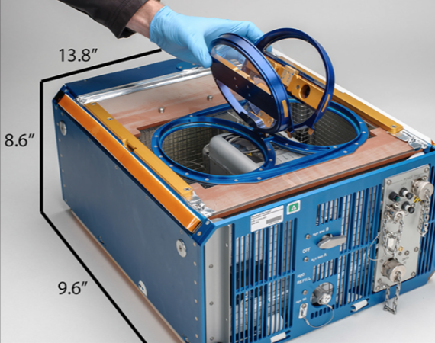
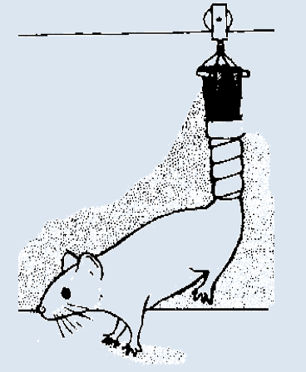
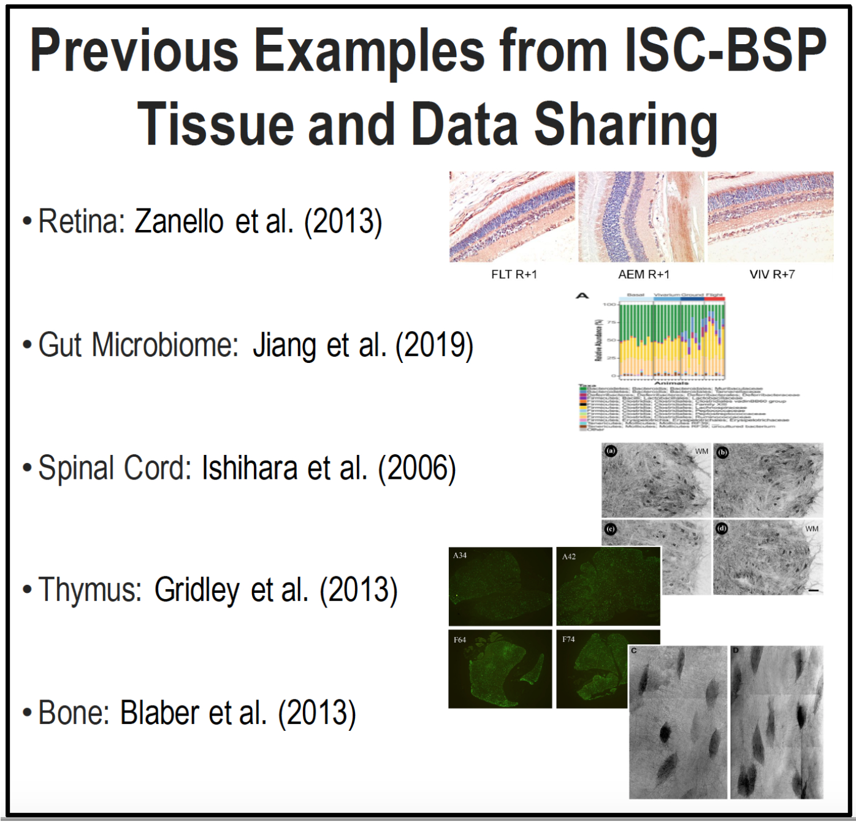
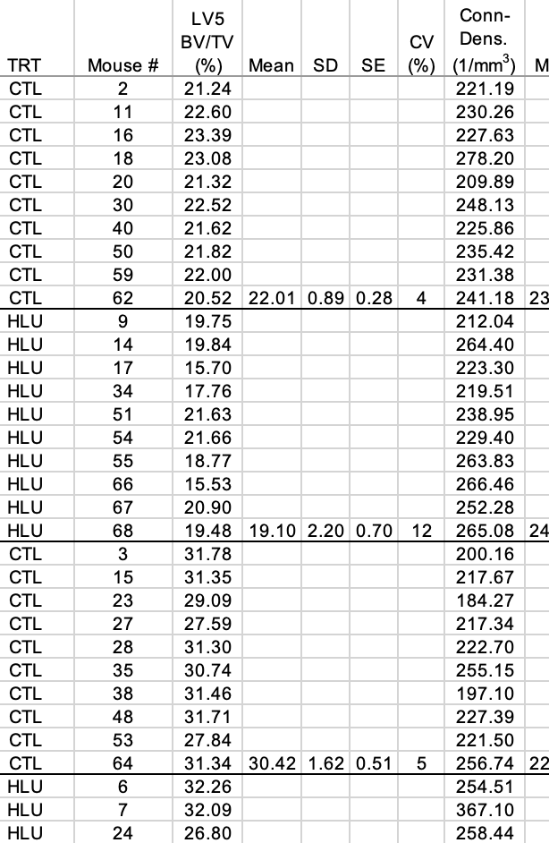
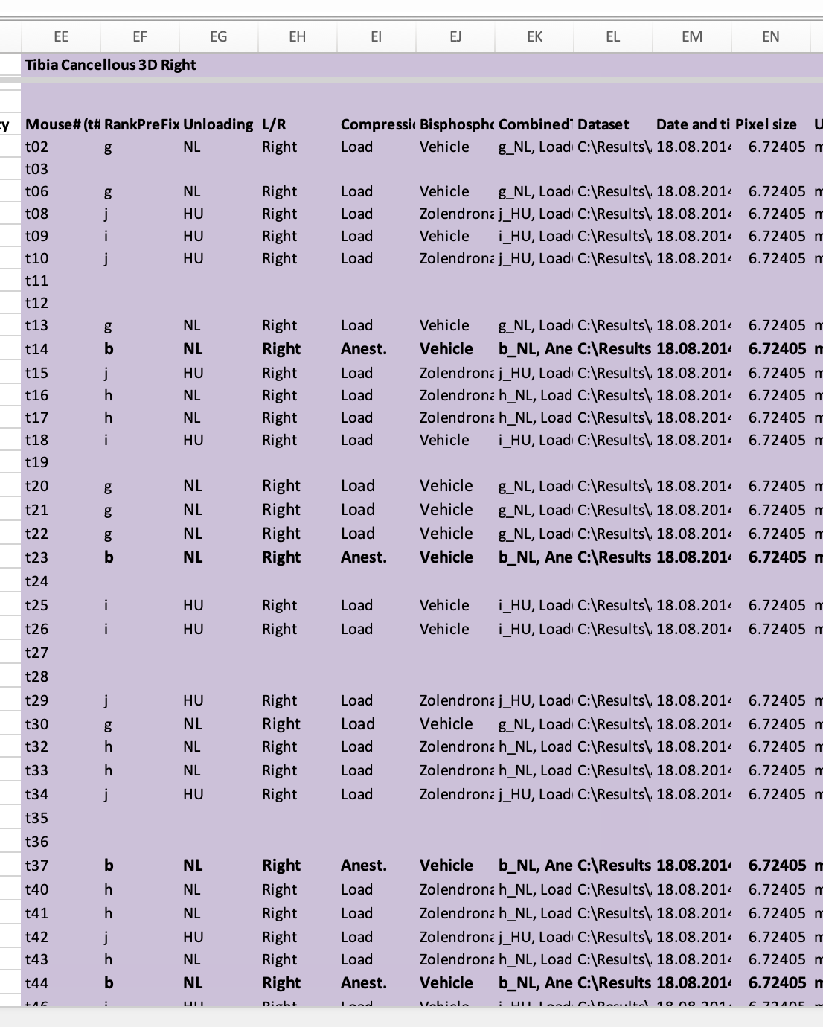
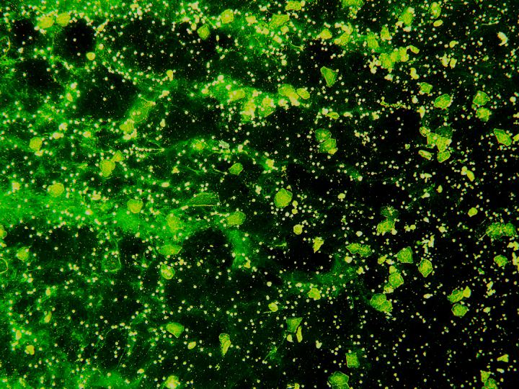
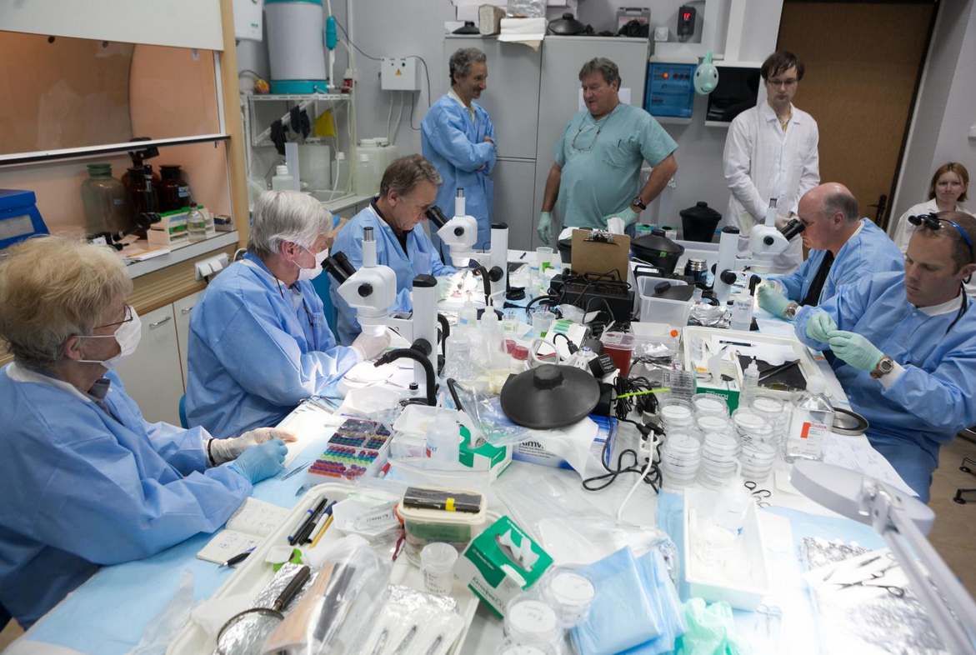
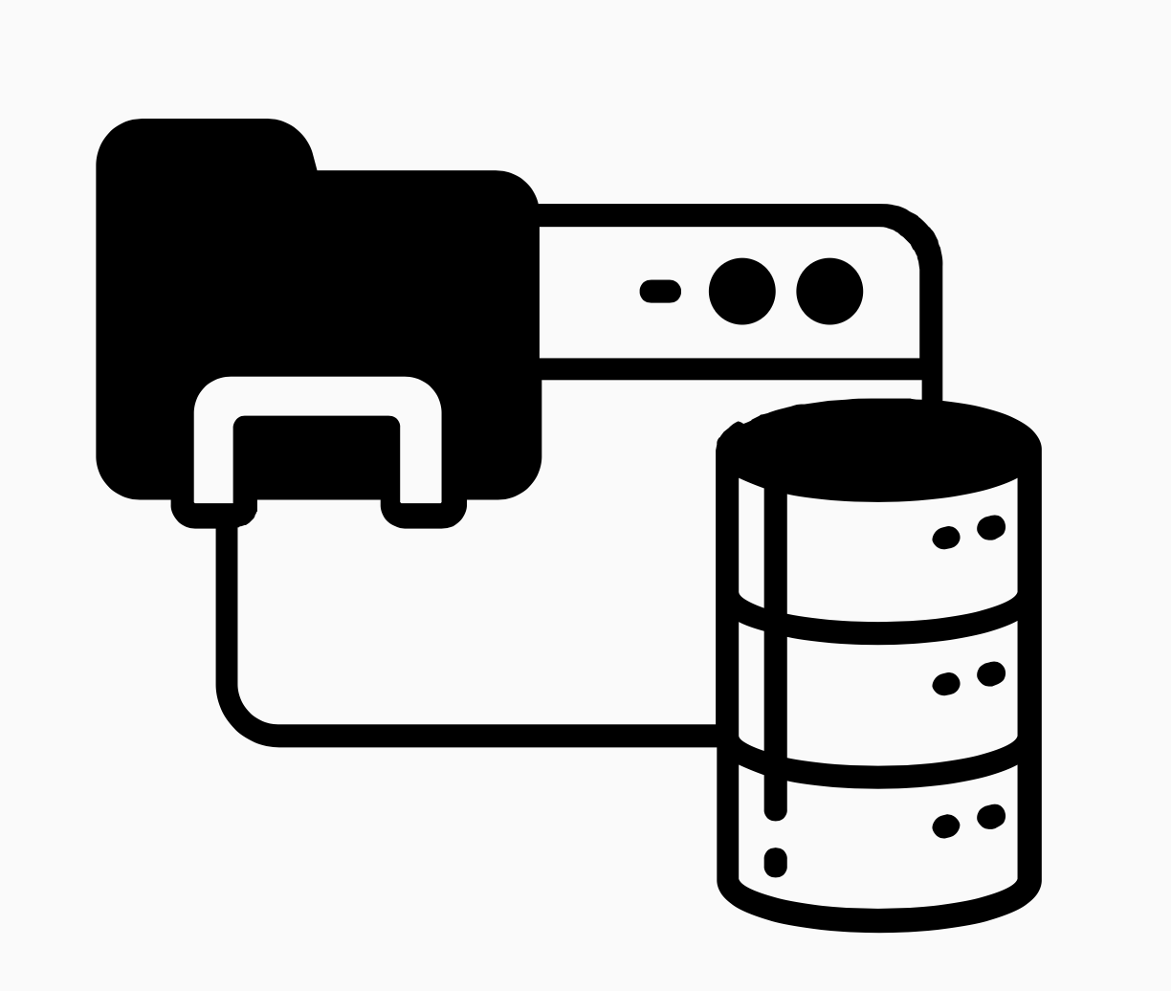
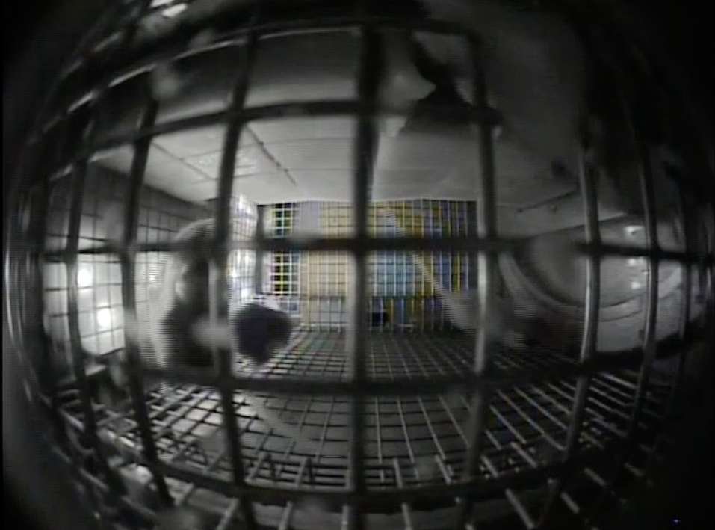
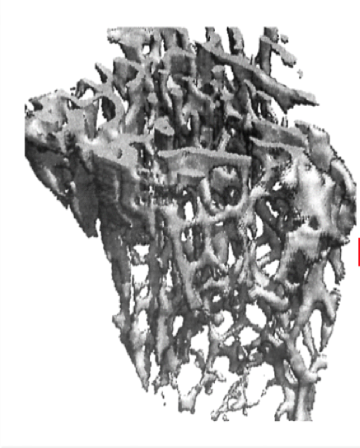
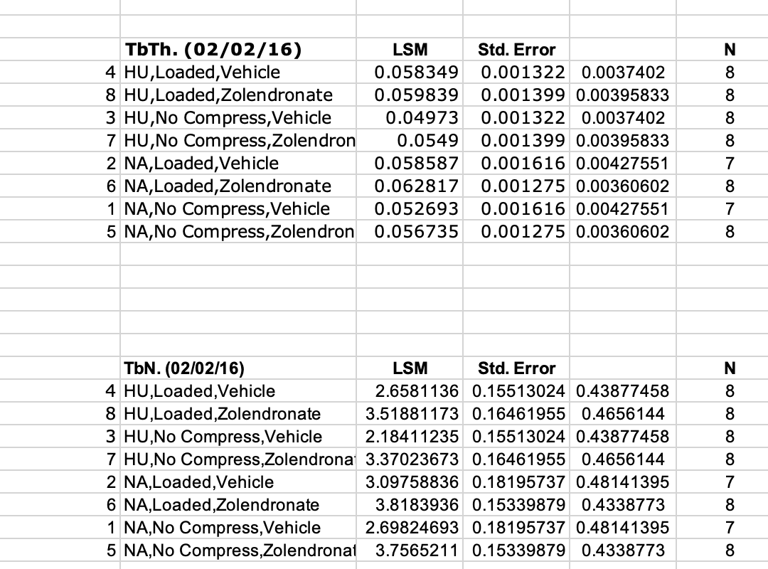





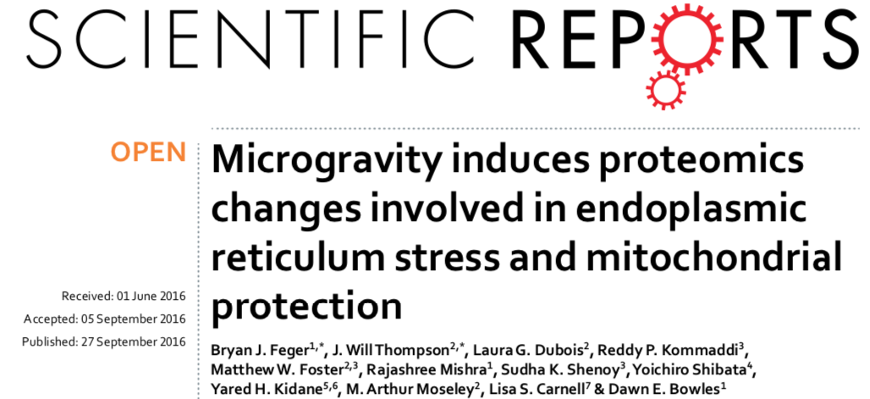
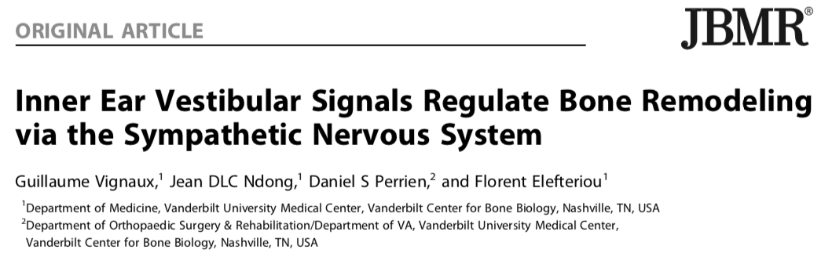
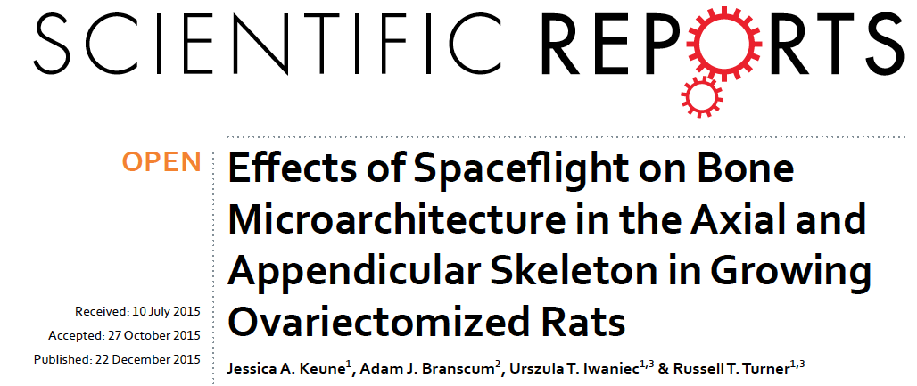
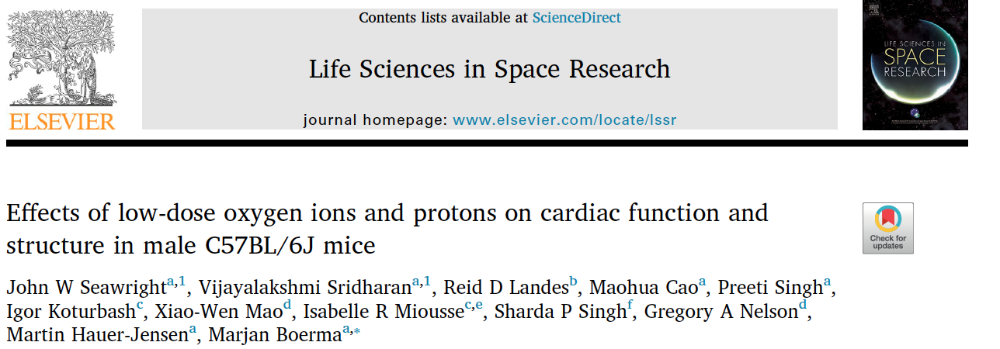
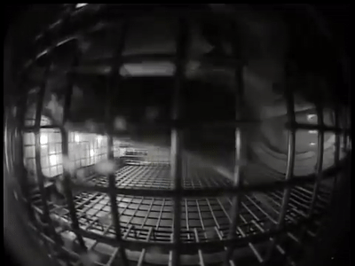
Non-Human Experiment Data and Biospecimen Collection
HRP and SB Primary
Investigators agree to submit their Data
Data and Descriptions from >900 Experiments
Space flown
Ground analogs
~32,000 Non-Human Biospecimens
Raw Data from Assays
ISC-ARC
Data Imagery, Video
metadata
Statistically Processed Data
ALSDA
specimens
Publications
sharing
Resulted in 33 publications since 2011. 44 tissue requests since 2016
sharing
40 data and 38 video requests fulfilled since 2016
(Ronca et al., 2019)
Notes:
Changed Imagery to Photographs – photographs and video are imagery so use one or the other
Changed Experimental to Experiment

Slide 8
Biospecimen
Availability
Notes:
Changed Imagery to Photographs – photographs and video are imagery so use one or the other
Changed Experimental to Experiment

Slide 9
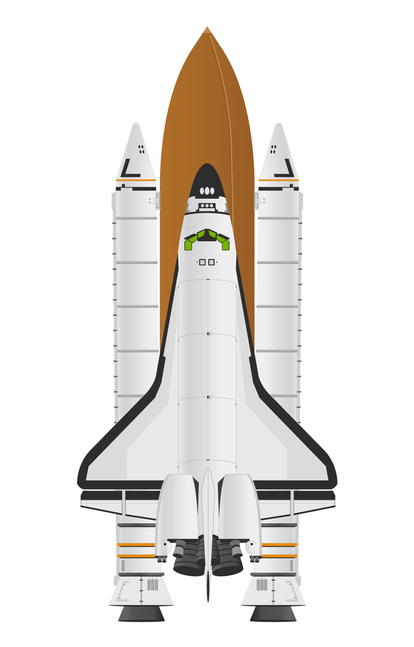
Biospecimen Challenge:
Add Omics/Molecular Chapters to Previous Research
Earlier Studies (Mostly Shuttle Missions)
  Experiments with little or no omics-level molecular analyses. Many studies still have tissues and blood available
  Approach usage of samples through examining data/results from previous experiments
EXAMPLE: SLS-1 Science Focus Tied to Rat Blood (10 relevant studies)
  Erythropoiesis, BV, Plasma Biochem, Erythrocyte, White Blood Cells.
  Several other Endocrine-related studies: Pituitary Somatatropic Cells, Lipid Peroxidation,
  Antioxidants, Norepinephrine, Vasopressin, ANP binding-site analysis
  Samples stored LN2 -80C, since August/September of 1991
    Male, Sprague-Dawley, duration 9-day 3hr, Age 65 days (at dissection)
    Variables: AEM/B, AEM/GC, AEM/GC+9, AEM/F, AEM/F+9 (recovery)
  SF adaptations? New insights through omics/molecular processing
    Proteomics - expected to maintain? microRNAs?
    DNA – genomics? Expecting SF induced SNPS/mutations in 9 days?
    SC sequencing DNA? Lipids/membranes?
    2018 study on RIN ISC-archive suggested RNA degradation
    from liver tissues (90s cohort). Quality and long-term stability
    Gene expression confound? (Stress related to re-entry of subject)
Notes:
Changed Imagery to Photographs – photographs and video are imagery so use one or the other
Changed Experimental to Experiment

Slide 10
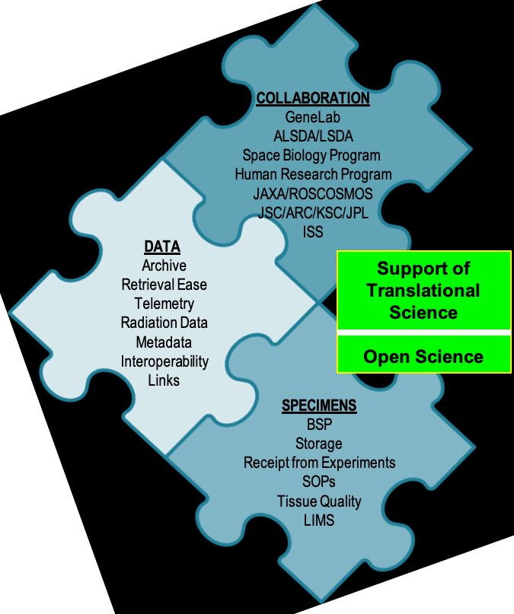
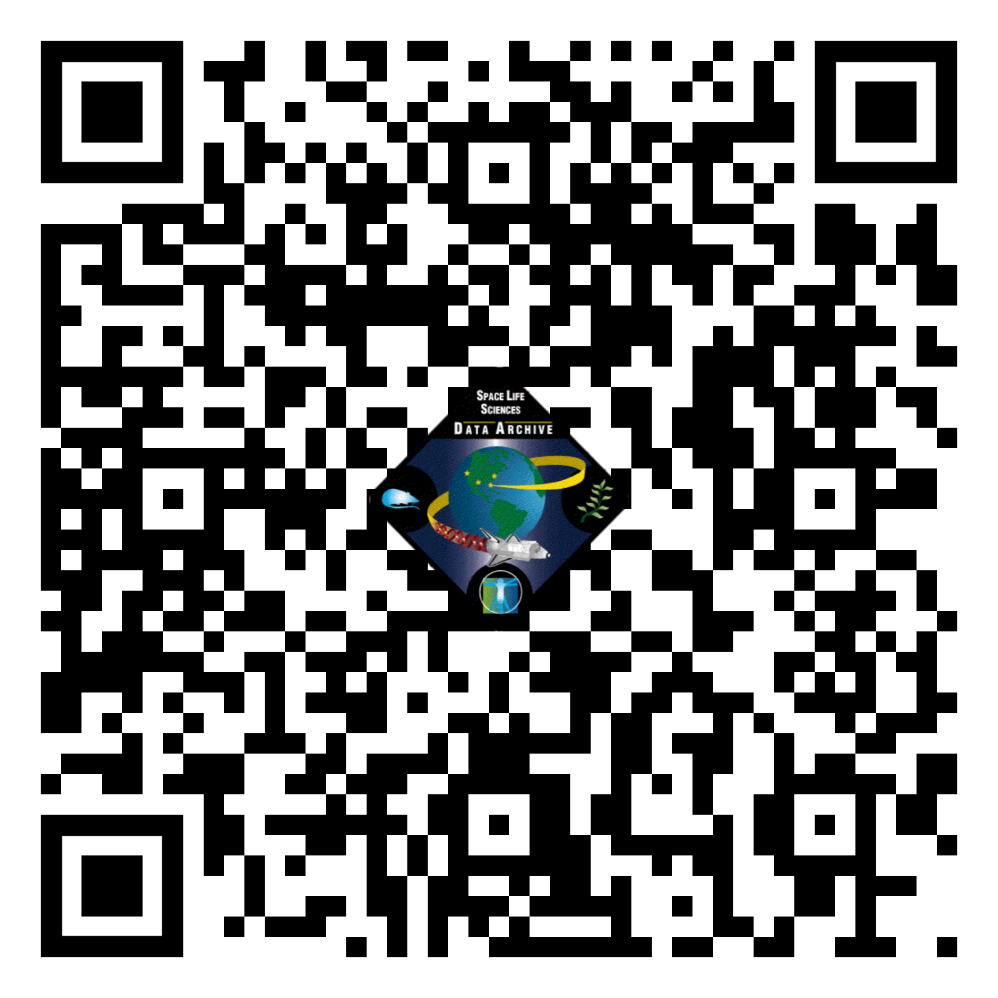

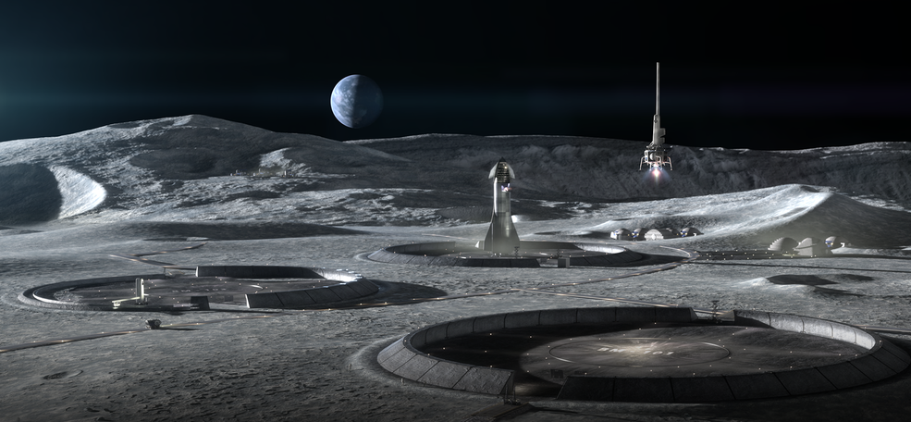
Acknowledgements: A TEAM EFFORT
Thanks to ARC LSDA: Alison French, Danielle Lopez, Elizabeth Keller, Alan Wood, April Gage, William Mcdermott, Sandeep Shetye, Martha Del Alto
Thanks to ARC SB BSP: Rebecca Klotz, America Reyes
Thanks to Diedre Thomas, Jessica Keune, Mary Van Baalen, Macresia Alibaruho (JSC), Deepak Kulkarni, Richard Mains, Sam Gebre, Sylvain Costes, Afshin Beheshti (ARC), Human Research Program, Laura Lewis, Chris Maese, Space Biology Program, Rob Vik, Diana Ly, Parag Vaishampayan, ARC GeneLab
(ICON/SEArch+ 2020)
Biospecimens: https://www.nasa.gov/ames/research/space-biosciences/isc-bsp
Data: https://www.nasa.gov/ames/research/space-biosciences/alsda
LSDA Portal: https://lsda.jsc.nasa.gov/
Notes:
Changed Imagery to Photographs – photographs and video are imagery so use one or the other
Changed Experimental to Experiment

