Slide 1
Prediction-based Auralization of the RVLT Quadrotor Reference Vehicle
Siddhartha Krishnamurthy
Structural Acoustics Branch
NASA Langley Research Center
Urban Air Mobility Noise Working Group, November 5, 2020

Slide 2
Contributors
Stephen A. Rizzi, Aeroacoustics Branch, NASA Langley Research Center
Rui Cheng, National Institute of Aerospace
Doug Boyd, Aeroacoustics Branch, NASA Langley Research Center
Brian C. Tuttle, Analytical Mechanics Associates, Inc.
Leonard V. Lopes, Aeroacoustics Branch, NASA Langley Research Center
Andrew W. Christian, Structural Acoustics Branch, NASA Langley Research Center
Aric R. Aumann, Analytical Services and Materials, (Science Applications International Corporation before November 1, 2020).

Slide 3
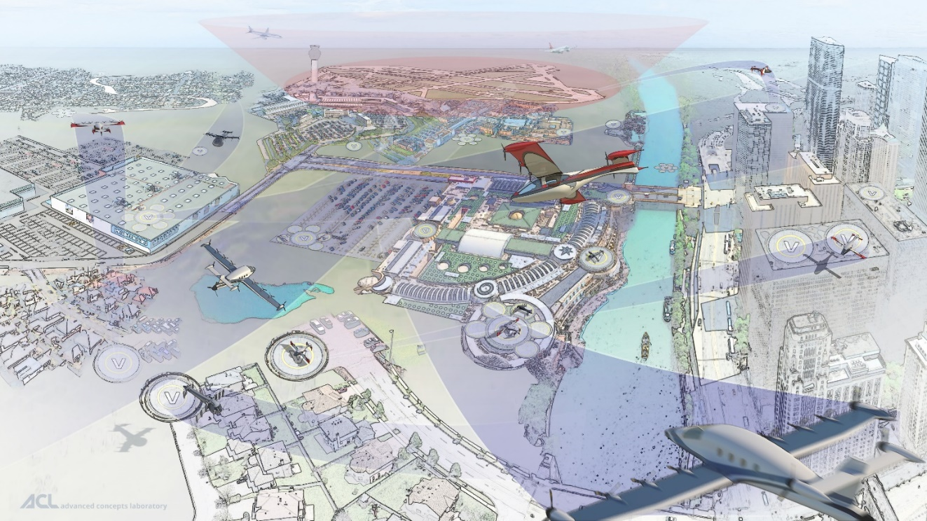
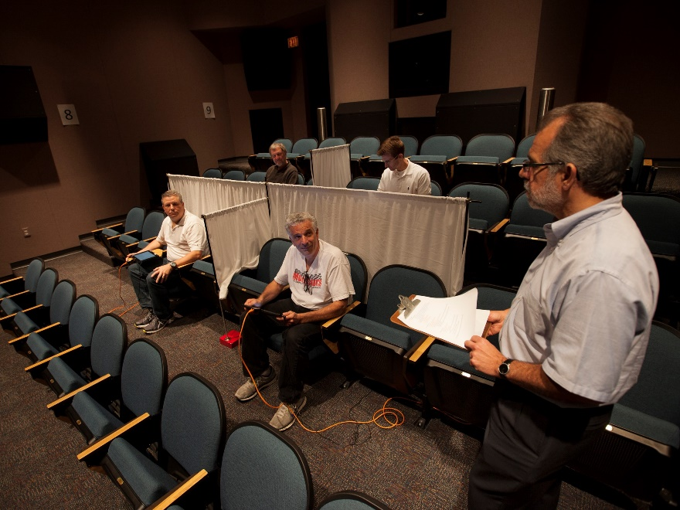
Motivation
Need to understand community response to noise from future advanced air mobility vehicles
Play recorded or auralized sounds of these aircraft in NASA Langley Exterior Effects Room to test subjects
  Auralizations: sounds generated from numerical data
From NASA Advanced Air Mobility National Campaign Overview website
Exterior Effects Room, NASA Langley Research Center

Slide 4
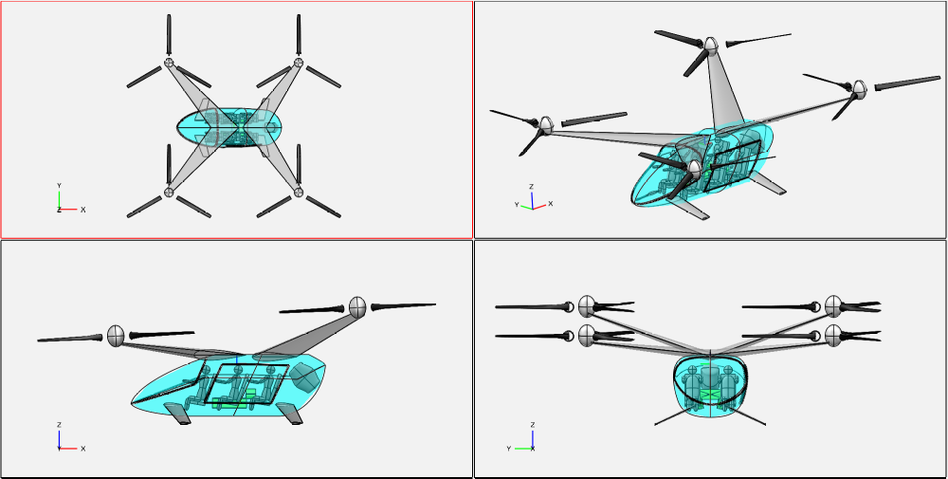
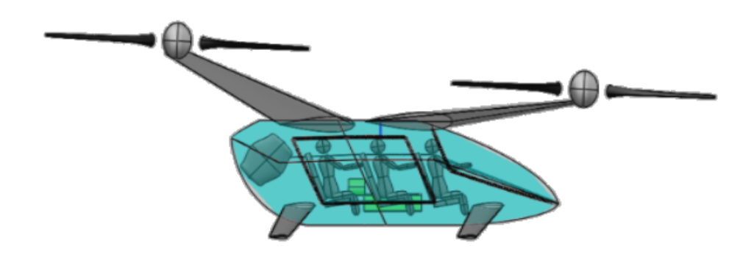

Quadrotor Flyover
Auralize straight and level flyover of NASA Quadrotor eVTOL concept
46.3 m/s (90 KIAS)
7.15$°$
1000 ft
(Not to Scale)
0.36 miles
0.36 miles
Start Position
Ground
Observer Flush with Ground
End Position

Slide 5
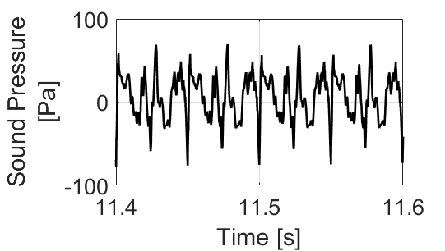
Auralization Process
Flyover auralization consists of obtaining input blade data, predicting sound pressures near the source, and propagation of sound pressures to a ground observer.
At/Near Source
Input Blade Data
Sound Pressure Predictions
Flyover Sound Synthesis
Propagate Synthesized Sound
At Ground Observer
Complete Auralization
:
:
:

Slide 6
Quadrotor Source Noise Predictions
Quadrotor flyover auralization to include sounds from both tonal periodic and broadband self-noise predictions.
Sound Pressure Prediction, ANOPP2
NASA Auralization Framework (NAF)
with F1A Synthesis Plugin
Input Blade Data
Sum at ground observer
Blade Loadings & Motions
Tonal Periodic (AF1AIFM)
Flyover Sound Synthesis
Propagate Synthesized Sound
CAMRAD II (for this effort)
Blade Inflow Velocity & Eff. Angle of Attack
Broadband Self Noise (ASNIFM)
Flyover Sound Synthesis
Propagate Synthesized Sound
Sum with sounds from other rotors to complete auralization

Slide 7
NAF F1A Synthesis Plugin
F1A Synthesis plugin provides greater audible fidelity for synthesized tonal sounds from rotors compared to earlier additive synthesis method.
  Proof of Concept: Krishnamurthy, S., Tuttle, B.C., and Rizzi, S.A., “Auralization of Unsteady Rotor Noise using a Solution to the Ffowcs Williams-Hawkings Equation,” Paper 48, Proceedings of the 75th Annual Forum, Vertical Flight Society, 2019.
  Plugin for NAF: Krishnamurthy, S., Tuttle, B.C., and Rizzi, S.A., “A Synthesis Plug-in for Steady and Unsteady Loading and Thickness Noise Aurlaization,” Paper 2597, AIAA Aviation Forum, 2020.

Slide 8
Quadrotor Source Noise Predictions
Quadrotor flyover auralization to include sounds from both tonal periodic and broadband self-noise predictions.
Sound Pressure Prediction, ANOPP2
NASA Auralization Framework (NAF)
with F1A Synthesis Plugin
Input Blade Data
Sum at ground observer
Blade Loadings & Motions
Tonal Periodic (AF1AIFM)
Flyover Sound Synthesis
Propagate Synthesized Sound
CAMRAD II (for this effort)
Blade Inflow Velocity & Eff. Angle of Attack
Broadband Self Noise (ASNIFM)
Flyover Sound Synthesis
Propagate Synthesized Sound
Propagation in NAF
Newly available Self Noise Internal Functional Module (ASNIFM)
Prototype Synthesis Process
Sum with sounds from other rotors to complete auralization

Slide 9
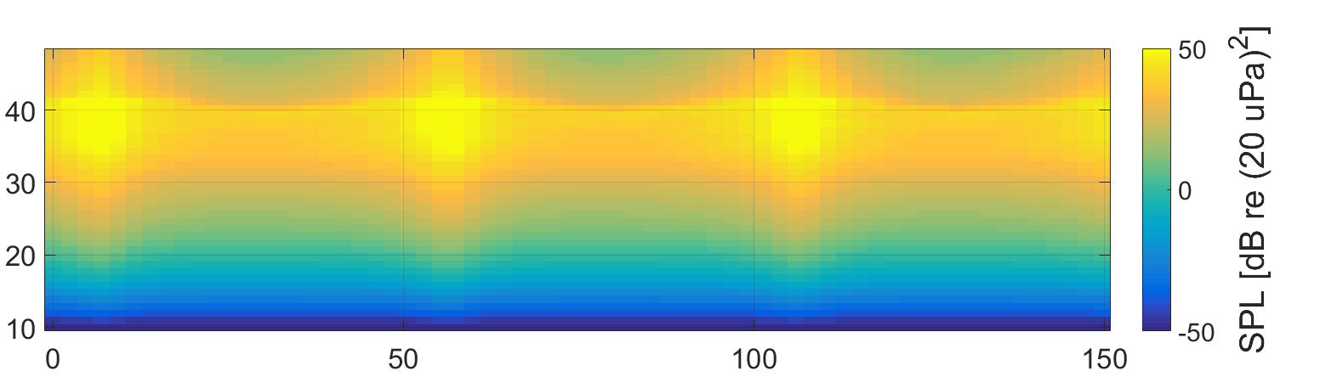
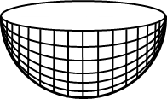
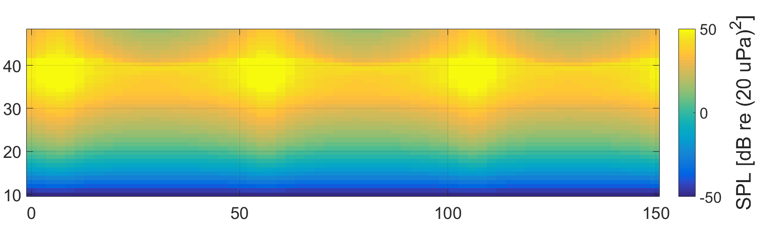
Broadband Self Noise Sound Pressure Predictions
Self noise sound pressure predictions from ANOPP2 are sound pressure levels in each 1/3 octave band as a function of time over a single rotor revolution.
1/3 Octave Band Number
Band Number
Band Number
Time [ms]
Single Rotor Revolution

Slide 10
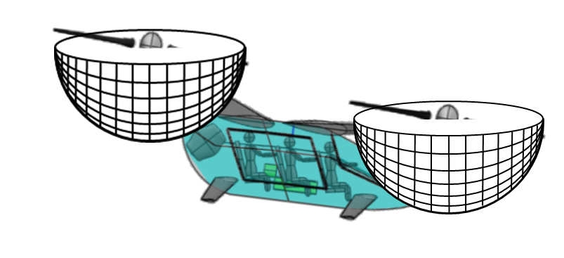
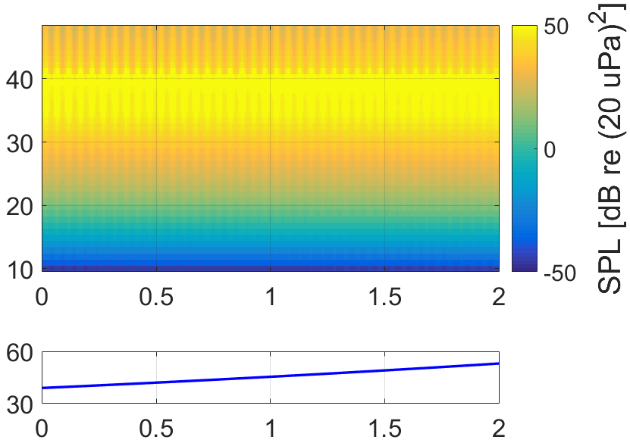
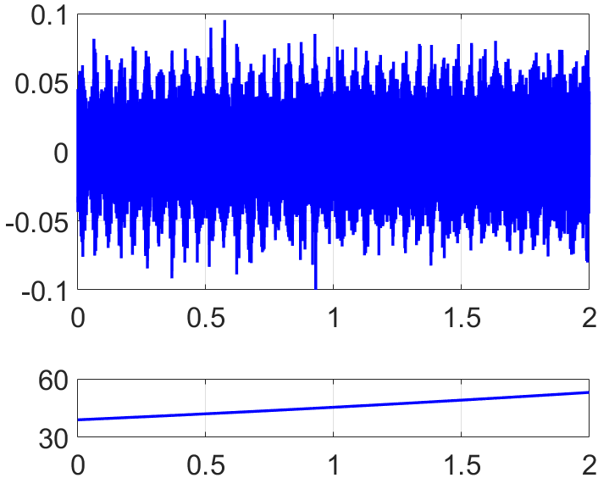



Self Noise Flyover Sound Synthesis
Generate longer sound pressure level data from many single rotor revolution predictions nodes along rotor to ground observer flyover emission angles.
Modulate bandlimited stochastic signal by the longer sound pressure level prediction data to generate synthesized self noise rotor sound.
Sound Pressure Level Prediction Data Formed by Interpolating Over Single Rotor Revolution Data
Synthesized Sound Near Rotor to Propagate to Ground Observer
Band Number
Pressure [Pa]
$$θ$$
Ground
Ground Observer
$θ$[deg]
$θ$[deg]
Flyover Duration [s]
Flyover Duration [s]

Slide 11
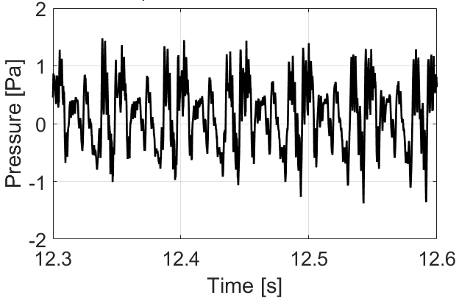
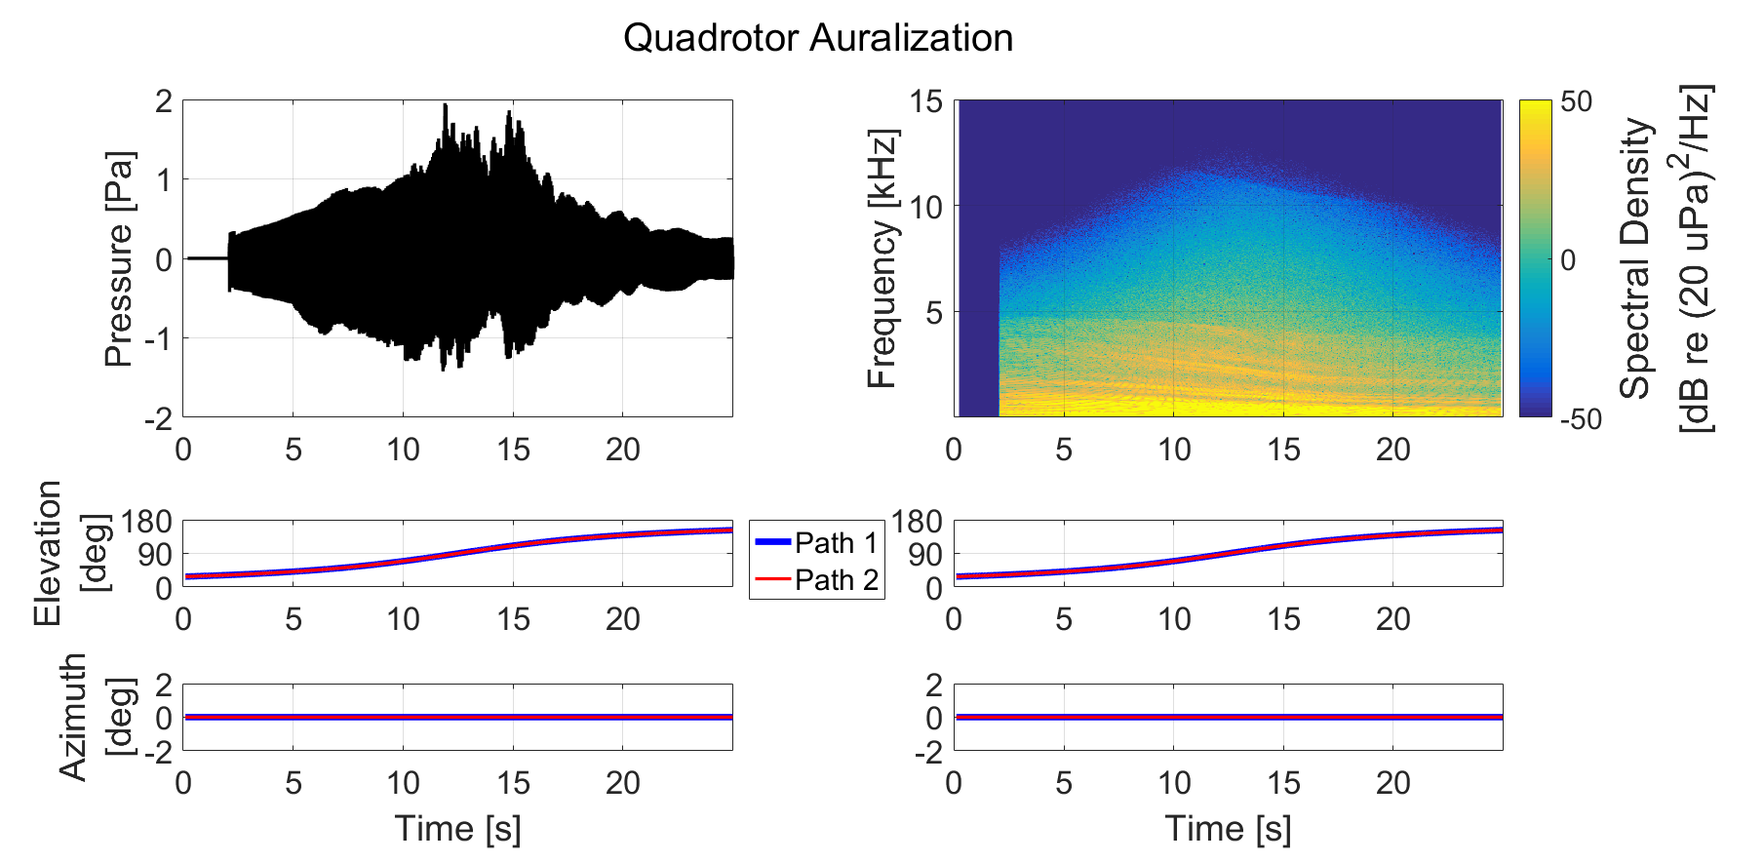
Auralization of Quadrotor Flyover
Quadrotor auralized by combining tonal periodic and broadband self noise sounds from all four rotors.
Sound file for auralization available online at https://stabserv.larc.nasa.gov/flyover/.

Slide 12
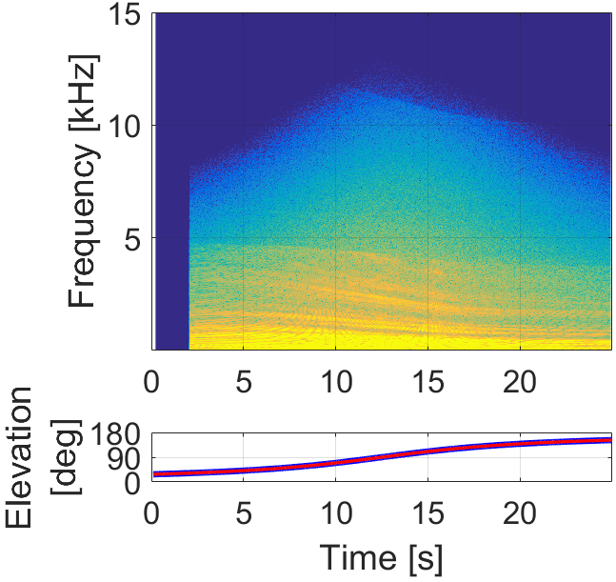
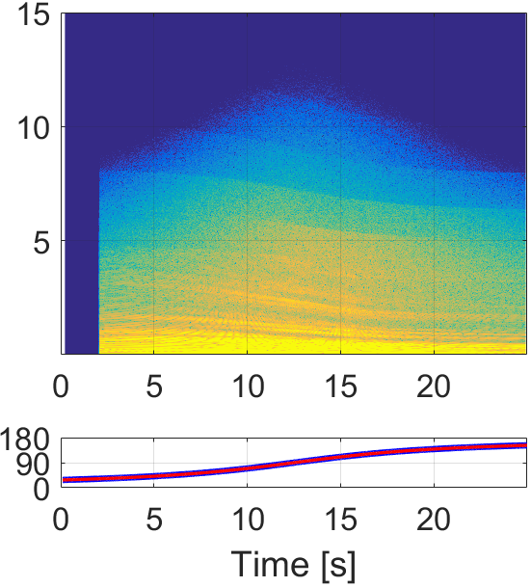
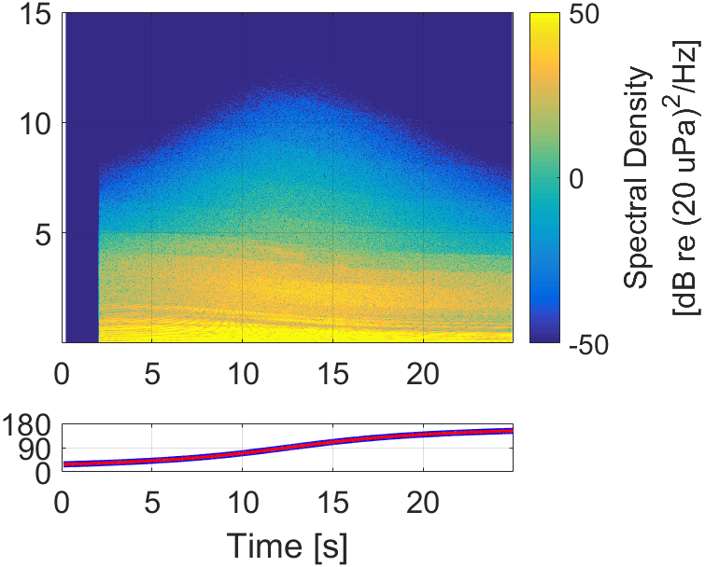
Changing Trailing Edge Thickness
Changing blade trailing edge thickness affects self noise and produces noticeable audible differences in full Quadrotor (all four rotors, tonal periodic and self noise) auralizations.
Audible sounds, including 0.9 mm Trailing Edge Thickness case, available online at https://stabserv.larc.nasa.gov/flyover/.
1.8 mm Trailing Edge Thickness
3.6 mm Trailing Edge Thickness
7.2 mm Trailing Edge Thickness

Slide 13
Summary
NASA Quadrotor eVTOL concept auralized for level flyover using tonal periodic and broadband self noise sounds.
Auralization would have been challenging without different components for blade data generation, acoustic prediction, sound synthesis, and sound propagation developed and working together.
  Key development for auralization of tonal sound synthesis: newly implemented NAF F1A Synthesis plugin, will be available in an upcoming NAF release.
  Self noise auralization process developed as proof of concept, will be implemented as NAF plugin and eventually be available in a NAF release.
Changing blade trailing edge thickness can have noticeable audible effects on self noise.
Upcoming publications on self noise:
  Krishnamurthy, S. and Rizzi, S.A., “Prediction-Based Auralization of a Multirotor Urban Air Mobility Vehicle.” AIAA SciTech Forum, 2021.
  Will be submitting abstract to AIAA Aviation 2021 on implementing broadband self noise synthesis as a NAF plugin.

Slide 14

Acknowledgements and Thank You
  Sound files are available for download at:
  http://stabserv.larc.nasa.gov/flyover/
Quadrotor auralization was performed with support from the Transformational Tools & Technologies Project of the NASA Transformative Aeronautics Concepts Program.
Developing the NAF F1A Synthesis plugin and self noise synthesis method were performed with support from the Revolutionary Vertical Lift Technology Project of the NASA Advanced Air Vehicles Program.
Email: siddhartha.krishnamurthy@nasa.gov

Slide 15
Image References
Slide 3:
  Urban Air Mobility artwork is from NASA Advanced Air Mobility National Campaign Overview website, https://www.nasa.gov/aeroresearch/aam/description/.
  Picture of Exterior Effects room provided by Steve Rizzi, NASA Langley Research Center.
Slides 4-6 and 8-10:
  Quadrotor pictures from Silva, C., et al., “VTOL Urban Air Mobility Concept Vehicles for Technology Development.” Paper 3847. 2018 Aviation Technology, Integration, and Operations Conference, Atlanta, GA, 2018.
All other images generated by presenter (Siddhartha Krishnamurthy).

Slide 16
Backup Slides

Slide 17
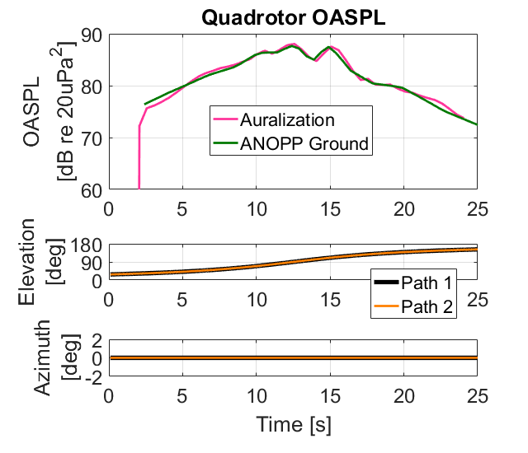
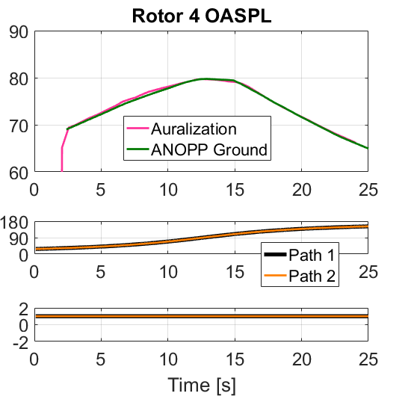
Checking Auralization
Overall sound pressure level (OASPL), 50 Hz – 10 kHz, compared between auralization and ANOPP Ground, tonal periodic and self noise combined.
  (Contributions from all four rotors)
Pressure Time History
Synthesis, Propagation, and Auralization
Input Blade Data
ANOPP2 Sound Pressure Predictions
1/3 Octave Band Spectrum
ANOPP Ground
  Similar OASPL traces for other three rotors

