Slide 1

Latest Release of Fast PCBoom Code for Sonic Boom Propagation
Acoustics Technical Working Group
Fall Meeting (Virtual)
Nov 3, 2020
Joel B Lonzaga*, Will Doebler, Alexandra Loubeau, and Aric Aumann (SAIC)
NASA Langley Research Center
Hampton, Virginia
Juliet Page and Meghan Shumway
Volpe Center
U.S. Department of Transportation
Cambridge, Massachusetts
*joel.b.lonzaga@nasa.gov

Slide 2
Background
PCBoom 6.7b (Legacy)
(Released in 2016)
Utility and Limitations (Early developments)
Utility
Flight planning in previous flight tests
  CarpetDIEM at AFRC
  QSF18 in Galveston, Texas
  SonicBAT at AFRC and KSC
For flight planning, leading order sonic boom waveform predictions
  Military aircraft
Built-in initial signature algorithms
  Based on Carlson F-function
  With CFD calculation, but not required
Prediction of ground-ray
  intersections
Limitations
Lossless’ Burgers Solver
  Fast but less accurate
  Only nonlinear effects, no atmospheric absorption effects
  Use of post-processors to apply artificial absorptions for noise metric calculations
Lossy Burgers solver (PCBurg)
  Slow and a little less accurate
  Nonlinear and atmospheric absorption effects
  No Doppler shift in absorption and nonlinearity coefficients
  Anti-Gibbs filter
  Need for constant user inputs

Slide 3
Background
PCBoom 6.7b (Legacy)
(Released in 2016)
Utility and Limitations (Early developments)
Utility
Flight planning in previous flight tests
  CarpetDIEM at AFRC
  QSF18 in Galveston, Texas
  SonicBAT at AFRC and KSC
For flight planning, leading order sonic boom waveform predictions
  Military aircraft
  Launch vehicles
Built-in initial signatures
  Algorithms based on Carlson f-function
  With CFD calculation, but not required
Prediction of ground-ray
  intersections
Limitations
Lossless Burgers Solver
  Fast but less accurate
  Only nonlinear effects, no atmospheric absorption effects
  Use of post-processors to apply artificial absorptions for noise metric calculations
Lossy Burgers solver (PCBurg)
  Slow but still less accurate
  Nonlinear and atmospheric absorption effects
  No Doppler shift in absorption and nonlinearity coefficients
  Anti-Gibbs filter
  Need for constant user inputs

Slide 4
Outline: Works to improve functionality, accuracy and speed
Overview of the recent PCBoom development
Works accomplished by Volpe through an IAA
  Modifications, Testing, and User’s Guide
Works done in-house (Enhanced Burgers solver) toward
  Greater accuracy and faster calculations
Validation with the SonicBAT flight test
Remaining Challenges: Turbulence Effects, Focusing, Secondary Boom
Summary

Slide 5
Overview of PCBoom 7.1 Development
PCBoom 7.1.0
(Release approval ongoing)
In-house Contribution
Increase in speed of Burgers equation solver
  From minutes to subsecond
Full wind effects
  Attenuation
  Nonlinearity coefficient
Better prediction of
  Ground-ray intersection
  Carpet width
Algorithm for asymmetrical initial pressure signature cylinder
Testing and bug fixes
NASA Partners Contributions
Volpe
  Initial pressure signature cylinder formats
  Updates for better LNTE interfacing
  Common Intel MKL-based FFT algorithm
  Volpe and SonicBAT versions harmonization
  Boom ref test cases database
  User’s Guide
  Testing and bug fixes
KBR (Wyle) and SonicBAT Partners
  KZK turbulence algorithms and filters
  Classical turbulence algorithm
  Burgers solver for automation (no GUI required)

Slide 6
Overview of PCBoom 7.1 Development
PCBoom 7.1.0
(Release approval ongoing)
In-house Contribution
Increase in speed of Burgers equation solver
  From min to subsecond
Full wind effects
  Attenuation
  Nonlinearity coefficient
Better prediction of
  Ground-ray intersection
  Carpet width
Algorithm for asymmetrical initial pressure signature cylinder
Testing and bug fixes
NASA Partners Contributions
Volpe
  Initial pressure signature cylinder formats
  Updates for better LNTE interfacing
  Common Intel MKL-based FFT algorithm
  Volpe and SonicBAT versions harmonization
  BoomRef test cases database and bug fixes
  User’s Guide
KBR (Wyle) and SonicBAT Partners
  KZK turbulence algorithms and filters
  Classical turbulence algorithm
  Automated Burgers solver (no GUI required)

Slide 7
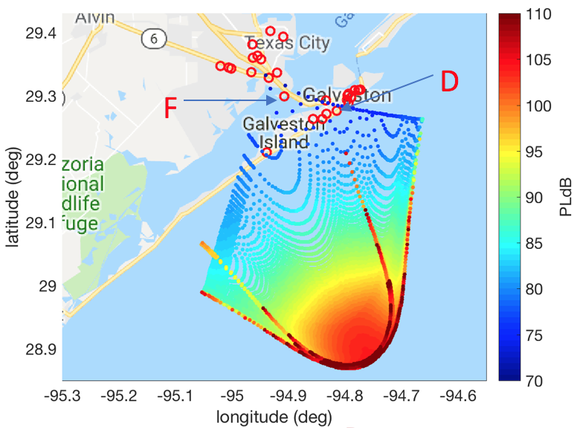
Overview of PCBoom 7.1 Development
PCBoom 7.1.0
(Release approval ongoing)
Future Version
Community testing with X-59
  Propagation code in
    Flight planning tool
    Loudness dose estimation tool
Sonic boom loudness standards development
Supersonic Route Planning
Faster and more accurate sonic boom waveform predictions
  Military aircraft
  Launch vehicles
NEPA Assessments
Utility

Slide 8
Outline: Works to improve functionality, accuracy and speed
Overview of the recent PCBoom development
Works accomplished by Volpe through an IAA
  Modifications, Testing, and User’s Guide
Works done in-house (Enhanced Burgers solver) toward
  Greater accuracy and faster calculations
Validation with the SonicBAT flight test
Future Works: Turbulence Effects, Focusing, Secondary Boom
Summary

Slide 9
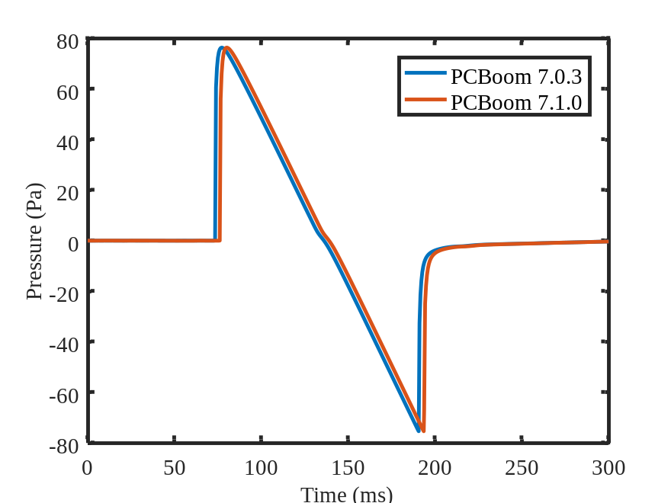
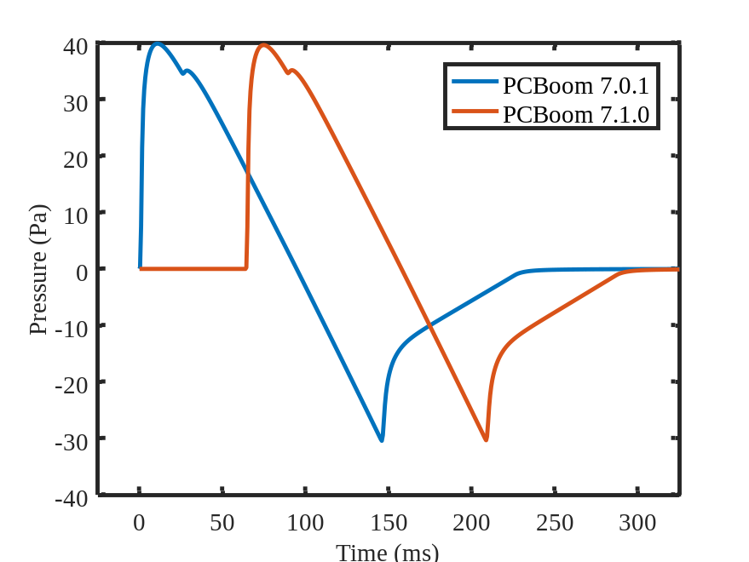
Volpe IAA: Testing of the Legacy PCBoom
Developed 80 BoomRef test cases covering all major PCBoom functions and workflows
  A subset was developed and used in-house to identify and fix bugs
  Test cases were used by Volpe to fully test the legacy portion of v7.1 before submitting for release
  Will continue to be used for testing future modifications to the software
Examples
Case #40: SonicBAT KZK Filters w/CFD Source: SonicBAT Flight3 Pass1
Case #22: SBPW2 Low Boom Cylinder Source

Slide 10
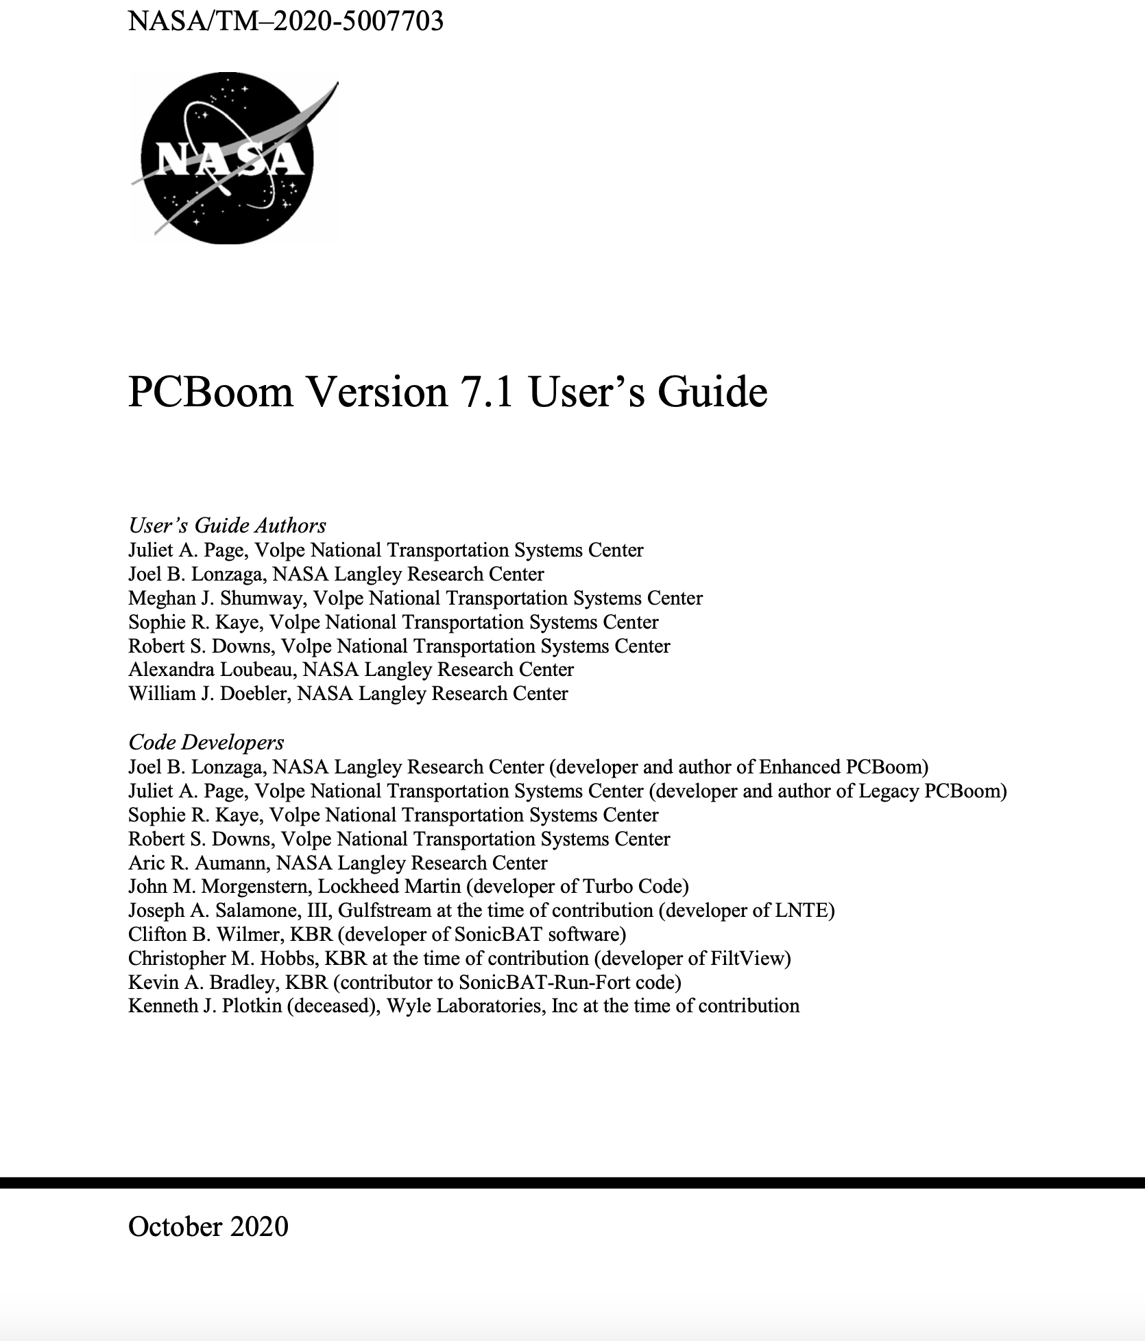
Volpe IAA: PCBoom User’s Guide
About User’s Guide
  First update to documentation since 2010
  New workflows and examples on how to use the PCBoom software suite
  Clarified texts for both novice and experienced users
  Updates for SonicBAT modifications and recent in-house enhancements
Organization by categories of modules within PCBoom
  Section 2: Getting started with PCBoom with systems specifications and
  installation, and an overview of the PCBoom modules and workflows
  Section 3: Primary propagation program, FOBoom
  Section 4: Post-processors PCBurg, PCBFoot, WCON, and Turbo to provide additional calculation and visualization options
  Section 5: Specialized post-processors RayCau, LNTE, OTTER, POTRAY, and POTTI for specialized workflows
  Section 6: Batch processing tool, SonicBAT-Run-Fort, which facilitates calculation of atmospheric turbulence effects
  Appendix: Detailed explanations for running 10 use cases distributed with the software suite

Slide 11
Outline: Works to improve functionality, accuracy and speed
Overview of the recent PCBoom development
Works accomplished by Volpe through an IAA
  Modifications, Testing, and User’s Guide
Works done in-house (Enhanced Burgers solver) toward
  Greater accuracy and faster calculations
Validation with the SonicBAT flight test
Future Works: Turbulence Effects, Focusing, Secondary Boom
Summary

Slide 12
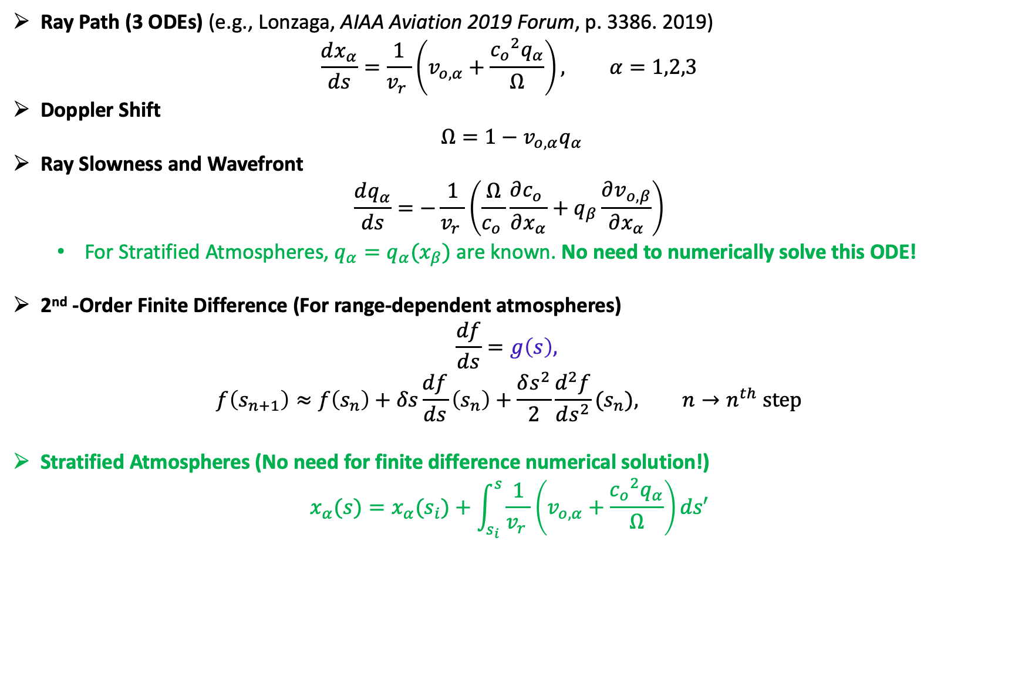
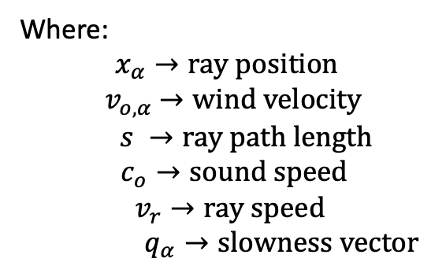
Kinematic Ray Tracing Equations
Ray Path (3 ODEs) (e.g., Lonzaga, AIAA Aviation 2019 Forum, p. 3386. 2019)
$$\frac{dx_{α}}{ds}=\frac{1}{{v_{r}}_{ }}\left(v_{o,α}+\frac{{c_{o}}_{ }^{2}q_{α}}{Ω}\right), α=1,2,3$$
Doppler Shift
$$Ω=1−v_{o,α}q_{α}$$
Ray Slowness and Wavefront
$$\frac{dq_{α}}{ds}=−\frac{1}{{v_{r}}_{ }}\left(\frac{Ω}{{c_{o}}_{ }}\frac{∂{c_{o}}_{ }}{∂x_{α}}+q_{β}\frac{∂v_{o,β}}{∂x_{α}}\right)$$
  For Stratified Atmospheres, $q_{α}=q_{α}(x_{β})$ are known. No need to numerically solve this ODE!
2nd -Order Finite Difference (For range-dependent atmospheres)
$$\frac{df}{ds}=g\left(s\right),$$
$$f\left(s_{n+1}\right)≈f\left(s_{n}\right)+δs\frac{df}{ds}\left(s_{n}\right)+\frac{δs^{2}}{2}\frac{d^{2}f}{ds^{2}}(s_{n}), {n→n}^{th} step$$
Stratified Atmospheres (No need for finite difference numerical solution!)
$$x_{α}(s)=x_{α}^{ }(s_{i})+\int_{s_{i}}^{s}{\frac{1}{{v_{r}}_{ }}\left(v_{o,α}+\frac{{c_{o}}_{ }^{2}q_{α}}{Ω}\right)ds′}$$
Where:
$$x_{α}→ray position$$
$${ v}_{o,α} →wind velocity$$
$$s →ray path length$$
$c_{o}→sound speed$
$$v_{r}→ray speed$$
$q_{α}→slowness vector$

Slide 13
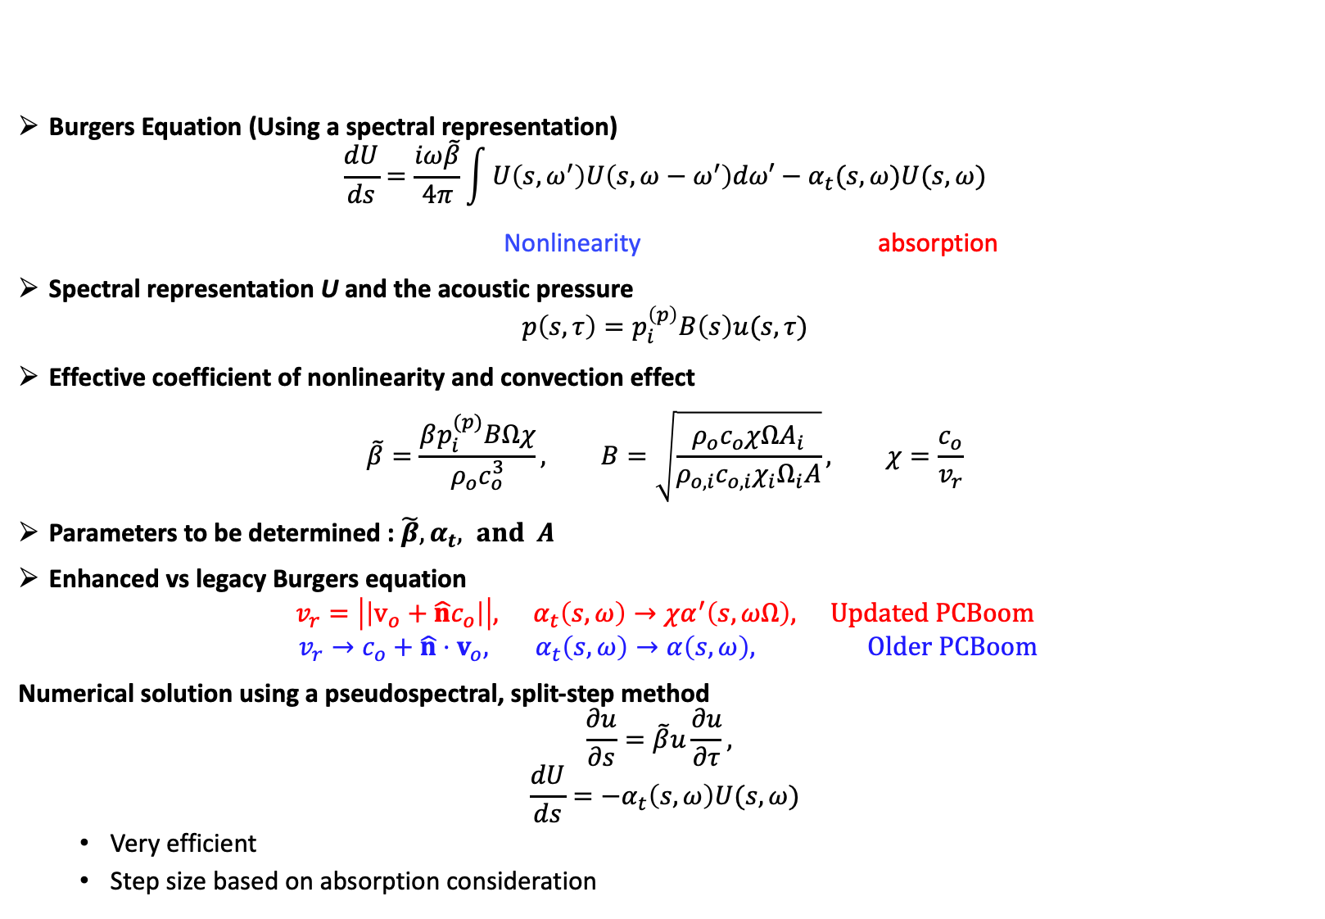
Burgers Equation: Dynamic Ray Tracing
Burgers Equation (Using a spectral representation)
$$\frac{dU}{ds}=\frac{iω\tilde{β}}{4π}\int{U\left({s,ω}^{′}\right)U\left(s,ω−ω^{′}\right)dω′−α_{t}(s,ω)U(s,ω)}$$
              Nonlinearity absorption
Spectral representation U and the acoustic pressure
$$p\left(s,τ\right)=p_{i}^{\left(p\right)}B\left(s\right)u(s,τ)$$
Effective coefficient of nonlinearity and convection effect
$$\tilde{β}=\frac{βp_{i}^{(p)}BΩχ}{ρ_{o}c_{o}^{3}}, B=\sqrt{\frac{ρ_{o}c_{o}χΩA_{i}}{ρ_{o,i}c_{o,i}χ_{i}Ω_{i}A}}, χ=\frac{c_{o}}{v_{r}}$$
Parameters to be determined : $\tilde{β}, α_{t}, and A$
Enhanced vs legacy Burgers equation
$$v_{r}=\left|\left|v_{o}+\hat{n}c_{o}\right|\right|, α_{t}\left(s,ω\right)→χα^{′}\left(s,ωΩ\right), Updated PCBoom$$
$$v_{r}→{c_{o}+\hat{n}⋅v}_{o}, α_{t}\left(s,ω\right)→α\left(s,ω\right), Older PCBoom$$
Numerical solution using a pseudospectral, split-step method
$$\frac{∂u}{∂s}=\tilde{β}u\frac{∂u}{∂τ},$$
$$\frac{dU}{ds}=−α_{t}\left(s,ω\right)U(s,ω)$$
  Very efficient
  Step size based on absorption consideration

Slide 14
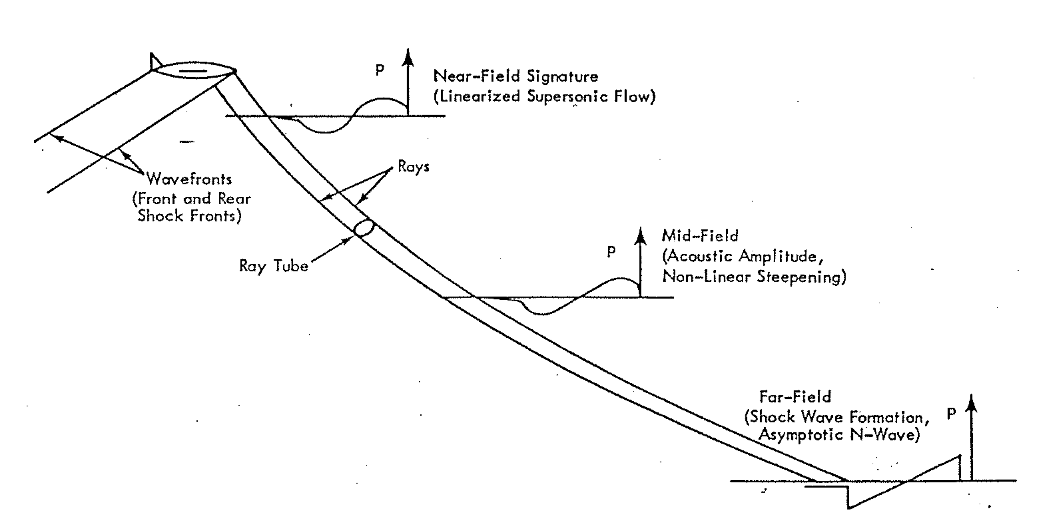
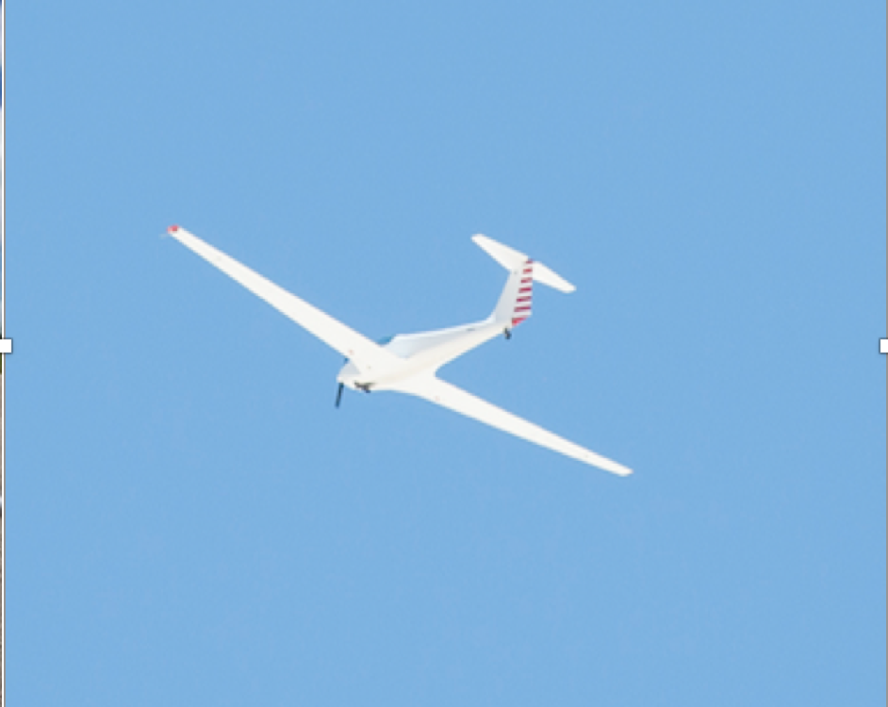
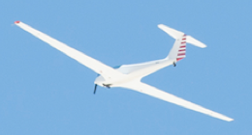
Comparison of Models With SonicBAT Data
F/A-18B
F/A-18B
TG-14 glider
Turbulence Boundary Layer
TG-14 glider
Ground

Slide 15
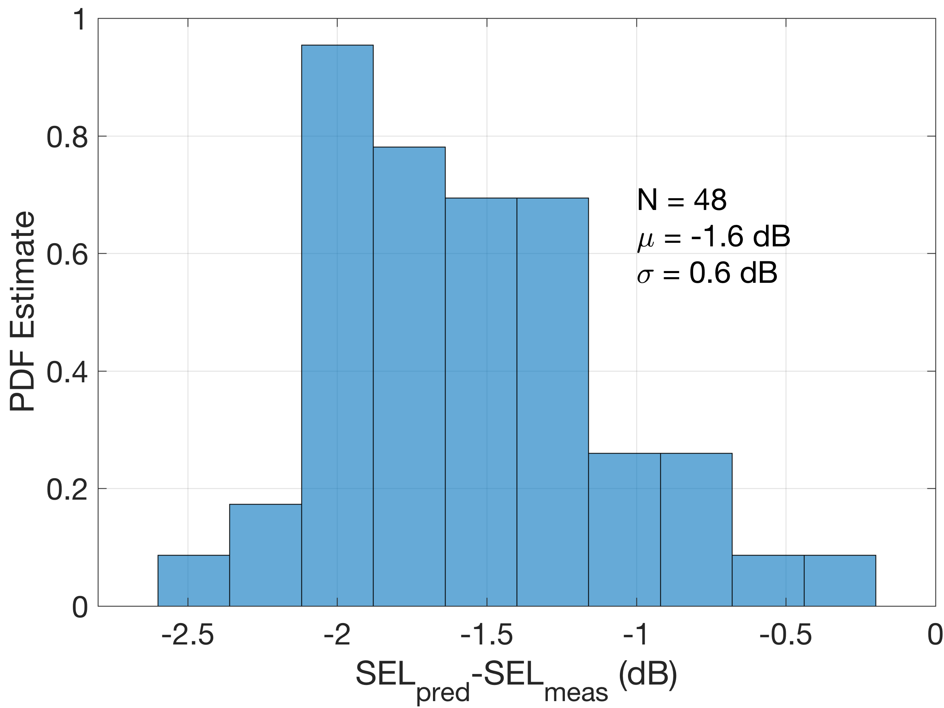
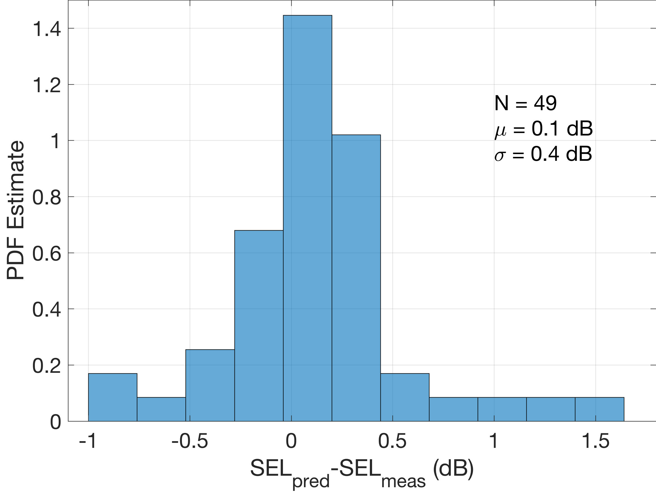
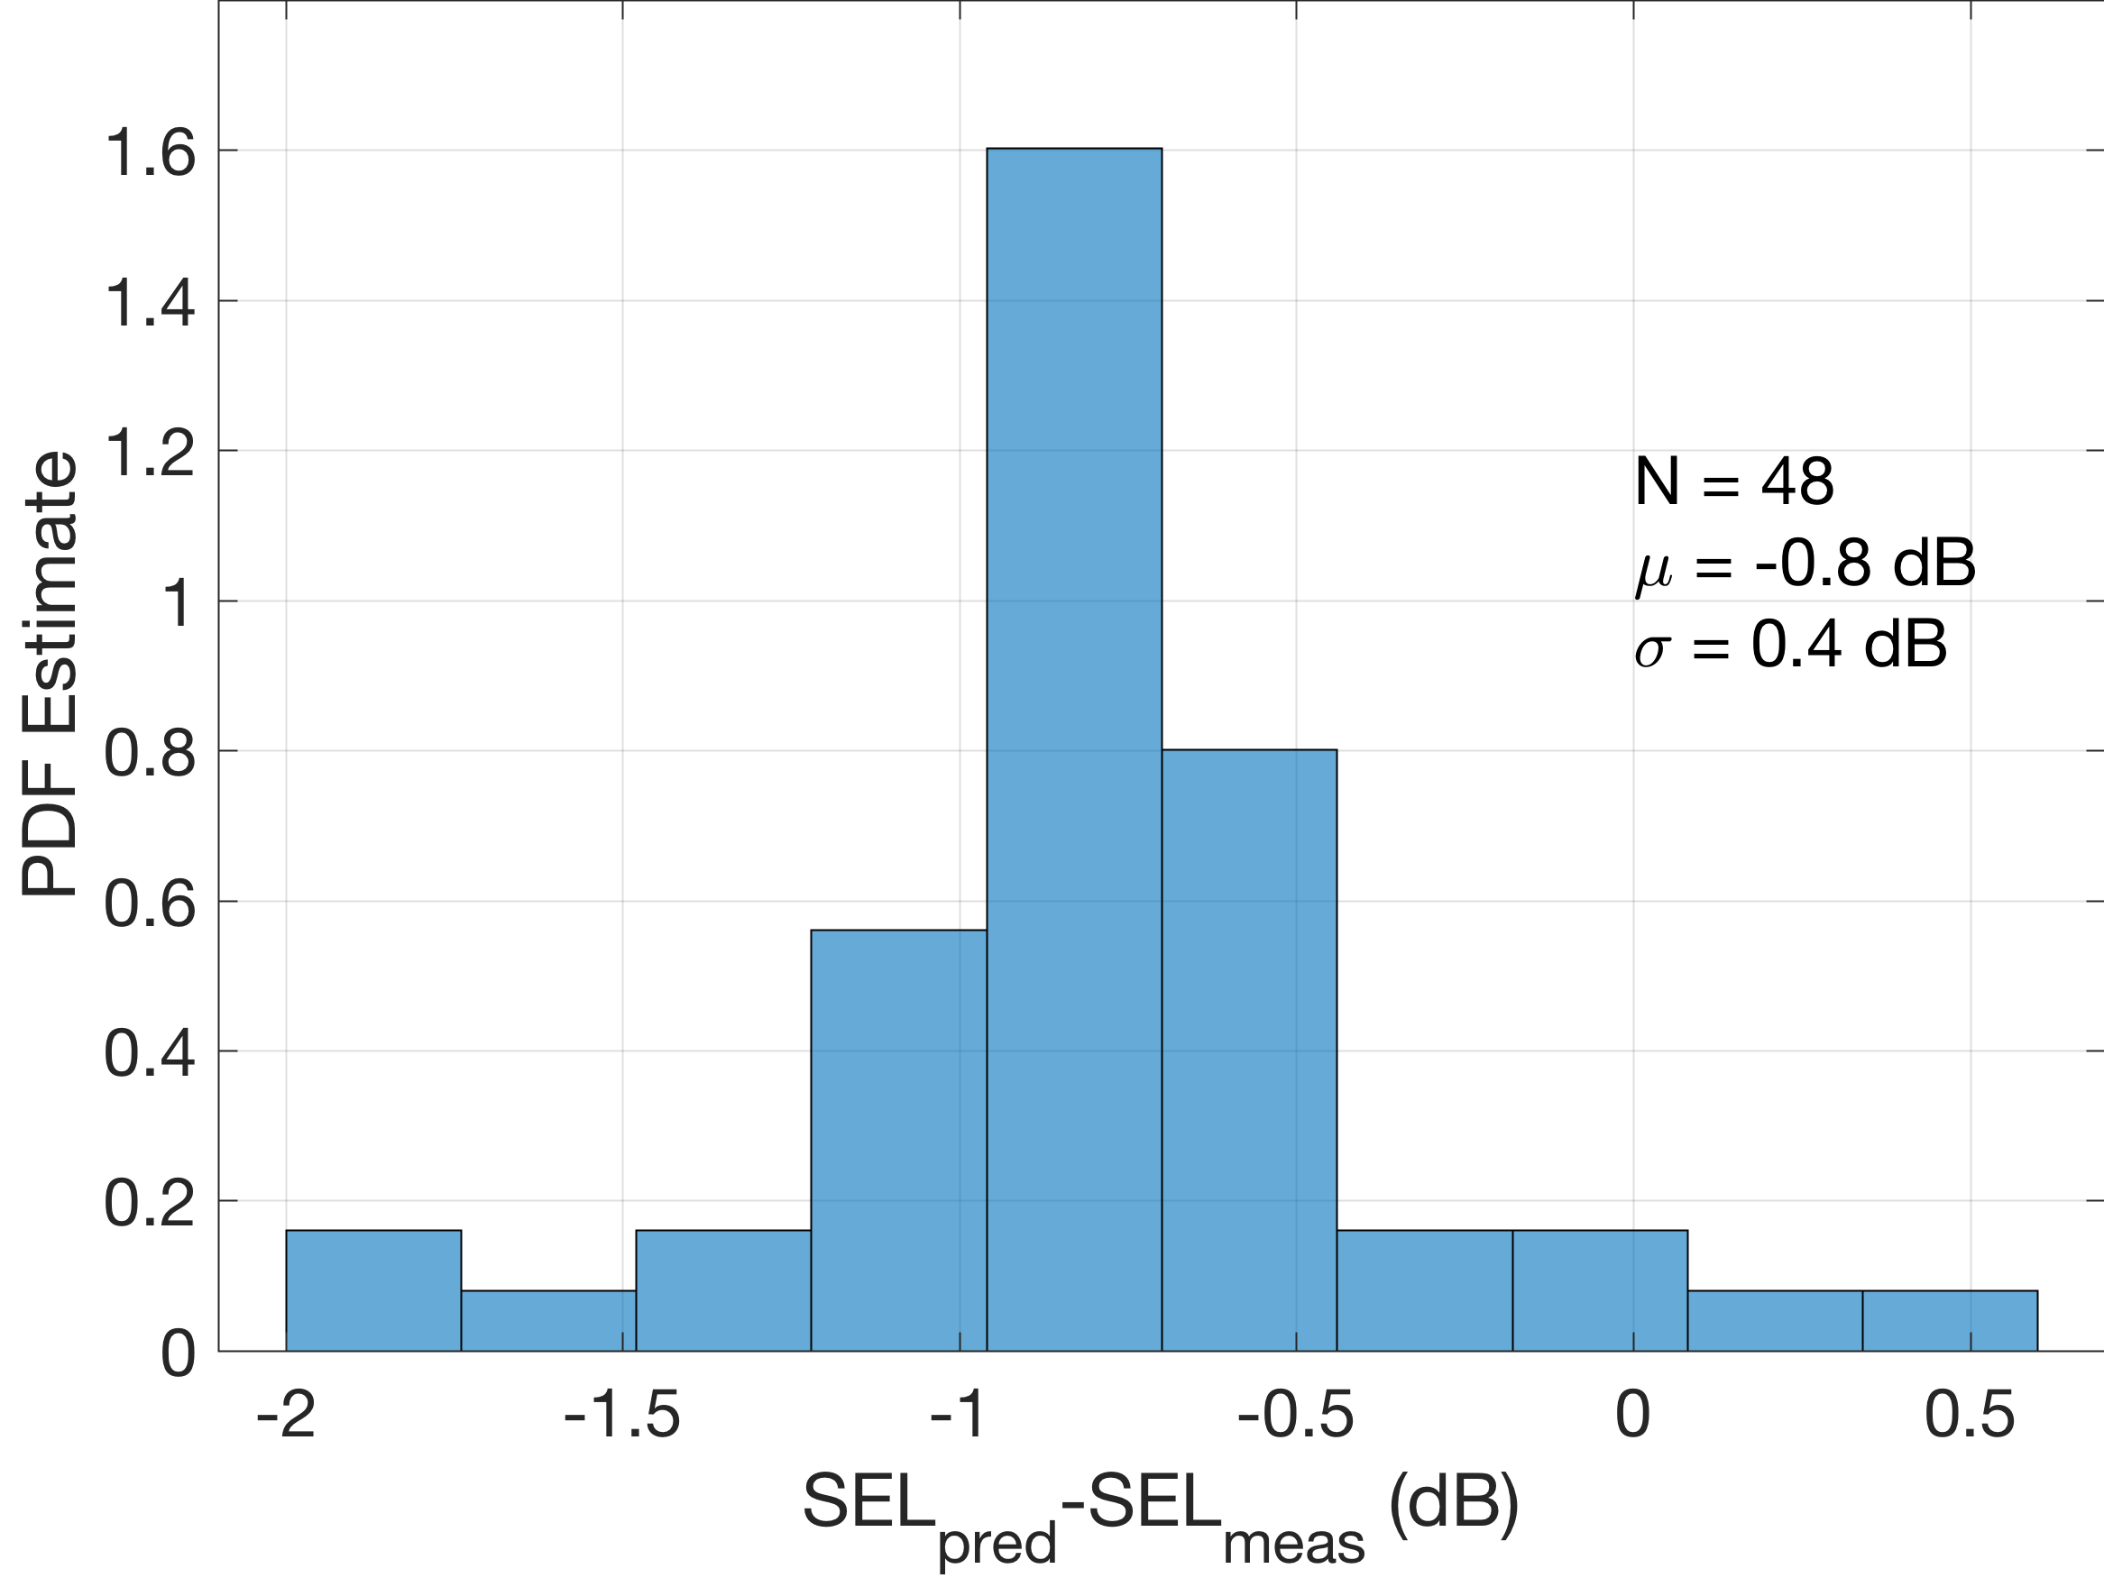
Unweighted Sound Exposure Level (SEL) Comparison
CFD Near-Field Solutions
Enhanced Burgers Prediction
PCBoom Near-Field Approximant
Legacy Burgers Prediction
Enhanced Burgers Prediction
Enhanced Burgers solver agrees better with measurement than Legacy Burgers solver
CFD near-field solutions lead to better agreement with measurements
No Legacy Burgers prediction using CFD. Code breaks down due to complicated signatures

Slide 16
Remaining Challenges
Turbulence Effects
  Can cause have a significant variability in ground signaturesimpact on NASA’s planned X-59
    Acoustic validation
    Community testing
Transition Focusing
Over-the-top Secondary Boom

Slide 17
Summary
Efforts to enhance PCBoom functionality, accuracy, and speed
Release of efficient PCBoom 7.1 for loudness dose estimation and supersonic route planning
Volpe’s contributions to improve functionality and documentation
In-house efforts to enhance speed and accuracy
Validation of the efficient numerical solution to a Burgers equation using data measured above the turbulence boundary layer
Remaining challenges involving turbulence, focusing, and secondary boom

Slide 18
Acknowledgement
Ed Haering and Larry Cliatt, NASA Armstrong for leading the SonicBAT flight test

Slide 19

Thank You
Are there any questions?

Slide 20
Backup Slides

Slide 21
PCBoom Code Structure
PCBoom (Main PCBoom executable)
Red Box: Post-processors
(standalone executables)
Atmospheric Profiles, A/C conditions,
and Initial Signatures
Ray Path Algorithms
Lossless Burgers Solver
Burgers Solvers
Enhanced Burgers
Solver
Post-processors:
PCBurg Burgers solver
Headless Burgers solver
Secondary
Boom
PCBFoot
WCON
Turbo
LNTE
FiltView (Turbulence Filter
From Numeric Modeling)
Output Waveforms

Slide 22
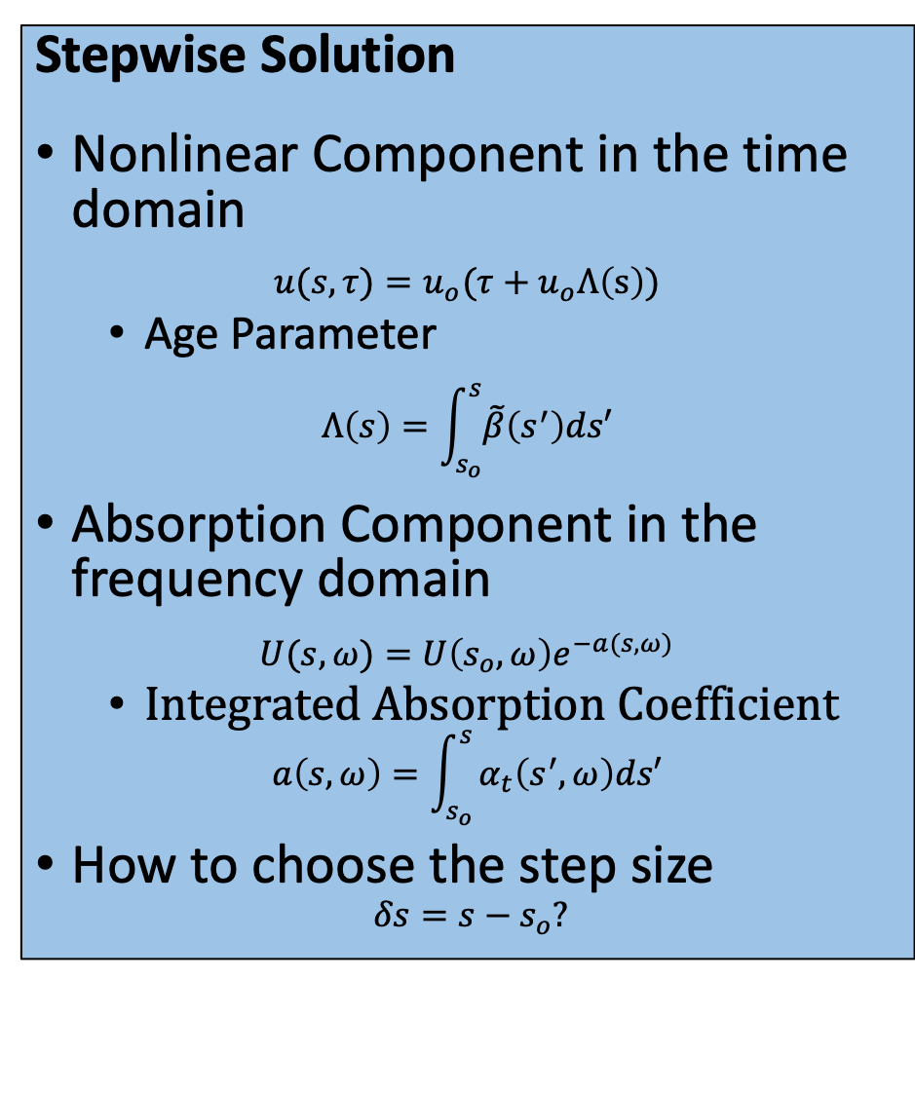
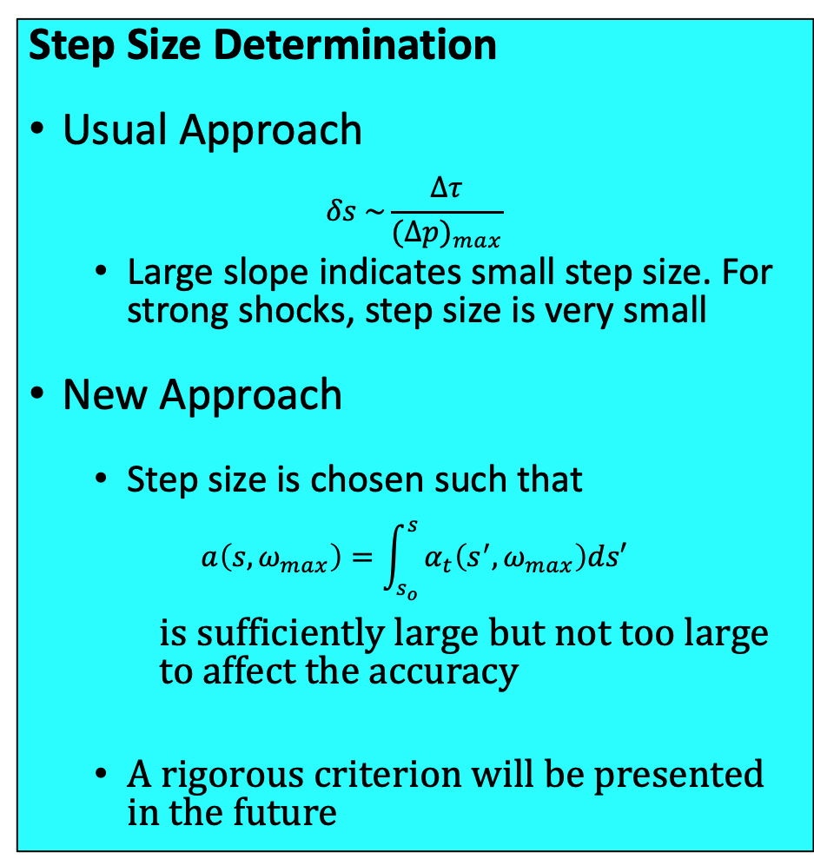
Absorption-Based Step Size: Efficient Computational Approach (1)
Stepwise Solution
Nonlinear Component in the time domain
$$u(s,τ)=u_{o}(τ+u_{o}Λ\left(s\right))$$
  Age Parameter
$$Λ\left(s\right)=\int_{s_{o}}^{s}{\tilde{β}\left(s^{′}\right)ds′}$$
Absorption Component in the frequency domain
$$U(s,ω)=U\left(s_{o},ω\right)e^{−a(s,ω)}$$
  Integrated Absorption Coefficient
$$a\left(s,ω\right)=\int_{s_{o} }^{s}{α_{t}\left(s^{′},ω\right)ds′}$$
How to choose the step size
$$δs=s−s_{o}?$$
Step Size Determination
Usual Approach
$$δs \sim \frac{Δτ}{(Δ{p)}_{max}}$$
  Large slope indicates small step size. For strong shocks, step size is very small
New Approach
  Step size is chosen such that
$$a\left(s,ω_{max}\right)=\int_{s_{o} }^{s}{α_{t}\left(s^{′},ω_{max}\right)ds′}$$
is sufficiently large but not too large to affect the accuracy
  A rigorous criterion will be presented in the future

Slide 23
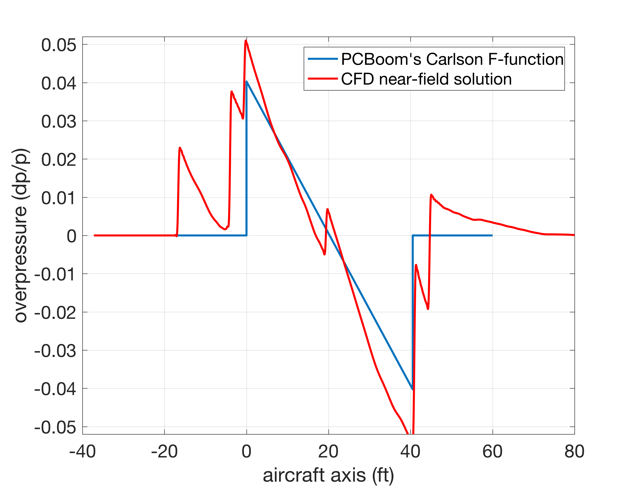
Initial Waveforms
Two types of initial waveforms:
  N-wave (PCBoom near-field approximant, Carlson F-function)
  CFD near-field solution (provided by Boeing)
Initial Waveforms
for Flight 1 - pass 1
event

