Slide 1
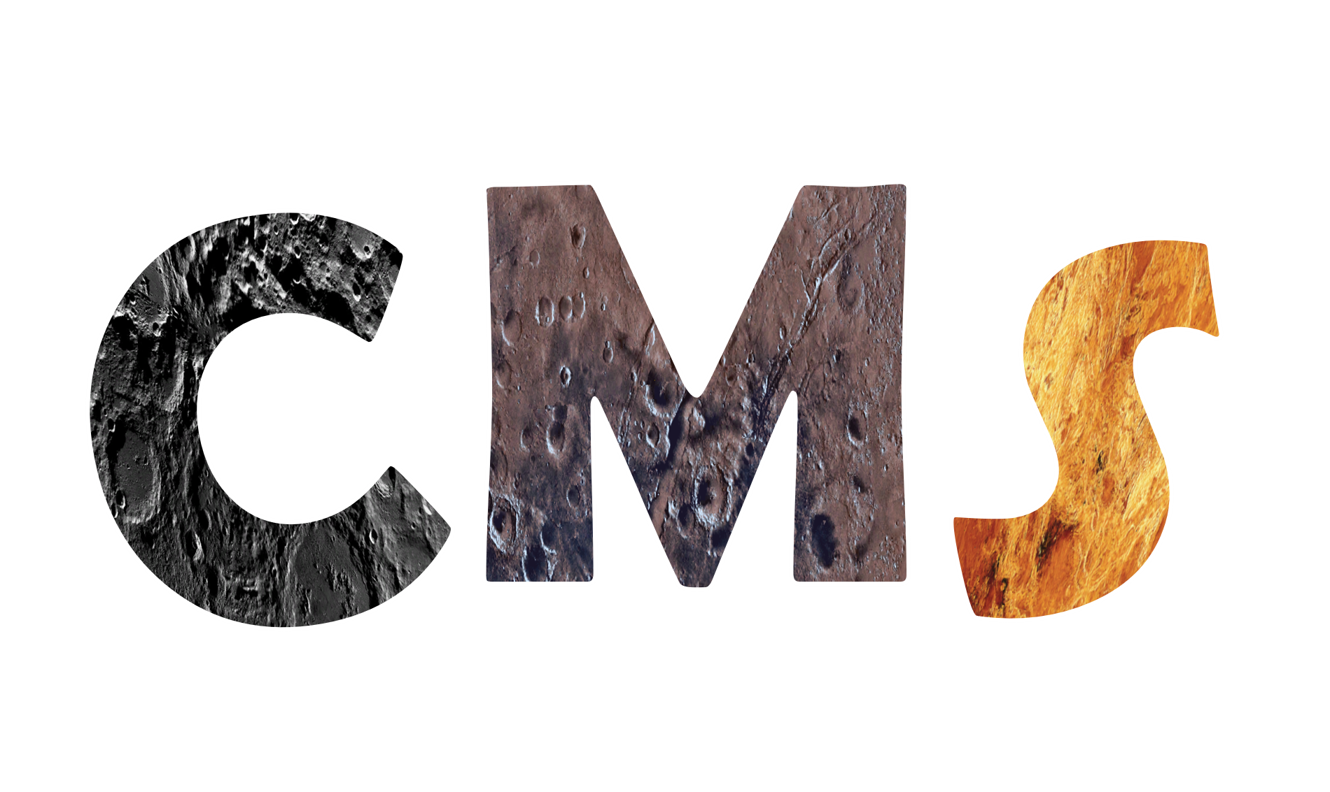
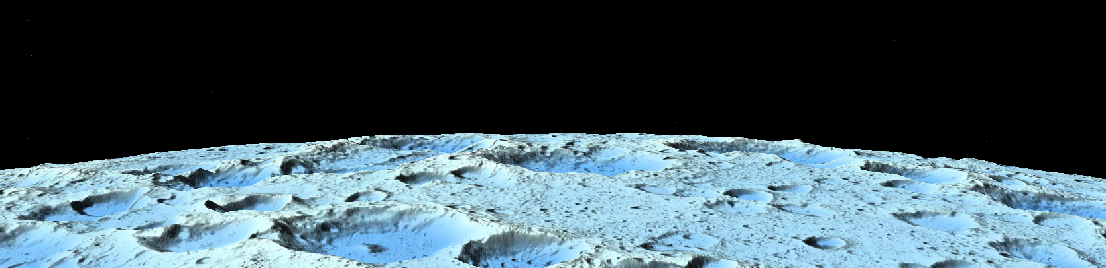
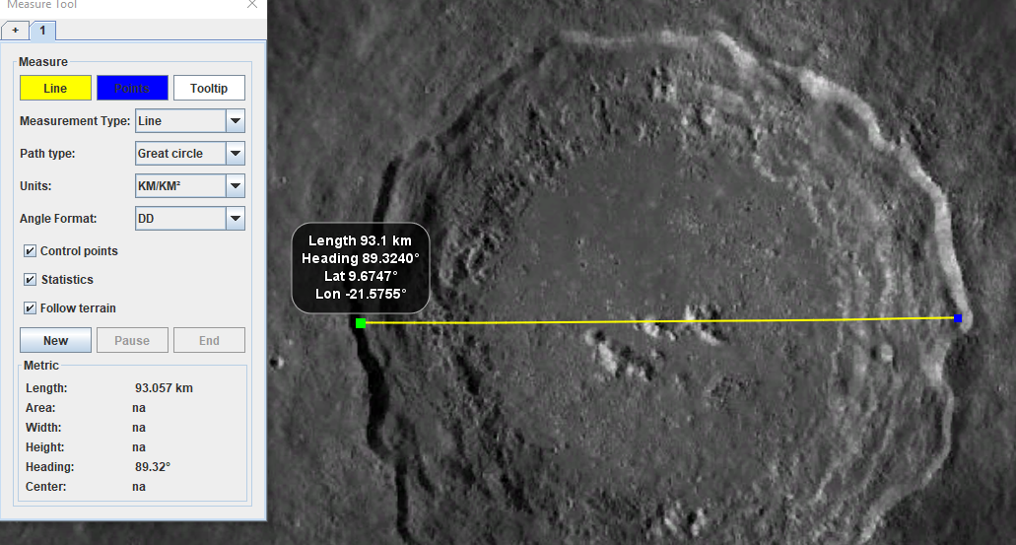
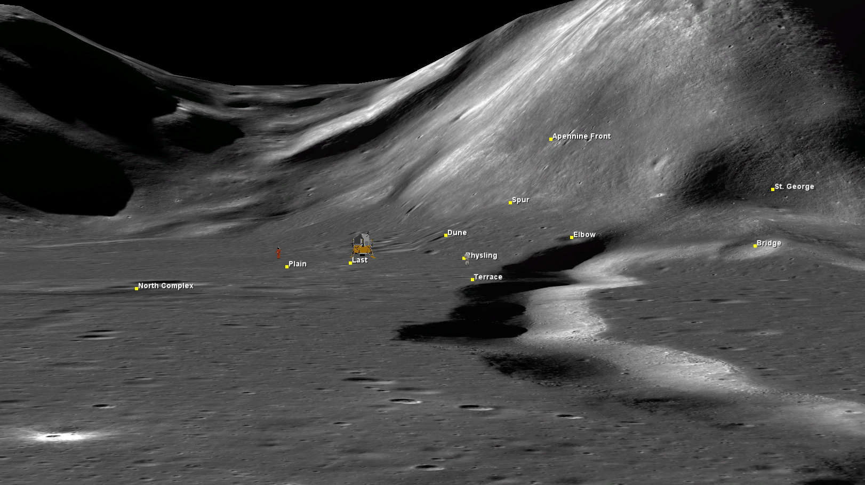
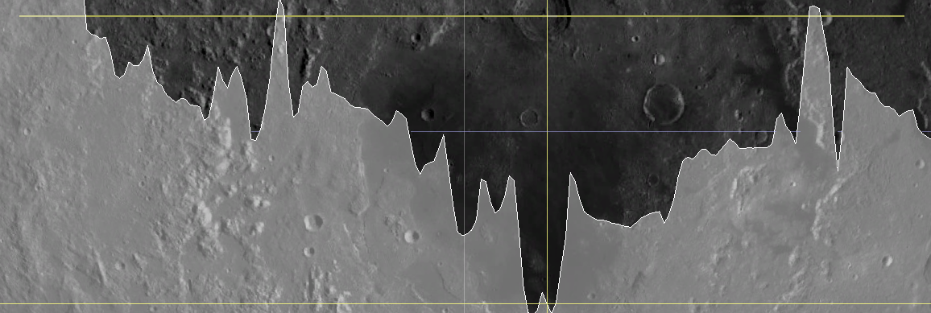
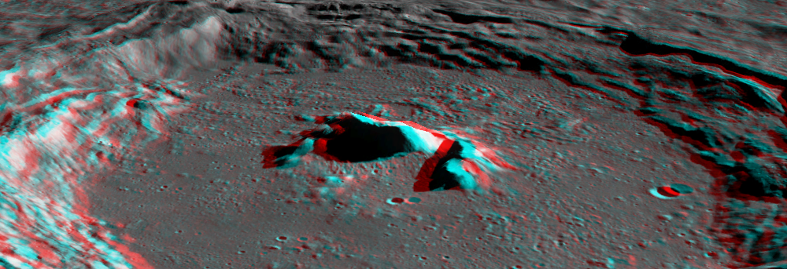
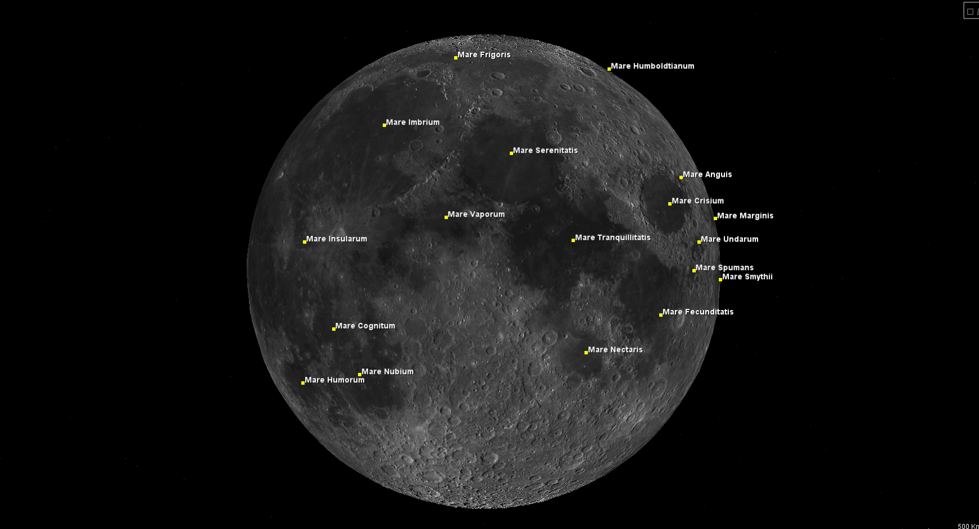




Celestial Mapping System
Choi, Tyler¹, Dickinson, Kaitlyn²,
(1) Bellevue College (2) Oregon Institute of Technology
(1) tyler.won.choi@gmail.com (2) kaitlyn.dickinson@oit.edu
Background
The focus of this project is to assist in the creation of a prototype desktop software application, Celestial Mapping System (CMS), for visualization and analysis of celestial bodies, starting with lunar features. Our aim is to develop tools and features that can be utilized within the CMS application tool kit. These tools include: the ability to display surface terrain and elevations, navigation capabilities, mapping of landing sites, measurement and analysis, and features for placemarks, labels and stereo view. CMS differentiates itself through high-resolution datasets, accurate elevation, and a 3D globe. With NASA’s focus on the Artemis program this application could be very useful to mission planners and the planetary science community.
Results
At the end of our project, we ended up with an application prototype called "Celestial Mapping System". This application allows the user to navigate a 3D globe of the moon with accurate viewing of lunar place names (fig. 5), imagery, and elevation. It also allows the user to view the Apollo landing sites (fig. 2), measure distance and area on the lunar surface (fig. 3), analyze terrain profiles (fig. 4) and display an anaglyph view of the Moon (fig. 6). For place names we used shapefiles from USGS which provides high accuracy viewing of craters, mares and notable landmarks. The integration of datasets and place names from USGS allows users to view the moon for their specific use cases. We have started the foundation for a celestial mapping library containing a lunar globe, with the ability to implement other planetary bodies and functionality as development goes forward.
Fig. 1. 3D terrain with LOLA Color Shaded Relief Blue Steel derived from LRO elevation data
Research
The development of Celestial Mapping System required research into the WorldWind Java library and architecture, which provided an extensive set of functionality we wanted to use for CMS, as well as having the ability to retrieve and cache data. After developing a good understanding of the capabilities we started looking into displaying the layers and place names. Implementing the place names was a challenge that required extensive analysis into how shapefiles are processed. Lunar imagery was pulled from USGS and LROC web map servers. We focused on high quality imagery that would be useful in upcoming missions. A major challenge was finding a global elevation model for the moon, which are not commonly published online. We ended up using a local model until we could utilize our own server (fig. 1). For lunar measuring we looked at classes that provided tools for calculating distance, area and location. Other research focuses included features for path optimization, situational awareness, lunar satellites and resource assessment.
Fig. 3. Measuring Copernicus crater (93km)
Fig. 2. High-res view of Apollo 15 with 3D astronauts and craft
Fig. 4. Analyzing the elevation profile of Mare Orientale
Fig. 6. Displaying a mountainous crater in stereo view
Objectives
Accurate display of lunar surface and terrain.
Accurate display of lunar place names.
Accurate lunar measuring.
Ability to display geometric figures.
Ability to display georeferenced imagery.
Ability to display lunar terrain profiles.
Ability to display stereo view.
Calculate and display terrain intersections.
Display 3D Apollo craft on the lunar surface.
Simulate a first-person view of a vehicle traversing through the lunar surface.
Implement a search bar
Set up a server
Methods
We programmed in Java to implement the features and sourced NASA WorldWind documentation to utilize the library for our use cases.
XML was used extensively to implement the base layers, elevation model and georeferenced imagery (<GetMap> and <GetCapabilities>)
We tested shapefiles, web map servers, and DTMs/DEMs through QGIS software.
GDAL was used to modify and analyze the elevation model.
The IAU2000 ellipsoid for the moon which defines a radius of 1,737,400m was utilized for the globe parameters.
Fig. 5. Displaying place names for mares
References
- USGS, www.usgs.gov
- LROC, https://www.lroc.asu.edu/
- NASA WorldWind, https://worldwind.arc.nasa.gov/
Acknowledgements
Bellevue College
Oregon Institute of Technology
Universities Space Research Association (USRA)
Oregon NASA Space Grant
Parul Agrawal | Mentor/Project Manager
Mark Peterson | Technical Mentor
Miguel Del Castillo | Technical Mentor

