Slide 1
Statistics & Data Science at
NASA Langley Research Center
2020 Corporate Partners Conference
Virginia Tech Department of Statistics
October 27-29, 2020
James Warner, Geoff Bomarito, Patrick Leser, William Leser
Durability, Damage Tolerance, and Reliability Branch
NASA Langley Research Center, Hampton, VA

Slide 2
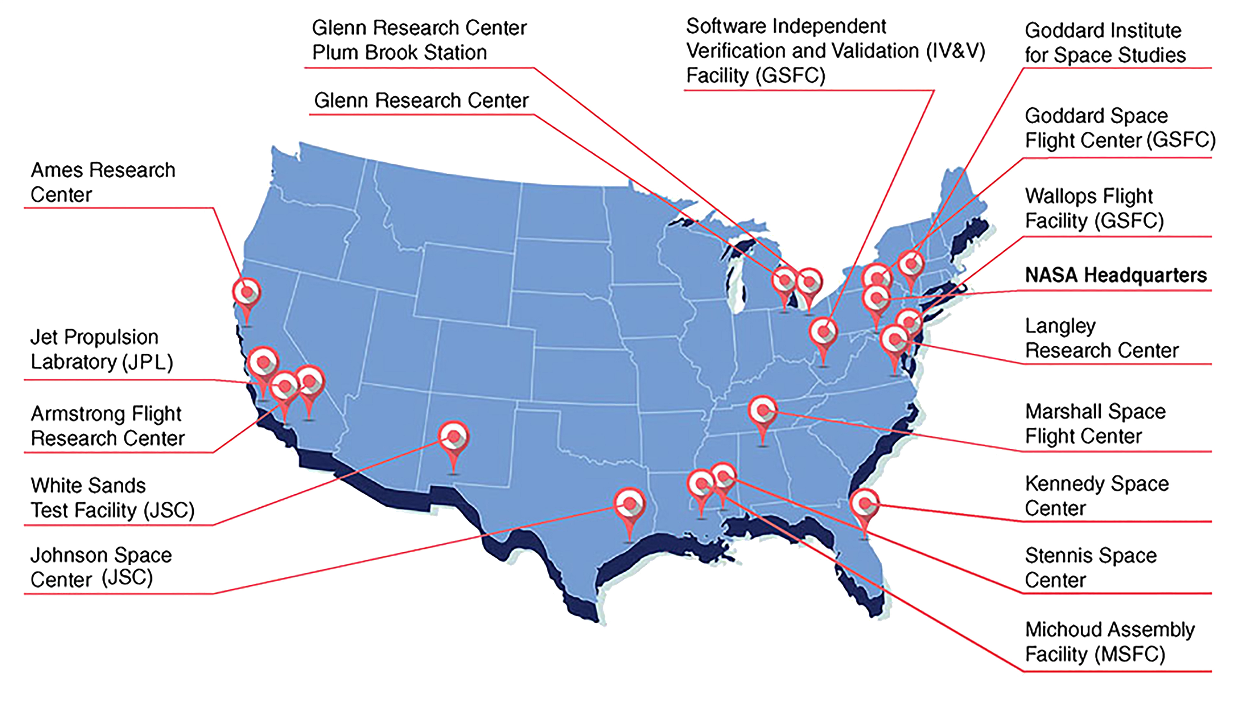
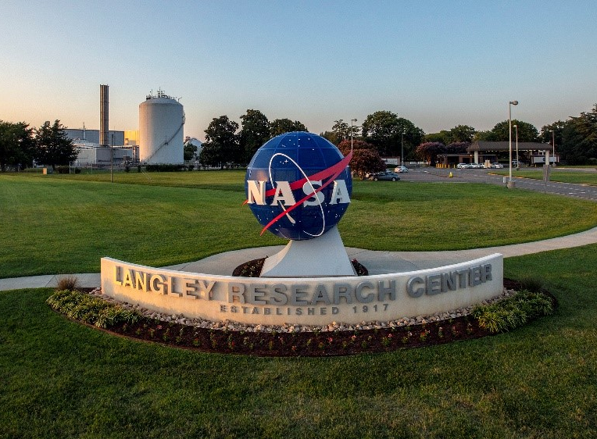
NASA Langley Research Center
NASA Facilities & Centers Across the US
Langley Research Center, Hampton, VA
https://www.nasa.gov/partnerships/center-capabilities.html
The oldest of the NASA Centers (est. 1917!) specializing in a range of aeronautics & space research:
  On-Demand Mobility Technologies
  Commercial Air Transport Technologies
  Earth’s Atmospheric Composition
  Entry, Descent & Landing Systems
  Advanced Space Structures
  Autonomous In-Space Assembly & Manufacturing
https://www.nasa.gov/langley
Notes:
Langley Research Center
Hampton, Virginia
On-Demand Mobility Technologies
Commercial Air Transport Technologies
Earth’s Atmospheric Composition
Lidar Remote Sensing Techniques
Entry, Descent & Landing Systems
Advanced Space Structures
Autonomous In-Space Assembly & Manufacturing
NASA Langley Research Center develops, demonstrates and delivers innovative concepts, solutions and technologies to enable and inspire current and future missions while also addressing national priorities in aeronautic applications, space exploration and Earth sciences.
https://strategy.larc.nasa.gov/center-overview/

Slide 3
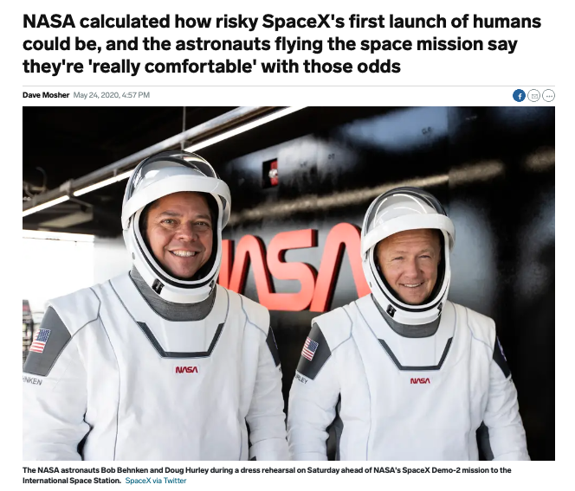
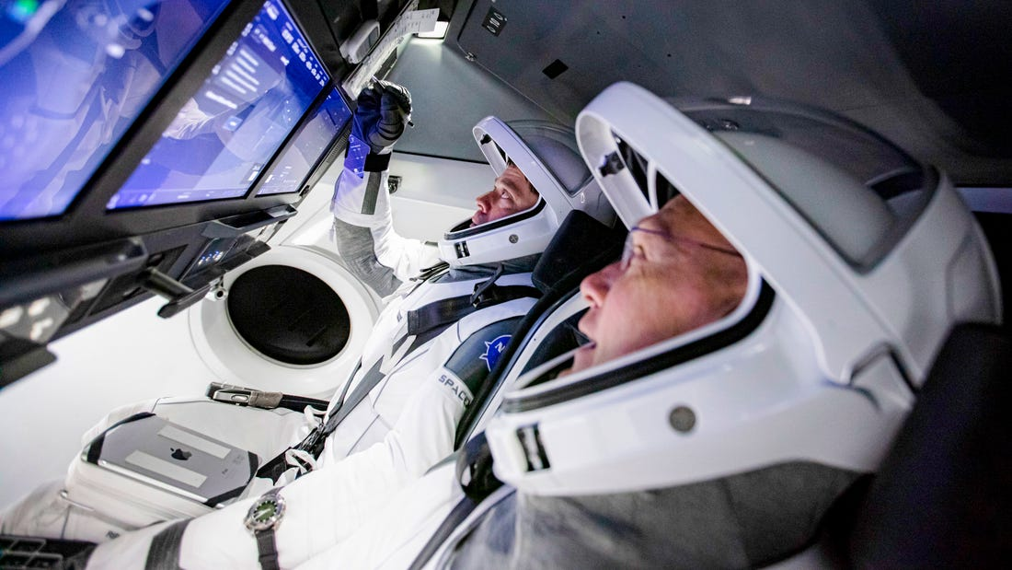

Calculating NASA Mission Risk
NASA/SpaceX Falcon 9 Launch (5/30/20)
https://www.businessinsider.com/nasa-spacex-crew-dragon-loss-crew-mission-failure-chances-probability-2020-5

Slide 4

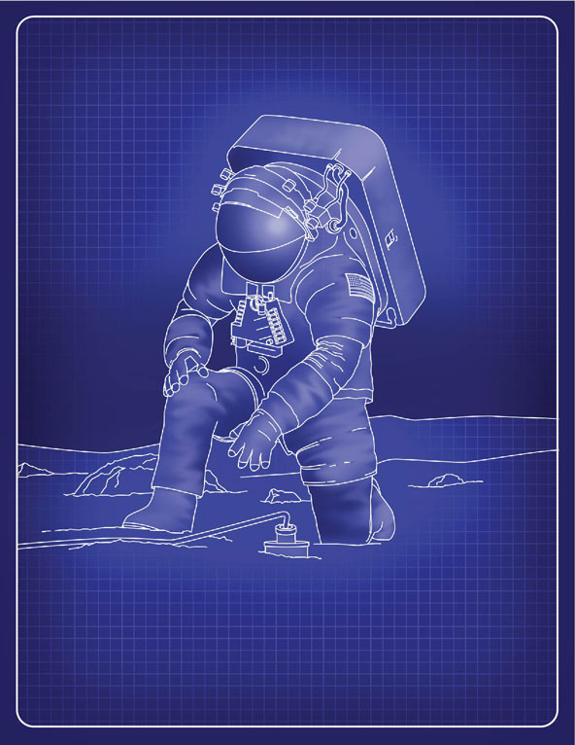
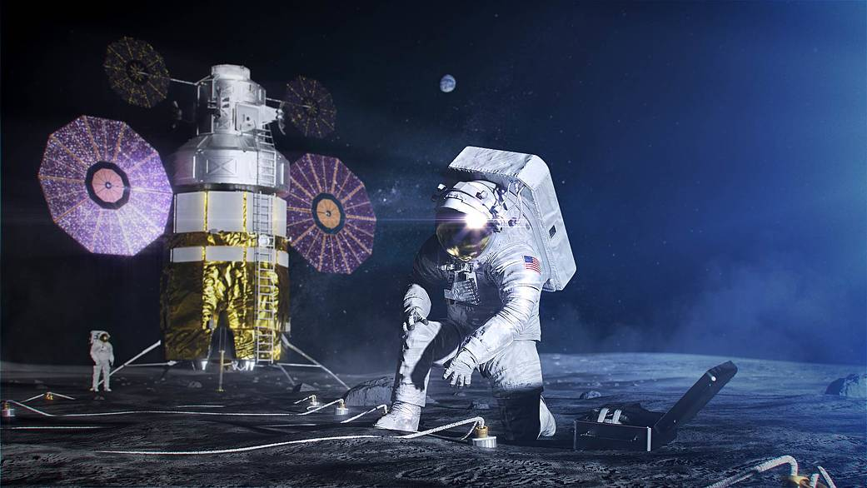
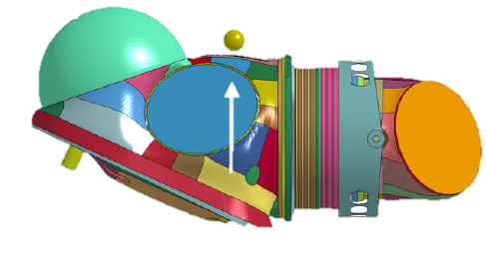
Certifying a New NASA Spacesuit
  NASA is designing a new spacesuit, the Exploration Extravehicular Mobility Unit (xEMU), for the upcoming lunar missions
  Problem: need to be able to calculate & prove that there is a probability of failure of 0.3% or less for impacts resulting from astronaut falls
Impact Damage Simulation
Probability of impact location
Mission-related probabilities
Material Uncertainties
Probability of fall
Impact velocity uncertainty
Probability of rock size

Slide 5
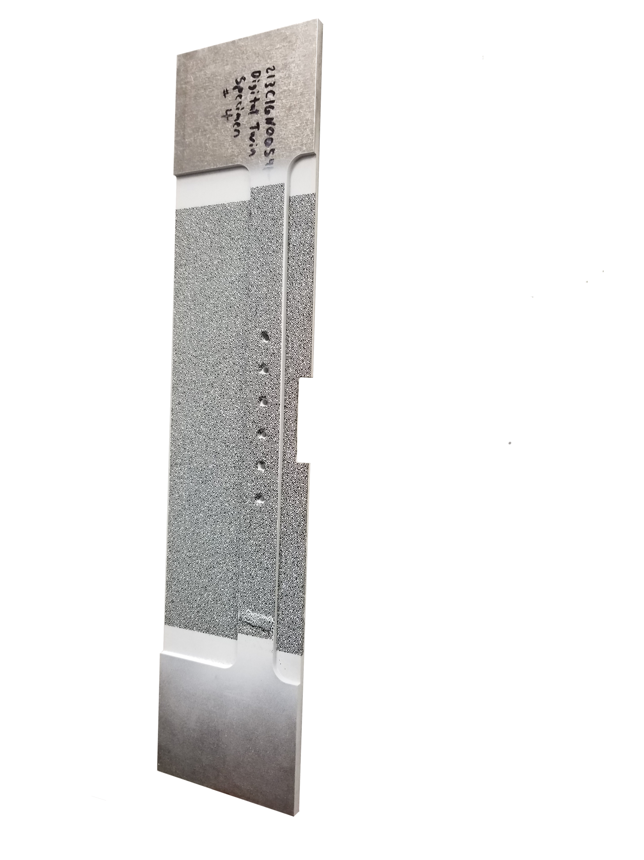
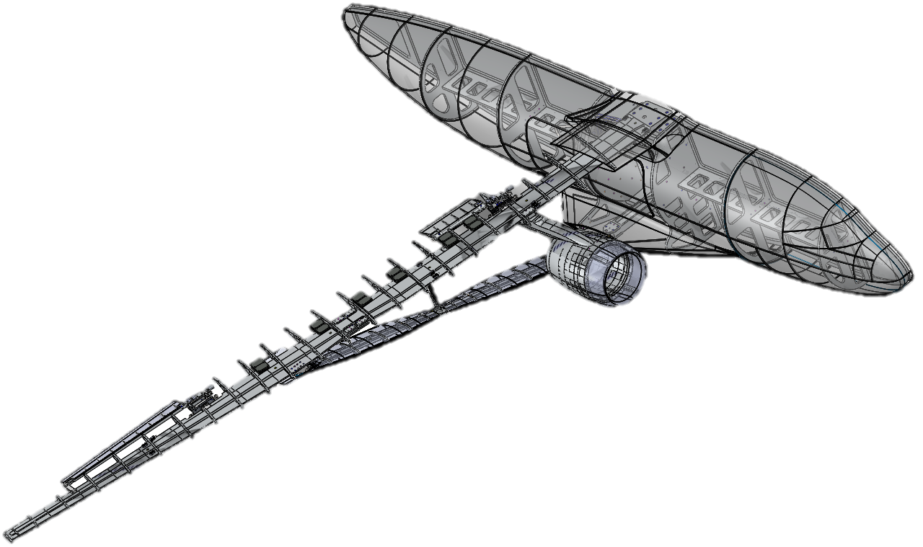
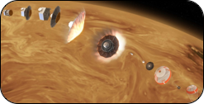
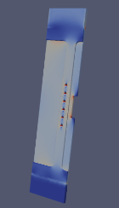

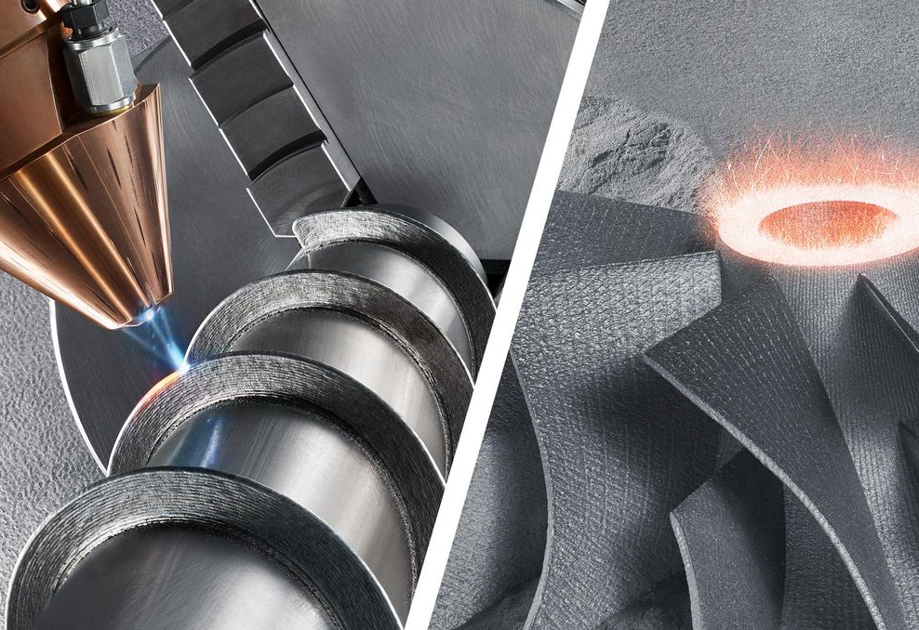
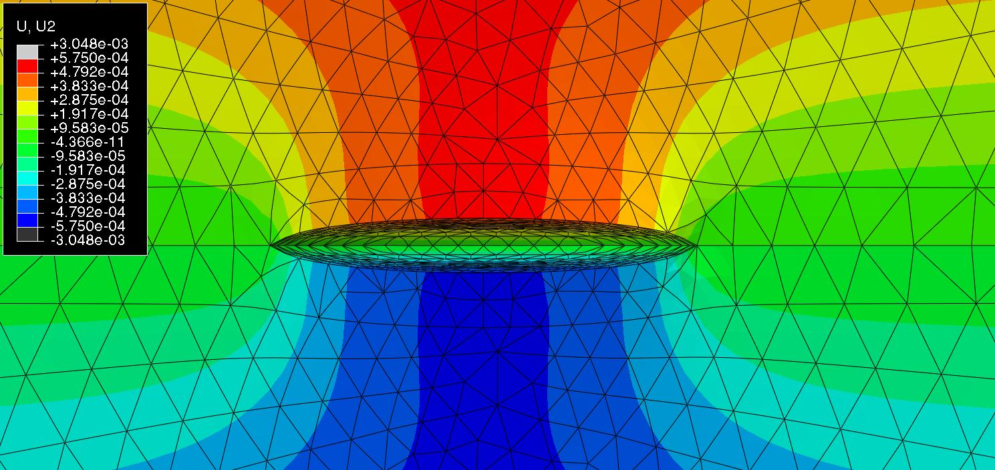
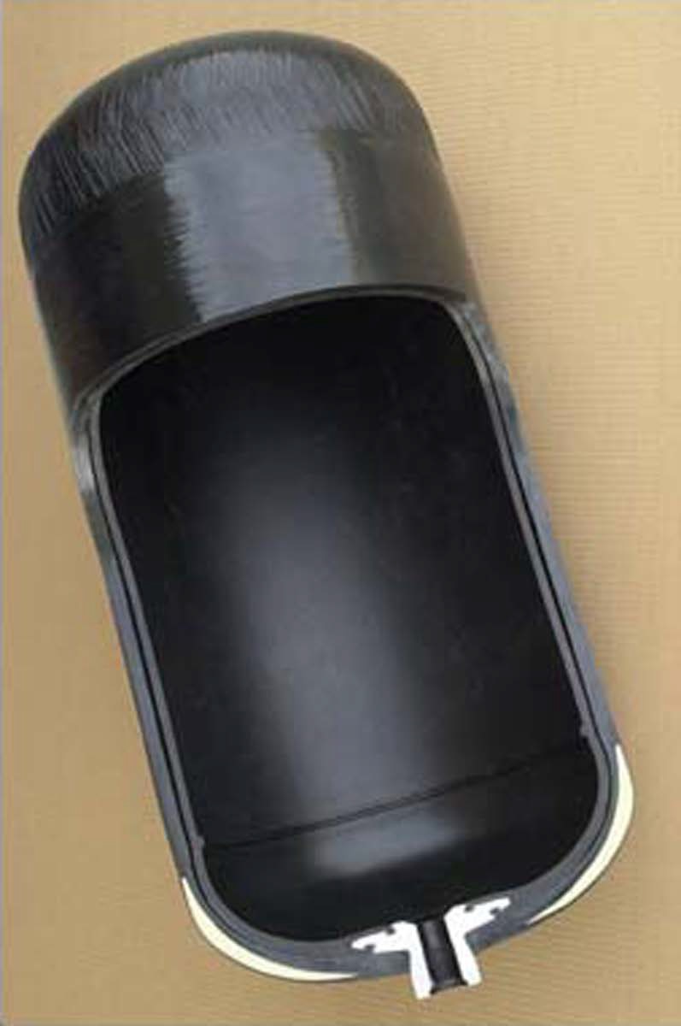
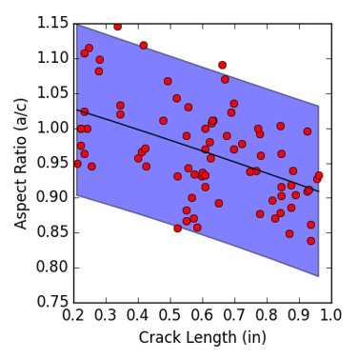
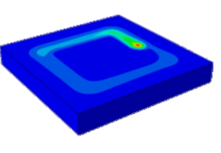
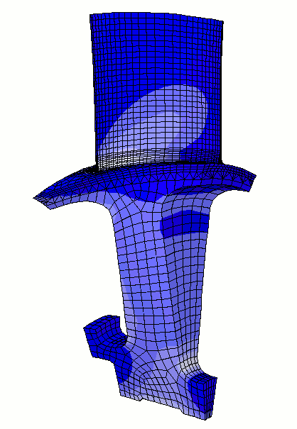
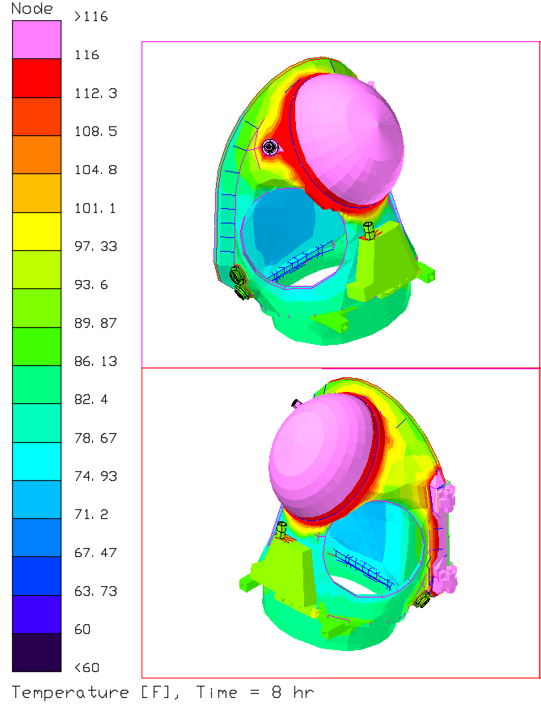
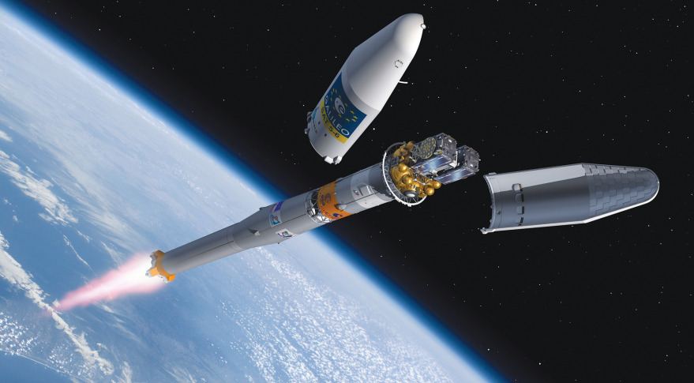
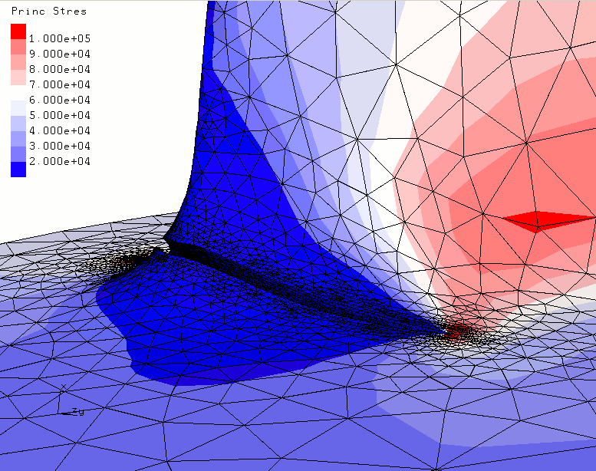
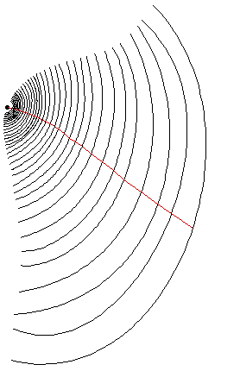
Research Group Overview
Skills
Research Areas
Applications
Applied Mathematics
Software Development
Probability
Statistics
Applied Physics
Mechanical Testing
Aerospace Engineering
Numerical Methods
Solid Mechanics
Structural Health Management
Entry, Descent, and Landing
Uncertainty quantification
Probability
Machine Learning
Digital Twin
End of Life
Additive Manufacturing
COPV Liner Fracture Mechanics
High Performance Computing
CMOD
Crack
Damage Science
xEMU Spacesuit Certification
Frangible Joint Reliability
Fatigue & Fracture

Slide 6
Internships in Our Group
Opportunities available year round (Fall, Spring, Summer terms)
Internship benefits:
  Research experience in a national lab setting; opportunity to potentially (co)author journal/conference publications
  Exposure to modern software development practices; Contribute to open-source software projects
  Have an impact; produce work/results of real importance to our group, NASA, and beyond
  Networking with NASA employees, other interns
Contact: Jim Warner, james.e.warner@nasa.gov
NASA-wide internships: https://intern.nasa.gov

