Slide 1

Implementation of HSI in NASA’s Gateway Program
Image from nasa.gov
Sherry Thaxton, PhD, CPE
sherry.s.thaxton@nasa.gov
Jackelynne Silva-Martinez, MS
jackelynne.p.silva-martinez@nasa.gov
NASA Johnson Space Center

Slide 2
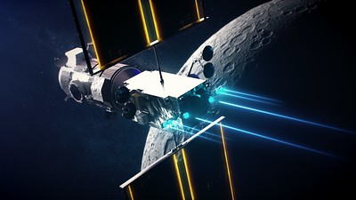
Agenda
HSI at NASA
Gateway Program
  Program Overview
  HSI Organization and Implementation
  Human System Requirements
Challenges to Implementation of HSI
Question to the audience
Image from nasa.gov

Slide 3
HSI at NASA
NASA defines Human Systems Integration as part of the overall systems engineering and acquisition strategy for space systems
  NPR 7123.1C NASA Systems Engineering Processes and Requirements defines HSI as:
  An interdisciplinary and comprehensive management and technical process that focuses on the integration of human considerations into the system acquisition and development processes to enhance human system design, reduce lifecycle ownership cost, and optimize total system performance. Human system domain design activities associated with operations, training, human factors engineering, safety, quality, maintainability and supportability, habitability, and survivability are considered concurrently and integrated with all other systems engineering design activities.
NASA has 6 HSI Domains:
  Human Factors Engineering
  Operations Resources
  Maintainability and Supportability
  Habitability and Environment
  Safety
  Training
Human Factors Engineering
Operations Resources
Safety
Habitability and Environment
Maintainability and Supportability
Training
HSI

Slide 4
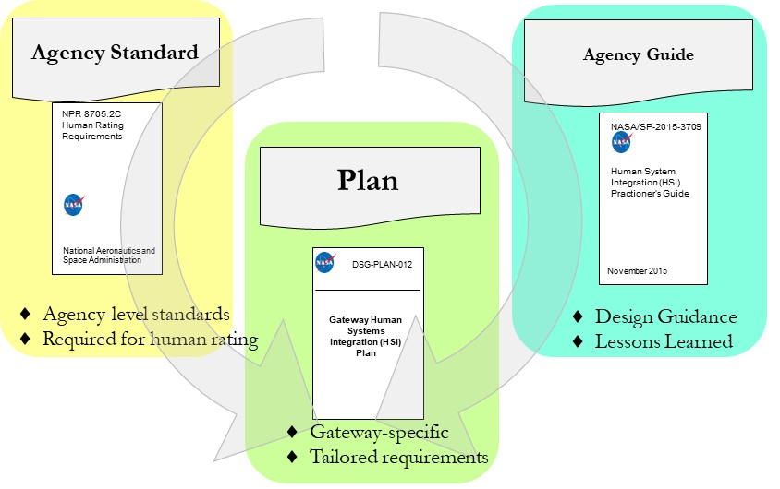
HSI at NASA
NPR 8705.2C NASA Human Rating Requirements for Space
  Requires formation of a Human Systems Integration Team for each Program/Project
  Identifies NASA-STD-3001 NASA Space Flight Human System Standard as Type 2 document that must be tailored for each Program/Project
    Volume 1: Crew Health and NASA Space Flight Human System Standard
    Volume 2: Human Factors, Habitability, and Environmental Health
Guidance for HSI implementation is provided in the NASA/SP-2015-3709 Human Systems Integration Practitioner’s Guide

Slide 5
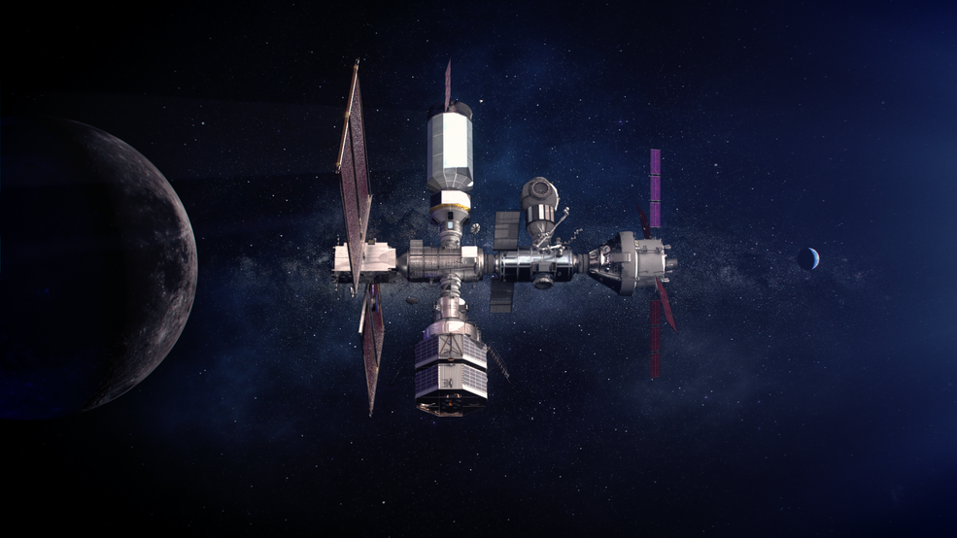
Gateway Overview
The Gateway Program is one element of the Artemis mission, which is driving toward boots on the moon (BOTM) by 2024
Artemis mission includes SLS, Orion, Human Landing System, Gateway, among others
For sustaining missions following the initial BOTM mission, Gateway will be positioned in a cis-Lunar orbit
  Crews of 4 for a minimum of 30 days
  Supporting staging of other assets including landers
  Uncrewed for extended periods of time between crewed mission
Image source: nasa.gov

Slide 6
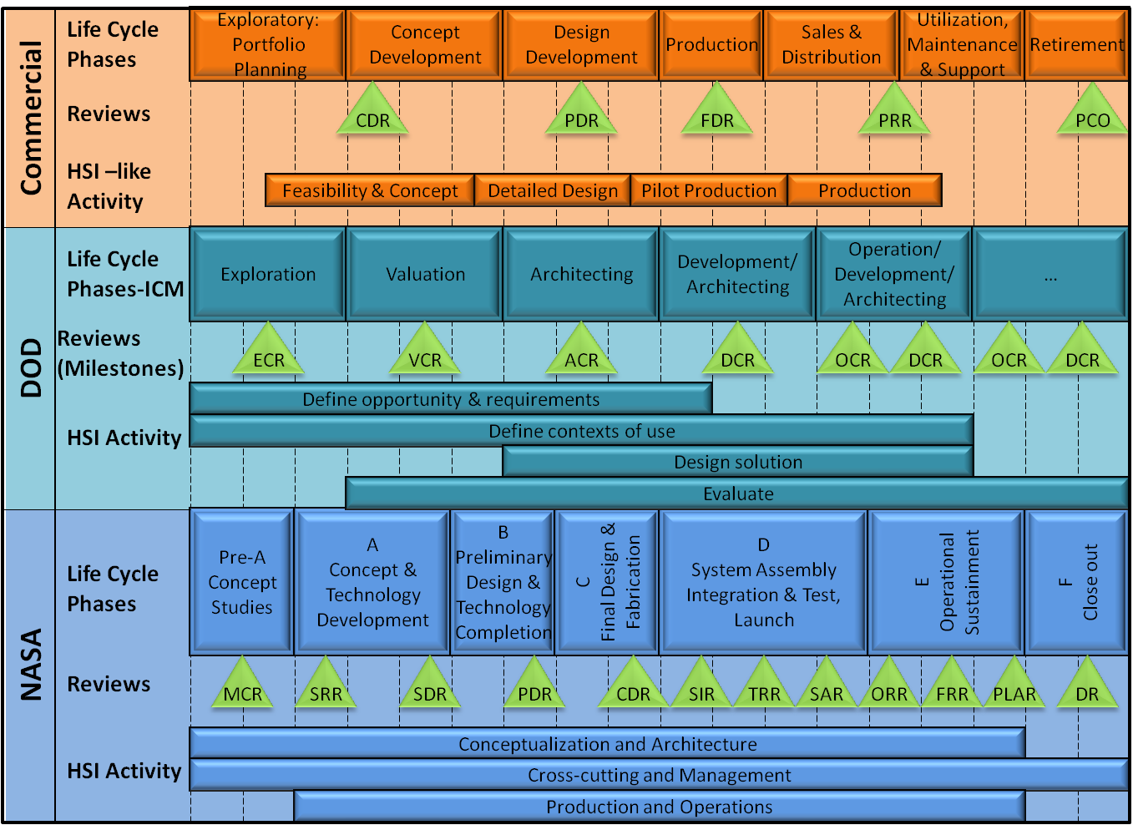
Gateway HSI Organization
HSI practitioners have close collaborative relationships across NASA organizations, Technical Authorities, and Program subsystems.
HSI practitioners participate throughout the systems engineering cycle:
  Concept development
  Requirements definition
  Design development/assessment
  Testing and evaluation
  Sustainment/closeout

Slide 7
Gateway HSI Organization
NASA supports HSI processes in Gateway through in-line teams assigned to the Program as well as a chartered Gateway HSI Working Group
  In-line teams:
    Human health and performance team supporting the Health and Medical Technical Authority
    Engineering teams focused on computer human interfaces, life support functions, and vehicle system management
    Operations teams focused on operational scenarios, automation, and training
    Safety and mission assurance experts
    Maintenance experts to ensure stowage and logistics considerations are taken into account during design development
  HSI Working Group:
    Collaborative forum that coordinates the integration of human considerations into Gateway Program acquisition and development, implementation, and operations processes
    Representation from in-line teams to represent all domains of HSI
    Provides integrated recommendations to Program management and/or NASA Technical Authorities

Slide 8
Gateway Human System Requirements
A key factor in HSI implementation is the establishment of appropriate requirements for interactions between the human and the vehicle and its subsystems
NASA-STD-3001 Vol. 1 and Vol. 2 are tailored for Gateway’s design reference mission
  Requirements reside in multiple documents throughout the Gateway requirements space, including a central Human Systems Requirements document and more than a dozen hardware and software subsystem specifications
Maintaining a clean trace from the standard to these requirements is critical to the Human Rating Certification Process
  Health and Medical Technical Authority must assess risks to human health and performance based on this requirements set

Slide 9
Challenges to Implementation of HSI
By its nature, HSI spreads across multiple systems and spacecraft modules
  Gateway is tightly coupled with multiple other NASA Programs including Orion and Human Landing System
  Risks to the human cannot be neatly divided amongst subsystems or even Programs
Formalized approach to HSI is relatively new to NASA
  There can be hesitancy to adopt HSI as a process, and challenges associated with certification of heritage hardware and the use of traditional procurement approaches
  This applies for both internal to NASA and module providers
Budget and schedule are incredibly constrained for Gateway
  Anything perceived as a “nice-to-have” is under close scrutiny
HSI practitioners must bring a clear and convincing story to management to justify the benefits of practicing HSI

Slide 10
Questions for the DoD HFE TAG
The hope in attending this TAG is to gain insight into some of the following questions:
What is DoD's overall approach to HSI? How is it evolving, and is it widely accepted, or does it face similar challenges as NASA?
Where does HSI reside within organizations and Programs in DoD?
What are some approaches to requirements and verifications that are compatible with decreased government implementation (changing oversight/insight models)?
How does DoD set HSI up for success during procurement processes?

