Slide 1

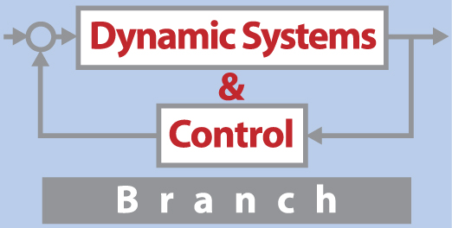
The NASA Langley Challenge on Optimization
Under Uncertainty
Luis G. Crespo and Sean P. Kenny
NASA Langley Research Center

Slide 2
Motivation
New vehicles and systems must operate under a wide array of uncertain operating conditions
These are high-consequence safety-critical systems for which data is either very sparse or very expensive to collect
NASA modeling and simulation standards require the quantification of uncertainties and the evaluation of risk

Slide 3
Motivation
We developed a UQ challenge problem in an effort to focus the community towards common goals
Problem formulation and software can be found at https://uqtools.larc.nasa.gov/nasa-uq-challenge-problem-2020/
The underlying application, cast in a discipline-independent framework, is consistent with the complexities of realistic systems

Slide 4
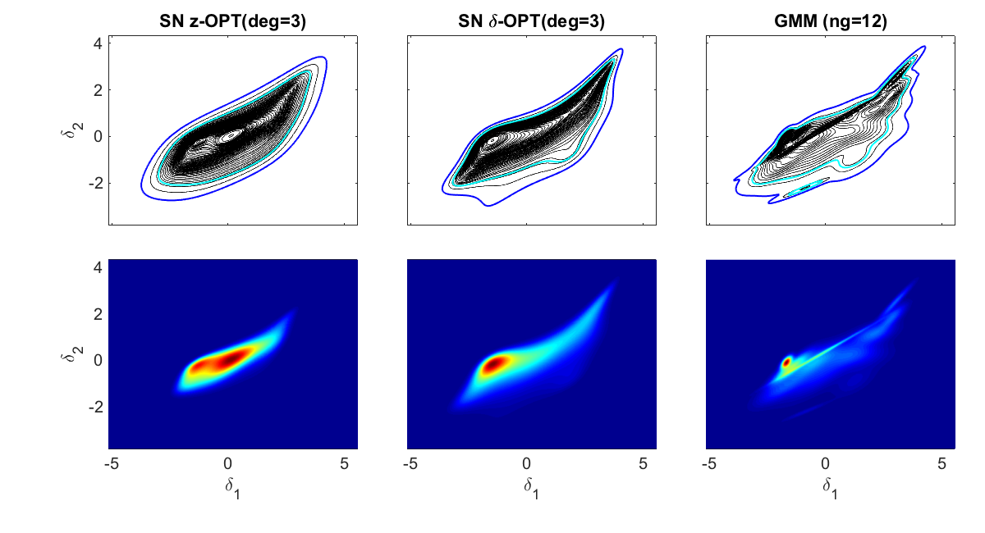
Uncertainty Classification
Aleatory uncertainty
  Caused by intrinsic variability (state of the system)
  Irreducible
  Modeled as a random vector

Slide 5
Uncertainty Classification
Aleatory uncertainty
  Caused by intrinsic variability (state of the system)
  Irreducible
  Modeled as a random vector
Epistemic uncertainty
  Caused by ignorance (state of the modeler)
  Reducible with additional experiments/simulations
  Can take on any fixed value within a set
  A refinement entails reducing the size of this set

Slide 6
Framework
Uncertain parameters
  Aleatory uncertainty
  Epistemic uncertainty
Notes:
5 aleatory 4 epistemic

Slide 7
Framework
Uncertain parameters
  Aleatory uncertainty
  Epistemic uncertainty
Uncertainty Model (UM)
The functional form of f_{a} and E are to be chosen by the respondents
Notes:
5 aleatory 4 epistemic

Slide 8
Framework
Uncertain parameters
  Aleatory uncertainty
  Epistemic uncertainty
Design variables:
System requirements:
Uncertainty Model (UM)
Notes:
5 aleatory 4 epistemic

Slide 9
The Subsystem
y
d
t
P(a,e)

Slide 10

The Integrated System
z₂
z₁
d
r
t
t
+
C($θ$)
P(a,e)
-

Slide 11
Analysis Framework
z₂
z₁
d
r
t
t
+
C($θ$)
P(a,e)
-

Slide 12

Design Optimization Framework
z₂
z₁
d
r
t
t
+
C($θ$)
P(a,e)
-
Closed-loop stability
Reliability requirements define conflicting objectives: stability, settling time, control effort
Epistemic uncertainty make probabilistic metrics vary in a range

Slide 13
High-level Goals
Create an UM according to observations of the subsystem
Choose which epistemic variables to refine
Perform a reliability analysis of a baseline design
Seek a design point with improved reliability
Improve the UM according to observations of the integrated system
Improving the design by taking some risk

Slide 14
Challenge Problem
Organized as a sequence of six interdependent subtasks to be introduced next

Slide 15
Subtask A: Model Calibration and UQ
y
d
t
P(a,e)
Generate an UM based on 100 observations
Are the aleatory variables dependent?
Evaluate the degree by which the UM overfits/underfits the data
What is the impact of only having 100 observations

Slide 16
Subtask B: Uncertainty Reduction
y
d
t
P(a,e)
Rank the epistemic variables according to the sensitivity of y(t)
Chose k≤4 refinements of the epistemic variables

Slide 17
Subtask B: Uncertainty Reduction
e₂
e₃
e₄
y
e₁
d
t
e₂
P(a,e)
e₃
Rank the epistemic variables according to the sensitivity of y(t)
Chose k≤4 refinements of the epistemic variables

Slide 18
Subtask B: Uncertainty Reduction
e₂
e₃
e₄
y
e₁
d
t
e₂
P(a,e)
e₃
Rank the epistemic variables according to the sensitivity of y(t)
Chose k≤4 refinements of the epistemic variables

Slide 19
Subtask B: Uncertainty Reduction
e₂
e₃
e₄
y
e₁
d
t
e₂
P(a,e)
e₃
Rank the epistemic variables according to the sensitivity of y(t)
Chose k≤4 refinements of the epistemic variables
Request refined epistemic ranges for such variables to us
Update the UM and the parameter ranking

Slide 20

Subtask C: Reliability Analysis of Baseline Design
z₂
z₁
d
r
t
t
+
C($θbaseline$)
P(a,e)
-
Closed-loop stability
Evaluate the range of failure probabilities
Rank the epistemic uncertainty according to the contraction of such a range that might result from their reduction (new dependent variable)
Evaluate the severity of each eventual requirement violation (risk)

Slide 21
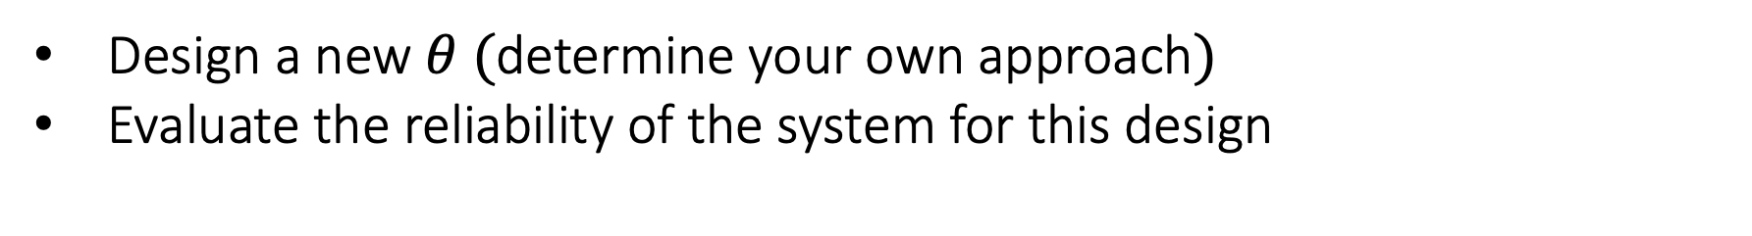

Subtask D: Reliability-based Design
z₂
z₁
d
r
t
t
+
C($θnew$)
P(a,e)
-
Closed-loop stability
Design a new $θ (\text{determine} \text{your} \text{own} \text{approach})$
Evaluate the reliability of the system for this design

Slide 22
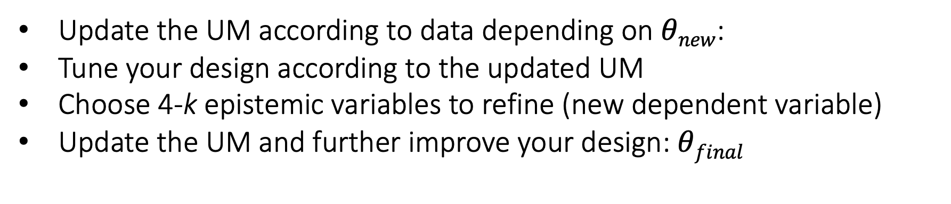
Subtask E: Model Update and Design Tuning
z₂
z₁
d
r
t
t
+
C($θnew$)
P(a,e)
-
Closed-loop stability
Update the UM according to data depending on $θnew$:
Tune your design according to the updated UM
Choose 4-k epistemic variables to refine (new dependent variable)
Update the UM and further improve your design: $θfinal$
Notes:
100 more observations, the chosen theta will impact the data and therefore the process. Closed loop sensitivity might differ significantly from the open loop sensitivity used earlier

Slide 23
Subtask F: Risk-based Design
z₂
z₁
d
r
t
t
+
C($θnew$)
P(a,e)
-
Closed-loop stability
Find a design point that ignores a fraction of the volume of the remaining epistemic space (the respondents choose which portion)
Evaluate the benefits and risks of adopting such a design

Slide 24
What is Next?
Each team will present a summary of its response
Teams were asked to omit information that might be used to reproduce their results
A full disclosure of the solutions will be compiled in a special edition of the Mechanical Systems and Signal Processing Journal
Anyone can still participate…
A review paper will be part of this edition
A comparative analysis of the resulting UMs and designs will be given in the last talk of the session
We will close the session by discussing lessons learned in open forum

Slide 25
The NASA Langley Challenge on Optimization
Under Uncertainty
Luis G. Crespo and Sean P. Kenny
NASA Langley Research Center
Notes:
Target the non-expert, emphasis to basic notions, ask as we go, ask me later if you need specifics

Slide 26
UQ Challenge Respondents
Thank you for the hard work
We hope you learned
18 teams started, 5 teams finished, only 4 provided information
Identity of each team will not be disclosed
Results will be color-coded
Team number | 1 | 2 | 3 | 4 | 5
Provided the requested information? | N | Y | Y | Y | Y
Notes:
(1 Muxia, Tsinghua univ), (2, Christian dnvgl industry), (3, Marco, Liverpool univ), (4, Nicola polimilano univ), (5, Zhiyuan, umich univ)

Slide 27
How to Measure Success?
Evaluating how well the identified UM characterizes additional data
Evaluating the performance of the final design for all available data
*These analyses use additional data and the “true” epistemic value. This information was unavailable to the respondents

Slide 28
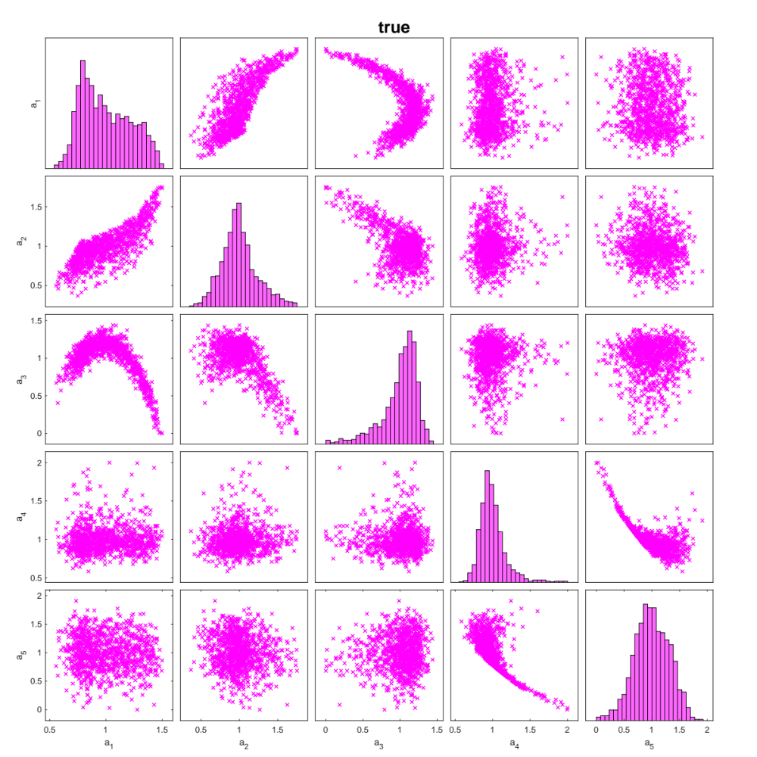
True Uncertainty Model
e = [0.8, 0.5, 0.3, 0.9]

Slide 29
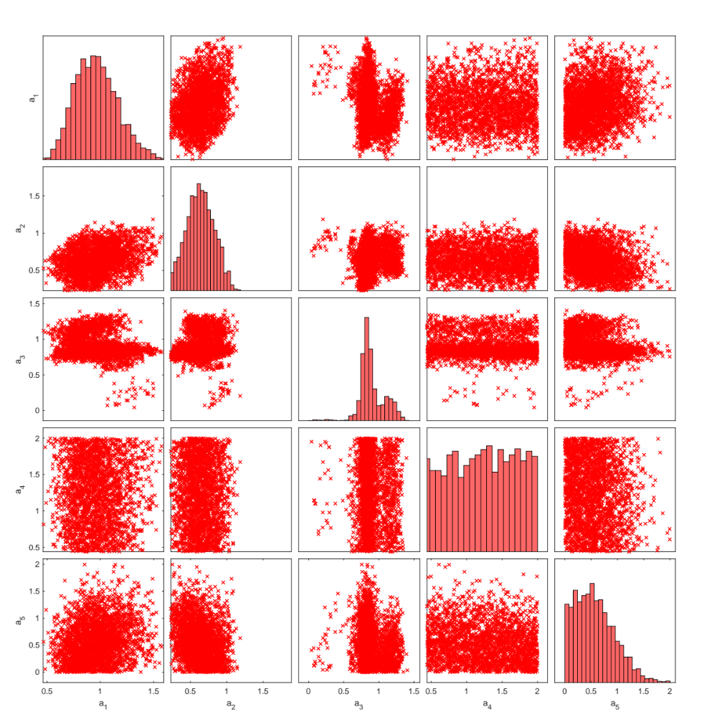
UM Team 2
Moment errors = [0.57, 0.29, 2.55]
E =
0.9000 1.2000
0.4500 0.7500
0.2777 0.3497
0.8894 0.9374
Relative error =
0.3333 1.3333
-0.1667 0.8333
-0.3097 0.6903
-0.2208 0.7792
Vol = 3.11e-4

Slide 30
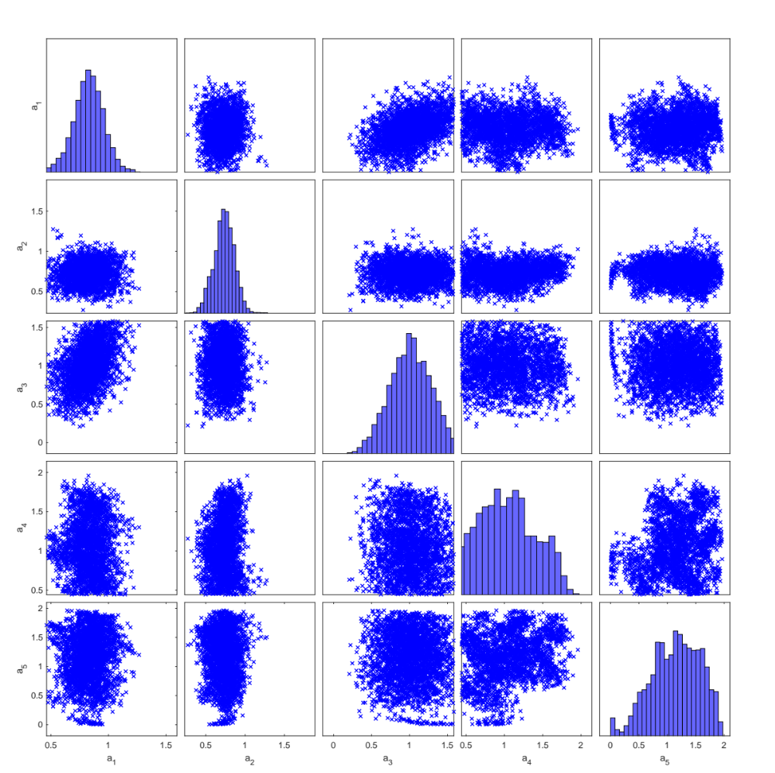
UM Team 3
Moment errors = [0.35, 0.20, 2.39]
E =
0.7670 0.8186
0.4064 0.7664
0.2296 0.5496
0.0000 2.0000
Relative error =
-0.6395 0.3605
-0.2600 0.7400
-0.2200 0.7800
-0.4500 0.5500
Vol = 0.0119

Slide 31
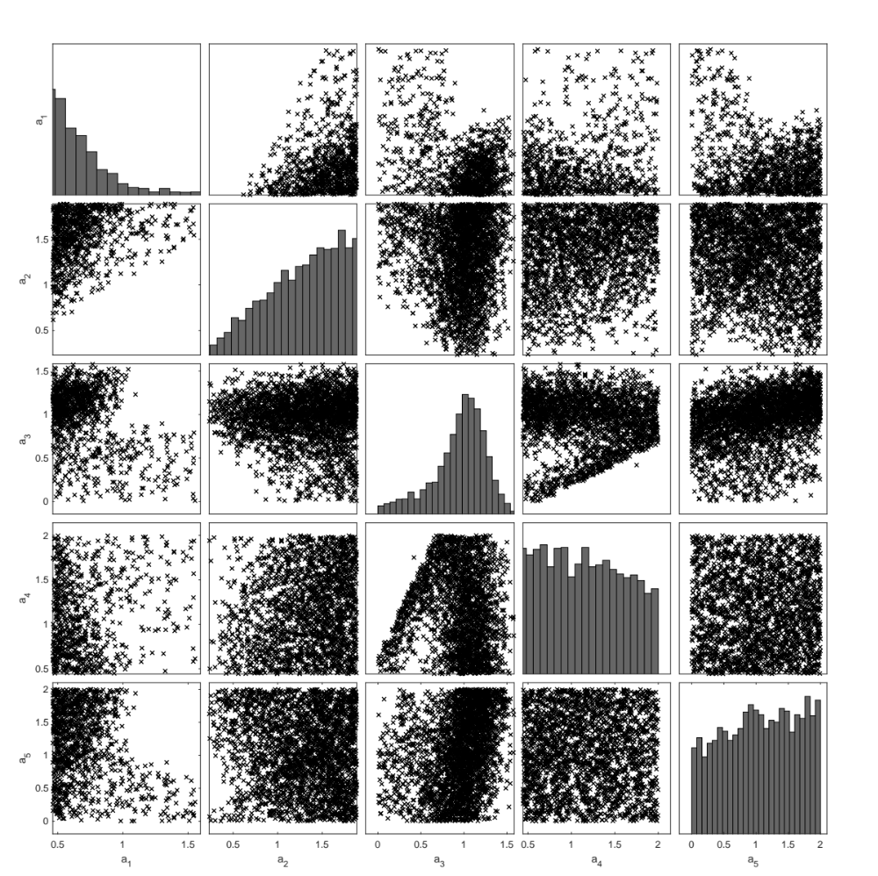
UM Team 4
Moment errors = [0.57, 0.29, 2.55]
E =
0.5240 0.7200
0.4873 0.5449
0.0330 0.3330
0.0000 2.0000
Relative error =
-1.4082 -0.4082
-0.2205 0.7795
-0.8900 0.1100
-0.4500 0.5500
Vol = 0.007

Slide 32
UM Team 5
E* =
0.7064 0.9000
0.4501 0.5141
0.2670 0.4500
0.0000 2.0000
A best- and worst-case f_{a} were identified for each value of e and each requirement
f_{a} was given as a set of weighted samples
This format prevented us from making some of the comparisons that follow
Relative error =
-0.4835 0.5165
-0.7797 0.2203
-0.1803 0.8197
-0.4500 0.5500
Vol = 0.0045 (0.0012)
*A smaller non-hyper-rectangular set was also calculated. This set also contains the true value

Slide 33
Assessment of the UM
EPISTEMIC | 2 | 3 | 4 | 5
containment | N (1 out) | Y | N (1 out) | Y(Y)
squared error | 0.59 | 2.06 | 2.08 | 2.02
volume of E | 3e-4 | 119e-4 | 70e-4 | 45e4 (12e4)
ALEATORY | 2 | 3 | 4 | 5
mean error | 0.57 | 0.35 | 0.68 | NA
covariance error | 0.29 | 0.20 | 0.31 | NA
skewness error | 2.55 | 2.39 | 2.23 | NA
dependency | N | N | N | NA

Slide 34
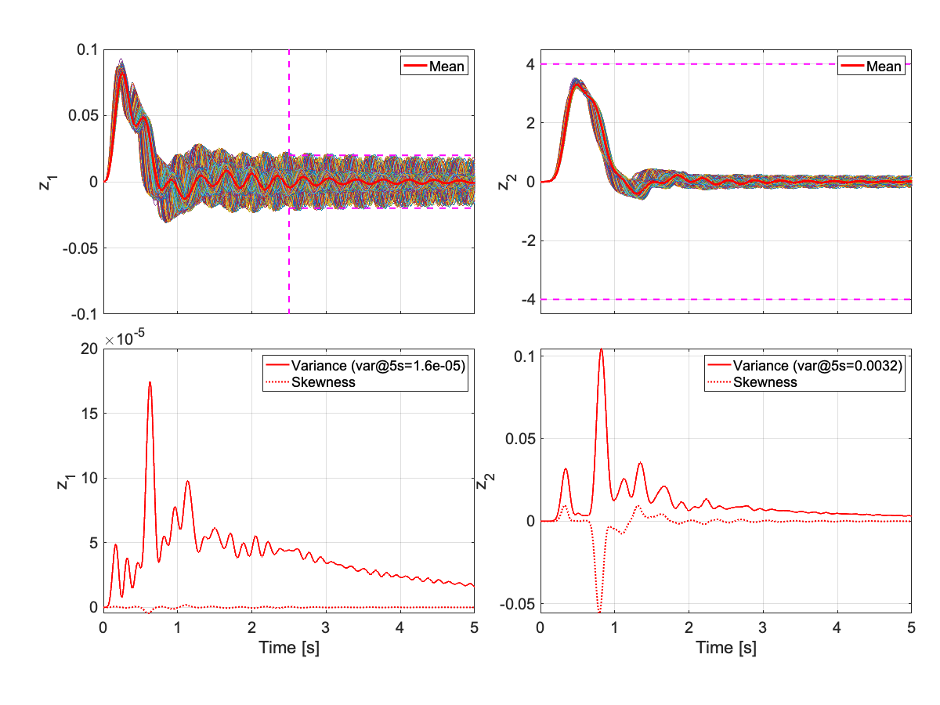
Team 2: Time Responses

Slide 35
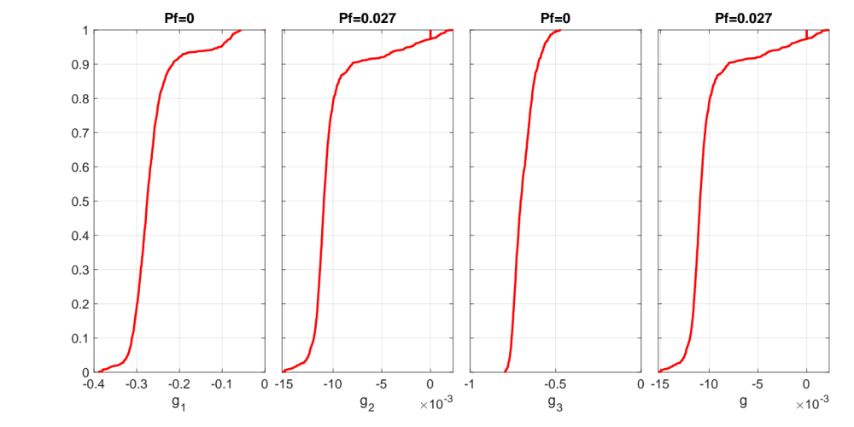
Team 2: CDFs

Slide 36
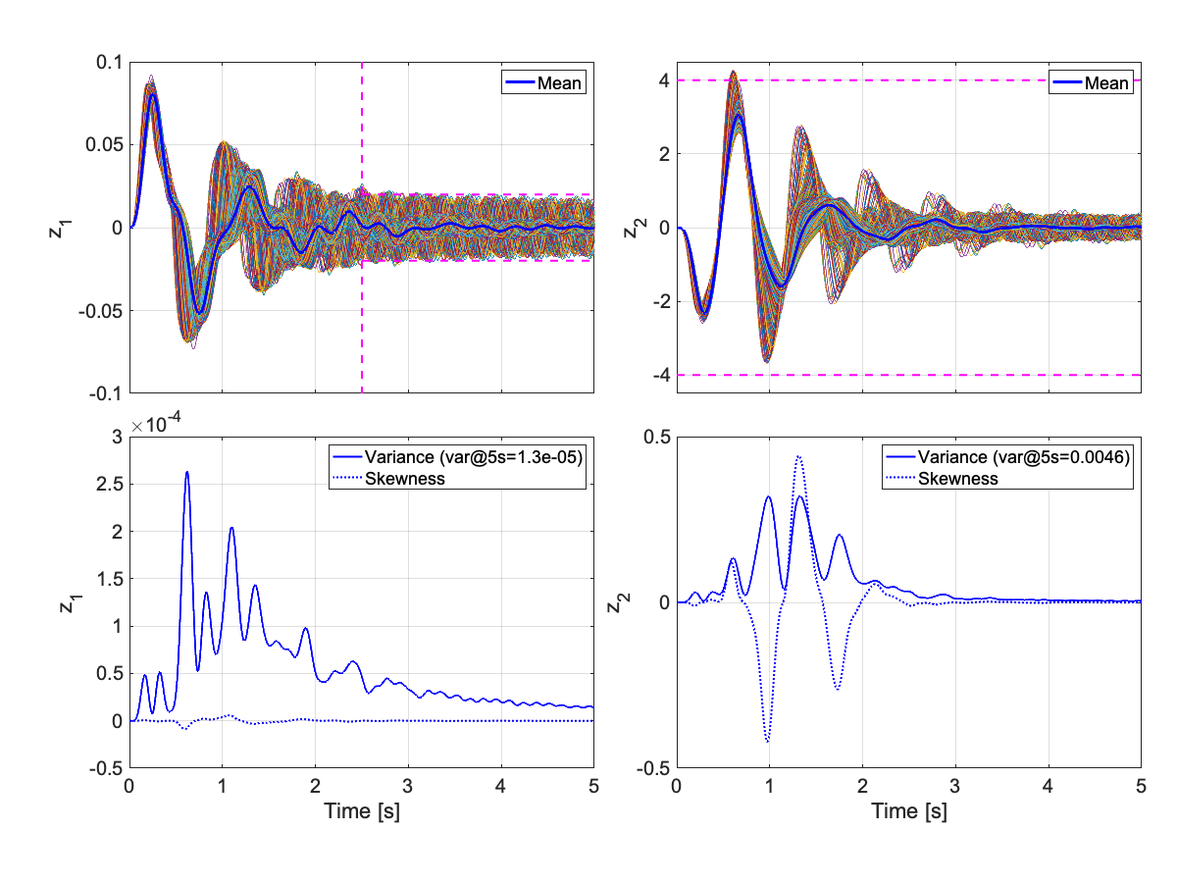
Team 3: Time Responses

Slide 37
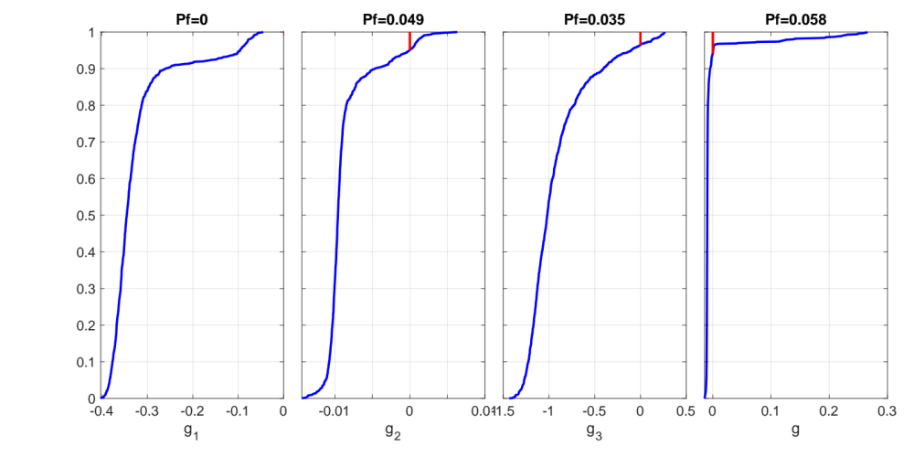
Team 3: CDFs

Slide 38
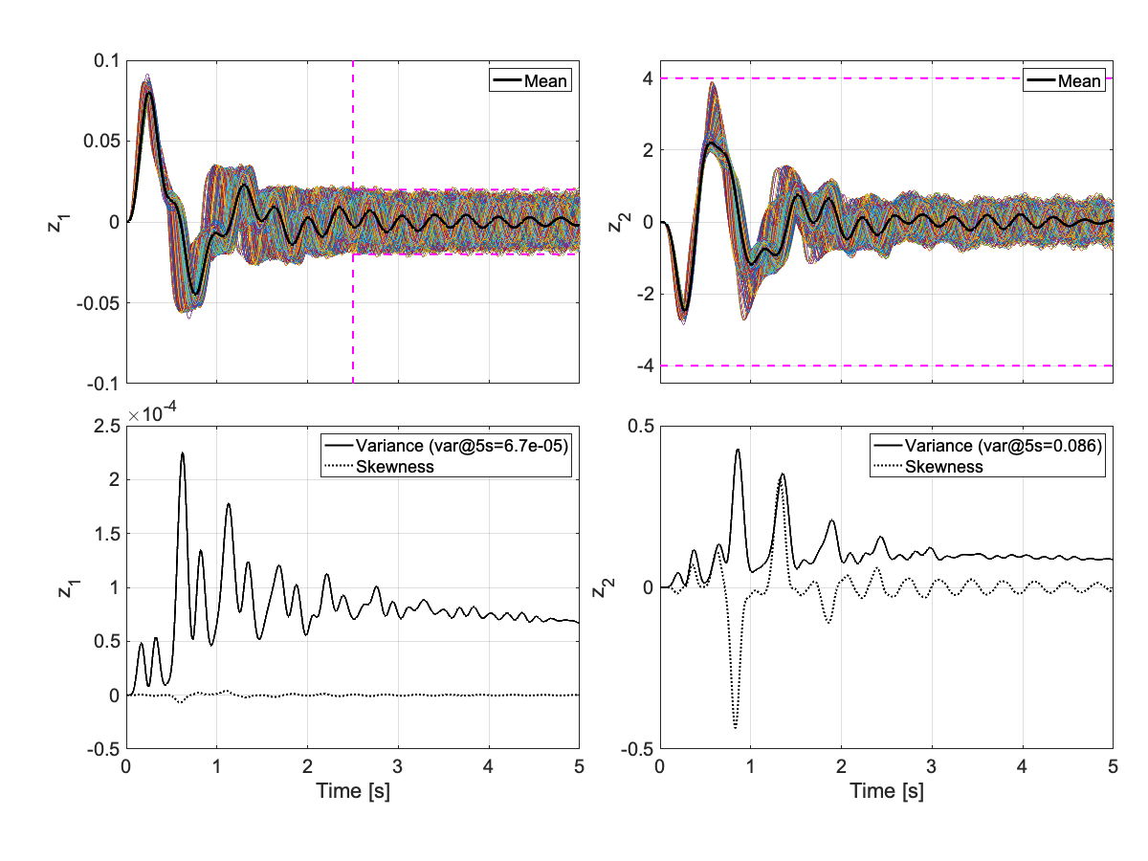
Team 4: Time Responses

Slide 39
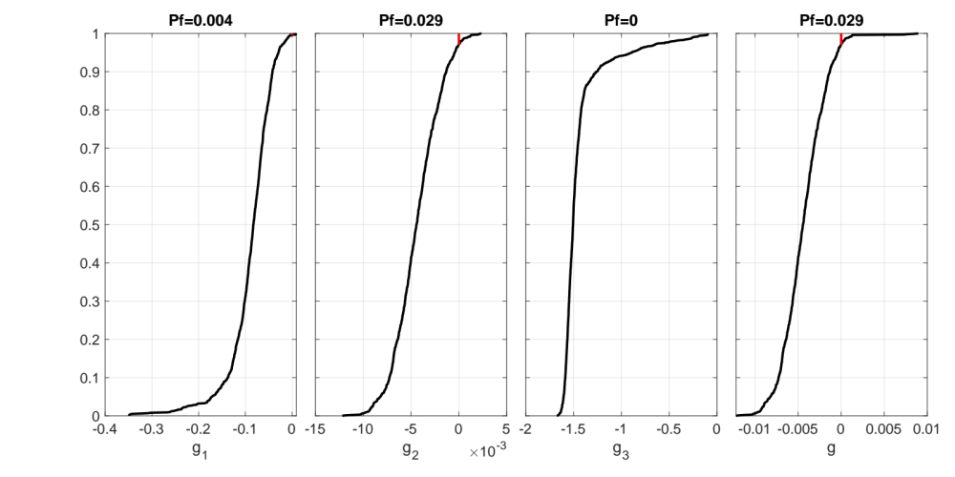
Team 4: CDFs

Slide 40
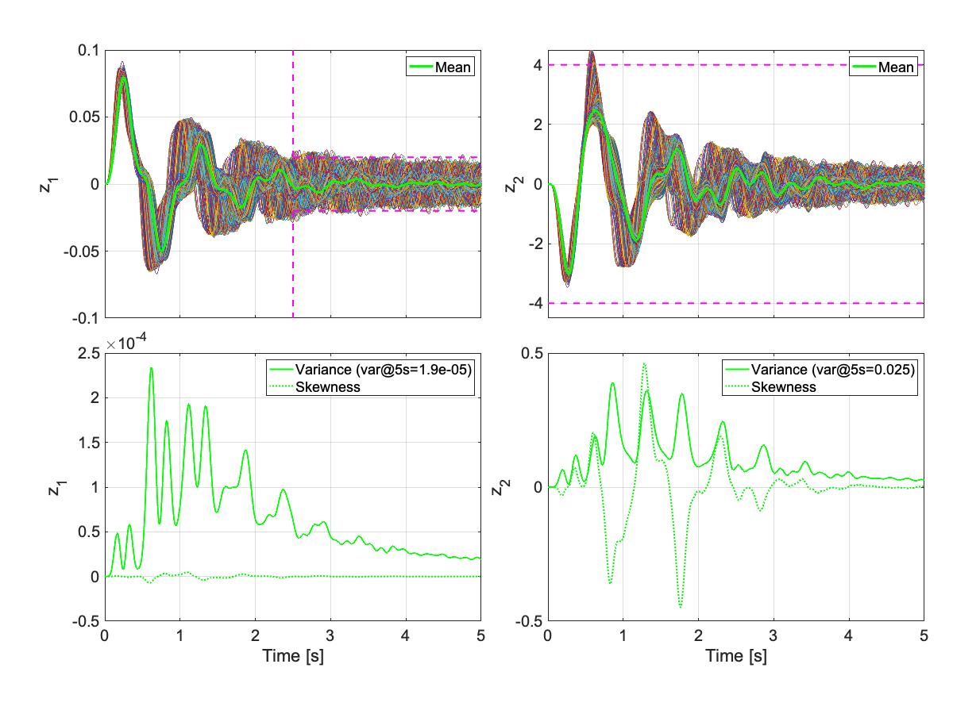
Team 5: Time Responses

Slide 41
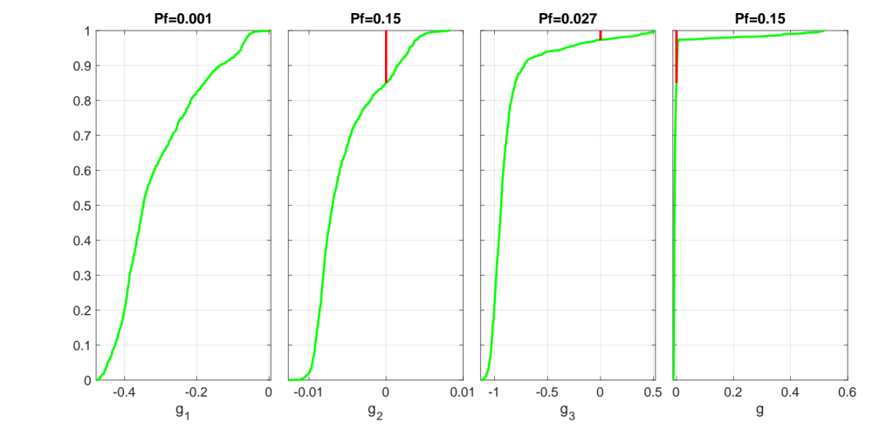
Team 5: CDFs

Slide 42
Team 2
Team 3
Sizeable residual oscillation in all cases
Team 4
Team 5

Slide 43
Team 2
Team 3
Sizeable residual oscillation in some cases
Team 4
Team 5

Slide 44
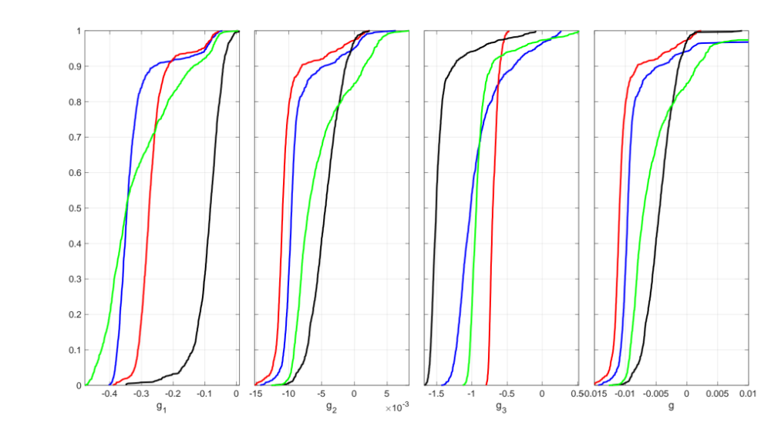
Teams 2, 3, 4 and 5
Critical req
for all teams

Slide 45
Assessment of the System Performance
 | 2 | 3 | 4 | 5
Predicted P[g₁>0] | [0, 0] | [0, 0] | [0, 0.004] | [0,0.167]
True P[g₁>0] | 0 | 0 | 0 | 0.001
Predicted P[g₂>0] | [0, 0.008] | [0, 0.075] | [0.025,0.055] | [0,0.162]
True P[g₂>0] | 0.027 | 0.049 | 0.042 | 0.15
Predicted P[g₃>0] | [0, 0] | [0,0] | [0.009, 0.018] | [0,0.005]
True P[g₃>0] | 0 | 0.035 | 0 | 0.027
Predicted P[g>0] | [0, 0.008] | [0, 0.075] | [0.028,0.056] | [0,0.255]
True P[g>0] | 0.027 | 0.058 | 0.029 | 0.15
Var of z₁ @ t=5s | 1.6e-5 | 1.3e-5 | 6.7e-5 | 1.9e-5
Var of z₂ @ t=5s | 0.003 | 0.005 | 0.086 | 0.025

Slide 46
Observations Regarding the Identified UM
Quantification of the aleatory uncertainty was poor
Quantification of the epistemic uncertainty was generally acceptable
Parameter dependencies were grossly mismodeled

Slide 47
Observations Regarding Sensitivities
Sensitivity of the subsystem vs. sensitivity of the integrated system
Different global sensitivities for different design points: a given design might be particularly sensitive to a subset of the uncertain parameters

Slide 48
General Observations
Significant variation in the results/designs among experts
Designs based on inaccurate UMs performed reasonably well

Slide 49
Open Discussion
What are the key lessons learned?
Which methods worked well, which ones did not?
What would you have done differently?
What will help you get a possibly better answer?
What will help you get an answer faster?
What area will benefit from further research?

Slide 50
The NASA Langley Challenge on Optimization
Under Uncertainty
Luis G. Crespo and Sean P. Kenny
NASA Langley Research Center

Slide 51
Motivational Ideas
What to do when the amount of data is insufficient?
  Introduce conservatism into the UM
  Use a robust design and scenario theory
Verification ⇆ Validation

Slide 52
Motivational Ideas
A good robust design might not perform well any given day
Performance
Satisfies requirements
N
Y
Scenario
Design 1

Slide 53
Motivational Ideas
A good robust design might not perform well any given day
Performance
Performance
Satisfies requirements
Satisfies requirements
N
N
Y
Y
Scenario
Scenario
Design 1 (+ complex, + robust, - performance)
Design 2 (- complex, - robust, + performance)

Slide 54
Motivational Ideas
A good robust design might not perform well any given day
Performance
⨯
Performance
Satisfies requirements
⨯
Satisfies requirements
N
N
Y
⨯
Y
⨯
Scenario
Scenario
Design 1 (+ complex, + robust, - performance)
Design 2 (- complex, - robust, + performance)
Design 1 is more robust/reliable than design 2 but the latter design performed better that day
Notes:
Robustness is unobservable

Slide 55
Motivational Ideas
A good robust design might not perform well any given day
Performance
Performance
Satisfies requirements
Satisfies requirements
N
⨯
N
⨯
⨯
Y
⨯
Y
Scenario
Scenario
Design 1 (+ complex, + robust, - performance)
Design 2 (- complex, - robust, + performance)
Design 1 is more robust/reliable than design 2 but the latter design performed better that day

Slide 56
Motivational Ideas
Reliability, risk and performance trade-off
f_{g}
P[g<0]
Risk
d
design 1
design 2
worse
d
design 1
g
E[g]
design 2
Notes:
Robust/reliable solutions are intrinsically conservative: driven by worst-case scenarios. Non-robust solutions might perform better for “best-case” scenarios

Slide 57
Motivational Ideas
How reliable is an identified UM based on limited data?
A poorly-trained validated model vs. a better-trained non-validated model
What are the convergence properties of your algorithm?
  As the value of the numerical parameters change
  As more data becomes available
  As outliers appear in the data
How to best refine the epistemic uncertainty: serial vs parallel?
Is your design policy overly/insufficiently conservative?
Notes:
e.g., ics, num sams

