Slide 1
Developing a Framework for Using In-Process Monitoring Data to Manage Risk in AM Hardware
Erin L. Lanigan, NASA Marshall Space Flight Center
November 18, 2020

Slide 2

Presenter Bio
Erin Lanigan
Native of Lenexa, Kansas (Kansas City metro)
Bachelor’s Degree in Mechanical Engineering from the University of Kansas
Non-Destructive Evaluation Team at NASA Marshall Space Flight Center since Oct. 2017
Pursuing Master’s in Mechanical Engineering at the University of Alabama in Huntsville
Focus Areas:
Infrared flash thermography
NDE of additive manufacturing
In-situ process monitoring
AM certification
In-space manufacturing

Slide 3
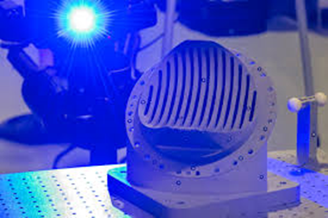
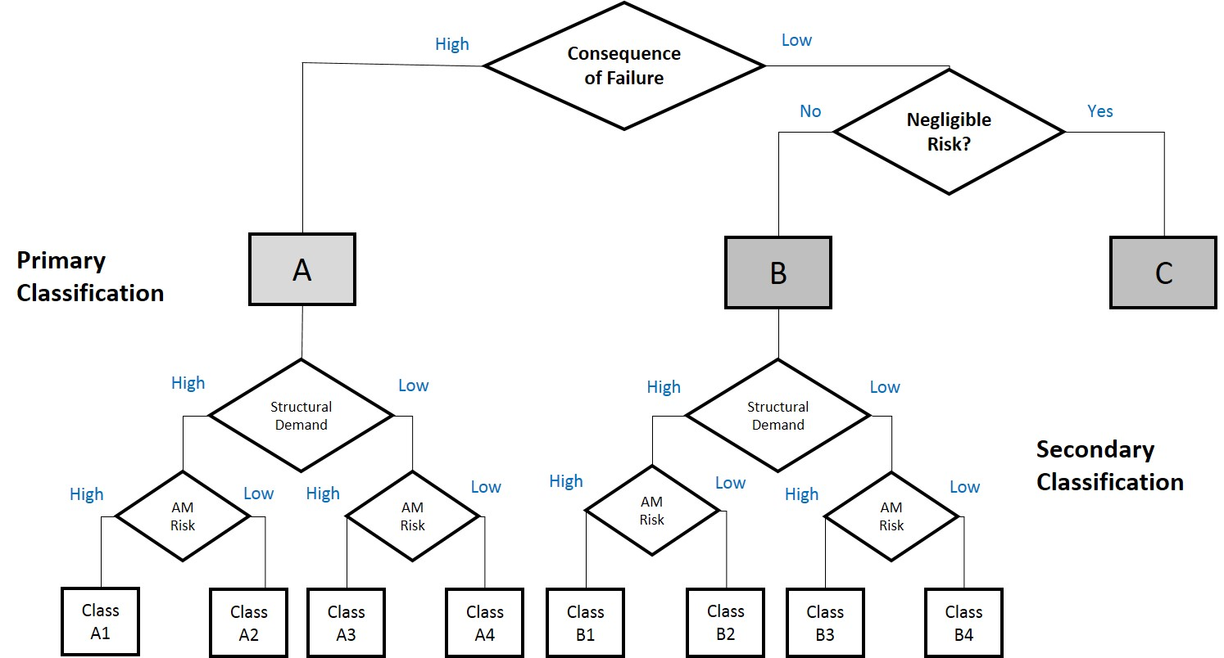

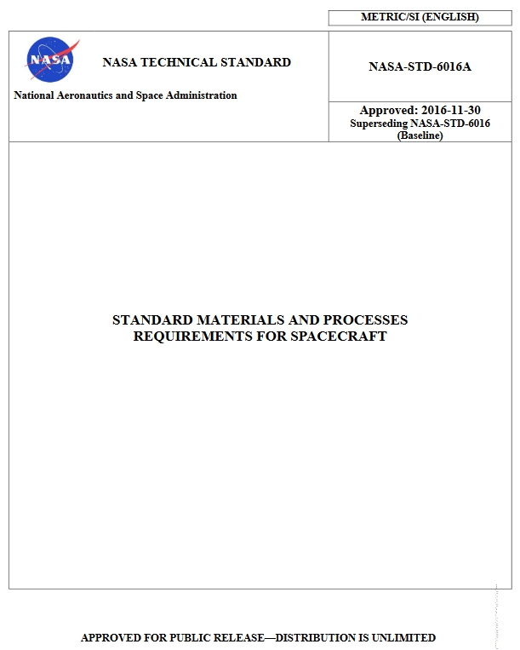

Use of In-Situ Monitoring for Managing Risk
NASA Objectives & Research Portfolio
Outlook on the Use of the Technology
Qualification Considerations

Slide 4
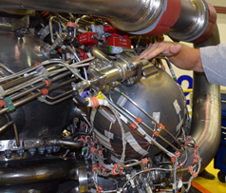
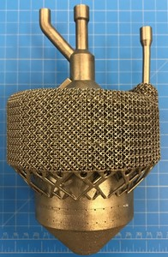
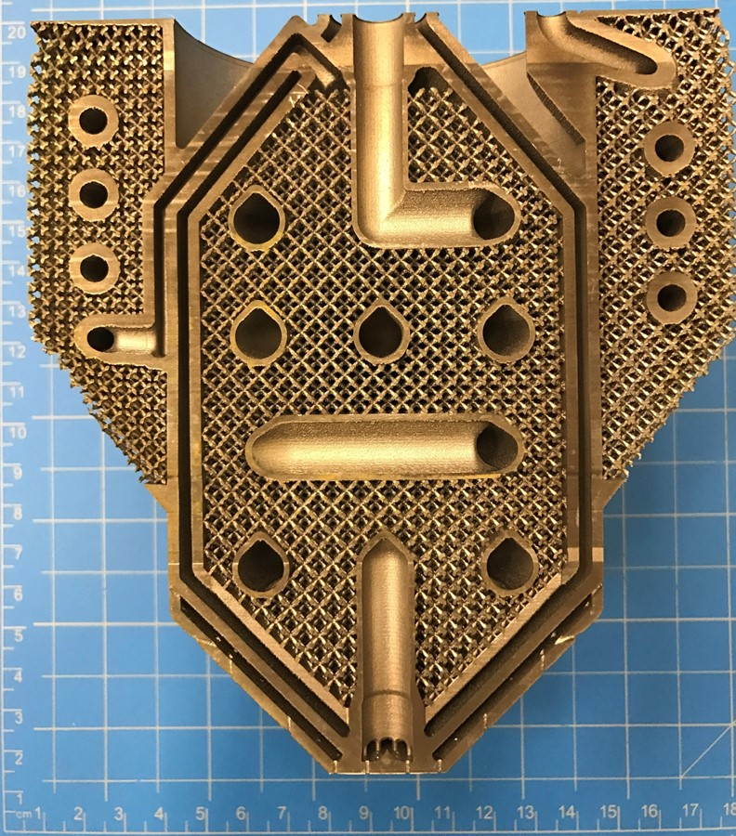
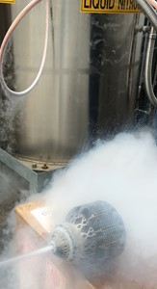
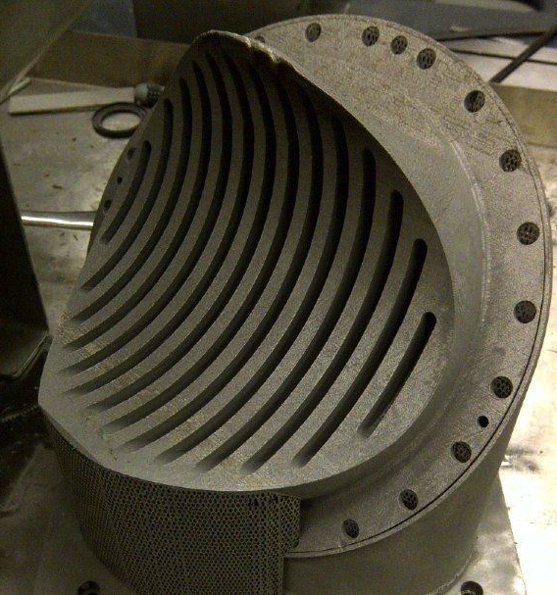
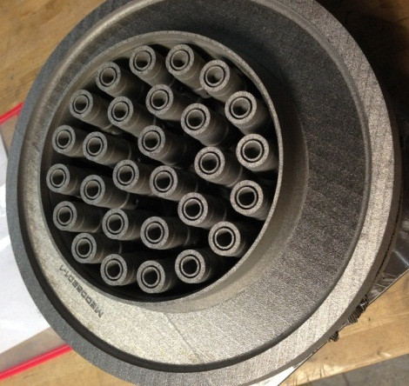
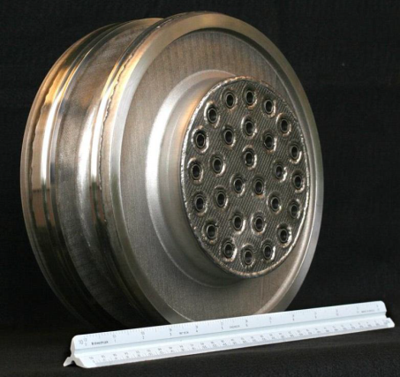
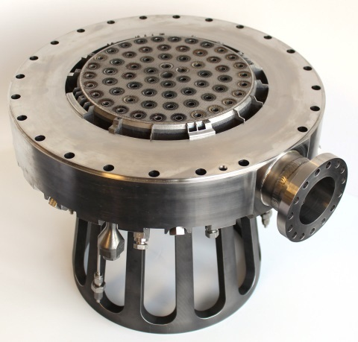
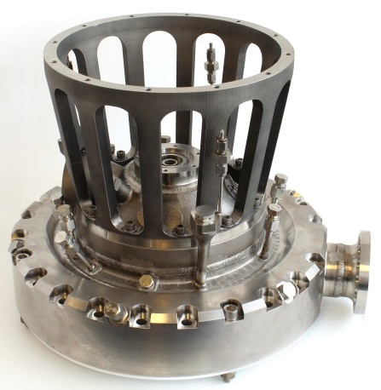
Use Case - Inspectability Challenges
NASA is most interested in in-situ monitoring for high criticality, complex parts that are difficult to inspect using traditional NDE.
Cryogenic Heat Exchanger-Injector-Condenser Demo
28-Element Inconel® 625 Fuel Injector
Reduced 163 parts to 2
Schedule reduced from 1 year to 4 months
70% cost reduction
RS-25 Pogo Accumulator Z-Baffle
Over 100 Welds Eliminated
Nearly 35% Cost Reduction
Injector Assembly
MSFC Project with Army Air and Missile Defense (AMD)

Slide 5
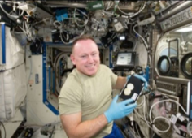
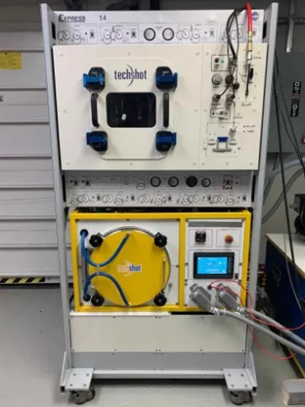
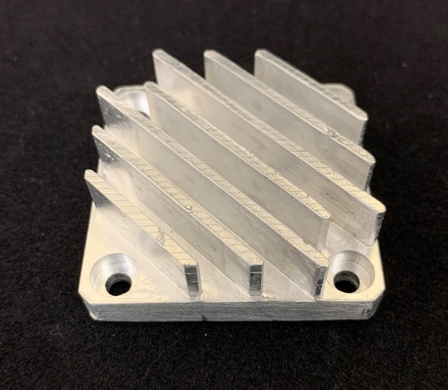
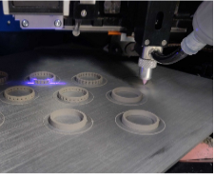
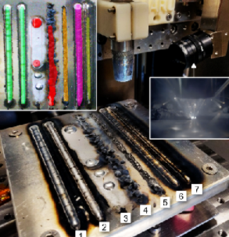

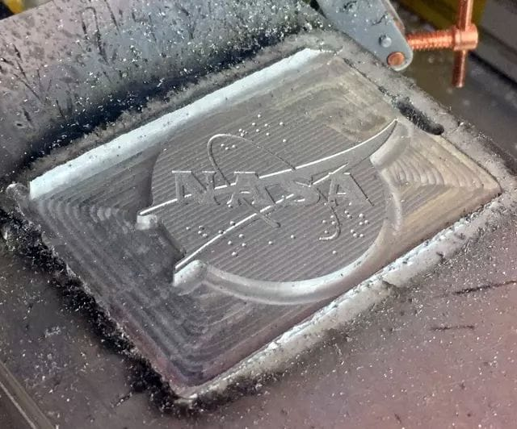
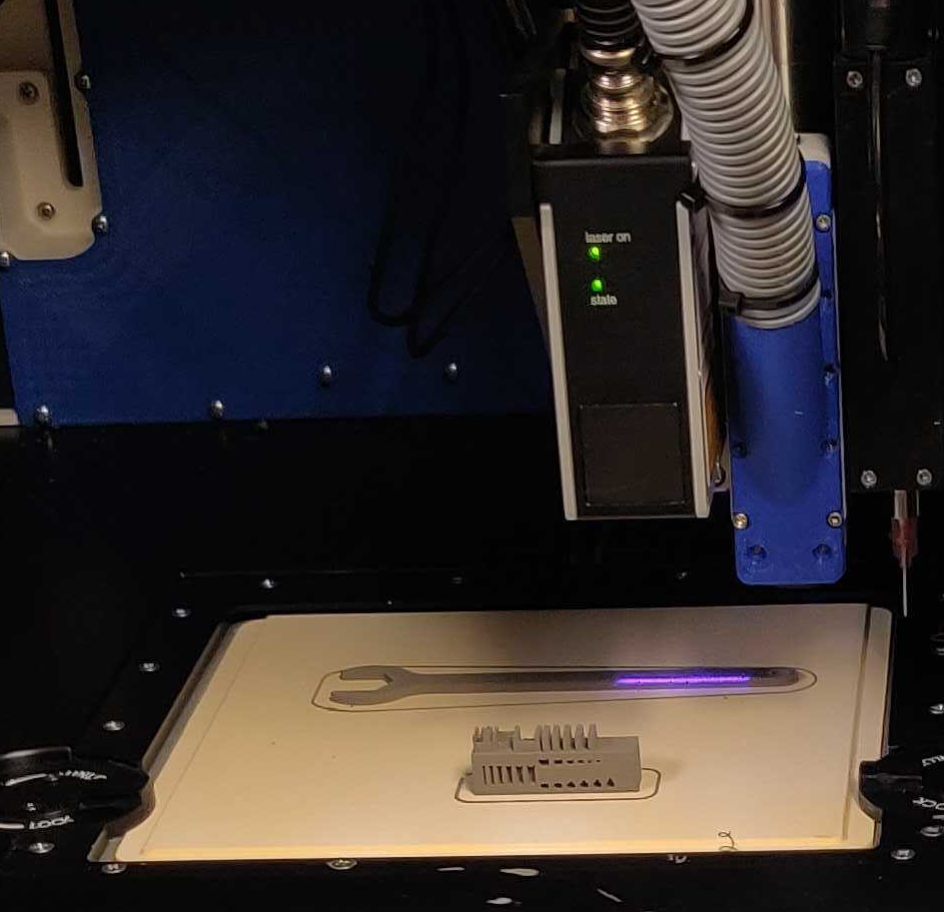
Use Case – In-Space Manufacturing
Another pressing need is the certification of parts manufactured in the space environment, where traditional nondestructive evaluation may not be available.
TechShot, Inc. FabLab
Made in Space, Inc. Vulcan
Bound Metal Deposition
Wire-Arc Additive Manufacturing
Ground-based prototype system

Slide 6
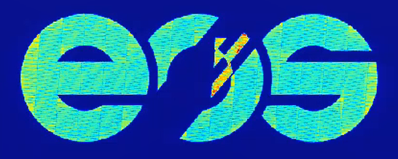
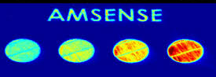
Investigating In-Situ Monitoring Technologies
Monitoring Systems
ASTM Working Group WK73289
EOS | Optical Tomography
& Meltpool Monitoring
ARCTOS | Thermal Tomography & High-Speed Spatter Imaging
NASA Marshall Space Flight Center | Automated defect detection
AM seeded defect creation | Correlating NDE and metallography data
“Standard Guide for In-Situ Monitoring of Metal Additive Manufactured Parts”
ASTM AM Center of Excellence
Small Business Innovation Research Grants
Phase III: Made in Space, Inc. | Wire Arc AM Machine Vision
Phase II: Intelligent Optical Systems | L-PBF In-Line Laser Ultrasonics
Phase I: Relativity Space Inc. | Wire-Feed AM Real-Time Defect Detection
Surveyed the landscape of in-situ monitoring technologies
Interviewed subject matter experts

Slide 7
Variety of In-Situ Monitoring Technologies
Electromagnetic Frequency Spectrum
Ultrasonic Frequency Spectrum
Monitor During Build Process
Inspection Between Build Layers
Passive
Infrared/near-IR
melt pool monitoring
Visual
Laser profilometry
(No external excitation)
Active
-
Laser ultrasonic
X-ray
(Added excitation)

Slide 8
Monitoring Different AM Systems
Powder Bed Systems
Freeform Fabrication
Laser Powder Bed Fusion (L-PBF)
Electron Beam Melting (EBM)
Selective Laser Sintering (SLS)
Laser Directed Energy Deposition (DED)
Electron Beam Free Form Fabrication (EBF³)
Rapid Plasma Deposition
Additive Friction Stir Weld
Fused Filament Fabrication (FFF)
Process:
Metals: Nickel alloys, copper alloys, titanium alloys, etc.
Polymers: nylon, polyamide
Metal powder/wire/chips
Filament: polymer, carbon fiber, biological, etc.
Feedstock:

Slide 9
Two Different Functions of In-Situ Monitoring
Process Control Function
Part Quality Function
Real-time warning of build problems
Use to check for process drift
Monitor effects of parameter changes, spatter, etc.
Not counting on it for quantitative part quality metrics or defect detection
  May help tell you where to look for a problem, but would require verification with NDE
Quantitative analysis of part quality
Requires a known correlation between indications, physics of the process, and actual defects in the finished part
Need to know probability of detection
  Extra step – verify actual size, location of created defects
Need to treat it like NDE – believe and investigate every indication
  Can’t dismiss anything as a false positive unless proven
vs.

Slide 10
Challenging the Qualification Paradigm
In-process vs. post-process NDE
Often, defect observations are indirect
  Directly observing process variation, inferring final defect
  Must understand physical basis for measured phenomena
  Need to prove a causal correlation from measured indications to defect state
Probability of detection (POD) study must include secondary verification of created defects
Closed-loop process control
Current qualification logic based on a locked process
For real-time parameter changes, a new approach is needed
no longer nondestructive

Slide 11
NASA AM Certification Approach
Policy
Procedure
MSFC-STD-3716
MSFC-SPEC-3717
MSFC Technical Standard
MSFC Technical Standard
Standard for Additively Manufactured Spaceflight Hardware by Laser Powder Bed Fusion in Metals
Specification for Control and Qualification of Laser Powder Bed Fusion Metallurgical Processes
NASA-STD-6030
NASA-SPEC-6033
NASA-STD-6016A
NASA Technical Standard
NASA Technical Standard
Additive Manufacturing Requirements for Crewed Spaceflight Systems
Additive Manufacturing Requirements for Equipment and Facility Control
Requirements for traditional manufacturing – also apply to AM

Slide 12
Comprehensive NDE Requirement
The new NASA standards require comprehensive NDE for surface and volumetric defects, unless otherwise substantiated.
Language:
“All AM parts shall receive comprehensive nondestructive evaluation (NDE) for surface and volumetric defects within the limitations of technique and part geometry unless otherwise substantiated as part of the Integrated Structural Integrity Rationale [ISIR] of PPP [Part Production Plan] per section 7.3”
Rationale:
“NDE provides a necessary degree of quality assurance for AM parts in addition to the process controls of this NASA Technical Standard.”
“There is currently no methodology to preclude all AM process failure modes through the available process controls.”
(emphasis added)

Slide 13
Qualified In-Situ Process Monitoring
However, passive in-situ process monitoring may be used as a quantitative indicator of part quality, if qualified by the CEO.
Language:
“Prior to use as a quantitative indicator of part quality, passive in-situ process monitoring technologies shall be qualified by the CEO to the satisfaction of NASA in a manner analogous to other NDE technologies.”
Rationale:
“All processes that are used to establish quantifiable quality assurance metrics are qualified to verify detection reliability, calibration, and implementation against established criteria. If in-situ monitoring techniques are employed for such purposes… the need for such qualification is unchanged.”
“Certification of a passive in-situ monitoring technology relies upon:
  A thorough understanding of the physical basis for the measured phenomena
  A proven causal correlation of the measured phenomena to a well-defined defective process state, and a proven level of reliability for detection of the defective process state.”
(emphasis added)

Slide 14
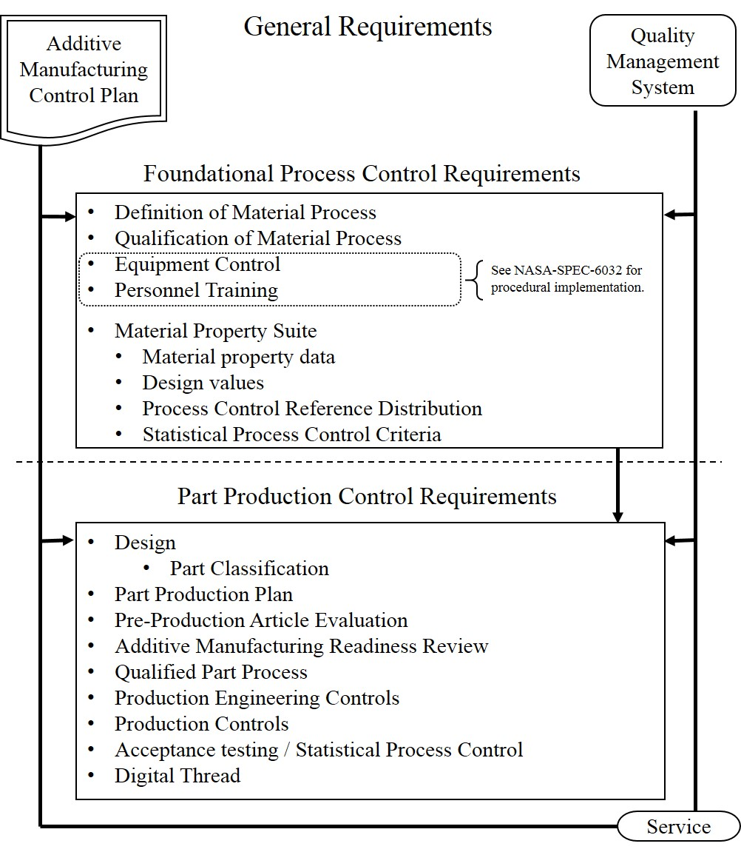
Qualification Flow Chart
In-situ monitoring can factor into several aspects of part certification.
Qualification of Material Process (QMP)
  Use in sync with process development
Part Classification
  Improve inspectability for better risk posture
  Inspection process must be qualified by CEO
Part Production Plan
  Integrated Structural Integrity Rationale (ISIR):
    Can be specified as a defect screening action
    Must be qualified by CEO
Production Controls
  Could develop certain metrics to track over time
Definition of Material Process
Qualification of Material Process
Equipment Control
Personnel Training
Material Property Suite
  Material property data
  Design values
  Process Control Reference Distribution
  Statistical Process Control Criteria
{
See NASA-SPEC-6033 for procedural implementation
Design
  Part Classification
Part Production Plan
Pre-Production Article Evaluation
Additive Manufacturing Readiness Review
Qualified Part Process
Production Engineering Controls
Production Controls
Acceptance testing / Statistical Process Control
Digital Thread

Slide 15
AM Risk Classification
Risk-based part classifications for AM parts consider the risk of AM manufacturability and inspectability.
Catastrophic Failure?
Heavily Loaded?
Does the build have challenging aspects or areas that cannot be inspected?
Notes:
Part Classification system is a risk communication tool
What happens if the part fails? How severe is the stress in the part? How challenging is the part to design, build, and inspect?
. By looking at the classification we get a quick and consistent view into the risk posture for that piece of hardware.
The higher a part’s classification, the more stringent the downstream requirements become
Non-destructive evaluation needs will differ

Slide 16
Adaptive (Closed-Loop) Systems
The current certification approach does not accommodate the use of adaptive systems.
“Active in-situ monitoring technologies that alter the defined AM process in response to monitored phenomena are not currently acceptable per this NASA Technical Standard.”
Adaptive (Closed-Loop) Systems:
Monitor the process using sensors (e.g. meltpool thermal signature) and change a machine/process parameter (e.g. laser power) to optimize the response
Currently available in many directed energy deposition (DED) systems
Two issues for verification:
Verify the sensor performance, algorithm and machine response
Verify the physics – does controlling this parameter result in a good part?
(control system)
(materials)

Slide 17
Control System Verification
For certifying closed-loop control systems, NASA can leverage the expertise of the spacecraft control systems community.
Verification of a control system:
Verify the accuracy of the sensor data
Verify the software/algorithm processing and response
Verify that the changed parameter responds correctly
Black box issue:
For commercial systems, machine parameters may not be known, algorithms may not be accessible
Ideal approach: collaborate with machine manufacturers
Can also develop transfer function by studying inputs/outputs

Slide 18
Material Control Verification
Verifying that the adaptive system results in good material is a challenge that will require further study.
What is being monitored, and to what end?
Assume you’re monitoring the meltpool thermal emissions
Are you looking to keep it constant, or vary it based on part geometry?
What does it really tell you about the process and the material?
Is this a good indicator of material quality?
Is the resulting microstructure/morphology consistent and repeatable?
What parameter will you change?
More complex if monitoring multiple signals and/or changing multiple parameters
Qualify process for each different system, alloy, part?

Slide 19
Conclusions
In summary, NASA encourages and wants to help enable the use of in-situ process monitoring for AM certification.
Use for process monitoring is highly encouraged.
→ Will help inform, develop, and prepare for part quality function
To use for quantitative part quality function, monitoring system must be qualified.
→ Main challenge: developing correlation of indication to verified defect
Qualifying closed-loop, adaptive systems will require a new approach to the QMP.
Thank you for your time!

Slide 20
Thank you.
Erin Lanigan, NASA Marshall Space Flight Center
November 18, 2020

