Slide 1
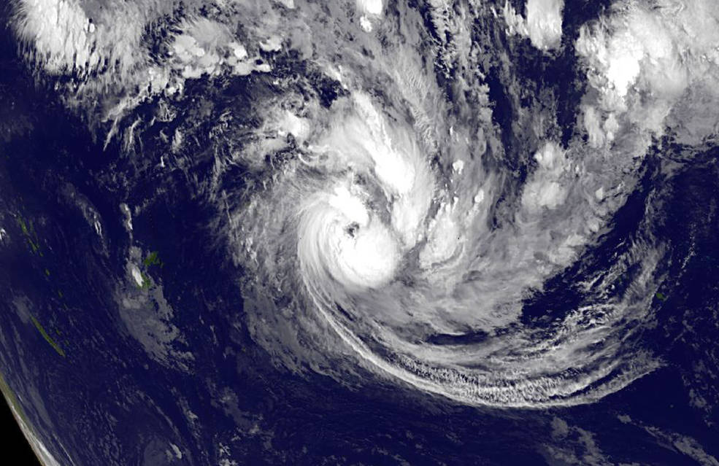


Making an IMPACT: From Open Data to Open Science
Dr. Rahul Ramachandran
Manager | Inter-Agency Implementation and Advanced Concepts Team (IMPACT)
Senior Research Scientist | Earth Science Branch (ST11)
Marshall Space Flight Center/NASA
Huntsville, Alabama 35812, USA
Updated 10/26/2020

Slide 2
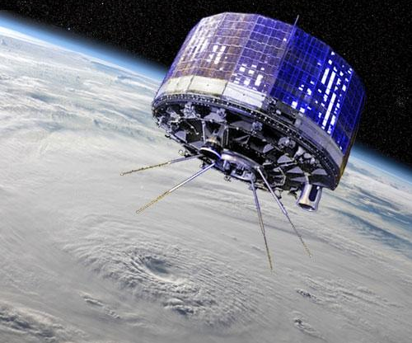
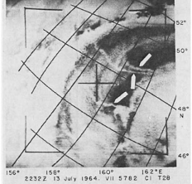
TIROS Series
Experimental satellites developed with the Weather Bureau
1st launched in April 1960
Series continued into the 1980s
Observation of anomalous cloud lines in the TIROS satellite imagery by Conover (1966), which he attributed to the impact of smoke emissions from ships on marine stratus clouds (Noone, 2000). Twomey et al. (1968) later showed that this phenomenon is caused by aerosols in ship exhaust functioning as cloud condensation nuclei increasing the albedo of clouds. Twomey’s work eventually motivated the research on indirect radiative effect of aerosols, a field of research active to the present day.
TIROS-1 (or TIROS-A) was the first successful weather satellite launched by NASA

Slide 3
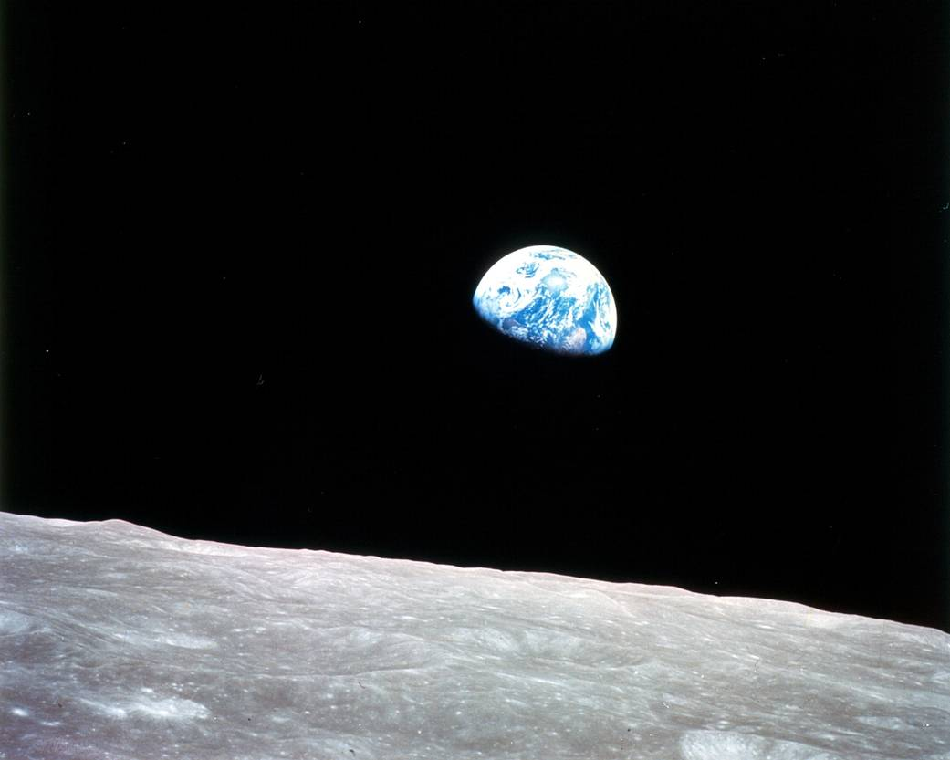
Earthrise: Apollo 8 December 1968
Changed our perspective of the planet
1970: NOAA is created
1970: EPA is created
1970: First Earth Day
1970: Clean Air Act
1972: Clean Water Act
1972: Landsat 1
Notes:
Earthrise: photo taken from lunar orbit during Apollo 8, photo taken by astronaut Bill Anders, around Christmas
watershed moment that changed how we view our planet
(think ‘pale blue dot’ from Carl Sagan)
series of major milestones in environmental policy

Slide 4

Blue Marble
Taken by the crew of Apollo 17 in December 1972
Became a symbol of the environmental movement
Helped gain momentum for a recognized Earth science program within NASA

Slide 5
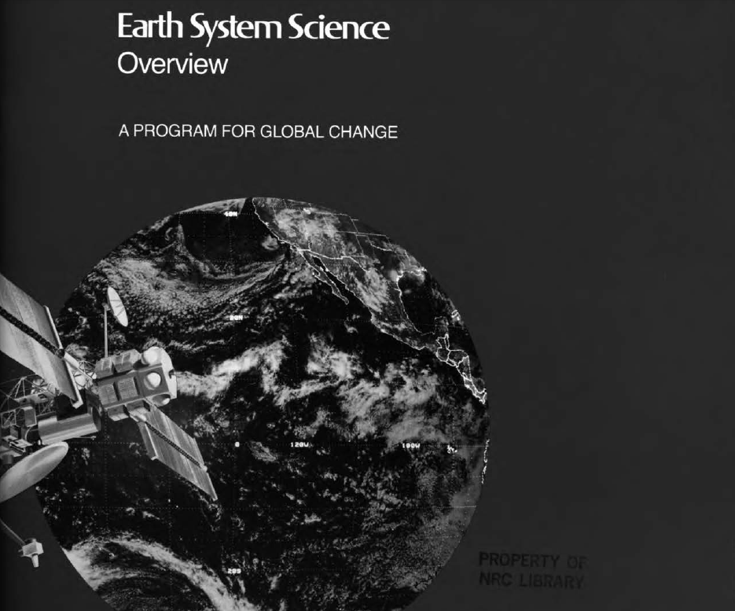
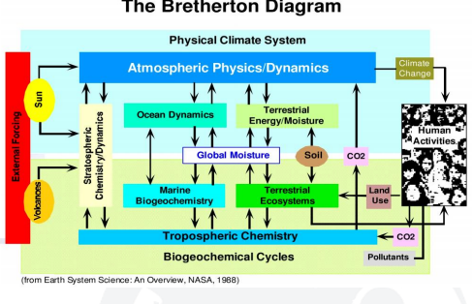
Earth System Science Report (1986)
1985
Mission to Planet Earth proposed
Would study Earth as an interconnected system
1986
NASA Earth System Sciences Committee recommends a program for Earth observations
Notes:
https://sites.nationalacademies.org/cs/groups/ssbsite/documents/webpage/ssb_174603.pdf
Groundbreaking image
Shows the multidisciplinary nature of studying Earth as a system, how connected and interdependent the systems are

Slide 6
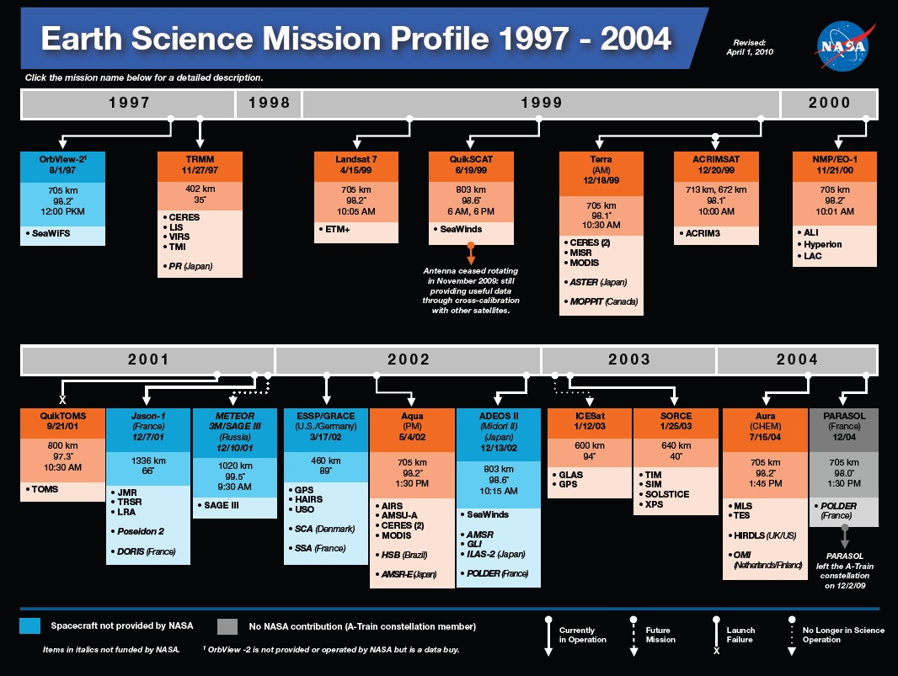
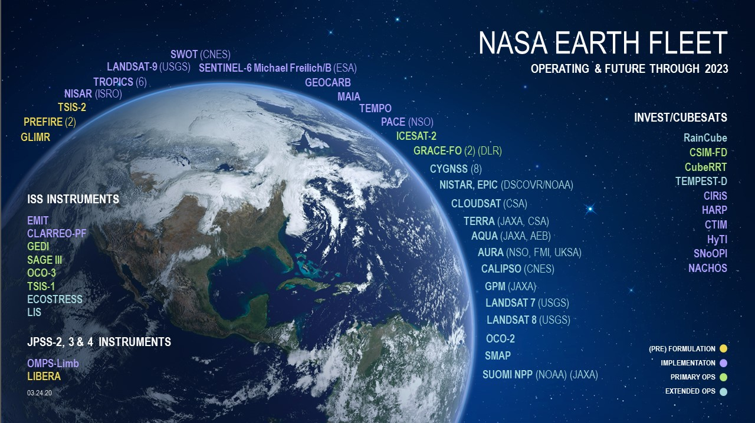
Key Elements from the Report (1986)
Proposed the Earth Observing System
Notes:
1987 - first data distributed online (Note internet took off in 1991)
Only 2% distributed but still a significant increase over physical distribution
O 2% of data but saw dramatic increase in data use

Slide 7
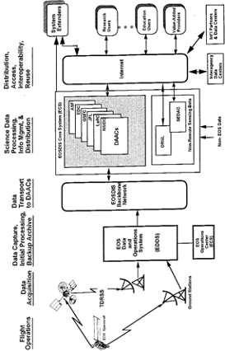
Key Elements from the Report (1986)
Recommended ‘an advanced information system’, Of ‘paramount’ importance
Requirements described
  Data catalogs
  Browse capabilities
  Full documentation on sensors, algorithms, missions & data
Notes:
1987 - first data distributed online (Note internet took off in 1991)
Only 2% distributed but still a significant increase over physical distribution
O 2% of data but saw dramatic increase in data use

Slide 8
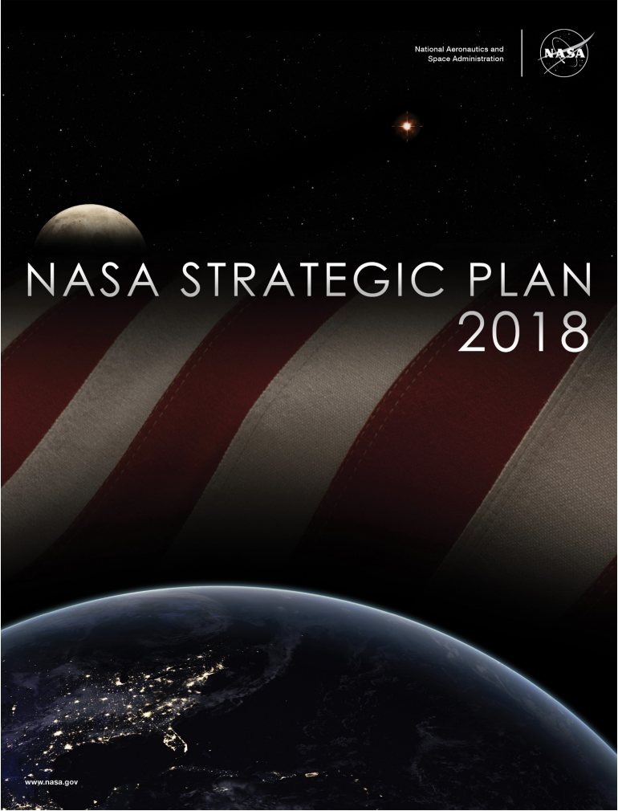
Earth Science – NASA’s Strategic Goal
This ability to observe our planet comprehensively matters to each of us, on a daily level. Earth
information—for use in Internet maps, daily weather forecasts, land use planning, transportation
efficiency, and agricultural productivity, to name a few—is central to our lives, providing substantial contributions to our economies, our national security, and our personal safety. It helps ensure we are a thriving society. - NRC, 2018
NASA’s Strategic Goal 1.1: “Understand The Sun, Earth, Solar System, And Universe.”
Notes:
Observe our planet comprehensively to address science questions as well societal applications

Slide 9
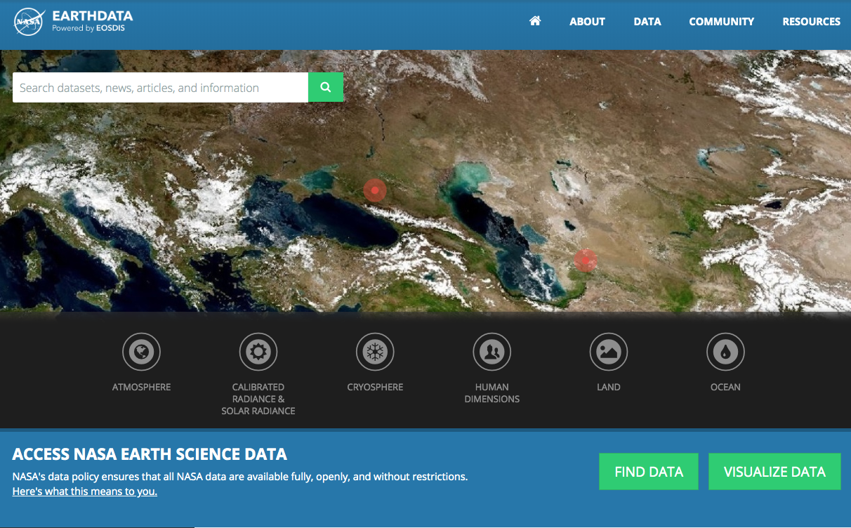
Earth Science Data System Program
The Earth Science Data System Program is an essential component of the Earth Science Division and is responsible for:
Actively managing NASA’s Earth science data (Satellite, Airborne, and Field).
Developing unique data system capabilities optimized to support rigorous science investigations and interdisciplinary research.
Processing (and reprocessing) instrument data to create high quality long-term Earth science data records.
Upholding NASA’s policy of full and open sharing of all data, tools, and ancillary information for all users.
Engaging members of the Earth science community in the evolution of data systems.
https://earthdata.nasa.gov
The Earth Science Data and Information System (ESDIS) project/GSFC maintains and operates a data and information system for Science Mission Directorate (SMD) and its Earth Science Division (ESD). IMPACT at MSFC supports ESDS Program and collaborates with ESDIS project

Slide 10
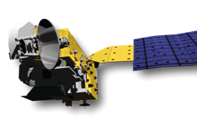
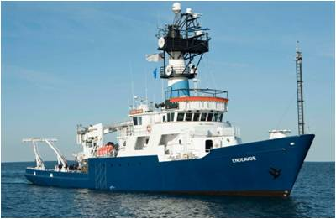
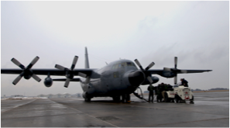
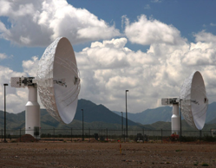
Earth Observing System Data and Information System (EOSDIS)
EOSDIS
Users
Research
distribute
Applications
Education
data downlink
subset
archive
capture and clean
process
Notes:
Functional view of what EOSDIS capabiities

Slide 11
Data are Produced and Managed by
Science Discipline Experts
ASF DAAC
SAR Products, Sea Ice, Polar Processes
U. of Wisc.
SNPP Atmosphere
SEDAC
Human Interactions in Global Change
LPDAAC
Land Processes and Features
CDDIS
Crustal Dynamics Solid Earth
NCAR, U. of Co.
MOPITT
GSFC
SNPP, MODIS, OMI, OBPG
JPL
MLS, TES, SNPP Sounder
OB.DAAC
Ocean Biology and Biogeochemistry
ORNL
Biogeochemical Dynamics
PO.DAAC
Ocean Circulation
Air-Sea Interactions
NSIDC DAAC
Cryosphere, Polar Processes
LAADS/MODAPS
Atmosphere
GHRC
Hydrological Cycle and Severe Weather
ASDC
Radiation Budget, Clouds, Aerosols, Tropo Composition
SIPS
DAAC
GHRC
AMSR-U, LIS

Slide 12
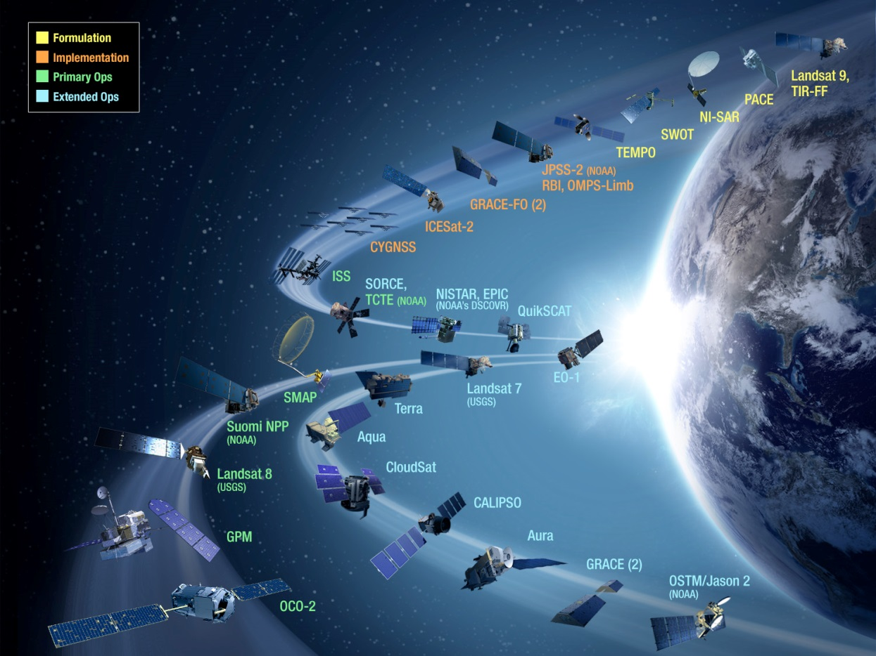





Extensive Data Collection
Started in the 1990s, EOSDIS today has 11,000+ data types (collections)
  Cover & Usage
  Surface temperature
  Soil moisture
  Surface topography
  Surface temperature
  Surface wind fields & heat flux
  Surface topography
  Ocean color
  Winds & Precipitation
  Aerosols & Clouds
  Temperature & Humidity
  Solar radiation
Land
Ocean
Atmosphere
  Population & Land Use
  Human & Environmental Health
  Ecosystems
  Sea/Land Ice & Snow Cover
Human Dimensions
Cryosphere

Slide 13
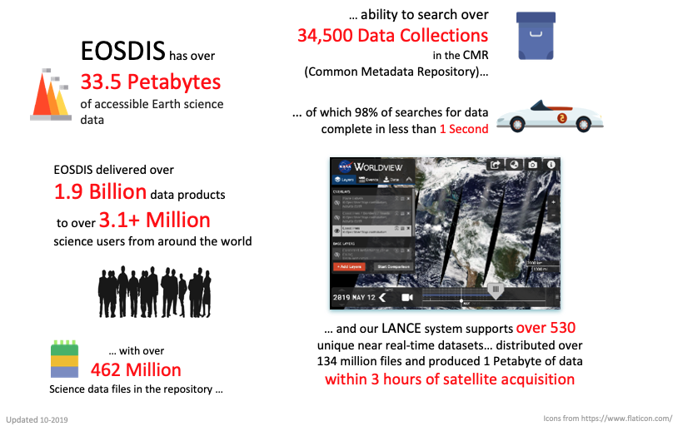
ESDS Program By The Numbers

Slide 14
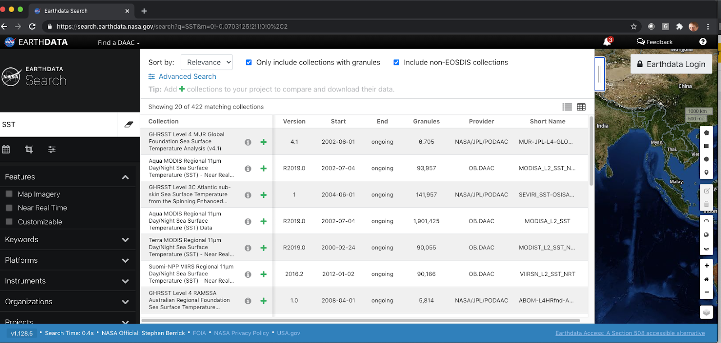
Earthdata Search
https://search.earthdata.nasa.gov

Slide 15
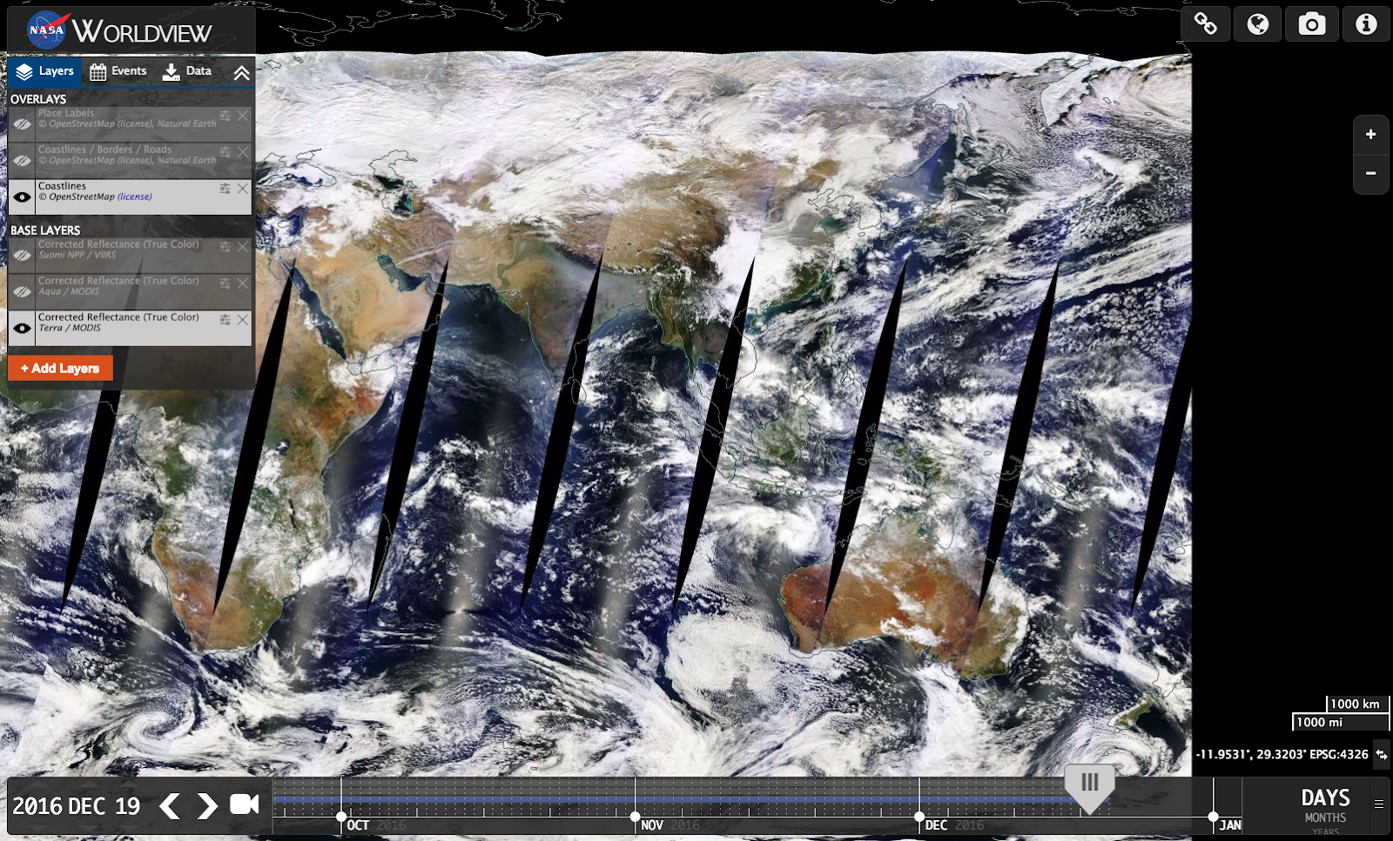
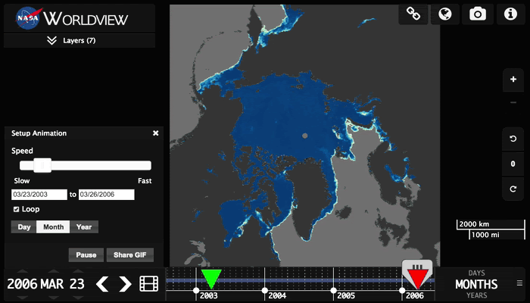
Worldview + GIBS
General-purpose, full-resolution satellite imagery browser built to:
  Explore
  Compare
  Download
  Share
  Educate
Key Features
  Browser-based and open source
  Animation capabilities
  Event Browser
https://worldview.earthdata.nasa.gov

Slide 16
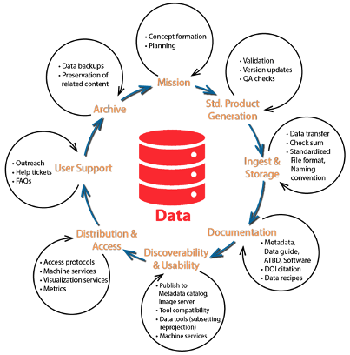

Data and Research Lifecycle (1)
Actively manage NASA’s Earth science data (Satellite, Airborne, and Field) through the entire data life cycle
Use systematic and engineered process for data stewardship
Process (and reprocess) instrument data to create high quality long-term Earth science data records
Uphold NASA’s policy of full and open sharing of all data, tools, and ancillary information for all users

Slide 17
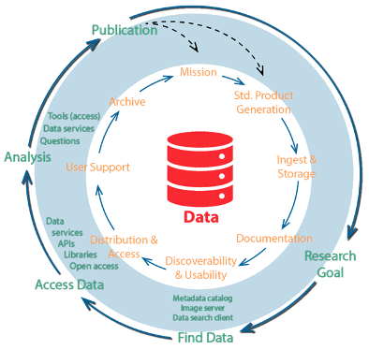
Data and Research Lifecycle (2)
Develop and provide unique data system capabilities optimized to support rigorous science investigations and interdisciplinary research
Data system supports the research life cycle
Utilize standards to ensure interoperability with other systems/agencies/organization
Engage members of the Earth science community to evolve the data systems

Slide 18
IMPACT Mission
Empowering Open Science and Applications by integrating Data, Technology and People together
DISCOVERY
ACCESS
USE
How can we ensure users find the right data set for their problem?
Informatics, Information Modeling, Data Stewardship
Example Project: CMR ARC
How can we minimize the users burden to access our data?
Data Systems, New technologies (Cloud)
Example Project: MAAP
How do we enable users to extract new knowledge/information from the archives?
Data Science, ML, New tools and algorithms
Example Projects: Hurricane/Phenomena Portal, Keyword recommender,
Notes:
Foster Innovation to reduce friction to data discovery, access and use via technology and process innovation
Strategic partnerships to expand data use ( other federal agencies, private partnerships)
Technology – proactive rather than reactive
Data and Information Systems cant be all things to all users
Need to ensure that Data and Information systems are scoped to do key core things well
Then leverage connections to scale out our capabilities
Attributions:
Noun project
innovation by Eric Bird from the Noun Project
connection by Guilherme Furtado from the Noun Project
Information Technology by Becris from the Noun Project

Slide 19
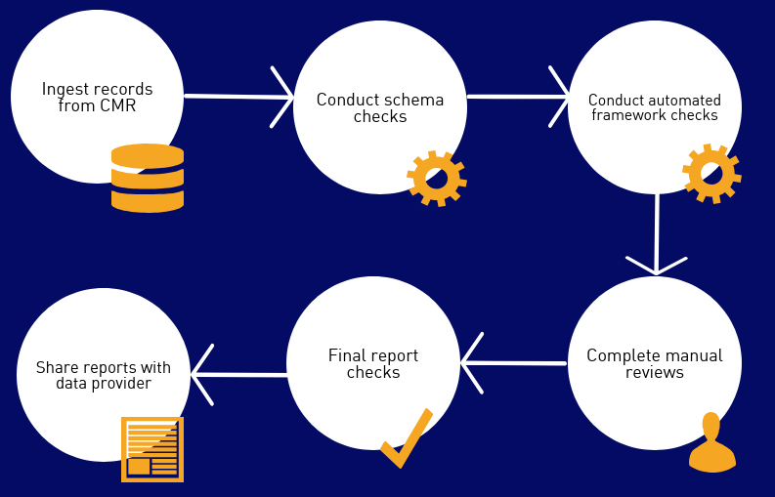
Analysis and Review of CMR (ARC)
Need: Improve the discoverability, accessibility and usability of NASA’s Earth science data holdings by ensuring all NASA metadata records in the NASA Common Metadata Repository (CMR) meet a minimum standard of quality
Objectives
Improved discoverability of NASA Earth science data in platforms that leverage CMR metadata
Appropriate data access points provided in all NASA metadata records
Users searching for NASA Earth science data see improvements in information consistency
Deliverables
Submit detailed reports to the NASA DAACs identifying metadata issues as well as actionable recommendations on how to improve metadata quality
Provide a metadata curation tool to streamline communication of findings between the ARC team and the DAACs
Provide best practices documentation to the metadata community

Slide 20
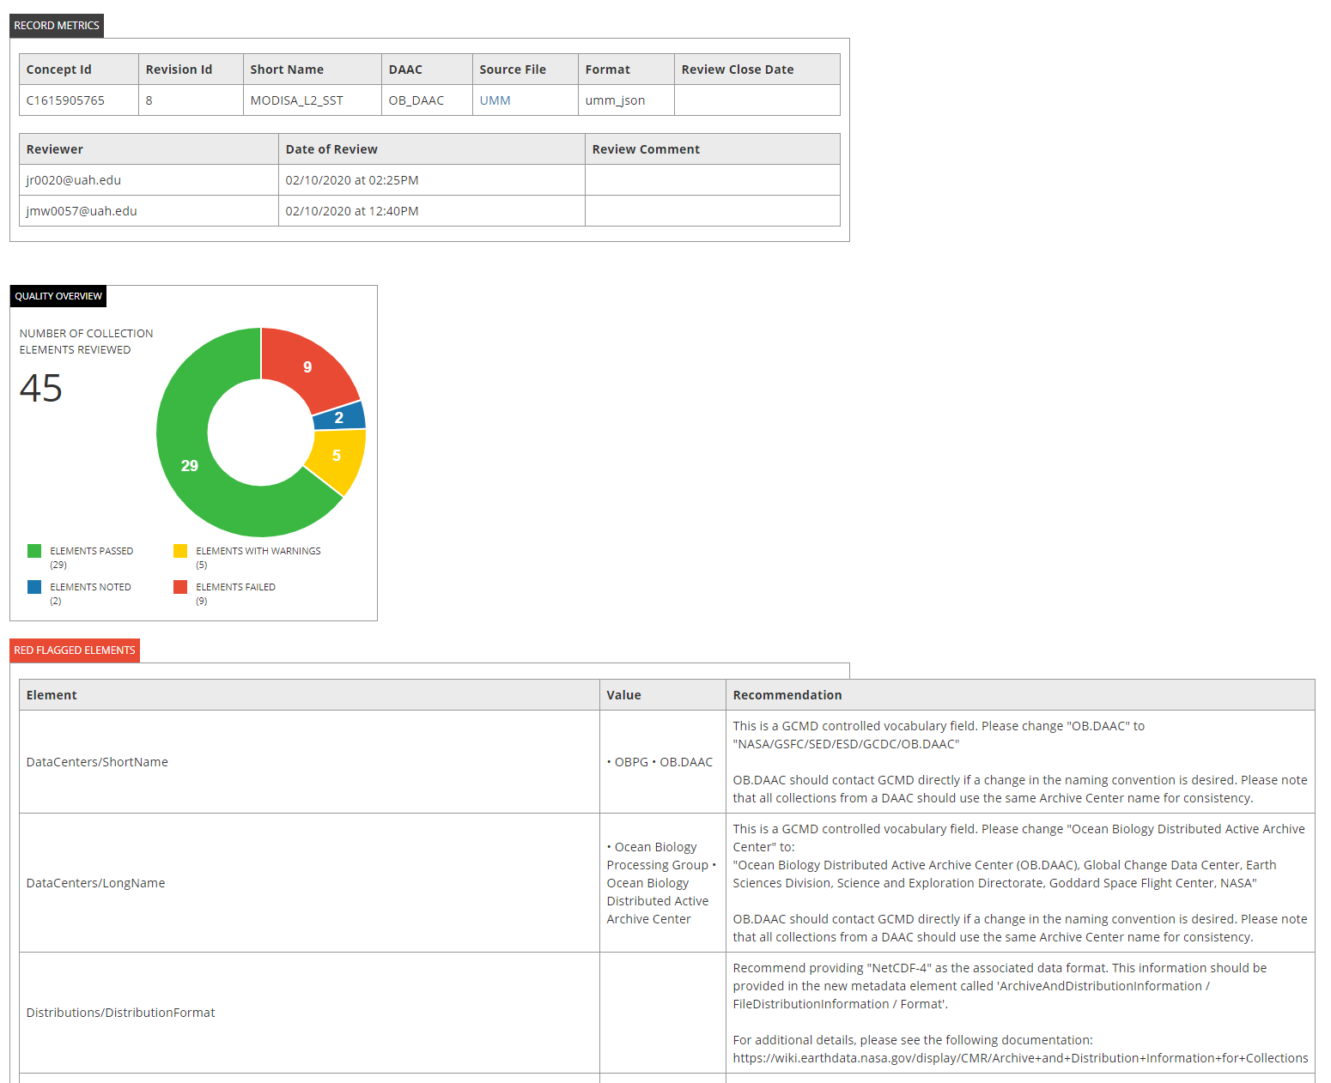
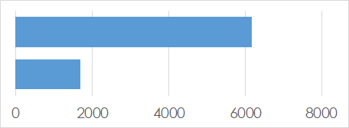
ARC: Impact
To date, ARC has conducted detailed assessments of metadata from all 12 DAACs. Key outcome include:
Increased consistency in metadata across the 12 DAACs
More complete metadata records & addition of new elements
Updated/improved metadata content (science keywords, abstracts, URLs, correct element usage, etc.)
Records Reviewed
Remaining Records
Example of a metadata quality report.

Slide 21



Multi-Mission Algorithm and Analysis Platform (MAAP)
Need: Establish a collaboration framework between ESA and NASA to share data, science algorithms and compute resources in order to support scientific research conducted by NASA and ESA scientists.
MAAP is a cloud-based environment dedicated to the unique needs of sharing and processing data from relevant field, airborne and satellite measurements related to ESA and NASA missions
Jointly managed by ESA and NASA and accessible to designated ESA and NASA scientists.
Initially populated with pre-launch and complimentary data from other projects.
Science focus is to improve the understanding of global terrestrial carbon dynamics & to support algorithm development
  Focus on using data from GEDI, BIOMASS and NISAR missions
Notes:
current paradigm - download the data then you are limited by your resources.
Cloud based approaches - compute is next to the data, you dont have to download and make redundant copies, scale out our processing and analysis

Slide 22
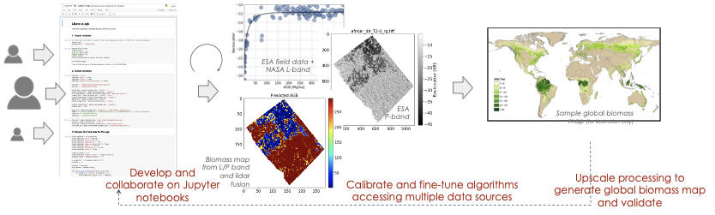
MAAP Objectives
Prototype new and innovative data system solutions to enable open science in cloud-based platforms
Enable seamless open access to airborne, spaceborne and field data from both ESA and NASA
Provide the ability to upscale user algorithms from small regions to global scale
Enable collaboration on end-to-end calibration and validation of higher-level science products

Slide 23
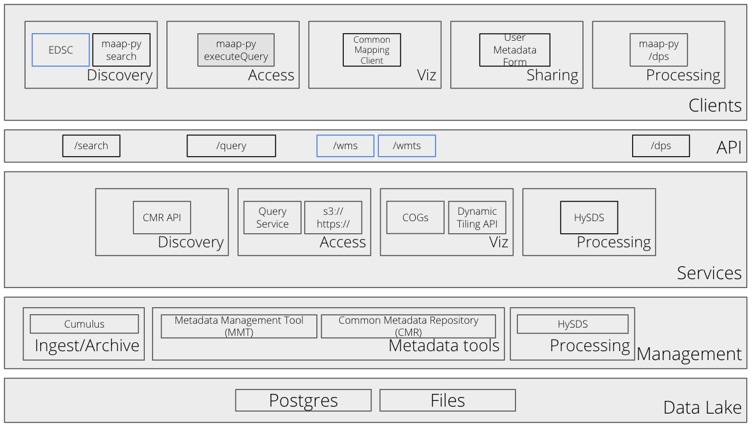
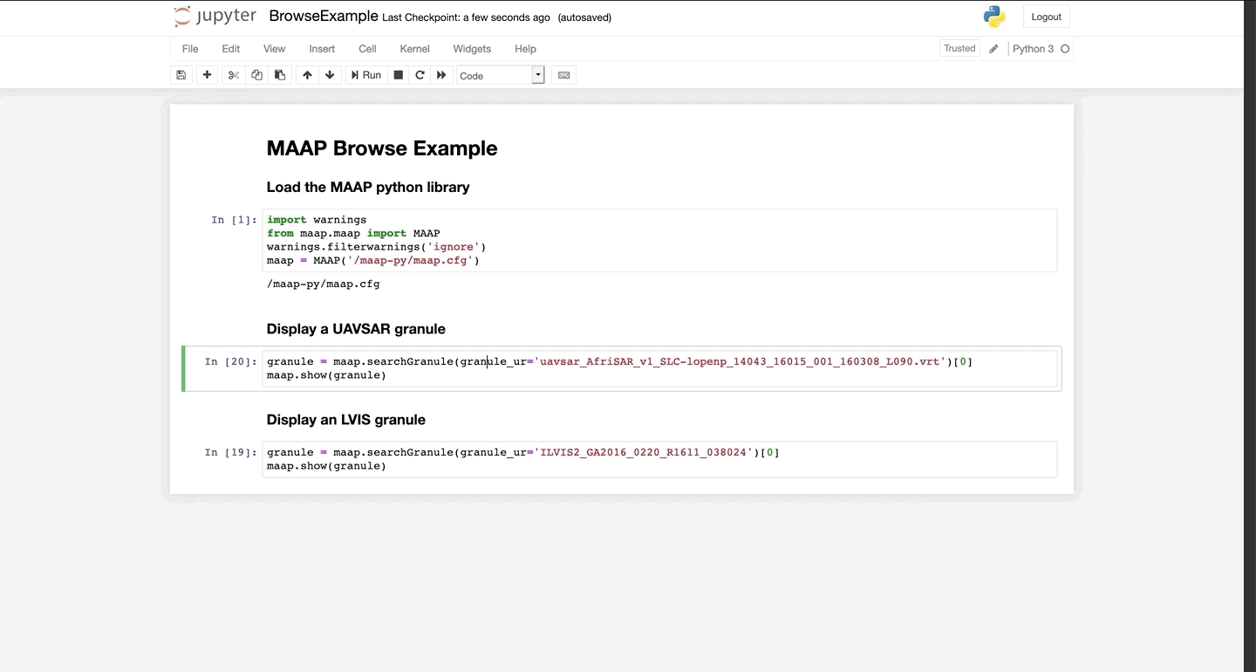
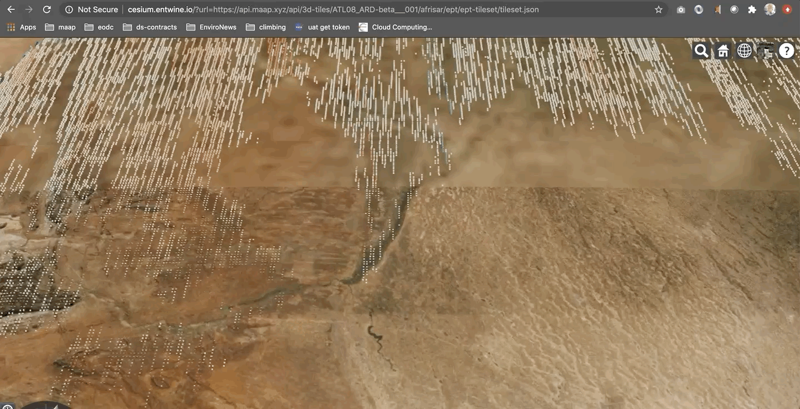
Multi-Mission Algorithm and Analysis Platform (MAAP)
IMPACT Deliverables
Develop a cloud-based data ecosystem to support open science
Develop a harmonized information model to prototype a graph database to enable discovery of data, software, algorithms and documentation
ICESat-2 Data in EPT Format (Point Cloud)
Notes:
ICESat-2 ATL08 - over the Afrisar region of interest (Gabon)

Slide 24

Tropical Cyclone Intensity Estimation Portal
Need: Demonstrable examples of AI/ML using EO data
Objectives
Use a Deep Learning (DL) method to objectively estimate tropical cyclone intensity
Create a situational awareness tool to display estimation and other information in real-time
Use cloud infrastructure (cumulus) to build a real-time system triggered by event notification
Deliverable: Demonstration Portal
http://hurricane.dsig.net/

Slide 25
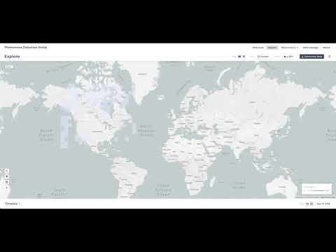
Phenomena Detection Portal
Need: Enable event based search for different phenomena
Objectives:
Discover and store interesting events using DL algorithm
Use event space/time parameters to enable search for relevant datasets
Leverage Cumulus framework to run DL operationally
Utilize GIBS server for image
Deliverable: Demonstration Portal
http://phenomena.surge.sh/

Slide 26
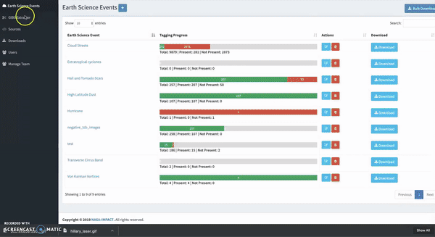
Multi-user Image Labeler
Need: Ability for domain users to create training data from the EO archive
Objective: Develop a scalable image labeling tool for Earth science events that leverages the image GIBS server
Deliverables
Image Labeler tool
Database of labeled images for Earth science events
Service APIs for external application integration
Notes:
bjective:
Develop a scalable image labeling tool for Earth science events
Approach:
Build a multi-user image labeler
Integrate directly with GIBS
Maintain a database of images for Earth science events
Output data in ML ready structure
Leverages GIBS

Slide 27
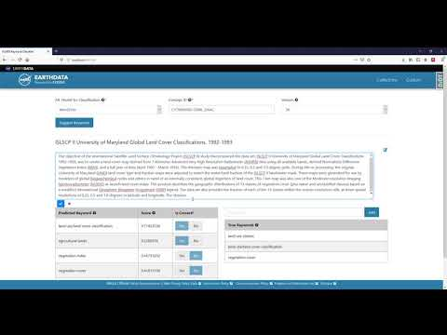
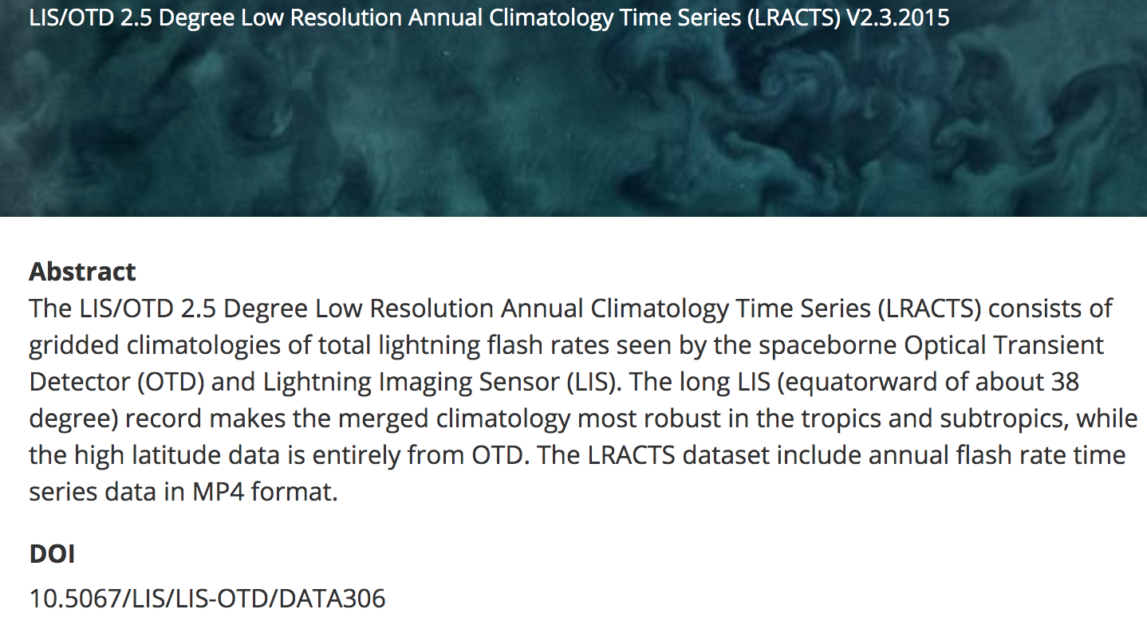
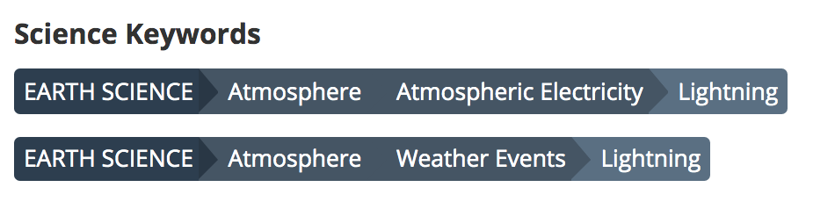
Automated Science Keyword Assignment
Objective: Improve metadata quality by training a machine learning model that aids SMEs in the process of assigning relevant science keywords by utilizing dataset abstracts
Approach: A data collection description is passed through a word2vec model built on an Earth science corpus to get word embeddings. These embeddings are used to train a classifier that suggests relevant science keywords.
CMR Dataset Title and Description

Slide 28
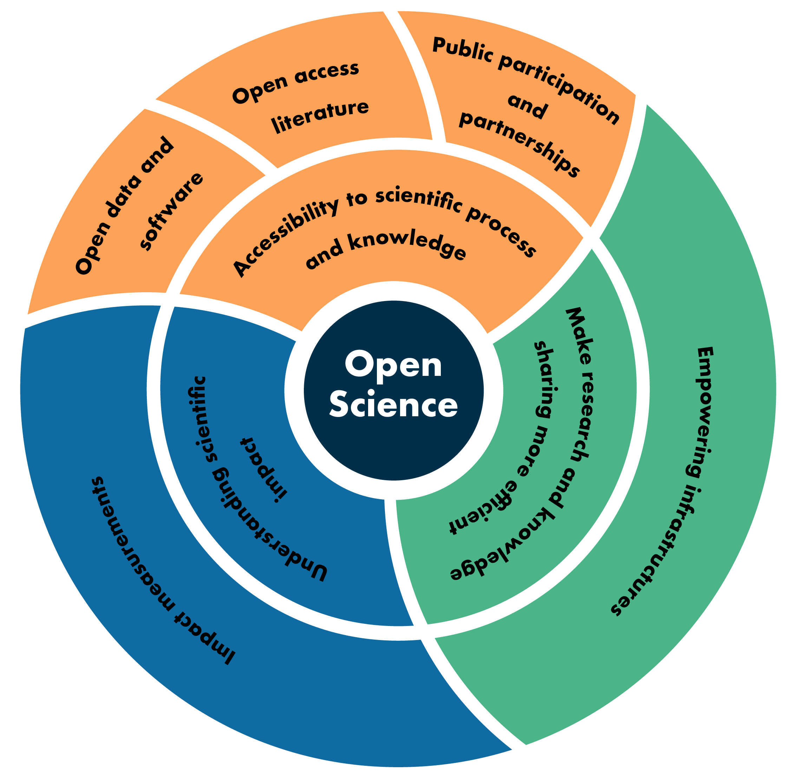
Moving from Open Data to Open Science
Definition(s)
Overview of different open science focus areas
Role of Data Programs in facilitating open science
Role you can play

Slide 29
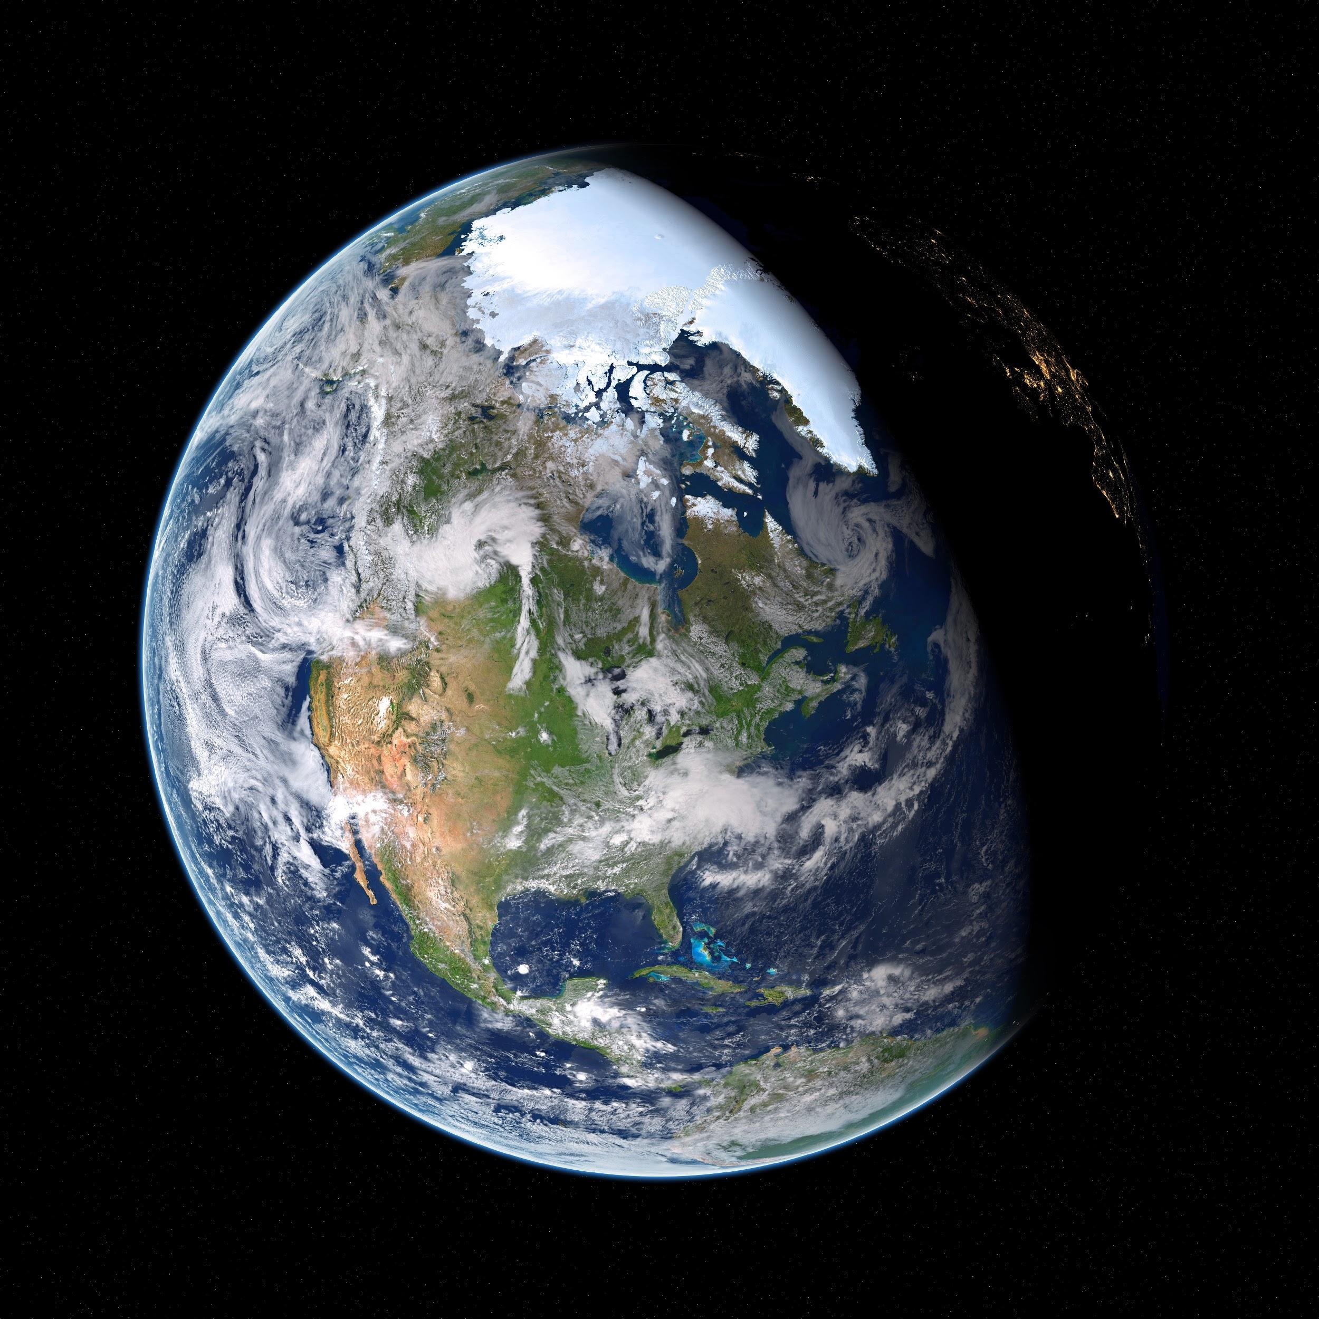
Open Science Definition(s)
Open science definitions
Open science is the idea that scientific knowledge of all kinds be openly shared as early as it is practical in the discovery process (Narrow)
Open science can be defined as any activity that covers anything about the future of knowledge creation and dissemination (Broad)
“open science as a collaborative culture enabled by technology that empowers the open sharing of data, information, and knowledge within the scientific community and the wider public to accelerate scientific research and understanding”
- Ramachandran, R., Bugbee, K., & Murphy, K. J. (Submitted 2020). Moving from Open Data to Open Science. Earth and Space Science, (Gold Access Journal), Wiley Publication
https://www.pexels.com/photo/astronomy-cosmic-cosmos-dark-355935/

Slide 30
Open Science Areas
Accessibility to Science
Science as a way of thinking
    Participation of non-scientists and amateurs in research
    Enabling broader comprehension of research results
Science as a body of knowledge
    Open data, open source software and open access literature (Gold/Green)
Efficient research processes and knowledge dissemination
  Cyberinfrastructure to support science
    Free a researcher from the constraints of limited local resources
    Abstract away the data management, wrangling and scaling complexity
  Collaborations
    Facilitate the management and sharing of research objects, support actionable research
Understanding Scientific Impact

Slide 31
Role of Data Programs
Accessibility to Science
  Support data collection activities, scientific challenges, hackathons, and other events that are open to the public
  Increase public awareness of the value of the data collected to advance science and humanity
  Develop open data and open source software policies and by ensuring those policies are enforced.
  Provide citations and DOIs for both data and software
Enabling efficient research processes and knowledge dissemination
  Invest in data infrastructures that enable "science at scale," such that researchers and other users can work with large, multisource data sets with minimal data management and wrangling overheads
  Have collaboration as a core feature to allow sharing of both code and data.
Understanding Scientific Impact through Data System Measurements
  Develop impact measurements for all first-class research objects within the data system, including data, software, documentation, services, and users that go beyond traditional metrics (altmetrics)

Slide 32
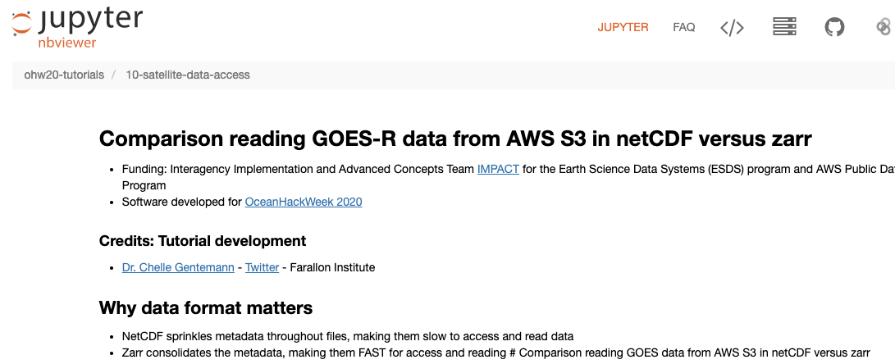
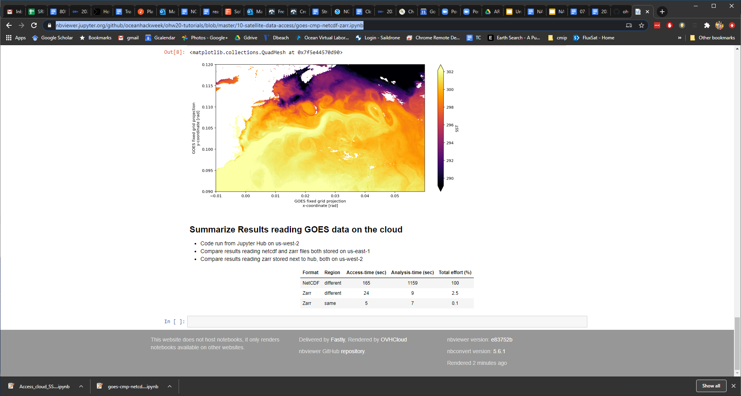
Example: Enabling Infrastructure
Infrastructure = AWS Cloud + Cloud Optimized Data Format (Zarr) + Pangeo Software stack
Analysis shows using Zarr data reduces compute costs by 99% compared to the same analysis with netCDF!
Link to code: https://nbviewer.jupyter.org/github/oceanhackweek/ohw20-tutorials/blob/master/10-satellite-data-access/goes-cmp-netcdf-zarr.ipynb

Slide 33
How can you be an advocate for Open Science?
Make your data available in an open repository
  Make sure your data is in a non-proprietary, standardized format
  Provide clear licensing information and use constraints surrounding your data
  Whenever possible, create a DOI for your data
Open source your software and code
  Give your code as permissive a license as possible to encourage reuse
  Use open source licenses that have wide community adoption. Avoid custom licenses whenever possible
  Make sure any libraries you use are also open sourced
  Follow software development best practices such as rigorous version controls
Support community development of open source software
  Contribute back to libraries, code and tools that are used by the larger community.
  When appropriate, allow your code to be open to community development and feedback as well

Slide 34
How can you be an advocate for Open Science?
Publish peer reviewed articles to (gold) journals
  If a reputable gold journal is not available for your domain, make sure your publisher allows self-publishing via a green repository
Actively engage with the public by
  Starting a science blog
  Working on a citizen science project or supporting hack-a-thons
  Sharing your results on social media: Twitter, Facebook, LinkedIn, YouTube
Be sure to cite data, software and documentation in journal articles

Slide 35
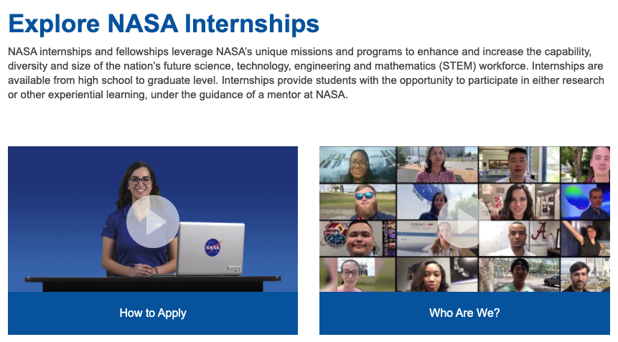
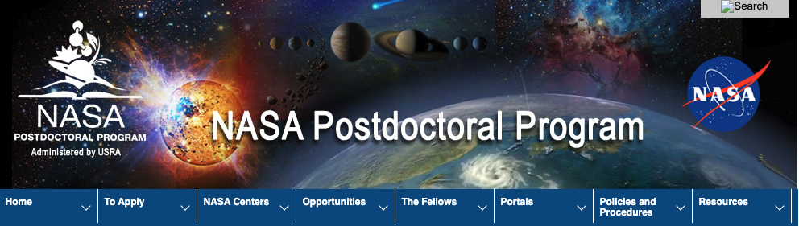
Opportunities to work with us
https://intern.nasa.gov/
https://npp.usra.edu/

Slide 36
Questions?
rahul.ramachandran@nasa.gov
Content attribution:
Kaylin Bugbee + IMPACT Leads
Kevin Murphy
US Nair
Chelle Gentemann

