Slide 1
Alternative Flight Platforms and Ground Microgravity Simulators for Deep Space Exploration
Ye Zhang, Ph.D.
Utilization & Life Sciences Office
Exploration Research and Technology Programs
NASA John F. Kennedy Space Center
November, 2020
Notes:
STILL

Slide 2
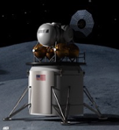
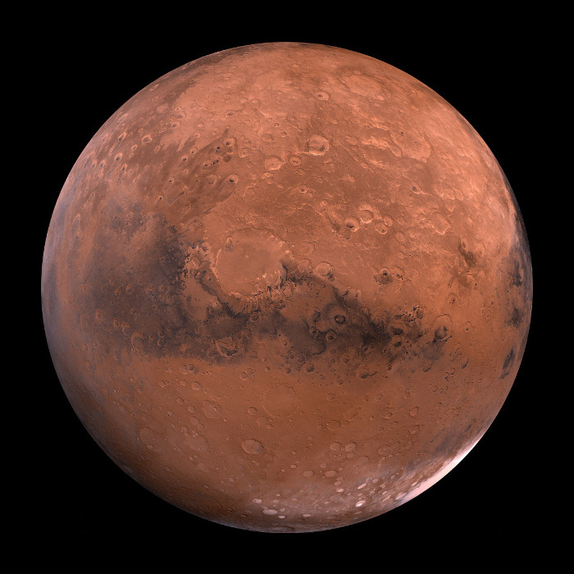
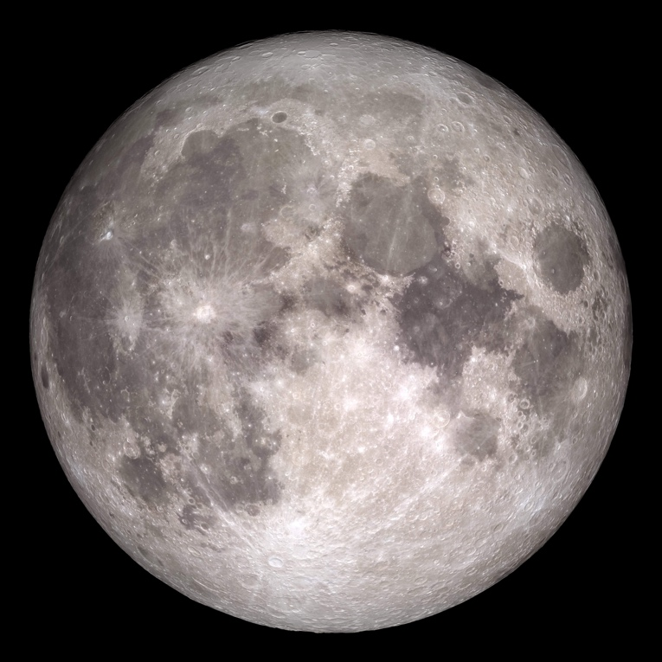
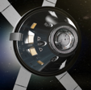
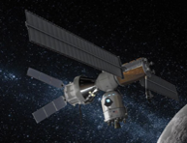
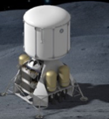


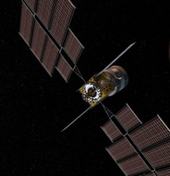
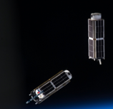


Pathways to Deep Space Exploration
Continuum of space environments for research to understand life in space
Earth vs. ISS
1G vs. Microgravity
Radiation: ~0.7 µSv/day vs. ~0.5 mSv/day (50-80% GCR)
Within the Earth magnetic field
Lab settings vs confined space
1/3 G
Radiation: 0.64-1.84 mSv/day (GCR)
Martian dust and others
Lack of magnetic field
Confined space
Limited capabilities and supplies
1/6 G
Radiation: 0.24-3 mSv/day (GCR)
Lunar dust
Lack of magnetic field
Confined space
Limited capabilities and supplies
Flight Capability – ISS and other LEO vehicles Lunar Transit Vehicles, Gateway, and Surface Mars Transit Vehicles and Surface

Slide 3
Flight Platforms
Low Earth Orbit: ISS with microgravity, and simulated lunar, Mars, and 1g conditions; Outside ISS for hostile space environment exposure. The same for other LEO vehicles.
Low Earth Orbit: Free flyers, CubeSat payloads released from LEO vehicles; Satellites and others.
Beyond Low Earth Orbit – Lunar - Transit: Orion (Artemis-1 and -2), and other transit vehicles.
Beyond Low Earth Orbit – Lunar – Long-term: Gateway and lunar surface.

Slide 4
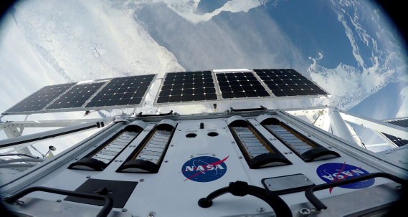
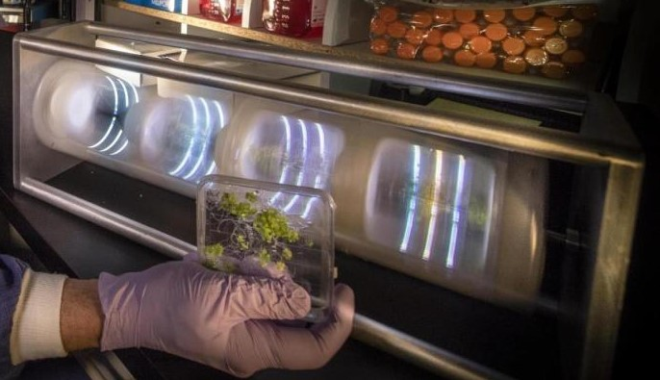
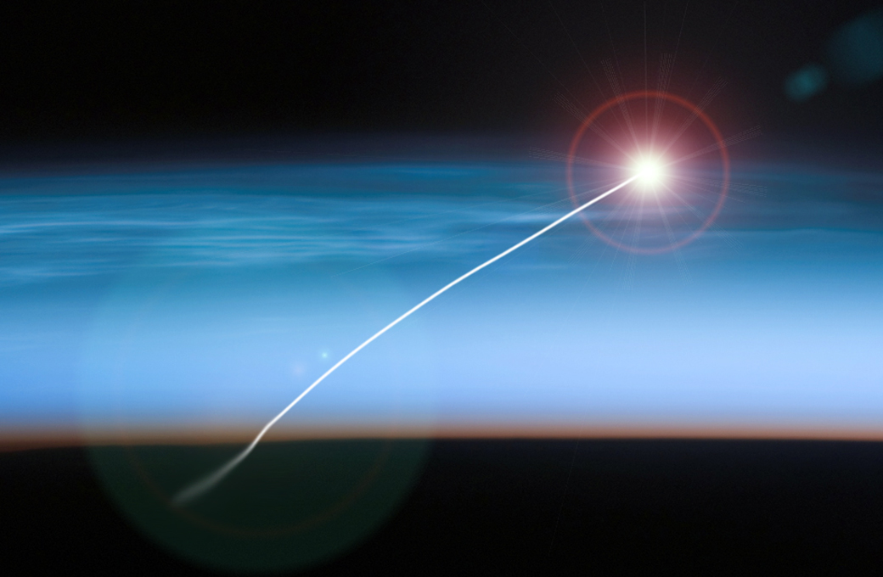
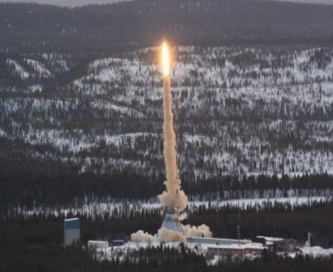
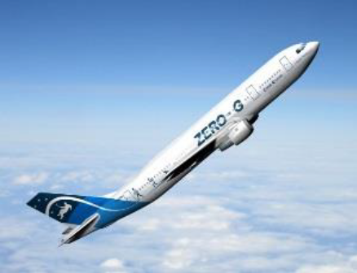
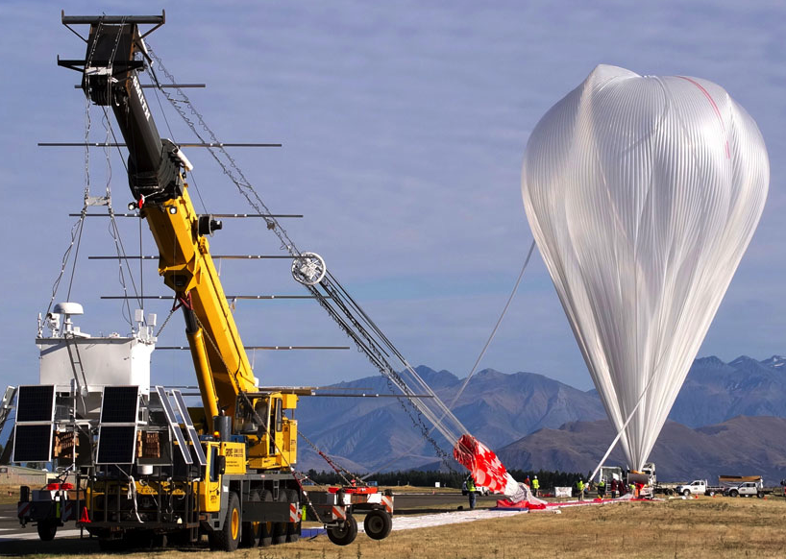
Alternative Flight Platforms and Ground Simulation Capabilities for Deep Space Exploration
Why do we need alternative platforms: Cost, Opportunities, Accessibilities, Risks, Uncertainties, Controlled Environment, Unlimited Technologies and Capabilities, Experiment Replication and Increased Sample Size, Robust Results …
Deep space flight opportunities are the platforms for proof of concepts based on what we have discovered and developed on Earth, and for exploring unknowns.
Suborbital Flights and Sounding Rockets
@SPECEREF
Microgravity Analogs, Microgravity Simulation Support Facility (MSSF) at KSC and Other Facilities
NASA Space Radiation Laboratory (NSRL) at Brookhaven National Lab (BNL) and Others
Parabolic Flights
Antarctica Balloon Flights

Slide 5
A Retrospective of Life Science Research
(PubMed 1950-2019)
What we have learned on how biological systems respond to space relevant conditions is largely embedded in these studies, most of which are ground based studies.

Slide 6
A Review on Studies Using Microgravity Simulation Devices
Review of articles on simulated microgravity effects to demonstrate trends of life sciences research using microgravity simulation devices.
Studies that paired simulated microgravity experiments with true microgravity platforms were given in-depth analysis.
Also emphasized were those articles that combined simulated microgravity with other study variables relevant to spaceflight, such as high carbon dioxide (CO₂), ionizing radiation, and partial gravity states.

Slide 7
A Large Body of Knowledge with Significant Gaps for Exploring Deep Space
We found a large, diversified, but fragmented body of knowledge with several major knowledge gaps identified for ground-based microgravity simulation research:
Integrated studies combining microgravity simulation research in parallel with other simulated or true microgravity platforms to identify microgravity effects.
Interactions among different organisms, species, and cell types using co-culture systems, or 3D tissue organoids for investigating microgravity effects at the tissue level, host responses, or at the ecosystem level.
Multi-generational studies under simulated microgravity.
State-of-the-art molecular and imaging analysis approaches in addition to phenotypic observations.
Research approaches targeting the impact of the deep space environment using combined conditions of simulated microgravity/partial gravity and other space related environmental risk factors, e.g. ionizing radiation.
These research gaps exist in many space related research areas, e.g. microbiology, plant research, human research, space radiation, and health risk assessments.

Slide 8
KSC Microgravity Simulation Support Facility (MSSF)
GOALS:
Support SMD/BPS investigators and space life sciences researchers conducting microgravity simulation research.
Conduct data mining to integrate data from 70-years of simulated microgravity research.
Improve the existing alternative platforms and develop new capabilities in order to functionally simulate the deep space environment and better enable deep space related biological research on the ground.
Develop strategies to continue the usage of alternative platforms and ground simulation capabilities for deep space exploration.

Slide 9
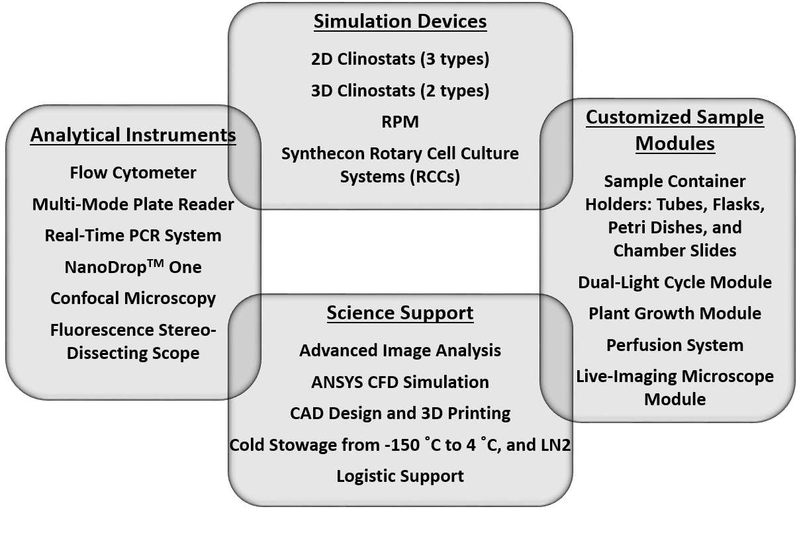
KSC Microgravity Simulation Support Facility (continued)
Strategies being implemented in the MSSF to reduce artifacts:
Using multiple microgravity research platforms with high fidelity controls.
Minimizing artifacts mechanically.
Understanding the localized physical nature around specimens through fluidic dynamics modeling.
Developing customized science modules based on individual experimental requirements.

Slide 10
Alternative Platforms for Deep Space Explorations
 | Microgravity | Hyper Gravity | Partial Gravity | Space Radiation | Closed Environment
Parabolic Flights | Transient 15-20s | Transient 15-20s | Transient | Ambient Levels | Within the hardware, mostly sterile
Sounding Rockets | Minutes | Minutes | Transient | Ambient Levels | Within the hardware, mostly sterile
Suborbital Flights | Minutes | Minutes | Transient | Ambient Levels | Within the hardware, mostly sterile
Microgravity Simulated Devices | Simulation, short-term (minutes) to long-term (months) | Simulation, short-term (minutes) to long-term (months) | Simulation, short-term (minutes) to long-term (months) | Possible when coupled to Radiation Sources | Possible when coupled to or placed in environmental chambers
Antarctic Balloon Campaigns | Not Applicable | Not Applicable | Not Applicable | Quantity and quality relevance | Not Applicable
Radiation Facilities | Not Applicable | Not Applicable | Not Applicable | Simulations using charged particles | Possible when coupled to or placed in environmental chambers
Environmental Chambers | Not Applicable | Not Applicable | Not Applicable | Ambient Levels | Yes
Deep Space | Yes | Yes | Yes | Yes | Yes

Slide 11
Decadal Survey Recommendation: Continue Development and Use of Alternative Platforms for Deep Space Exploration
Key Questions:
How to continue using cost-effective ground research capabilities to address research gaps targeting deep space exploration?
How to effectively simulate the deep space environment on Earth for life sciences research?
How to integrate the large database of past space related biological research to contribute to NASA’s deep space exploration activities?
How to translate ground research findings for deep space applications?
How to improve existing alternative platforms and develop new capabilities for deep space exploration?

Slide 12
Thank you!
Please contact us: Ye Zhang, Ph.D. E-mail: ye.zhang-1@nasa.gov
Howard G. Levine, Ph.D. E-mail: howard.g.levine@nasa.gov
https://kscpartnerships.ksc.nasa.gov/Partnering-Opportunities/Capabilities-and-Testing/Testing-and-Labs/Microgravity-Simulation-Support-Facility

