Slide 1

Ultrasonic nondestructive evaluation using non-contact air-coupled Lamb waves
Wenfeng Xiao
PhD Dissertation Defense
Department of Mechanical Engineering
University of South Carolina, Columbia
November 10th , 2020

Slide 2


Acknowledgements
Advisor: Dr. Lingyu Yu
Committee: Dr. Giurgiutiu, Dr. Chao, Dr. Zhang
My family and friends
VSHM colleagues
LAMSS members
U. S. Department of Energy (DOE)
National Aeronautics and Space Administration (NASA)
University of South Carolina, ASPIRE Innovation award
NASA
*A part of the proposal is based upon work supported by National Aeronautics and Space Administration (NASA) under Award Nos. NNL09AA00A and 80LARC17C0004.
Any opinions, findings, and conclusions or recommendations expressed in this material
are those of the author and do not necessarily reflect the views of the NASA.

Slide 3
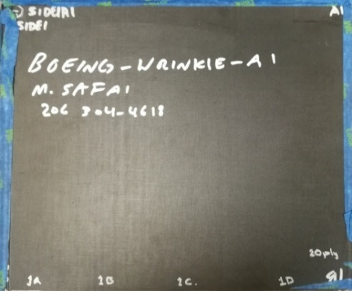
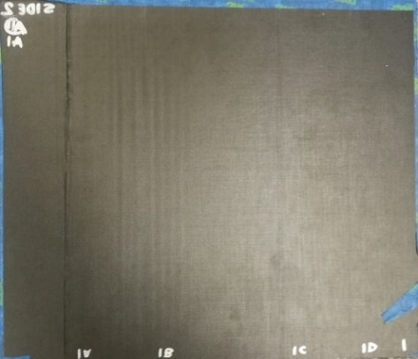
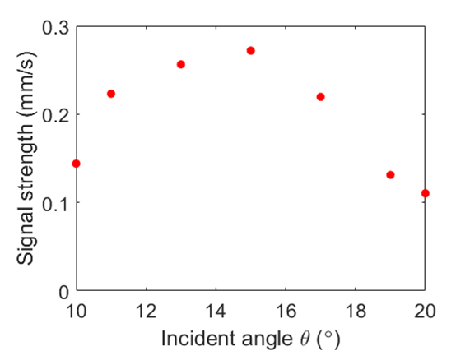
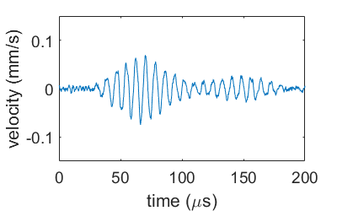
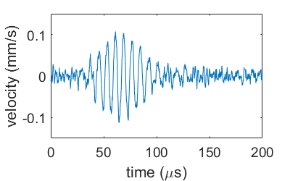
Wrinkle inspection setup
Wrinkle specimen
  Dimension: 306 × 205 × 3.74 mm
  No other information is available
  Wrinkle region: more visible wrinkles
  Reference region: less visible or likely no wrinkles
Top surface
Bottom surface
Wrinkle region
Reference region
y
y
Wrinkle region
Reference region
Inspection setup
  Excitation: 120 kHz ACT with incident angle 
  Sensing: SLDV for out-of-plane velocity measurement
O
x
(b)
O
x
x
60
125
190
220
Courtesy of NASA Langley Research Center and Boeing
Optimal incident angle tuning is conducted along x-axis direction in the reference region with  set as 10˚, 11˚, 13˚, 15˚, 17˚,19˚, and 20˚.
Peak value
❑ = 10˚
❑ = 17˚
_{optimal}= 15˚
Signal strength vs. incident angle

Slide 4
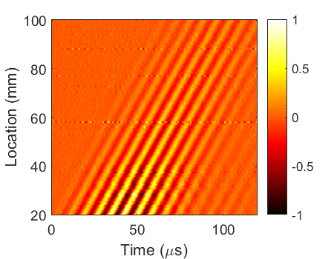
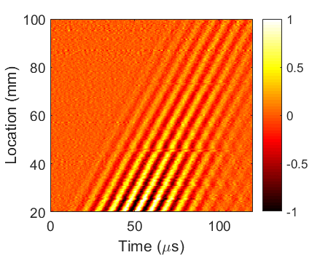

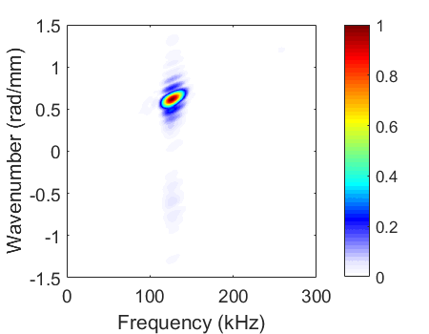

Line scan inspection
Line scan along the x-axis direction is conducted with optimized setups for ACT and SLDV
R3 wavefield
W3 wavefield
Reference region: R1, R2, and R3
Wrinkle region: W1, W2, and W3
Inspection results:
Time-space wavefield
f-k spectrum
Little reflections
Wrinkle reflections
y
Wrinkle region
Reference region
ACT
R3 f-k spectrum
W3 f-k spectrum
ACT
W1
O1
R1
265 mm
W2
O2
R2
W3
O3
R3
Weak negative wavenumbers
Negative wavenumbers
O
x
306 mm
Little wrinkle reflections
Weak negative wavenumbers
Wrinkle reflections
Negative wavenumbers
Schematic of the line scans
Courtesy of NASA Langley Research Center and Boeing
The wrinkle defects’ signatures are successfully achieved!

Slide 5
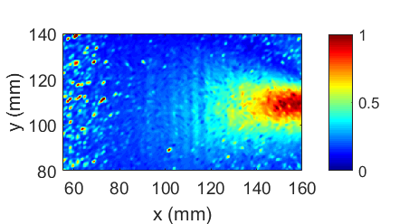
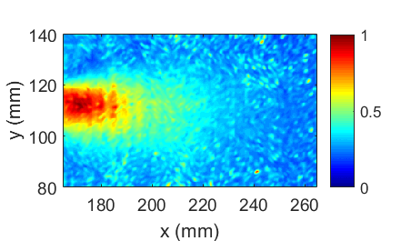

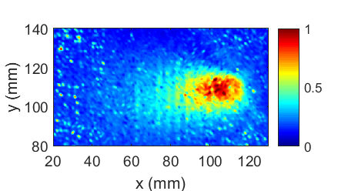
Wrinkle imaging inspection
Area scans are conducted in both wrinkle regions and reference region for wrinkle inspection
Imaging method:
Wave energy imaging method for quick inspection
Wrinkle region imaging
Reference region imaging
Wrinkle pattern
Wrinkle pattern
y
Wrinkle region
Reference region
ACT
90
120
265 mm
60
Wrinkle pattern from 90 to120 mm are imaged
ACT
100
100
0˚ direction
x
60
125
190
220
60
125
O
Courtesy of NASA Langley Research Center and Boeing
306 mm
Less wrinkles from 190 to 220 mm are imaged as well.
Courtesy of NASA Langley Research Center and Boeing
Wrinkle pattern
60
90
The entire wrinkles in the wrinkle region are successfully imaged
The less wrinkle in the reference region are imaged as well
The noncontact Lamb wave system has successfully inspected the wrinkle defects
Schematic of the area scans
ACT excitation at 160 mm
SLDV scans with 1 mm resolution
The excitation moved to x = 110 mm
Wrinkle pattern from 60 to 90 mm are imaged

