Slide 1
Overview of NASA Psychoacoustic Activities for UAM
Presented by:
Andrew Christian Structural Acoustics Branch NASA Langley Research Center
Matthew Boucher Structural Acoustics Branch
Menachem Rafaelof National Institute of Aerospace
Durand Begault Human Systems Integration Division NASA Ames Research Center
UAM Noise Working Group Meeting 5 November 2020, Virtual Meeting

Slide 2
Introduction
Why are we concerned with human response?
Although the starting point for UAM noise assessment will be rooted in results from other vehicle types, there is decent indication that the UAM space might be very wide in terms of types of noise, where/when the noise is heard, and the context in which it is heard.
Researchers, regulators, OEMs, and operators may benefit from having a large slate of psychoacoustic knowledge to draw from when wrestling with this breadth.
We’re working on the cutting edge.
Our research is not meant to directly suggest that regulations or industry should work a certain way, but to generate knowledge that may be used by anyone when the time comes.
Notes:
PID/PBE/etc.

Slide 3
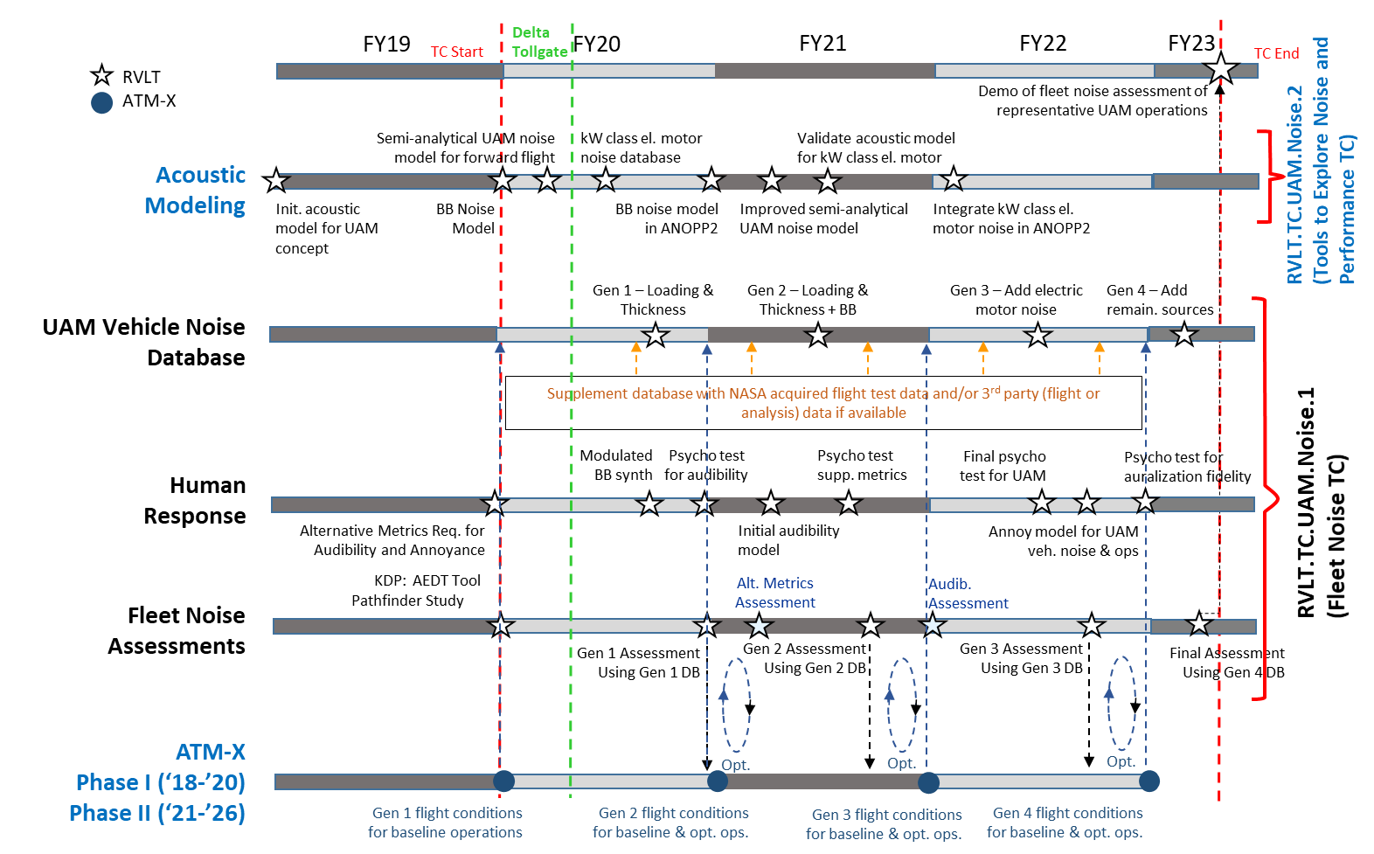
Notes:
Next two talks also deal with this, more or less

Slide 4
An equation for “Psychoacoustic Annoyance”
$$PA=N_{5}\left(1+\sqrt{w_{S}^{2}+w_{FR}^{2}}\right)$$
The terms on the RHS come from metrics that capture various auditory sensations such as the “sharpness,” “fluctuation strength,” and “roughness” of a sound.
Here’s a textbook example equation for predicting annoyance due to noise.
This equation suggests a process by which one can take a recording of a sound, compute various “sound quality metrics,” and combine them into a prediction of annoyance.

Slide 5
An equation for “Psychoacoustic Annoyance”
$$PA=N_{5}\left(1+\sqrt{w_{S}^{2}+w_{FR}^{2}}\right)$$
This kind of distillation could be used as a factor in an MDAO approach to the design and evaluation of UAM vehicles.
Other methods might predict things like distraction or sleep disturbance.
But how does this actually apply to UAM noise?

Slide 6
3 Facets of this Question
Checking the applicability of this kind of an approach to UAM vehicles can be roughly broken into 3 parts, corresponding to the 3 years of the TC. In reverse order:
3. Sound Quality
A good UAM [might] not sound like a good lawnmower.
2. Time Integration
UAMs (multiple) will not be a stationary noise source.
1. Audibility
UAMs will operate within an existing urban-sound environment.
Notes:
The facets are the means to the end.
Looking at the swimlane, different language is used, but this is conceptually what is planned.

Slide 7
3: Sound Quality
What is the appropriate formula for PA for UAM given a set of sound quality metrics?
What metrics are useful for the evaluation of UAM noise?
For instance, a measure of “tonality” is likely to be important.
What metrics seem to be the keys to annoyance for UAM-like sounds?
Does the metric help to discriminate between UAM vehicles?

Slide 8
2: Time Integration
How should one adapt a PA-like equation for a situation in which time-variation is a significant aspect of the noise?
Sounds will come and go as the vehicles fly by. How do we “cook down” the exposure of a flyover into a single number?
What’s the best way to take into account integration across multiple exposures?
What about situations where there are so many vehicles that there is a relatively constant sound perceived?
The hurdle is that there is no “default” way of doing this – there is no equal-energy principle as there is for simpler metrics.
Percentile values have been used in the past, but how does that apply to the above situations?

Slide 9
And then, it was 2020…
This was already an ambitious schedule.
None of these questions are necessarily new, and many researchers have spent entire careers trying to push the state-of-the-art forward.
Much of the answers to these questions (notionally) depended upon an ability to perform human-subject tests – a capability which is sidelined for the moment.
Tests at both LaRC and ARC were shelved.
Work is continuing based on available data/literature.
This is distinct from the UnWG human response study.

Slide 10
1: Audibility
It’s well-known that background sounds can “mask” the perception of individual noise sources, and that this can lead to a reduction of annoyance.
→ Higher background levels lead to lower annoyance when all other things are kept equal, but what does this mean for a novel noise source?
Can we formulate a predictive method to assess the impact of background sounds on UAM operations?

Slide 11
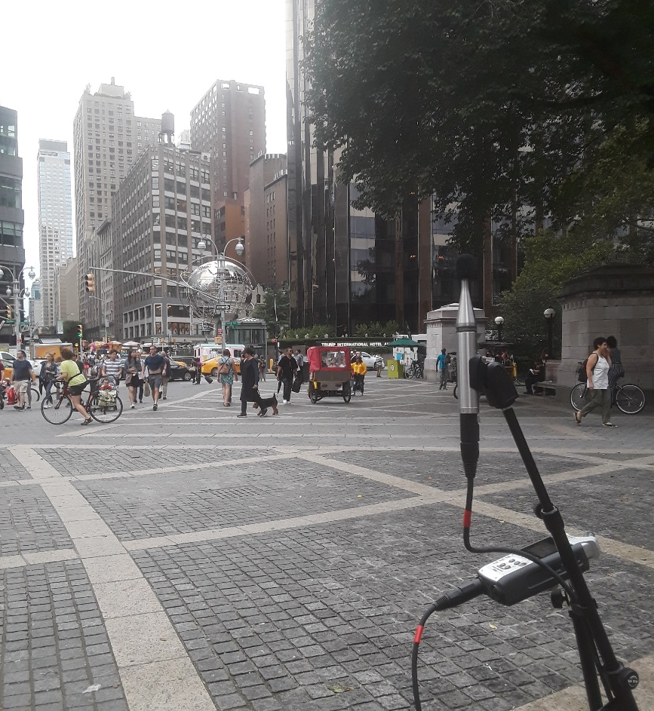
Characterizing the Background
The first job is to have confidence in a recording of the existing noise.
Durand is preparing a NASA TM along these lines.
It will bring together best practices from various sources for how to record and document backgrounds.

Slide 12
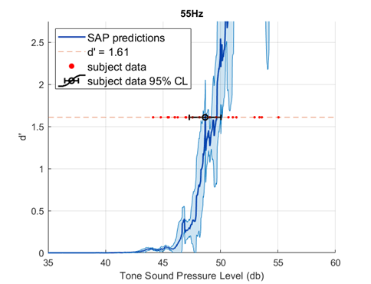
Formulating a New Audibility Algorithm
A new audibility algorithm is under development based on models of loudness (SAP).
This work started with Kyle Wendling (NIFS) 2018, and has been carried forward by Menachem Rafaelof.

Slide 13
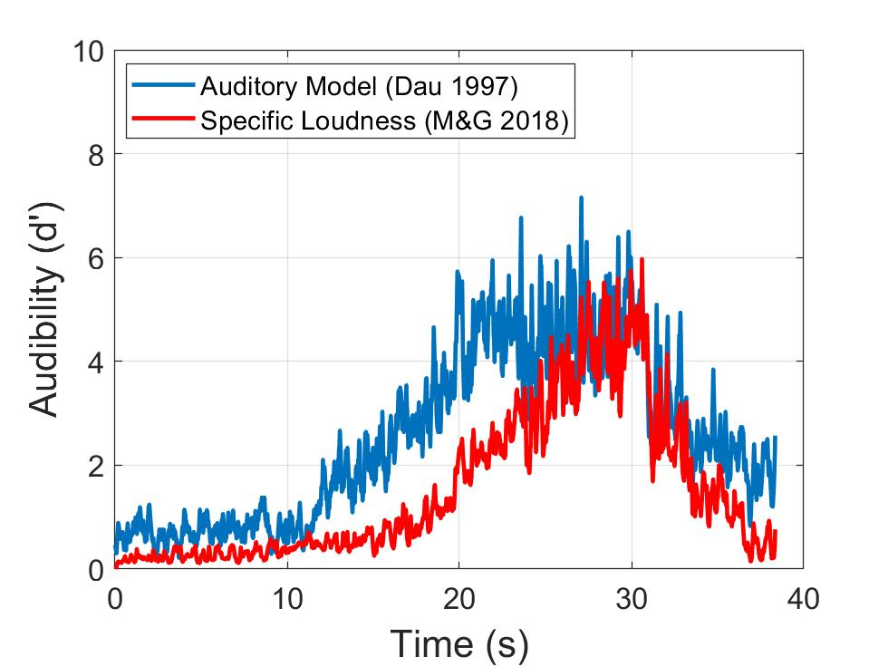
Comparing Models of Audibility
There are a number of existing audibility algorithms with various properties:
How much information do they need?
How hard are they to compute/how complex are they?
What data are they based on/where have they been used previously?
Which audibility algorithm is best suited for use with UAM?
This effort is being led by Matt.

Slide 14
“Discounting” the Predicted Annoyance
$$PA=N_{5}\left(1+\sqrt{w_{S}^{2}+w_{FR}^{2}}\right)−f\left(d′\right)$$
Whatever audibility algorithm is used, the output will likely be a “detectability index” value, usually denoted as d’.
How does this measure relate to the predicted annoyance?
Can we figure out, or at least constrain this relationship with information available in the literature?
This is what has been keeping me up at night recently.

Slide 15
Final Thoughts
The Human Response swimlane of the RVLT UAM TC is working to further the understanding of psychoacoustics in ways that will hopefully prove fruitful within the emerging UAM space.
Although COVID-19 has significantly altered the particular things that were likely to get done, work is still pushing forward.
This may be a blessing in disguise: We should not expect to overturn anything found in decades of literature and lifetimes of experience of other researchers with data from 5 (or so) psychoacoustic tests. While we might not wind up with something that is explicitly based on UAM data, it’s likely worth our time to build from a more firm foundation on what has already been done.
We still don’t have any (good) recordings of UAM vehicles…

Slide 16
andrew.christian@nasa.gov

