Slide 1
Miserable Risk Estimation:
“Managing” Low-Probability,
High-Consequence Risks
Mary K. Kaiser, Ph.D.
mkkaiser@comcast.net
626-319-6055

Slide 2
All Grand Enterprises Must Define Their Risks (Including High-Consequences, Low-Probability Risks)
Defining the High-Consequence Part of Risks is Comparatively Straightforward:
NASA Mishap Investigations
Military Incident Levels
“Everybody dies.” – C. Null
Defining the Low-Probability (Especially Very-Low-Probability) Part of Risks is More Fraught:
Tongue-in-Check Methodology
NASA (“Management Science”) Methodology

Slide 3
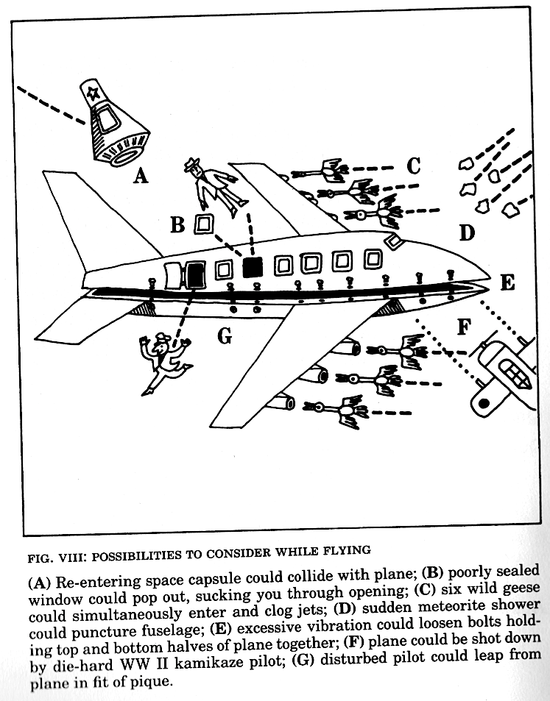
Defining Low-Probability,
High-Consequence Airline Risks… A Tongue-In-Cheek Approach:
Seven risks to worry about from: “How to Make Yourself Miserable (for the Rest of the Century): A Vital Training Manual” by Dan Greenburg with Marcia Jacobs, Vintage Books, 1966

Slide 4
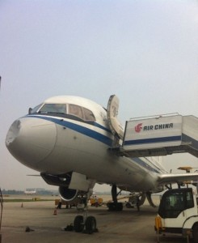
Actual Miserable Accidents
A or D. Maybe…
(Visualize a B-757 with its Radome [nose] punched in.)
June 4, 2013: An Air China Boeing 757-200 collided with an unknown object while climbing through FL260 (26,000’), resulting in evident damage to its radome.
-- Space Safety Magazine Press Clip, June 20, 2103 (Credits: The Aviation Herald)

Slide 5
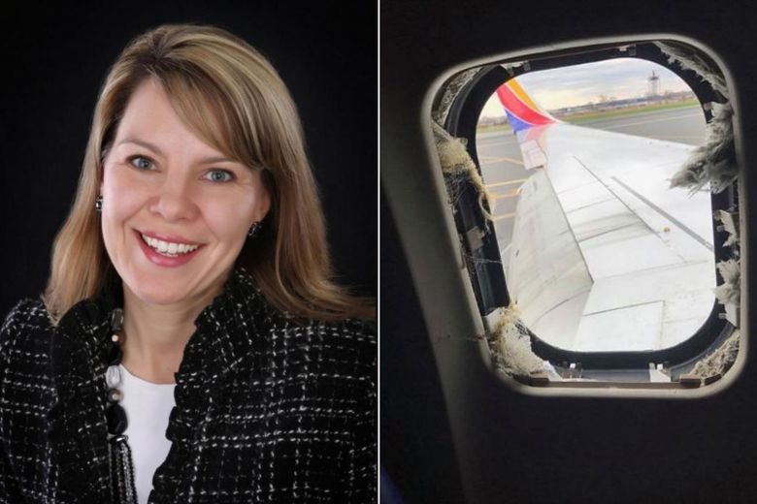
B. Technically, not all the way out, and it wasn’t a sealant failure…
(Visualize side-by-side pictures of Ms. Riordan and the broken-out window.)
April 17, 2018: Shrapnel resulting from an engine’s fractured fan blade of a Southwest Boeing 737-700 damaged the fuselage and window near passenger Jennifer Riordan. Despite wearing her seat belt, she was partially blown out of the plane and died from blunt impact trauma.
-- The Straits Times, April 19, 2018 (https://www.straitstimes.com/world/united-states/from-her-waist-above-she-was-outside-of-the-plane-passengers-describe-southwest ; Credits: The United Way of Central New Mexico, Facebook/Marty Martinez)

Slide 6
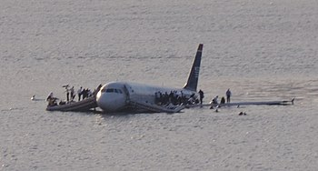
C. The exact number of geese is unknown, but they only had to take out TWO engines…
January 15, 2009: US Airways Flight 1549 (an Airbus A320-214) struck a flock of geese while climbing through an altitude of 2800’. Both engines shut down, forcing an emergency landing in the Hudson River performed by Captain Chesley “Sully” Sullenberger (Tom Hanks) and First Officer Jeffrey B. Skiles
Ng, G. L. (n.d.). Plane crash into Hudson River [Photograph]. CC BY 2.0

Slide 7
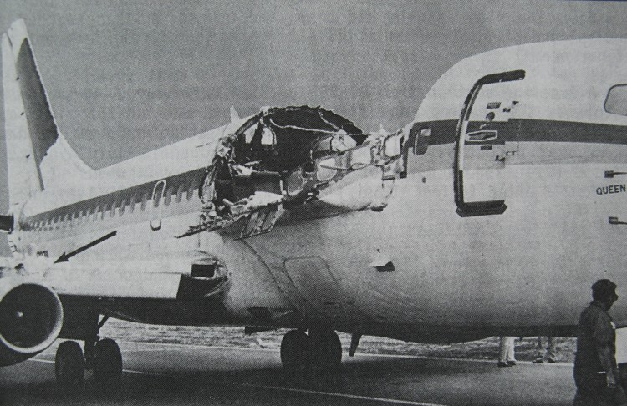
E. Does the fuselage peeling apart count?…
April 28, 1988: Aloha Airlines Flight 243 (a Boeing 737-297) suffered an explosive decompression resulting from metal fatigue exacerbated by crevice corrosion. The aircraft had operated for 19 years in a coastal environment, and had logged nearly 90,000 flight cycles (takeoffs and landings).
-- Wikipedia, Accessed 4/18/20 (https://en.wikipedia.org/wiki/Aloha_Airlines_Flight_243#/media/File:Aloha_Airlines_Flight_243_fuselage.png )
-- Image Source (public domain): (http://aviation-safety.net/photos/displayphoto.php?id=19880428-0&vnr=2&kind=C )

Slide 8
F. Not a die-hard WWII Kamikaze pilot, but…
…Well, this is too depressing. Starting with a failed assassination attempt in 1938 during the Second Sino-Japanese War (which WAS by performed by a Japanese aircraft), Wikipedia lists 38(!) “airliner shootdown incidents” – these include wartime incidents, but not terrorist bombings or sabotage.
So… REALLY not funny.

Slide 9
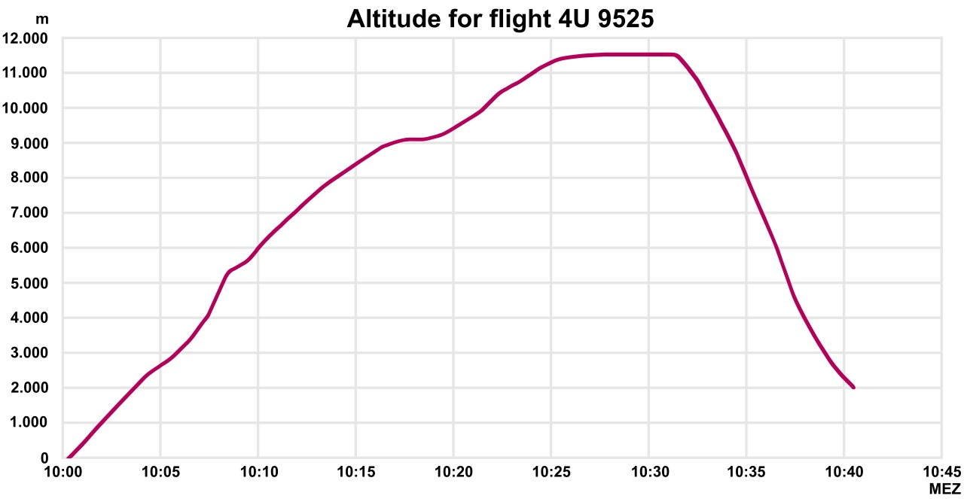
G. Pilot didn’t actually leap from the airplane…
March 24, 2015: Germanwings Flight 9525 (an Airbus 1320-311) was intentionally crashed into the French Alps by Co-pilot Andreas Lubitz.
If you wish to make yourself more miserable, read the “Suicide by Pilot” wiki page, which lists a slew of declared or suspected pilot suicides.
-Lampel. (n.d.). Altitude for flight 4U 9525 [Graph]. https://commons.wikimedia.org/wiki/File:Altitude_Chart_for_Flight_4U9525_register_D-AIPX.png
CC BY 3.0

Slide 10
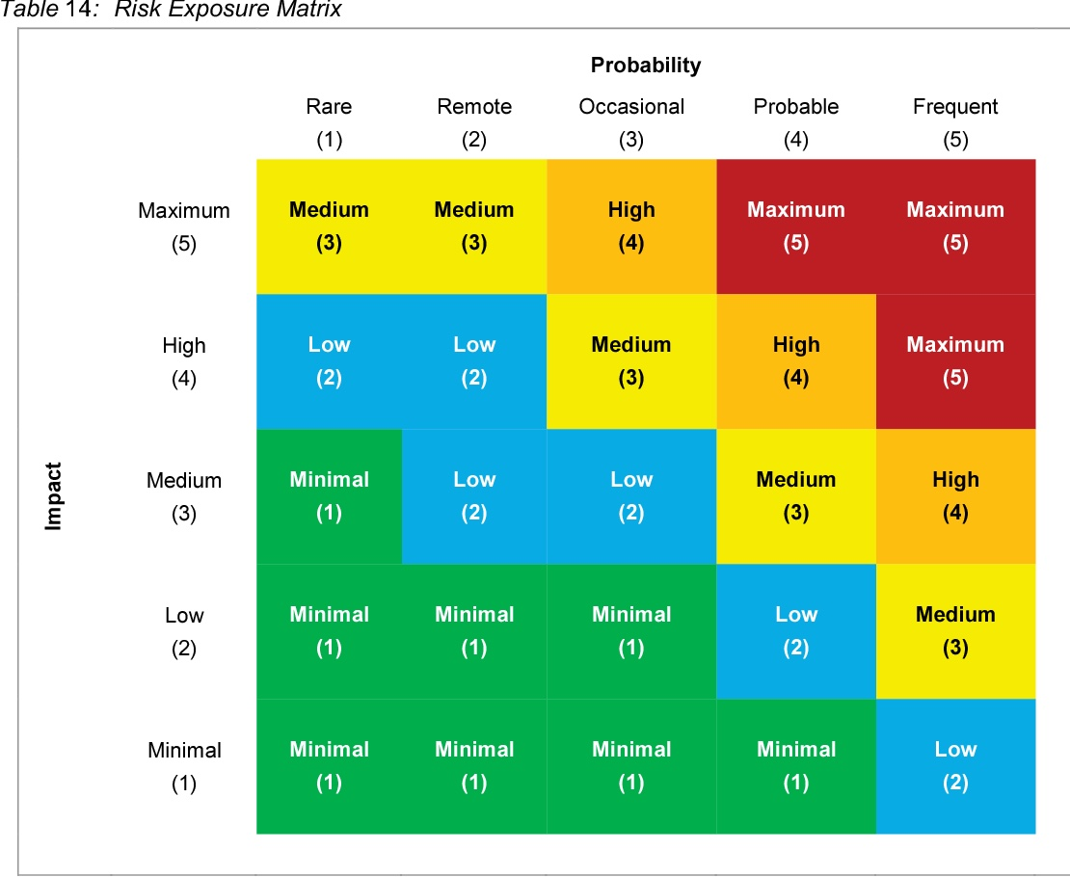
A “Management Science” Approach to Risk Management:
The L x C Table
Risk Severity is defined as a function of the Likelihood of the event and the Consequence of its occurrence.
Many hours were billed in determining the correct number of squares, their proper color, and which axis is which.
The Granddaddy:
5 x 5; Five Color
From Alberts, Woody, & Dorofee
(2014). Introduction to the Security
Engineering Risk Analysis (SERA)
Framework. Technical Note, CMU/
SEI-20140TN-024, Carnegie Mellon
University

Slide 11
Visualize* Many Pretty Matrices!
3 X 3, 4 X 4, 5 X 5!
L X C, C X L, P X I, I X P!
No consistency in transitions from Green to Yellow to Red
Maybe throw in Oranges and Blues
Few definitions of levels of Probability/Likelihood!
Little definition of resource allocation for Red vs. Yellow
*or Google “L x C Matrices” and click on “Images”

Slide 12
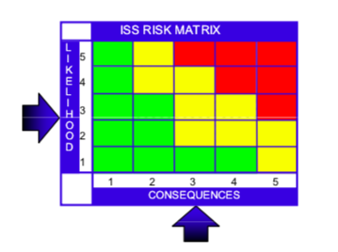
NASA Has Its Own Favorite(s)
5 | 15 | 10 | 6 | 3 | 1
4 | 19 | 14 | 9 | 5 | 2
3 | 22 | 18 | 13 | 8 | 4
2 | 24 | 21 | 17 | 12 | 7
1 | 25 | 23 | 20 | 16 | 11
 | 1 | 2 | 3 | 4 | 5
ISS
Program
Likelihood
Consequence
Commercial Crew Program
L
I
K
E
L
I
H
O
O
D
5
10
16
20
23
25
4
7
13
18
22
24
3
4
9
15
19
21
ESD
Scorecard
2
2
6
11
14
17
1
1
3
5
8
12
1
2
3
4
5
CONSEQUENCE

Slide 13
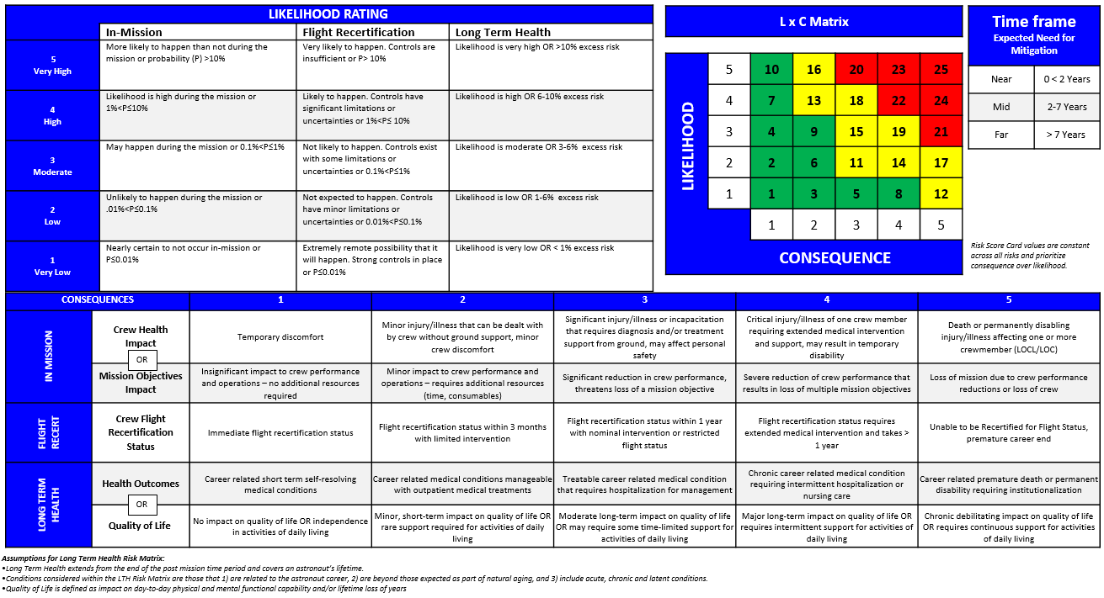
Human Safety Review Board
Consequence
Over Likelihood*
*not fully consistent with CCP ordering
But ALL the matrices imply that at a sufficiently low Likelihood, one can worry less… even for catastrophic consequences.

Slide 14
So… How Good is NASA at Judging What Goes in That Lower, Right-Hand Cell*…and How Comfortable are We Coding It Yellow?
How to make yourself miserable thinking about this:
Worry that we don’t have good data (curse of small N)
Worry that we fall prey to reasoning fallacies:
“It hasn’t happened so far…”
“It happened, but it was due to such weird circumstances that it won’t happen again…”
Our analyses/models give a p of 10 to the -6th
“It’s so incredibly costly to prevent, we just have to accept the risk…”
“If it happens, it happens…”
Worry that we’re not very good at learning from past events
*or equivalent

Slide 15
Three Risk Examples to Worry About
NASA: In-Space Fires (Issue for Gateway Systems Design)
Fallacy #2 leads to lack of redundant systems, sufficient training
Everyone please keep an eye on this (so that I can worry less)
NASA: Space Debris (NORAD Tracks >26,000 Objects* >10 cm)
Interesting article (“The Trash Nebula”) in The New Yorker (9/28/20)
Describes ISS’s near-miss with Object #36912 on 7/16/15, S. Kelly’s logs
Fallacy #1 leads to our inconsistent efforts (or even acknowledging the issue)
Fallacy #3 leads to insufficient resources being allocated
Fallacy #4 leads Russians to ignore closing hatches in favor of eating a good lunch before sheltering in the Soyuz (which holds a 3-day food supply)
Pacific NW: Earthquakes (Cascadia Subduction Zone)
Interesting article (The Really Big One”) in The New Yorker (7/13/15)
Many people resorted to Fallacy #1 (even though it has happened before)
Some retrofitting underway, but many local governments are resorting to Fallacy #3
Confronted with a possible 9+ quake, Fallacy #4 leads some people to choose wine, craft beer, and cannabis for their emergency supplies
*estimated 100M > 1 mm

Slide 16
Conclusions (Such as They Are)
Every Great Enterprise Needs People who Worry
It’s fine… Most of us worriers are miserable anyway
Need to exploit worries to develop mitigations, contingencies, fail-safes, redundancies, and other ass-saving designs and procedures
Don’t Be Seduced by Pretty Matrices
Question cell assignments
Question cell colorings
Question resource allocations
Point Out Bad Human Tendencies
Illuminate fallacies in reasoning
Illuminate diffusion of responsibility
Illuminate failures to learn
Rogers Report (Challenger) ----(new cover)----→ CAIB Report (Columbia)
Thank You for Your Attention (and Your Worries)!!

