Slide 1

Human Landing System Program Overview
Greg Chavers, Ph.D.
HLS Deputy Program Manager

Slide 2
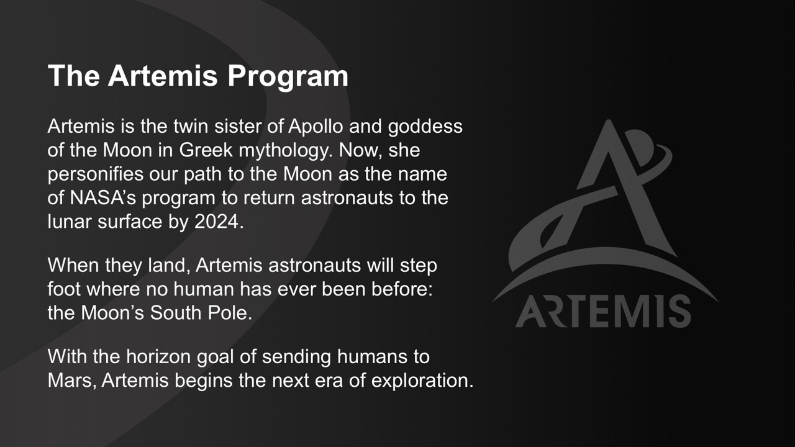

Slide 3
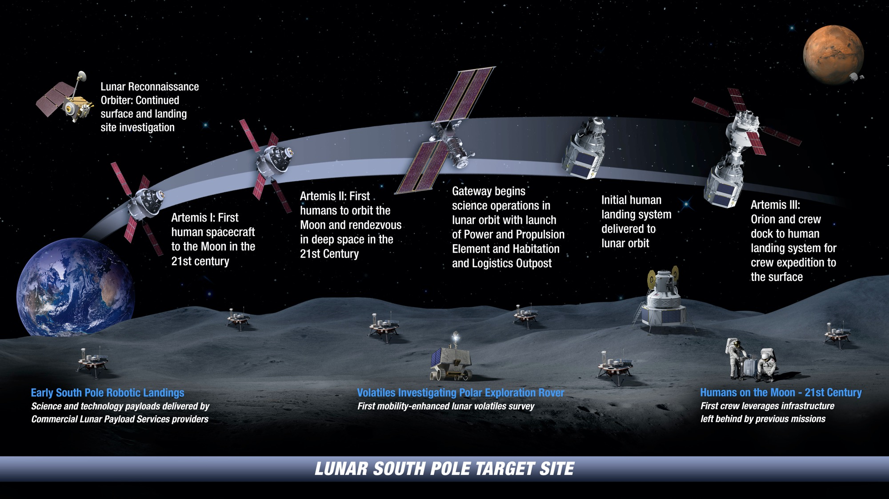

: Landing Humans on the Moon in 2024

Slide 4
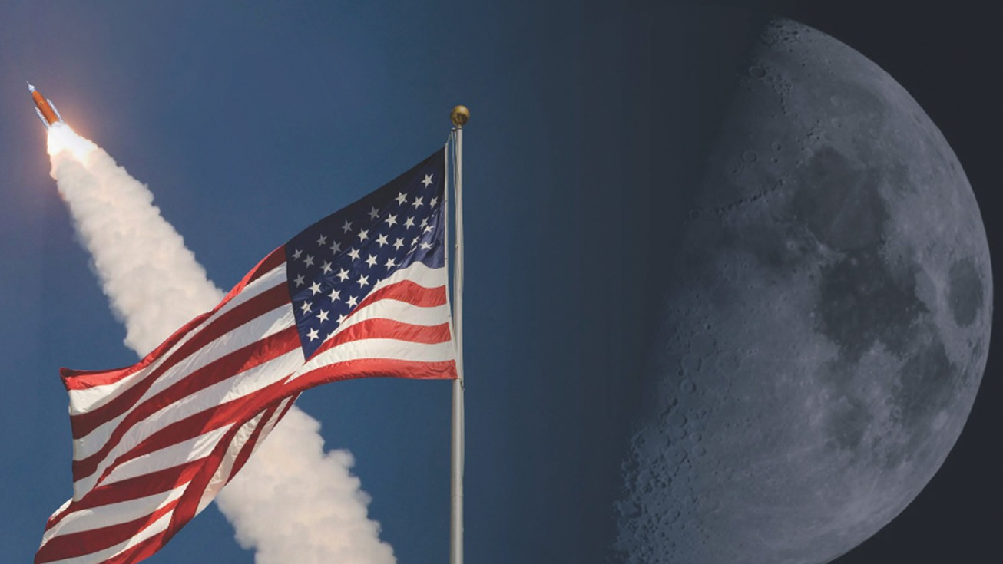
THE POWER OF NASA’S
DEEP SPACE EXPLORATION SYSTEMS
ORION – The only spacecraft capable of carrying
and sustaining crew on missions to deep space, providing emergency abort capability, and safe
re-entry from lunar return velocities
SLS – The only rocket with the power and
capability required to carry astronauts to deep
space onboard the Orion spacecraft
EXPLORATION GROUND SYSTEMS – The only ground systems team that can integrate, launch,
and recover the Orion spacecraft and the SLS rocket
NATIONAL CAPABILITY – The SLS and Orion programs, along with Exploration Ground Systems support at Kennedy Space Center, leverages nearly 4,000 suppliers and over 60,000 workers who have represented all 50 states
Notes:
NASA will get to the Moon using the Space Launch System (SLS) rocket and Orion spacecraft, serving as the transportation system to bring astronauts to and from Earth,

Slide 5


HUMANS ON THE MOON:
Artemis III will land the first woman and
the next man on the Moon in 2024.
Orion and its crew will travel to the Moon, making
history with the first woman and next man to walk on the surface. Two astronauts will board the human landing system, which will carry them to the lunar South Pole with science tools and equipment.
The exact landing site depends on several factors, including the specific science objectives
and the launch date.

Slide 6

Human Landing System
Firm Fixed Price Broad Agency Announcement for rapid development and crewed demonstration to return humans to the lunar surface by 2024
Leveraging commercial capabilities to the maximum extent possible; may tailor the traditional NASA program management and systems engineering processes to expedite the schedule
NASA will not take ownership of the HLS hardware/software
HLS will launch as commercial cargo; checkout and testing will occur on orbit prior to any crew launch and egress
NASA provides certification and technical expertise
The HLS plan is to leverage the speed and operating models of the commercial space industry while applying NASA expertise to ensure safety and mission success

Slide 7
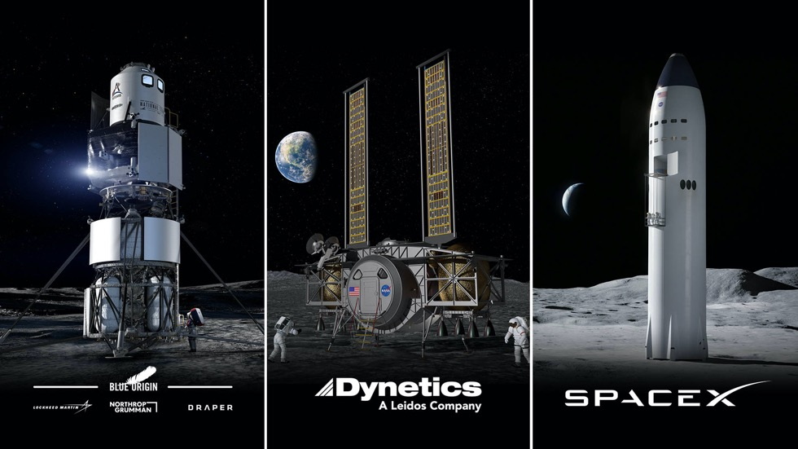
Three contracts awarded April 30, 2020
Complete lander systems were proposed including launch vehicles for an end to end solution for 2024 and sustaining
Base Period:
May 2020 – February 2021
The Broad Agency Announcement catalyzed the innovation in U.S. Industry it was designed to do.

Slide 8
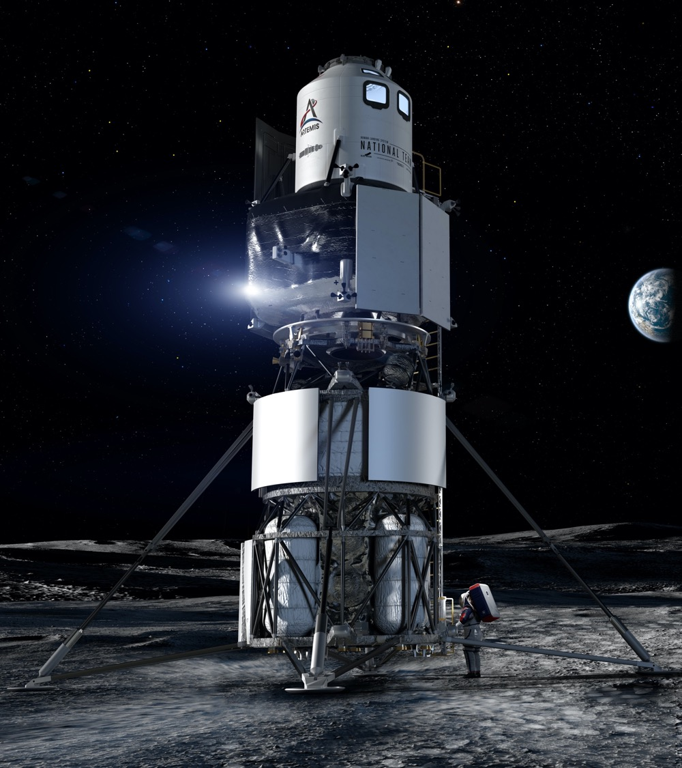

“INTEGRATED LANDER VEHICLE”
Three-stage landing system
  Ascent – Lockheed Martin
  Descent – Blue Origin
  Transfer – Northrop Grumman (future refueler)
  GN&C, Avionics, Software – Draper
Rockets: New Glenn & ULA Vulcan
KEY ATTRIBUTES
Significant proven spaceflight heritage
Orion and Gateway compatible

Slide 9
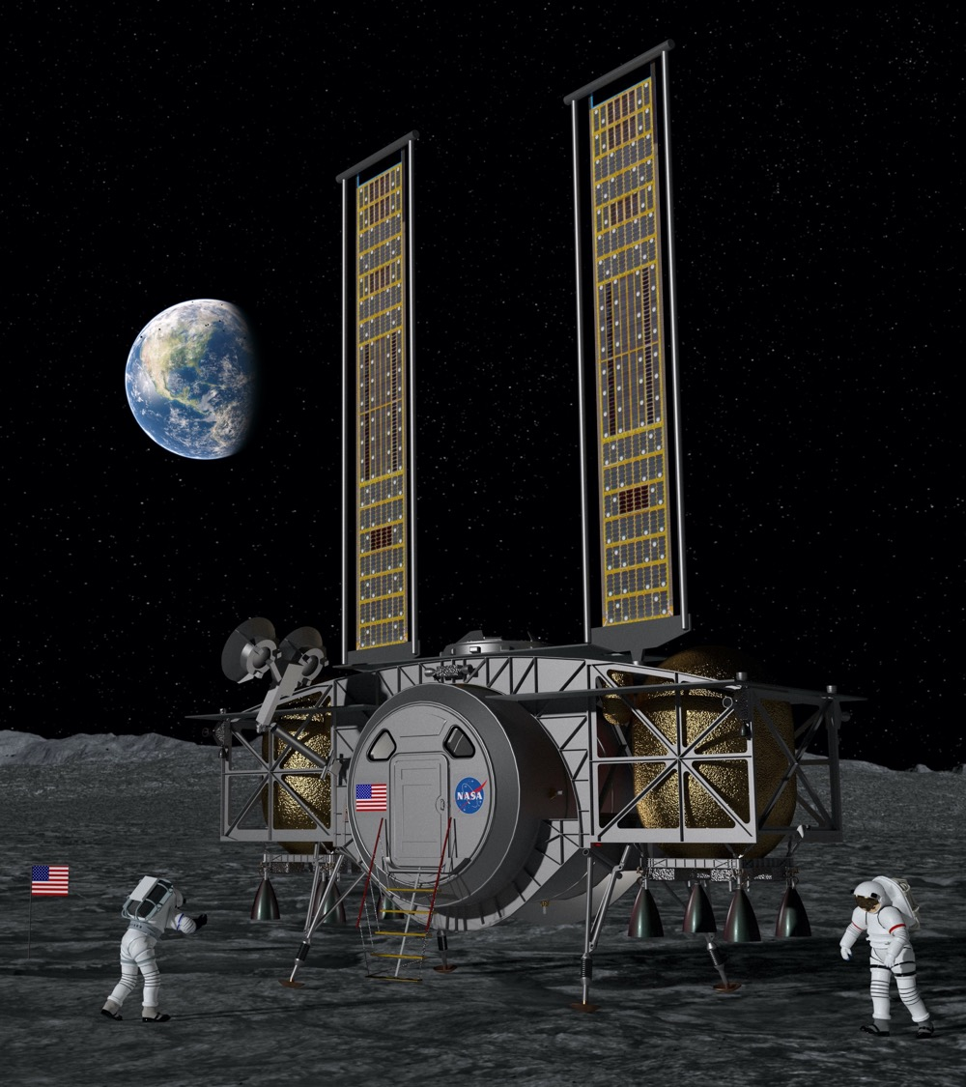

“DYNETICS HUMAN LANDING SYSTEM”
Single element providing the ascent and descent capabilities
Large subcontractor team
Rockets: ULA Vulcan Centaur
KEY ATTRIBUTES
Crew cabin sits low to the surface
Refueling capability
Double-androgynous docking system
Orion and Gateway compatible

Slide 10
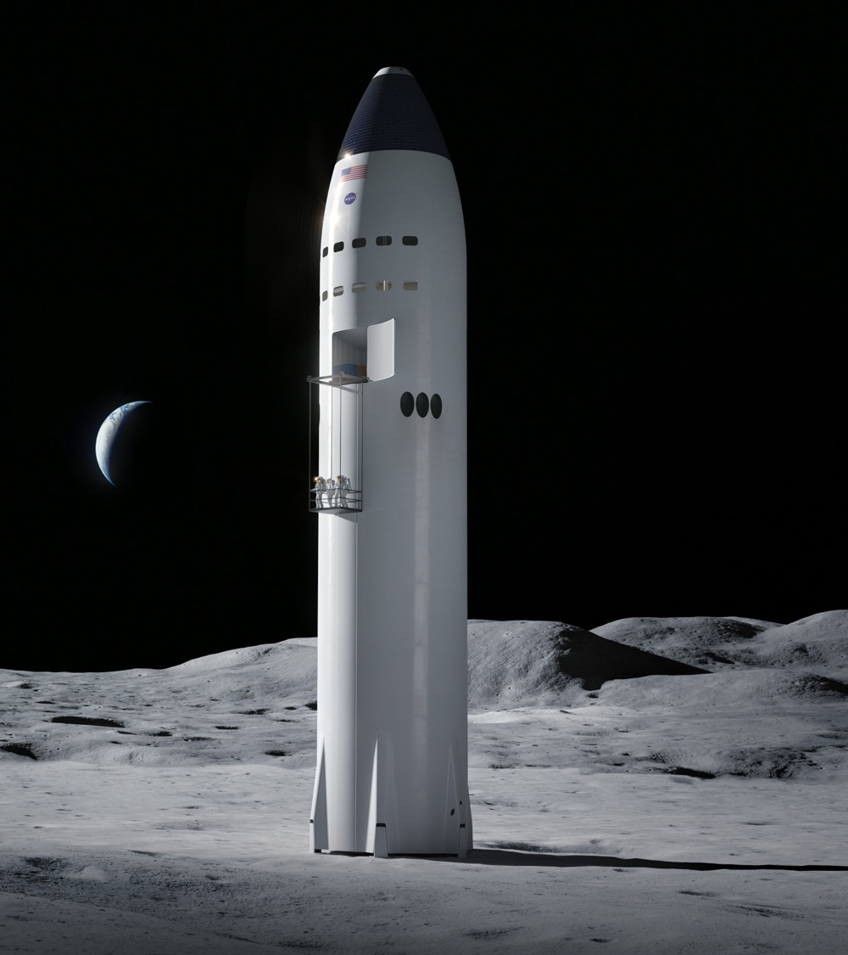

“STARSHIP”
Integrated lander
Fully reusable launch and landing system
Fueling in low-Earth orbit with Starship storage and Starship Tanker variants
Rocket: SpaceX Super Heavy
KEY ATTRIBUTES
Spacious cabin
Two airlocks
Orion and Gateway compatible; Orion for first demo

Slide 11

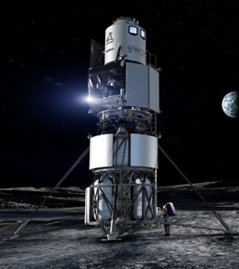
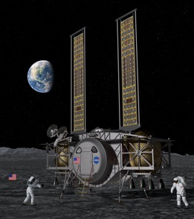

Human Landing System – NextSTEP-2 Appendix H
  Sept 2019 Final BAA solicitation issued
  Nov 2019 Proposals submitted
  Apr 2020 Selections announced for Base Period
  May 2020 Base Period contracts signed
  Aug 2020 Certification Baseline Reviews
          Requirements and Design/Construction, Safety
          & Human System Standards finalized
  Oct 2020 Final Option A Solicitation
  Dec 2020 Continuation Reviews
          Option A proposals due
  Feb 2021 Base Period contracts end
  Spring 2021 Option A contracts awarded for
  2024 Crewed Demo Mission
  2024 Crewed Demo Mission
Notes:
HLS timeline – where we’ve been and where we’re going

Slide 12


CREW SURFACE OPERATIONS
Two crew live in the landing system cabin for 6.5 days on the lunar surface
Goal of up to four moonwalks, with reserves for a fifth contingency moonwalk
Collect a variety of samples to return to Earth for later research:
  Rock samples to help date the sequence of impact events on the Moon
  Core tube samples to capture ancient solar wind trapped in regolith layers
  Paired samples of material within and outside a permanently shadowed region

Slide 13
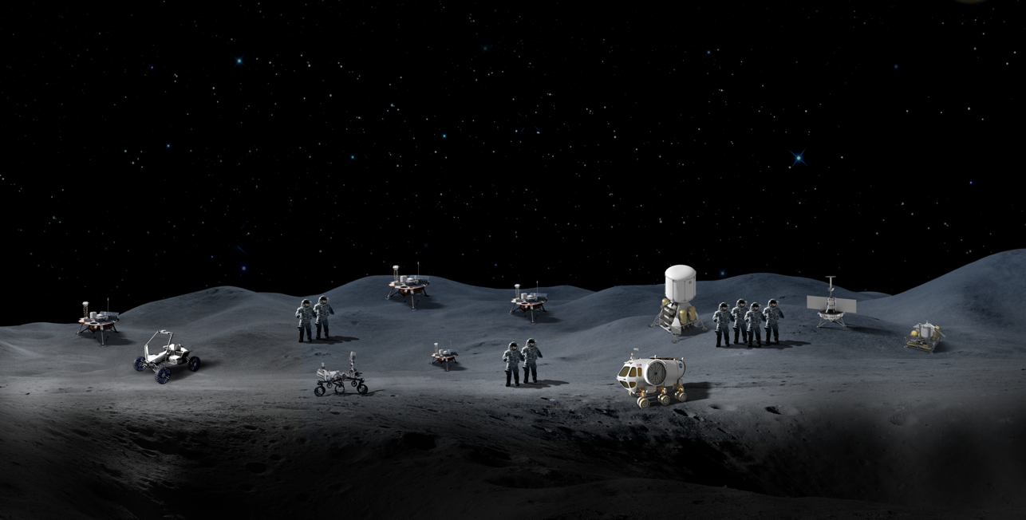


Technology Objectives
The Lunar Surface Innovative Initiative works across industry, academia and government through in-house efforts and public-private partnerships to develop transformative capabilities for lunar surface exploration.
In-situ resource utilization technologies for collecting, processing, storing, and using material found or manufactured on the Moon or other planetary bodies
Surface power technologies that provide the capability for sustainable, continuous power throughout the lunar day and night
Dust mitigation technologies that diminish dust hazards on lunar surface systems such as cameras, solar panels, space suits, and instrumentation
Extreme environment technologies that enable systems to operate throughout the range of lunar surface temperatures
Extreme access technologies that enable humans or robots to efficiently access, navigate, and explore previously inaccessible lunar surface or subsurface areas
Excavation and construction technologies that enable affordable, autonomous manufacturing or construction
Sustainable
Power
Lunar Dust Mitigation
Surface Excavation/Construction
Extreme Access
Extreme Environments
In-Situ Resource Utilization

Slide 15
Mission Needs Drive Design
Notes:
The Mission drives design. NASA is building the exploration systems needed to go beyond low earth orbit to the Moon and Mars.

Slide 16
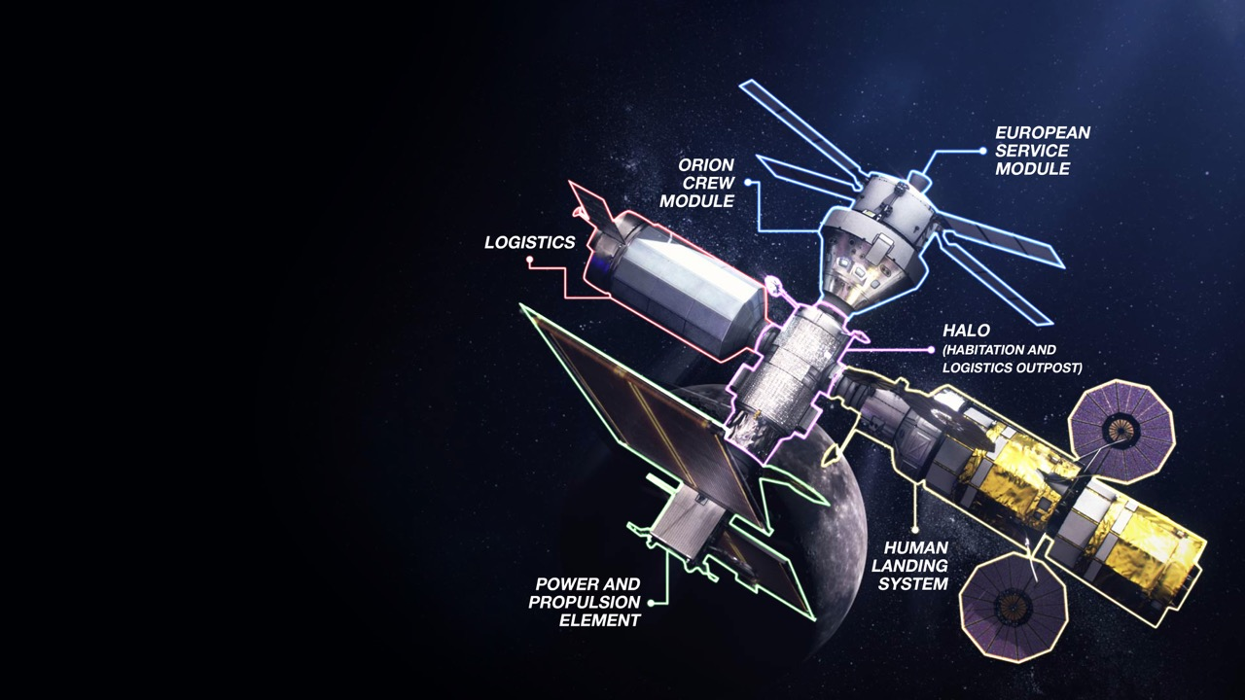
Gateway Enables Lunar and Mars Exploration
Strategic presence around
the Moon
Resilience, sustainability and robustness in the lunar architecture
Open architecture and interoperability standards are building blocks for partnerships and future expansion

Slide 17
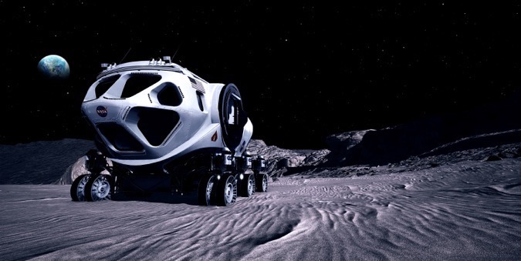

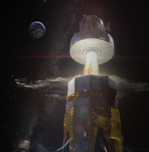
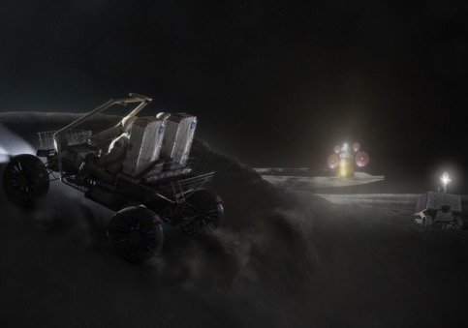
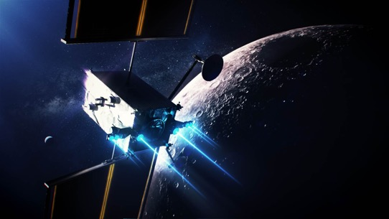
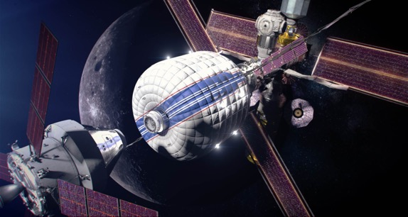
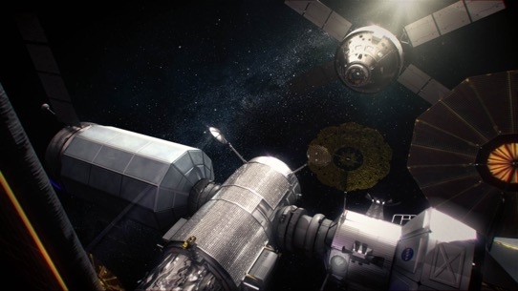
Commonality and Interoperability
MOBILITY
SUITS
ASCENT SYSTEMS
PROPULSION
HABITATION SYSTEMS
DEEP SPACE AGGREGATION
– Orbiting outpost with landing system
– Scientific exploration of a planetary surface
– Automation and robotics to assist/maximize
human-led science
– End-to-end dust mitigation
– Physical and behavioral health operations
– Communications and navigation
– Power systems

Slide 18
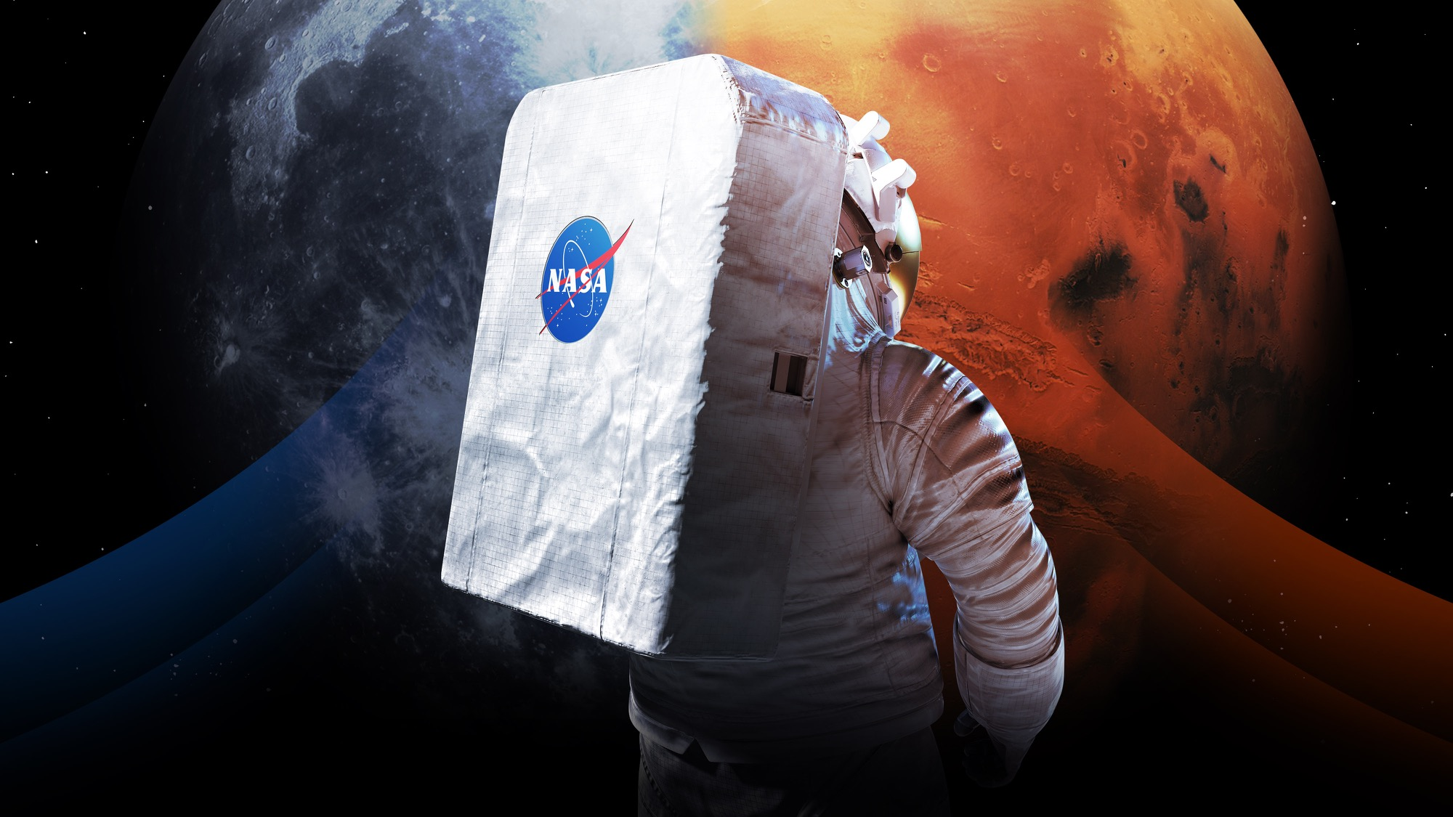
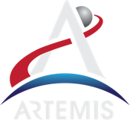
Let’s go. The time is now.

Slide 19
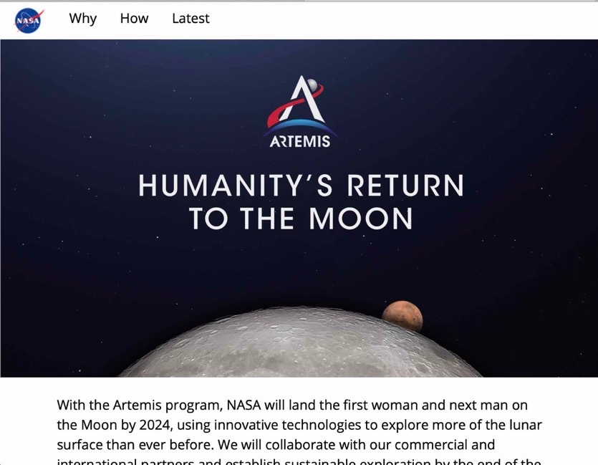




Version suggested for wide public audiences and general topics
Update handles and web links to match your topic
Connect with us
@NASAExplores
@ExploreNASA
@NASAExplores
blogs.nasa.gov/artemis
Sign up for updates at nasa.gov/subscribe
nasa.gov/artemis

