Slide 1
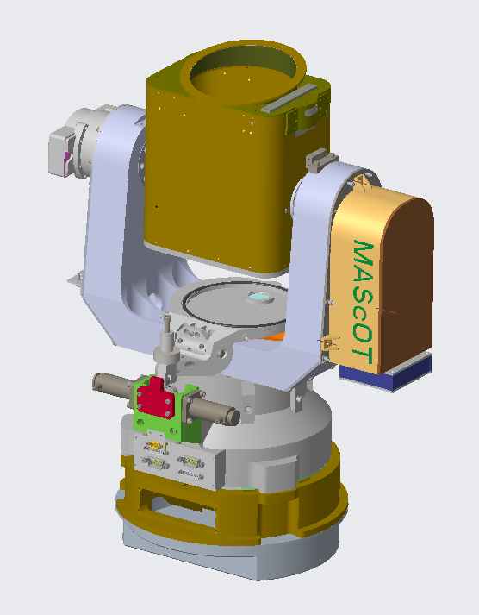
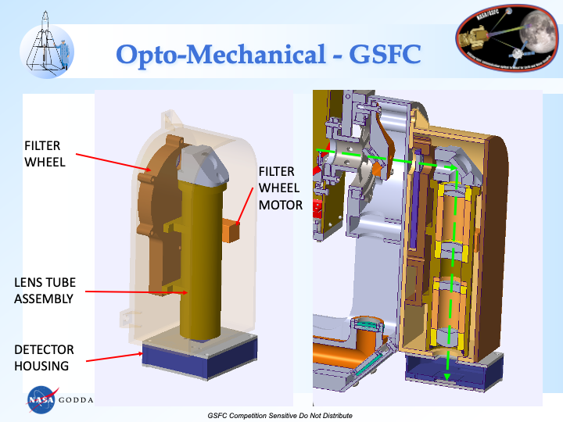
Dual-purpose (Laser Communications and Earth / Planetary Imaging) Terminal: Optimization Study
PI: Nickolay Krotkov, 614
Starting TRL: 2, Ending TRL: 3
Additional Team Members: A. Marshak, M. Kowalewski, S. Janz, L. Ramos-Izquierdo, G. Bowers, R. Roder, T. Shih, B. Robinson, S. Marchenko, N. Gorkavyi, K. Young
Motivation/Problem Statement:
Our study addresses the strategic need to develop a “Multi-functional Science /Communications /Navigation instrument”, that can be scaled and upgraded for the future missions
Project Summary:
This is a design study to combine both laser communication and science imaging functionalities into a single optical communication terminal.
Challenges Encountered / Lessons Learned:
1) Solar rejection filter (SRF) location modification to accommodate broad spectral range needed for science.
Collaborated with MITT/LL to ascertain impacts of SRF relocation on laser comm requirements.
Lessons learned: Early and frequent discussions helped in design trades.
2) Obtain mission requirements that define environment and operations.
Studied potential conops.
Lessons learned: Difficult to make complete design decisions without mission profile, so documenting assumptions and rationale are key for future work.
Optimized imager to replace star tracker on outrigger arm of MAScOT Elevation yoke
Existing mechanical accommodations can be leveraged for broadband/comm optical splitter
Results:
A complete review of the imager optical and mechanical design was conducted by MITLL with respect to the impacts on the terminal’s primary laser communications objectives.
The review identified no “show-stoppers” in the imager design that would prevent its integration to the optical terminal.
The terminal’s optical reflectivities accommodate the broad spectral range needed for both laser communications and science.
Project Objectives:
Our objective was to optimize a high-level ultraviolet and visible (UV/VIS) scientific imager design that mechanically, optically, and electrically integrates to an existing MIT/LL MAScOT optical communication telescope with minimal alterations.
Future Plans / Next Steps:
Demonstrate this concept using the MAScOT terminal at MITLL.
  We are proposing full Earth disk imaging from Lunar surface during Artemis deployments and local lunar surface imaging. The unique vantage point would offer wide range of Earth viewing geometries.
  Additional applications include dual-use laser comm at GEO and other orbital planes
Conclusions:
We demonstrated feasibility of cross-cutting use of MAScOT without incurring significant redesign.
The overall Technology Readiness Level (TRL) of the imager increased from 2 to 3.
The impact of this IRAD is increased potential value of laser comm terminals by demonstrating applicability to science.
Process/Materials/Methodology:
We developed an optimized system concept by augmenting the MAScOT telescope with an imaging channel that acquires multi-wavelength images of Earth and moon from the cislunar orbit.
We focused on reducing the size and mass of the mechanical packaging, ensuring spectral range and signal to noise meet science requirements.
Optimized imager optical design using refractive optics.
Defined filter wheel design capabilities.
Refined Earth science objectives.
Defined Earth and Moon viewing geometry.

