Slide 1
Jeff Gramling
Mars Sample Return Director
Mars Sample Return (MSR)
Presentation to the Space Studies Board
November 5th, 2020
Notes:
STILL

Slide 2

Mars Sample Return
Mars Sample Return Campaign Concept Review
Mars Sample Return (MSR) is the robotic science campaign the Mars community has been building towards for multiple decades
  Number one Planetary Science community priority in the last Decadal Survey
A MOU establishing an ESA/NASA program partnership was signed on October 5th, 2020
The Mars Sample Return “Campaign” includes M2020 for sample collection and the MSR Sample Receiving Facility
Notes:
10/26 UKR Comment: Added items in red for clarity. Deleted some extra spaces. Changed last sub-bullet for consistency.
JG- all good with these.

Slide 3





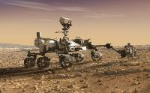
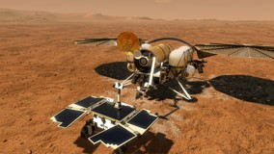
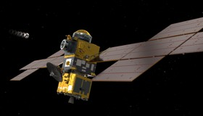
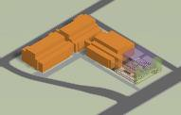
Mars Sample Return Campaign
Mars Sample Return Campaign Concept Review
Mars Sample Return Program
2 3
1
+ 1
Sample Caching Rover (Mars 2020) Operations
Sample acquisition/caching
Sample (subset) delivery
Mars Returned Sample Handling
Sample Receiving Facility
Curation
Sample science investigations
Sample Retrieval Lander
Fetch Rover
Orbiting Sample (OS) container
Mars Ascent Vehicle
Earth Return Orbiter
Capture/Containment System
Earth Return Vehicle
“Initiates the Campaign”
“New Element”
“New Element”
“New Element”
Ground Element
to be reviewed at a future date
The MSR Campaign spans three launches and one ground element
The MSR Program manages development and operations of elements 2 and 3 above and interfaces to elements 1 and 4; program concludes with recovery/containment of OS for transfer to SRF
The MEP Program manages M2020 Phase E operations & will be the home of the future SRF Project
Notes:
10/26 UKR Comment: Enlarged bullets to bigger font for readability and consistency.
JG- all good with these.

Slide 4
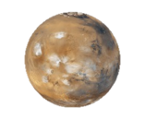
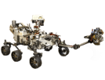













MSR Architectural Overview
Mars Sample Return Campaign Concept Review
Mars
Mars 2020
Tube Delivery
SRL
Mars Ascent
Vehicle
Tube Retrieval
Sample Fetch Rover
Tube Collection & Depot
Orbiting Sample
Retrieve OS
Relay Support
ERO
Break-the-Chain
Avoid Earth
Earth Entry Vehicle
Earth
Mars2020
Earth Return Orbiter
Sample Retrieval Lander
Sample Return and Science
Notes:
10/26 UKR Comment: Is the grey shading behind some of the elements supposed to match the light orange shading behind the meatball in the upper right? Are we trying to show which parts are NASA and which are ESA? If so, please change that grey shading or the color behind the meatball so they match.
JG- done

Slide 5


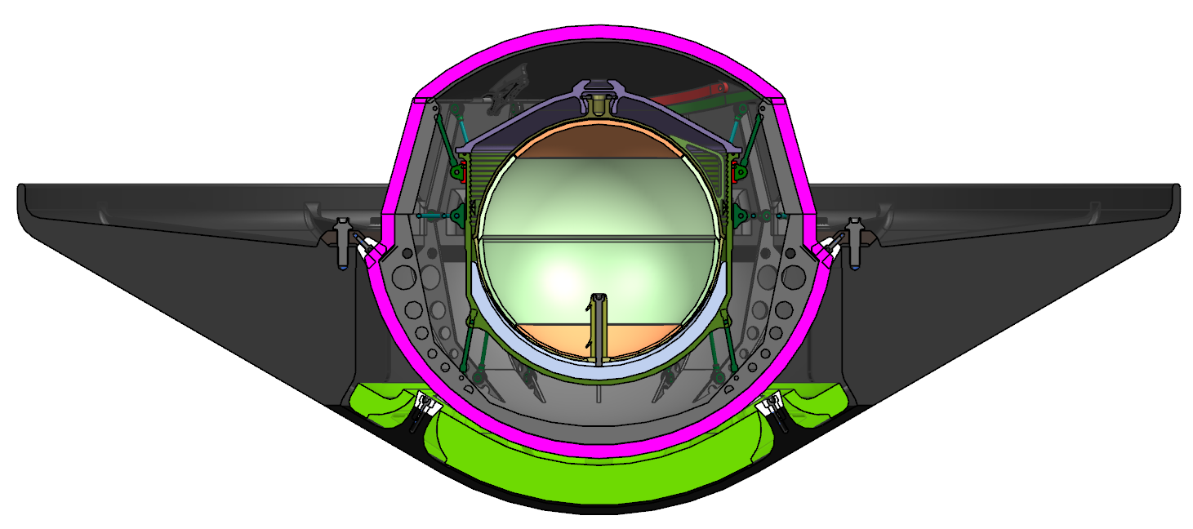
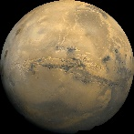


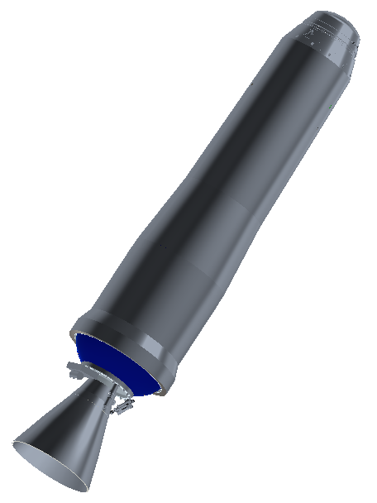
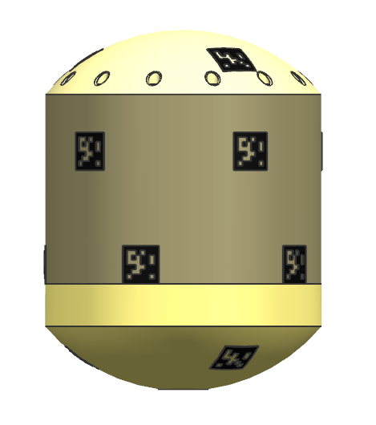



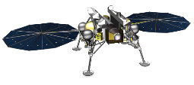
Campaign Timeline Overview
*Illustrates an example scenario
2026 |  |  |  |  |  |  |  |  |  |  |  | 2027 |  |  |  |  |  |  |  |  |  |  |  | 2028 |  |  |  |  |  |  |  |  |  |  |  | 2029 |  |  |  |  |  |  |  |  |  |  |  | 2030 |  |  |  |  |  |  |  |  |  |  |  | 2031
J | F | M | A | M | J | J | A | S | O | N | D | J | F | M | A | M | J | J | A | S | O | N | D | J | F | M | A | M | J | J | A | S | O | N | D | J | F | M | A | M | J | J | A | S | O | N | D | J | F | M | A | M | J | J | A | S | O | N | D | J | F | M | A | M | J | J | A | S | O | N | D
 |  |  |  |  |  |  |  |  |  |  |  |  |  |  |  |  |  |  |  | Reg. |  | Dust Storm Season |  |  |  |  |  |  |  | Reg. |  |  |  |  |  |  |  |  |  |  |  | Reg. |  | Dust Storm Season |  |  |  |  |  |  |  | Reg.
 |  |  |  |  |  |  |  |  |  |  |  |  |  |  |  |  |  |  |  |  |  |  |  | N Winter |  |  |  |  |  |  |  |  |  |  |  |  |  |  |  |  |  |  |  |  |  | N Winter
 |  |  |  |  |  |  |  | Earth to Mars |  |  |  |  |  |  |  |  |  |  |  |  |  | Spiral Down |  |  |  |  |  |  |  | Low Mars Orbit (Relay) |  |  |  |  |  |  |  |  |  |  |  |  |  | RDV and Contain |  |  | Spiral Up |  |  |  |  |  |  |  | Mars to Earth
 |  |  |  |  |  | Earth to Mars |  |  |  |  |  |  |  |  |  |  |  |  |  |  |  |  |  |  |  |  |  |  |  |  |  | Surface*
Conj
Conj
26-26-31
ERO
MOI
EES
EDL
M2020
MAV
OS
SRL
SFR
26 – 26 – 31
SRL Launches in 2026
Samples are returned in 2031
ERO launches in 2026
SRL avoids winter and global dust storm season, enabling all-solar SRL/SFR
SRL Entry, Descent and Landing (EDL) occurs in a favorable season, maximizing landed mass
ERO can provide all relay services needed for MSR (SRL, SFR, M2020, MAV)
SRL and ERO fit on available launch vehicles and trajectories are feasible
Notes:
10/26 UKR Comment: Spelled out EDL for clarity. Deleted “Mars Ascent Vehicle” since previously defined.
JG- all good with these.

Slide 6
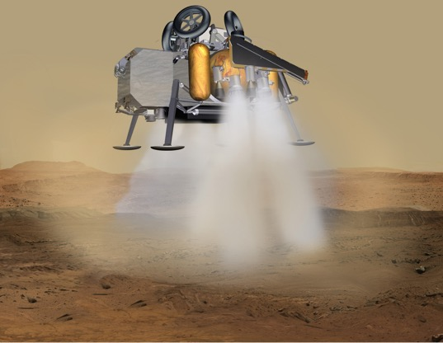
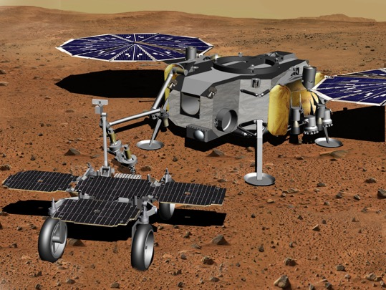
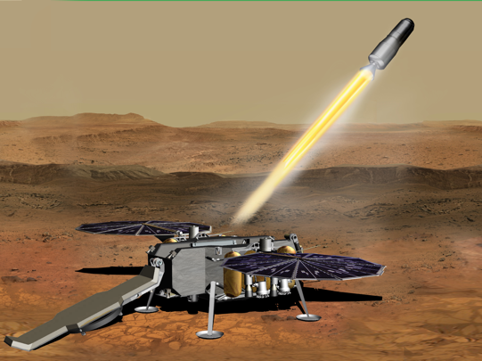
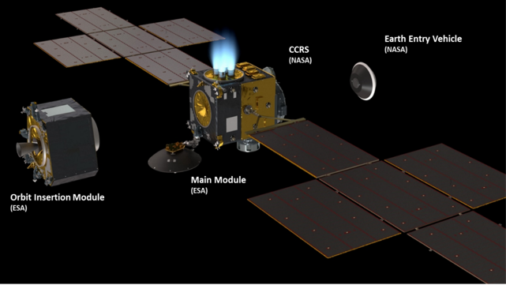
MSR Program Elements
Sample Retrieval Lander (SRL) Touchdown
Sample Transfer
Mars Ascent Vehicle (MAV) Launch
Earth Return Orbiter (ERO)
Notes:
10/26 UKR Comment: Added acronyms in red used later in presentation.
JG- all good with these.

Slide 7


with us

