Slide 1

Sonic Boom Propagation Model Based on a Single-Ray Jacobian
Joel B. Lonzaga
NASA Langley Research Center
Hampton, Virginia
Acoustical Society of America (179th Meeting)
Acoustics Virtually Everywhere
Dec 8, 2020
joel.b.lonzaga@nasa.gov

Slide 2
Motivation: (Why are we interested in sonic boom?)
Support of NASA’s projects
  Enable overland commercial supersonic travel
  Support the development of space launch and reentry vehicles
Generation of sonic boom at air speeds higher than Mach 1
  Need to accurately predict sonic boom propagation
  Mitigate sonic boom impacts
Needs have increased
  Greater accuracy
  More efficient prediction

Slide 3
Outline
Governing equations of sonic boom propagation and numerical solutions
Exact solution in a windless stratified atmosphere with constant temperature gradient
Comparison between the exact and numerical solutions
  Ray paths
  Geometrical spreading (Jacobian) between 1-ray and 4-ray approaches
Comparison between these 2 approaches using a real atmosphere
  Jacobians
  Ground waveform
Summary

Slide 4
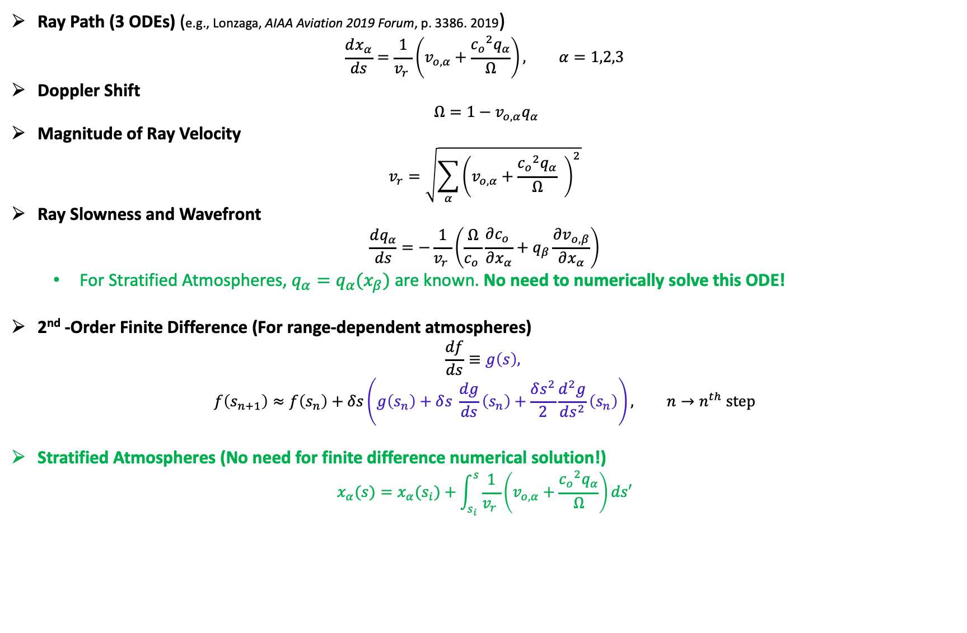
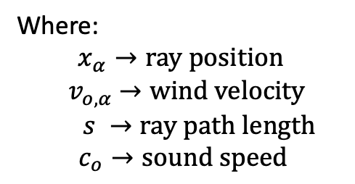
Kinematic Ray Tracing Equations
Ray Path (3 ODEs) (e.g., Lonzaga, AIAA Aviation 2019 Forum, p. 3386. 2019)
$$\frac{dx_{α}}{ds}=\frac{1}{{v_{r}}_{ }}\left(v_{o,α}+\frac{{c_{o}}_{ }^{2}q_{α}}{Ω}\right), α=1,2,3$$
Doppler Shift
$$Ω=1−v_{o,α}q_{α}$$
Magnitude of Ray Velocity
$$v_{r}=\sqrt{\sum_{α}{{\left(v_{o,α}+\frac{{c_{o}}_{ }^{2}q_{α}}{Ω} \right)}^{2}}}$$
Ray Slowness and Wavefront
$$\frac{dq_{α}}{ds}=−\frac{1}{{v_{r}}_{ }}\left(\frac{Ω}{{c_{o}}_{ }}\frac{∂{c_{o}}_{ }}{∂x_{α}}+q_{β}\frac{∂v_{o,β}}{∂x_{α}}\right)$$
  For Stratified Atmospheres, $q_{α}=q_{α}(x_{β})$ are known. No need to numerically solve this ODE!
2nd -Order Finite Difference (For range-dependent atmospheres)
$$\frac{df}{ds}≡g\left(s\right),$$
$$f\left(s_{n+1}\right)≈f\left(s_{n}\right)+δs\left(g\left(s_{n}\right)+δs^{ }\frac{dg}{ds}\left(s_{n}\right)+\frac{δs^{2}}{2}\frac{d^{2}g}{ds^{2}}\left(s_{n}\right)\right), {n→n}^{th} step$$
Stratified Atmospheres (No need for finite difference numerical solution!)
$$x_{α}(s)=x_{α}^{ }(s_{i})+\int_{s_{i}}^{s}{\frac{1}{{v_{r}}_{ }}\left(v_{o,α}+\frac{{c_{o}}_{ }^{2}q_{α}}{Ω}\right)ds′}$$
Where:
$$x_{α}→ray position$$
$${ v}_{o,α} →wind velocity$$
$$s →ray path length$$
$c_{o}→sound speed$

Slide 5
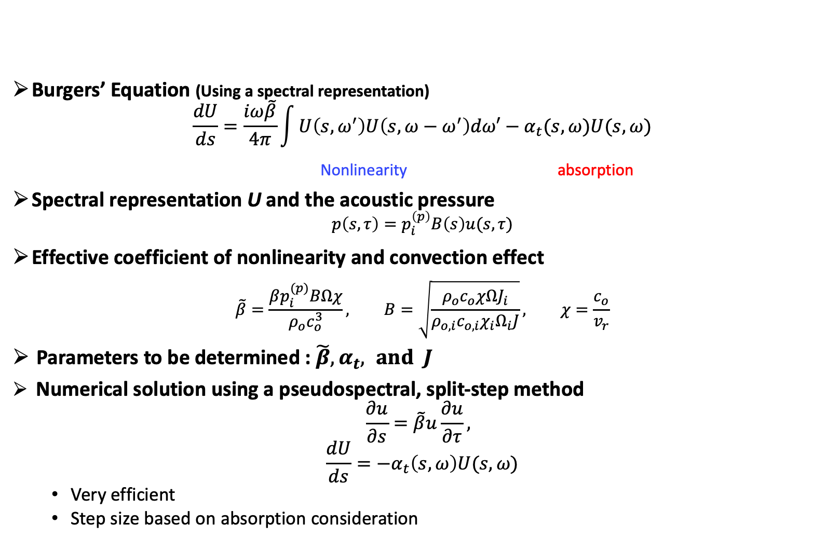
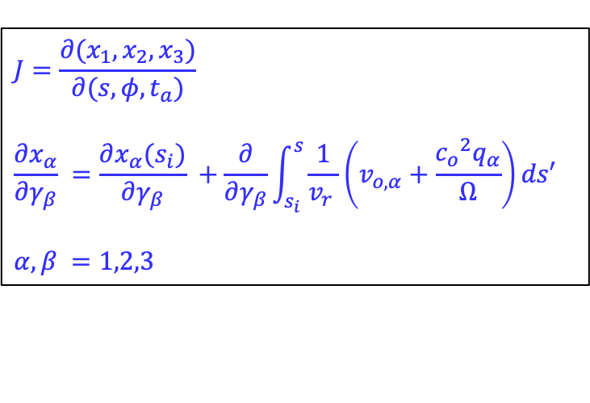
Burgers Equation: Sonic Boom Governing Equation
Burgers’ Equation (Using a spectral representation)
$$\frac{dU}{ds}=\frac{iω\tilde{β}}{4π}\int{U\left({s,ω}^{′}\right)U\left(s,ω−ω^{′}\right)dω′−α_{t}(s,ω)U(s,ω)}$$
              Nonlinearity absorption
Spectral representation U and the acoustic pressure
$$p\left(s,τ\right)=p_{i}^{\left(p\right)}B\left(s\right)u(s,τ)$$
Effective coefficient of nonlinearity and convection effect
$$\tilde{β}=\frac{βp_{i}^{(p)}BΩχ}{ρ_{o}c_{o}^{3}}, B=\sqrt{\frac{ρ_{o}c_{o}χΩJ_{i}}{ρ_{o,i}c_{o,i}χ_{i}Ω_{i}J}}, χ=\frac{c_{o}}{v_{r}}$$
Parameters to be determined : $\tilde{β}, α_{t}, and J$
Numerical solution using a pseudospectral, split-step method
$$\frac{∂u}{∂s}=\tilde{β}u\frac{∂u}{∂τ},$$
$$\frac{dU}{ds}=−α_{t}\left(s,ω\right)U(s,ω)$$
  Very efficient
  Step size based on absorption consideration
$$J=\frac{∂(x_{1},x_{2},x_{3})}{∂(s,φ,t_{a})}$$
$$\frac{∂x_{α}}{∂γ_{β}} =\frac{∂x_{α}(s_{i})}{∂γ_{β}} +\frac{∂}{∂γ_{β}}\int_{s_{i}}^{s}{\frac{1}{{v_{r}}_{ }}\left(v_{o,α}+\frac{{c_{o}}_{ }^{2}q_{α}}{Ω}\right)ds′}$$
$$α,β =1,2,3$$

Slide 6


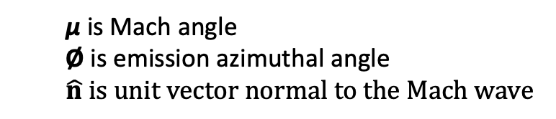



Mach Angle and Ray Coordinates
180˚
Mach wave
µ
-90˚
90˚
$$φ$$
$$\hat{n}$$
$$\hat{n}$$
0˚
  µ is Mach angle
  Ø is emission azimuthal angle
  $$\hat{n} is unit vector normal to the Mach wave$$

Slide 7
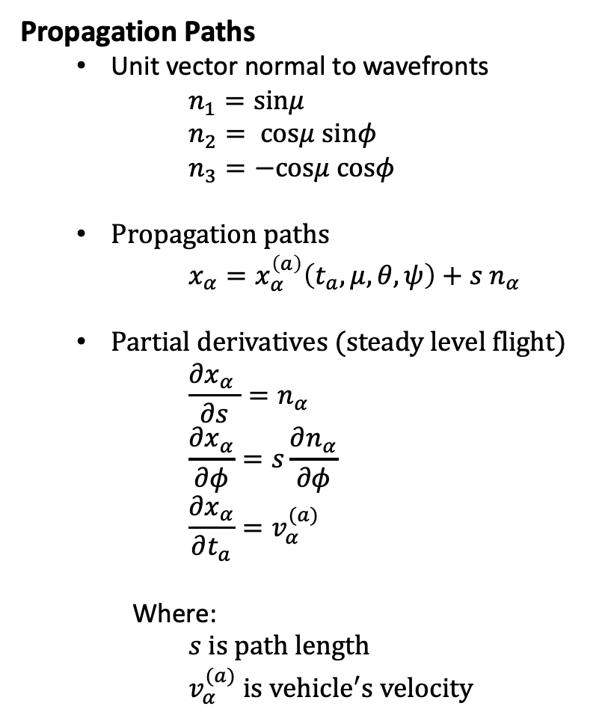
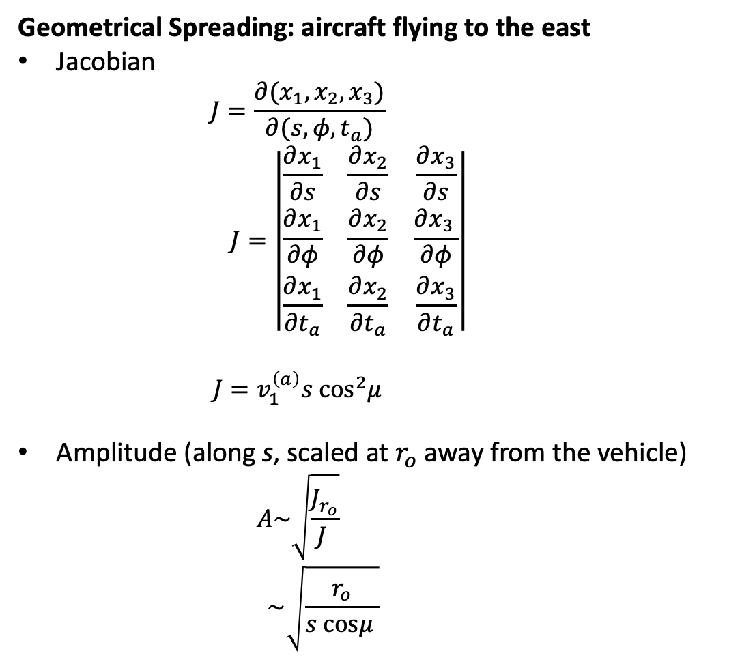
Isothermal, Windless Atmosphere
Propagation Paths
  Unit vector normal to wavefronts
      $$n_{1}=sinμ$$
      $$n_{2}= cosμ sinφ$$
      $$n_{3}=−cosμ cosφ$$
  Propagation paths
      $$x_{α}=x_{α}^{\left(a\right)}\left(t_{a},μ,θ,ψ\right)+s n_{α}$$
  Partial derivatives (steady level flight)
      $$\frac{∂x_{α} }{∂s}=n_{α}$$
      $$\frac{∂x_{α}}{∂φ}=s\frac{∂n_{α}}{∂φ}$$
      $$\frac{∂x_{α}}{∂t_{a}}=v_{α}^{(a)}$$
  Where:
      $$s is path length$$
      $$v_{α}^{(a)} is {vehicle}^{′}s velocity$$
Geometrical Spreading: aircraft flying to the east
Jacobian
      $$J=\frac{∂(x_{1},x_{2},x_{3})}{∂(s,φ,t_{a})}$$
  $$J=\left|\begin{matrix}\frac{∂x_{1}}{∂s} & \frac{∂x_{2}}{∂s} & \frac{∂x_{3}}{∂s} \\ \frac{∂x_{1}}{∂φ} & \frac{∂x_{2}}{∂φ} & \frac{∂x_{3 }}{∂φ} \\ \frac{∂x_{1}}{∂t_{a}} & \frac{∂x_{2}}{∂t_{a}} & \frac{∂x_{3}}{∂t_{a}}\end{matrix}\right|$$
      $$J=v_{1}^{\left(a\right)}s \cos^{2}μ$$
Amplitude (along s, scaled at $r_{o}$ away from the vehicle)
      $$A\sim \sqrt{\frac{J_{r_{o}}}{J }}$$
    $$\sim \sqrt{\frac{r_{o}}{s cosμ }}$$

Slide 8
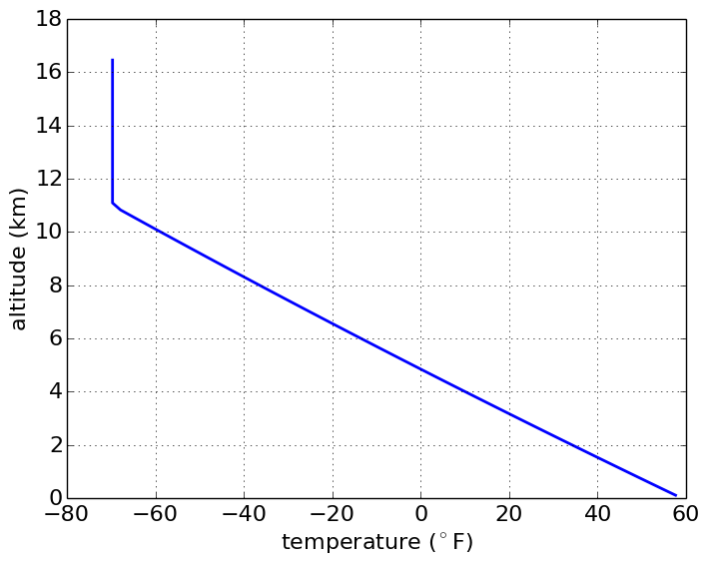
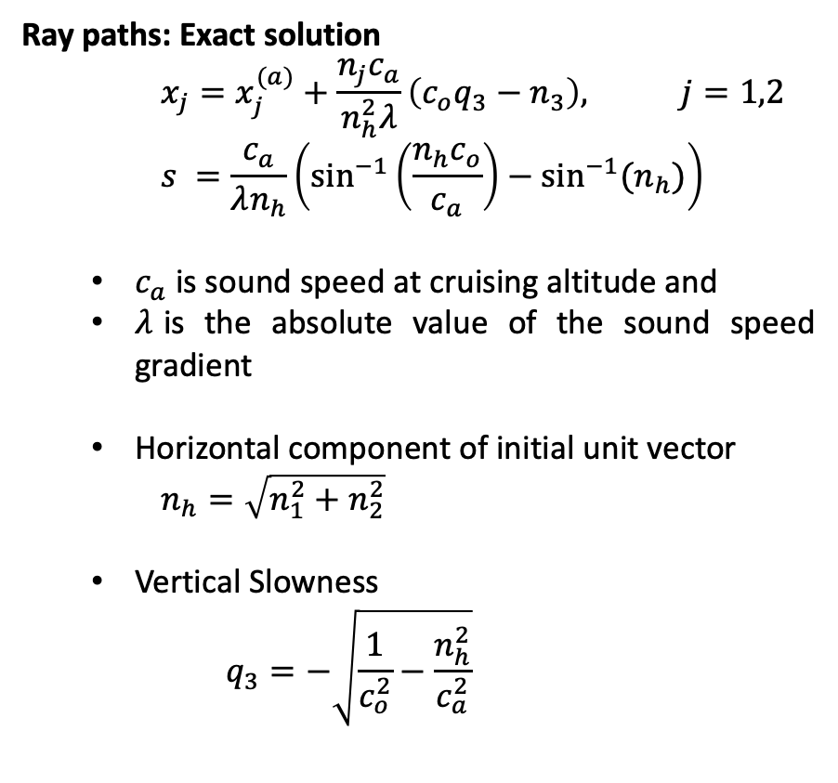
U.S Standard Atmosphere: Exact Solution
U.S. Standard Atmosphere
Ray paths: Exact solution
    $$x_{j}=x_{j}^{(a)}+\frac{n_{j}c_{a}}{n_{h}^{2}λ}\left(c_{o}q_{3}−n_{3}\right), j=1,2$$
    $$s =\frac{c_{a}}{λn_{h}}\left(\sin^{−1}\left(\frac{n_{h}c_{o}}{c_{a}}\right)−\sin^{−1}⁡(n_{h})\right)$$
  $c_{a}$is sound speed at cruising altitude and
  $λ$is the absolute value of the sound speed gradient
  Horizontal component of initial unit vector
    $n_{h}=\sqrt{n_{1}^{2}+n_{2}^{2}}$
  Vertical Slowness
    $$q_{3}=−\sqrt{\frac{1}{c_{o}^{2}}−\frac{n_{h}^{2}}{c_{a}^{2}}}$$
Cruising altitude
Exact solution is valid for:
cruising altitude below the tropopause
sonic boom propagation below the tropopause

Slide 9
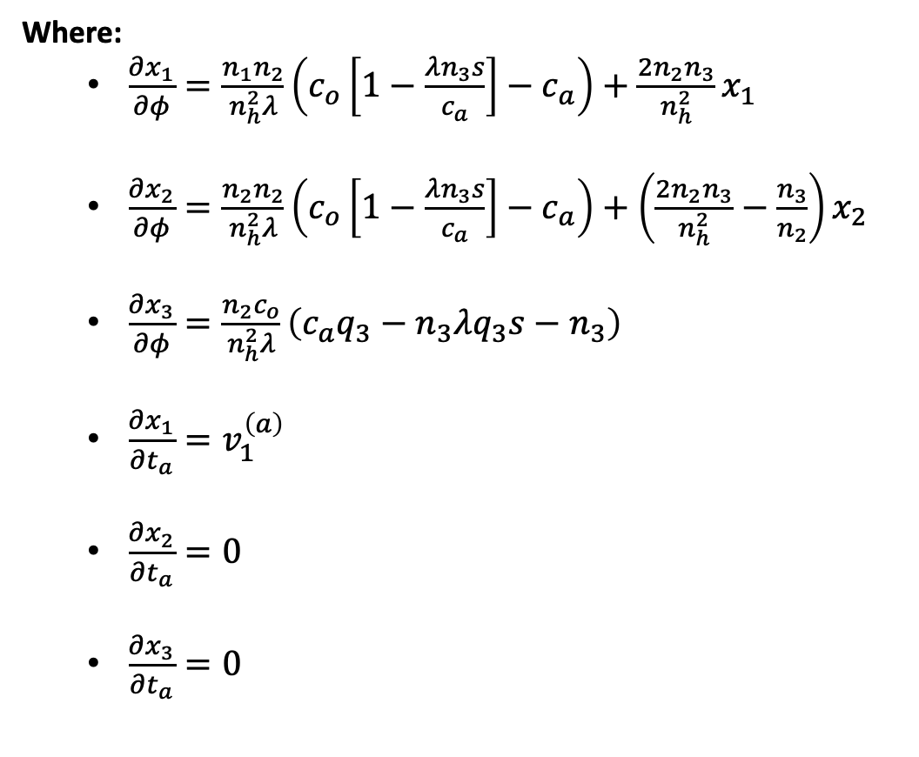
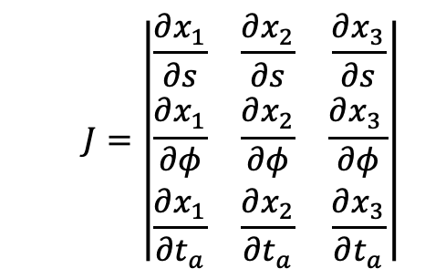
Standard Atmosphere: Exact Solution
Jacobian: Exact Solution
Where:
  $\frac{∂x_{1}}{∂φ}=\frac{n_{1}n_{2}}{n_{h}^{2}λ}\left(c_{o}\left[1−\frac{λn_{3}s}{c_{a}}\right]−c_{a}\right)+\frac{2n_{2}n_{3}}{n_{h}^{2}}x_{1}$
  $\frac{∂x_{2}}{∂φ}=\frac{n_{2}n_{2}}{n_{h}^{2}λ}\left(c_{o}\left[1−\frac{λn_{3}s}{c_{a}}\right]−c_{a}\right)+\left(\frac{2n_{2}n_{3}}{n_{h}^{2}}−\frac{n_{3}}{n_{2}}\right)x_{2}$
  $\frac{∂x_{3}}{∂φ}=\frac{n_{2}c_{o}}{n_{h}^{2}λ}\left(c_{a}q_{3}−n_{3}λq_{3}s−n_{3}\right)$
  $\frac{∂x_{1}}{∂t_{a}}=v_{1}^{\left(a\right)}$
  $\frac{∂x_{2}}{∂t_{a}}=0$
  $\frac{∂x_{3}}{∂t_{a}}=0$
  $$J=\left|\begin{matrix}\frac{∂x_{1}}{∂s} & \frac{∂x_{2}}{∂s} & \frac{∂x_{3}}{∂s} \\ \frac{∂x_{1}}{∂φ} & \frac{∂x_{2}}{∂φ} & \frac{∂x_{3 }}{∂φ} \\ \frac{∂x_{1}}{∂t_{a}} & \frac{∂x_{2}}{∂t_{a}} & \frac{∂x_{3}}{∂t_{a}}\end{matrix}\right|$$

Slide 10
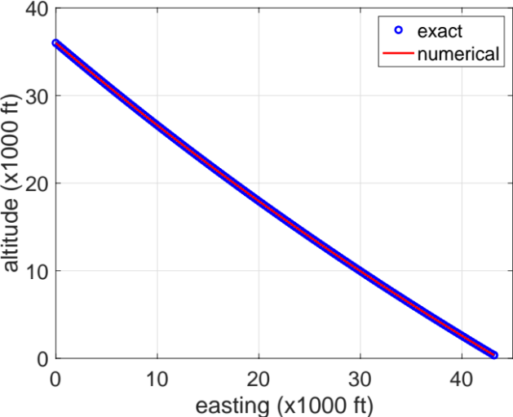
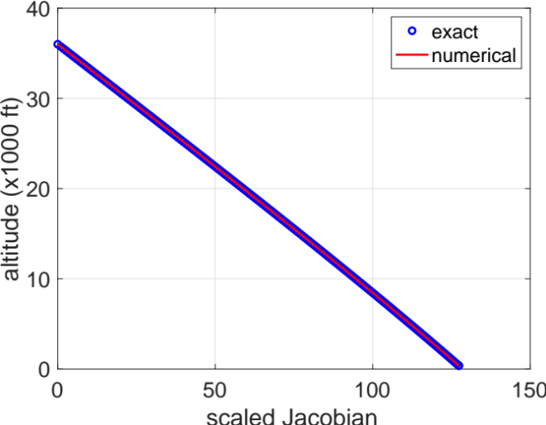
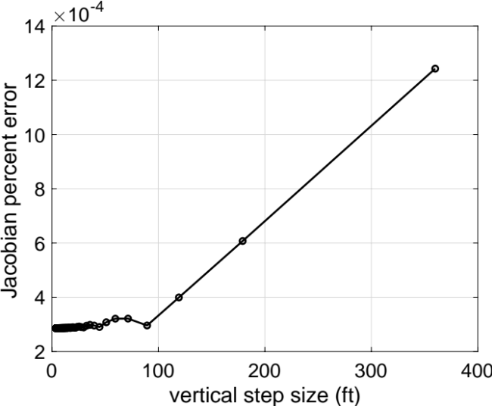
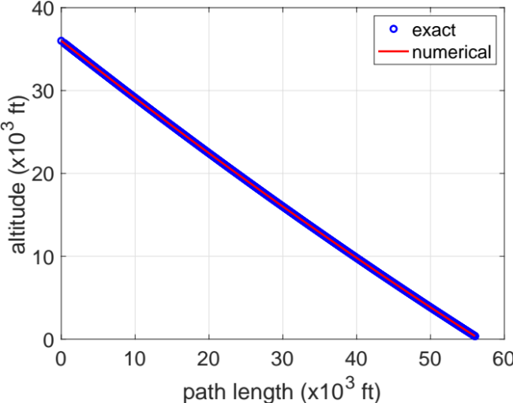
Exact vs. Single-Ray Jacobian: Undertrack
Ray path
Scaled Jacobian
Left:
Comparison of the x-component (easting) and the path length of the ray path obtained using the exact solution and numerically using the single-ray Jacobian (Enhanced PCBoom).
Right:
Comparison of the Jacobians, scaled by their values at 3 body lengths away from the aircraft, between the exact solution and single-ray method. The error of the numerical solution is also shown as a function of the step size.
This excellent agreement gives confidence in the accuracy of the single-ray Jacobian method used in Enhanced PCBoom.
Path length
Numerical convergence

Slide 11
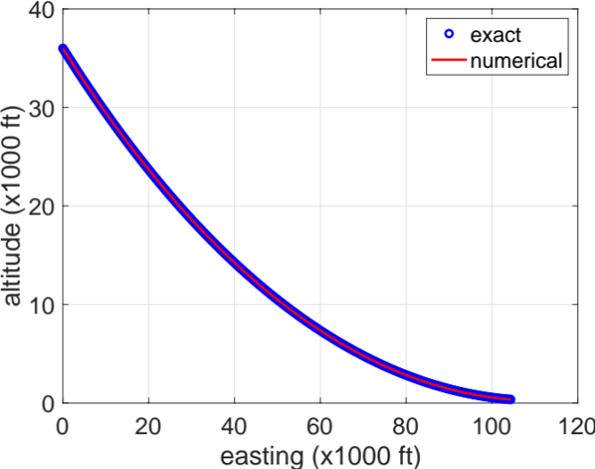
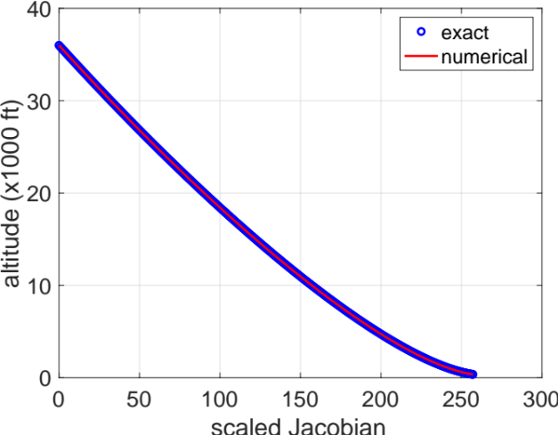
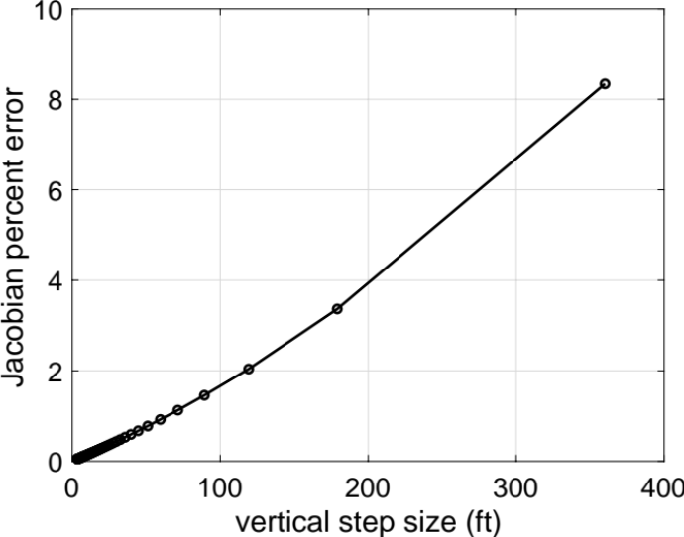
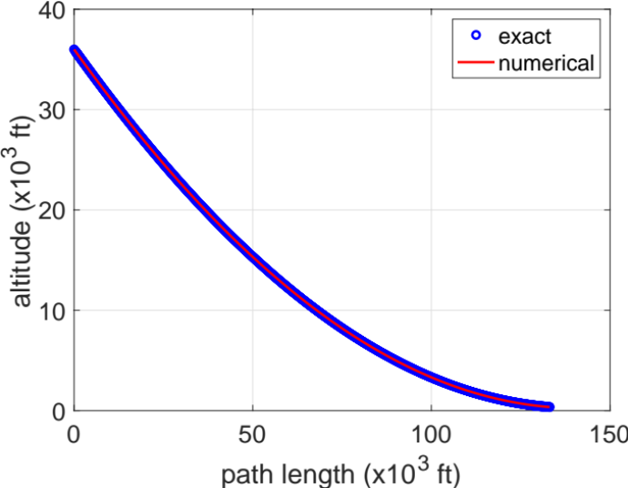
Exact vs. Single-Ray Jacobian: Carpet Edge
Ray path
Scaled Jacobian
Left:
Comparison of the x-component (easting) and the path length of the ray path obtained using the exact solution and numerically using the single-ray Jacobian (Enhanced PCBoom).
Right:
Comparison of the Jacobians, scaled by their values at 3 body lengths away from the aircraft, between the exact solution and single-ray method. The error of the numerical solution is also shown as a function of the step size.
This excellent agreement gives confidence in the accuracy of the single-ray Jacobian method used in Enhanced PCBoom.
Numerical convergence
Path length

Slide 12
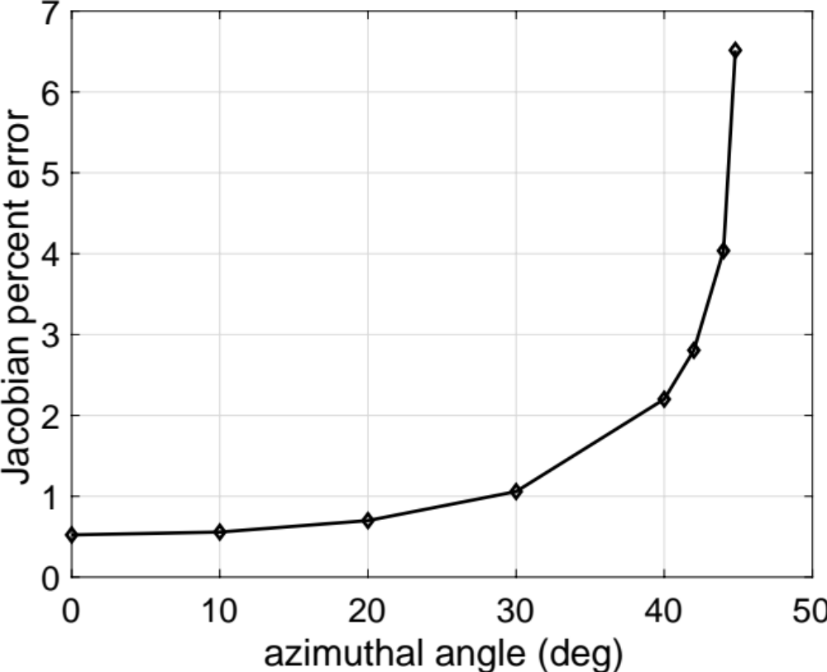
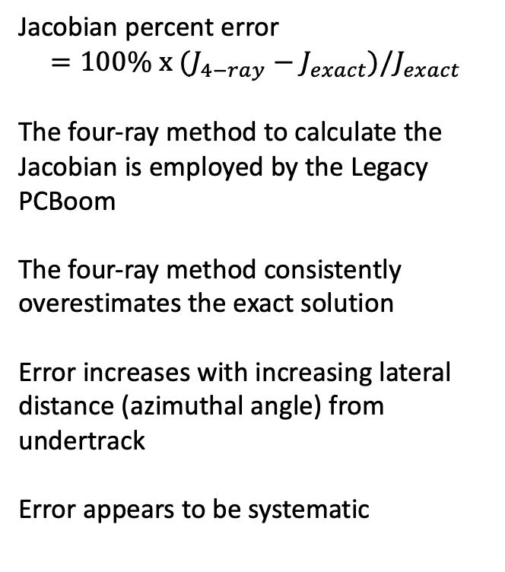
Exact vs. Four-ray Method: Standard Atmosphere
Jacobian percent error
$$=100\% x (J_{4−ray}−J_{exact})/J_{exact}$$
The four-ray method to calculate the Jacobian is employed by the Legacy PCBoom
The four-ray method consistently overestimates the exact solution
Error increases with increasing lateral distance (azimuthal angle) from undertrack
Error appears to be systematic
Four-ray method is used by the Legacy PCBoom

Slide 13
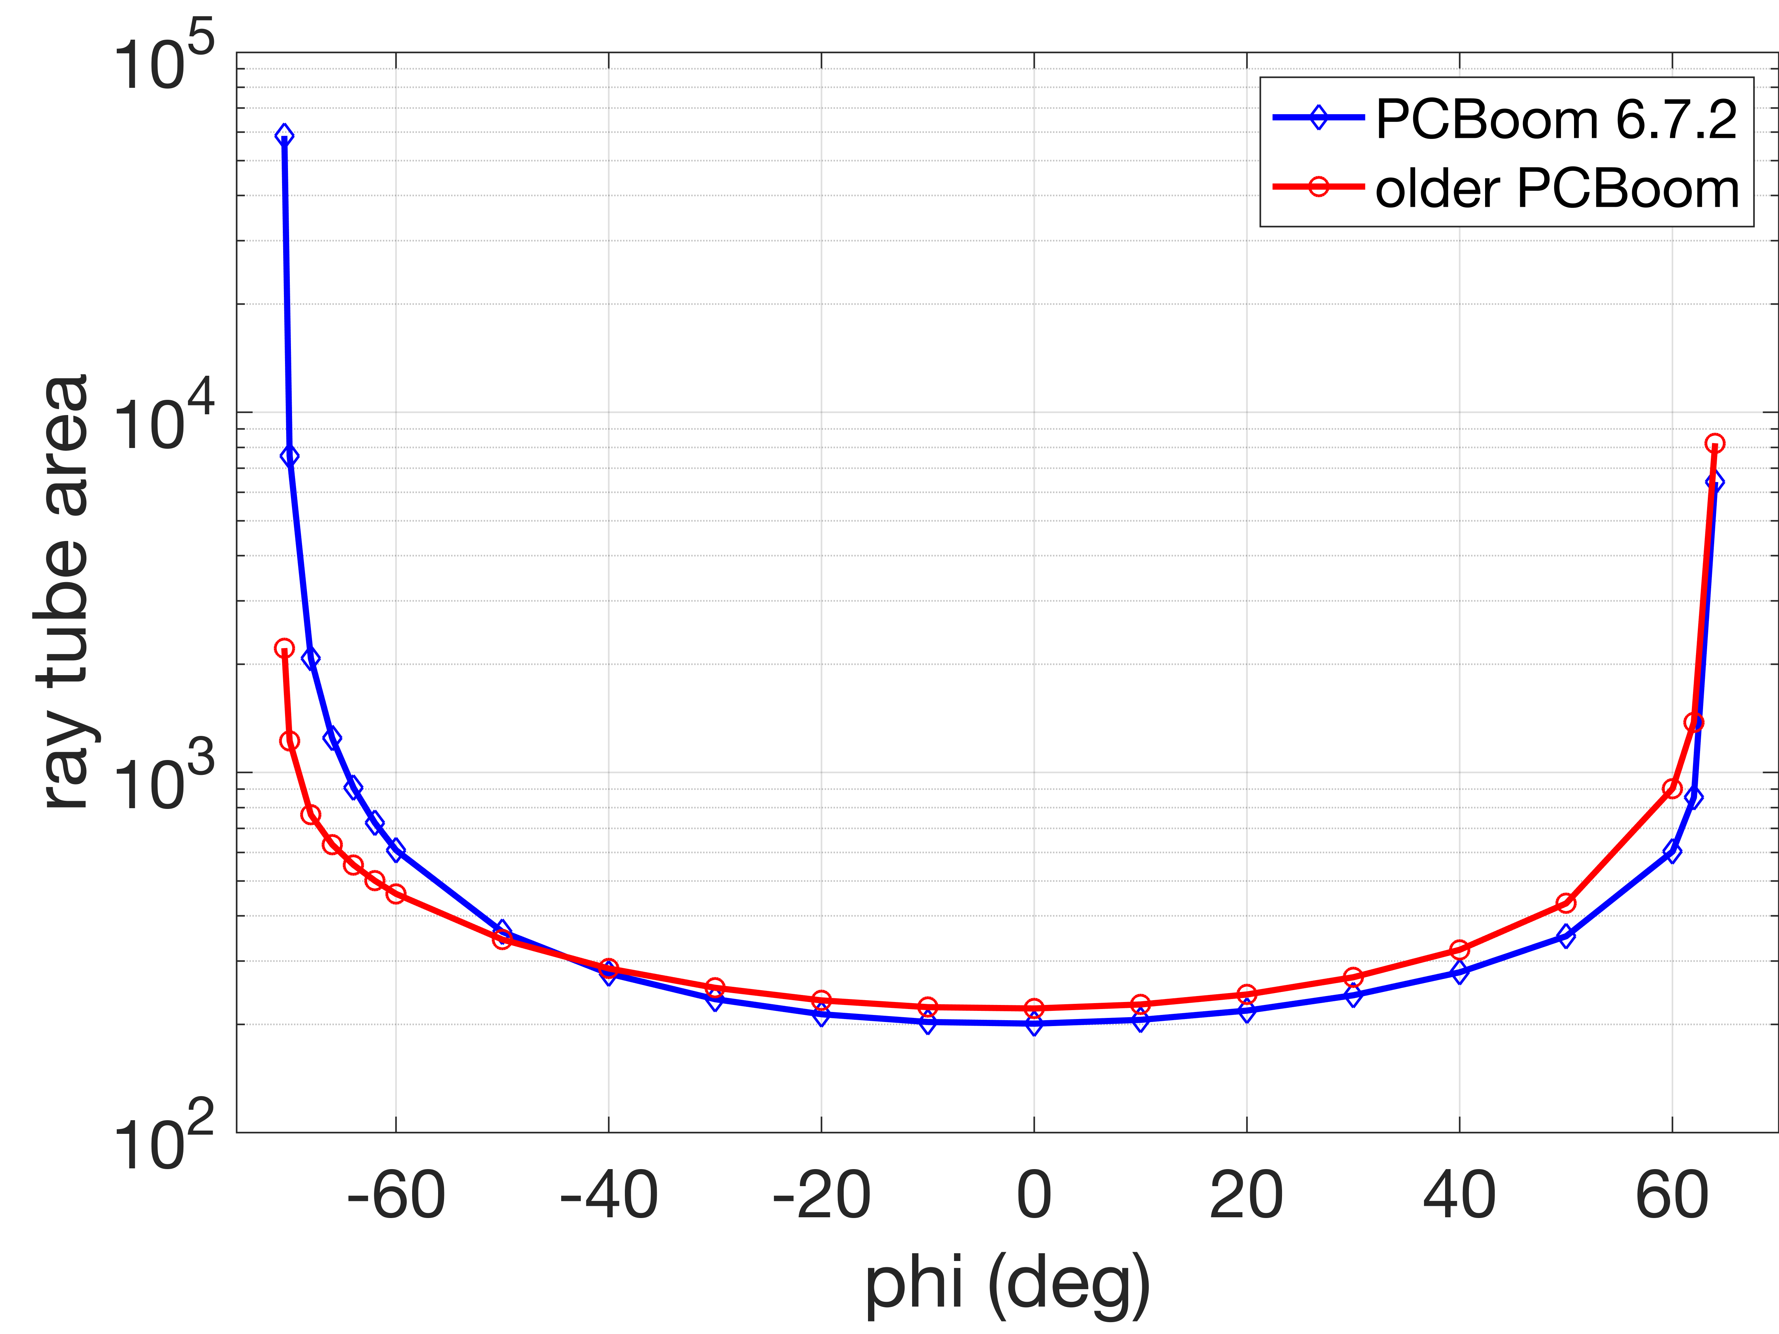
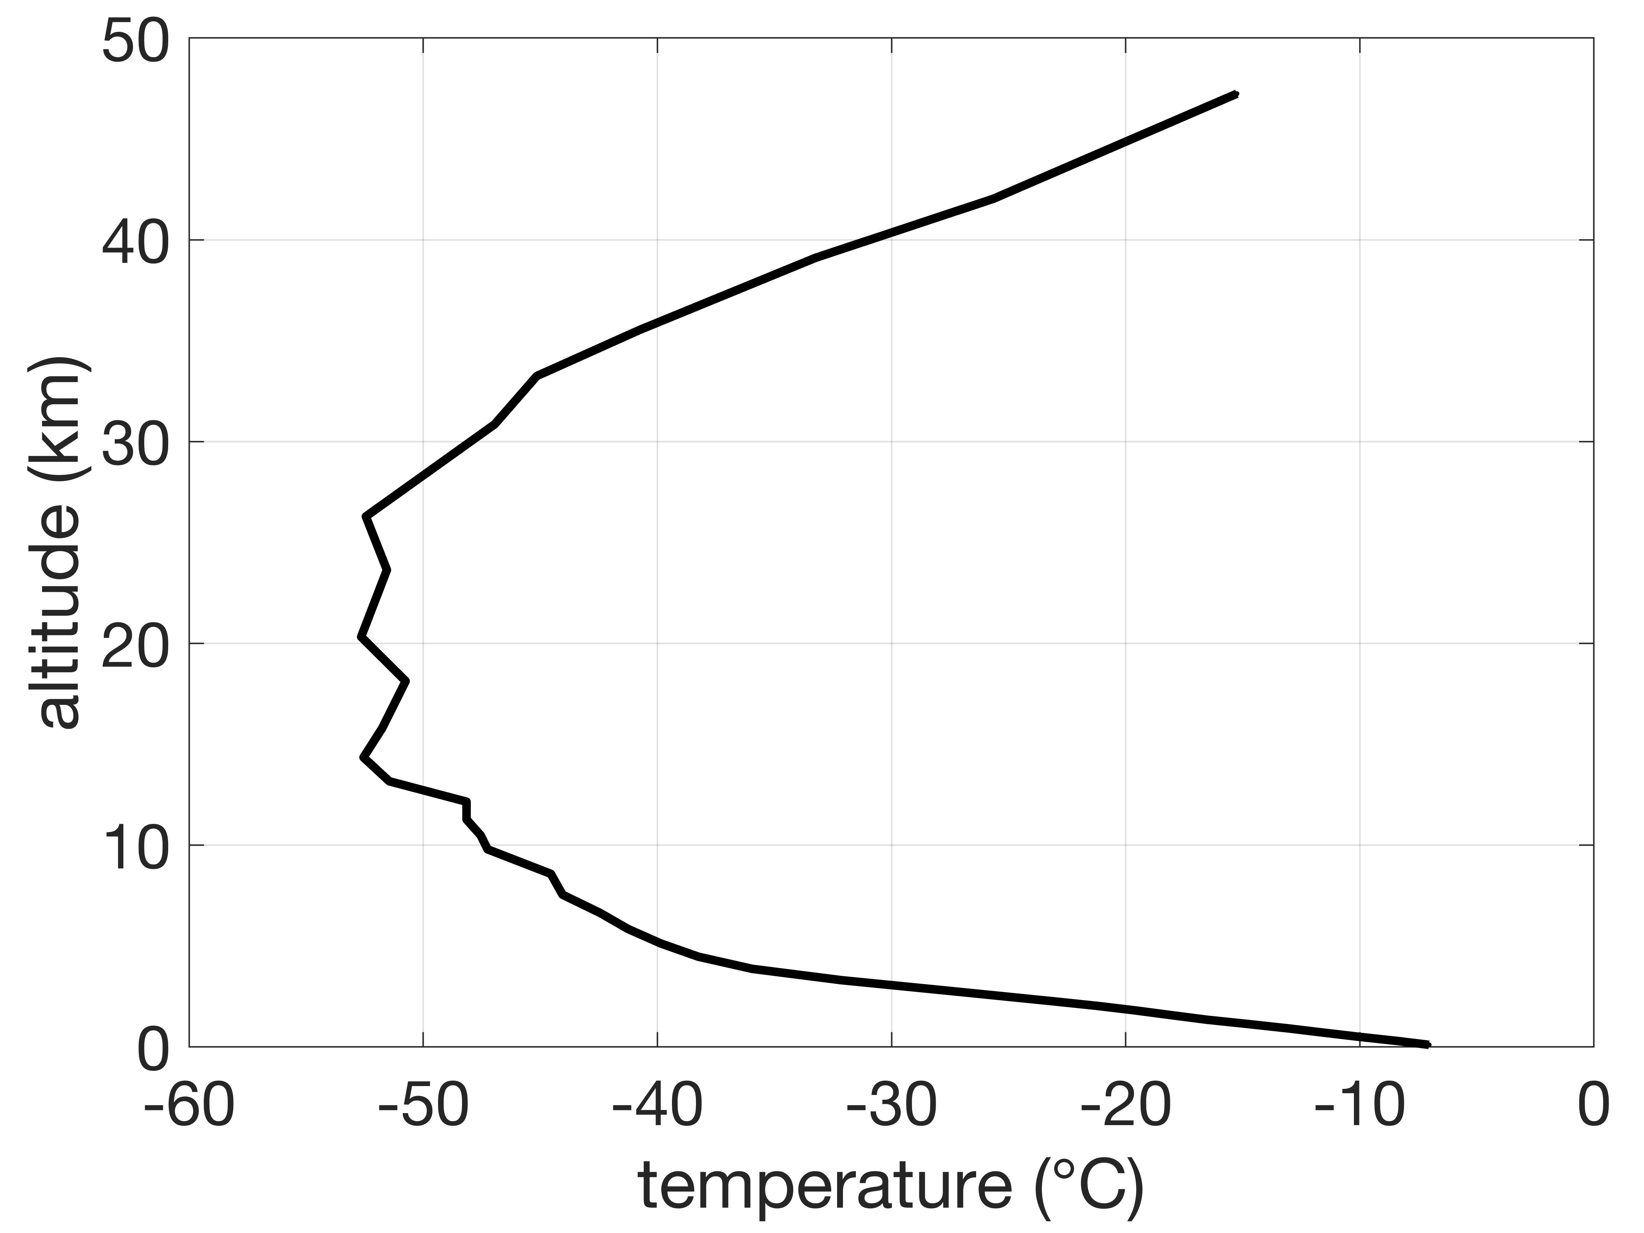
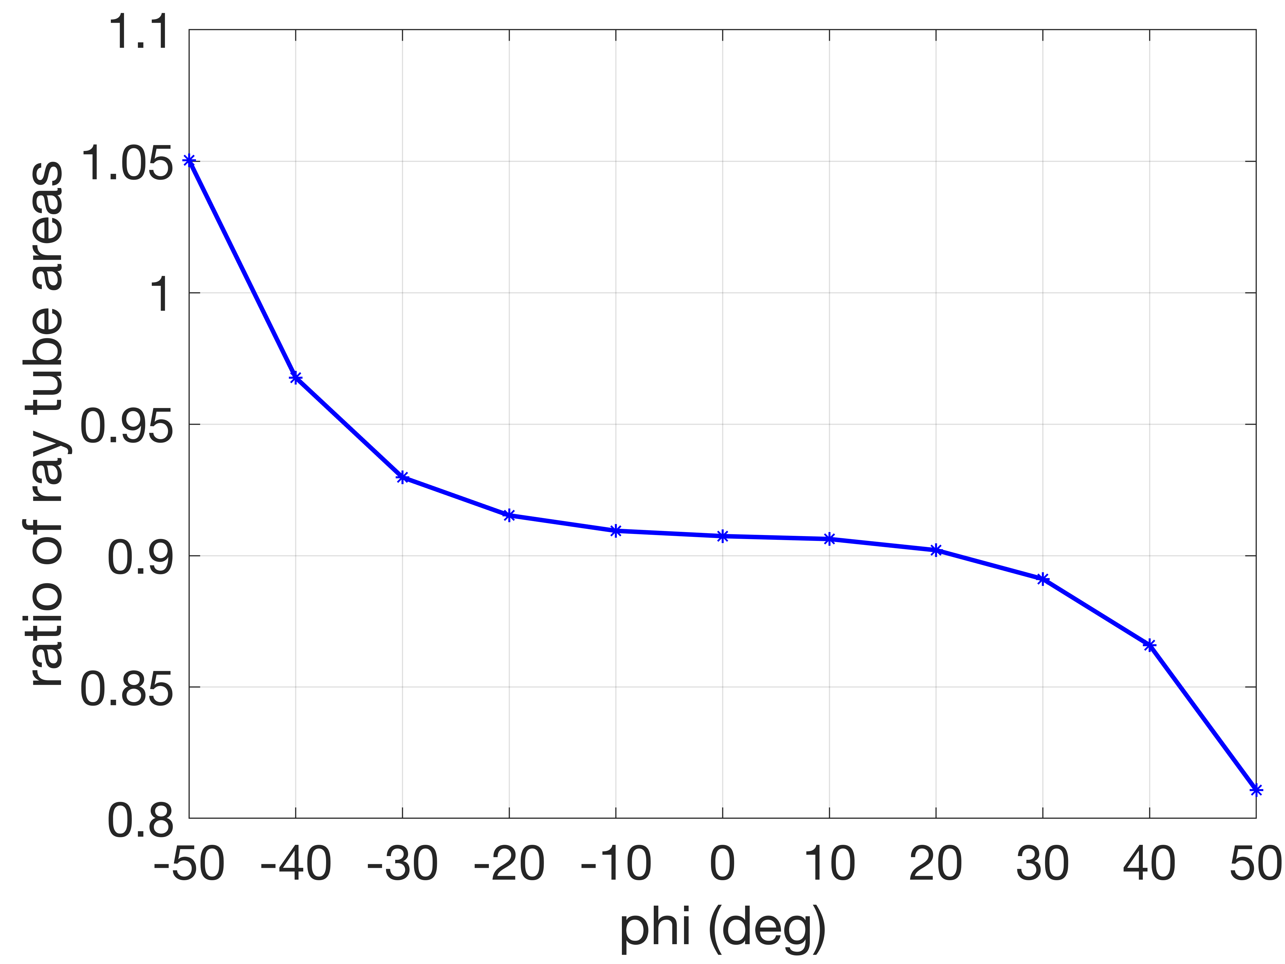
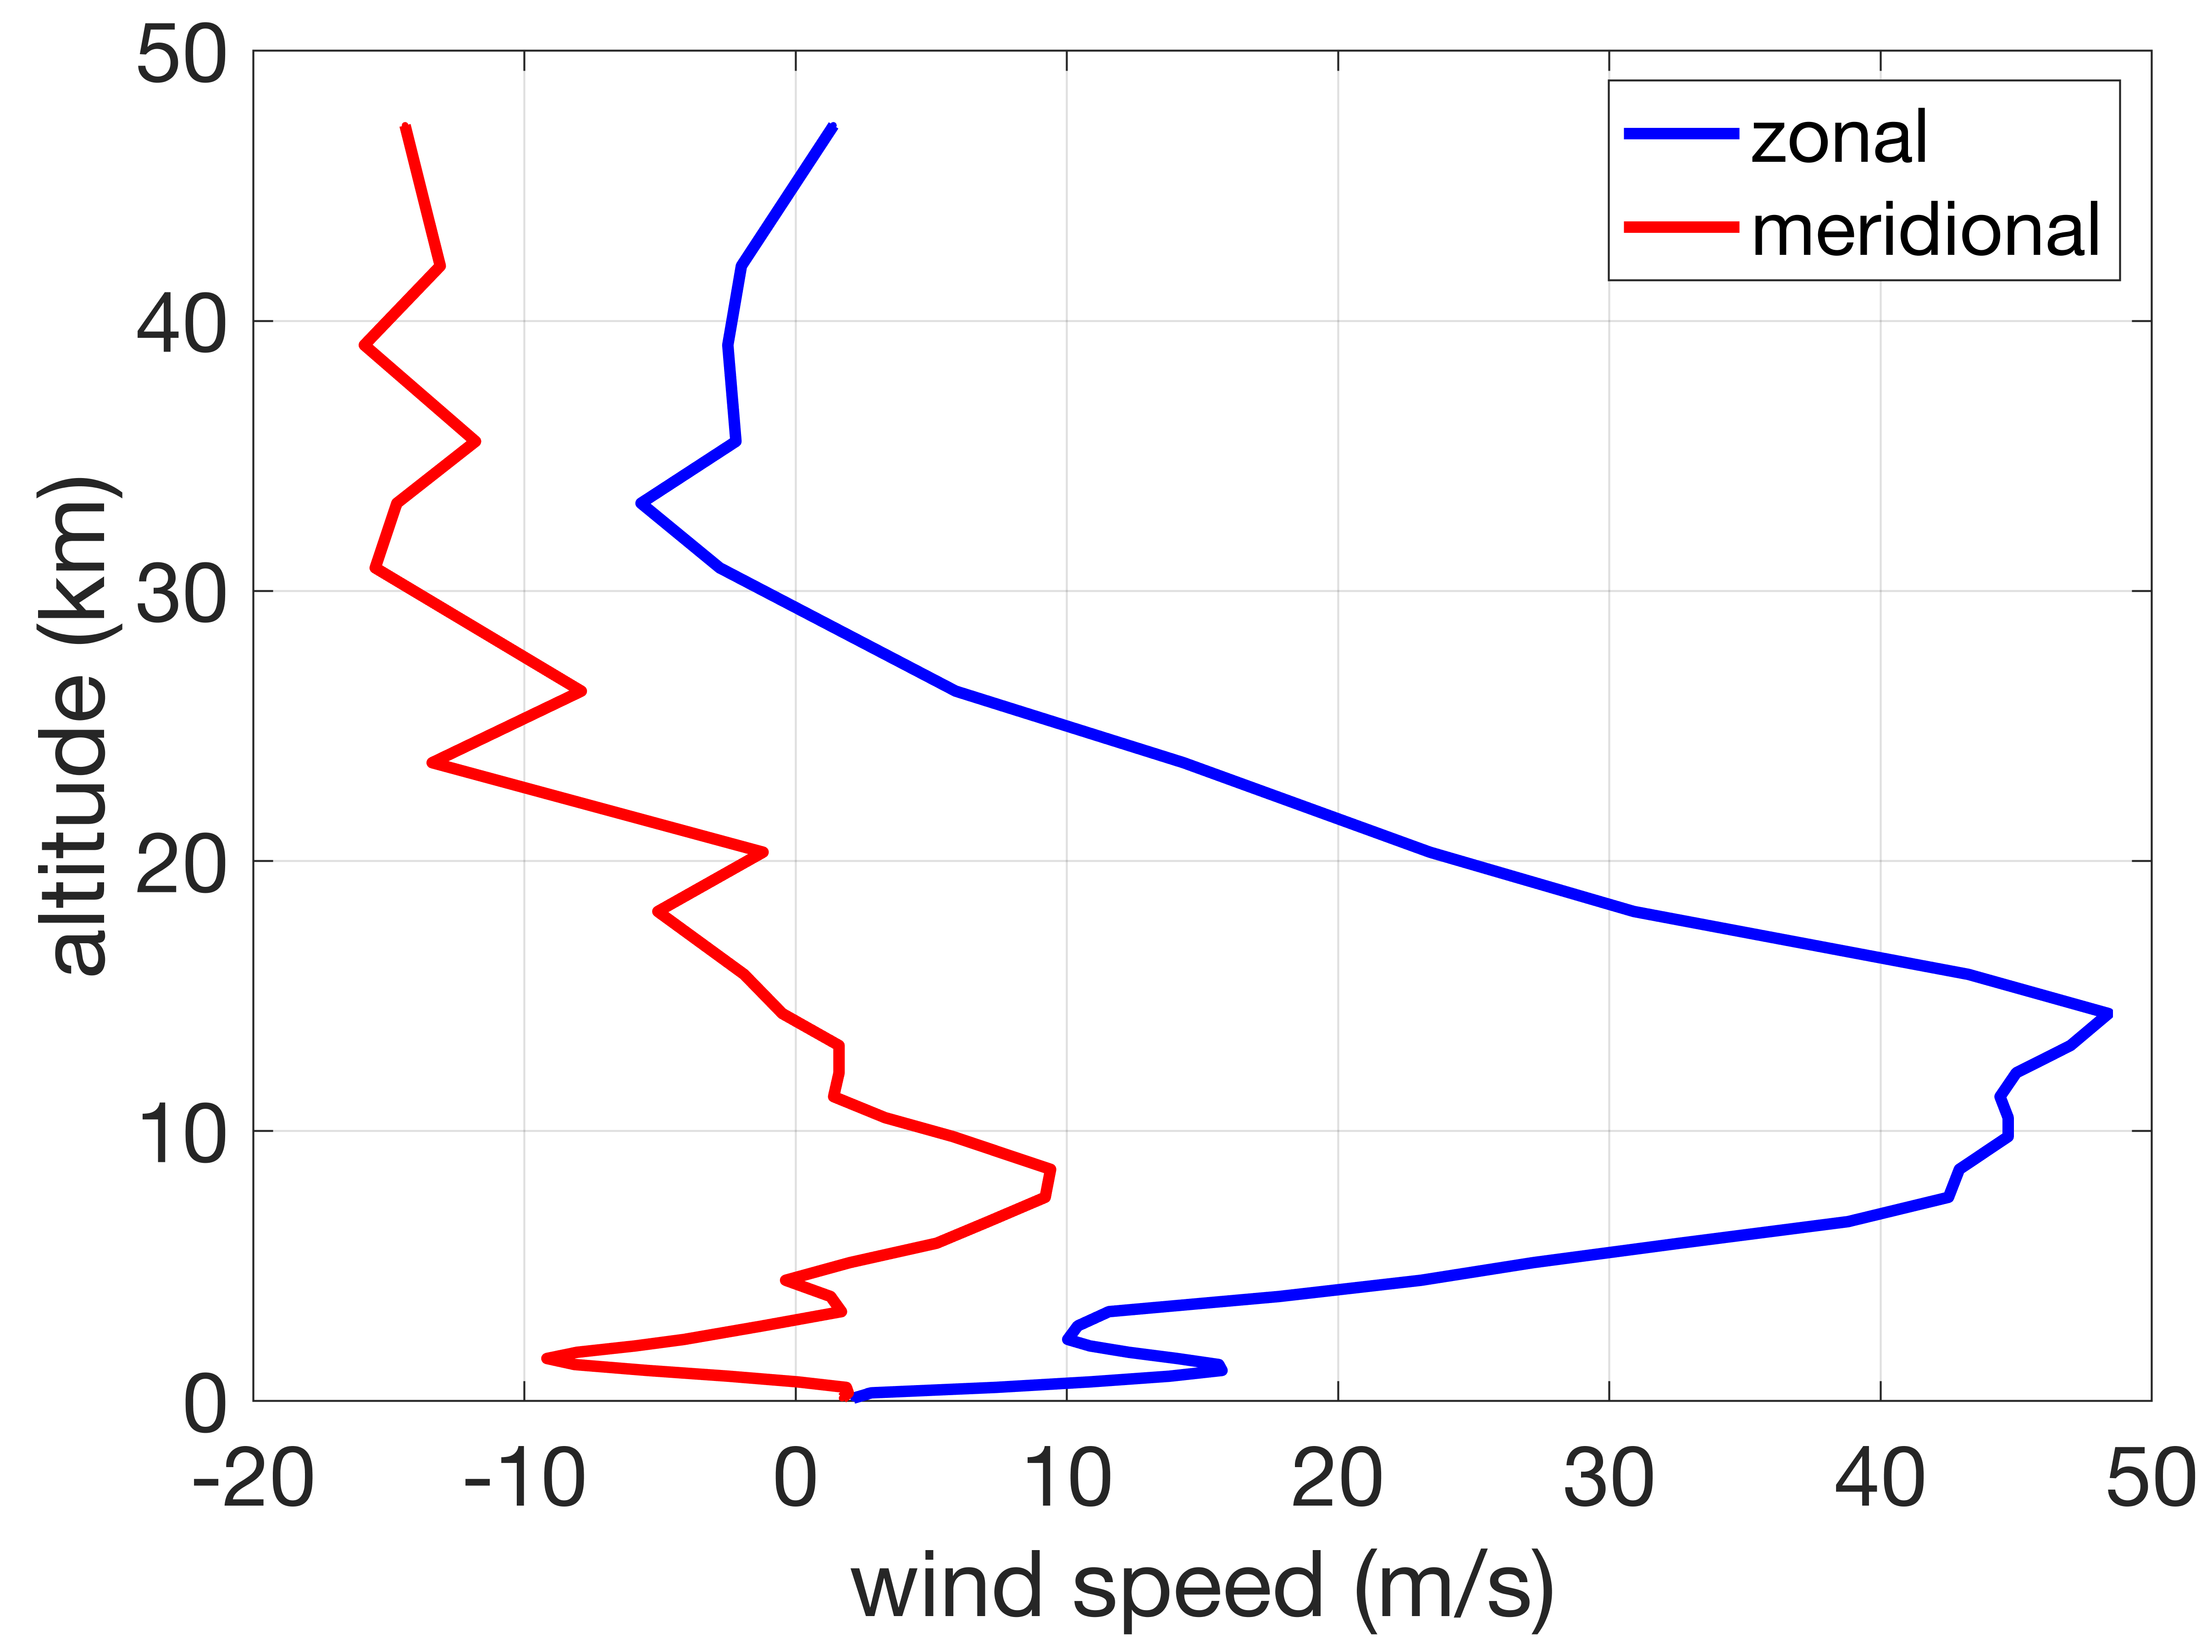
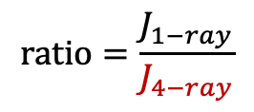
Single-Ray vs Four-Ray Methods: Real Atmosphere
Temperature Profile
Jacobian Comparison
Left:
Temperature and Wind Profiles
Strong tropospheric jet stream blowing from west to east with maximum speed of ~48 m/s at an altitude of 15 km
Right:
Comparison of the Jacobians (ray tube area) obtained numerically using:
Enhanced PCBoom that employs 1 ray to calculate the Jacobian
Older PCBoom that employs 4 rays
Significant differences in the Jacobians using the two approaches
PCBoom 6.7.2 uses 1 ray
Older PCBoom uses 4 rays
Wind Profiles
$$ratio=\frac{J_{1−ray}}{J_{4−ray}}$$

Slide 14
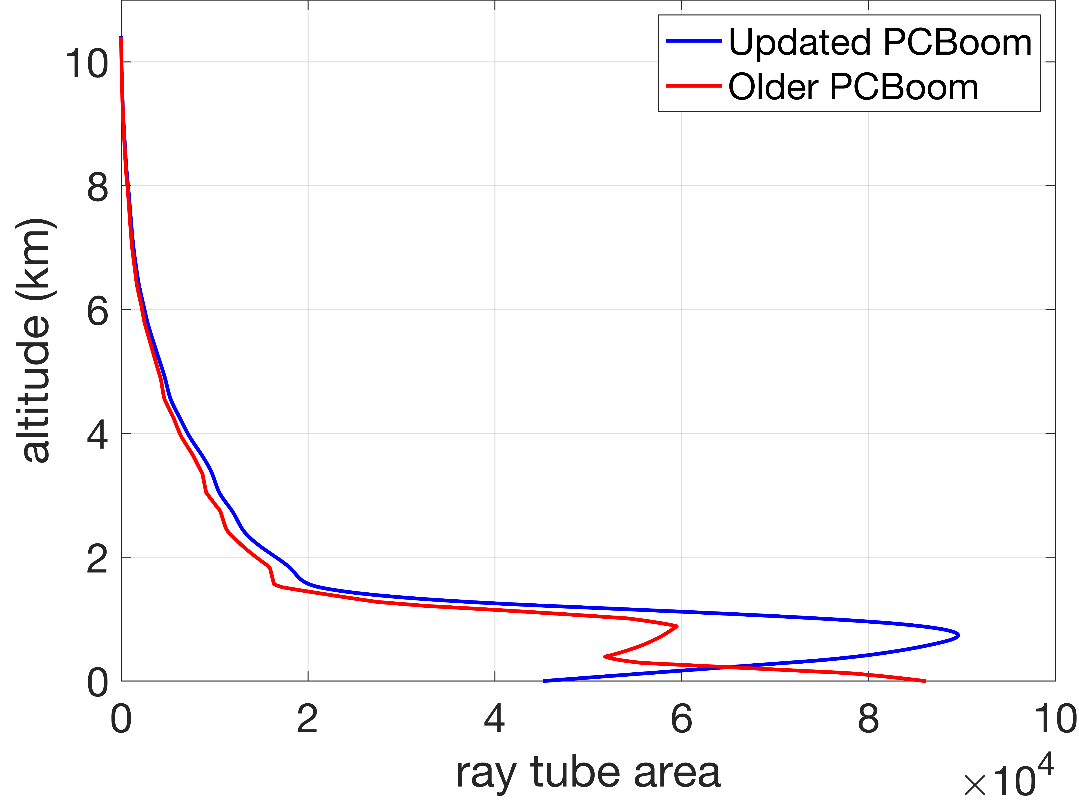
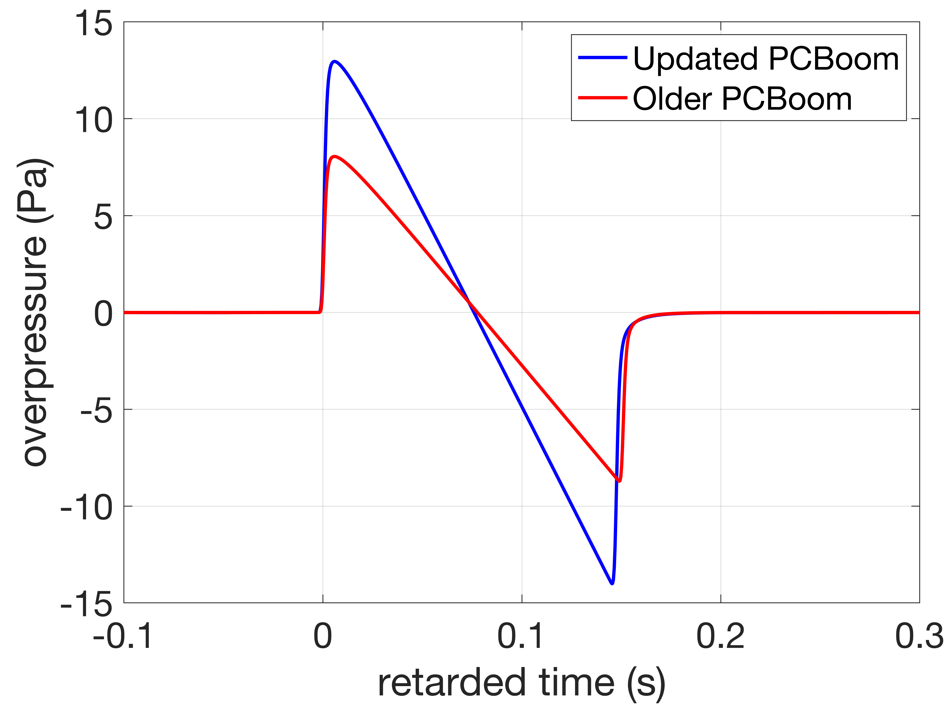
A Case Study From a Flight Test : Geometrical Spreading and Waveform Comparison
Spreading, A (or J)
Waveforms
Single-ray Jacobian
Four-ray Jacobian
Single-ray Jacobian
Four-ray Jacobian
, A
Left figure: Comparison of the geometrical spreading (ray tube area or Jacobian)
  Near the ground, the ray tube areas are significantly different
Right figure: The waveform using the single-ray Jacobian (Enhanced PCBoom) has much larger peak overpressure than the waveform using the four-ray Jacobian (Legacy PCBoom)
Geometrical spreading affects the waveform amplitude and nonlinear evolution
  Need for accurate calculation

Slide 15
Summary
Use of a ray theory for sonic boom propagation
Discussion of kinematic ray tracing and geometrical spreading under general conditions
  using a single-ray method
Derivation of exact solutions using a standard atmosphere
Validation of the single-ray Jacobian (employed by the Enhanced PCBoom) by the exact solutions
Discrepancy between the exact solutions and the 4-ray method (employed by the Legacy PCBoom)
Discrepancy between the Legacy and Enhanced PCBoom versions using a realistic atmosphere

