Slide 1
GPM Products
George J. Huffman
NASA/GSFC Earth Sciences Division – Atmospheres
GPM Deputy Project Scientist, Multi-Satellite Team Lead
george.j.huffman@nasa.gov
Introduction
IMERG
GPM Product Levels and Postings
Example Analyses
Schedule and Final Remarks

Slide 2
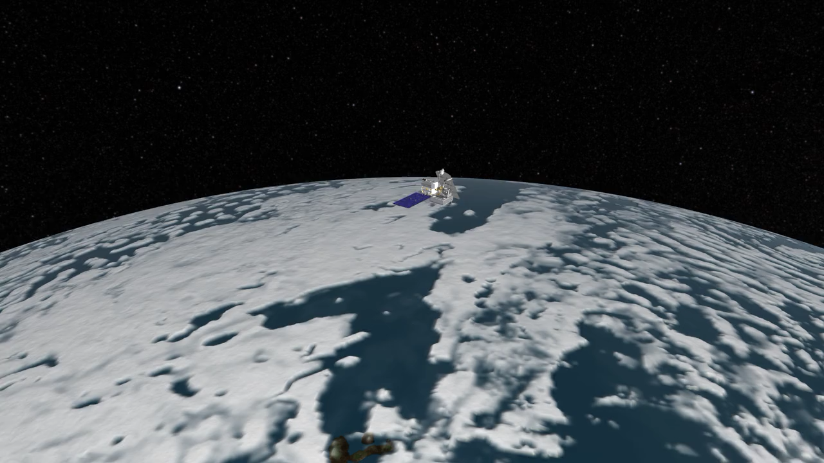
1. Introduction – The GPM Core Observatory
Launched in 2014
Covers 65ºN-S
Carries 2 sensors
• Dual-frequency Precipitation Radar (DPR)
• 3-D
• narrow swath
• GPM Microwave Imager (GMI)
• 2-D
• wider swath

Slide 3
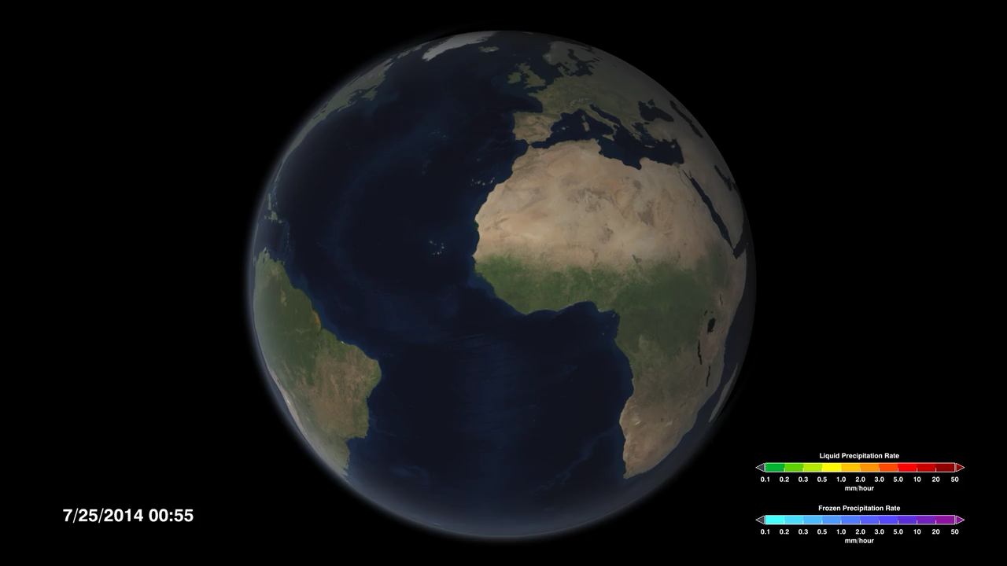
1. Introduction – The GPM Constellation
The Core Observatory by itself gives really sparse coverage
• DPR gives 1 snapshot every 3 days
• GMI gives 1 snapshot per day
So, we asked to use data from other agencies’ satellites
And then we do interpolation to fill in the gaps

Slide 4
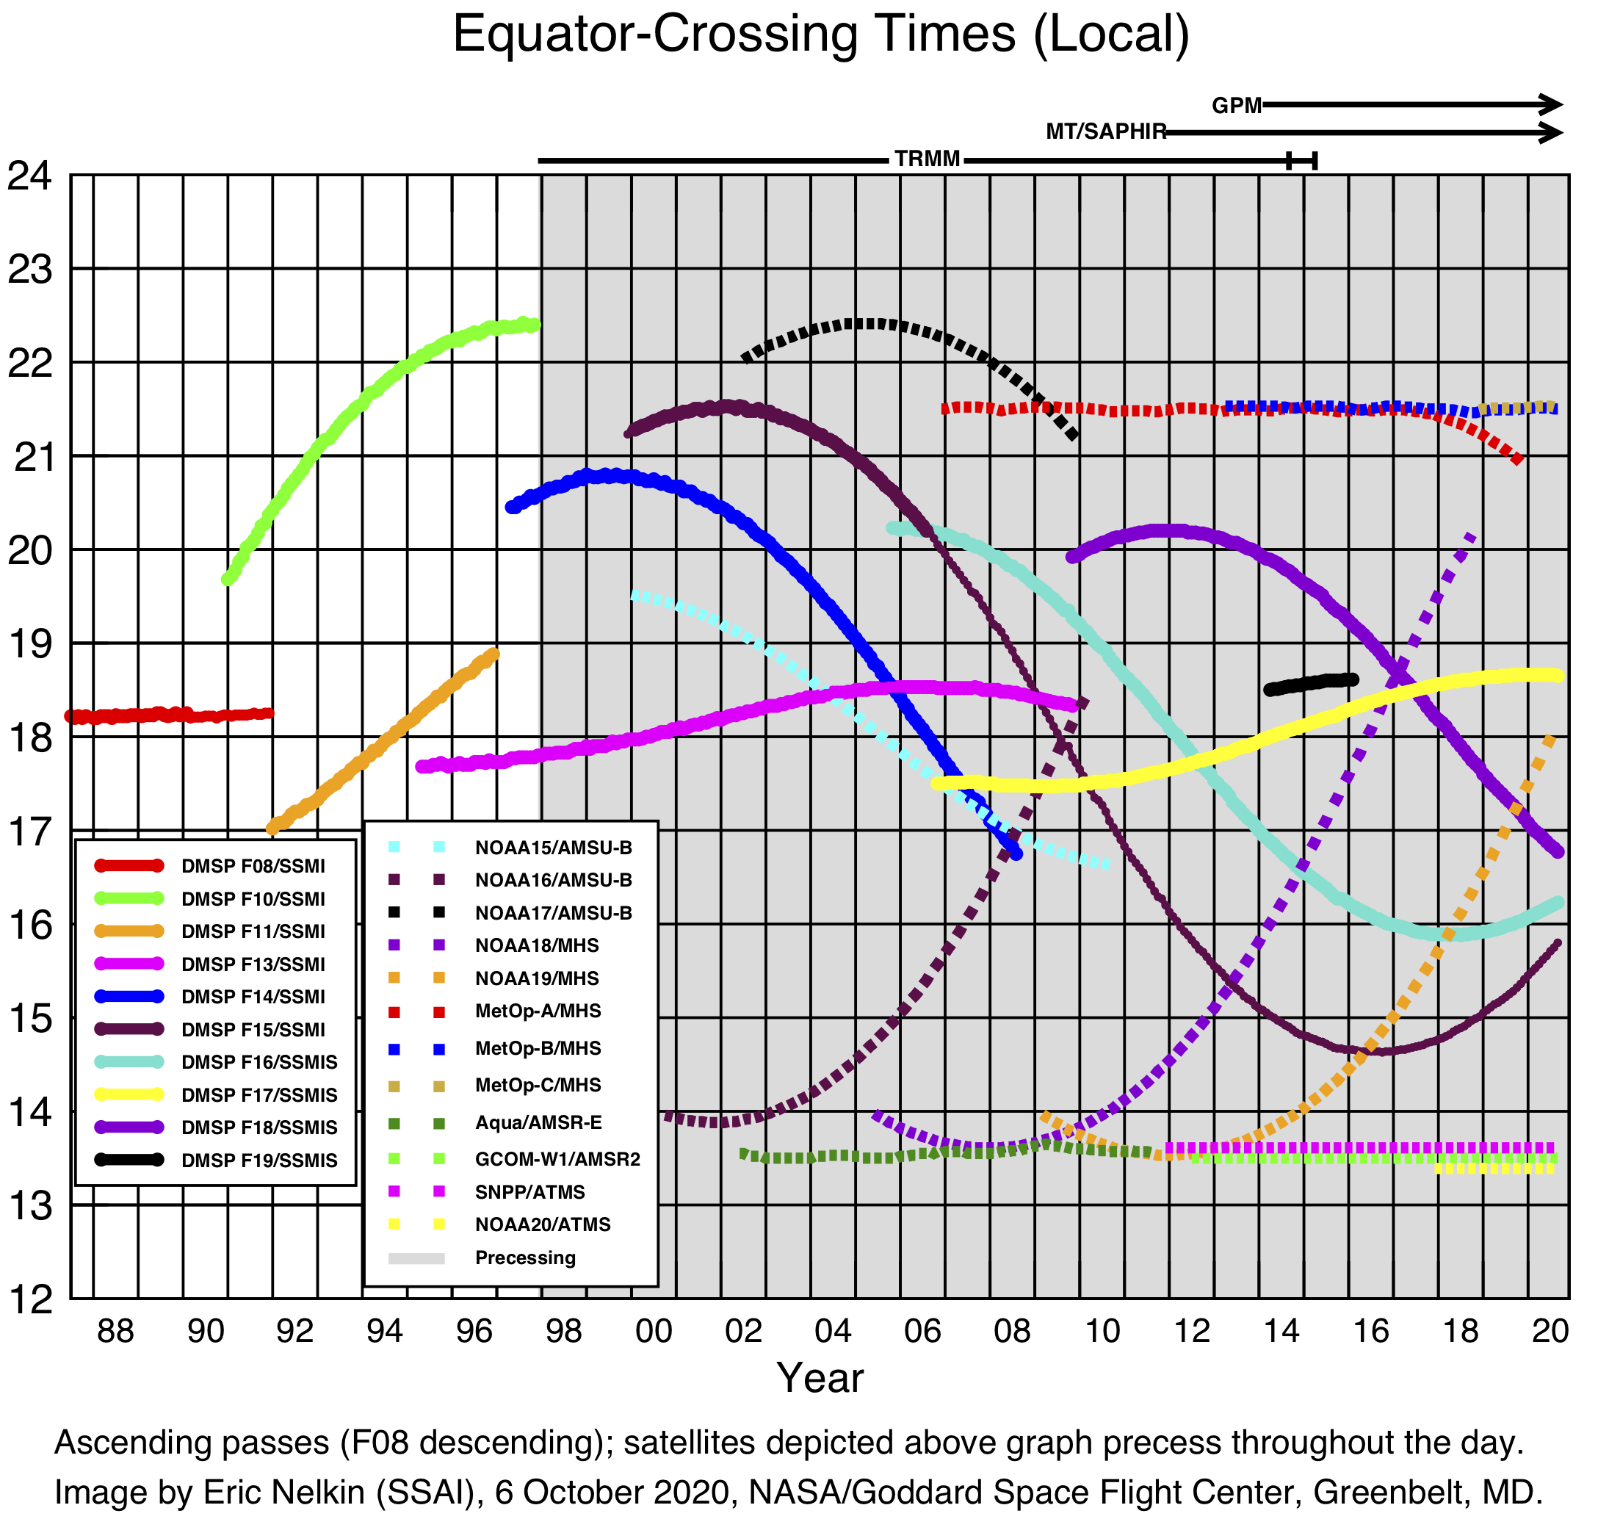
1. Introduction – The Constellation
The current GPM constellation includes:
• 5 polar-orbit passive microwave imagers
  • 3 SSMIS, AMSR-2, GMI
• 6 polar-orbit passive microwave sounders
    • 3 MHS, 2 ATMS, SAPHIR*
    • which provides ~3-hourly observations
    • we also use geosynchronous infrared observations as a last-ditch fill-in
The constellation is evolving
Before GPM in 2014, the Tropical Rainfall Measuring Mission (TRMM) provided similar radar and radiometer data starting in 1998
TRMM era
GPM era

Slide 5
2. IMERG – Quick Description
Integrated Multi-satellitE Retrievals for GPM (IMERG) provides
• multiple runs for different user requirements for latency and accuracy
• “Early” – 4 hr (flash flooding)
• “Late” – 14 hr (crop forecasting)
• “Final” – 3 months (research)
• half-hourly time interval
• 0.1º global lat./long. (CED) grid
Currently at Version 06
Original product data fields
 | Half-hourly data file (Early, Late, Final)
1 | [multi-sat.] precipitationCal
2 | [multi-sat.] precipitationUncal
3 | [multi-sat. precip] randomError
4 | [PMW] HQprecipitation
5 | [PMW] HQprecipSource [identifier]
6 | [PMW] HQobservationTime
7 | IRprecipitation
8 | IRkalmanFilterWeight
9 | [phase] probabilityLiquidPrecipitation
10 | precipitationQualityIndex
 | Monthly data file (Final)
1 | [sat.-gauge] precipitation
2 | [sat.-gauge precip] randomError
3 | GaugeRelativeWeighting
4 | probabilityLiquidPrecipitation [phase]
5 | precipitationQualityIndex

Slide 6
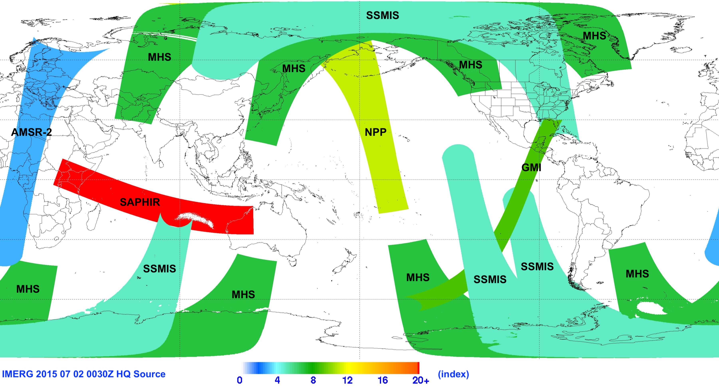
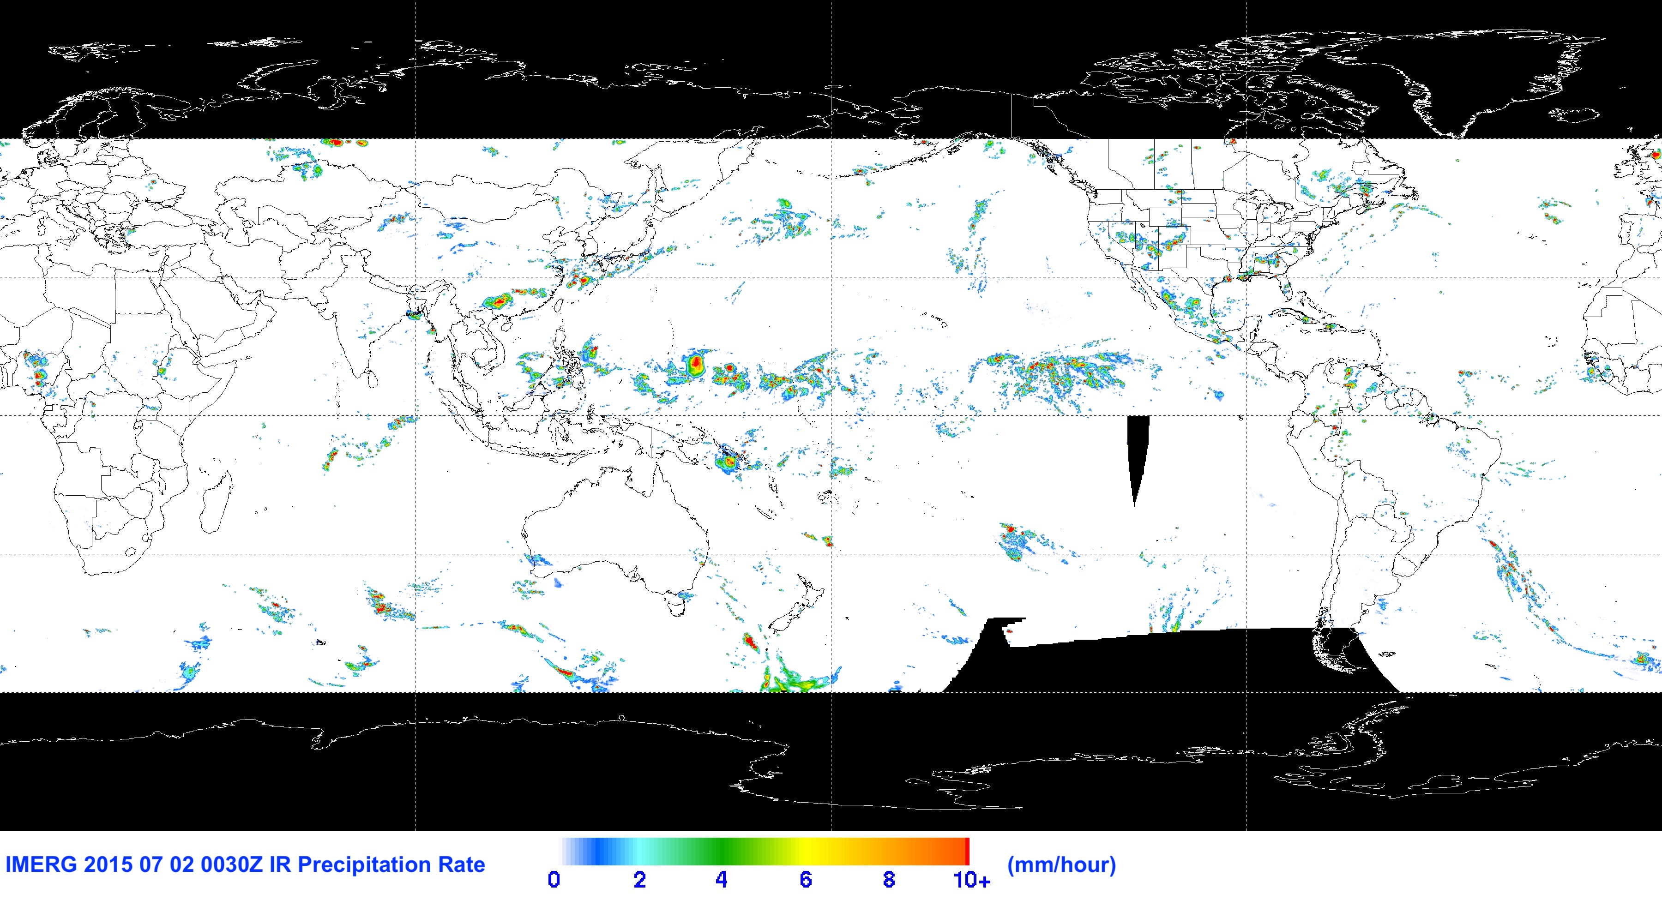
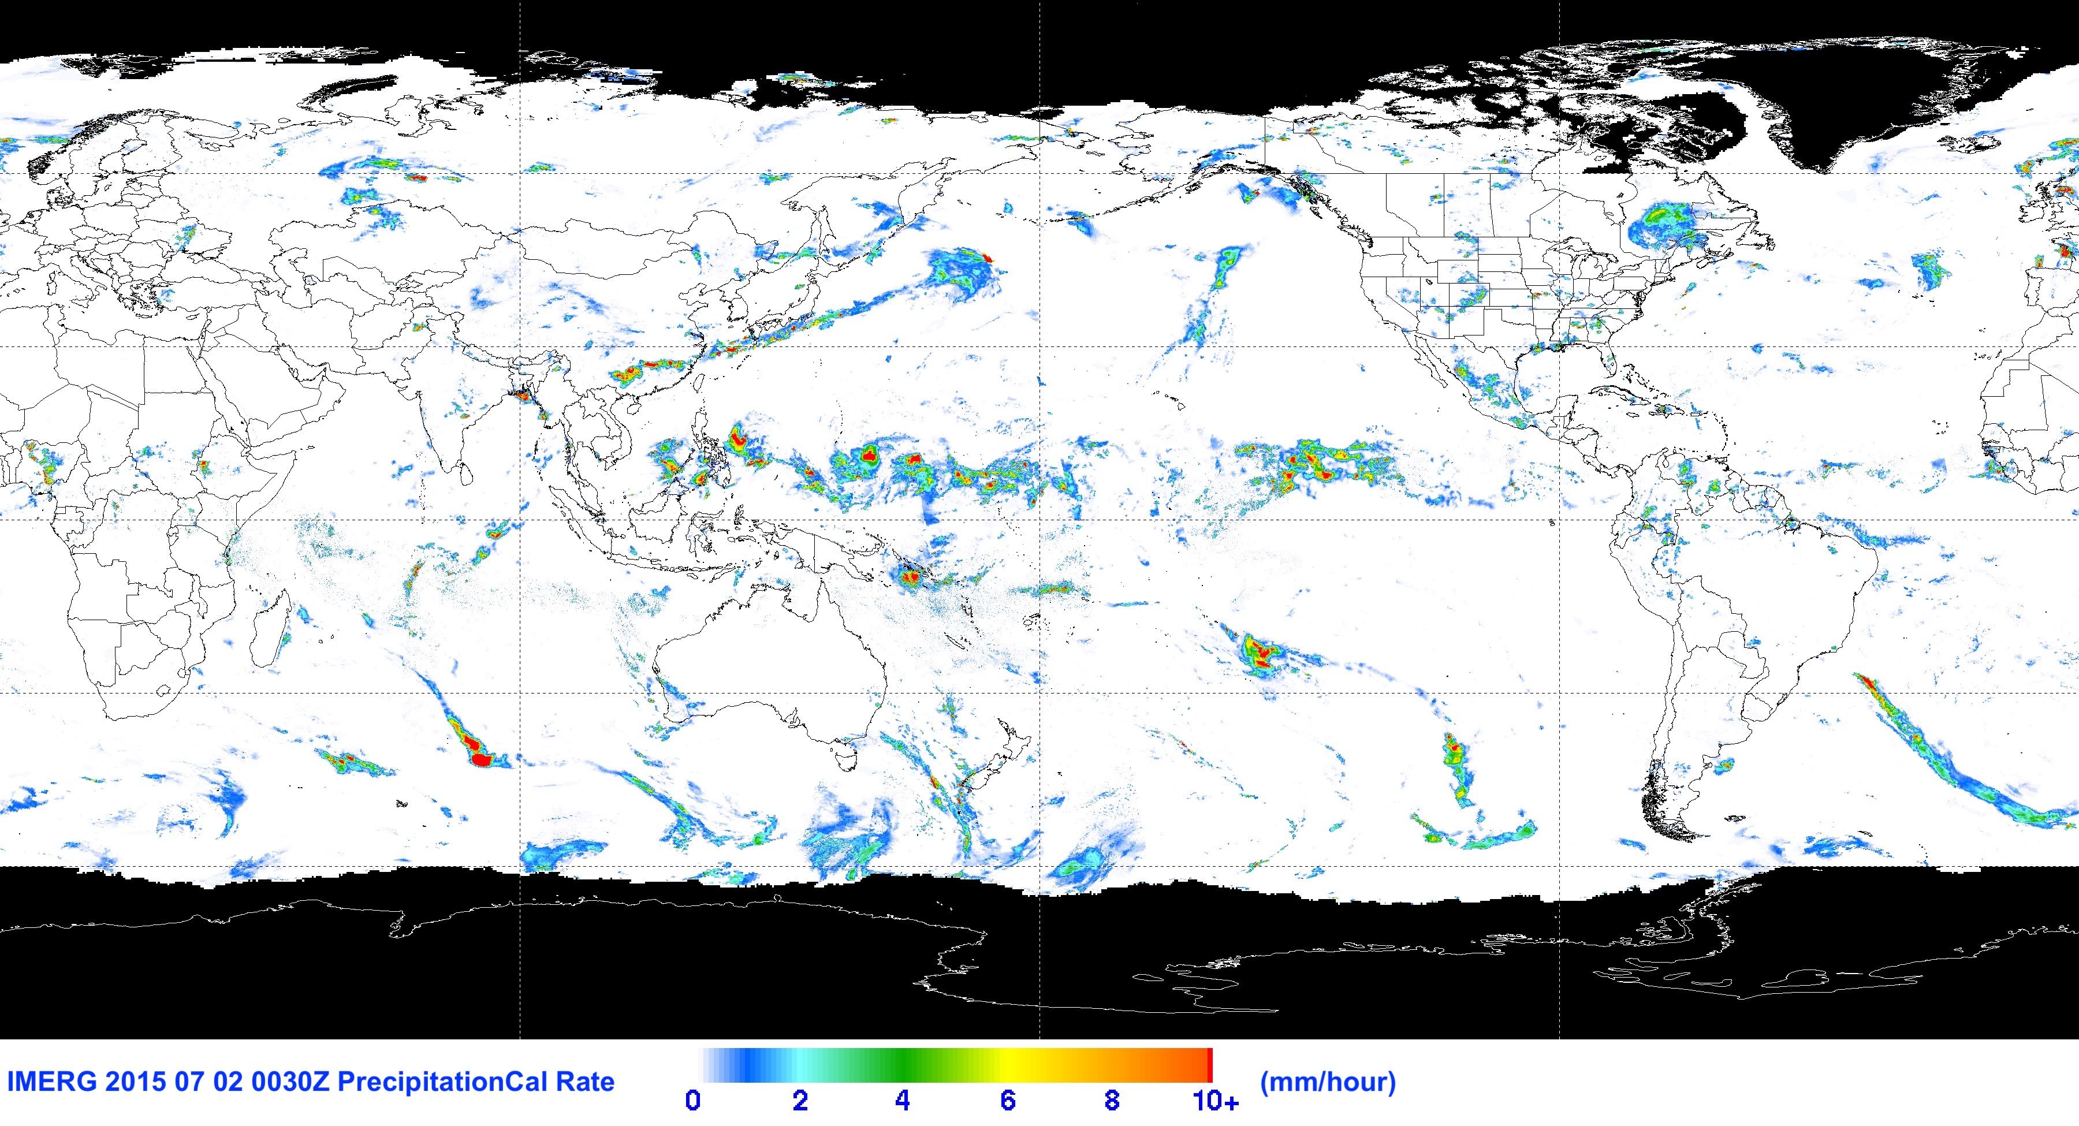
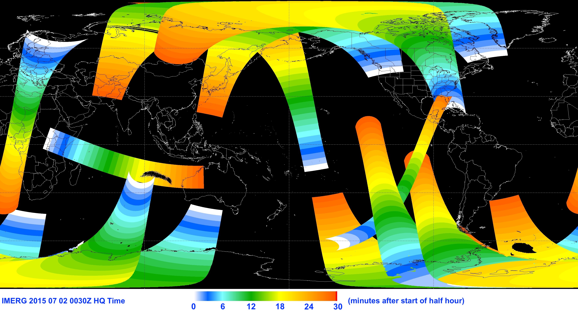
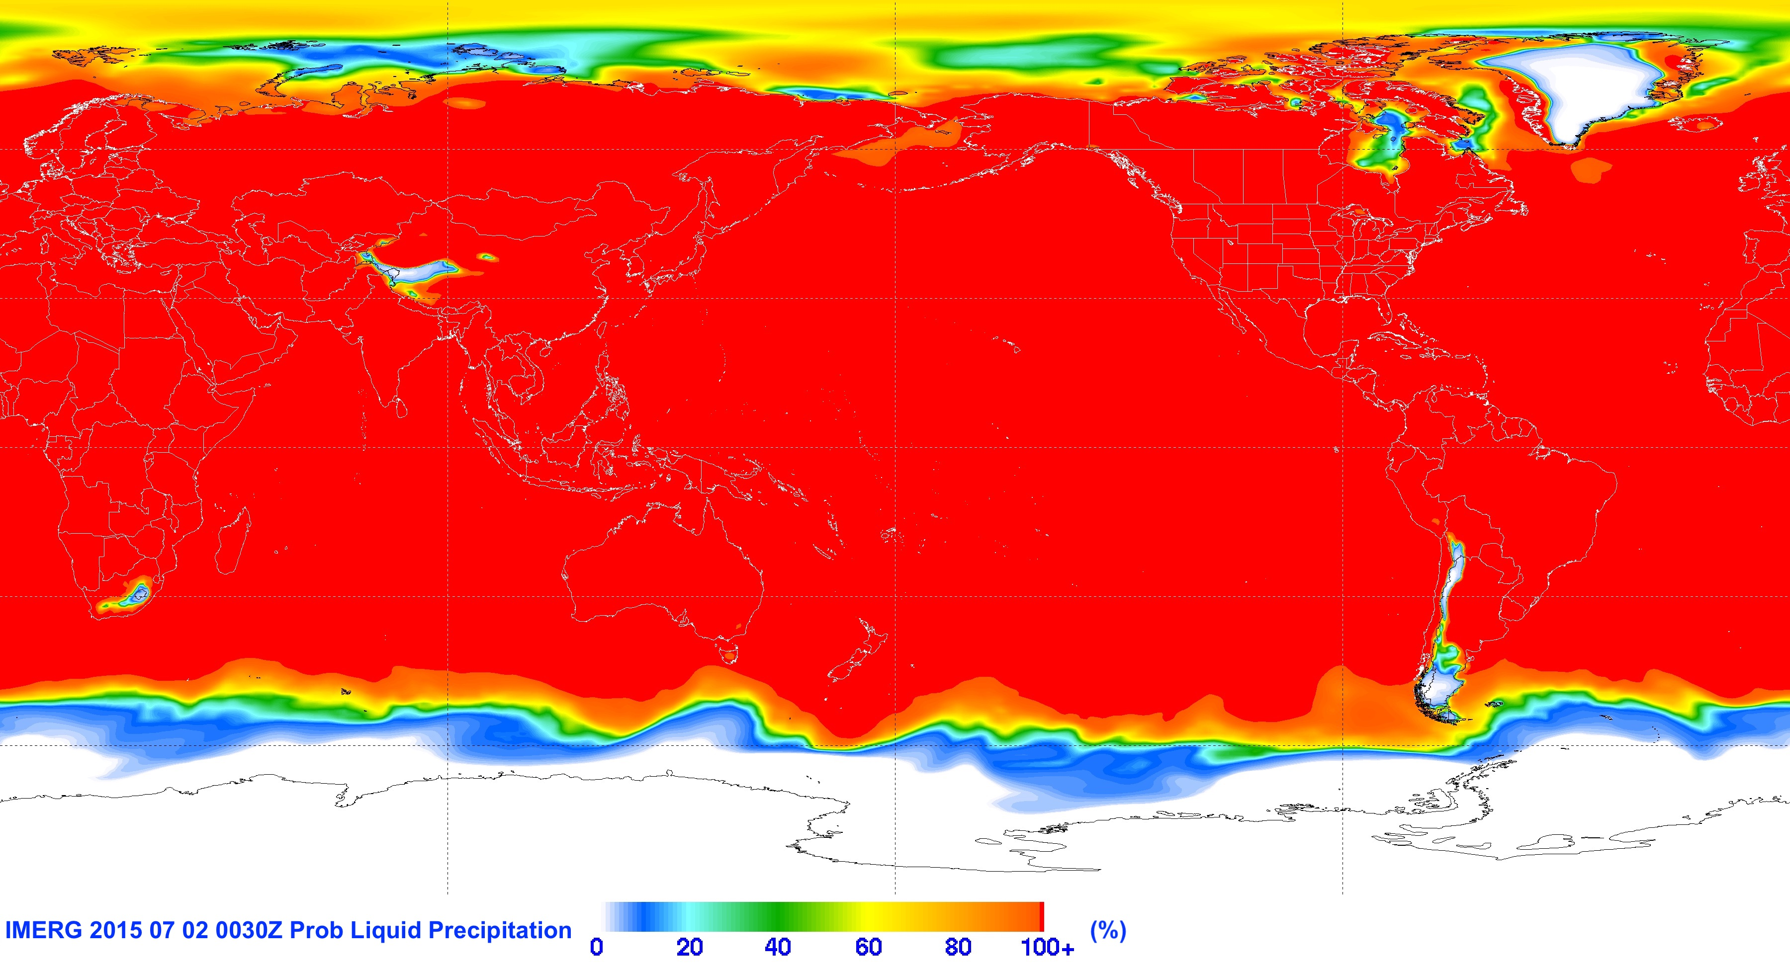
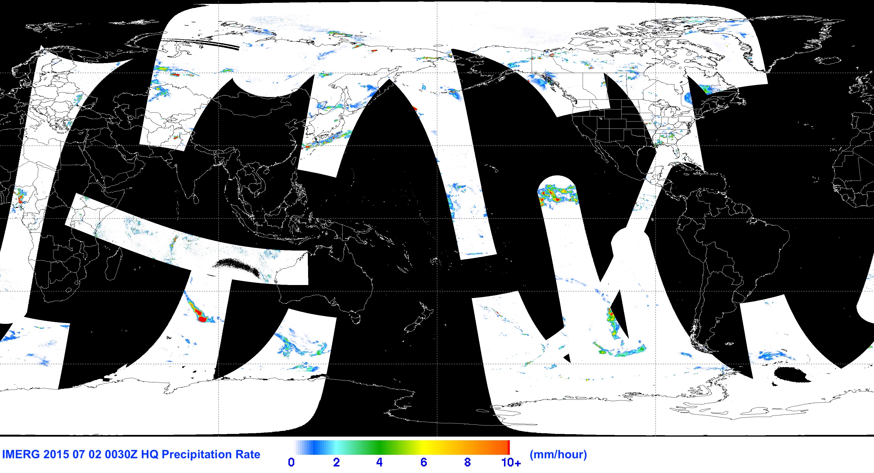
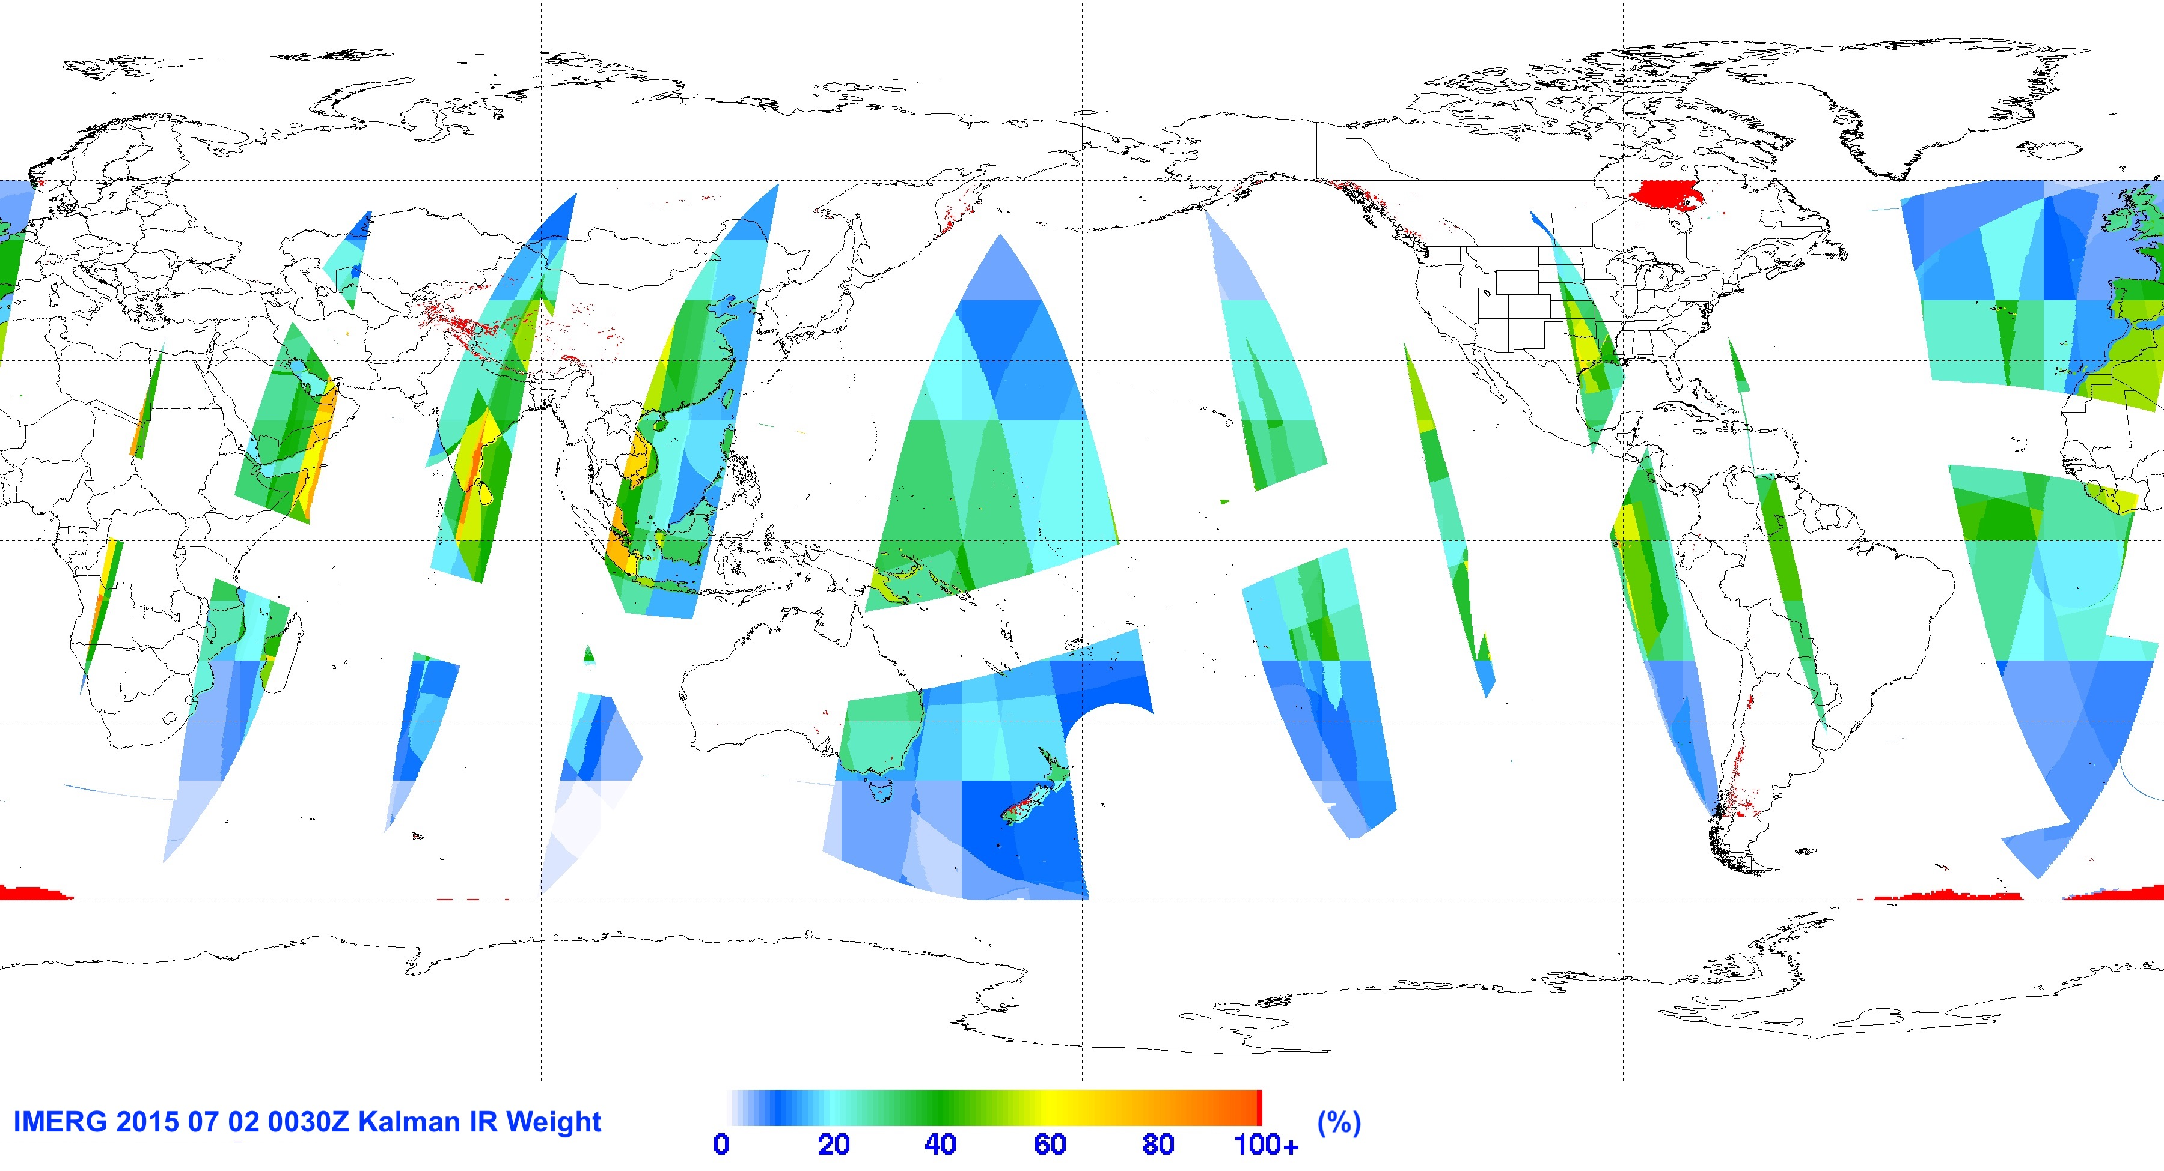
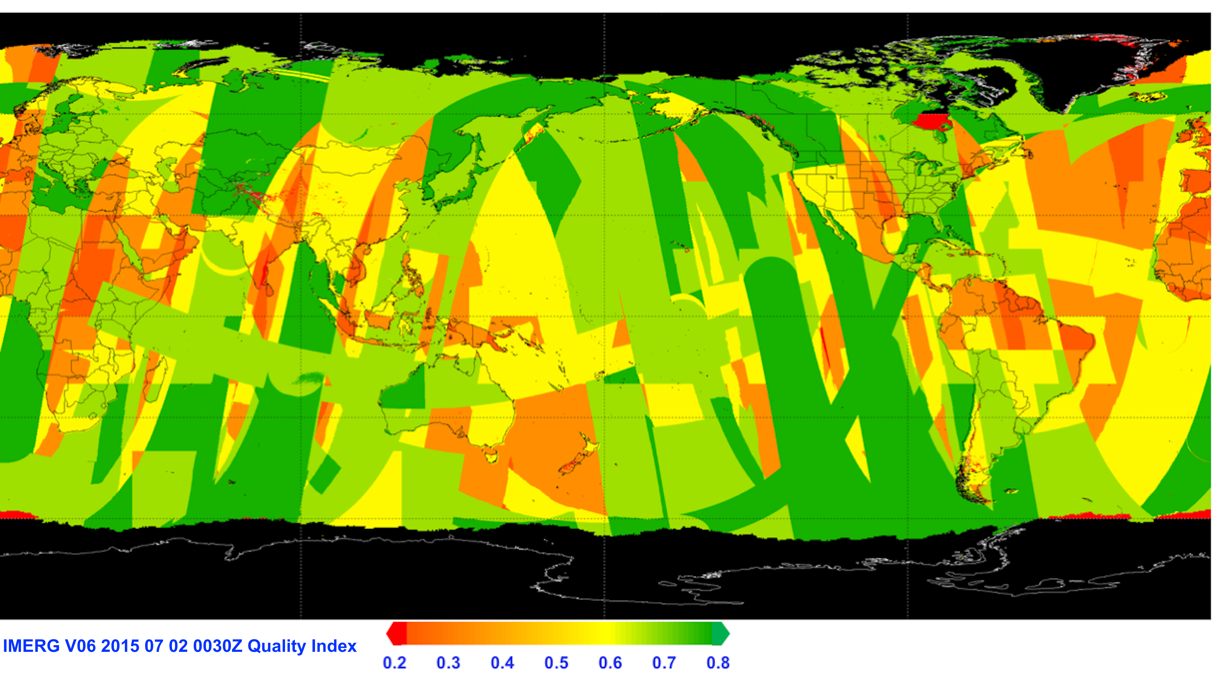
2. IMERG – Examples of Data Fields
HQprecipSource
IRprecipitation
precipitationCal
precipitationUncal
HQobservationTime
2 July 2015 0030 UTC
probabilityLiquidPrecipitation
IRkalman
FilterWeight
precipiotation QualityIndex
HQprecipitation

Slide 7
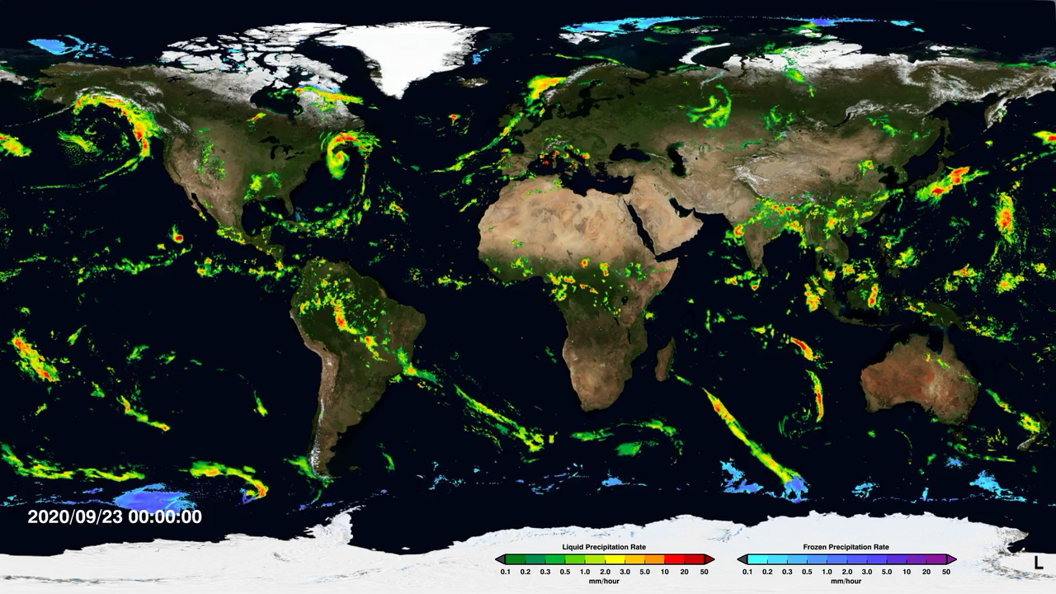
2. IMERG – Example Animation
http://svs.gsfc.nasa.gov/cgi-bin/details.cgi?aid=4285

Slide 8
3. GPM Product Levels and Postings
Data are provided at different processing levels, defined as:
• Level 1: science data close to what the instrument measures
• Level 2: Derived geophysical parameters at the same resolution/location as those of the Level 1 data
• Level 3: Geophysical parameters spatially and/or temporally resampled from Level 1 or Level 2 data
The data postings at Goddard cover:
• Level 1: TMI, GMI, partner PMW instruments
• Level 2: precipitation from radiometers, radar products, radar-radiometer combination
• Level 3: precipitation from radiometers, radar products, radar-radiometer combination, IMERG
• related datasets: TRMM LIS, land/sea mask, …
• plus, multiple “value-added” products: various formats, various time resolutions
• https://gpm.nasa.gov/data/directory catalogues all of these

Slide 9
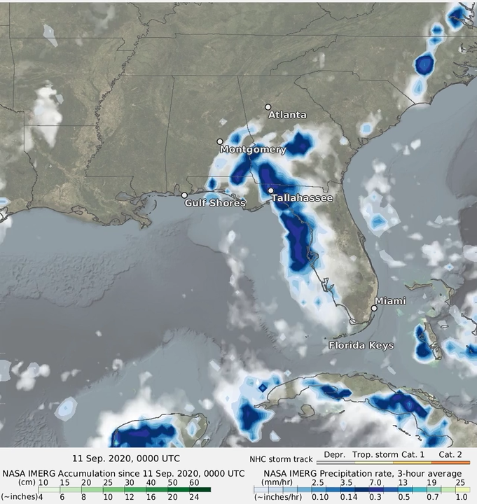
4. Example Analyses – Hurricane Sally
11-17 September 2020
• rainfall rate in blues
• accumulation in greens
• preliminary track from NHC
• amounts on-shore are low compared to gauges
• seems typical of IMERG in landfalling tropical storms
IMERG provides critical continuity of data as you move off-shore
• high coastal values are lower than amounts off-shore
• “lumpy” accumulation up to landfall seems to reflect diurnal cycle in tropical storm dynamics
https://gpm.nasa.gov/applications/weather/hurricane-sally-extremely-heavy-rain-northern-gulf-coast

Slide 10
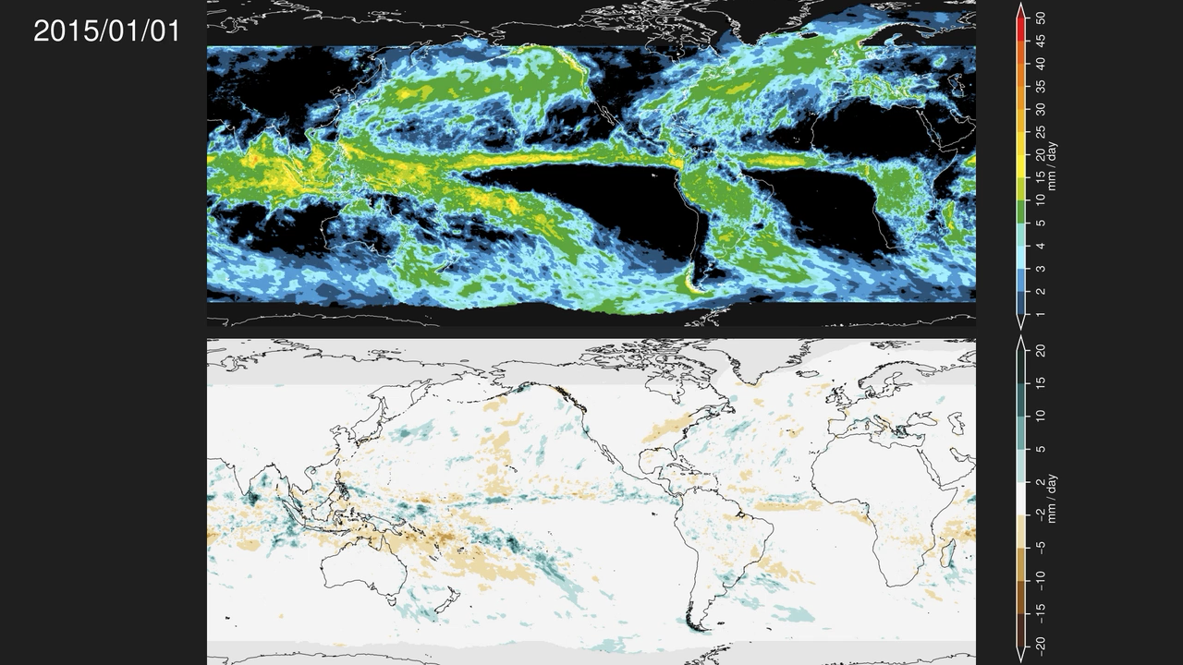
4. Example Analyses – Anomaly Analysis
2015-2016
• “fading” accumulation (top)
• anomaly (variation) from seasonal climatology (bottom)
• 20 year IMERG record allows us to compute a reasonably accurate climatology
• all 3 runs have a complete 20 years
• each Run has slightly different statistics
• allows calibration of your model to the Run you want to use
Fading accumulation
Fading anomaly
https://svs.gsfc.nasa.gov/13347

Slide 11
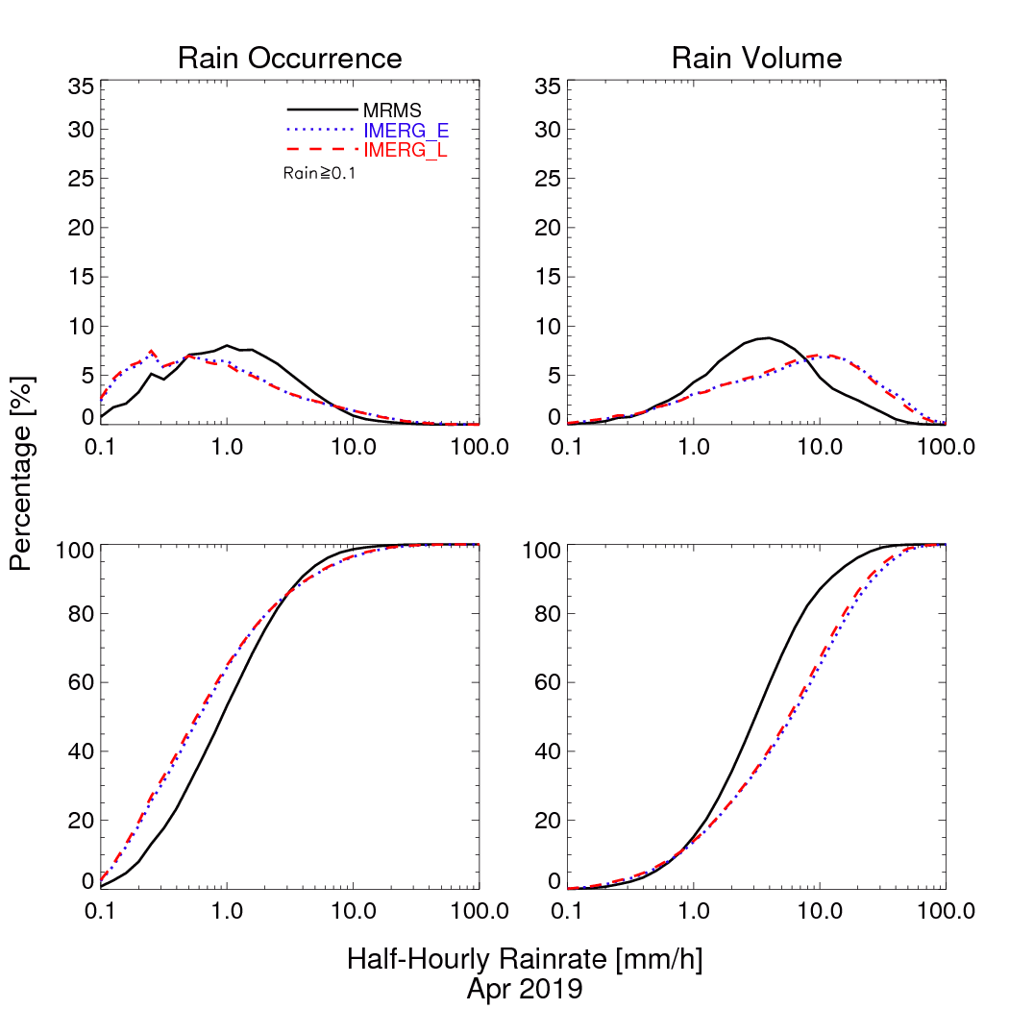
4. Example Analyses – GPM GV Office MRMS-Late IMERG Validation
GPM Ground Validation (GV) Office computes key statistical measures with the NOAA Multi-Radar Multi-Sensor (MRMS) for CONUS
• GPM era
• https://wallops-prf.gsfc.nasa.gov/NMQ/IMERG_MRMS_30m/
Probability Density Function (PDF) for half-hourly 0.1º boxes in April 2019
• high at low and high ends, low in the middle
• this particularly affects applications that depend on extremes, like flooding
• but recall low bias in landfalling hurricanes
• emphasizes the need for users to calibrate their applications
GPM GV Office

Slide 12
4. Schedule and Final Remarks
Development Work for V07
• improve error estimation
• address apparent bias issues
• address extra smoothing in morphed data (higher occurrence, lower extremes)
• improve performance over mountains, polar regions
Version 07 release should be in “early 2022”
“Fitness for use” can be a difficult judgment
• estimates tend to be better over ocean than land
• estimates tend to be worse over mountains, snowpack, and sea ice
• time/space averaging tends to improve statistics
• bias at high rates tends to be high, but regime-dependent
• is your application quantitative or more qualitative?
• can your application be calibrated with 20 years of the chosen Run to give more consistent results?
• what is the quality of the alternative(s)?
• gauges tend to be sparse, so the analysis scheme is critical
• radars have known issues
• models tend to have trouble with convection (tropics and summertime mid-latitudes)

