Slide 1
HSRL-2 Status Update
November 5, 2020
NASA LaRC HSRL-2 Team - Rich Ferrare, Chris Hostetler, Sharon Burton, Marta Fenn, Dave Harper, Tony Cook, Amy Jo Scarino, John Hair, Marian Clayton, Joe Lee
Contributions from:
Sue van den Heever (CSU); Arlindo da Silva (GSFC); Ed Eloranta, Bob Holz (UW)

Slide 2
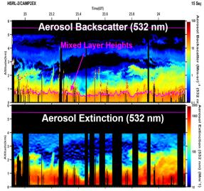
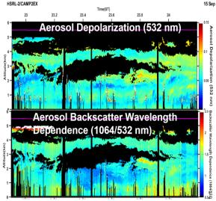
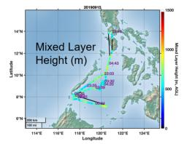
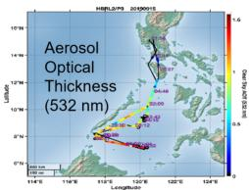
Summary of HSRL2 CAMP2Ex Products
Available Data Products
Aerosol Extensive Measurements (data(hdf5) and imagery(png) archived)
  Particulate backscatter profiles (355, 532, 1064 nm)
  Aerosol extinction profiles and AOT (355 and 532 nm)
Aerosol Intensive measurements (data(hdf5) and imagery(png) archived)
  Particle depolarization profiles (355, 532, 1064 nm)
  Extinction-to-backscatter ratio profiles (355 and 532 nm)
  Angstrom exponent profiles
    Extinction: 355-532
    Backscatter 355-532, 532-1064
Aerosol Type (data(hdf5) and imagery(png) archived)
Aerosol Optical Thickness (data(ICARTT) archived)
Mixed Layer Heights (data(ICARTT) archived)
Mean aerosol extinction and backscatter values within and above the Mixed Layer (data(ICARTT) archived)

Slide 3
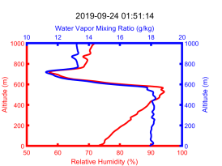
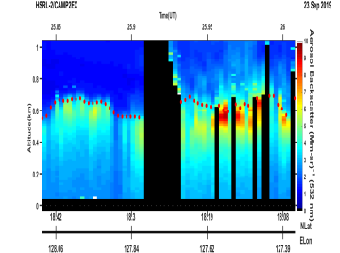
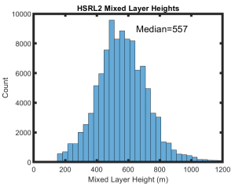
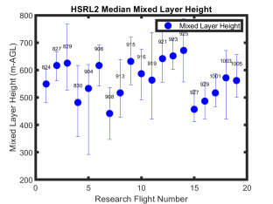
Mixed Layer Heights derived from HSRL2
Mixed Layer (ML) heights derived from cloud-screened aerosol backscatter profiles
ML heights can be a good proxy for daytime PBL heights
Technique uses a Haar wavelet covariance transform with multiple wavelet dilations to identify sharp gradients in aerosol backscatter (adapted from Brooks, JAOT, 2003)
Automated HSRL algorithm chooses ML from among aerosol gradients with input from manual inspection where necessary (Scarino et al., 2014, ACP)
During CAMP2Ex, median MLH = 557 m
Water Vapor
Mixing Ratio
Aerosol
Backscatter (532 nm)
Aerosol Backscatter (532 nm)
Relative
Humidity
Mixed Layer Heights
Mixed
Layer
Heights
Mixed
Layer
Heights
Dropsonde data from Sue van den Heever (CSU)

Slide 4
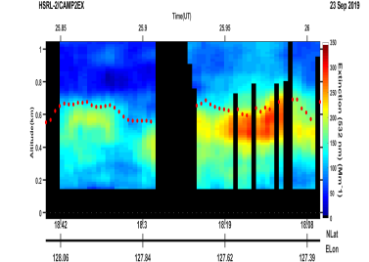
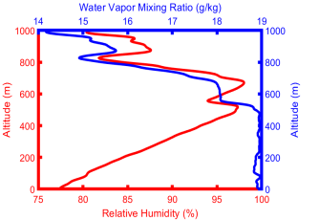
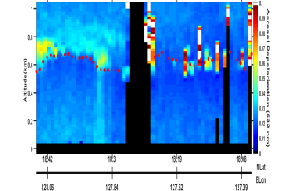
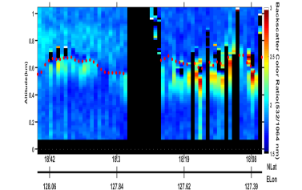
Vertical Variability of Aerosol Properties within the Mixed Layer Associated with Relative Humidity (RH)
Aerosol
Backscatter (532 nm)
Aerosol
Extinction (532 nm)
Water Vapor
Mixing Ratio
Relative
Humidity
Mixed Layer Heights
As RH increases near top of Mixed Layer, fine mode hygroscopic particles take on water
  Aerosol backscatter and extinction increase
  Particles become more spherical so particulate depolarization decreases
  Increase in fine mode particle scattering so backscatter color ratio increases
Aerosol
Depolarization (532 nm)
Backscatter
Color Ratio (532 /1064 nm)
Dropsonde data from Sue van den Heever (CSU)

Slide 5
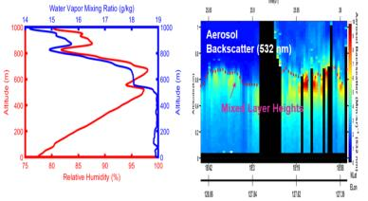
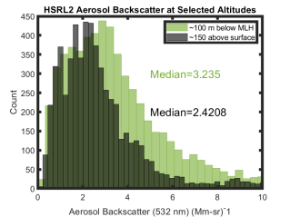
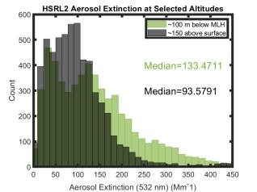
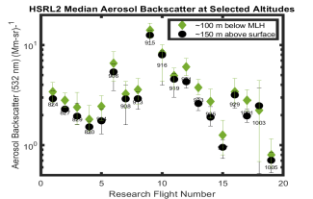
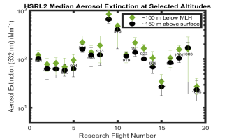
Systematic Vertical Variability of Aerosol Backscatter and Extinction within the Mixed Layer Due to RH
Water Vapor
Mixing Ratio
Relative
Humidity
Near top of ML
Near
Surface
Near top of ML
Near
Surface
Aerosol backscatter and extinction are systemtically larger during all of CAMP2Ex near the top of the Mixed Layer due to the increase in fine mode scattering and fine mode particle size associated with increased RH
Near top of ML
Near top of ML
Near
Surface
Near
Surface

Slide 6
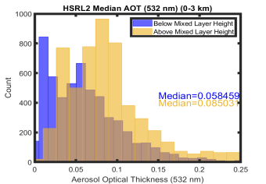
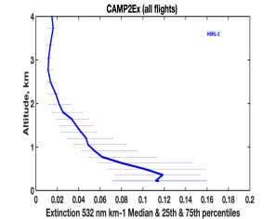
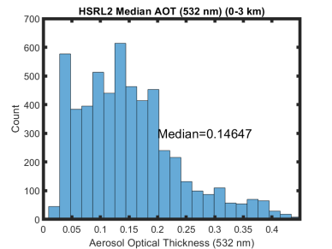
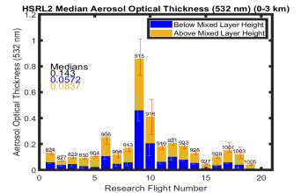
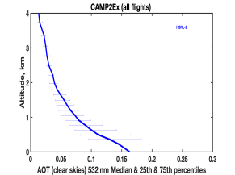
HSRL2 Measurements of Aerosol Optical Thickness (AOT) During CAMP2Ex
Median AOT (532 nm) within the 0-3 km layer ~ 0.15
About 40% of AOT within Mixed Layer
About 60% of AOT above Mixed Layer
Median Aerosol Extinction Profile (532 nm)
Median AOT
Profile (532 nm)

Slide 7
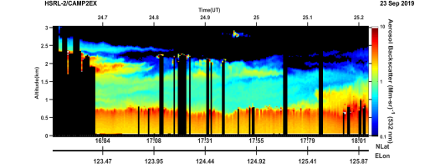
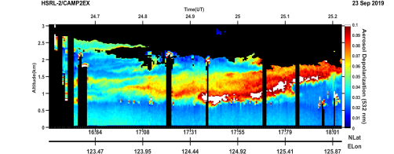
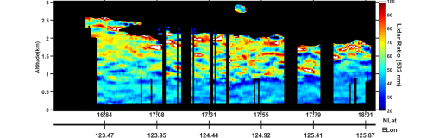
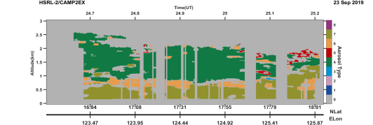

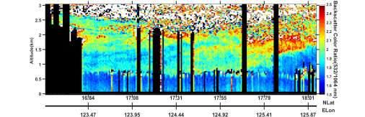
HSRL2 Measurements used to Infer Aerosol Type
Aerosol Backscatter (532 nm)
Aerosol Depolarization (532 nm)
Lidar ratio (532 nm)
Aerosol type inferred from measurements of aerosol intensive parameters (Burton et al., 2012, AMT)
Aerosol Type
Backscatter Color Ratio (532/1064 nm)

Slide 8
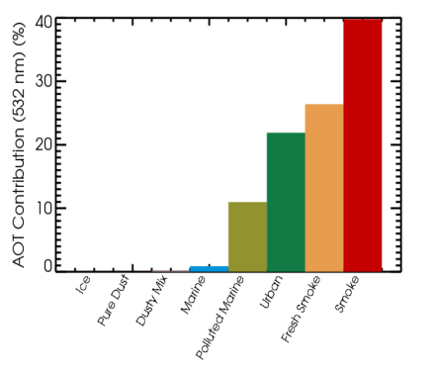
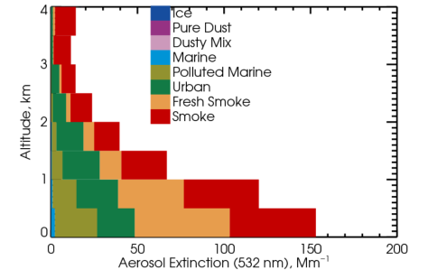
AOT and Aerosol Extinction Apportioned to Aerosol Type
Majority of AOT and aerosol extinction classified using HSRL2 data during CAMP2Ex attributed to smoke
Aerosol Optical Thickness (532 nm)
Aerosol Extinction (532 nm)

Slide 9
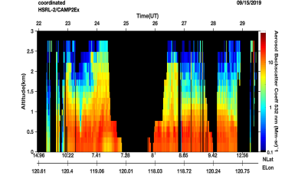
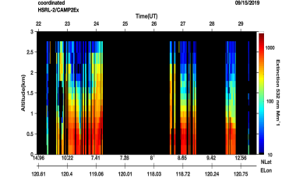
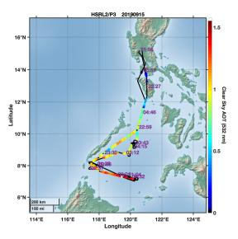
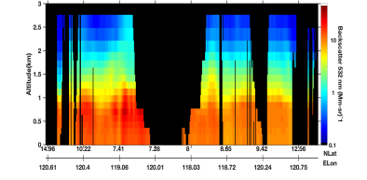
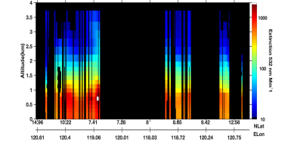
Example: HSRL-2/GEOS-5 Comparison of Aerosol Extensive Parameters for Sept. 15
Aerosol Backscatter (532 nm)
Aerosol Extinction (532 nm)
HSRL2
HSRL2
RF9
September 15
AOT (532 nm)
Aerosol Backscatter (532 nm)
Aerosol Extinction (532 nm)
GEOS5
GEOS5
GEOS5
GEOS5
GEOS-5 Simulations provided by Arlindo da Silva (GSFC)

Slide 10
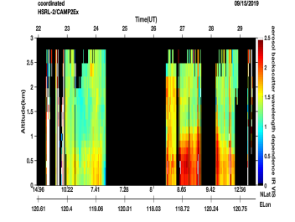
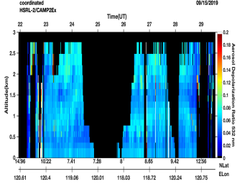
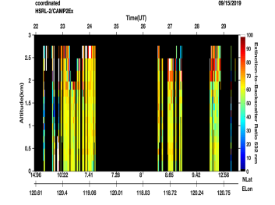
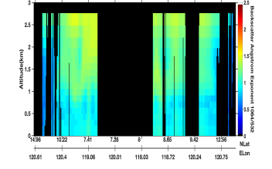
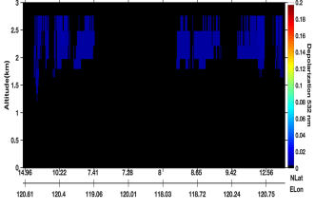
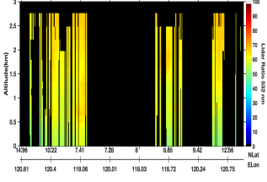
Example: HSRL-2/GEOS-5 Comparison of Aerosol Intensive Parameters for Sept. 15
Backscatter Wavelength Dependence (532/1064 nm)
Aerosol Depolarization (532 nm)
Lidar Ratio (532 nm)
HSRL2
HSRL2
HSRL2
Backscatter Wavelength Dependence (532/1064 nm)
Aerosol Depolarization (532 nm)
Lidar Ratio (532 nm)
GEOS5
GEOS5
GEOS5
GEOS5
GEOS-5 Simulations provided by Arlindo da Silva (GSFC)

Slide 11
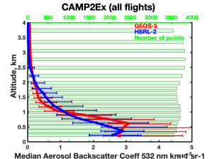
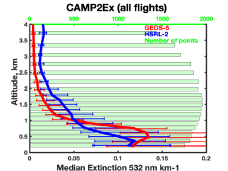
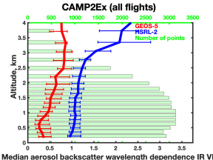
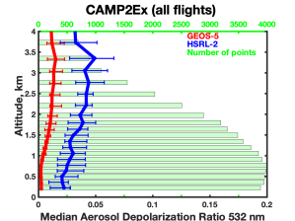
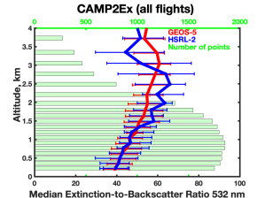
HSRL- 2/GEOS-5 Comparison of Median Aerosol Profiles for all of CAMP2Ex
Median Profiles for all of CAMP2Ex flights
HSRL-2
GEOS-5
Aerosol
Backscatter (532 nm)
Aerosol
Extinction (532 nm)
GEOS-5 Simulations provided by Arlindo da Silva (GSFC)
Backscatter
Wavelength
Dependence
(532/1064 nm)
Lidar
Ratio
(532 nm)
Aerosol
Depolarization (532 nm)

Slide 12
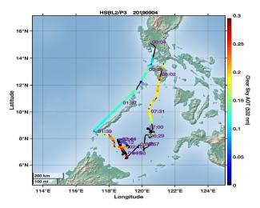
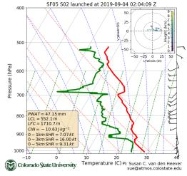
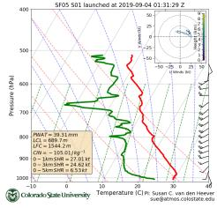
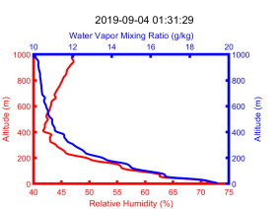
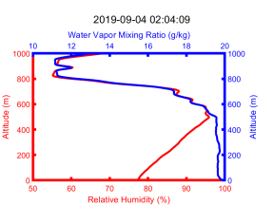
Unusual Dropsonde – Sept. 4
“Unusual dropsonde”
RF5
September 4
AOT (532 nm)
“Usual dropsonde”
“Sounding 20190904_013129 (SF05) shows an unusually dry boundary layer with a minimum relative humidity of 42 % at about 500 m altitude. This is about 50% drier than the median at that altitude and 20% drier than the next driest profile. At the same time, the profile is nearly isothermal in the boundary layer, showing the warmest temperatures of the entire data set. All engineering data of the sonde indicate proper functioning of the instrument. This profile may require more scientific attention and validation.” (Dropsonde Data Quality Report-CAMP2Ex) (italics added)
“Unusual dropsonde”
“Usual dropsonde”
Dropsonde data from Sue van den Heever (CSU)

Slide 13


Unusual Dropsonde – Sept. 4
HSRL2 data also show significant differences between dropsondes released west and southeast of Palawan
“Usual dropsonde”
“Unusual dropsonde”
Aerosol
Backscatter (532 nm)
Aerosol
Depolarization (532 nm)
“Unusual dropsonde”
“Usual dropsonde”
Dropsonde data from Sue van den Heever (CSU)

Slide 14






Comparison of HSRL2 and UW HSRL During Flight over Manila (Oct. 4)
West
Time
East
LaRC HSRL2
(looking down)
Aerosol
Backscatter (532 nm)
Time
UW HSRL (Manila)
(looking up)
Aerosol
Backscatter (532 nm)
UW HSRL data provided by Ed Eloranta and Bob Holz (UW)

Slide 15
HSRL-2 Related Ongoing Work
Characterize aerosol distributions and aerosol loading
Analyze Mixed Layer Heights (MLH) and distributions of aerosols relative to MLH
Study behavior of aerosol extensive and intensive parameters within ML and variability with RH
Locate and identify aerosol types and apportion extinction and AOT to type
Assess model simulations of aerosol distributions and properties
Pursue lidar-only and combined lidar+polarimeter retrievals of aerosol physical and optical properties
Support satellite aerosol and cloud retrievals
Support use of lidar data for retrievals of cloud properties
Provide support and collaborate on your studies?

Slide 16
Extra Slides

Slide 17





Cold Pool Example RF7-Sept. 8
Cold air appears to force up aerosol layer and generate clouds at leading edge
Very clean air in cold pool
Aerosol Backcatter (532 nm)
Aerosol Extinction (532 nm)
Aerosol Depolarization (532 nm)
Aerosol Optical Thickness (532 nm)
Cold Pool study led by Sue van den Heever (CSU)

Slide 18




CALIPSO Underpass Aug. 31 2019
HSRL2 Particulate Backscatter (532 nm) (km-sr)^-1
CALIOP Total Attenuated Backscatter (532 nm) (km-sr)^-1
CALIOP Total Attenuated Backscatter (532 nm) (km-sr)^-1
Underpass Flight Segment

