Slide 1










SERVIR
LAND COVER ACTIVITIES
Andrea Nicolau
NASA-SERVIR Regional Science Associate
Mekong

Slide 2
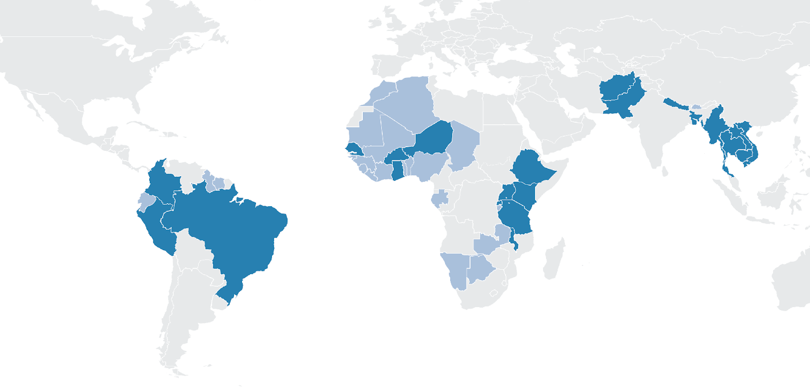

SERVIR SERVICES MEET NEEDS IN ASIA, Africa, and the Americas
SERVIR Science Coordination Office
NASA MSFC
SERVIR Hindu Kush Himalaya
ICIMOD
USAID Washington
NASA Headquarters
SERVIR Amazonia
CIAT
SERVIR Eastern & Southern Africa
RCMRD
SERVIR Mekong
ADPC
SERVIR West Africa
AGRHYMET
Focus Countries
Additional Reach

Slide 3
SERVIR SERVICES MEET NEEDS IN ASIA, Africa, and the Americas
Hindu-Kush Himalaya & Mekong
Crop area estimation and crop yield security
Regional land cover monitoring system
Regional drought monitoring and enhancing drought resilience
Forest monitoring, biomass estimation, development of protected areas alerts system
Eastern and Southern Africa & West Africa
Drought monitoring and assessment
Frost monitoring
Land cover mapping and crop area estimation
Charcoal production monitoring and artisanal mining monitoring
Locust infestation monitoring
Amazonia
Detection of illegal gold mining
Fire forecasting and mapping
Monitoring of mangroves
Monitoring of zero deforestation value chains using active remote sensing
Monitoring of ecosystem services & biodiversity
Deforestation monitoring and reporting in Ecuador
Use of Synthetic Aperture Radar (SAR) to monitor forest degradation

Slide 4
FROM SPACE TO forest
When conditions are more favorable to fire spread, it’s critical to have information in advance that enhances and informs decision-making. The Amazon Fire Season Forecast does
just that.
The seasonal fire forecast provides an early indication of fire risk to guide prevention planning across the Amazon region—supporting lives and livelihoods
SERVIR-Amazonia is working at various fronts to improve the robustness of seasonal fire forecasting and monitoring, including a research effort by Doug Morton, SERVIR Applied Science Team PI
The platform shows prediction of fire risk in high biomass burning regions of South America – 6 states in Brazil, 3 departments in Bolivia, and in Peru
The tool also provides observed and modeled fire season severity from past years for comparison. An upcoming monitoring tool will be released to identify fire typology

Slide 5
Thank You.
For further questions, please contact:
andrea.puzzinicolau@nasa.gov
africa.flores@nasa.gov – SERVIR Land Cover and Land Use Change Theme lead

