Slide 1

Human Stress During Spaceflight
Implications and Countermeasures for Astronauts
November 5, 2020
Alexandra Whitmire
Ajit Mulavara
Sara Whiting
Tom Williams
Human Factors and Behavioral Performance
NASA Human Research Program

Slide 2
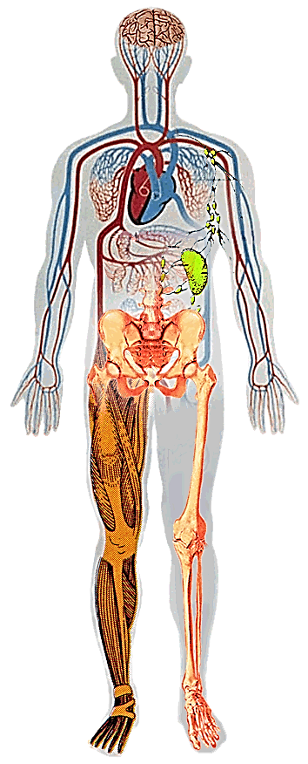
Hazards of Spaceflight
Altered Gravity - Physiological Changes
Distance from Earth
Drives the need for additional “autonomous” medical care capacity – cannot come home for treatment
  Balance Disorders
  Fluid Shifts
  Cardiovascular Deconditioning
  Muscle Atrophy
  Bone Loss
Hostile/
Closed Environment
Space Radiation
Vehicle Design
Acceleration/Vibration/Noise
Environmental – CO₂ Levels, Toxic Exposures, Water, Food
  Decreased Immune Function
Acute In-flight effects
Long-term cancer risk
CNS-Cognitive
?
1. Outlier
Isolation & Confinement
2. Impact is extreme
Behavioral aspect of isolation
Sensory deprivation
Sleep disorders (circadian dysregulation)
3. Retrospective predictability

Slide 3
Human Factors and Behavioral Performance
Purpose
  Manage and mitigate the human factors, behavioral health and performance risks associated with space travel, exploration and return to terrestrial life
Risk of Performance and Behavioral Health Decrements due to Inadequate Cooperation, Coordination, Communication and Psychosocial Adaptation within a Team
Risk of Performance Decrements and Adverse Health Outcomes Resulting from Sleep Loss, Circadian De-synchronization, and Work Overload
Risk of Adverse Cognitive & Behavioral Conditions and Psychiatric Disorders
Risk of Adverse Outcome Due to Inadequate Human Systems Integration Architecture
Risk of Injury from Dynamic Loads

Slide 4
Stressors for Mars
Social Isolation
Distance from Family
Prolonged Confinement with Crew
Physical Isolation
Confinement
Sensory Monotony
Galactic Cosmic Radiation
Increased Stress Response
Altered Gravity / Gravitational Transitions
Behavior and Performance Changes

Slide 5
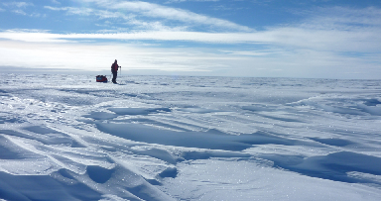
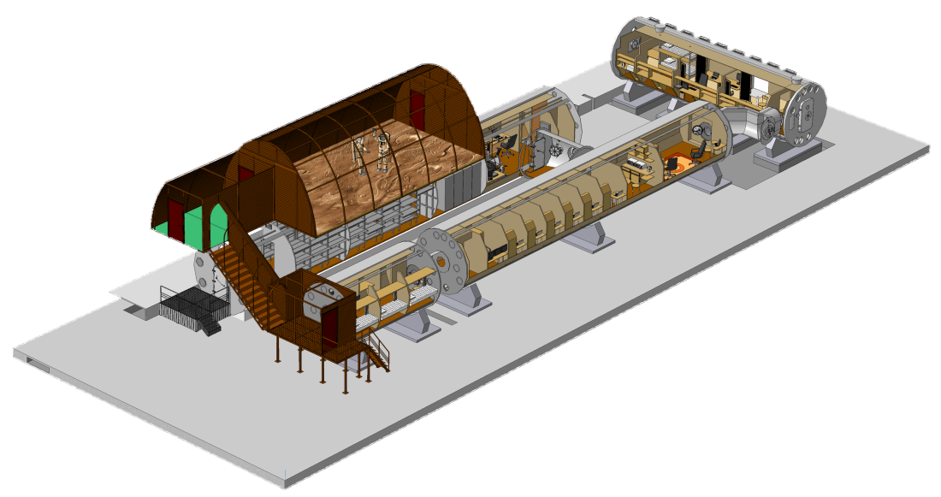
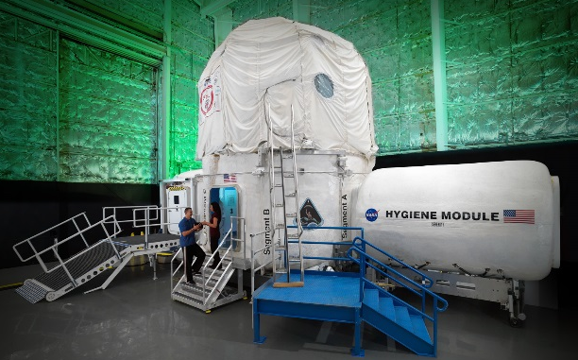
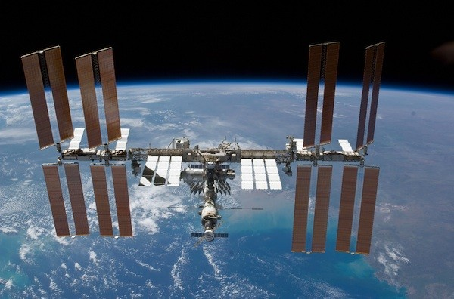
Flight and Analog Evidence
Research Platforms – Communication Delay
Antarctica
Human Exploration Research Analog (HERA)
Scientific International Research In a Unique terrestrial Station (SIRIUS)
International Space Station (ISS)
SIRIUS
ISS
HERA

Slide 6
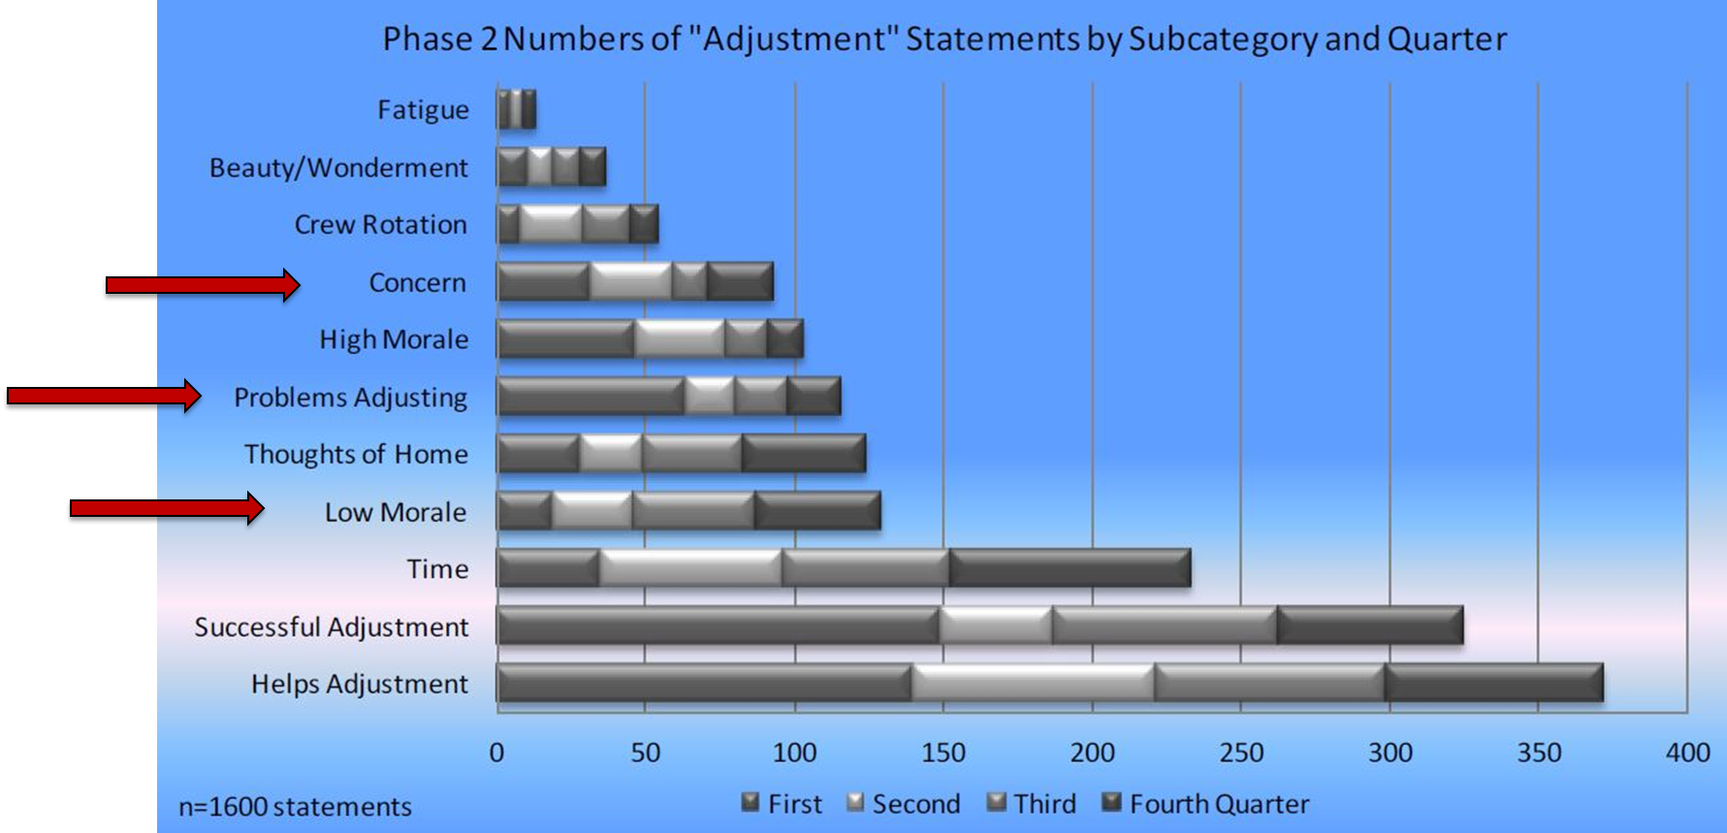
Evidence - ISS
(Stuster, 2016)

Slide 7
Evidence - ISS
There is also link between elevated stress biomarkers and immune system dysfunction in space flight, such as reactivation of latent viruses, increased production of inflammatory cytokines, and alterations of salivary antimicrobial proteins (Agha et al., 2020; Buchheim et al., 2019; Mehta et al., 2014; Stowe et al., 2001; Stowe et al., 2011).
In a study of n=21 on the ISS, completed visual analog scales twice a day every four days. Stress ratings were highest in the 4th quarter in-flight compared to the 1st (p=0.0037) and 2nd quarters in-flight (p=0.0038). Analyses within individual astronauts revealed that n=10 (48%) had significant positive correlations between stress ratings and time in-flight (Dinges et al., 2017).

Slide 8
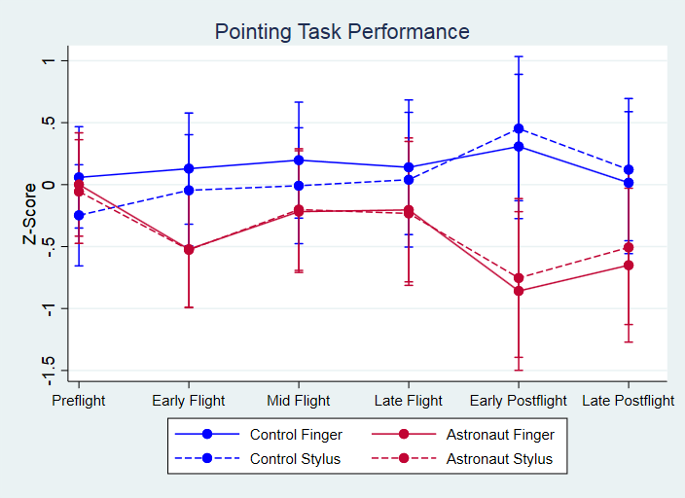
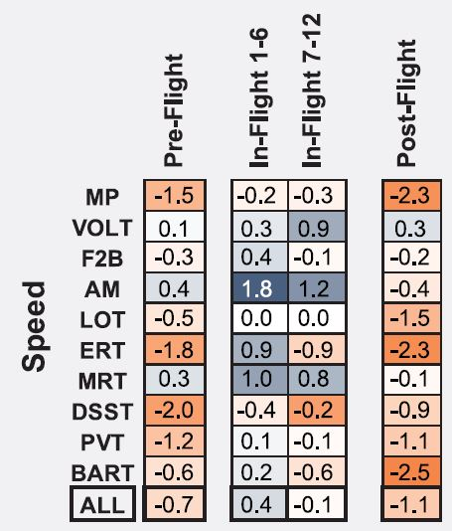
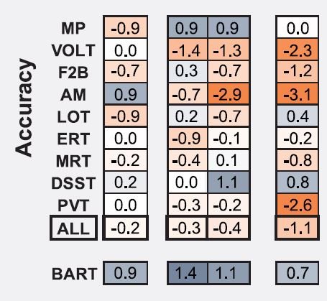
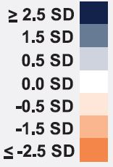
Evidence - ISS
1 year (ISS) ()
Significant changes in fine motor performance during gravitational transitions
(Holden et al., unpublished)
Mild in-flight speed decrements
In-flight visual memory accuracy decrement
Post-flight decrements persisted at least 6-months
(Garrett-Bakelmn et al., 2019)
Notes:
The Twin Study is currently our only in-flight evidence of cognitive decrements. Data collection is ongoing but more meaningful results are likely to be available in 1-2 years.
What we see is an indication of mild and limited inflight decrements that are stable inflight. The more prominent cognitive functions with decrements were
- Abstract reasoning (Abstract Matching and Matrix Reasoning) saw speed declines
- Abstract matching (logical reasoning) also saw an in-flight accuracy decrement
In this case study, we see more concerning evidence of return-to-flight or what is currently called Long-Term Health risk.

Slide 9
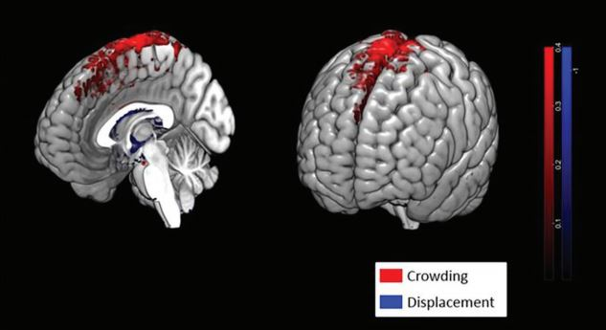
Evidence - ISS
Altered Gravity
Structural and Functional Alterations (Lee et al., 2019; Keppelmans et al., 2016; Roberts et al., 2017; 2019)
Vertical displacement and narrowing of CSF spaces at the vertex
Altered vestibular & sensorimotor-related functional connectivity
Prominence of altered findings correlates with mission duration
Reduced grey matter volume in temporal and frontal poles
Potential Cognitive Performance Decrement
Trend for a correlation between processing
speed and structural changes (Roberts et al., 2019)
  Reduced task accuracy
  Increase task speed

Slide 10
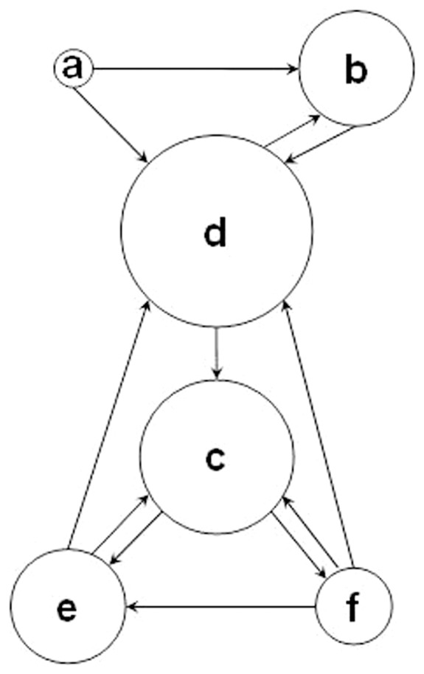
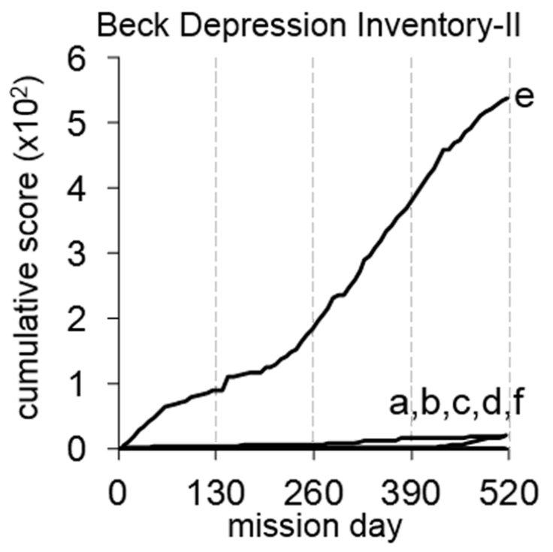
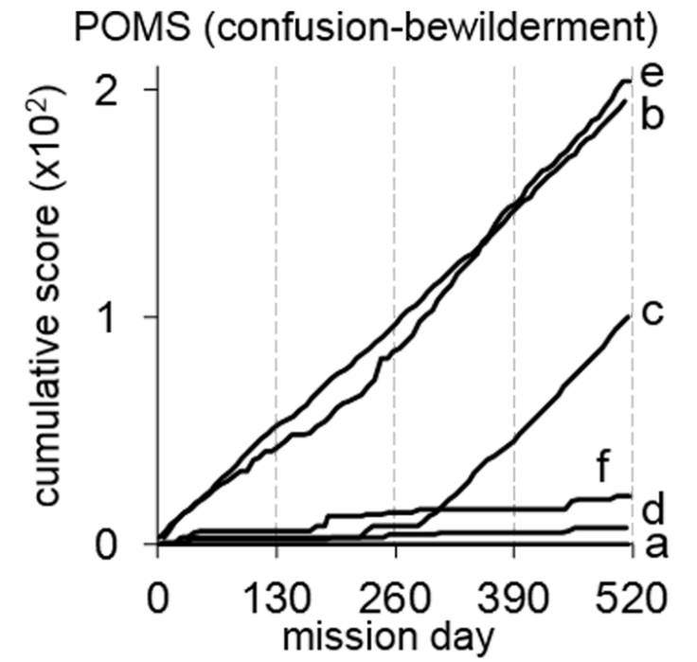
Social and Physical Isolation - Analogs
520 days (Mars 500) (Basner et al., 2014)
1 of 6 (20%)
Adverse Behavioral Condition
3 of 6 (50%)
Adverse Mood

Slide 11
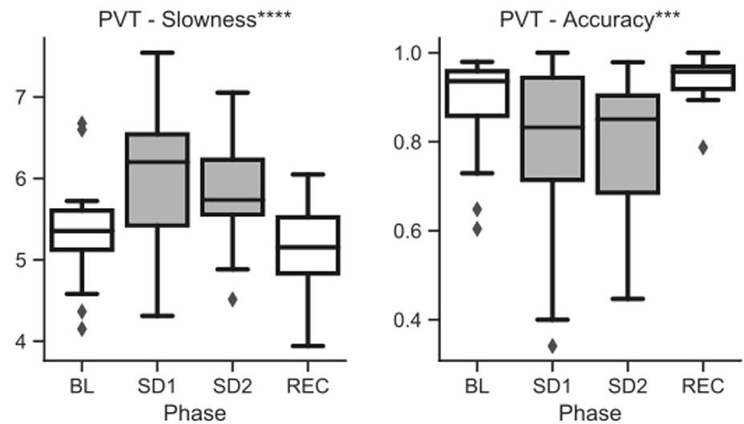
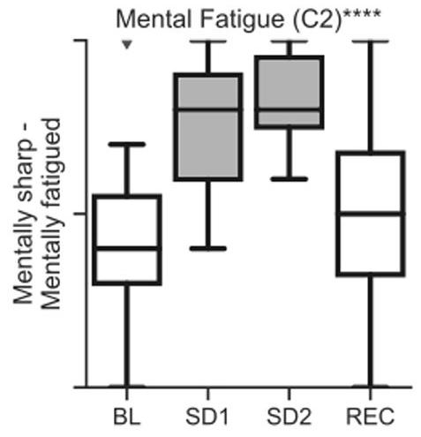
Social and Physical Isolation - Analogs
Cognitive Performance During Confinement and Sleep Restriction in NASA’s Human Exploration Research Analog (HERA) (PI: Basner)
Significant decrements:
--Vigilant attention (PVT) speed and accuracy
--Sensorimotor reaction speed & visual scanning
processing speed
Sleep deprivation (~27h awake) and 1 day partial sleep restriction (~4h sleep) (Campaign 1)
Total sleep deprivation (Campaign 2) (SD1 = ~22h awake; SD2 = ~ 38h awake)
  Reduced accuracy on facial emotion recognition test (both timepoints)
(Nasrini et al., 2020)

Slide 12
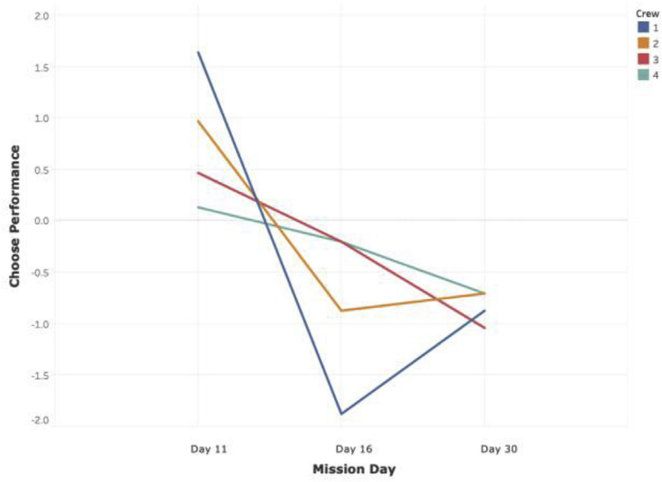

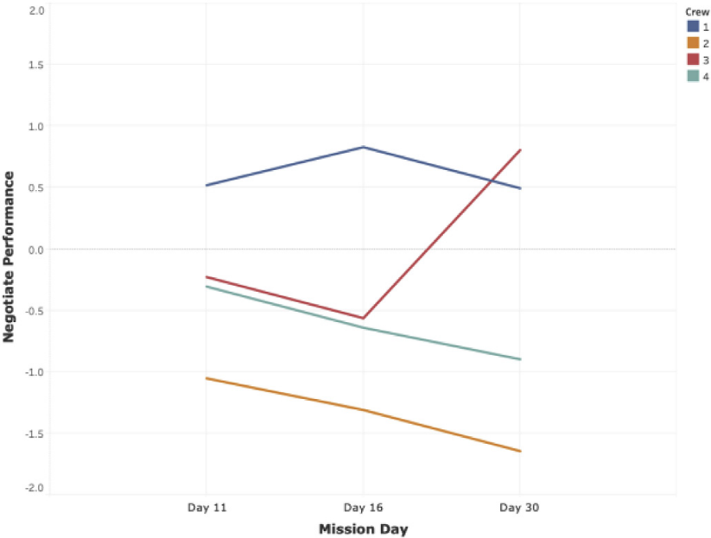
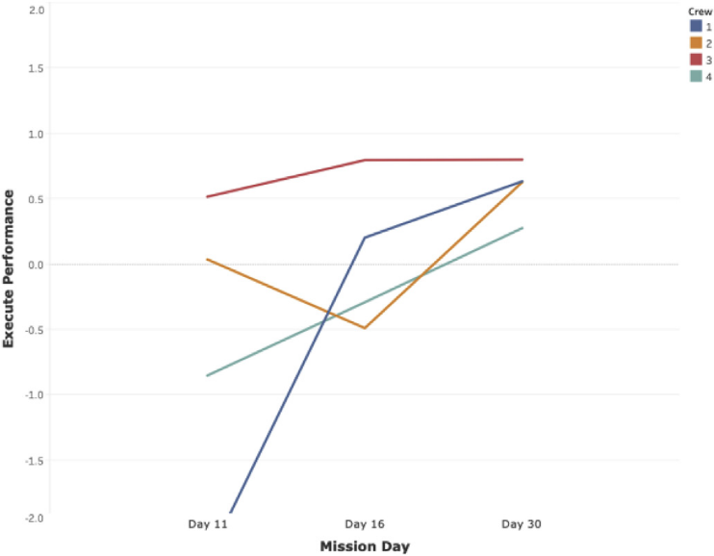
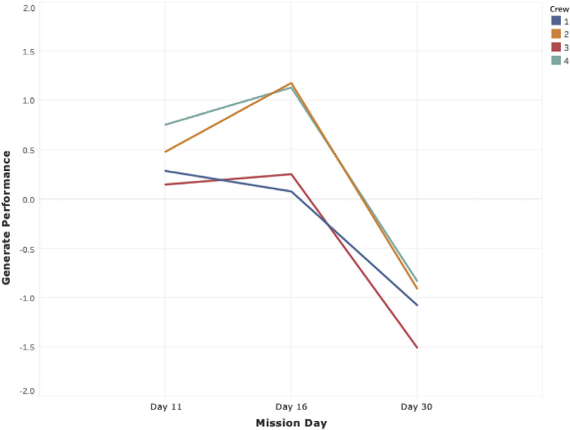
Social and Physical Isolation - Analogs
  Team Level Outcomes
HERA Campaign 3, four 30-day missions: Team performance is dynamic. Team psychomotor performance (team behavioral task) increased over mission duration, whereas team creativity, ethical decision-making, and problem solving declined. Middle time point included comm delay.
(Larson et al., 2019)
Problem Solving
Team/Crew
1
2
3
4
Psychomotor
Ethical decision-making
Creativity

Slide 13
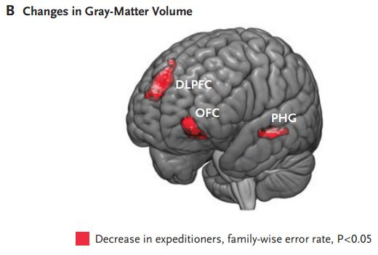
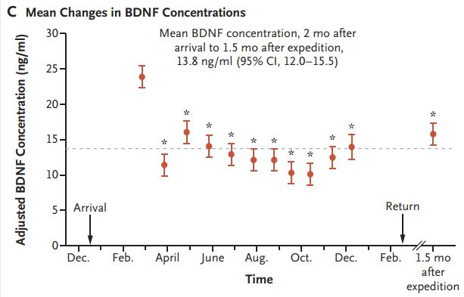
Social and Physical Isolation - Analogs
14 months (Neumayer III Station) (Stahn et al., 2019)
  Environmental monotony and prolonged physical and social isolation impede neurogenesis
    Dentate gyrus volume and grey matter volume reductions

Slide 14
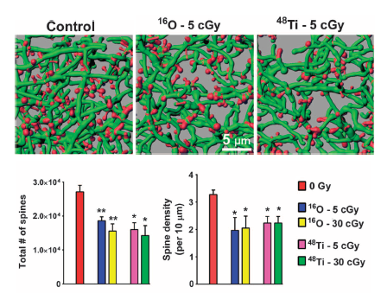
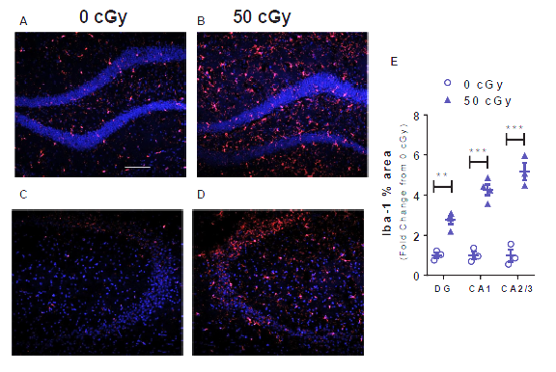
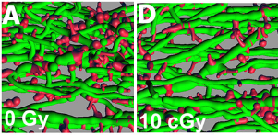
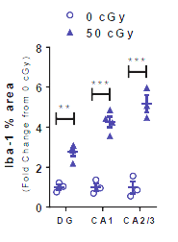
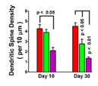
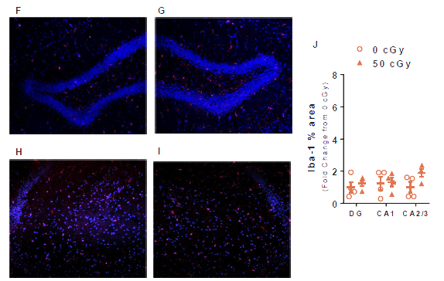
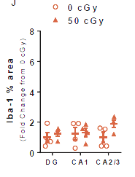
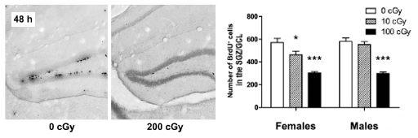
Radiation Effects
Neuronal Structure in Mice: Reduced Dendritic Spine # and density 8 weeks post ¹⁶O or ⁴⁸Ti ions exposure. Reduced spine density 30 days after ¹H exposure.
Inflammation: Increased microglia activation 100 days after ¹H + ²He + ¹⁶O exposure
♀ < ♂
Control ¹H 10 cGy
Sensitivity of Inflammatory response:
Sensitivity of Neurogenesis:
♀ < ♂
Parihar et al. (2015a)
Parihar et al. (2015b)
Neurogenesis in mice: Reduction in mouse dividing neuronal precursor cells, 48 hours post ¹H exposure
♀ > ♂
♀ > ♂
Sweet et al. (2014)
Krukowski et al. (2018)

Slide 15
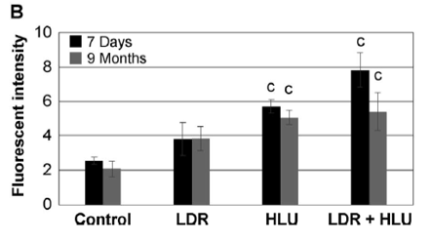
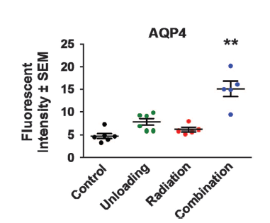
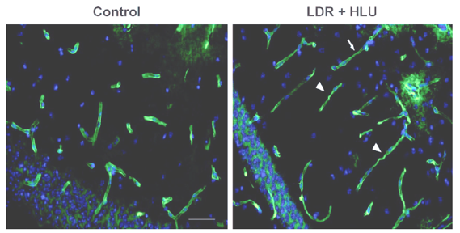
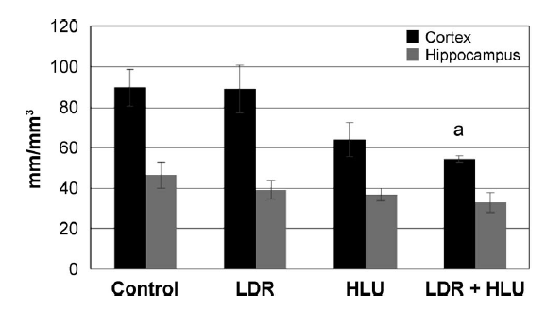
Synergistic Effects
Stressors:
Low dose gamma radiation (LDR) using a ⁵⁷Co source (0.01 cGy/h for a total dose of 0.04 Gy)
Hindlimb unloading (HLU)
Combination of both for 3 weeks
Measurements of LDR+ HLU Effects on:
Mouse Brain Oxidative Stress increases (4-HNE)
Blood Brain Barrier modified (AQP4)
Microvessel changes
4-hydroxynonenal (4-HNE) staining in the hippocampus (panel B) at 7 days or 9 months.
Water transporter aquaporin 4, astrocyte foot / endothelium interface marker at 9 months.
Microvessel morphological changes in cortex at 9 months after combination treatment with LDR + HLU and in control.
Microvessel length density (mm/mm³) in the cortex and hippocampus at 9 months.
Mao et al. (2016), Bellone et al. (2016)

Slide 16
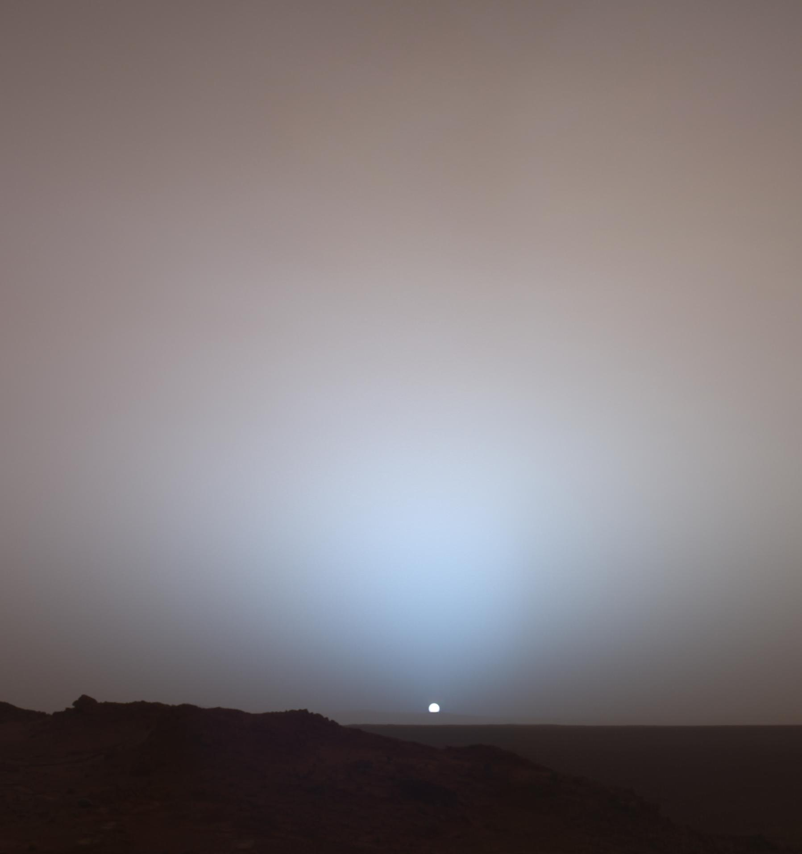
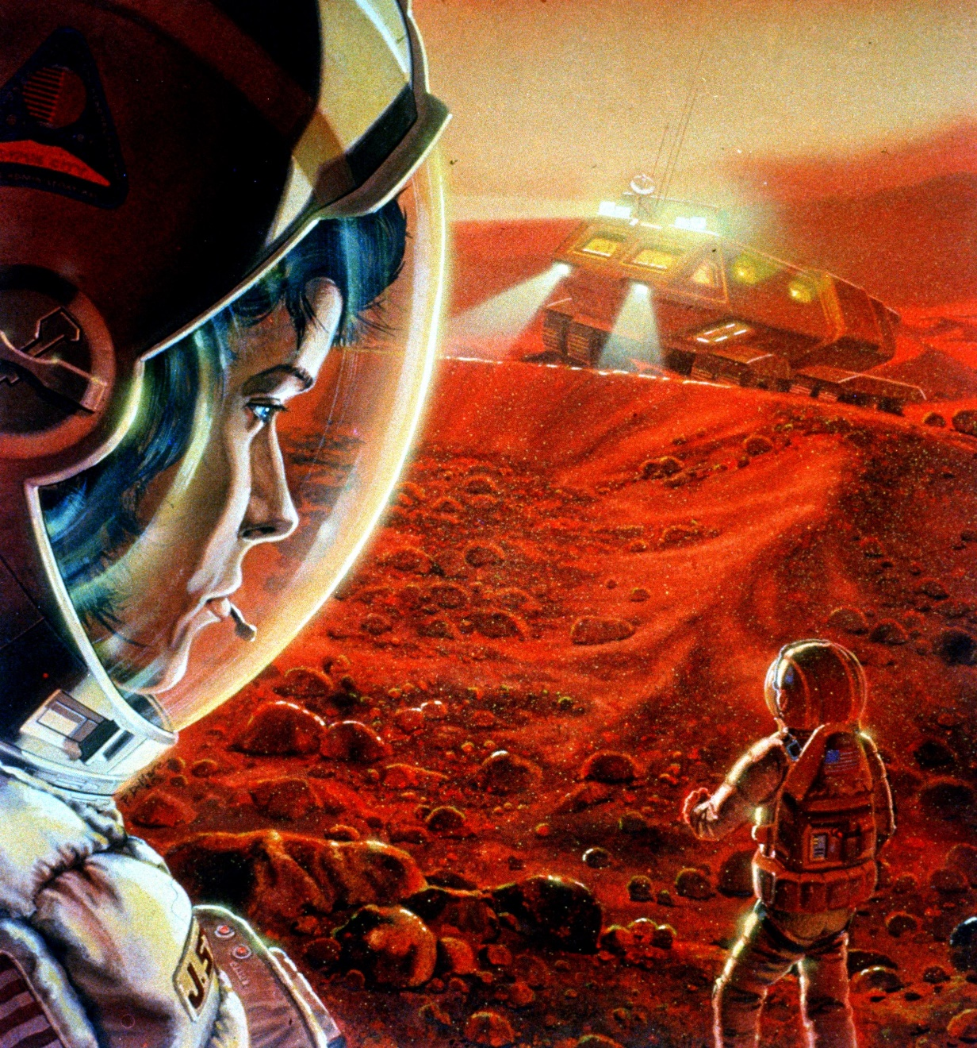
Countermeasures for Mars

Slide 17
Countermeasures for Mars
Evaluating behavioral health and performance effects of:
Stress-management training
Exploration-like food system
Reduced habitable volume and privacy
Virtual reality as a sensory monotony countermeasure
Plant systems
Exercise with guided imagery
Communication protocols

Slide 18
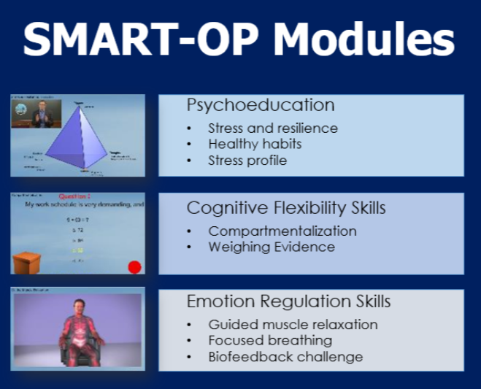
Countermeasures for Mars
Evaluating behavioral health and performance effects of:
Stress-management training
Validated with UCLA graduate students
Validated with n=45 mission controllers at NASA JSC
Participants who completed SMART-OP over 6 weeks, reported decreased stress compared to controls
Rose et al. (2018)

Slide 19
Countermeasures for Mars
Evaluating behavioral health and performance effects of:
Exploration-like food system in 30 day missions
Given volume restrictions in future exploration vehicles, specially designed meal replacement bars will be provided in place of current standard menus. Four HERA missions evaluated crew responses to the food bars and found that these were associated with reduced daily caloric intake, weight loss, and decrements in mood and neurobehavioral functioning, with no significant impacts on somatic symptoms and physical functioning
Continued testing in extended durations
HERA
Sirmons et al. (2020)

Slide 20
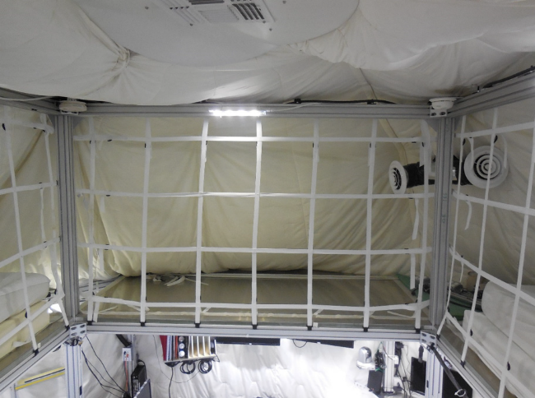
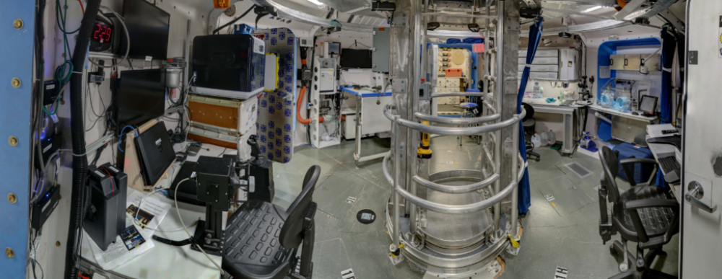
Countermeasures for Mars
Evaluating behavioral health and performance effects of:
Reduced habitable volume and privacy
Evaluation of individual and team behavior and performance outcomes, in reduced volume and privacy over 45 days in HERA
Continued testing in longer duration analogs
HERA
HERA
Roma et al. (2020, in work)

Slide 21
Countermeasures for Mars
Evaluating behavioral health and performance effects of:
Virtual Reality as a sensory monotony countermeasure
Evaluation of behavioral responses to virtual reality in pro-longed isolation and confinement
Antarctica
Stankovic et al. (in work)

Slide 22
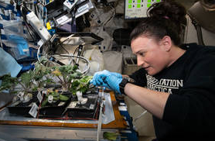
Countermeasures for Mars
Evaluating behavioral health and performance effects of:
Plant systems
Evaluation of behavioral responses to VEGGIE on ISS, and plant systems in pro-longed isolated, confined and extreme environments
Antarctica
Massa et al. (in work)

Slide 23
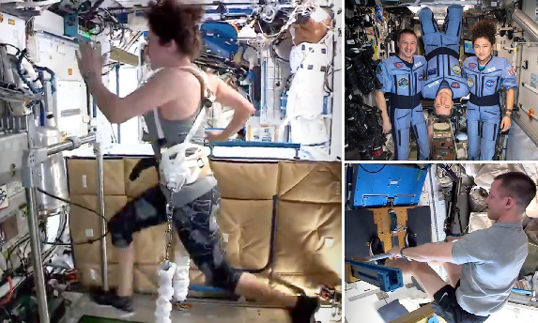
Countermeasures for Mars
Evaluating behavioral health and performance effects of:
Exercise with guided imagery
Evaluation of immune, stress, and behavioral responses to exercise protocols across multiple HERA Campaigns, with and without the addition of guided imagery
Antarctica
Simpson et al. (in work)

Slide 24
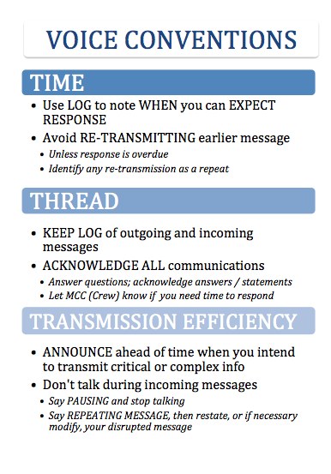
Countermeasures for Mars
Evaluating behavioral health and performance effects of:
Communication protocols
Demonstrated effectiveness of communication protocol guidelines as they relate to individual and team performance outcomes under conditions of comm delays
Continued testing of cognitive aids and supportive technologies
Antarctica
Fischer and Mosier (2016, in work)

Slide 25
Thank you!

