Slide 1
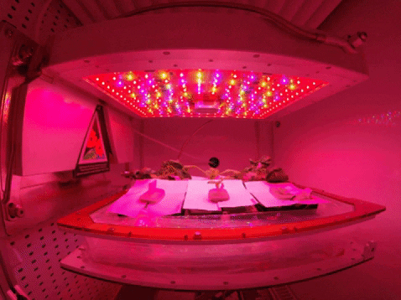
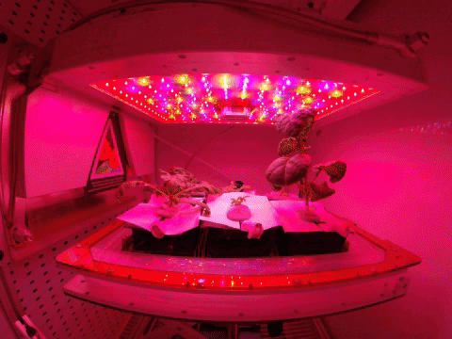
Sustained Veggie
Jess Bunchek, Aaron Curry, & Matt Romeyn

Slide 2
Introduction
Research Gap Study Goals Study Objective

Slide 3
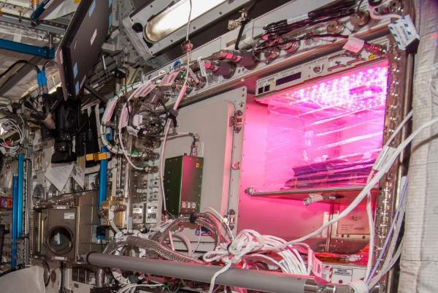
Veggie Vegetable Production System
The Veggie concept is a simple, low-power system to grow fresh, nutritious food for astronauts to supplement their diet and use as a tool to support relaxation and recreation.
Requires ~70 watts for lights, fans, and control electronics
Uses plant pillows filled with arcillite clay media, as well as a root mat water reservoir.
Clear plastic bellows minimize debris risk while, with fans, help create air flow.
First Veggie study, “Veg-01A,” with ‘Outredgeous’ red romaine lettuce (May 2014).

Slide 4
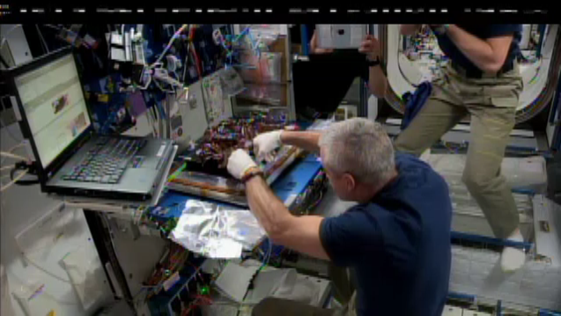

Slide 5
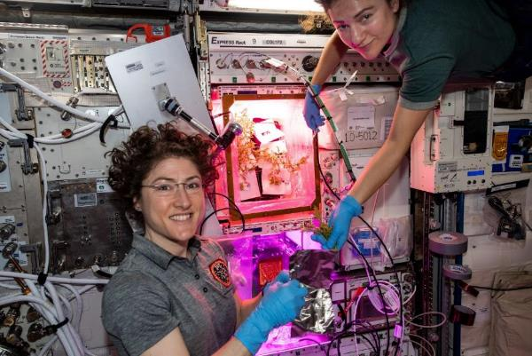
Veggie Vegetable Production System
Second Veggie unit installed in 2018
13 Veggie studies to date
  6 one-month studies
  6 two-month studies with multiple harvests from the same plants (“cut-and-come-again” technique)
  1 three-month study with zinnias to test flowering in space; precursor to fruit production
Ability to weigh produce in microgravity as of 2019 with the Mass Measurement Device
Most recent Veggie study, “Veg-04B,” with ‘Mizuna’ mustard (November 2019). NASA astronauts Christina Koch (left) and Jessica Meir (right) pictured.

Slide 6
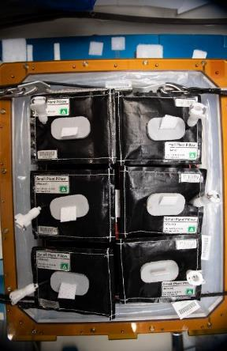
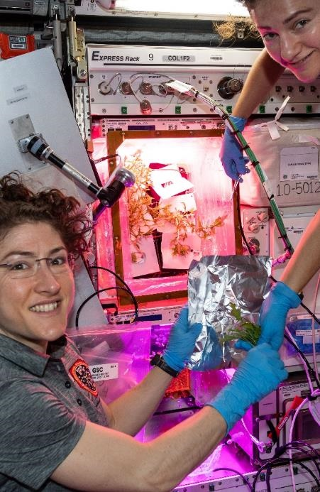
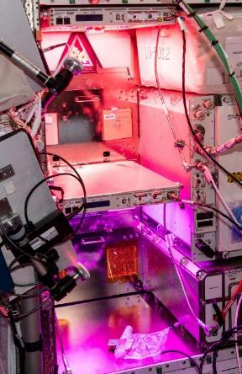
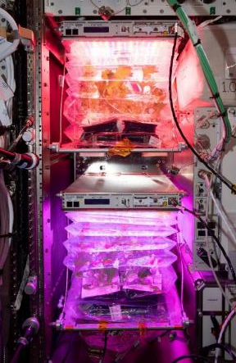
(28-56 days)
Initiation
Growth
Harvest
Dormancy
Cooper et al. 2017. Microgravity. 3:17.
Massa et al. 2015. ICES-2015-252.
Notes:
Only 1-2 month crop production cycles (initiation to harvest) have been evaluated so far in a flight hardware system under environmental conditions similar ISS, followed by hardware cleanout and a crop-free period. This intermittent growth cycle does not indicate the feasibility of a realistic continuous crop production cycle, where plants are replaced once concluded and there is ideally always something ready to harvest.

Slide 7
(28-56 days)
Initiation
Growth
Harvest
Dormancy
Cooper et al. 2017. Microgravity. 3:17.
Massa et al. 2015. ICES-2015-252.
Notes:
Only 1-2 month crop production cycles (initiation to harvest) have been evaluated so far in a flight hardware system under environmental conditions similar ISS, followed by hardware cleanout and a crop-free period. This intermittent growth cycle does not indicate the feasibility of a realistic continuous crop production cycle, where plants are replaced once concluded and there is ideally always something ready to harvest.

Slide 8
Introduction
Research Gap Study Goals Study Objective

Slide 9

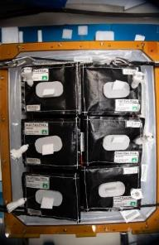

Predicted direction for future long-duration spaceflight missions
ISS
Moon
Mars
Transit vehicle
What do we need to consider in order to move from periodic to continuous plant production?
Growth
Initiation
Harvest
Perchonok et al. 2012. Ann. Rev. Food Sci. Techno 3:311-330.
Notes:
Long-duration missions beyond low Earth orbit will encounter challenges in maintaining adequate nutrition and acceptability in the food system (Cooper et al., 2017). In situ production of fresh vegetable and fruit crops can supplement the crew diet with nutrients deficient in the stored diet (Massa et al., 2015). Steady-state, continuous crop production during long-term, deep space missions will be critical for consistent nutrient supplementation and potential psychological benefits – together ideally improving crew health and performance (Perchonok et al., 2012).

Slide 10
The goals of this study were to:
Establish baseline performance metrics of the Veggie hardware in a sustained crop production capacity to determine its effectiveness and serve as a reference for future space crop production systems.
  Plant Harvest Metrics
  Microbiology
  Waste Stream
  Crew Time
Quantify potential challenges.
Growth
Initiation
Harvest
Notes:
A continuous crop production cycle has the potential to introduce challenges from plant competition due to multiple plant ages within the cycle, increased crew time, and microbiological growth.

Slide 11
Introduction
Research Gap Study Goals Study Objective

Slide 12
Study Objective
To demonstrate sustained crop production with two different harvest treatments:
A traditional 28-day, single harvest approach
A 56-day, multiple harvest “cut-and-come-again” approach with two intermediate harvests and a third, final harvest

Slide 13
Experimental Design
Study Parameters Harvest Treatments Pillow Scheme

Slide 14
Study Parameters
120-day study, April-August 2019
Predating Veg-04, this study was the first detailed comparison of these harvest treatments.
The harvest treatments were grown concurrently using ground-based Veggie plant growth units in Chambers G & H at ISS-like environmental conditions:
  23°C
  50% RH
  3000 ppm CO₂
  16 h light, 8 h darkness

Slide 15
Experimental Design
Study Parameters Harvest Treatments Pillow Scheme

Slide 16
Multiple Harvest
Single Harvest
Initiation
Harvest
Day 28
Initiation
Harvest
Harvest
Harvest
Day 28
Day 42
Day 56

Slide 17
Multiple Harvest
Single Harvest
Initiation
Harvest
Initiation
Harvest
Day 28
Day 56
Initiation
Harvest
Harvest
Harvest
Day 28
Day 42
Day 56

Slide 18
Experimental Design
Study Parameters Harvest Treatments Pillow Scheme

Slide 19




Pillow Scheme
 | KSC Screening Trials (Plant A) | Grown on the ISS (Plant B)
Series 1 | ‘Amara’ Mustard | ‘Red Russian’ Kale
Series 2 | ‘Shungiku’ Greens | ‘Extra Dwarf’ Pak Choi
Pair 1 | Pair 2 | Pair 3
Day 0 | Day 7 | Day 14
Notes:
We looked at 4-5 pillow scheme designs, and this design optimized yield and minimized the number of weeks without a harvest.

Slide 20
Results
Plant Harvest Metrics Microbiology Waste Stream Crew Time

Slide 21
Plant Harvest Metrics
Fresh Edible Biomass
  Single harvest treatment:
    All stem and leaf tissue removed at 28 days after pillow initiation (DAI)
  Multiple harvest treatment:
    All older leaves removed at 28 DAI
    Repeated at 42 DAI
    All stem and leaf tissue removed at final harvest (56 DAI)
Morphological Measurements
  Captured at each plant’s harvest
  Plant dimensions
  Edible biomass fresh weight
  Leaf number
  Leaf surface area
Plant health
  Chlorophyll content (SPAD)
  Anthocyanin content

Slide 22
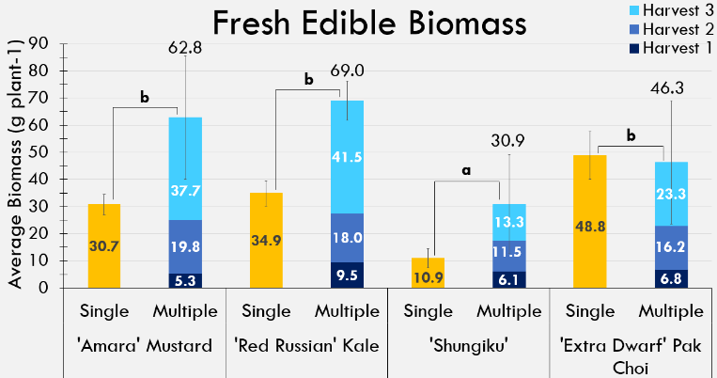
Plant Harvest Metrics
Fresh Edible Biomass
Multiple harvest:
  Biomass shown for each harvest and overall plant (above standard error bars)
Per-plant biomass higher in multiple harvest treatment, except pak choi (P < 0.005)
Shungiku poorest crop
No interaction effect
Standard error bars shown.
Notes:
The average per plant fresh edible biomass was higher in the multiple harvest approach than the single harvest for all crops (P < 0.005; Figure 2). ‘Shungiku’ did not perform as well as expected in Veggie hardware. While many ‘Shungiku’ plants did appear healthy (Figure 3), others suffered from tip burn, a symptom of deficient calcium accumulation in the leaves caused by suboptimal airflow in the VGU. Further ground testing with ‘Shungiku’ also showed inconsistent growth; however, determining the exact cause or causes would require further investigation.

Slide 23
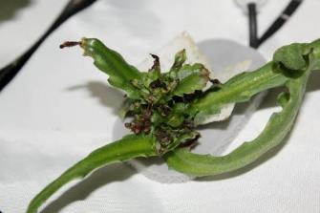
Plant Harvest Metrics
Standard error bars shown.
‘Shungiku’ greens exhibited tip burns at the ends of leaves. This loss of plant vascular tissue caused plant deformities and stunting.
Notes:
The average per plant fresh edible biomass was higher in the multiple harvest approach than the single harvest for all crops (P < 0.005; Figure 2). ‘Shungiku’ did not perform as well as expected in Veggie hardware. While many ‘Shungiku’ plants did appear healthy (Figure 3), others suffered from tip burn, a symptom of deficient calcium accumulation in the leaves caused by suboptimal airflow in the VGU. Further ground testing with ‘Shungiku’ also showed inconsistent growth; however, determining the exact cause or causes would require further investigation.

Slide 24

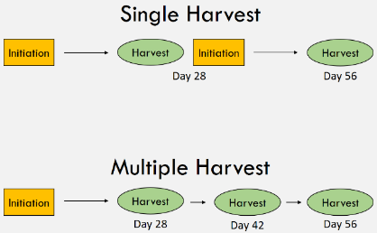
Plant Harvest Metrics
Average fresh edible biomass (g plant-1) adjusted to a 56-day growth period for both harvest treatments
‘Extra Dwarf’ pak choi biomass higher in the single harvest treatment
‘Amara’ mustard and ‘Red Russian’ kale consistent across treatments
‘Shungiku’ green biomass unexpectedly low in both harvest treatments, likely due to morphological issues
 | Harvest Treatment | Fresh Edible Biomass (g plant⁻¹)
'Amara' Mustard | Single | 61.4
 | Multiple | 62.8
'Red Russian' Kale | Single | 69.8
 | Multiple | 69.0
'Shungiku' Greens | Single | 21.8
 | Multiple | 30.9
'Extra Dwarf' Pak Choi | Single | 97.6
 | Multiple | 46.3
Notes:
However, comparing fresh edible biomass production across the same amount of time (56 days) showed that 2 successive rotations of the single harvest treatment grew as much or more than a single rotation of the multiple harvest treatment (Figure 2). ‘Shungiku’ greens were an exception, likely due to morphological inconsistencies. Multiple harvest treatment crops continued to produce biomass after the first harvest at 28 days old, but the growth rate slowed. Depending on the crop, using the single harvest treatment may be more effective at providing continuous fresh produce to crew members.

Slide 25
Results
Plant Harvest Metrics Microbiology Waste Stream Crew Time

Slide 26
Microbiology
For this study, we were interested in testing microbial growth in the Veggie units over time and across harvest treatments.
Plant Samples
  Collected at each harvest event for both harvest treatments
  Half of the edible biomass used for collecting Aerobic Plate Counts and Yeast & Mold Counts and yeast & mold counts
  Mix sample effluent was also plated to screen for Escherichia coli and Staphylococcus aureus.
Environmental Swabs
  Collected at 8, 42, 78, and 120 DAI
  Designated positions on the bellows, cabin fan screen, and outlet duct
Khodadad et al. 2020. Frontiers in Plant Science. 11:199.
Lindow & Brandl. 2003. Appl. Environ. Microbiol. 69.
United Fresh Produce. 2010.

Slide 27
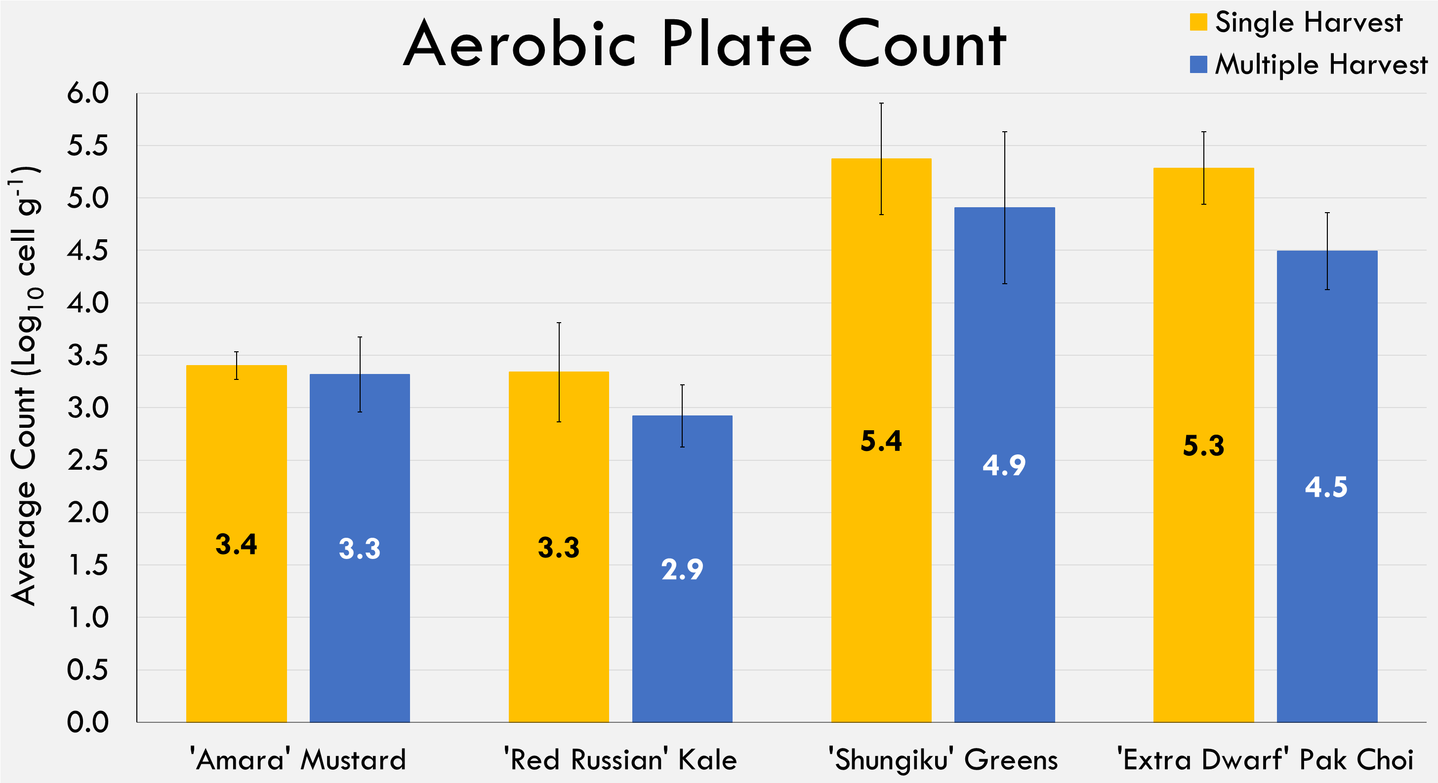
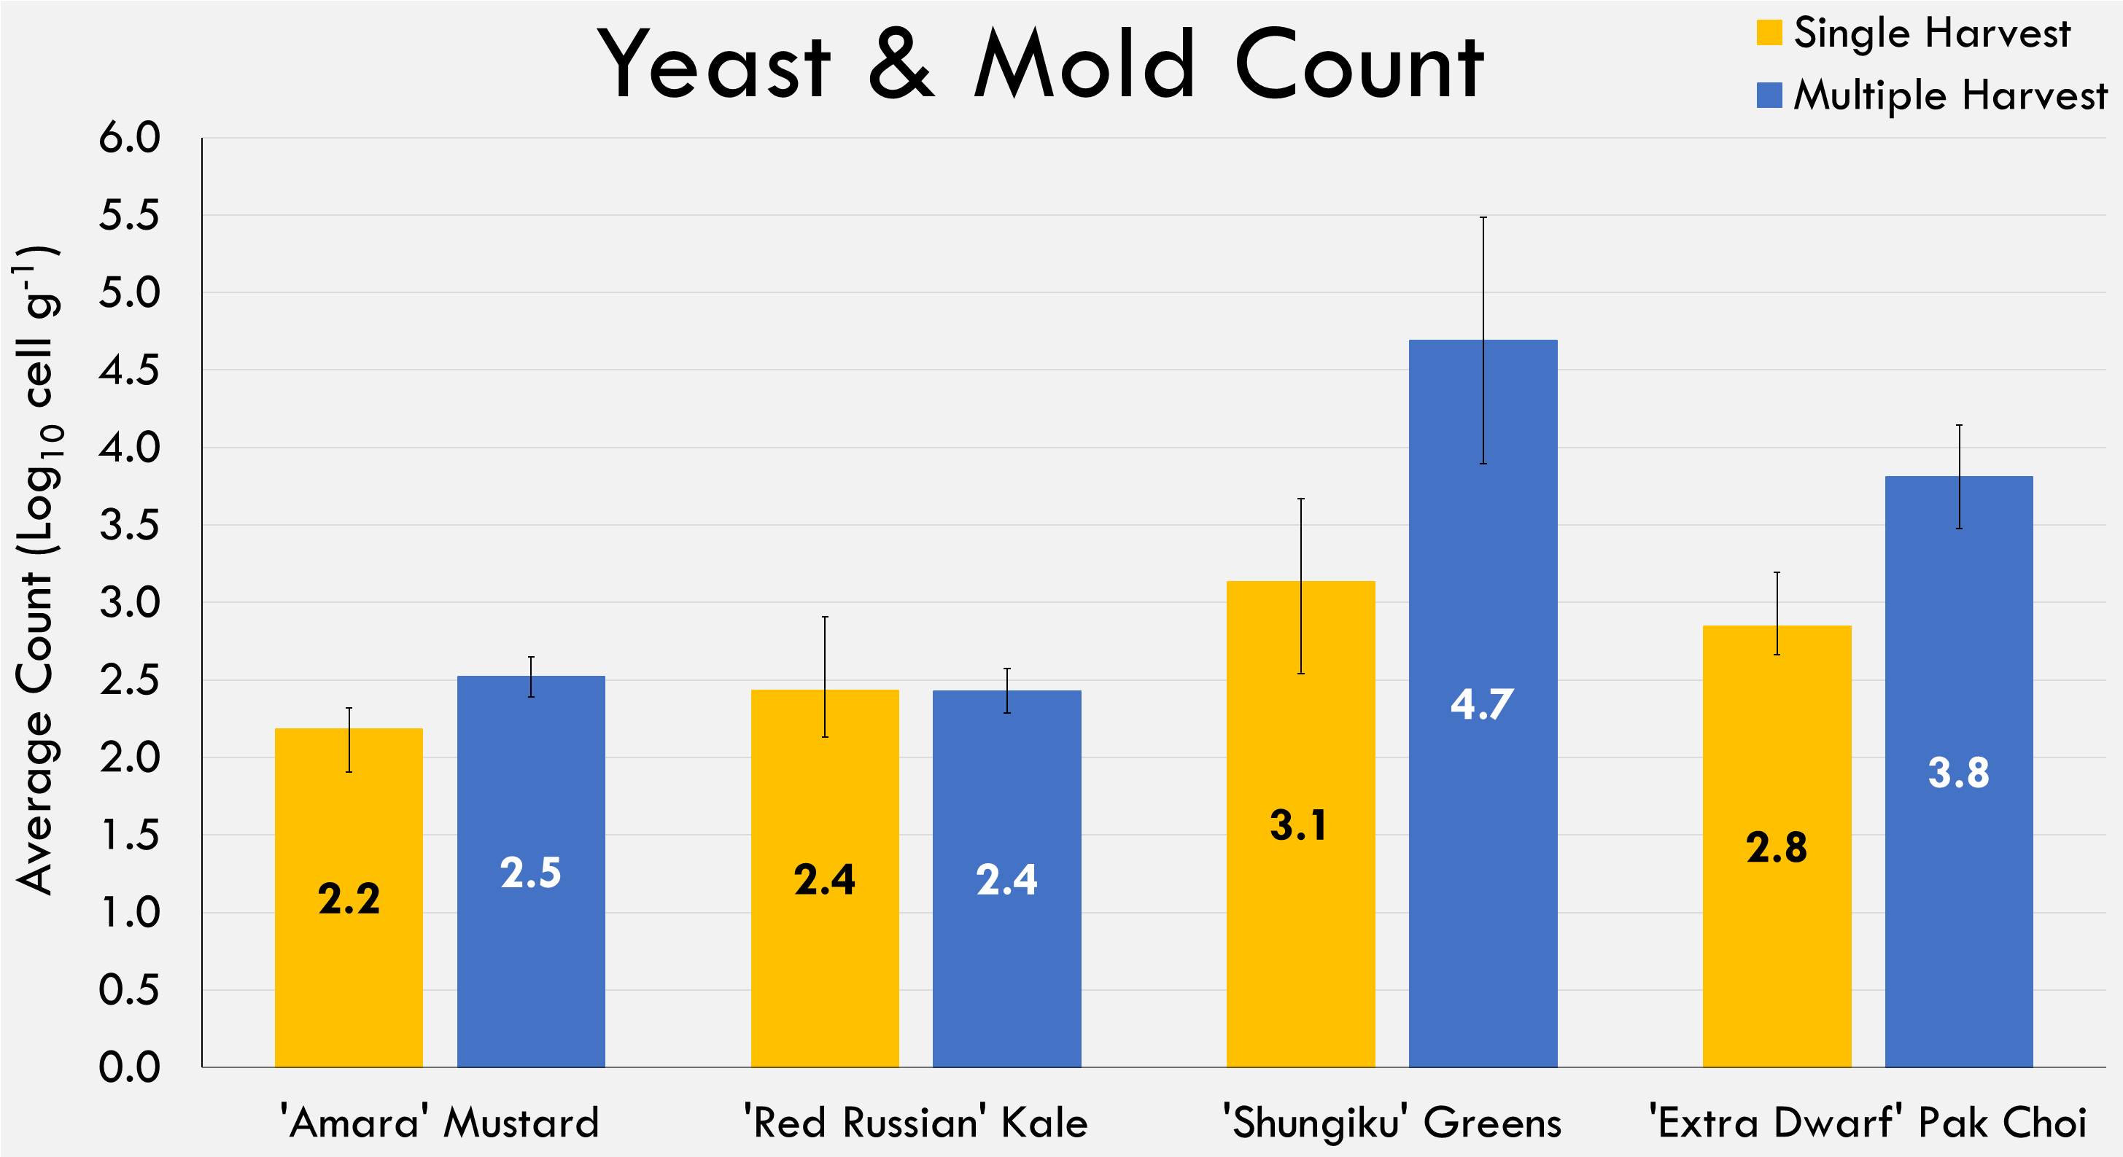
Microbiology
Standard error bars shown.
Standard error bars shown.
Negative for E. coli and S. aureus
Aerobic Plate Count
  Increased across cropping pairs (P < 0.005)
  No harvest treatment effect
Yeast and Mold Count
  Increased across pairs (P < 0.005)
  Higher for multiple harvest treatment (P = 0.02)
  No interaction effect
Environmental swabs showed no treatment effect.
Notes:
All plant samples and environmental swabs were negative for E. coli and S. aureus. Some samples had positive coliform petrifilms; these colonies were isolated and identified as native plant species such as Enterobacter cloacae. APC for ‘Shungiku’ greens and ‘Extra Dwarf’ pak choi were higher than average for both the single (µ = 4.3 Log₁₀ cell g⁻¹) and multiple harvest (3.9 Log₁₀ cell g⁻¹) treatments (P < 0.005; Figure 4). Conversely, the ‘Amara’ mustard and ‘Red Russian’ kale were below average for both harvest treatments. We preliminarily attribute this more to an increase in counts throughout the study than the crops themselves.
For both harvest treatments, Y&M were also higher than average (µ_{single harvest} = 2.6 Log₁₀ cell g⁻¹; µ_{multiple harvest} = 3.4 Log₁₀ cell g⁻¹) for ‘Shungiku’ greens and ‘Extra Dwarf’ pak choi than ‘Amara’ mustard and ‘Red Russian’ kale (P < 0.05; Figure 5). We again preliminarily attribute to microbial growth over time. Y&M was also higher in the multiple harvest treatment for the latter pair of crops (P = 0.02).
Currently, VGUs and plants are not cleaned during use. As we look to produce crops consistently, regular cleaning procedures will need to be developed to avoid a potential food safety concern. Facilities are susceptible to microbial growth over time, and older plants are even more susceptible.

Slide 28
Results
Plant Harvest Metrics Microbiology Waste Stream Crew Time

Slide 29
Waste Stream
Plant harvest index and water consumption assessed to better understand the amount of waste generated in both harvest treatments.
The remaining half of harvested edible biomass was dried for 72 hours at 70°C.
Completed pillows were carefully opened and poured into a large beaker, with care taken to ensure roots did not desiccate.
Root biomass was separated from the arcillite using a root washing treatment, weighed as fresh inedible biomass, and dried.
Edible and inedible biomass was weighed when dry to determine the plant water content.

Slide 30
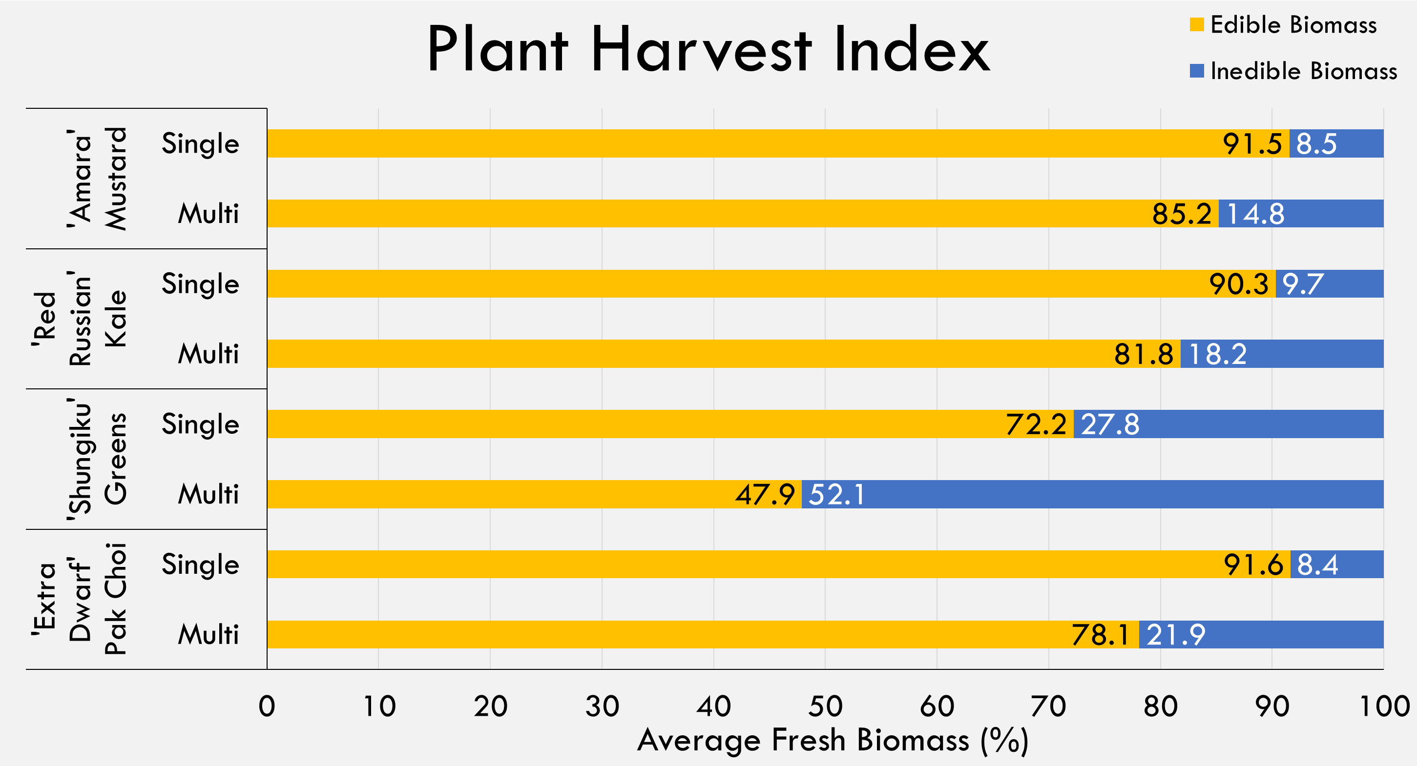
Waste Stream
Plant Harvest Index
  Average fresh edible and inedible biomass (%). Edible biomass was slightly higher in the single harvest treatment.
Notes:
Fresh edible biomass from ‘Amara’ mustard, ‘Red Russian’ kale, and ‘Extra Dwarf’ pak choi ranged from 90-91% and 78-85% in the single and multiple harvest treatments, respectively (Figure 6). ‘Shungiku’ greens averaged 72% and 47%, respectively. The lower ratio of edible: inedible in the multiple harvest treatment may indicate how leafy green crops allocate resources for growth as the plants age.
On orbit, concluded plant pillows are either returned to Earth for science sampling or trashed with root mats. Single-use components require payload space and contribute to launch mass without the ability to be reused. One way to quantify the extent of this system inefficiency is an input-output analysis across harvest treatments. In this study, the single harvest treatment used 24 pillows, including 2 pillows with failed plant establishment; the multiple harvest treatment used 13 pillows, including 1 pillow with failed plant establishment. Failed pillows are a current reality in Veggie hardware, so having spare pillows available would be vital for maintaining regularly available fresh produce. At initiation, each pillow weighs approximately 198 g. For this 120-day grow-out, the single harvest treatment used 4.8 kg, while the multiple harvest treatment used 2.6 kg in consumable hardware – 46% less than the single harvest treatment.

Slide 31
Waste Stream
Water Use Efficiency
Scaled to 56 growing days
Includes amounts added to plant pillows only
Water added to root mats excluded
Biomass index compares how much more water was required to produce 1 g fresh edible biomass in the multiple harvest treatment versus the single harvest treatment.
 | Harvest Treatment | Water Use (L 56 days⁻¹) | Water per Fresh Edible Biomass (L g⁻¹) | Biomass Index
'Amara' Mustard | Single | 2.1 | 35
 | Multiple | 2.2 | 35 | 1.0
'Red Russian' Kale | Single | 1.9 | 28
 | Multiple | 1.6 | 23 | 0.8
'Shungiku' Greens | Single | 1.3 | 62
 | Multiple | 1.4 | 45 | 0.7
'Extra Dwarf' Pak Choi | Single | 1.7 | 17
 | Multiple | 1.8 | 38 | 2.3
Notes:
In a closed system like the ISS, water use is also an area of potential inefficiency. Water use across harvest treatments differed by crop. Both harvest treatments were watered 1,800 mL to the root mat throughout the study (600 mL each on 0, 28, and 71 DAI). In the multiple harvest treatment, ‘Extra Dwarf’ pak choi pillows were watered with 2.3 times the amount of water than the single harvest treatment to produce 1 g of edible fresh biomass (Table 4). Conversely, ‘Red Russian’ kale and ‘Shungiku’ greens used 80% and 70%, respectfully, of the water used in the single harvest treatment to produce 1 g of fresh edible biomass. ‘Amara’ mustard used water consistently across treatments.
Whereas water use is more dependent upon the individual crop species than the harvest treatment, there is a trade-off with consumable hardware. Growth time being equal, leafy crops grown under a single harvest technique can potentially yield more edible fresh biomass but may require more plant pillow hardware to achieve this.

Slide 32
Waste Stream
 | Harvest Treatment | Fresh Edible Biomass (g plant⁻¹)
'Amara' Mustard | Single | 61.4
 | Multiple | 62.8
'Red Russian' Kale | Single | 69.8
 | Multiple | 69.0
'Shungiku' Greens | Single | 21.8
 | Multiple | 30.9
'Extra Dwarf' Pak Choi | Single | 97.6
 | Multiple | 46.3
 | Harvest Treatment | Water Use (L 56 days⁻¹) | Water per Fresh Edible Biomass (L g⁻¹) | Biomass Index
'Amara' Mustard | Single | 2.1 | 35
 | Multiple | 2.2 | 35 | 1.0
'Red Russian' Kale | Single | 1.9 | 28
 | Multiple | 1.6 | 23 | 0.8
'Shungiku' Greens | Single | 1.3 | 62
 | Multiple | 1.4 | 45 | 0.7
'Extra Dwarf' Pak Choi | Single | 1.7 | 17
 | Multiple | 1.8 | 38 | 2.3
Notes:
In a closed system like the ISS, water use is also an area of potential inefficiency. Water use across harvest treatments differed by crop. Both harvest treatments were watered 1,800 mL to the root mat throughout the study (600 mL each on 0, 28, and 71 DAI). In the multiple harvest treatment, ‘Extra Dwarf’ pak choi pillows were watered with 2.3 times the amount of water than the single harvest treatment to produce 1 g of edible fresh biomass (Table 4). Conversely, ‘Red Russian’ kale and ‘Shungiku’ greens used 80% and 70%, respectfully, of the water used in the single harvest treatment to produce 1 g of fresh edible biomass. ‘Amara’ mustard used water consistently across treatments.
Whereas water use is more dependent upon the individual crop species than the harvest treatment, there is a trade-off with consumable hardware. Growth time being equal, leafy crops grown under a single harvest technique can potentially yield more edible fresh biomass but may require more plant pillow hardware to achieve this.

Slide 33
Results
Plant Harvest Metrics Microbiology Waste Stream Crew Time

Slide 34
Crew Time
Crew time required for continuous plant growth operation included
  Hardware setup, maintenance, cleanup
  Pillow initiation
  Daily plant checks and watering events
  Opening wicks
  Plant thinning
  Harvest
  Plant sanitization (estimated)
Harvest time estimates exclude data collection activities that would not occur on-orbit.
Current flight activities excluded
  Crew questionnaires
  Taste test surveys

Slide 35
Crew Time
Crew time required for continuous plant growth operation included
  Hardware setup, maintenance, cleanup
  Pillow initiation
  Daily plant checks and watering events
  Opening wicks
  Plant thinning
  Harvest
  Plant sanitization (estimated)
Cross-referenced estimates with Veg-04 on-orbit crew activity time; similar
Harvest time estimates exclude data collection activities that would not occur on-orbit.
Current flight activities excluded
  Crew questionnaires
  Taste test surveys

Slide 36
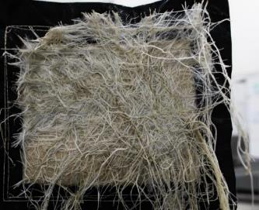
Crew Time
Crew Time Estimates (minutes)
  Over whole study (120-day production period)
  Single harvest (24 pillows)
    More time for plant initiation, wick opening, & thinning due to more pillows
  Multiple harvest (13 pillows)
    More time for harvest & plant sanitization due to more harvest events
    Hardware time higher because of root cleanout
Task | Single | Multiple
Hardware | 370 | 465
Pillow Initiation | 360 | 180
Plant Checks & Watering | 1,470 | 1,470
Wick Opening | 40 | 20
Plant Thinning | 50 | 25
Harvest | 420 | 715
Plant Sanitization | 60 | 90
Total | 2,770 | 2,965
370
2,870
Notes:
Roots typically grow through the bottom of the plant pillows in search of either water or oxygen, and these roots often venture underneath adjacent pillows. Removing and replacing pillows less frequently contributed to a greater buildup of material, so the multiple harvest treatment required more hardware maintenance time to routinely remove roots from the root mats. Plant initiation, wick opening, and plant thinning required twice the amount of time in the single harvest treatment due to the higher turnover rate of plants. Harvest and plant sanitization estimates were more time-intensive activities in the multiple harvest treatment due to the intermediate harvests. Finally, plant checks and watering time estimates were similar across treatments. Overall, continuously producing crops under a single harvest technique required approximately 200 fewer hours than crops grown under a multiple harvest technique for 4 months.

Slide 37
Discussion
Considerations & Challenges Potential Future Research

Slide 38
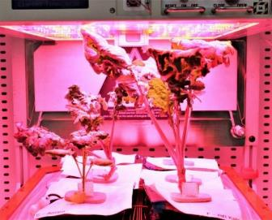
Discussion
Plant Competition
  Older plants shading younger
  Still occurred, despite careful pillow scheme design
Younger amara plant
Older kale plant
Plant competition in the multiple harvest treatment.

Slide 39
Plant Competition
“Time lapse” collected final 28 days of study
Single Harvest
Multiple Harvest

Slide 40
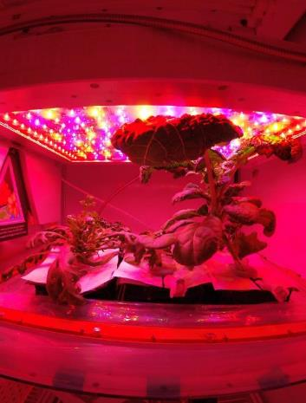
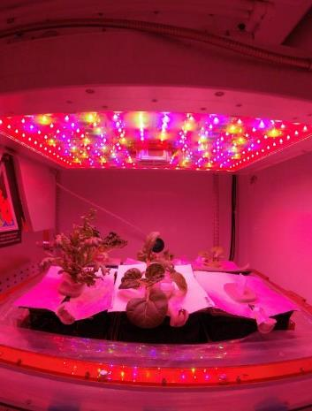
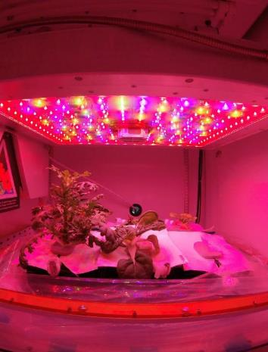
Harvest
1 Day After Harvest
2 Days After Harvest

Slide 41
Discussion
Plant Competition
  Older plants shading younger
  Still occurred, despite careful pillow scheme design
  To what extent did plant competition affect performance?
  Future research:
    Try other scheme designs
    Have enough time to scale up production, eliminate plant staggering
Younger amara plant
Older kale plant
Plant competition in the multiple harvest treatment.

Slide 42
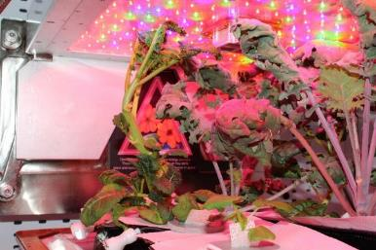
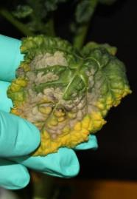
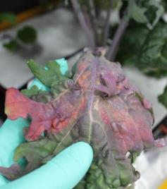
Discussion
Plant Competition
Plant Health
  Edible biomass per harvest too low for intended elemental and nutrition analyses
  Nutrition tapered by end of multiple harvest
  Using middle light cap height caused leaf burning.
  Future research:
    Test different fertilizer scheme for optimized plant health.
    Scale up production: 1 Veggie = 1 crop, grown concurrently
‘Amara’ mustard
‘Red Russian’ kale

Slide 43
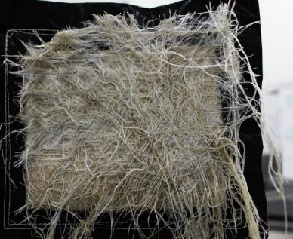
Discussion
Plant Competition
Plant Health
Root Accumulation
  Created thick mats on pillow bottoms, especially multiple harvest treatment
  Dead roots pose smell and micro risk
  Unanticipated cleanup time
  What kind of procedure would we need?
  How often should cleanup be performed?
Root matting on pillow bottom in multiple pillow after being in place for 56 days. Matting not exclusive to this plant.

Slide 44
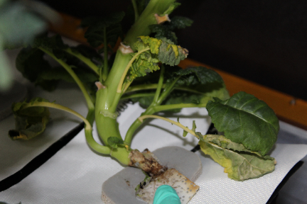
Discussion
Plant Competition
Plant Health
Root Accumulation
Microbial Analyses
  Switch crop pair order to better understand timing effect versus crop effect.
  What kind of procedure would we need for regular hardware cleaning?
  How often should cleaning be performed?
  How do we better quantify microbial risks on inedible biomass?
Microbial growth at the base of ‘Amara’ mustard plant at 49 DAI.

Slide 45

Discussion
Plant Competition
Plant Health
Root Accumulation
Microbial Analyses
Waste Stream
  Future research:
    Measure pillows and root mats post-harvest to help close water use loop
Inedible biomass (lost)
Evaporated and collected (reclaimed)
Edible biomass (reclaimed)

Slide 46
Conclusion

Slide 47
Conclusion
Continuous leafy green production is achievable in Veggie hardware.
  Identified areas of concern, such as potential hardware incompatibility of ‘Shungiku’, and challenges for implementing this in space.
  New procedures for routine hardware cleaning would be vital for maintaining the low risk for food safety contaminants and odors, especially if production exceeded the tested 120-day duration.
Successfully established baseline performance metrics and identified numerous areas for future research.
  Current leafy green production with single harvest continues to be a viable option.
  The main tradeoff associated with the single harvest technique is the greater requirement of consumable hardware,
  Multiple harvest technique requires more crew time, potentially increases overall microbial load over time, and is less effective at producing fresh edible biomass given the same amount of resources.
Verified ‘Amara’ mustard as potential new crop candidate for spaceflight
Repeating this study would be valuable for achieving the following:
  Eliminate confounding factors
  Verify the source of microbial growth over time
  Conduct plant nutrition analyses
  Retest this cropping system design or an alternative design that could further minimize plant competition
  Determine routine hardware cleaning procedures
  Complete waste stream calculations
  Look for areas of improved crew time
Notes:
Continuous leafy green production is achievable in Veggie hardware. This Sustained Veggie study identified areas of concern, such as potential hardware incompatibility of ‘Shungiku’ greens, and challenges for implementing this in spaceflight. New procedures for routine hardware cleaning would be vital for maintaining the low risk for food safety contaminants and odors, especially if production exceeded the tested 120-day duration.
This study also successfully established baseline performance metrics and identified numerous areas for future research. In addition to verifying ‘Amara’ mustard as a potential new crop for spaceflight, the data showed that current leafy green production in VGUs, which uses a single harvest technique, continues to be a viable option. The main tradeoff associated with the single harvest technique is the greater requirement of consumable hardware, whereas the multiple harvest technique requires more crew time, potentially increases overall microbial load over time, and is less effective at producing fresh edible biomass given the same amount of resources.
However, repeating this study would be valuable for achieving the following: eliminate confounding factors, verify the source of microbial growth over time, conduct plant nutrition analyses, retest this cropping system design or an alternative design that could further minimize plant competition, determine routine hardware cleaning procedures, complete waste stream calculations, and look for areas of improved crew time.

