Slide 1
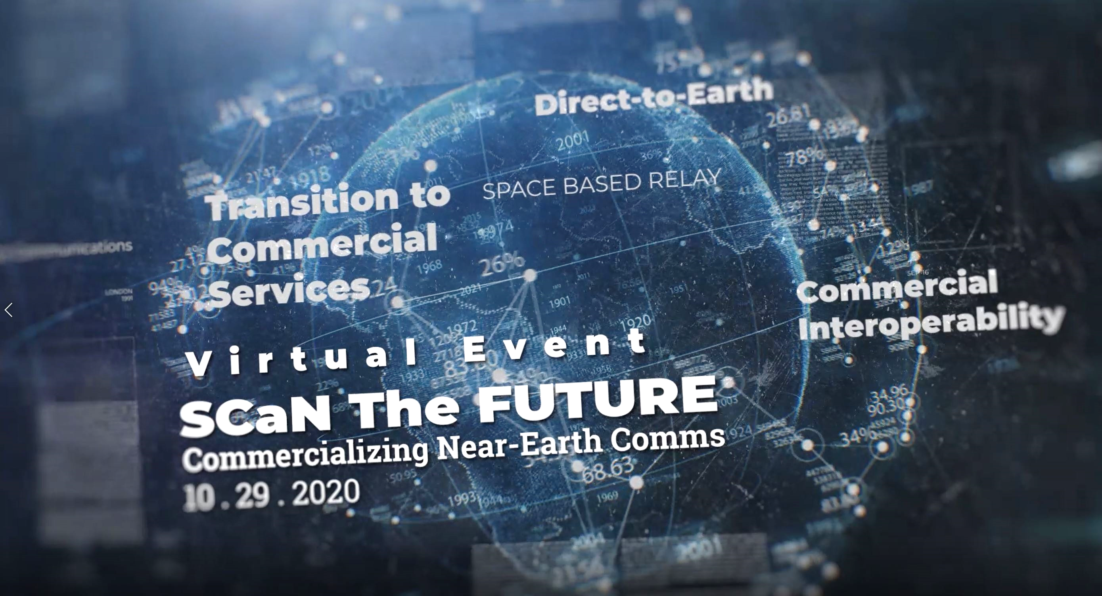
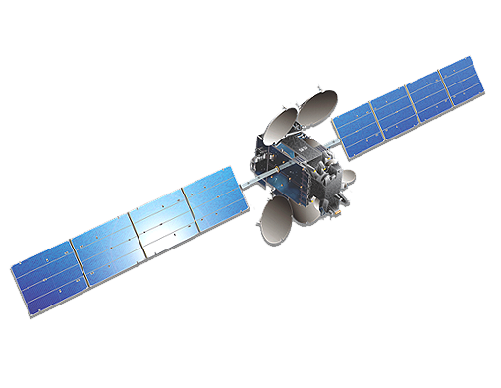
Welcome! SCaN The Future will begin shortly at 1PM EDT.
Please be advised that this virtual event will be recorded, and all microphones muted. We encourage attendees to use the Q&A “chat” feature to submit questions for our speakers and panelists. Thanks!

Slide 2

SCaN. Exploration, enabled.
www.nasa.gov/scan

Slide 3
Welcome Remarks
Badri Younes
Deputy Associate Administrator and Program Manager for Space Communications and Navigation (SCaN)

Slide 4


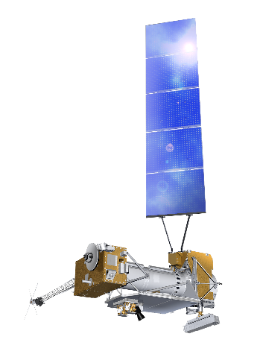




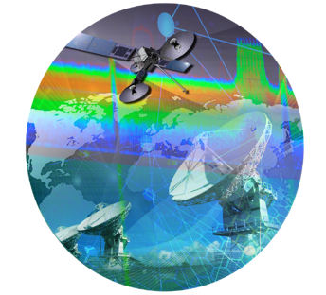
Enabling Human Space Exploration and Science Missions
Space Communications and Navigation (SCaN) Serves as the Program Office for all of NASA’s space communications activities
24/7 Global Near Earth
and Deep Space
Communications
and Navigation Services
100+ Missions currently
Supported by SCaN
Develop, operate and manage all NASA space communications capabilities
Develop technologies to enable and enhance future mission experience
Manage NASA spectrum; represent NASA
on national and international spectrum management forums
Develop space communication standards as well as positioning, navigation, and timing policies
Represent and negotiate on behalf of NASA on all matters related to space communications

Slide 5


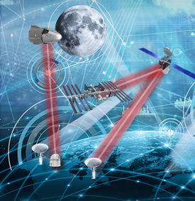
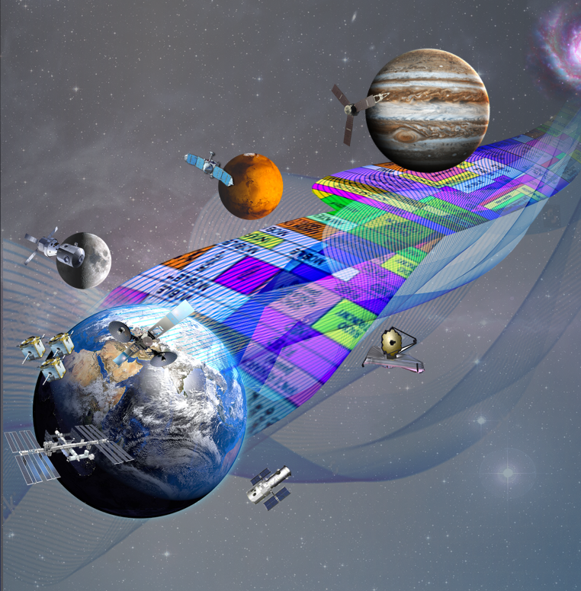

SCaN’s Vision, Goal & Strategy
VISION: Interoperable and resilient space and ground communications and navigation infrastructure
GOAL: Enable high speed, robust, secure, and cost-effective space communications and navigation services to future science and exploration missions
Foster an Affordable and
Growing U.S. Space Industry
Leverage Commercial Capabilities to Increase Efficiency and Robustness of NASA Space Networks
Infuse Transformational Technologies to Enhance Services Near the Moon and Beyond
Ensure Efficient Use of Spectrum through Regulatory Oversight and Streamlined Processes
Provide Technical Leadership in Pursuing and Implementing PNT Policies and Technology
PSC64_092419

Slide 6

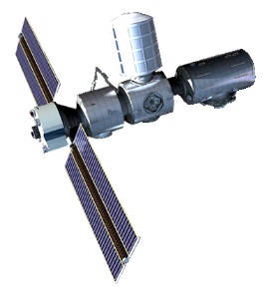


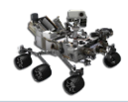

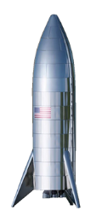
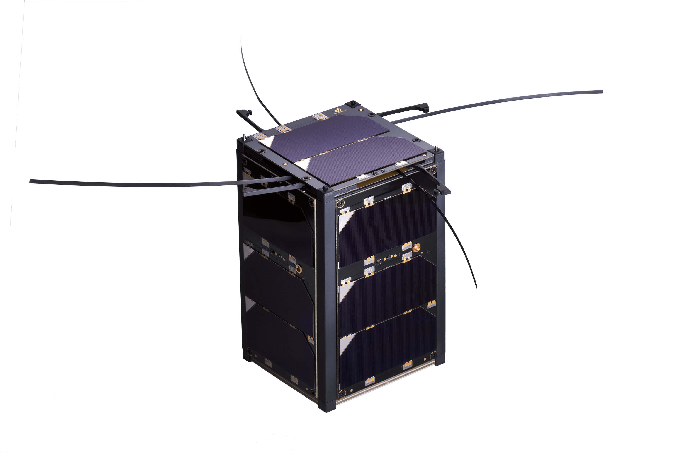
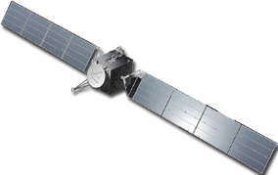
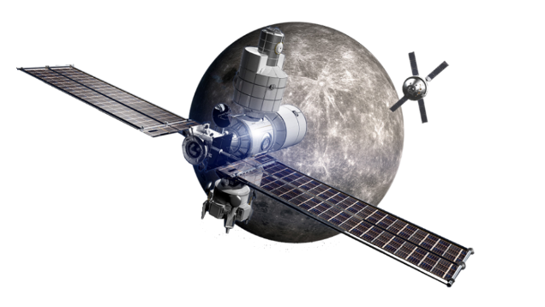

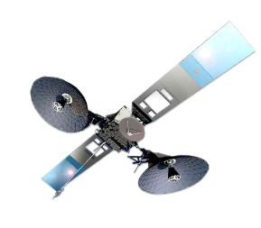
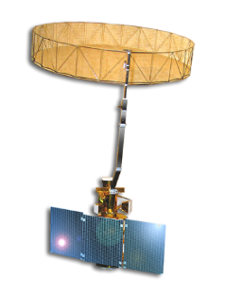
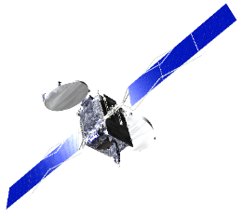
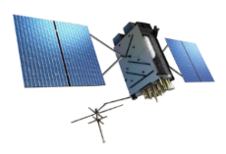
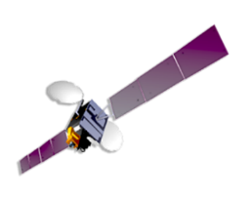
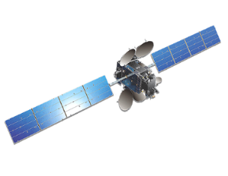
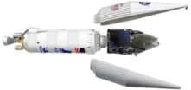
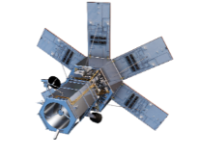
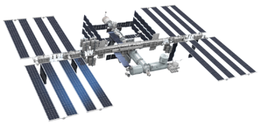

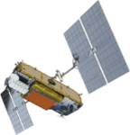


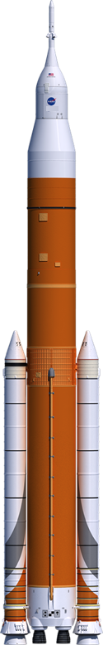


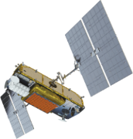
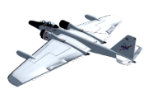
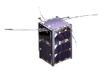




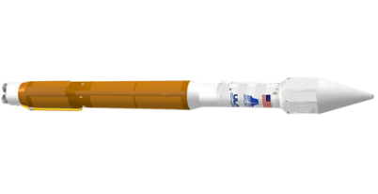
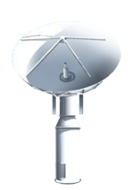


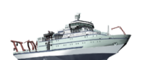


Interoperability links
Optical links
Space Interoperability
Increased Mars
Missions
Return to
the Moon
Commercial
Space Vehicles
above GEO
Science Missions Communications
Increased Need
for Real Time Communications
Larger More Powerful GEO Communication Satellites
Navigation Satellites
Increasing
Number of Commercial Constellations
Imaging Satellites
High Altitude
Missions
Increase in number of launches
Rapid Growth in the Number of Cubesats and Small Satellites
6
PSC57_092419

Slide 7



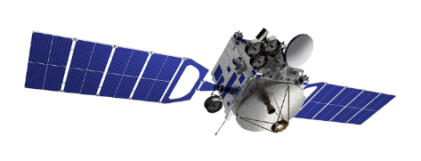
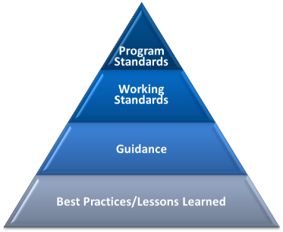



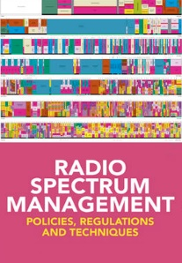











Our Pathway to Interoperability
…create an interoperable space communications and navigation environment that can leverage civil, commercial, domestic, and international capabilities to enable the seamless transfer of information.
  Adopting commercial standards whenever possible
  Supporting standards bodies such as CCSDS
  Creating new standards to fill the gaps: optical, network management, bundle protocol
  Infusing standards into operations
Standards
  Working with the space community to identify the spectrum needs of a growing space market
  Working to remove regulatory barriers that impede progress
Spectrum
Access
  Investing in low TRL, high impact technologies
  Wideband receivers that allow operation across all Ka-band
  Cognitive Networks to provide dynamic, flexible user access, increased security and resiliency
Technology
7

Slide 8
Thank You for Your Participation and Engagement

Slide 9
Commercial Plan Overview
Gregory Heckler
Acting Director, SCaN Commercial Services Office

Slide 10
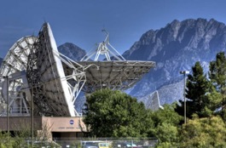
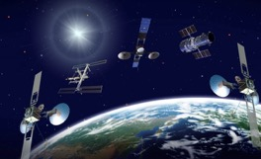
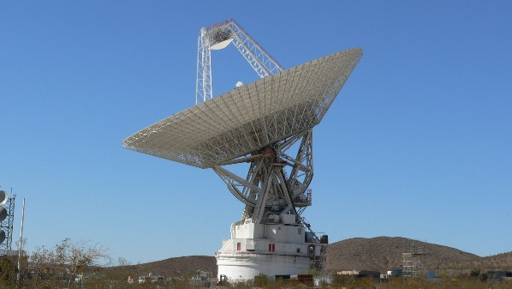
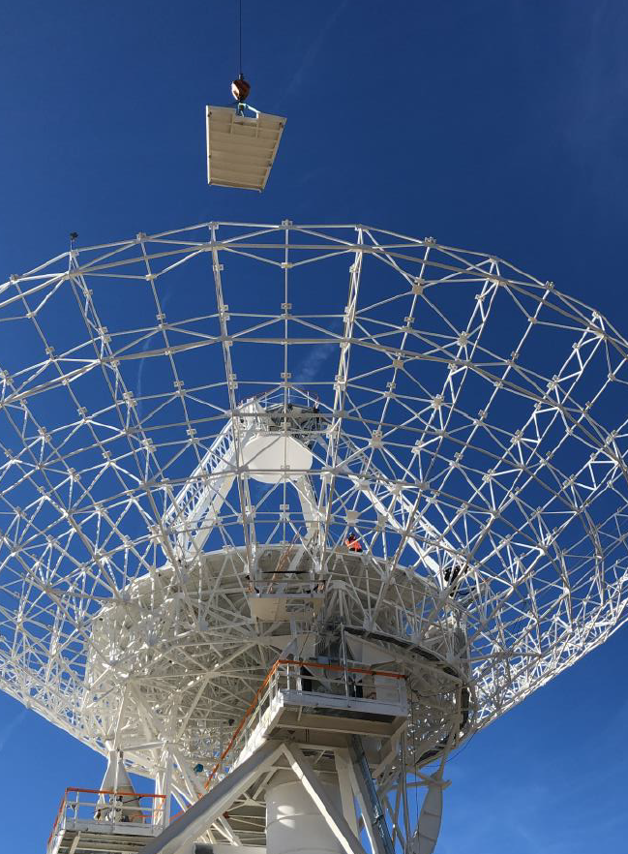
Network Overview
Communications and Navigation services are fundamental to NASA’s execution of science and exploration endeavors
The current network architecture includes:
  Space Network (SN): Ten geosynchronous Tracking and Data Relay Satellites (TDRS) and three ground stations that relay data from missions in Earth orbit and launch vehicles
  Near Earth Network (NEN): Ground station / antenna assets supporting missions close to the Earth
  Deep Space Network (DSN): Three ground station complexes with unique (large) antennas designed to communicate with spacecraft within and beyond the solar system
NASA provides communications and navigation services to over 100 NASA missions and systems, other United States (U.S.) Government agencies, international civil space agencies, and commercial missions.
Space Network
Near Earth Network
Deep Space Network

Slide 11
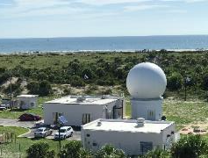
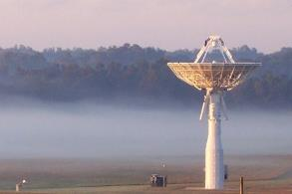

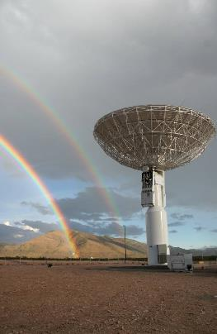
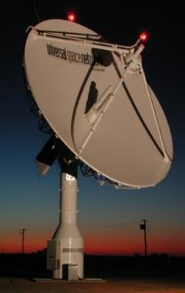
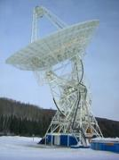
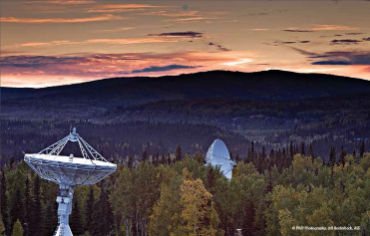
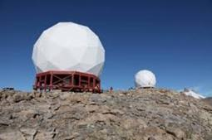


Near Earth Network
NEN Today: A Hybrid Network
Integrates NASA, Commercial,
and Partner ground station resources
Missions are scheduled on any combination of government and commercial assets that meet needs
NASA buys services from its commercial partners
Unique services such as launch support are conducted from NASA-owned stations
Commercial / Partner Stations
NASA Owned Stations

Slide 12

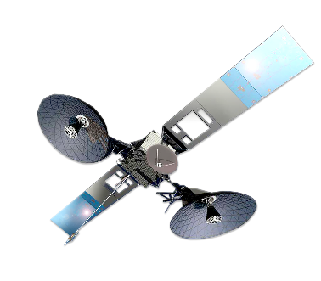
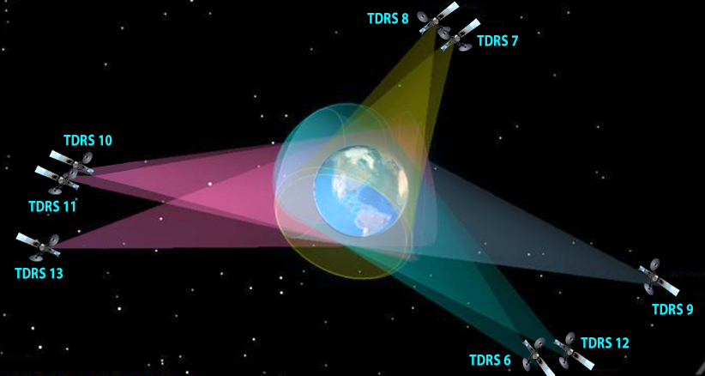
Space Network
Unique network assets designed for the express purpose of supporting NASA orbital missions
Global coverage from ground stations in the US and Guam
24 x 7 coverage of missions below geosynchronous orbit
High power beams that track spacecraft and minimize user burden
Radiometric observations for spacecraft navigation
NASA managing flyout of existing TDRS fleet; need alternatives in place by 2030
TDRS SN Earth Coverage
The Space Network provides nearly 12 million minutes of service time to users each year; Launch vehicles during their launch and ascent phase, the International Space Station (ISS), the Hubble Space Telescope, and other NASA missions

Slide 13
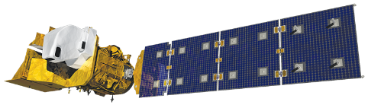
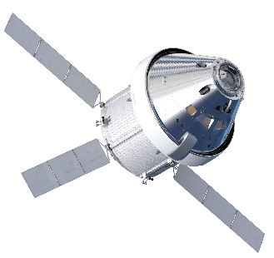

Extending Commercial Capabilities to Space Users
Commercial
Space Relay
Science Missions
Existing Market
New Market
Human Space Flight
Small Sats
Land, Sea and Air
User Terminals
Launch
Commercial Ground Stations

Slide 14

























Commercialization Approach
Move the Locus of Missions toward Commercial-Provisioned Services Over Time
Notional
NASA Networks
2020
Commercial Networks
This will be an evolution of support over time with a spectrum of solutions:
  Existing missions on the SN will remain and fly-out on the SN
  Some missions, may use a mixture of government and commercial resources in the near term
  Others may be able to readily transition to complete commercial
  Operational functions as well as provision of services; e.g. scheduling
NASA-provisioned service
Commercially-provisioned service

Slide 15



Commercialization Approach
Move the Locus of Missions toward Commercial-Provisioned Services Over Time
Notional
NASA Networks
2030
Commercial Networks
This will be an evolution of support over time with a spectrum of solutions:
  Existing missions on the SN will remain and fly-out on the SN
  Some missions, may use a mixture of government and commercial resources in the near term
  Others may be able to readily transition to complete commercial
  Operational functions as well as provision of services; e.g. scheduling
NASA-provisioned service
Commercially-provisioned service

Slide 16
Plan for Commercial Communications Services
“Divide and Conquer” approach is tailored to market capabilities and risks…
  Near-term increase in services provisioned by current commercial & partner ground sites
  Infuse new vendors drawing on vibrant and growing market
  Targeting 2023 for 100% commercial service; applies to existing and new missions
Rapid Commercialization of
Direct-to-Earth (DTE) Services
2020
2030
  NASA will no longer build/deploy Tracking and Data Relay Satellites
  Time required to gradually transition future NASA users
  New commercial capability used only for new missions; legacy missions fly out on the Space Network
Measured Transition to Commercial SATCOM Services
2020
2030
NASA-owned service capability
Commercially-provided
Notes:
Greg to present

Slide 17

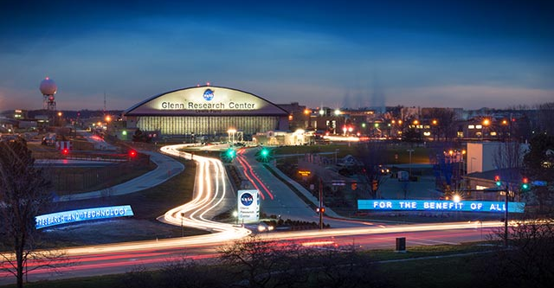

The NASA Team
Glenn Research Center
Coordinate the spectrum regulatory changes required to use commercial services
Invest in supporting technology and standards coordination
Authority for determining commercial service acquisition and operationalization
Management of Communications Services Project
Pursue space-based relay building on successful COTS approach
Execute on-orbit demos of commercial SATCOM capability
Rapidly onboard new DTE providers
Solicit new DTE providers from diverse / existing market
Divest NASA assets as appropriate

Slide 18
Contact Information:
Greg Heckler
Acting Director – SCaN Commercial Services Office
Email: gregory.w.heckler@nasa.gov

Slide 19
The Communications Services Project and Commercial SATCOM Demonstration Plans
Eli Naffah
CSP Manager, NASA Glenn Research Center,
and Tom Kacpura, CSP Deputy Manager

Slide 20


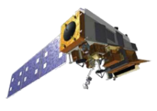
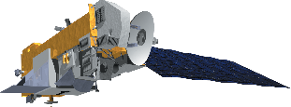
























Versatility of Space Network Capabilities
Suomi NPP
and JPSS
Aura
AIM
- Cygnus
- Soyuz
- HTV
Aqua
LandSat 8
  Launch Vehicles
  Altitude: Varies
  Latency: Real time
  Speed: 4.9 miles/second
THEMIS
ISS
HST
Atlas II
Atlas V
  Human Space Flight
  Altitude: 186.4-372.8 miles
  Inclination: 28-57˚
  Latency: Real time
  Max Speed: 4.80 miles/second
TIMED
NuStar
NeoWise
OCO 2
SWIFT
FGST - GLAST
  Heliophysics and Astrophysics Missions
  Altitude: 217.5-93,205.7 miles
  Inclination: 20-35˚
  Latency: Near Real Time
  Max Speed: 4.78 miles/second
GPM
SMAP
SORCE
LandSat 7
Hi-Altitude
Scientific Balloon
  Earth Science
  Altitude: 217.5-4971.0 miles
  Inclination: 35-99˚
  Latency: Near Real Time
  Max Speed: 4.78 miles/second
MMS Constellation
20
Notes:
Sue to present

Slide 21
Space Network User Profile
Provides scheduled, on-demand and emergency support services to users
  Scheduled services allow users to preplan service needs and reserve services in advance
  On-demand services provides flexibility; does not guarantee the resource
  Emergency support services (911) provide rapid connectivity to the spacecraft during critical times
Top users
  ISS: 88.0 service hours per day
  Fermi Gamma-ray Space Telescope (FGST): 45.71 service hours per day
  AQUA, AURA, GPM, HST, SORCE: Between 27 and 29 service hours per day

Slide 22
Communications Services Project (CSP)
The CSP, led by GRC, will have a long-term impact on the agency’s missions as well as influencing potential communications infrastructure for other government agencies
Focus on demonstrating the feasibility of commercial SATCOM providing data services to space users:
  Establish public private partnerships to leverage private investment and existing commercial satellite communications infrastructure for the development and demonstration of end-to-end capability
  Critical step to increasing confidence and ensuring services are ready for operations
Tenets:
  Technology and architecture agnostic
  Commercial end-to-end services; limited government involvement
  Robust, reliable and cost effective
  Goal to be one of many users
  Promote a diverse and growing commercial satcom industry to support NASA’s LEO to near-Earth commercialization goals
Objective: Near-term demonstration of commercial SATCOM services for space users

Slide 23
Commercial Services Capability Development and Demonstrations
Rolling wave approach of demonstrating new or expanded services over the 2020’s
Objective is to have multiple providers demonstrate services during each demo period
  The business case, user burden, performance and security are key aspects to address
  Nearer term opportunity to meet a subset of user needs with existing commercial capabilities
  As commercial capabilities are matured and demonstrated, broader set of capabilities and user needs will be met – take advantage of dynamic market capability and evolution
The Program will evaluate acquisition and operationalization of demonstrated services at each KDP
KDP for Relay Operational Status and subsequent acquisition
Begin infusing service for User Class/ Group 1
KDP
Begin infusing service for User Class/ Group 2
Solicitation Released for
Demonstrations
Preceding actions:
Draft
Industry Day
KDP
Begin infusing service for User Class / Group 3
Awards for Demonstrations
Demonstration and Validation Activities
User Class / Group 1
Demonstration and Validation Activities
User Class / Group 2
Demonstration and Validation Activities
User Class / Group 3
FY21
FY22
FY23
FY24
FY25
FY26
FY27
FY28
FY29
2030

Slide 24
Next Steps
Industry Day date to be announced
More information available at: https://www1.grc.nasa.gov/space/communications-services-program/

Slide 25
Contact Information:
Eli Naffah
CSP Manager - NASA GRC
Email: elias.t.Naffah@nasa.gov
Tom Kacpura
CSP Deputy Manager – NASA GRC
Email: thomas.kacpura@nasa.gov
Michael Pepen
CSP Lead Systems Engineer – NASA GRC
Email: michael.a.pepen@nasa.gov

Slide 26
Commercial Services Transformation at Goddard Spaceflight Center and Direct to Earth Communications
LaNetra Tate, Ph.D
Chief, Commercialization, Innovation, and Synergies (CIS) Office, NASA Goddard Space Flight Center

Slide 27


Goddard Space Flight Center and
Space Communications and Navigation (SCaN)
Since the inception of the agency, Goddard Space Flight Center has played a critical role in space communications and navigation with Mercury, Gemini, and Apollo missions.
The Exploration and Space Communications (ESC) projects division is a global leader in mission support, mission execution, and technology development.
Today, ESC is reorganizing the operations and management portion of the division to align with SCaN’s vision of commercialization.

Slide 28


Current Infrastructure – Goddard’s Networks
    Near Earth Network
      Worldwide network of over 30 commercial and NASA-owned, contractor-operated ground systems
      Provides telemetry, tracking, and command services to spacecraft at a variety of orbits within 2 million kilometers of Earth.
      NEN has used commercial providers since the early 2000’s
      Use of commercial providers to support low-Earth orbit users
      Conducting market surveys to identify potential Space Link Providers who will want to participate in the future commercialization of the Earth-proximity region.
    Space Network
    A constellation of 10 Tracking and Data Relay Satellites (TDRS) in geosynchronous orbit and associated ground stations
    The architecture enables continuous communications services
    Missions supported includes the International Space Station, Hubble Space Telescope, and much more
    Critical tracking and telemetry services to launch vehicles

Slide 29

Exploration and Space Communications Service Management
    ESC integrates communications services for missions seeking access to data obtained from space.
      Missions supported include:
          Launch vehicles
          Science missions
          Technology missions
          Human exploration missions
      Support for entire mission life cycle:
          Mission design,
          Compatibility testing
          Spectrum analysis.

Slide 30


Reorganizing Commercialization Effort at GSFC
Fostering a more robust and interoperable space communications marketplace
Direct engagement with industry to facilitate and increase the industrial base
Enhancing the collaboration between industry and government
  Industry leading
  NASA serving as a cornerstone to drive complete interoperability
  Shared opportunity for infusion on new and enabling technology to provide for a robust user experience
Path for small businesses and entrepreneurs to provide niche services and capabilities to the space communications community.
Single entry point and interface for near space missions. Mapping broad spectrum of provider capabilities with diverse and unique user needs.
Commercialization, Innovation, and Synergies Office
nasa-commercialsynergies@mail.nasa.gov
Near Space Network
Project
nasa-nearspacenetwork@mail.nasa.gov

Slide 31
What Industry Can Expect
The first initiative for evaluating the scope and breadth of this potential expansion of commercial participation seeks private sector input on the means and methods to achieve this goal for DTE RF users in the Earth Proximity regime.
Request for Information (RFI) was released in July 2020 and responses have been evaluated.
This RFI aimed to benchmark the current capabilities of private industry to provide communications and navigation data services for NASA missions in three timeframes:
  Present Capabilities – current through CY2022
  Mid-Term Capabilities: CY2023-CY2027
  Long-Term Capabilities: CY2028 – CY2032
GSFC Comm and Nav Forum
Virtual Roadshows
Virtual Roadshows
Industry Engagement Event
Jul
Aug
Sep
Oct
Nov
Dec
Jan
Feb
Mar
Apr
May
Jun
Jul
Aug
Sep
Oct
Nov
Dec
2020
2021
DTE RFI Submitted and Reviewed
SCaN
Town Hall
Lunar RFI Submissions
Reviewed
SCaN
Industry Engagement Event
SCaN
Industry Engagement Event
Notes:
RFI Capabilities:
Satellite telemetry downlink and uplink services
C-band, Ku-band,-band, S-band, L-band, Ka-band, Broadband, UHF/WHF antenna hosting
Flexibility to offer optical communications
Software centric and cloud-based computing services
Terrestrial and space-based radio frequency (satellite to ground and ground to satellite communications
Advanced Manufacturing
Machine Learning
Artificial Intelligence
Global fiber network with low latency
Power and back up power and internet connections
Scheduling

Slide 32
Contact Information:
Dr. LaNetra Tate
Chief
Commercialization, Innovation, and Synergies Office
Email: Email: lanetra.c.tate@nasa.gov
Kira Blackwell
Commercial Engagement Manager
Commercialization, Innovation, and Synergies Office
Email: kira.a.blackwell@nasa.gov
Vir Thanvi
Project Manager
Near Space Network Project
Email: vir.thanvi@nasa.gov

Slide 33
SCaN. Exploration, enabled.
www.nasa.gov/scan

Slide 34

PANEL SESSION
Bringing the Spaceflight Mission Perspective to the Commercial Communications Dialogue
Our Panelists:
Florence Tan, Chair NASA SmallSat Coordination Group
Penny Roberts, Avionics Development and Integration Office Manager, International Space Station Program Office
Jeffrey Hayes, Discipline Scientist, Heliophysics Division, Science Mission Directorate, NASA
Co-Moderators:
Al Feinberg, SCaN Content & Media Advisor
Greg Heckler, Acting Director, Commercial Services Office, NASA SCaN
Please be advised that the session is being recorded, and all participants will be muted.
We encourage attendees to use the Q&A “chat” feature to submit questions for the panelists.

Slide 35
The Science Mission Directorate’s
Suite of Science Missions.
(Operational and planned)
Jeffrey Hayes (jeffrey.hayes-1@nasa.gov)
October 29, 2020

Slide 36


Slide 37

A Day in the Life of ISS Comm
A NASA Human Space Flight Communications Use Case
Presented by
Penny Roberts, ISS Avionics Development and Integration
with inputs from the NASA HSF community.

Slide 38





Crew wakes up – View of Reid Wiseman, using Ipad, and European Space Agency (ESA) Alex Gerst, in sleep station, in the Node 2. Wiseman and Gerst are Expedition 41 Flight Engineers (FEs).
Through out the night, large files are downlinked and uplinked (e.g., imagery, data, procedures)
Recent transition to O365 challenges were numerous - example – first time activation maxed out the forward link (21 Mbps) with mail loading for the first time – User Authentication challenges resulted in transition back to ground servers
Robotic operations – MCC, CSA, JAXA
  Real time video downlink from multiple views
  Vehicle performance data downlink
  Commands uplink
  Emergency crew comm if needed – audio and caution and warning tones
Payload operations – ECOSTRESS shown being installed on JEM EF
  Wi-Fi data transfer to onboard laptop running DTN for downlink
  Protocols used on ISS: SSH, HTTPS, RDP, CFDP, DTN, UDP, SFTP
Social media – Internet access via handheld devices such as iPADs and laptop computers
Challenges – operating system transitions and security patches
Lunar observations taken by the Expedition 23 crew aboard the International Space Station (ISS). View was released via astronaut Twitter, with the following message: Moon today. Sleep well!!!
Dark view of Nick Hague, Expedition 60 Flight Engineer (FE), watching mapping program on one of the ISS laptop computers during 57S Landing.
View of Expedition 60 Flight Engineer (FE) Drew Morgan during Spheres-Zero-Robotics Run Test Session (Middle School Competition) using Expedite the Processing of Experiments to the Space Station (EXPRESS) Laptop. Photo was taken by Expedition 60 crew.
PAO events: Media, dignitaries, events like super bowl or world series, science with Schools
  live two-way audio and sometimes two way video
  scheduled and time sensitive (before the bell rings or kick-off or next show)
Notes:
Social media – Internet access via handheld devices such as iPADs and laptop computers
Challenges – operating system transitions and security patches
Robotic operations – MCC, CSA, JAXA
Real time video downlink from multiple views
Vehicle performance data downlink
Commands uplink
Emergency crew comm if needed – audio and caution and warning tones
Payload operations – ECOSTRESS shown being installed on JEM EF
Wi-Fi data transfer to onboard laptop running DTN for downlink
Protocols used on ISS: SSH, HTTPS, RDP, CFDP, DTN, UDP, SFTP
Crew wakes up – View of Reid Wiseman, using Ipad, and European Space Agency (ESA) Alex Gerst, in sleep station, in the Node 2. Wiseman and Gerst are Expedition 41 Flight Engineers (FEs).
Through out the night, large files are downlinked and uplinked (e.g., imagery, data, procedures)
Recent transition to O365 challenges were numerous - example – first time activation maxed out the forward link (21 Mbps) with mail loading for the first time – User Authentication challenges resulted in transition back to ground servers
Dark view of Nick Hague, Expedition 60 Flight Engineer (FE), watching mapping program on one of the ISS laptop computers during 57S Landing.
View of Expedition 60 Flight Engineer (FE) Drew Morgan during Spheres-Zero-Robotics Run Test Session (Middle School Competition) using Expedite the Processing of Experiments to the Space Station (EXPRESS) Laptop. Photo was taken by Expedition 60 crew.
PAO events: Media, dignitaries, events like super bowl or world series, science with Schools
live two-way audio and sometimes two way video
scheduled and time sensitive (before the bell rings or kick-off or next show)
Astronaut Ops
PAO events
Medical/family/private two-way conferences
E-mail
Procedures ups
Pysch support (internet, entertainment)
Emergency ops

Slide 39


ISS National Laboratory
Two-way audio for communications with researchers and operators on ground
Live video seen by researchers and operators on ground
Uplinked procedures and diagrams for viewing
Digital still imagery
Notes:
View of Expedition 63 Commander Chris Cassidy during Advanced Combustion via Microgravity Experiments (ACME) Igniter Change Out Operations from Combustion Integrated Rack (CIR) Combustion Chamber in the U.S. Laboratory. Photo was taken by Expedition 63 crew
View of Fluids and Combustion Facility (FCF) Combustion Integrated Rack (CIR) Micro lens camera. Photo was taken by Expedition 63 crew.
Experiment Ops:
Big data down via DTN and nominal file transfer protocols
Astronaut supported real time experiment ops - video, two-way audio, proprietary ops, data down in realtime
Secondary payloads ops on VVs

Slide 40





ISS Vehicle and Critical Operations
Nominal Ops
Constant monitoring, control, sustainment, and upgrade of the ISS hardware and software
    Readiness for rapid re-configuration for emergency events
Critical Ops
EVAs, VV proximity operations, robotic operations
  Scheduled events to ensure maximum comm coverage
  Operations Go-No Go prior to events
  Redundancy established throughout operations
  Automatic fail over & responses if LOS for pre-defined duration
  Flight rules define continuation of operations if degraded comm

Slide 41
















Global vehicle and experiment command, control, and data delivery
Real time, two-way audio and video conferencing communications with operators, researchers, public affairs, and friends and family
Support for commonly available communications protocols including delay/disruption tolerant networking
Privacy, security, and reliability
Automatic failure detection isolation and recovery for critical operations
Service provider support for mission readiness and failure recovery to support continued mission operations with redundancy and service assurance
Integrated ground test support for upgrades and troubleshooting (helpdesk)
Notes:
Maintain the quality and performance of the services provided (high FWD and RTN rates, excellent coverage, upgradable)
Simplify scheduling, make flexible, and reduce effort required to qualify user equipment to work with comm service

Slide 42
SCaN THE FUTURE
SmallSat “Telecom as a Service”
Florence Tan
Chair, NASA Small Spacecraft Coordination Group
Science Mission Directorate
NASA Headquarters
Oct 29, 2020
Notes:
Meeting:
Meeting Dates:
Meeting Location: NASA HQ (Virtual)
Meeting Website: None
PRESENTATION DETAILS:
Talk:
Presentation Title:
Attendees:

Slide 43

Commercialization of LEO is at a tipping point, much like the building of the transcontinental railways in conquering the West.
Notes:
This is a transformational time in LEO. More and more groups – industry, nations, and NASA are launching small sats into space. An era of growth in LEO akin to the conquering of the west – and transportation and communication play role. Access to space with more capable LVs providing frequent rides to NASA smallsats for applications such as astro, helio, earth applications – applications such as remote sensing, terrestrial and space weather forecast, nowcast. And we will need comm services for these smallsats …

Slide 44

MINXSS-2 ⁺
SPHEREX
PHARMASAT * ⁺
CERES
CURIE
IXPE
SPRITE
O/OREOS ⁺
ICON
REAL
Q-PACE
GENESAT * ⁺
AERO
CUPID
BURSTCUBE
NUSTAR+
LLITED
PUNCH
TESS
BLACKCAT
NEASCOUT
CIRBE
ITC
CUTE
JANUS
CUSP
AEPEX
CPOD*
PATCOOL
SPORESAT⁺
STARLING
DAILI
VISTA
ACS3
PREFIRE
PHONESAT⁺
BIOSENTINEL
IPEX⁺
TSIS-2
ALBUS⁺
ELFIN
TRACERS
GPX2
CYGNSS
HYTI
NANOSAIL-D⁺
MINI-CARB*
RADSAT-G
OCSD-A ^{*+}
SWFO-L1
GTOSAT
SUNRISE
OCSD-B/C*⁺
EDSN⁺
SHIELDS-1*
ISARA⁺
TECHEDSAT-8*
DIONE
ASTERIA*⁺
CSUNSAT-1⁺
TECHEDSAT-12
TBEX
LAICE
PETITSAT
HALOSAT
HEOMD
SPORT
TECHEDSAT-7*
JASD
MINXSS⁺
SORTIE
COURIER SEP DEMO*
EARTH SCIENCE
DELLINGR*
RAVAN ⁺
ESCAPADE
HELIOPHYSICS
TILE DEMO*
PLANETARY SCIENCE
RAINCUBE
TROPICS
ASTROPHYSICS
CSIM-FD
NACHOS
X-NAV*
BIOLOGICAL & PHYSICAL
PTD-1 HYDROS*
MC/COVE-2⁺
  STMD
CIRIS-BATC
CTIM-FD
DUPLEX*
MARCO-A/B⁺
ON-ORBIT ANOMALY
ICECUBE⁺
HARP
PTD-2 HYPER XACT*
SNOOPI
PTD-3 T-BIRD*
LUNAR ICECUBE
CLICK-A*
FUTURE MISSIONS IN BOLD
CUBERRT
PTD-4 LISA-T*
GRIFEX⁺
PARTNER-LED MISSIONS*
TEMPEST-D
LUNAR TRAILBLAZER
LUNIR
CAPSTONE
CLICK-B/C*
COMPLETED MISSIONS+
LUNAR FLASHLIGHT
MIRATA
OPERATING, PAST, & FUTURE
R2D2 X-1
SMALLSAT/CUBESAT FLEET
LUNAH-MAP
CU-E3
CHOMPTT*
October 2020
TEAM MILES
V-R3X
CISLUNAR EXPLORERS
PACE1
Notes:
This is our Small Sat Fleet Chart. We recognize Small sats as a new and transformational platform for science, exploration, and technology. We are making measurements that cannot otherwise be done without using small sats. Today, ground station availability is the primary limitation to expanded science. Some design reference missions include a new observing strategy or NOS, where we deploy a sensor web of sensors in orbit, on the ground, to acquire coordinated observations and track dynamic and spatially distributed phenomena and assimilate various data into models and analytic workflows and feeding observation requests back into the sensor web – acquitting and integrating complementary and coincident data to build a complete and in-depth picture of science phenomena. This sort of data intensive operations would require robust, highly reliable, global, persistent, high availability, high reliability, low cost, and ground data system webservices integrated capabilities in an open and secure means for PIs developing flight missions

Slide 45
Future Needs SmallSat “Telecom as a Service”
 | LEO
Uplink Data Rates | 2 Mbps
Downlink Data Rates | 300Mbps – 1 Mbps
Network | Commercial, NASA, or OGA
Radios | Interoperable, Low SWaP, highly reliable, affordable
Ground Stations | Globally available and persistent Co-located with data centers High data rates Low cost access Integrated with web services Open and secure, highly reliable Easy access, easy scheduling, encrypted, DTN Educating community on policy and access the NEN Service Low latency Inter-spacecraft, Ground station communications
Notional
Today, ground station availability is the primary limitation to expanded science
Notes:
Lack of such a service directly impacts future science as due to an inability to provide global, persistent, high availability, high reliability, low cost, and ground data system webservices integrated capabilities in an open and secure means for PIs developing flight missions. It’s one of the highest risks to mission success for SmallSats, but also one that can be mitigated relatively easily with such a service provided to the community. Once the service infrastructure is in place developers can confidently select appropriate radios compatible with the service. Ideally, it would be great if NASA paid for this capability simply leaving the radio selection/integration costs to the PI.

Slide 46


Slide 47

We Welcome Your Questions and
Thank You for Your Participation

Slide 48
SCaN. Exploration, enabled.
www.nasa.gov/scan

Slide 49
Back-up
ISS Communications and Data Architecture 2020

Slide 50


