Slide 1
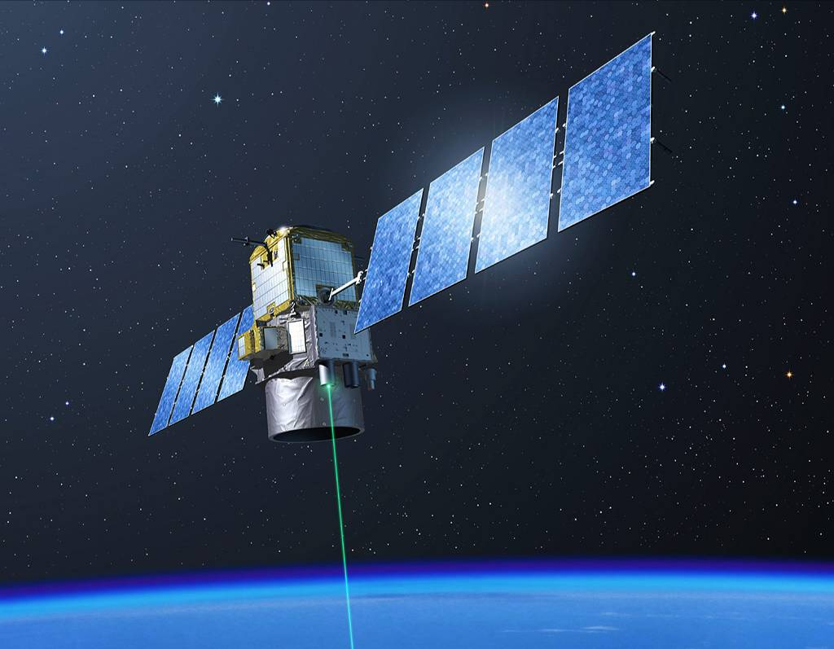
CALIPSO Spin-Off Products
Dave Winker
NASA LaRC
Hampton, Virginia
Aeolus Cal/Val/Science Workshop, 2-6 November 2020

Slide 2
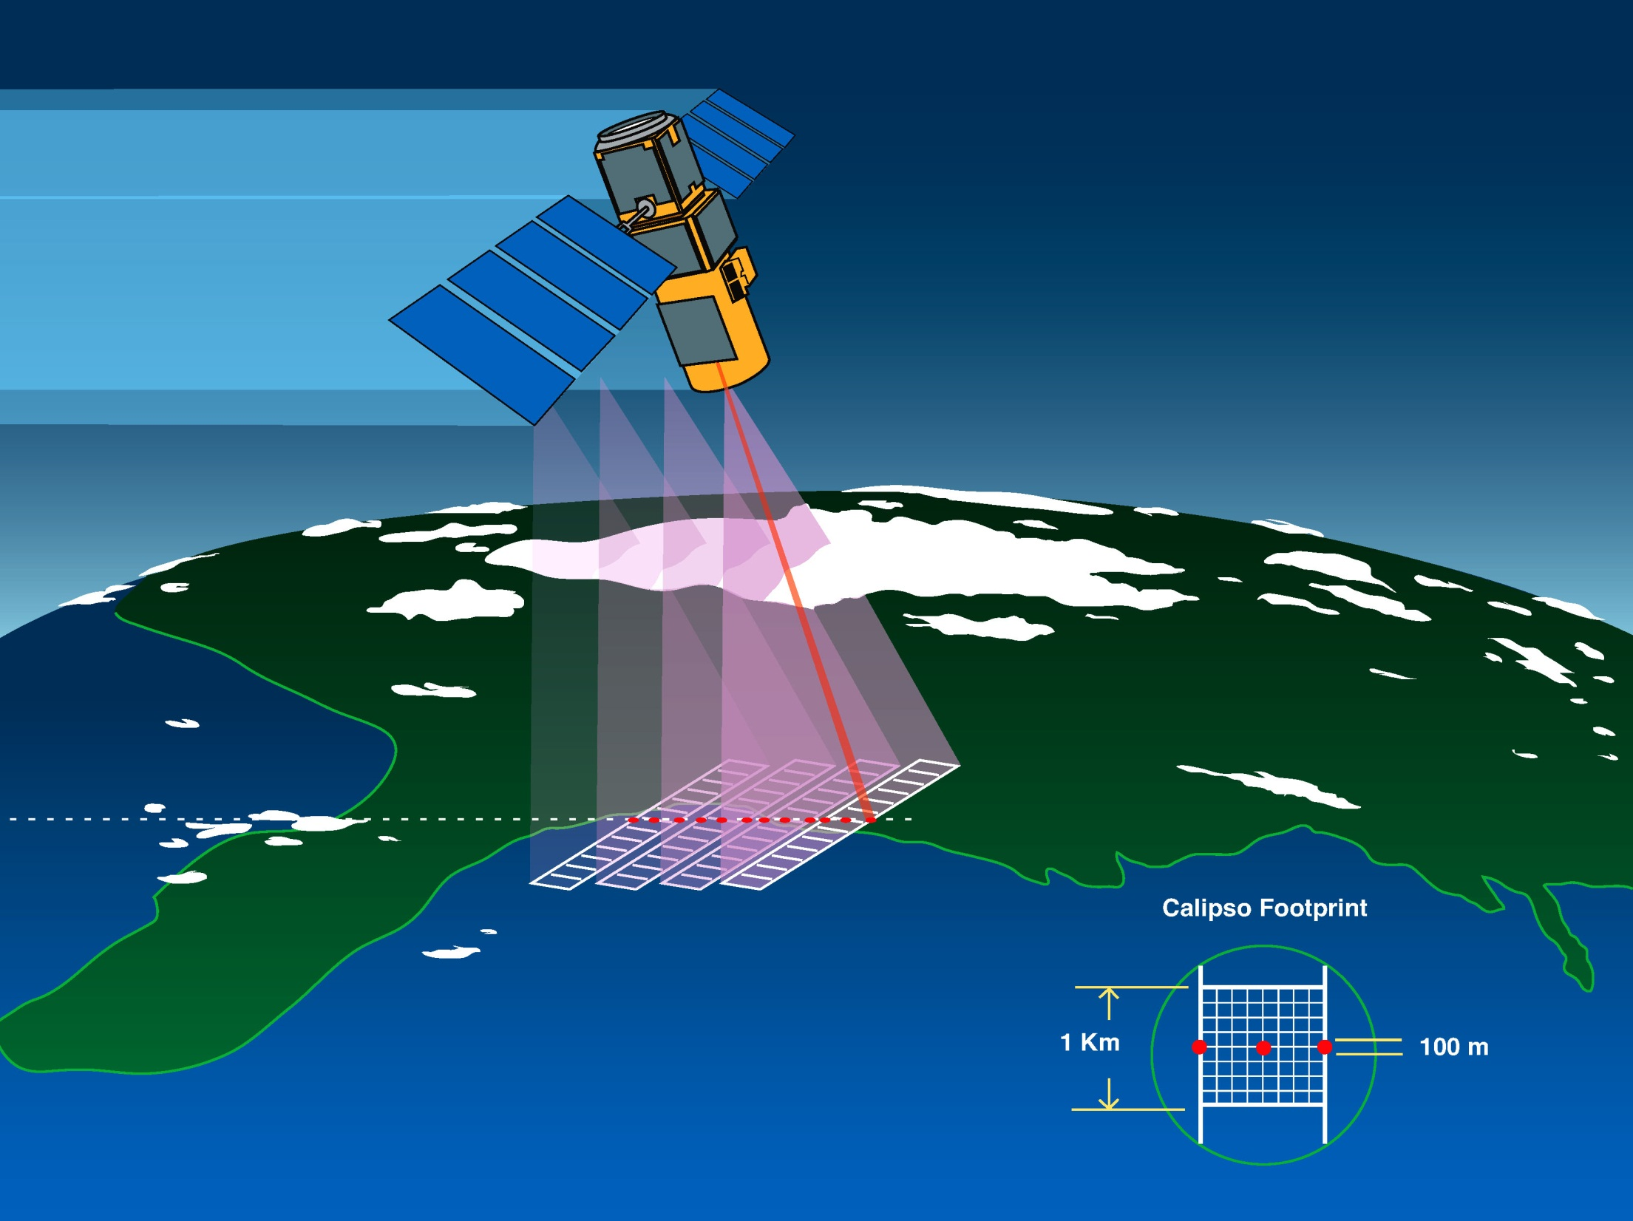
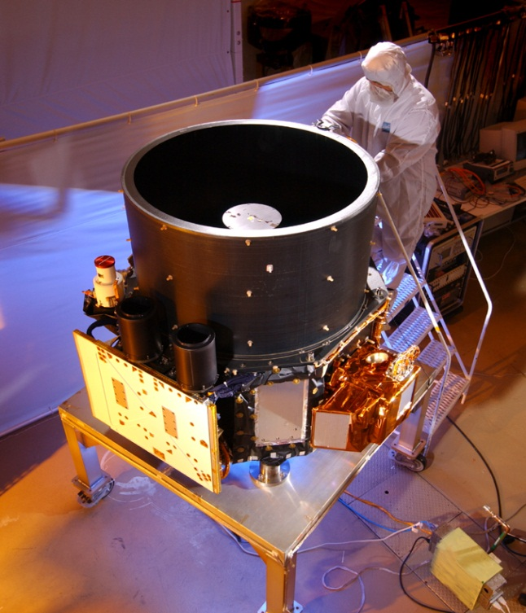
CALIPSO Satellite
First light: 7 June 2006
Three co-aligned instruments:
CALIOP: polarization lidar
  532 nm, 1064 nm
  30 m vertical resolution
  90 m footprint
Imaging IR radiometer
  8.6, 10.5, 12.0 um
  60 km swath
Wide-Field Camera
  650 nm
  60 km swath

Slide 3
CALIPSO Data Products - Overview
Official products from the CALIPSO project
  A comprehensive set of Level 2/3 cloud and aerosol products
    Aerosol/cloud mask
    Aerosol type/Cloud thermodynamic phase
    Aerosol/cloud extinction profiles
  Level 2 cloud products combining CALIOP and IIR
  Additional products made possible by performance exceeding expectations
    Stratospheric Aerosol
    Polar Stratospheric Clouds
  Products to address unforeseen applications
    Blowing snow product
Synergy products combining CALIOP with other A-train sensors
  CALIOP + CloudSat (W-band),
  CALIOP/CloudSat + CERES/MODIS
3rd party products
  PBL height product (CIMSS)
Research products
  Surface and sub-surface properties

Slide 4
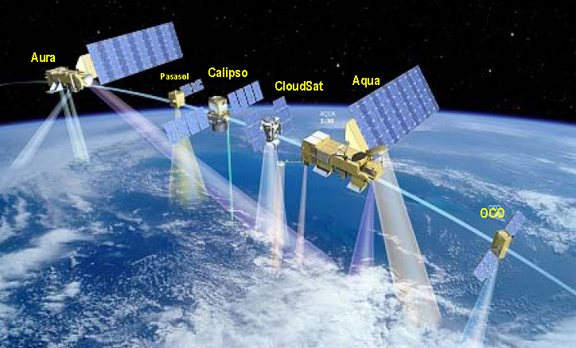
CALIPSO Synergy Products
A large number of synergy products have been produced by combining CALIOP with other A-train sensors
  CALIOP + CloudSat (W-band radar)
    GeoProf-Lidar
    dardar
    2C-ICE
    Cld-Class
    SODA
  CALIOP/CloudSat + CERES/MODIS
    C3M
    FluxHR-Lidar

Slide 5
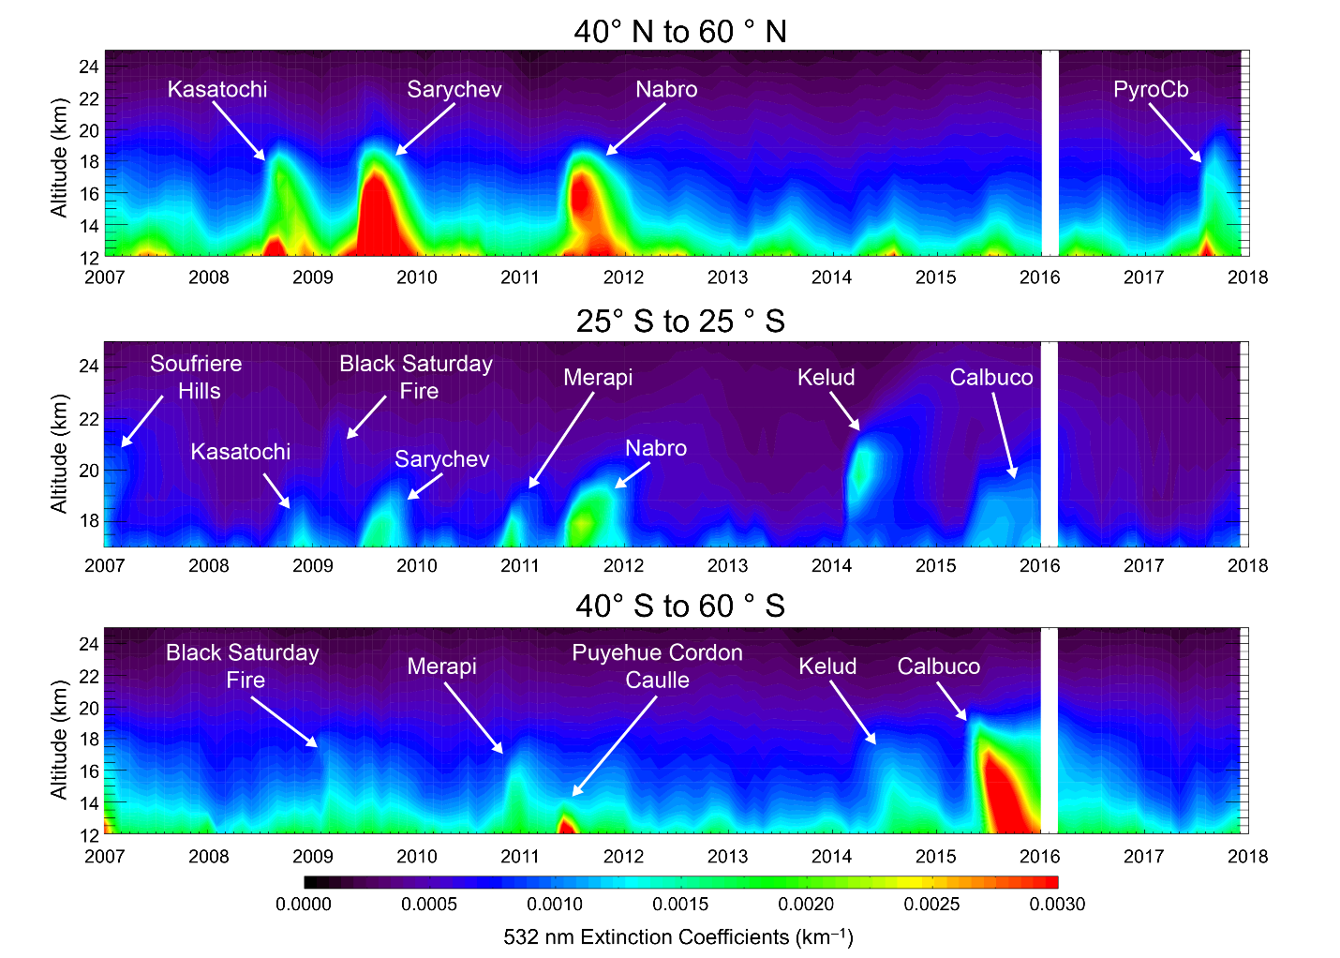
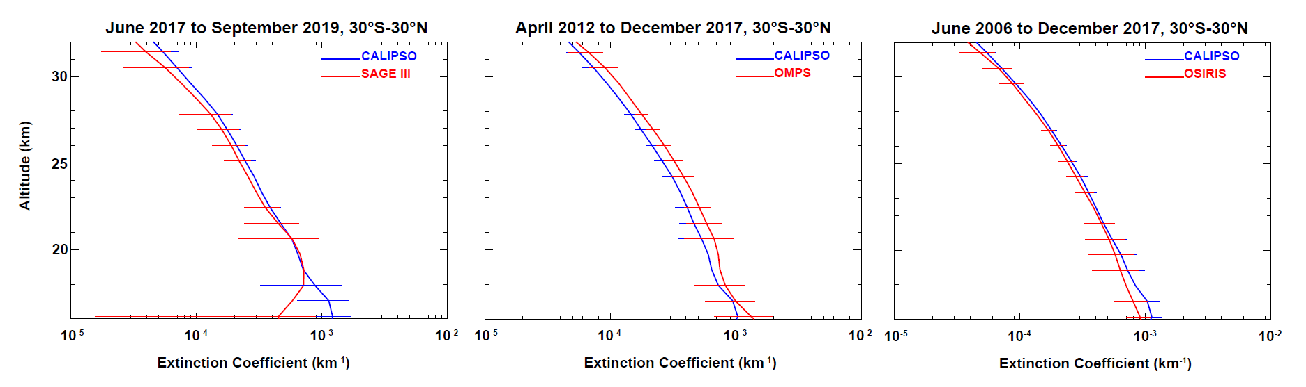
CALIOP Level 3 Stratospheric Aerosol Product
The CALIOP Level 3 stratospheric aerosol profile product reports monthly mean gridded profiles of 532 nm aerosol extinction, particulate backscatter, attenuated scattering ratio and stratospheric aerosol optical depth.
The L3 aerosol profiles are derived from CALIOP L1B nighttime cloud-filtered 532 nm attenuated backscatter profiles
CALIOP profiles are averaged on a 5° by 20° lat-long grid and over 900 m vertically, to compensate for the low SNR in the stratosphere.
Zonally averaged CALIOP extinction coefficient profiles for data acquired between 30°N and 30°S compared to data from SAGE III-ISS, OMPS, and OSIRIS (Kar et al. 2019)
Time-height cross sections of CALIOP stratospheric aerosol extinction, Jan 2007 to Dec 2017 (Kar et al., 2019)

Slide 6
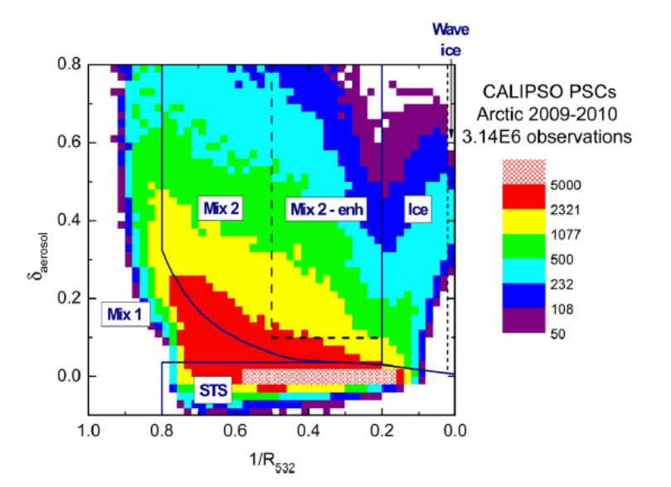
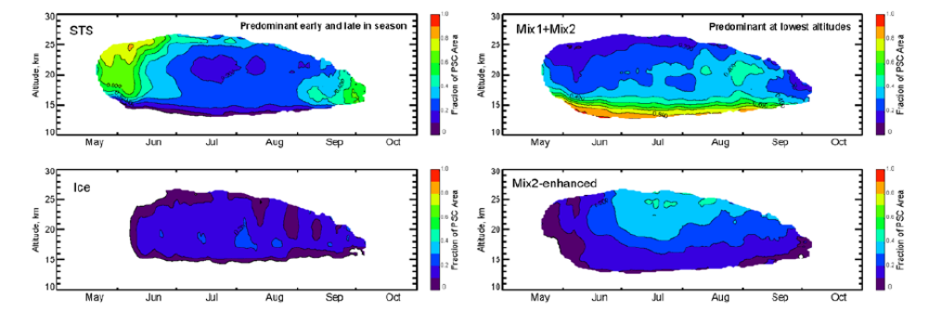
Level 2 CALIOP Polar Stratospheric Cloud (PSC) product
PSC data is derived from nighttime lidar Level 1B profiles using detection and composition classification algorithms based on scattering ratio and depolarization profiles
Spatial distribution and properties of PSC layers are reported on a 5 km horizontal by 180 m vertical grid.
2-D histogram of all CALIOP PSC observations during the 2009–2010 Arctic winter with the boundaries of the PSC composition domains and sub-classes
Evolution of Antarctic PSC area fraction partitioned by composition (2006-2014)
Top left: supercooled ternary solution (STS)
Top right: mixtures of STS with nitric acid trihydrate (NAT) particles
Bottom left: water ice; Bottom right: STS-NAT mixtures with dominated by NAT
(Pitts et al, ACP 2009, 2013)

Slide 7
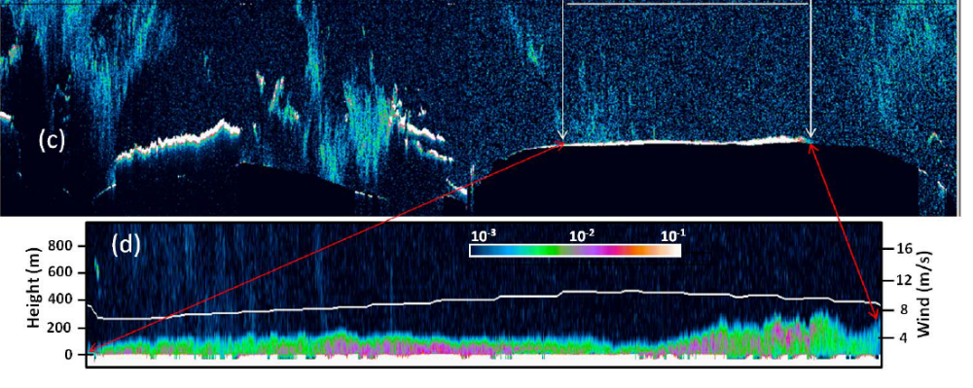
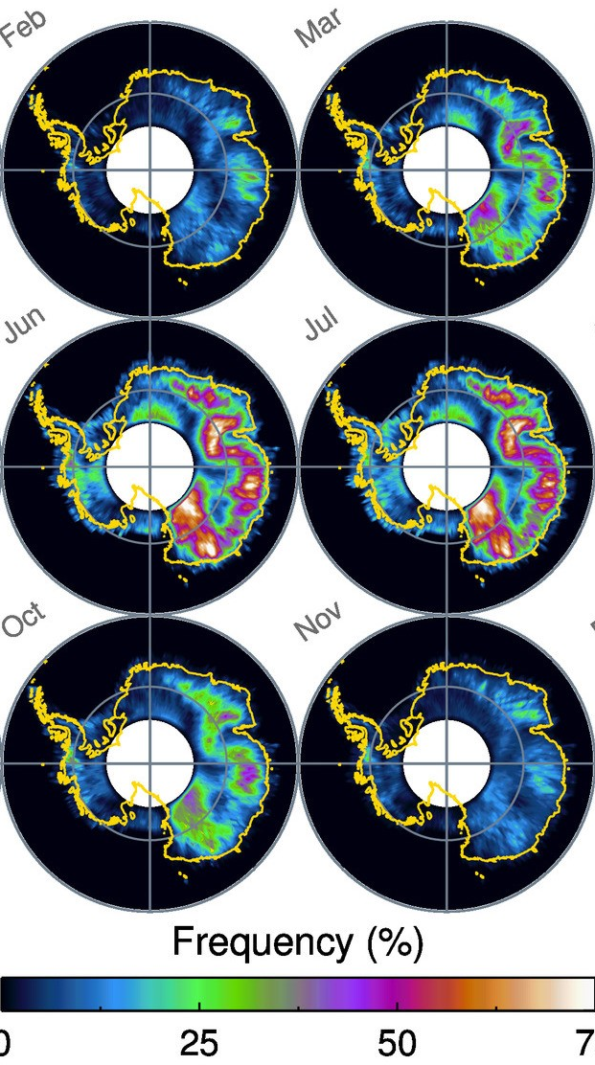
CALIOP Level 2 Blowing Snow Product
Blowing snow detected by CALIOP on 14 October 2009 over East Antarctica. (c) detected blowing snow shown as the white area between the arrows; (d) magnification of white area (Palm et al. 2011)
Confined within a few hundred meters of the surface, extensive fields of blowing snow are common near the surface of the Antarctic plateau and are a mechanism which transports significant mass from the central plateau toward the coast
The Lidar Level 2 Blowing Snow data product reports the spatial and temporal frequencies, layer heights, and optical depths of blowing snow detected over Antarctica from 2006 to the present
When combined with model re-analysis fields of temperature and moisture, the estimates of sublimation magnitudes derived from the CALIPSO blowing snow retrievals are considerably larger than model estimates
Average monthly blowing snow frequency over Antarctica, 2006-2017 (Palm et al. 2017)

Slide 8
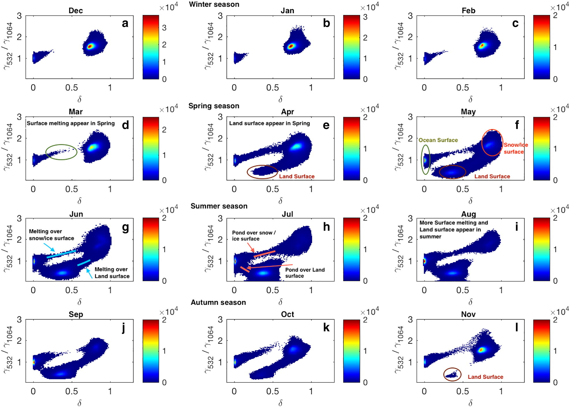
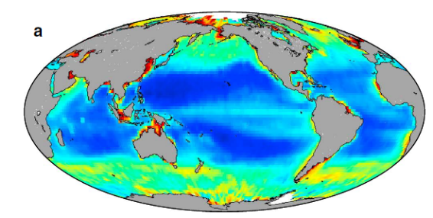
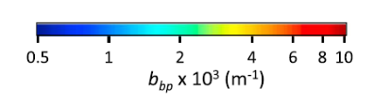
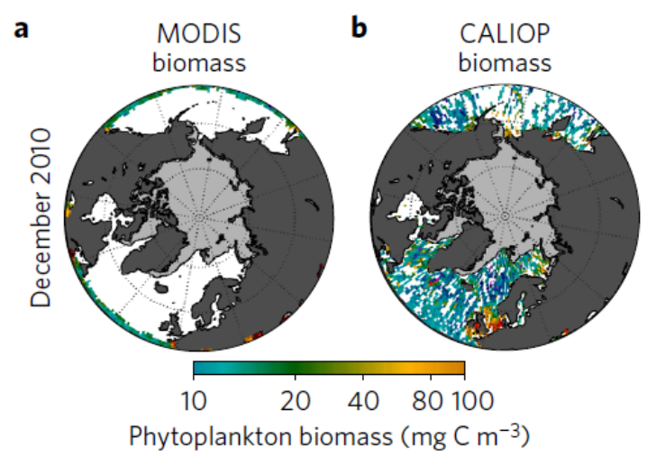
Research Products
The CALIOP sub-surface cross-polarized signal can be used to derive phytoplankton biomass
Using depolarization and color ratio of CALIOP surface returns, can identify several Arctic surface types:
open ocean
bare land
snow/ice
surface melt ponds
Can distinguish melt ponds forming on land from ponds forming on sea ice
Complementary to existing capabilities:
high spatial resolution (90 m)
insensitive to lighting conditions
Ocean particulate back-scatter from CALIOP (Behrenfeld et al 2013)
CALIOP provides high latitude phytoplankton data at low sun angles and even during polar night
Depolarization →
(Lu et al. Rem Sens Env, 2017)
(Behrenfeld et al 2017)

Slide 9
References
Behrenfeld, M. J., Y. Hu, C. A. Hostetler, G. Dall’Olmo, S. D. Rodier, J. W. Hair and C. R. Trepte, 2013: “Space-based LIDAR measurements of global ocean carbon stocks”, Geophys. Res. Lett., 40, 4355–4360, https://doi.org/10.1002/grl.50816.
Behrenfeld, M. J., Y. Hu, R. T. O’Malley, E. S. Boss, C. A. Hostetler, D. A. Siegel, J. L. Sarmiento, J. Schulien, J. W. Hair, X. Lu, S. Rodier and A. J. Scarino, 2017: “Annual boom–bust cycles of polar phytoplankton biomass revealed by space-based lidar”, Nat. Geosci., 10, 118–122, https://doi.org/10.1038/ngeo2861.
Kar, J., K.-P. Lee, M. A. Vaughan, J. L. Tackett, C. R. Trepte, D. M. Winker, P. L. Lucker and B. J. Getzewich, 2019: “CALIPSO Level 3 Stratospheric Aerosol Product: Version 1.00 Algorithm Description and Initial Assessment”, Atmos. Meas. Tech., 12, 6173–6191, https://doi.org/10.5194/amt-12-6173-2019.
Lu, X., Y. Hu, Z. Liu, S. Rodier, M. Vaughan, C. Trepte and J. Pelon, 2017: “Observations of Arctic snow and sea ice cover from CALIOP lidar measurements”, Remote Sens. Environ., 194, 248–263, https://doi.org/10.1016/j.rse.2017.03.046.
Lu, X., Hu, Y., Pelon, J., Trepte, C., Liu, K., Rodier, S., Zeng, S., Lucker, P., Verhappen, R., Wilson, J., Audouy, C., Ferrier, C., Haouchine, S., Hunt, B., Getzewich, B., 2016. Retrieval of ocean subsurface particulate backscattering coefficient from space-borne CALIOP lidar measurements. Opt. Express 24 (25):29001–29008. http://dx.doi.org/10.1364/OE.24.029001.
Palm, S., Y. Yang, J. Spinhirne, and A. Marshak, 2011 “Satellite Remote Sensing of Blowing Snow Properties over Antarctica”, J. Geophys. Res., 116, D16123, https://doi.org/10.1029/2011JD015828
Palm, S. P., V. Kayetha, Y. Yang and R. Pauly, 2017: “Blowing snow sublimation and transport over Antarctica from 11 years of CALIPSO observations”, The Cryosphere, 11, 2555–2569, https://doi.org/10.5194/tc-11-2555-2017.
Pitts, M. C., L. R. Poole, and L. W. Thomason, 2009: “CALIPSO Polar Stratospheric Cloud Observations: Second-Generation Detection Algorithm and Composition Discrimination”, Atmos. Chem. Phys, 9, 7577–7589, https://doi.org/10.5194/acp-9-7577-2009.
Pitts, M. C., L. R. Poole, A. Lambert, and L. W. Thomason, 2013: “An assessment of CALIOP polar stratospheric cloud composition classification”, Atmos. Chem. Phys., 13, 2975–2988, https://doi.org/10.5194/acp-13-2975-2013.
Pitts, M. C., L. R. Poole and R. Gonzalez, 2018: “Polar stratospheric cloud climatology based on CALIPSO spaceborne lidar measurements from 2006–2017”, Atmos. Chem. Phys., 18, 10881–10913, https://doi.org/10.5194/acp-18-10881-2018.

