Slide 1


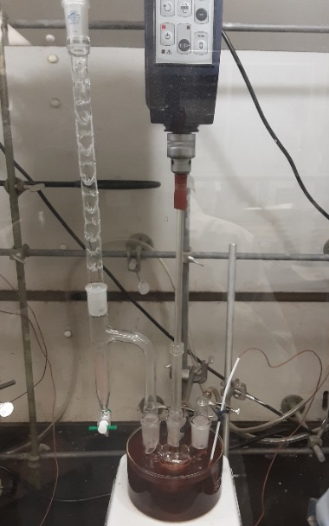
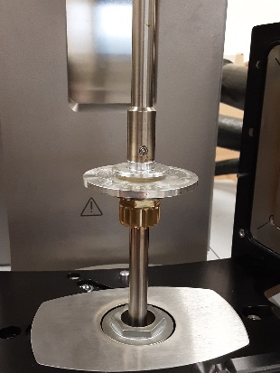
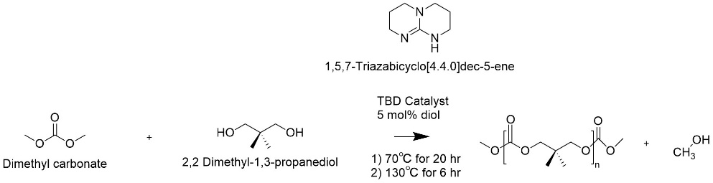
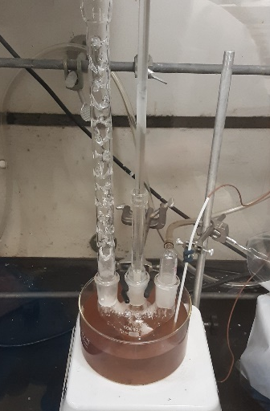
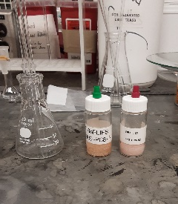
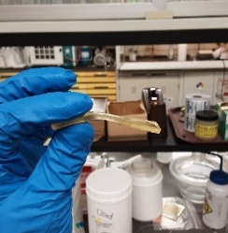
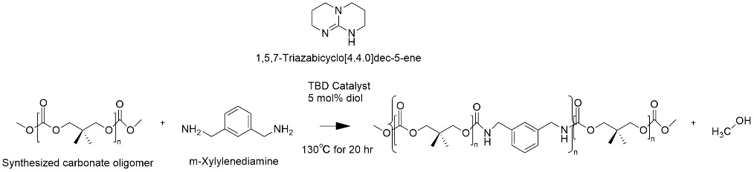
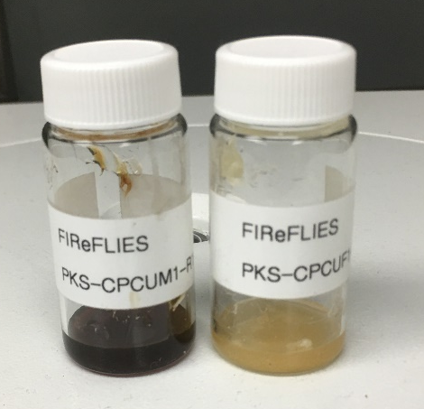
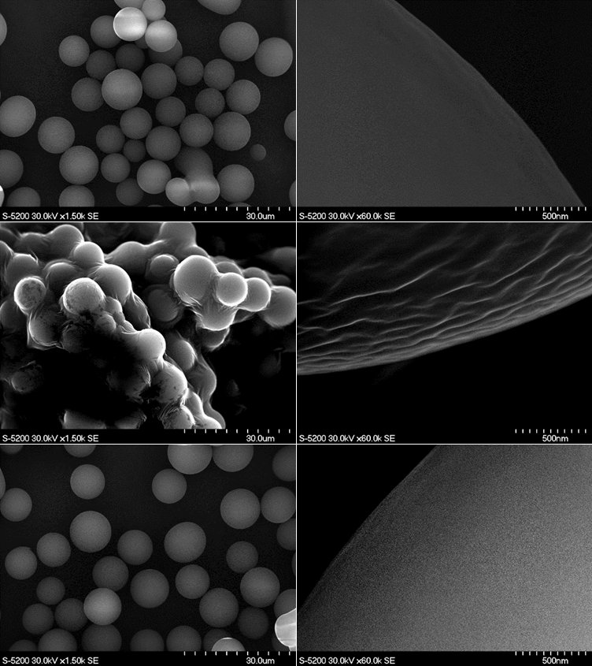
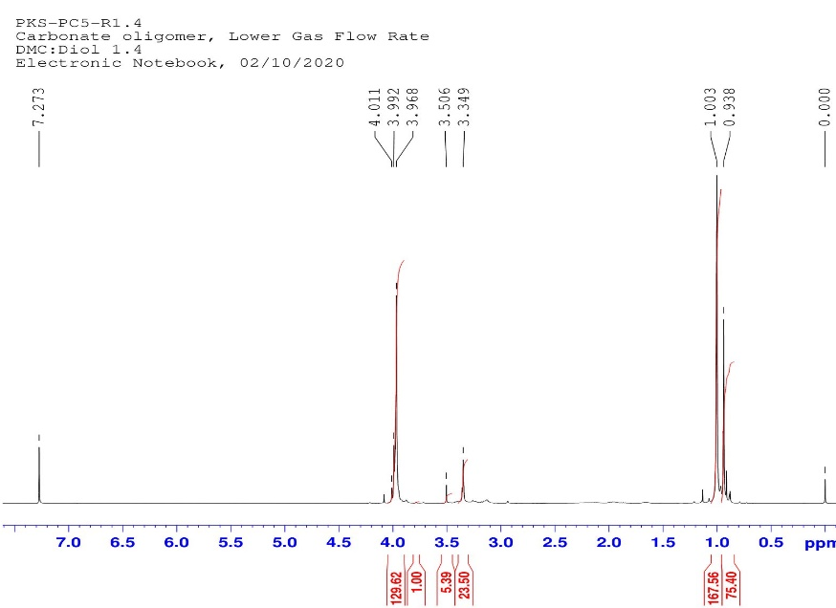
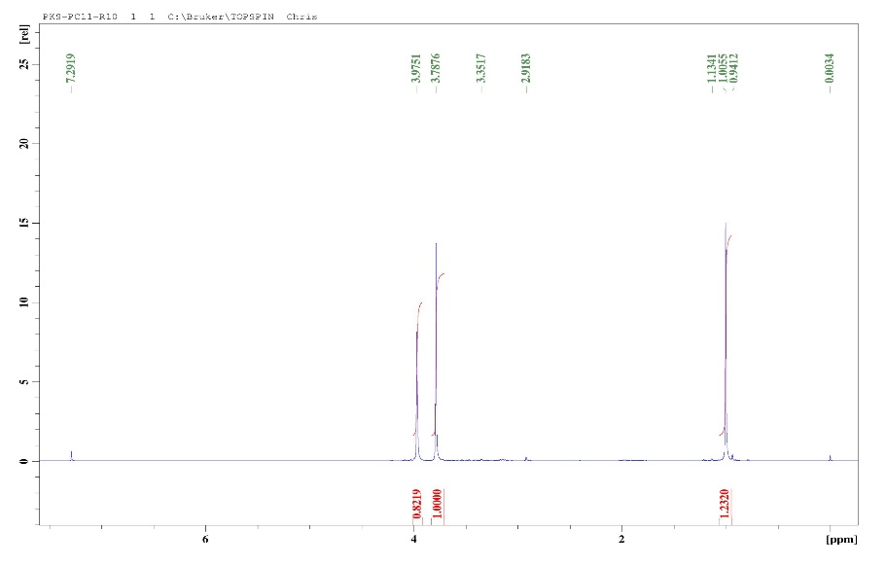
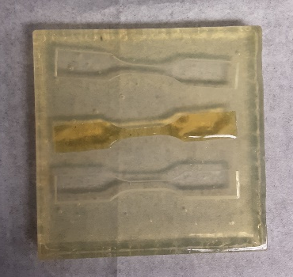
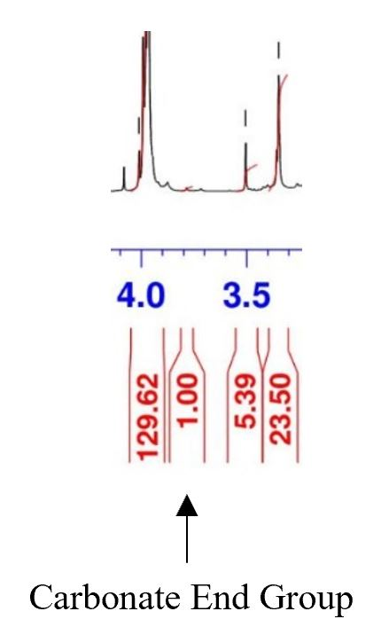
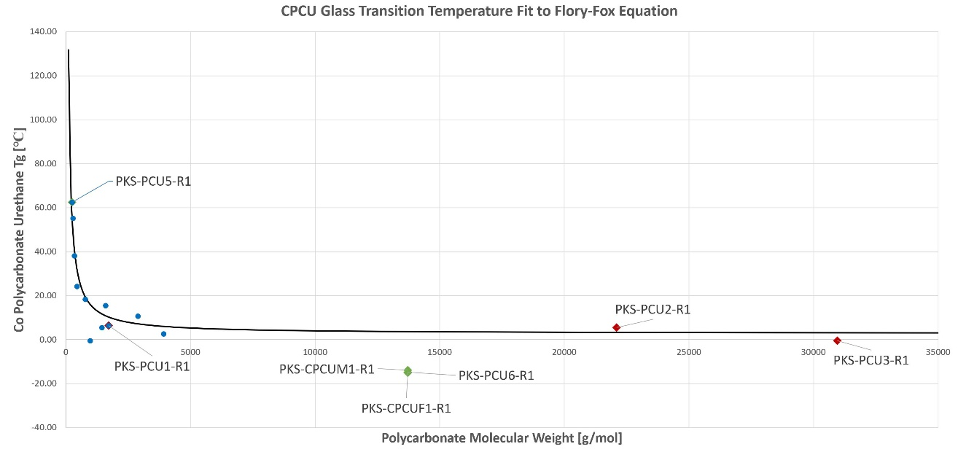
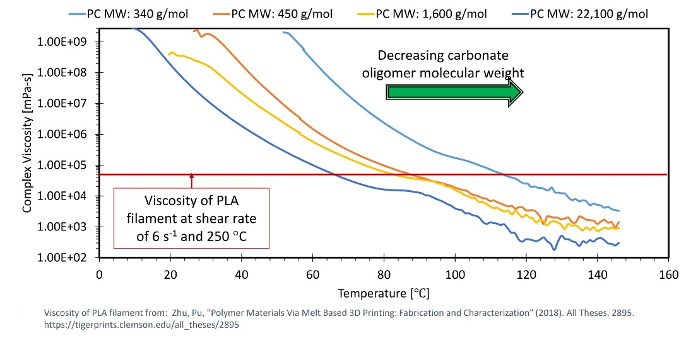
Enabling Sustained Lunar Presence Using Recyclables
Peter Strohmaier – Oregon State University and OSGC
Dr. Christopher Wohl – Advanced Materials and Processing Branch, NASA Langley Research Center
Bryce Horvath – Vehicle Analysis Branch, NASA Langley Research Center
Project Introduction
Experimental Methods
Conclusion
With continued research into deep-space missions and the increased attention toward long-endurance human presence and habitation, novel materials are needed to meet the performance requirements of future missions. Resupply launches are sent regularly to the International Space Station (ISS) to deliver necessary scientific experiments and resources. An advantage of remaining in low-earth orbit is that spare parts can be sent with resupply missions regularly. Spare parts contribute to large payload masses and are typically limited to the very specific application they are designed for.
Additive manufacturing has been researched by Marshall Space Flight Center (MSFC) to meet the evolving needs of space missions. MSFC has worked with industry partners to develop in-space 3D printing technology currently in use on the ISS. Additive manufacturing is an attractive solution because it has the potential to significantly decrease payload expenses for spare part requirements.¹ Recyclable materials present even greater advantages when used with additive manufacturing applications. A trade study conducted by Owens and de Weck evaluated the anticipated benefits to using recyclable feedstocks in conjunction with additive manufacturing.¹
At NASA Langley Research Center, Dr. Christopher J. Wohl has been working with a research team on the Enabling Sustained Lunar Presence Using Recyclables (ESPUR) project. The goal of ESPUR is to develop a polymer material with integrated click chemistry functionalities for this specific application. An experimental procedure and synthesis scheme has been devised for the manufacturing of this material. The two-component material consists of epoxy microspheres coated with a maleimide functionalized CoPoly(Carbonate Urethane) (CPCU) and epoxy microspheres coated with a furan functionalized CPCU. This material could be used as packaging material or sent in bulk form for space missions and recycled via the “click chemistry” interaction between the maleimide and furan components when heated.
The thermal, rheological (as seen in Figure 8), and spectral data collected this spring aligned well with literature and anticipated results. Initial challenges encountered with ¹H NMR spectra analysis complicated the process of determining the PC molecular weight, however this process was streamlined through literature review. Figure 9 shows examples of PC material samples.
From this research it was also found that adjusting nitrogen flow rate has a large impact on the resulting polymer. As a result of these two discoveries, the research team has refined the polymer synthesis and analysis processes. This will allow future experiments to more accurately reach desired mechanical properties by adjusting reagent ratios.
Polycarbonate (PC) Oligomer Synthesis
Figure 2: PC Experimental Setup.
Figure 8: Rheology testing of CPCU samples.
CoPoly(Carbonate Urethane) (CPCU) Synthesis
As part of introducing new transformative research practices, digital laboratory notebook tablets were used rather than traditional laboratory notebooks. This provided the opportunity for detailed photos to be directly implemented in laboratory notes.
Figure 3: CPCU Experimental Setup.
Figure 9: Polycarbonate samples.
Figure 10: Flexible CPCU material sample.
Previous Work
Two major synthesis types were conducted using various molecular ratios of reagents. The polycarbonate oligomer (PC) was synthesized via a two-step polycondensation reaction. The synthesis was conducted in a three-neck round-bottom flask while heating in an oil bath at 70℃ for 20 hours. A mechanical stir-rod stirred the mixture while nitrogen flowed through the flask to avoid interference with humidity from the air. After 20 hours, the Vigreux column was replaced with a Dean-Stark trap to catch excess dimethyl carbonate while the reaction continued for an additional 6 hours at 130℃. Figure 2 shows the PC synthesis setup.
The CPCU synthesis was conducted similarly, however the reagents used were the polycarbonate oligomer from the first synthesis and m-xylylenediamine. The reagents were heated for 20 hours at 130℃ using the same experimental setup as the previous synthesis. Figure 3 shows the CPCU synthesis experimental setup.
Future Goals/Outlook
Near Future:
Test “click chemistry” interaction with furan-maleimide functionalized CPCU coating created during spring (these material samples are shown in Figure 11)
Integrate CPCU coating with epoxy microparticles to create one material
Arrive at a PC and CPCU reagent ratio which exhibits desired properties
Distant Future:
Characterize mechanical properties of the optimized material (examples of the dogbone test specimen used for mechanical characterization are shown in Figure 12)
Conduct a large-scale synthesis of bulk material (~500 g NPG)
Send material to MSFC and potential industry partners
Polymer synthesis process realized
Polymer-coated epoxy microspheres successfully generated, scanning electron microscopy (SEM) images shown in Figure 1
Acoustic separation researched and tested
Maleic anhydride material generated
Polyureas researched for coating applications
Polycarbonate and epoxy mechanically characterized
Agile project management introduced in research practices
Results
Figure 11: Maleimide and furan functionalized CPCU.
Figure 1: Polymer-coated epoxy microspheres from past research team.
Internship Goals
Figure 12: CPCU dogbone test specimen.
Figure 4: Low reagent ratio (1.4:1) ¹H NMR spectra with ether formation.
Figure 5: High reagent ratio (10:1) ¹H NMR spectra.
Acknowledgements
There were multiple goals that were outlined which needed to be reached to arrive at the end material. Several of these were researched concurrently as they were separate components of the final product.
The first goal during this internship session was to develop a coating material with properties favorable for 3D printer filament extrusion.
The second area of research was integrating maleimide and furan functionalization with the CPCU coating to demonstrate “click chemistry” with this material.
The third goal was to perform medium and eventually a large-scale synthesis to create a bulk sample of this material. This task demonstrates the ability for larger scale production and would provide stock material to supply research partners with.
For the syntheses conducted, it was necessary to characterize the material using analytical chemistry methods. These included characterizing the thermal, rheological, spectral, and mechanical properties.
Finally, the research team worked to incorporate new transformative research practices into standard laboratory practice.
An interesting phenomenon was observed throughout the research process when determining polycarbonate molecular weight. At reagent ratios of dimethyl carbonate (DMC):neopentyl glycol (NPG) below 3:1, ether groups began forming near 3.3-3.5 ppm. The carbonate peak which was needed for analysis became increasingly small and was therefore mistaken for the ether peak in several initial experiments. The carbonate peak is near 3.75-3.8 ppm. Figure 4 shows an example of how subtle the carbonate peak is at this low reagent ratio (1.4:1). The second spectra shown in Figure 5 demonstrates the difference at a high (10:1) reagent ratio.
The following syntheses were conducted during the spring: 11 PC, 6 CPCU, 1 furan functionalized CPCU, and 1 maleimide functionalized CPCU. Figure 6 shows the theoretical and actual glass transition temperatures. As well as synthesizing new material samples, some past samples were analyzed. Figure 7 shows rheological data collected for four CPCU samples with low to high molecular weight PC materials used as reagents. The results show promising viscosity characteristics with comparable performance to Polylactic Acid (PLA).
Dr. Nancy Squires
Oregon Space Grant Consortium
AMPB Research Staff and Interns
Dr. Joseph G. Smith
Dr. Keith L. Gordon
Dr. Frank L. Palmieri
Dr. Scott Zavada
Crystal Chamberlain
Dr. Lopamudra Das
NASA Langley Internships Team
References
Figure 6: CPCU glass transition temperature data.
¹A. C. Owens and O. L. de Weck, “Systems Analysis of In-Space Manufacturing Applications for the International Space Station and the Evolvable Mars Campaign,” AIAA Space 2016, 2016.
S. Eichelberger, N. Junaid, B. Horvath, S. Applin, and C. Wohl, “Novel poly(carbonate urethane) materials for additive manufacturing in space,” tech., 2019.
J. Sun and D. Kuckling, “Synthesis of high-molecular-weight aliphatic polycarbonates by organo-catalysis,” The Royal Society of Chemistry, vol. 7, no. 8, pp. 1642–1649, Jan. 2016.
“IRAD FY20 Midterm Review: Reversibly Assembling Materials Systems for In-Space Production.” 08-Apr-2020.
Figure 7: CPCU coating rheology data.

