Slide 1
Charles River Watershed
Water Resources
Assessing Flooding Vulnerability to Assist High Water Intervention and Urban Planning Programs in the Charles River Watershed
Trista Brophy, Willow Coleman, Anna Garik, Will Peters
Massachusetts – Boston
Notes:
For the Fall 2020 NASA DEVELOP term at the Massachusetts Node, the team worked on a water resources project in the Charles River watershed. This project aimed to assess flood vulnerability and flood susceptibility within the Charles River watershed and the Town of Natick, Massachusetts to support urban planning programs and assist with high water intervention.

Slide 2
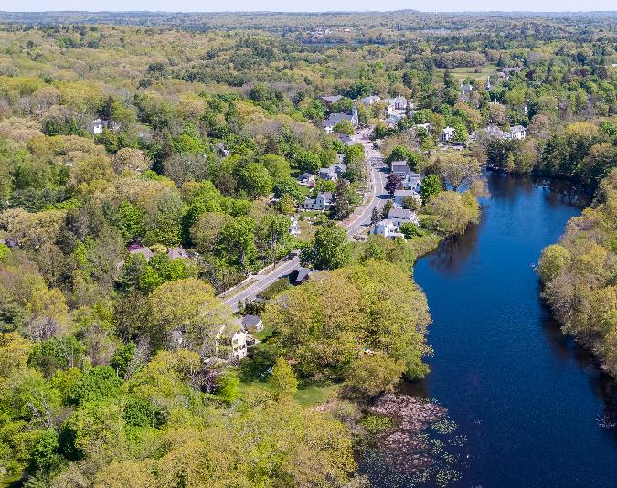
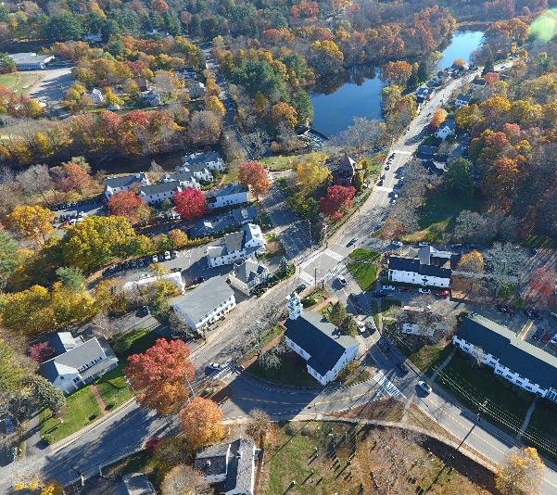
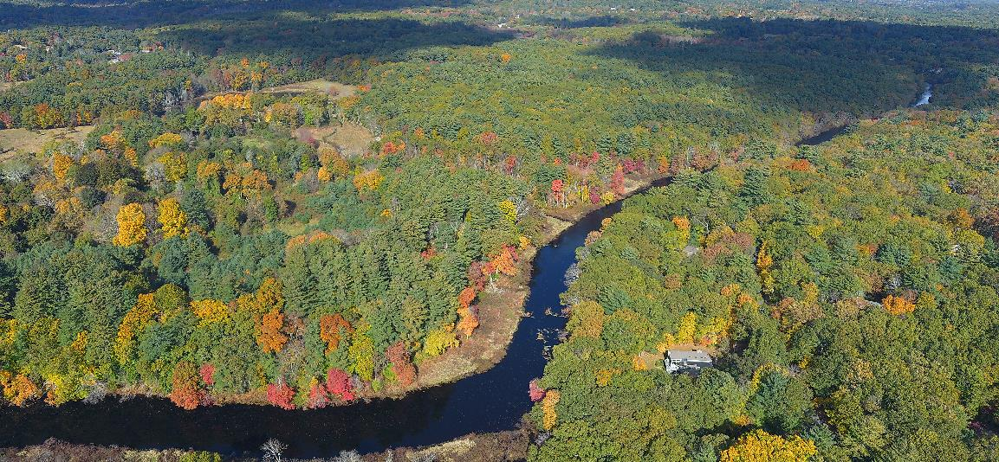
Partners
Charles River Watershed Association
The Town of Natick’s Office of Sustainability
Massachusetts Audubon Society
Image credit: Natick GIS
Notes:
The Charles River Watershed Association (CRWA) and Town of Natick were looking to assess their flood susceptibility and vulnerability, and The Massachusetts Audubon Society (Mass Audubon) was interested in assessing flood vulnerability for the lands they manage.
All partners were in the process of creating preparedness plans for future flooding events, especially in the most vulnerable areas. The partners were primarily using FEMA flood maps and GIS data in their decision making, vulnerability assessments, and climate preparations. However, all partner organizations were interested in incorporating cost-effective remotely-sensed data into decision-making processes and management.
------------------------------Image Information Below ------------------------------
•Image Credits: Natick GIS (permission)
•Image Source: Town of Natick, MA
Creative Commons Attribution-Share Alike 3.0 Unported License

Slide 3
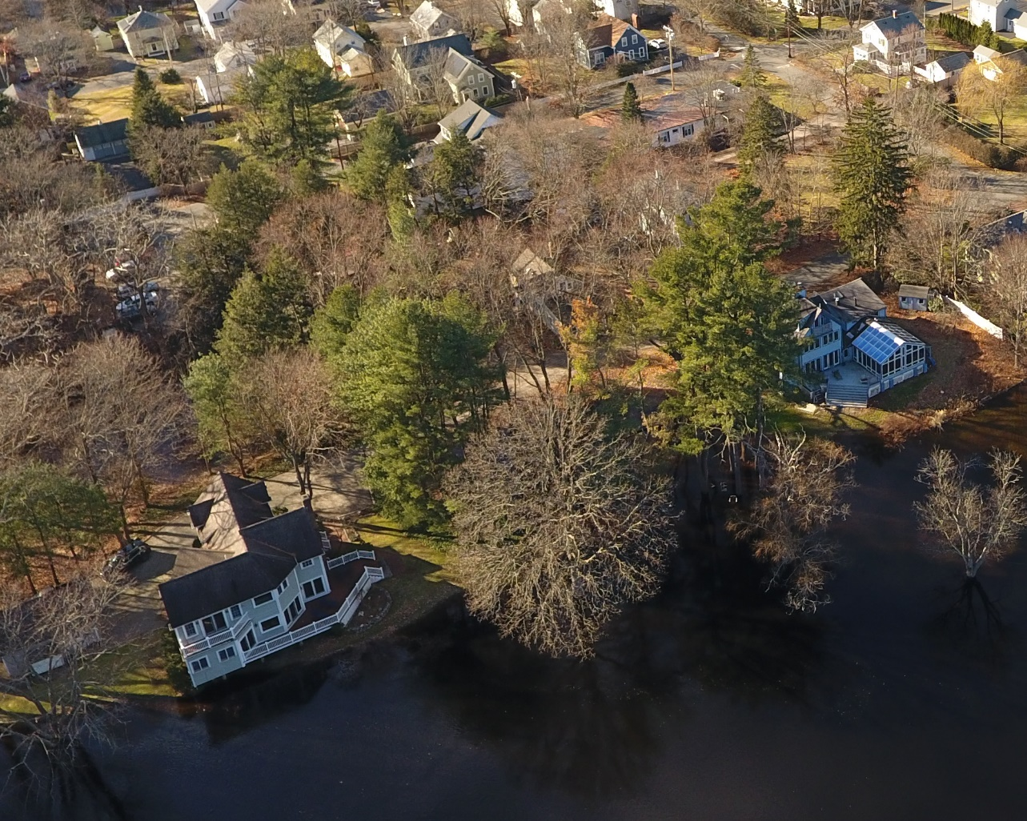

Community Concerns
Image credit: Natick GIS
Image credit: Roy Luck
Flooding
Surface runoff
Vulnerability
Notes:
As temperatures rise in New England, a rise in the frequency and intensity of precipitation is predicted, leading to more flood events. At the same time, population and economic growth are likely to increase the pressure to develop land in the region. New development increases not only the amount of infrastructure at risk, but also the fraction of impervious surface, which increases runoff that impacts rivers, streams, and stormwater systems.
Municipal representatives in the Charles River watershed have identified flooding as one of the most threatening environmental hazards in their communities.
Flooding and surface runoff have been increasingly impacting communities in the Charles River watershed, likely due to increased urban development and extreme precipitation events.
Local governments in the watershed are interested in incorporating remote sensing data to better address their communities’ risk from climate change impacts, especially flood vulnerability and susceptibility.
------------------------------Image Information Below ------------------------------
•Image Credits: Natick GIS (permission)
•Image Source: Town of Natick, MA
Creative Commons Attribution-Share Alike 3.0 Unported License
•Image Credits: Roy Luck
•Image Source: https://www.flickr.com/photos/21550937@N03/44090514642
Creative Commons Attribution-Generic 2.0 License (https://creativecommons.org/licenses/by/2.0/)

Slide 4
Objectives
Map impervious surfaces and population density to show potential for watershed degradation
Assess flood vulnerability and flood susceptibility across the watershed
Create an ArcGIS StoryMap for scientific communication and outreach
Notes:
The 3 main objectives of this DEVELOP term were to:
Map impervious surfaces and runoff degradation in the watershed
This will provide local policymakers and municipalities with information to help prepare for future flood events
Assess flood vulnerability and susceptibility across the watershed
This aid in identifying communities and areas of the watershed that are particularly vulnerable to flood events
Increases in flooding and severe rainfall events often disproportionately impact low-income and minority communities and may require additional community engagement to prepare for these events
Create an ArcGIS StoryMap for scientific communication and outreach
The StoryMap will improve dissemination of information of flood events, flood susceptibility, and flood vulnerability in the Charles River watershed
This will serve as an outreach tool to ensure that all communities have access to the understanding that they need for future flood events
------------------------------Image Information Below ------------------------------
•Image Credits: Powerpoint Template Icon
•Image Source: PowerPoint (Office 2020) [Computer Software]. Redmond, WA: Microsoft

Slide 5
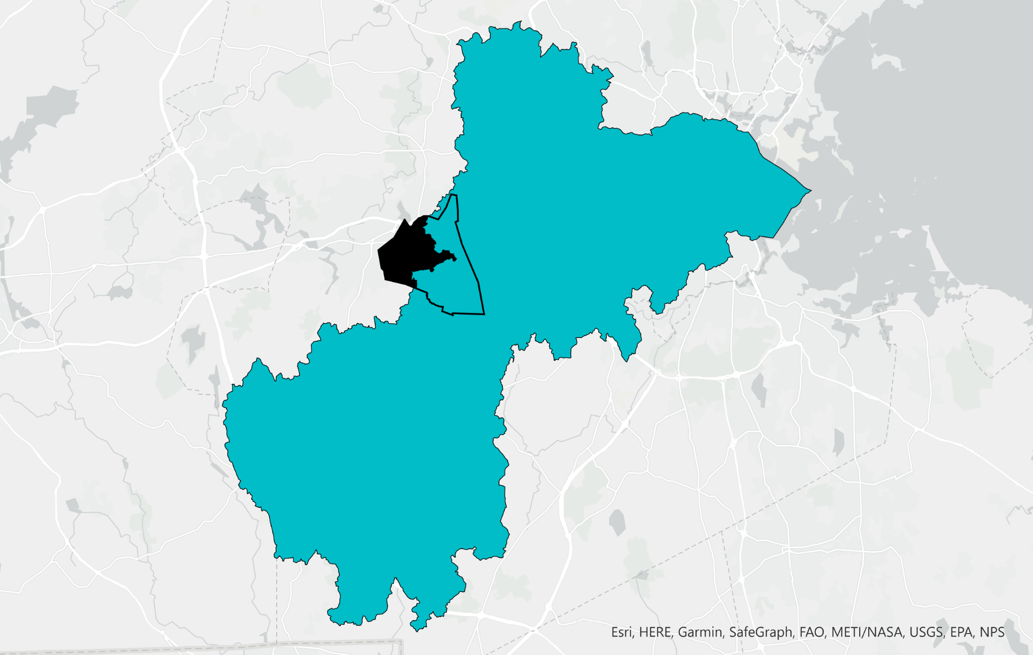
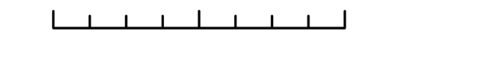
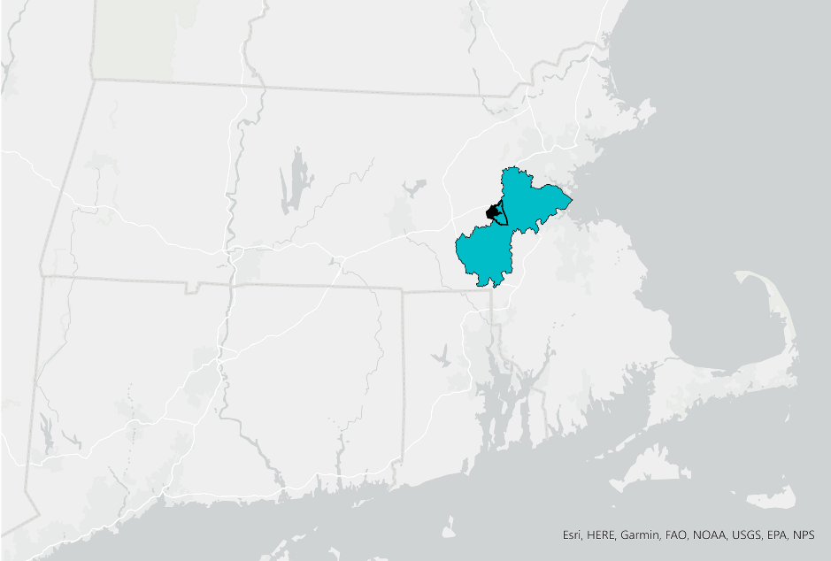
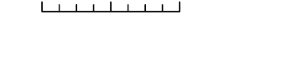

Study Area
0
4
8
16
km
Charles River watershed (CRW)
Boston
Town of Natick
Town of Natick outside of CRW
0
30
60
km
MA
CT
RI
Notes:
The study area included the Charles River watershed, highlighted in blue, and the Town of Natick, outlined in black. The Charles River begins in Hopkinton, Massachusetts and runs 182 km before emptying into the Boston Harbor, intersecting municipalities that were home to 1.2 million people in 2017. The Charles River watershed drains 778 km² and consists of 50% urban landcover, 41% forest and wetland, and 3% water. High streamflow events (flood events), do occur in the watershed, mainly due to seasonally high precipitation caused by coastal storms, seasonally high soil moisture, and antecedent streamflow due to snowmelt.

Slide 6
Methods: Impervious Surface Maps
Mass GIS data portal
Ancillary data set
Calculation step
Final deliverable
2016 1m land cover
2010 Census data
Impervious fraction per census tract
Population density per census tract
Map of impervious surface in watershed
Bivariate map of impervious fraction and population density
Notes:
The team downloaded 2010 census population data aggregated to the census block group level and a 1 m land cover/land use map from the MassGIS web portal. The Census data was used to calculate population density per census block group by dividing the total population by the area of the census block group in acres in ArcGIS. Impervious surface fraction was calculated by summing the number of impervious pixels and dividing by the total number of pixels in a census block group using Google Earth Engine.
Given that we now had population density and impervious surface fraction per census block group, we were able to create a bivariate map using bivariate symbology in ArcGIS, which enabled us to visualize which census block groups had both high impervious surface fraction and high population density.

Slide 7
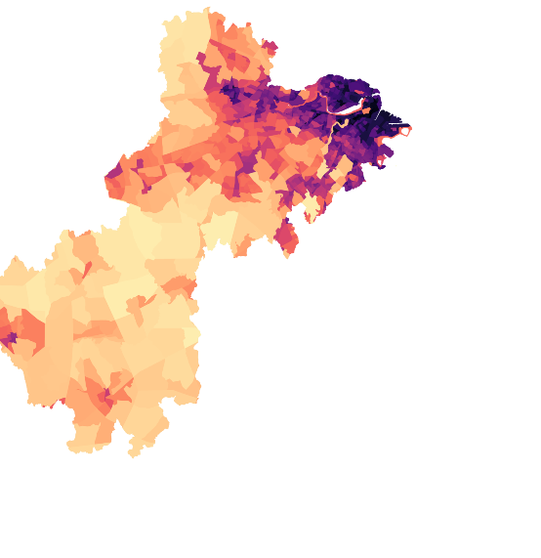
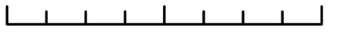
Results: Impervious Surface Fraction
0
4
8
16
km
High impervious surface fraction
Increased potential for surface runoff
Flooding can occur
100%
Impervious surface
0%
Notes:
The team calculated the impervious surface fraction per census block group across the Charles River watershed and Natick using the 1 m land cover map provided by MassGIS. We found that the impervious surface fraction per census block group is highest in the upper Charles River watershed near downtown Boston, while impervious surface fraction is lower in the rural and suburban middle and lower Charles River watershed. These findings are relevant to the map of watershed degradation because high impervious surface fraction increases the potential for surface runoff and flooding.
Census block groups with an impervious surface fraction of greater than 10% are likely to experience some form of watershed degradation or modification due to surface runoff.

Slide 8
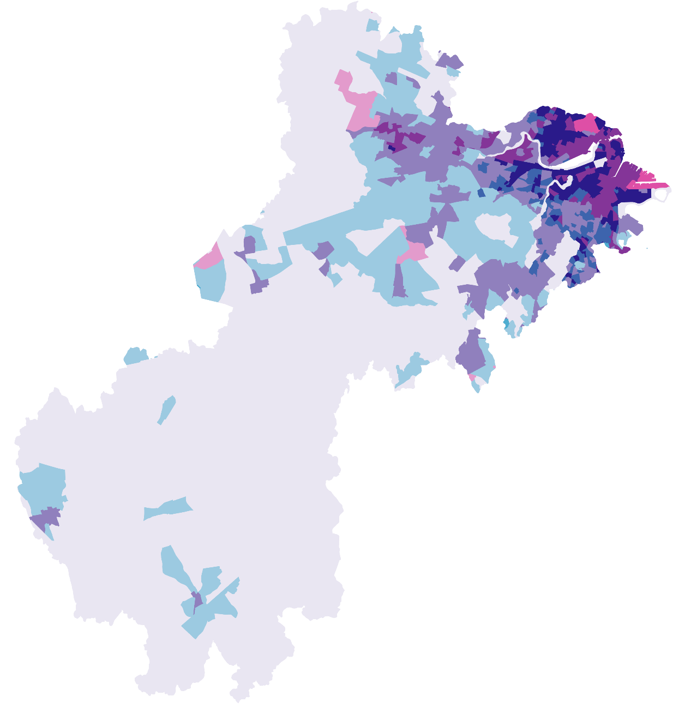
Results: Watershed Degradation Potential
0
4
8
16
km
High
Impervious fraction
Low
High
Population density
High population density + high impervious surface fraction =
Potential for severe watershed degradation
Notes:
The team developed a bivariate map of population density and impervious surface fraction to map the potential for watershed degradation in the Charles River watershed. Areas with both high population density and high impervious surface fraction are most likely to experience severe watershed degradation, following the rules of the NOAA ISAT tool.
While much of the middle and lower Charles River watershed has both low impervious fraction and low population density, parts of the upper watershed near Boston have moderate to high impervious surface fraction and moderate to high population density, suggesting that there could be watershed degradation occurring in these locations.

Slide 9
Methods: Vulnerability & Susceptibility Maps
Vulnerability & Susceptibility Maps
Database of flood conditioning factors
FEMA flood hazard layer
Classify flood susceptibility and vulnerability due to flood factors
Flood inventory map
Flood susceptibility map
Ancillary data set
Flood vulnerability map
2010 Census data
Calculation step
Final deliverable
Notes:
NOAA's storm events database was used to search for satellite imagery of flood events within the Charles River Watershed over the study period. Because sufficient satellite data was not available, FEMA flood maps were used as a proxy. NOAA's Coastal Digital Elevation Model provided data from which several flood conditioning factors were calculated. Data from the USDA's Gridded Soil Survey Geographic (gSSURGO) database was used as a proxy for soil filtration. Landcover data was taken from MassGIS's 1m landcover map.

Slide 10
Flood Susceptibility & Vulnerability Maps
Socioeconomic and/or environmental factors
Flood
susceptibility
Flood
vulnerability
Notes:
Flood susceptibility is the likelihood of a dangerous event occurring in an area on the basis of local terrain conditions (Santangelo et al., 2011).
Flood vulnerability is a measure of the sensitivity of individuals, groups, or communities to their flood susceptibility (IPSS, 2007), and so layers the flood susceptibility map with socioeconomic data.

Slide 11
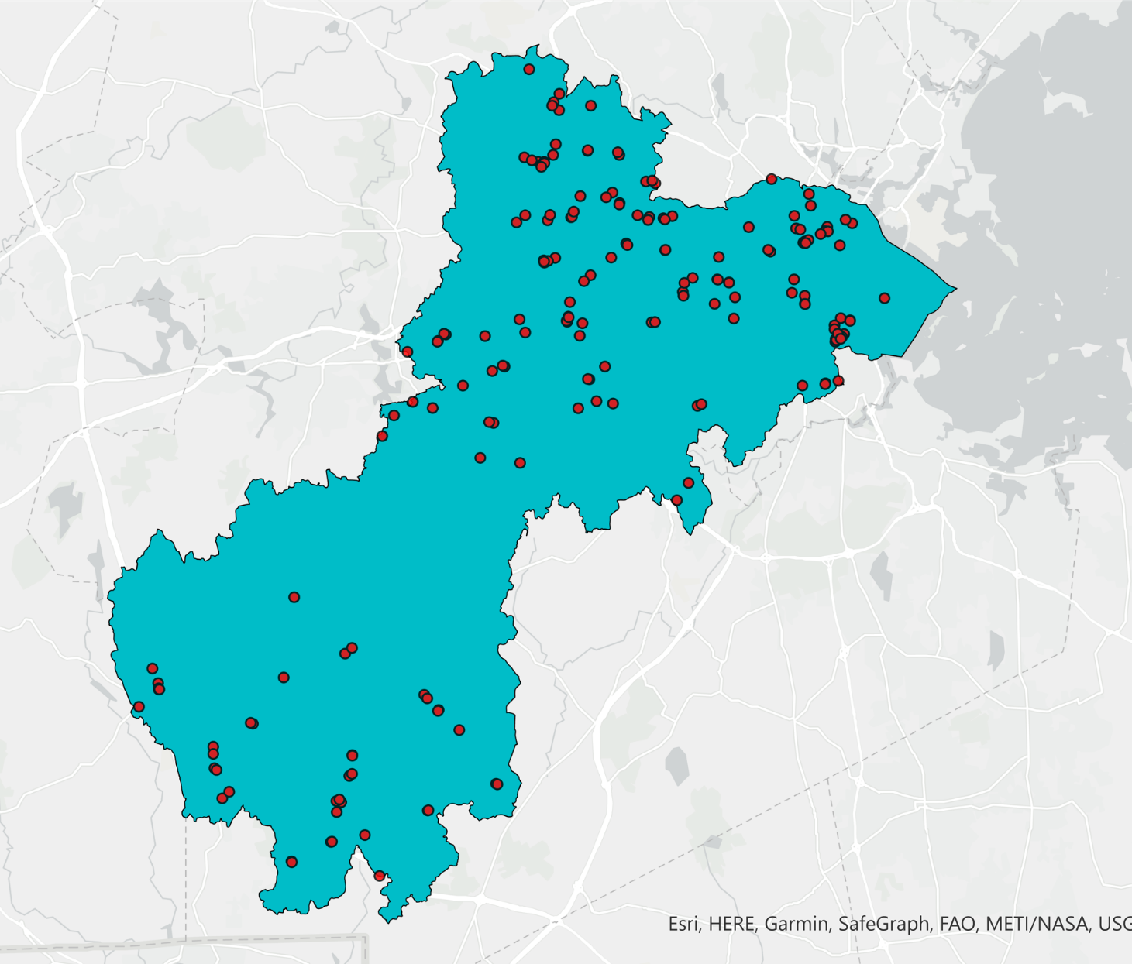


Susceptibility Mapping:
Where is flooding occurring?
0
4
8
16
km
Boston
57 flood events reported to NOAA from 2000 to 2020
Charles River watershed
Reported flood events
Notes:
To create a flood susceptibility map, the first step is to create a flood inventory map, which shows where flooding occurs within the study area. To create a flood inventory map, the team found 57 flood events on NOAA's storm database within the study period (January 2000-September 2020). The team then searched for satellite imagery for each of the dates plus a buffer period of 4 days before and after the event. No usable satellite imagery was found due to date misalignment, inadequate resolutions, and weather conditions such as cloud cover and snow.
----------------------Image Information Below ------------------------------
Image Credit: Powerpoint Template Icon
Image Source: PowerPoint (Office 2020) [Computer Software]. Redmond, WA: Microsoft

Slide 12
Flood Susceptibility Mapping:
What is a Flood Conditioning Factor?
Land cover
Physical factors that influence the likelihood of flooding
Flood
conditioning factors
Geology
Topography
Notes:
The team identified flood conditioning factors for the study area based on past literature and data availability. These are physical factors that influence the likelihood of flooding, including land cover makeup, geology and topography. For this study, we've identified factors at the watershed level, but they could be defined even more specifically for smaller areas of interest.

Slide 13




Susceptibility Mapping:
Earth Observations
Landsat 5 TM
2006 – 2012
30 m resolution
Landsat 8 OLI
2014 – 2020
30 m resolution
Sentinel-1 C-band SAR
2015 – 2020
10 m resolution
Sentinel-2 MSI
2015 – 2020
10 m resolution
Image credit: NASA & ESA
Notes:
The team began this project to determine the feasibility of earth observations for predicting flood frequency. The team searched for satellite imagery for each of the known flood dates, as reported in the NOAA Storm Events Database, plus a buffer period of 4 days before and after the event. No usable satellite imagery was found due to date misalignment, inadequate resolutions, and weather conditions such as cloud cover and snow.
------------------------------Image Information Below ------------------------------
•Image Credit: NASA Images
•Image Source: https://www.nasa.gov/multimedia/imagegallery/index.html
•Image Credit: ESA (European Space Agency)
•Image Source: https://www.esa.int/ESA_Multimedia/Images

Slide 14
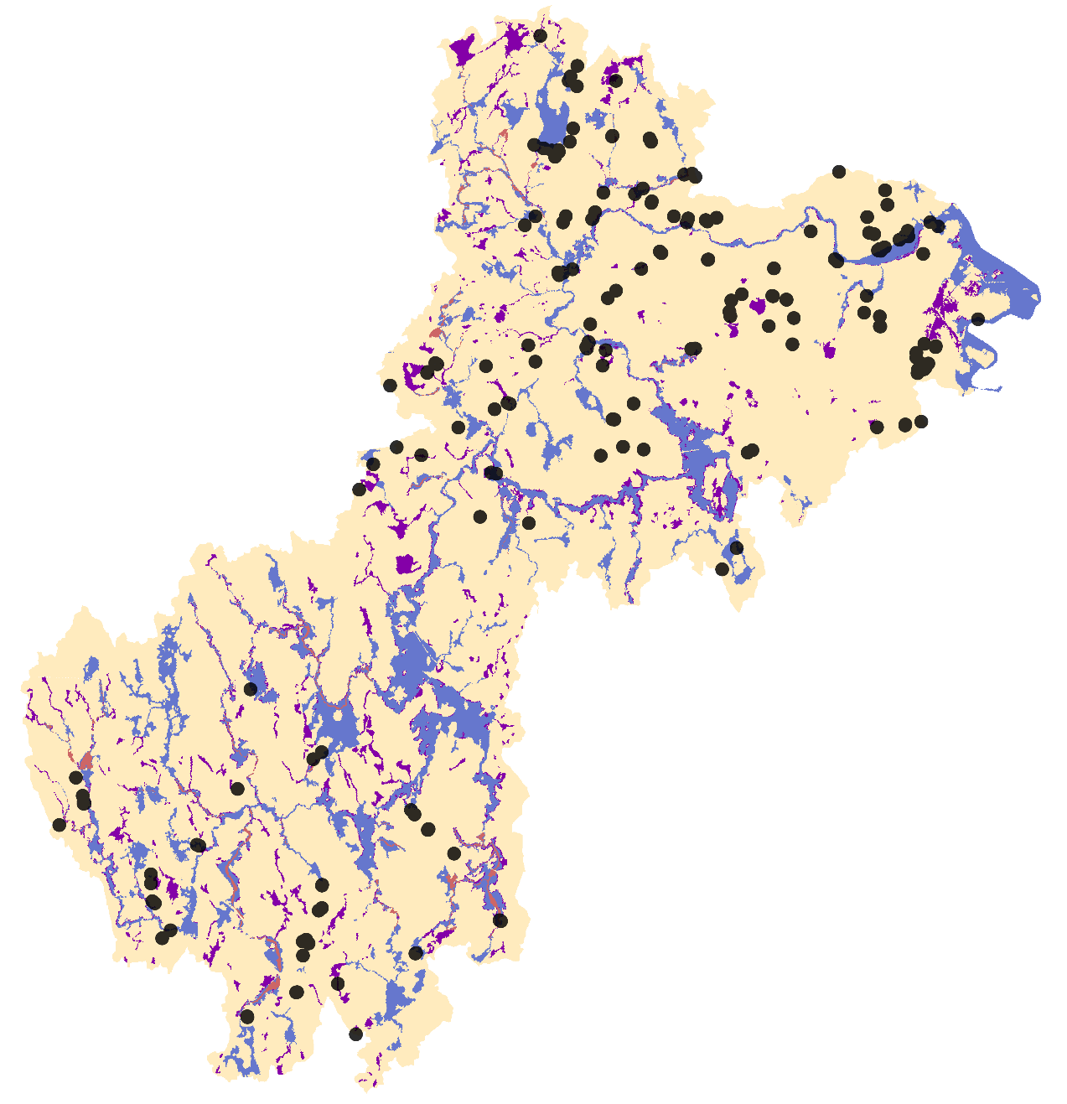

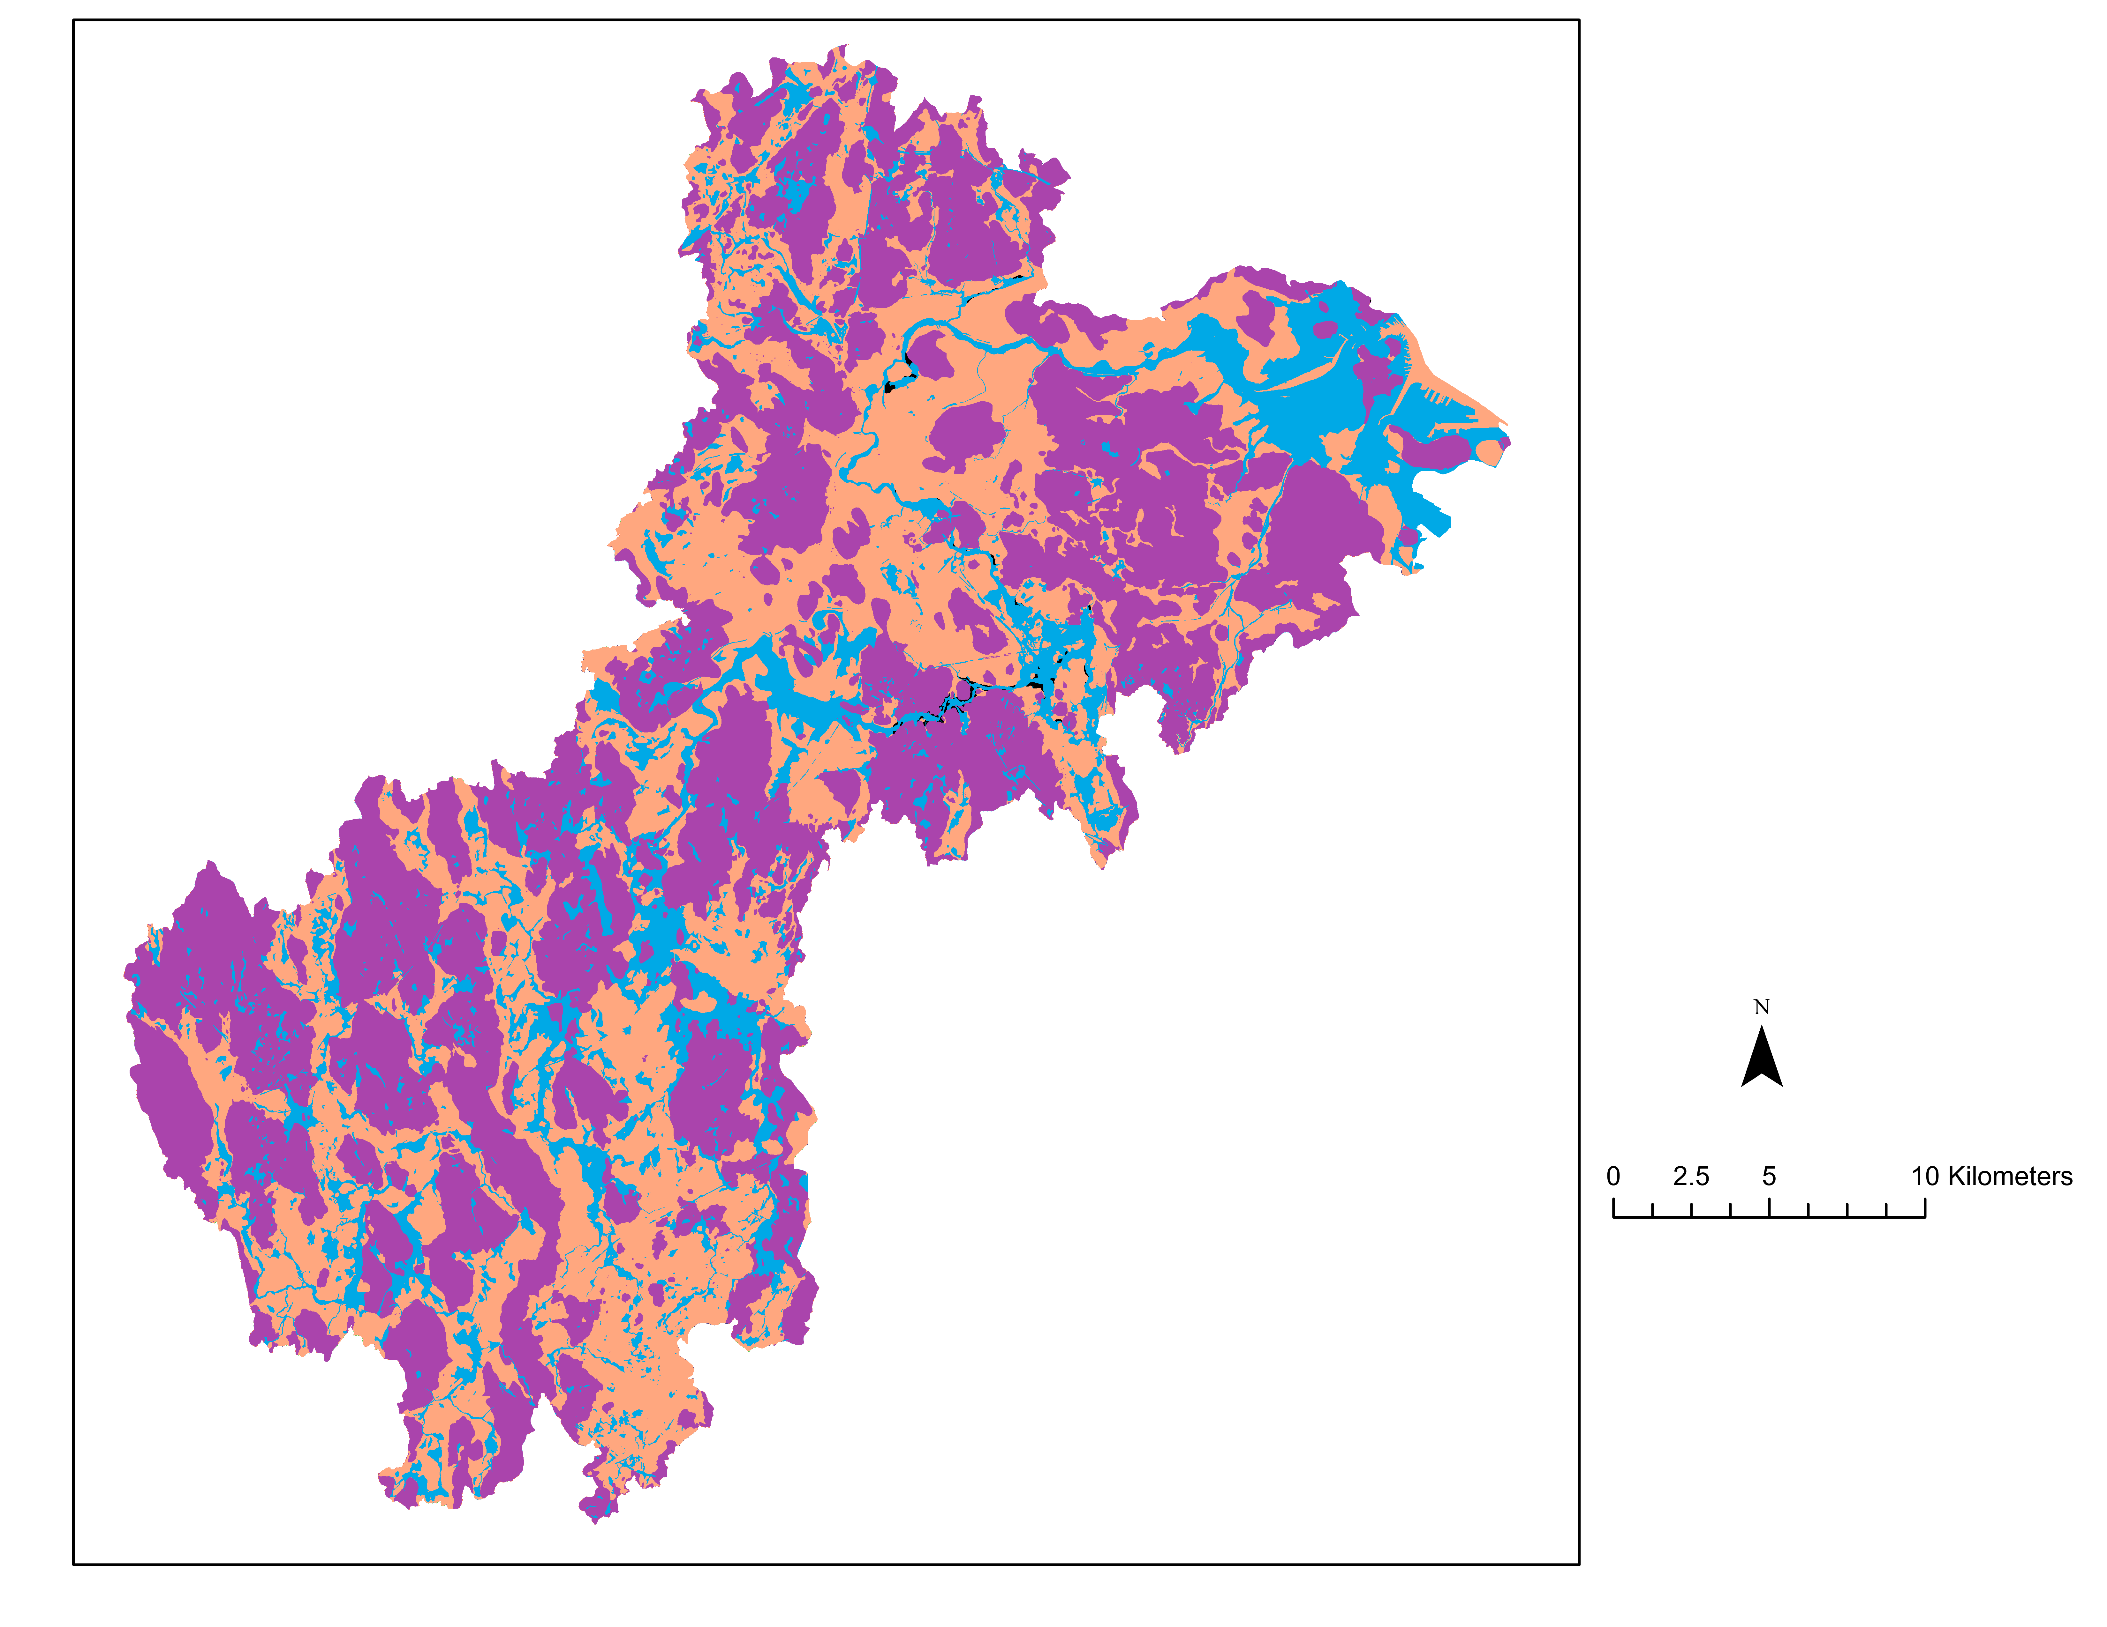
Susceptibility Mapping:
FEMA Flood Maps
0
5
10
km
Only 1/3 of reported flood events occur in 100-year or 500-year floodplains
FEMA National Flood Hazard Layer
100-year floodplain
Regulatory floodway
500-year floodplain
Minimal flood hazard
Reported flood events
Notes:
This slide shows the FEMA National Flood Hazard layer for the Charles River Watershed. The 100-year floodplain follows the Charles River and its tributaries closely. The black dots represent the 57 flood events reported in the NOAA Storm events database from 2000-2020. It is interesting to note that 38 of these reported floods occurred outside of the FEMA 100-year and 500-year floodplains.
Image Credit: Powerpoint Template Icon
Image Source: PowerPoint (Office 2020) [Computer Software]. Redmond, WA: Microsoft

Slide 15
Susceptibility Mapping:
Bivariate and Multivariate Statistical Analysis
Multivariate: multivariate logistic regression (LR)
Bivariate: frequency ratio (FR)
Focuses on the individual relationship between conditioning factors and flooding
Focuses on the relationship between conditioning factors
Notes:
Bivariate statistical analysis measures the individual relationship between the flood conditioning factors and flooding but neglects the relationship among the variables. Multivariate statistical analysis takes into account the relationship between conditioning factors but neglects the influence of different classes of conditioning factors on flooding. The team used both methods to allow for a more accurate prediction of flood susceptibility.

Slide 16
Susceptibility Mapping:
Random Forest Classification
Binary flood susceptibility map
Random Forest Classifier
Flood
conditioning factors
Probability of high flood susceptibility
Notes:
Random forest is a type of decision tree used for classification and prediction. RF models can handle data from various measurement scales. In GEE, there are 2 output modes for the random forest model: ‘classification’ and ’probability’. Classification mode outputs whether or not each pixels is expected to flood, and probability outputs the predictive power of the RF model at each pixel (how likely the RF model is to have correctly predicted flooding at that pixel).

Slide 17
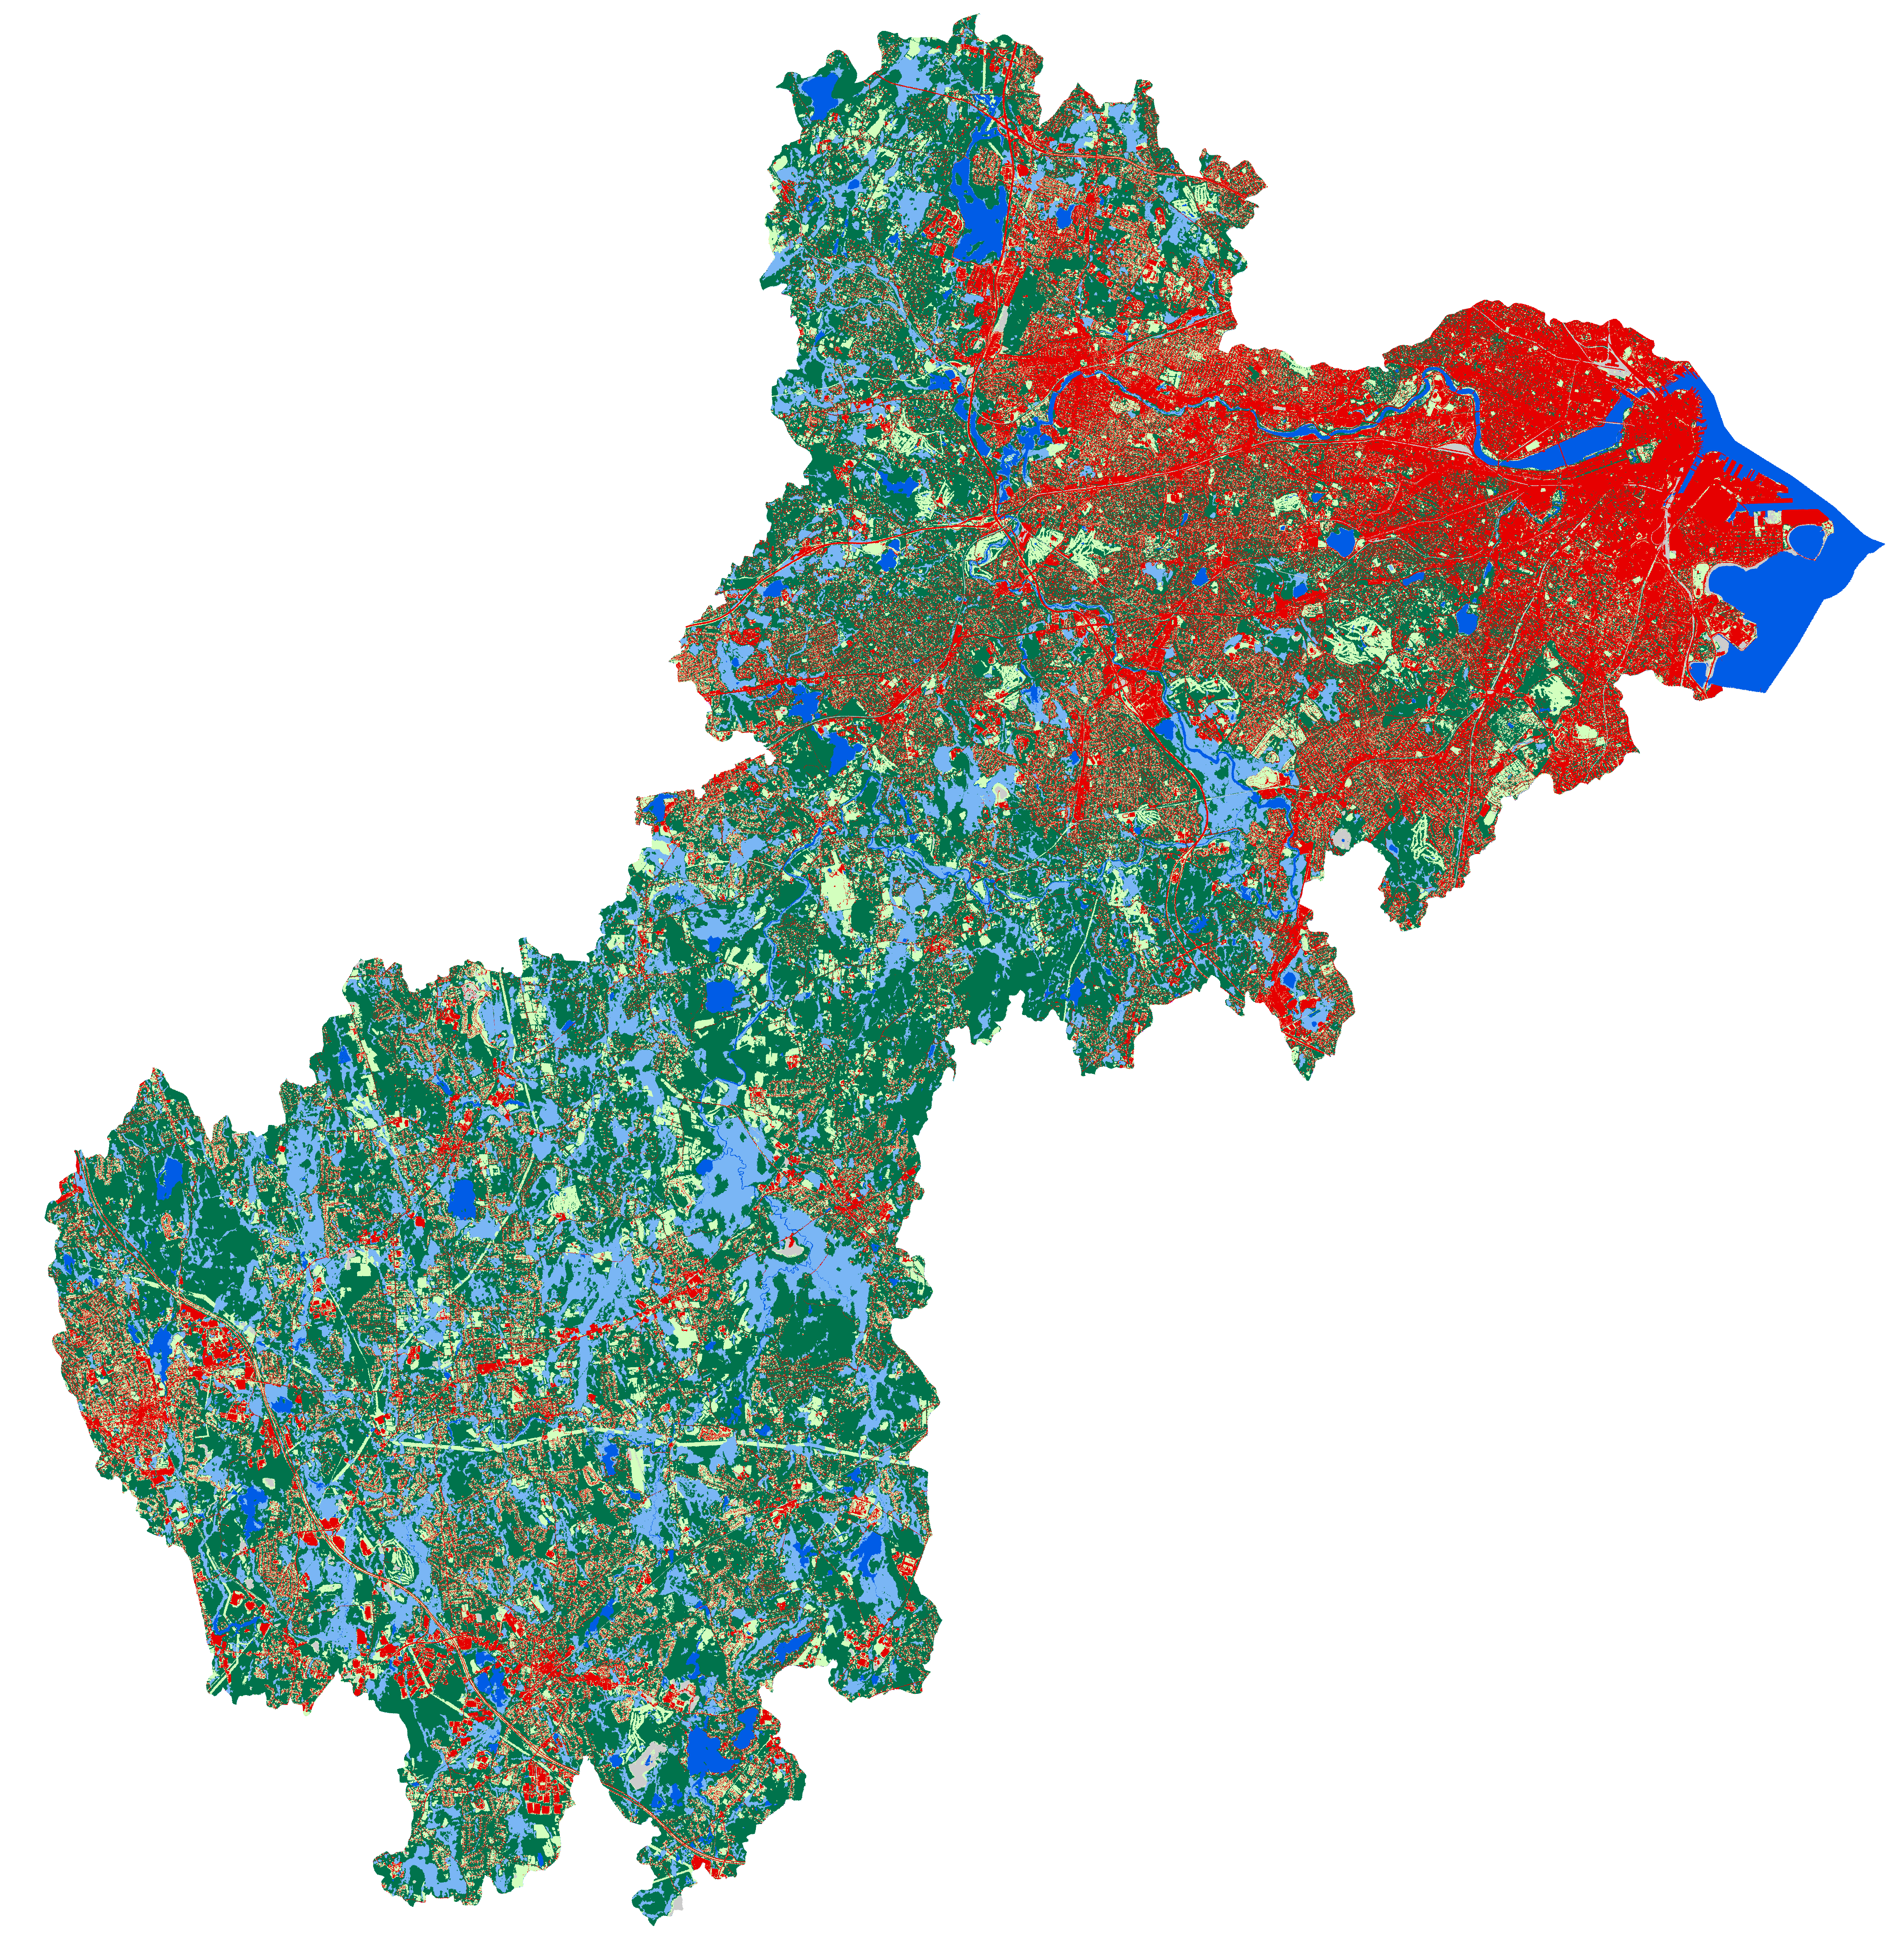
Bivariate Flood Susceptibility Mapping:
Land Cover
km
0
5
10
Low FR
Grass/Field: 0.234
Impervious: 0.303
Forest/Scrub: 0.399
Bare land: 2.374
Land Cover
Impervious
Wetland: 3.555
Grass/Field
Open water: 5.316
Forest/Scrub
Wetland
High FR
Bare land
Open water
Notes:
The team identified several flood conditioning factors for the study area based on past literature and data availability and calculated the flood frequency ratio for each. A higher frequency ratio means a higher likelihood of falling within the FEMA floodplain. This slides shows Land Cover, where wetland, bare land, and open water have the highest frequency ratios. Landcover is strongly based on the presence and type of vegetation and is a good proxy for estimating runoff potential.

Slide 18
Bivariate Flood Susceptibility Mapping:
Surficial Materials
km
0
5
10
Low FR
Glacial till and bedrock: 0.167
Glacial stratified deposits: 0.845
Postglacial deposits: 4.015
Early postglacial deposits: 4.285
Surficial Materials
High FR
Glacial till and bedrock
Glacial stratified deposits
Postglacial deposits
Early postglacial deposits
Notes:
This slide shows surficial materials, where postglacial and early postglacial deposits have the highest frequency ratios. Surficial materials are sediments that sit between the bedrock and soil zone and impact the infiltration of water. The distribution of postglacial deposits and early postglacial deposits seems to closely follow the course of the Charles River.

Slide 19
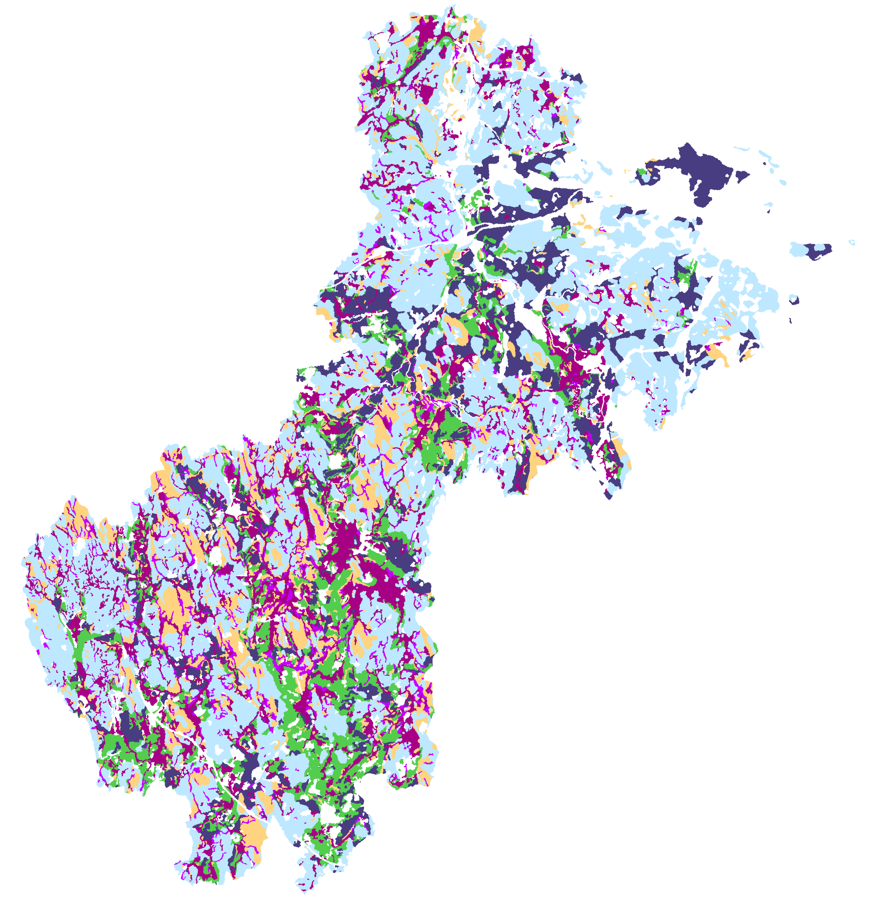
Bivariate Flood Susceptibility Mapping:
Soil Drainage
km
0
5
10
Low FR
Well drained: 0.151
Partially excessively drained: 0.293
Excessively drained: 0.655
Moderately well drained: 0.754
Soil Drainage
Poorly drained: 1.909
Excessively drained
Somewhat excessively drained
Very poorly drained: 4.552
Well drained
High FR
Moderately well drained
Poorly drained
Very poorly drained
Notes:
This slide shows soil drainage, where poorly drained and very poorly drained soils have a higher frequency ratio. Soil drainage is based on soil sediment makeup and impacts how well water can move through the soils. Areas with high impervious surface fraction (such as downtown Boston) are masked out because there should be minimal to no drainage in these regions.

Slide 20
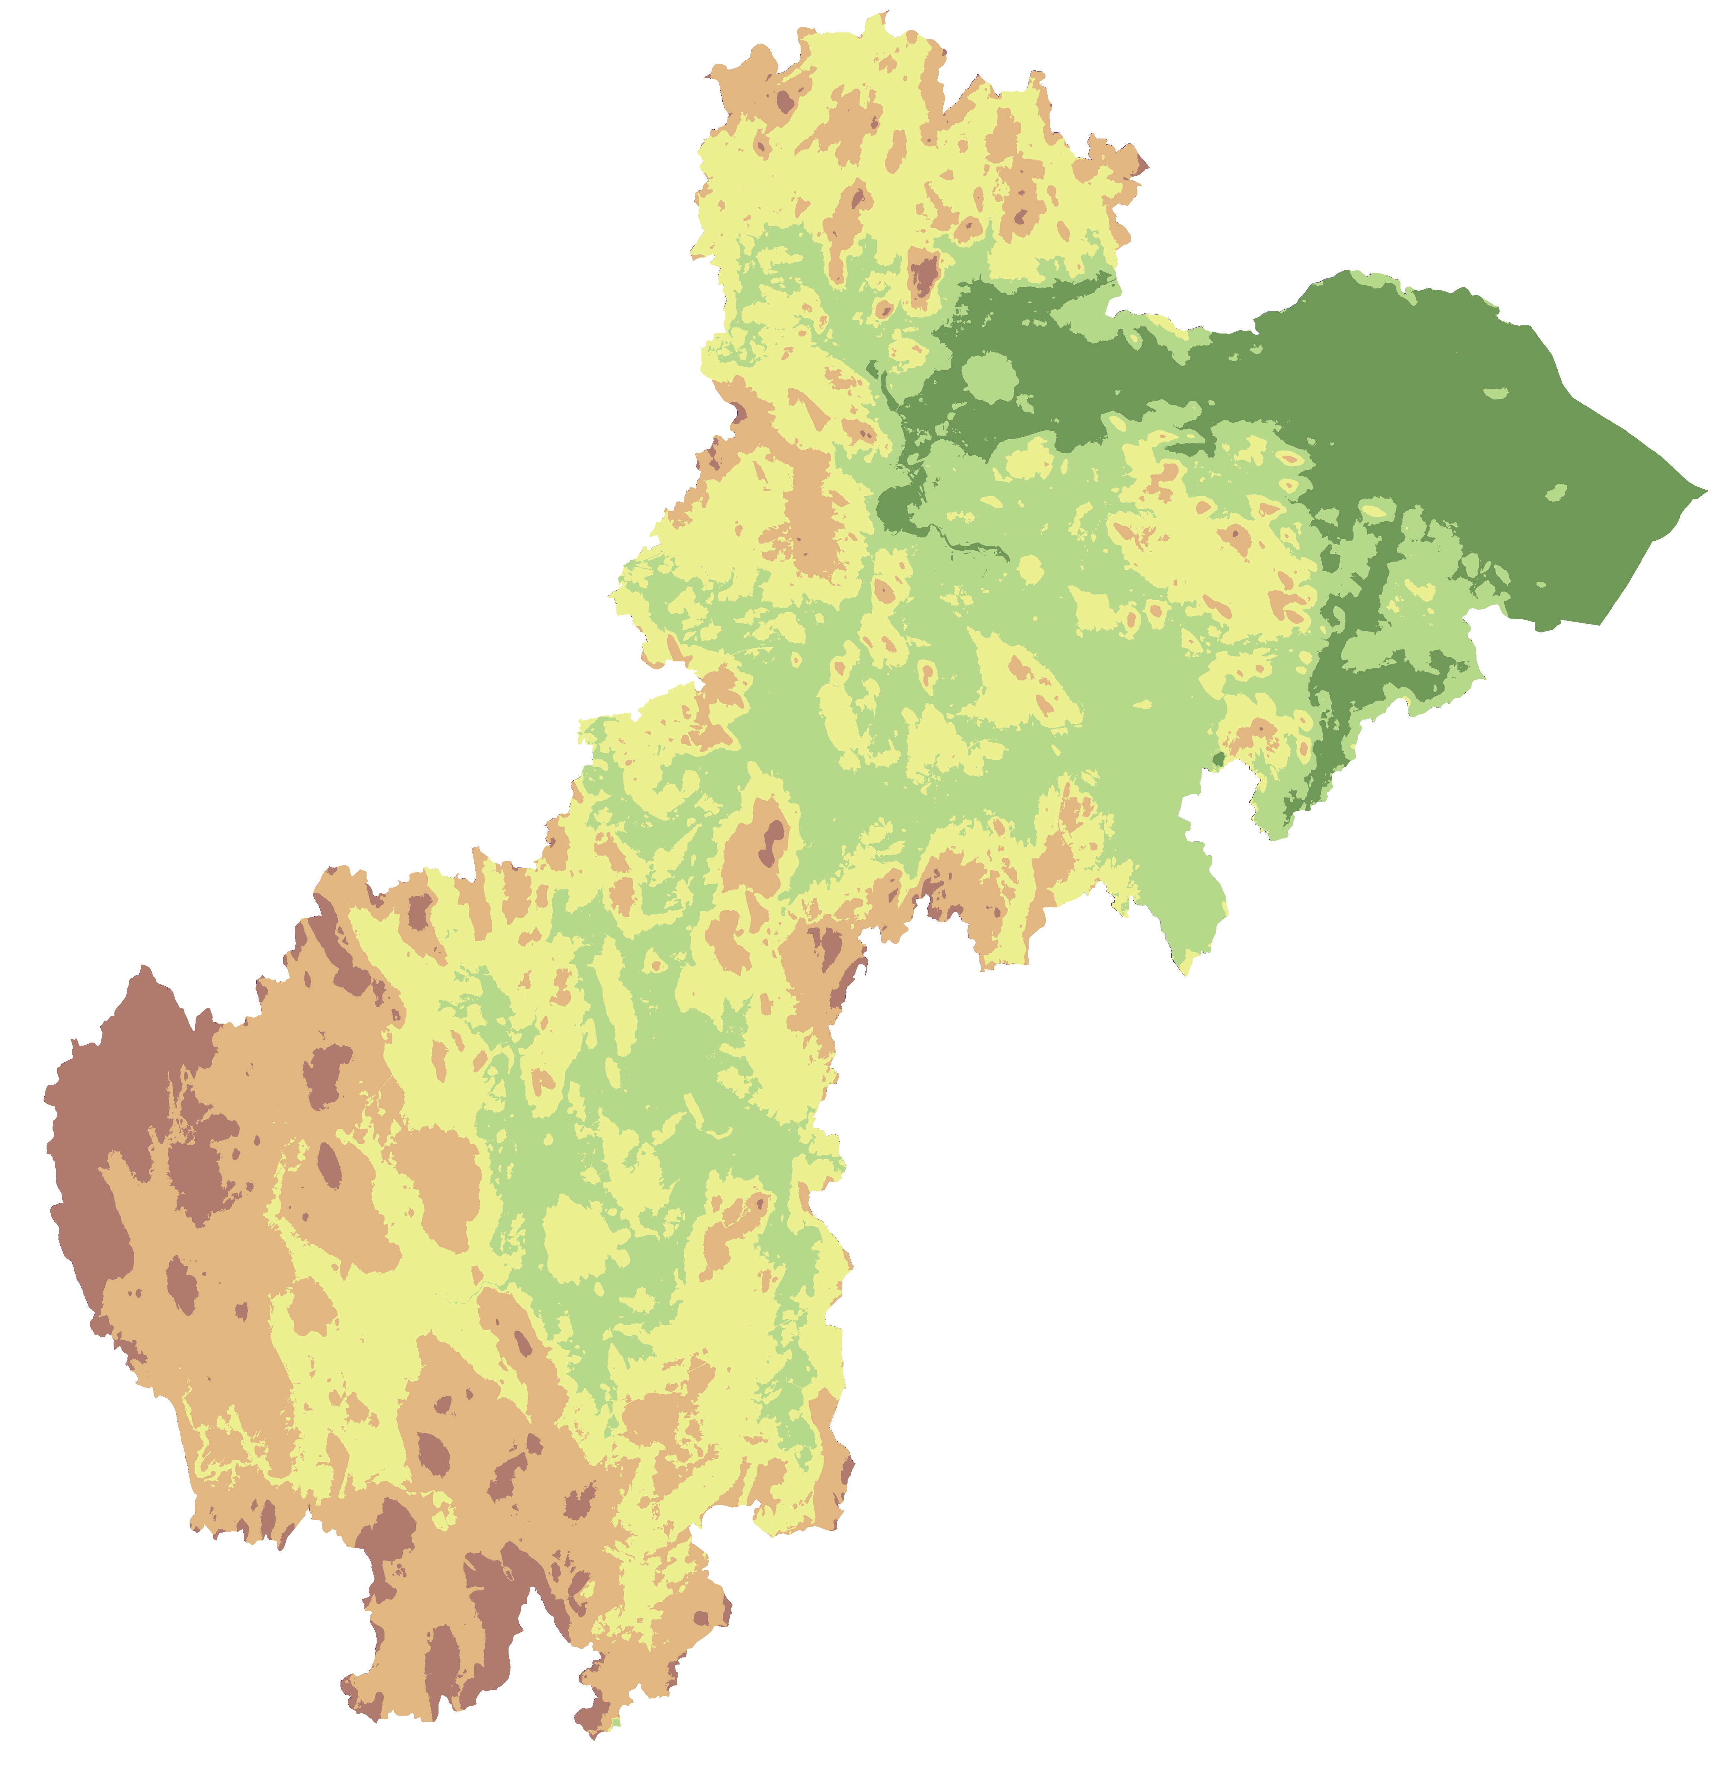
Bivariate Flood Susceptibility Mapping:
Elevation
km
0
5
10
Low FR
≤ 180.37 m: 0.085
≤ 98.91 m: 0.446
≤ 69.74 m: 0.761
≤ 47.61 m: 1.813
Elevation (m)
0 - 19.45
≤ 19.45 m: 1.411
19.45 - 47.61
High FR
47.61 - 69.74
69.74 - 98.91
98.91 - 180.37
Notes:
This slide shows elevation, where the lowest elevations have the highest frequency ratios. Because water flows and collects downhill, low elevations are more likely to experience flooding. The Boston area is a low-lying coastal area, making it more susceptible to sea level rise and costal inundation.

Slide 21
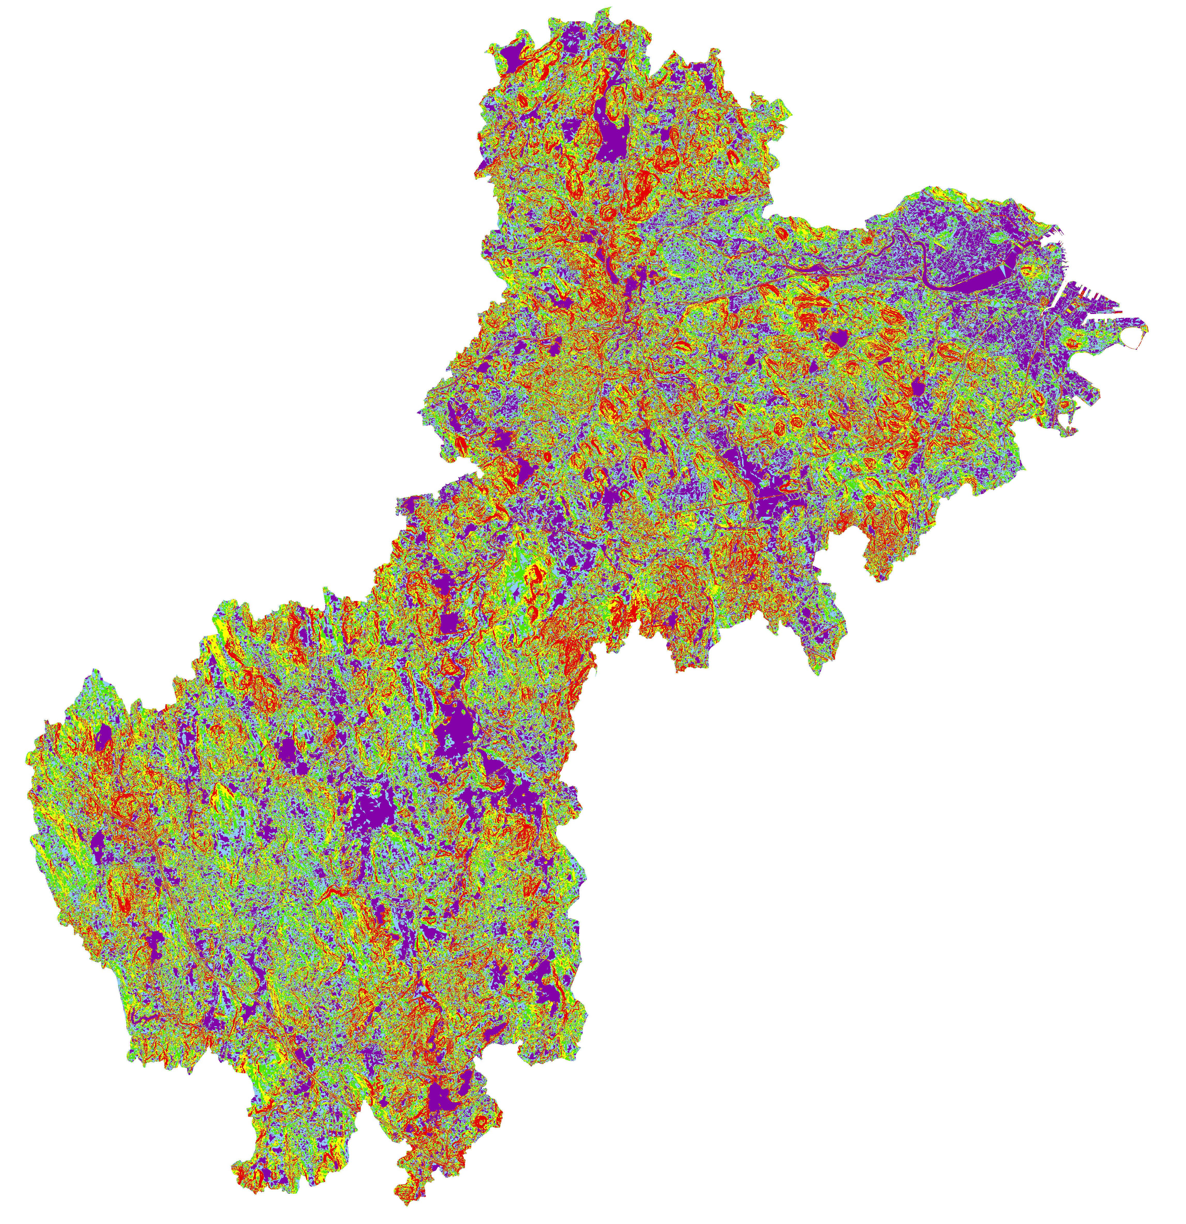
Bivariate Flood Susceptibility Mapping:
Slope
km
0
5
10
Low FR
≤ 6.85°: 0.334
≤ 72.81°: 0.356
≤ 3.71°: 0.475
Slope (°)
≤ 2.00°: 0.990
0 - 0.86
≤ 0.86°: 2.772
0.86 - 2.00
2.00 - 3.71
High FR
3.71 - 6.85
6.85 - 72.81
Notes:
This slide shows slope, where less steep slopes have higher frequency ratios. While steeper slopes generally reduce infiltration and increase the rate of runoff, less steep slopes allow water to collect. This is dependent on many factors, including vegetation and soil type along the slope. Slope is heterogeneous across the watershed, except for the Boston area where slope is less than 1 degree gradient.

Slide 22
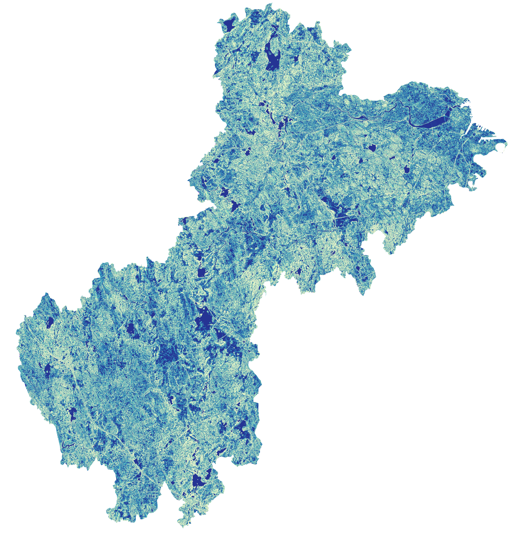
Bivariate Flood Susceptibility Mapping:
Topographic Wetness Index (TWI)
km
0
5
10
Low FR
≤ 4.87: 0.375
≤ 5.85: 0.485
≤ 6.73: 0.686
TWI
≤ 8.00: 1.075
0 - 4.87
≤ 25.41: 2.373
4.87 - 5.85
5.85 - 6.73
High FR
6.73 - 8.00
8.00 - 25.41
Notes:
This slide shows topographic wetness index, or TWI, where higher indices correspond to higher frequency ratios. TWI quantifies topographic controls on hydrological processes by incorporating slope, flow direction, and flow accumulation factors. TWI will be high in and around areas of water and wetlands, as it is a measure of wetness. The Boston area has a high TWI because it is a natural coastal wetland consisting primarily of salt marsh, although much has been infilled throughout it's urban development

Slide 23
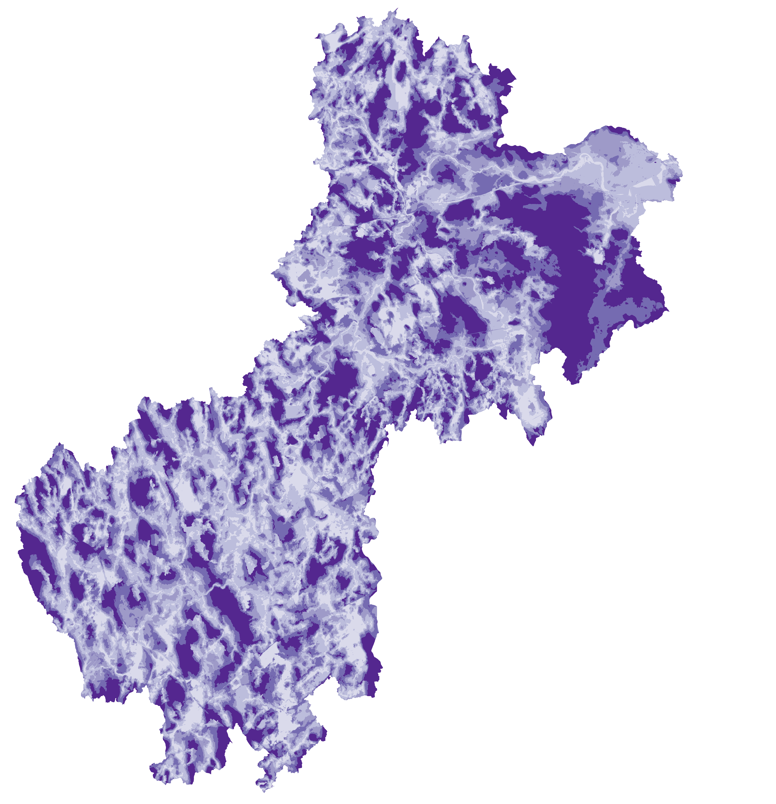
Bivariate Flood Susceptibility Mapping:
Height Above Nearest Drainage (HAND)
km
0
5
10
Low FR
≤ 180.28 m: 0.007
≤ 19.09 m: 0.027
≤ 9.90 m: 0.138
≤ 4.24 m: 1.635
HAND (m)
0 m: 4.832
0
0 - 4.24
High FR
4.24 - 9.90
9.90 - 19.09
19.09 - 180.28
Notes:
This slide shows the Height Above Nearest Drainage, or HAND, where the lowest heights correspond to the highest frequency ratios. HAND quantifies the vertical distance between a location and its nearest stream using a digital elevation model and the area's stream network. This calculation helps describe the hydraulic properties of the stream network.

Slide 24
Flood Susceptibility Mapping:
Statistical Analysis Results
Flood Conditioning
Factor
Maximum Frequency
Ratio
Logistic Regression
Coefficient
Surficial Materials
Early postglacial deposits: 4.285
0.947
Soil Drainage
Very poorly drained: 4.552
0.363
Land Cover
Open water: 5.316
0.836
Elevation
≤ 19.45 m: 1.411
-0.561
Slope
≤ 0.86°: 2.772
-0.184
HAND
0 m: 4.832
-1.351
TWI
≤ 25.41: 2.373
-0.108
Notes:
This slide lists the flood conditioning factors and the classifications with the highest frequency ratio for each. The highest frequency ratio for each flood conditioning factor is important because it shows which quantile is most strongly related with the likelihood of being within a FEMA flood zone. The slide also lists the logistic regression coefficients, which show each factor's relationship with flooding while accounting for its relationship with other factors.

Slide 25
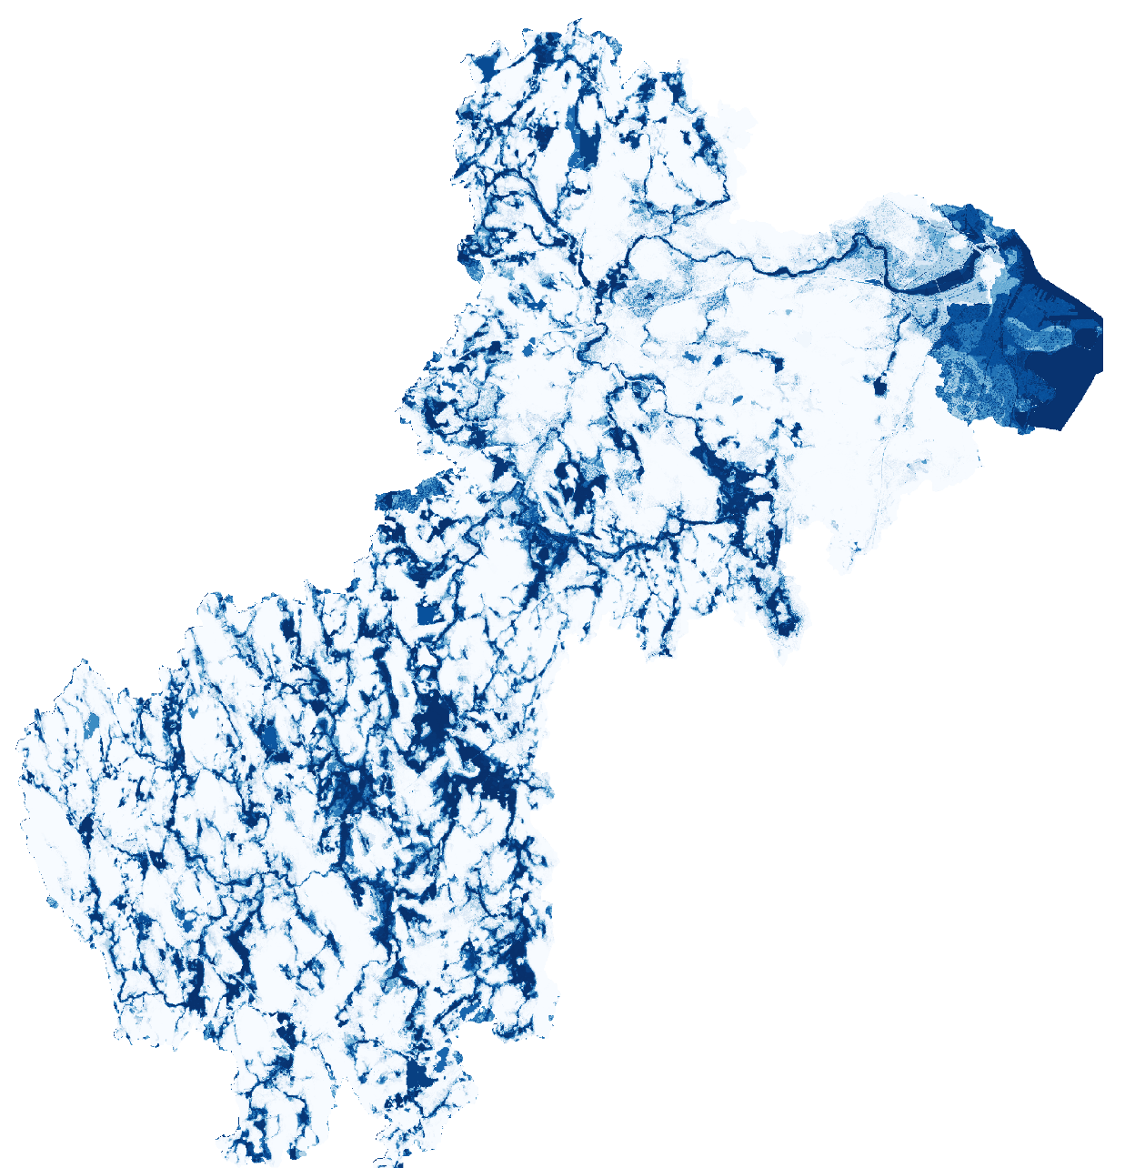
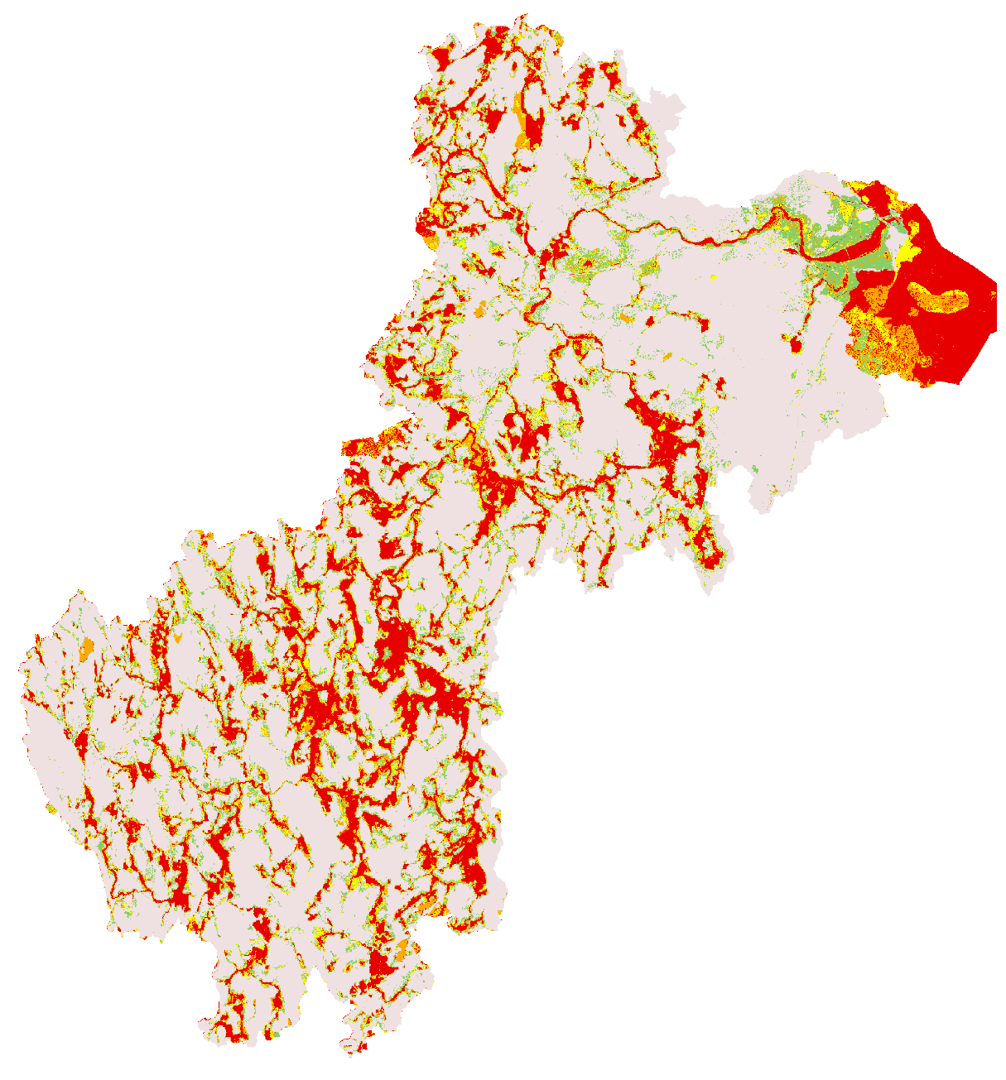
Flood Susceptibility Map:
Logistic Regression
0
5
10
km
0
5
10
km
1
Flood Susceptibility
Very low
Probability of flooding
Low
Moderate
High
0
Very high
Notes:
Logistic regression outputs the probability of flooding in a pixel given the values of the flood conditioning factors. The team ran a multivariate logistic regression, which focuses on the relationship between flood conditioning factors. To calculate flood susceptibility, the team split this probability of flooding into five quantiles that represent different susceptibility zones.

Slide 26
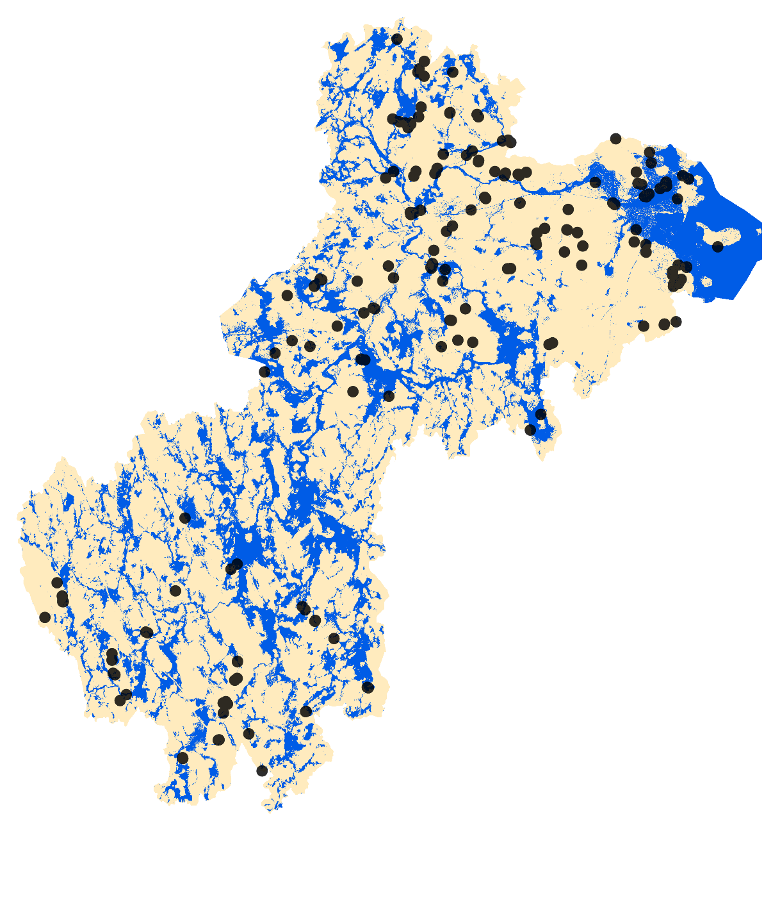
Decision Tree Flood Susceptibility Mapping:
Random Forest
0
5
10
km
Over 2/3 of recorded flood events occur in areas classified as susceptible to flooding
Susceptible to flooding
Minimal flood susceptibility
Reported flood events
Notes:
This slide shows the resulting susceptibility map created by the team using the previously calculated flood conditioning factors, with the areas susceptible to flooding shown in blue. The team then overlaid the NOAA Storm Events Database with susceptibility map. The team's map captured 68%, or two-thirds, of the reported storm events, whereas the FEMA flood map only captured 33%, or one-third, of the reported flood events.

Slide 27
Determining Flood Vulnerability:
Flood Vulnerability Index
% of elderly residents
% of residents below poverty line
% of non-white residents
Flood Vulnerability Index
Notes:
As described previously, flood vulnerability is calculated using socioeconomic data overlaid with flood susceptibility. The team chose to look at three vulnerable groups within the areas susceptible to flooding. These groups included the percent of elderly residents, the percent of residents below the poverty line, and the percent of non-white residents. These groups were chosen based on conversations with the partner organizations as well as being commonly vulnerable populations identified within the literature.

Slide 28
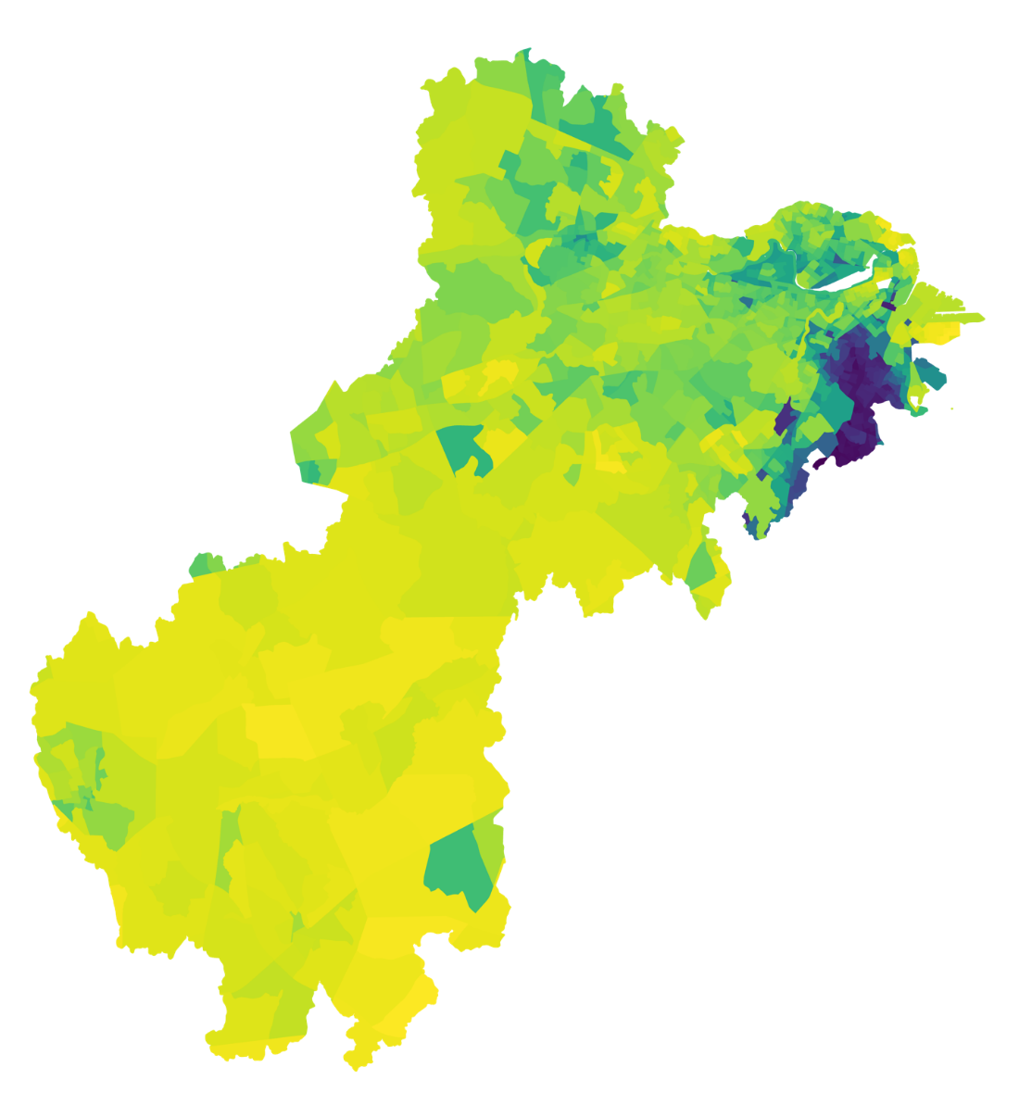
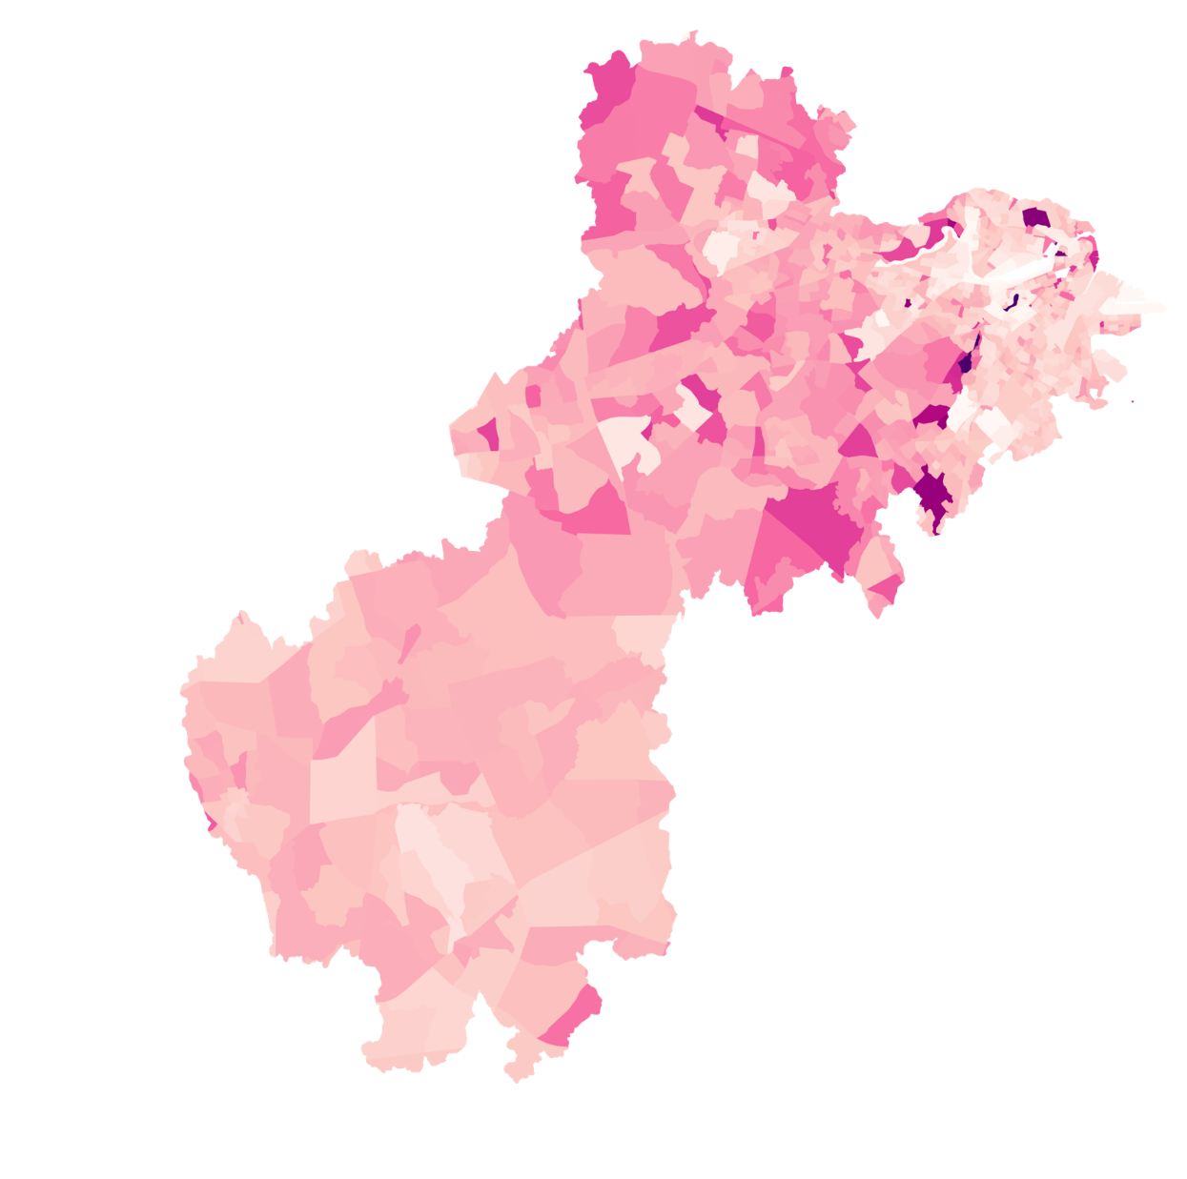
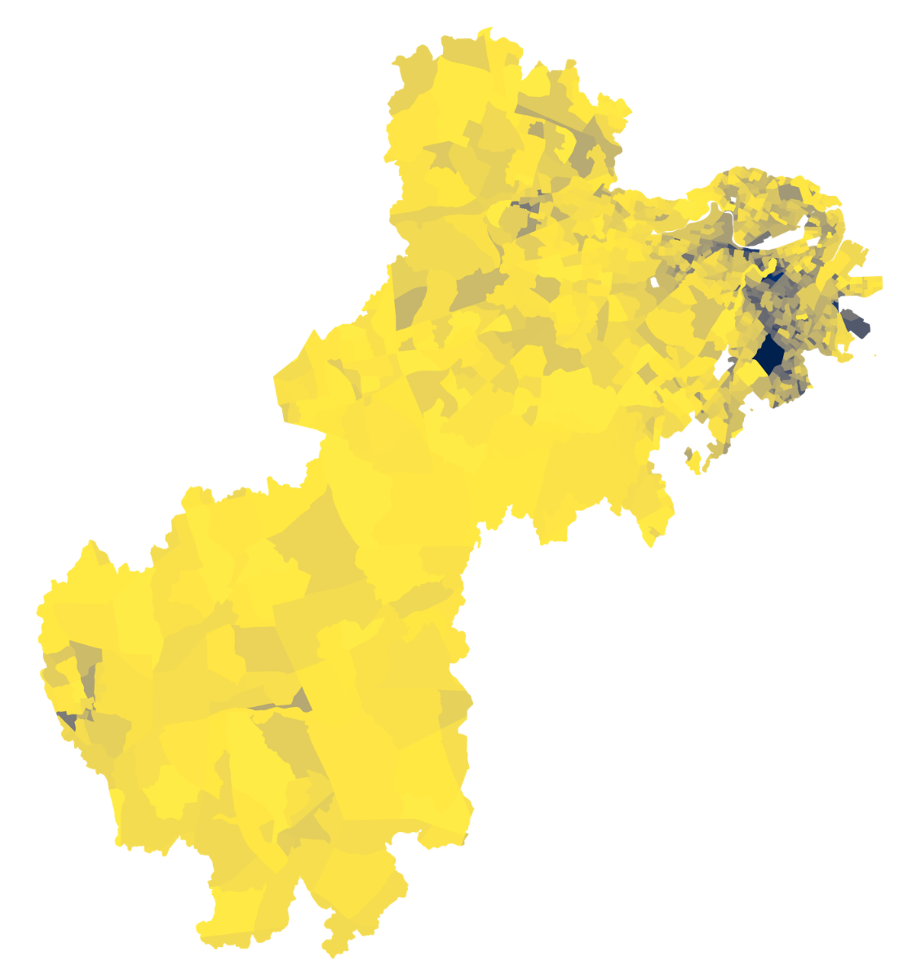
Flood Vulnerability Factors
0
8
16
km
100%
100%
100%
Non-white population
Elderly population
Population in poverty
0%
0%
0%
Notes:
This slide shows maps of the three selected vulnerable groups. In all of the maps, there is a greater proportion of these groups in the upper portion of the watershed. The non-white population is concentrated in the Boston metro area and the population in poverty is concentrated in pockets across southern Boston. There is relatively little elderly population in the Boston metro area, except for a pocket in southwest Boston. There is also a pocket of non-white and population in poverty in the Milford area of the watershed.

Slide 29
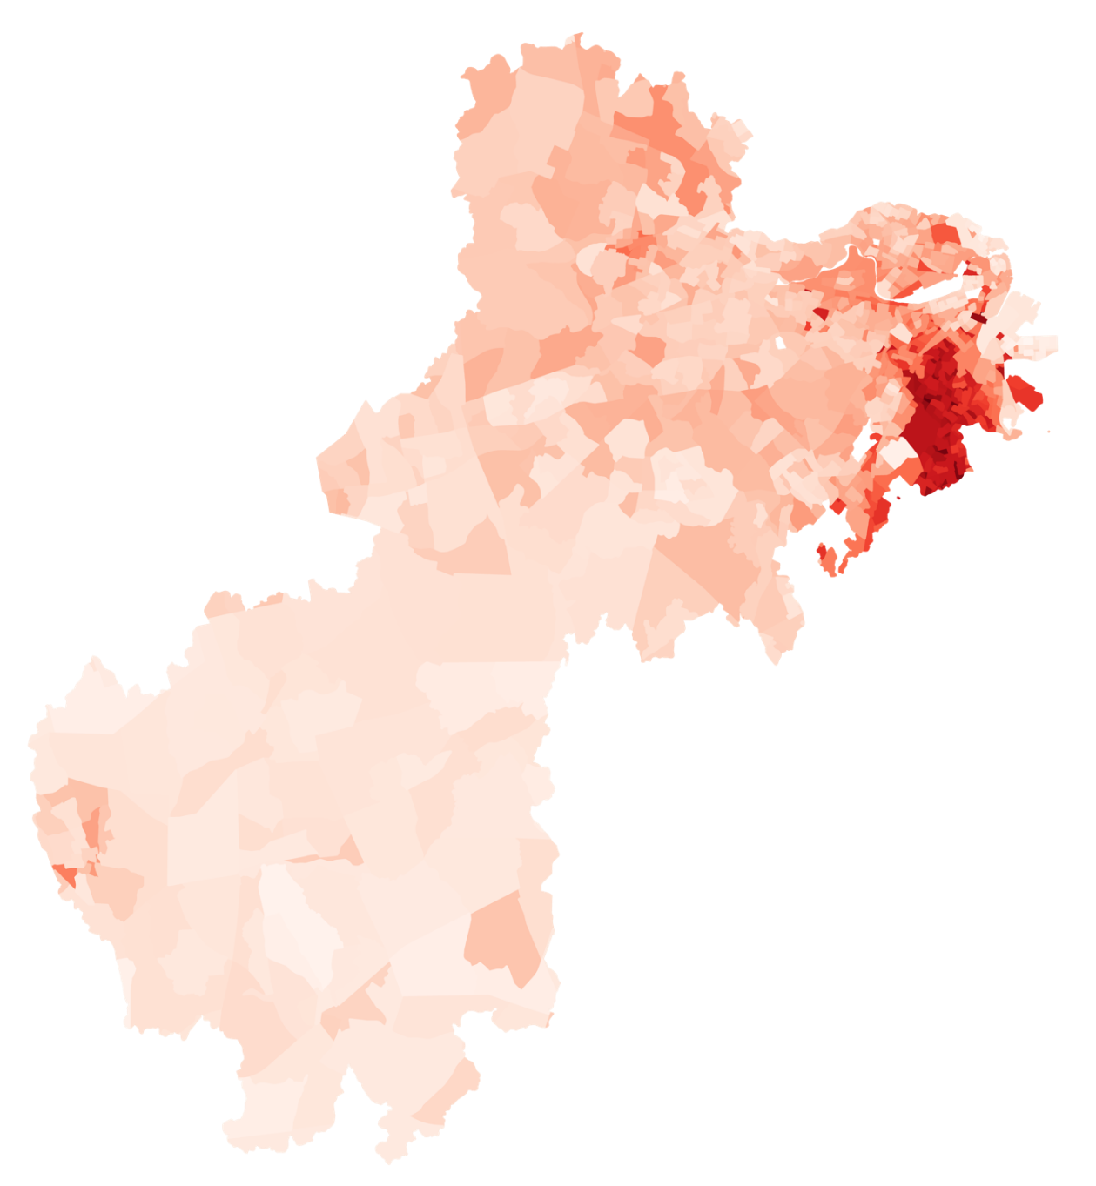
Flood Vulnerability Index
0
5
10
km
High flood vulnerability index
  Boston
    Allston
    South End
  Cambridge
  Roxbury
  Dorchester
  Milford
  Waltham
1.7
Vulnerability Index
0
Notes:
This slide shows the vulnerability index aggregated for the three groups. As in the previous maps, we see a greater proportion of vulnerable populations in the upper watershed, and particularly across the Boston area, with higher vulnerability in South Boston. There is also a small pocket in the Milford area.

Slide 30
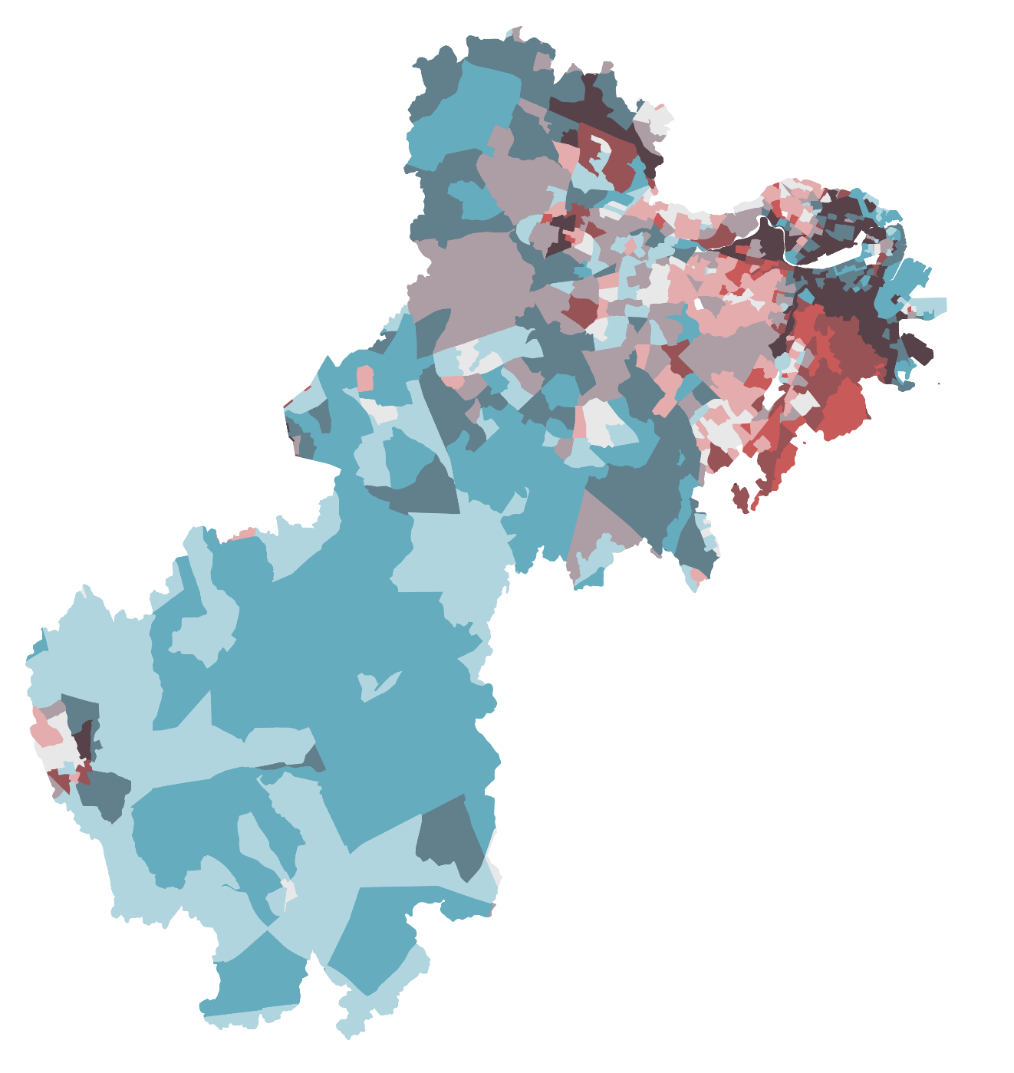
Flood Vulnerability Map
0
5
10
km
High flood vulnerability
  Boston
    Allston
    South End
  Milford
  Cambridge
  Dorchester
  Waltham
High
% in Susceptible Flood Area
Low
High
Vulnerability Index
Notes:
The team developed a bivariate map using the susceptibility map and the vulnerability index, as seen here. For each of the census block groups, the team calculated what percent of the pixels in each census block group fell within the flood susceptibility zone. This was mapped with the aggregated vulnerability index. Areas with a high percent of pixels in the flood susceptibility zone and high vulnerability index are the most vulnerable to flood events.

Slide 31
Conclusions
NASA Earth observations were not feasible for detecting localized flooding in this study
The highest potential for watershed degradation occurred near the mouth of the Charles River near downtown Boston
FEMA flood maps captured 33% of reported NOAA flood events, while the team’s flood susceptibility map captured 68% of reported events
Areas with the highest flood vulnerability were found to be in Boston, Cambridge, Milford, Waltham, and Dorchester
Notes:
After data processing and analysis, the team was able to draw several conclusions. First, areas with the highest likelihood for watershed degradation are located near the mouth of the Charles River in downtown Boston, MA. This was shown through our watershed degradation map, indicating that high population density and impervious surface fraction result in severe watershed degradation. In addition, the use of NASA Earth Observations were not sufficient for this particular project. The spatial and temporal resolution of each satellite, local scale of flooding in the Charles River watershed, flood events from the NOAA Storm Events Database, and time constraints for this project led the team to pursue other methods for detecting urban flooding. As mentioned earlier, the team's flood map captured roughly twice as many flood events from the NOAA Storm Events Database than the FEMA flood map. 2/3 of the NOAA reported flood events fell outside of the FEMA 100-year floodplain, while less than 1/3 of NOAA reported flood events fell outside of the flood conditioning factor-informed flood map. As a culmination of our conclusions and findings, we were able to conclude that the areas with the highest flood vulnerability are in Boston, Cambridge, Milford, Waltham, and Dorchester.

Slide 32
Errors & Uncertainties
Limitations of the NOAA Storm Events Database
Challenges with identifying localized urban flood events with NASA Earth observations
Validation of supervised and ensemble flood susceptibility classification efforts
Potential for confounding factors in the logistic regression equation
Notes:
Although we were able to draw conclusions from this project, there were errors and uncertainties. It is likely that NOAAs Storm Events Database did not capture all of the flooding events in the study area, and some may not be accurate due to citizen reporting. As a result, there may be missing data points. Also, as previously mentioned, there were errors and uncertainties when using NASA Earth Observations to detect urban flooding in the Charles River watershed. Resolution and local flood size created "false positives" in our preliminary results, making it difficult to determine true flood detection. Some logistic regression coefficients deviated from trends in the literature, implying that there are confounding factors not yet accounted for.

Slide 33
Future Work
Include more socioeconomic & environmental data
1
Incorporate precipitation data
2
Re-examine remote sensing feasibility
3
Map stormwater infrastructure
4
Notes:
1) Include more/other socioeconomic and environmental data to further develop the vulnerability analysis. This could include % of people living on a first floor in high density areas, access to transportation, proximity to road networks for evacuation.
2) Incorporation of precipitation data and long-term trends to determine if flood events are more related to development patterns, changes in precipitation, or both.
3) Incorporate higher resolution remote sensing imagery to understand the extent of flood events as it becomes available
4) Map traditional stormwater conveyance and green infrastructure to find relationships with flood probability

Slide 34

Project Partners
  Danielle Perry, Massachusetts Audubon Society
  Marianne Larossi, Town of Natick
  Jillian Wilson Martin, Town of Natick
  Julie Wood, Charles River Watershed Association
NASA DEVELOP
  Celeste Gambino, MA – Boston Fellow
Science Advisors
  Dr. Cedric Fichot, Boston University
  Dr. Kenton Ross, NASA Langley Research Center
Notes:
The Team would like to thank the following partners for their enthusiasm and guidance throughout the span of this project:
Danielle Perry, Marianne Larossi, Jillian Wilson-Martin, Julie Wood, and their staff members
The authors would like to thank Celeste Gambino, Fellow at NASA DEVELOP, for her guidance and coordination of this project.
We would also like to acknowledge the contributions made by Dr. Kenton Ross of NASA Langley Research Center, and Dr. Cedric Fichot of Boston University who served as scientific advisors for this research.
•------------------------------Image Information Below ------------------------------
••Image Credit: Powerpoint Template Icon
••Image Source: PowerPoint (Office 2020) [Computer Software]. Redmond, WA: Microsoft

Slide 35
Backup Slides

Slide 36
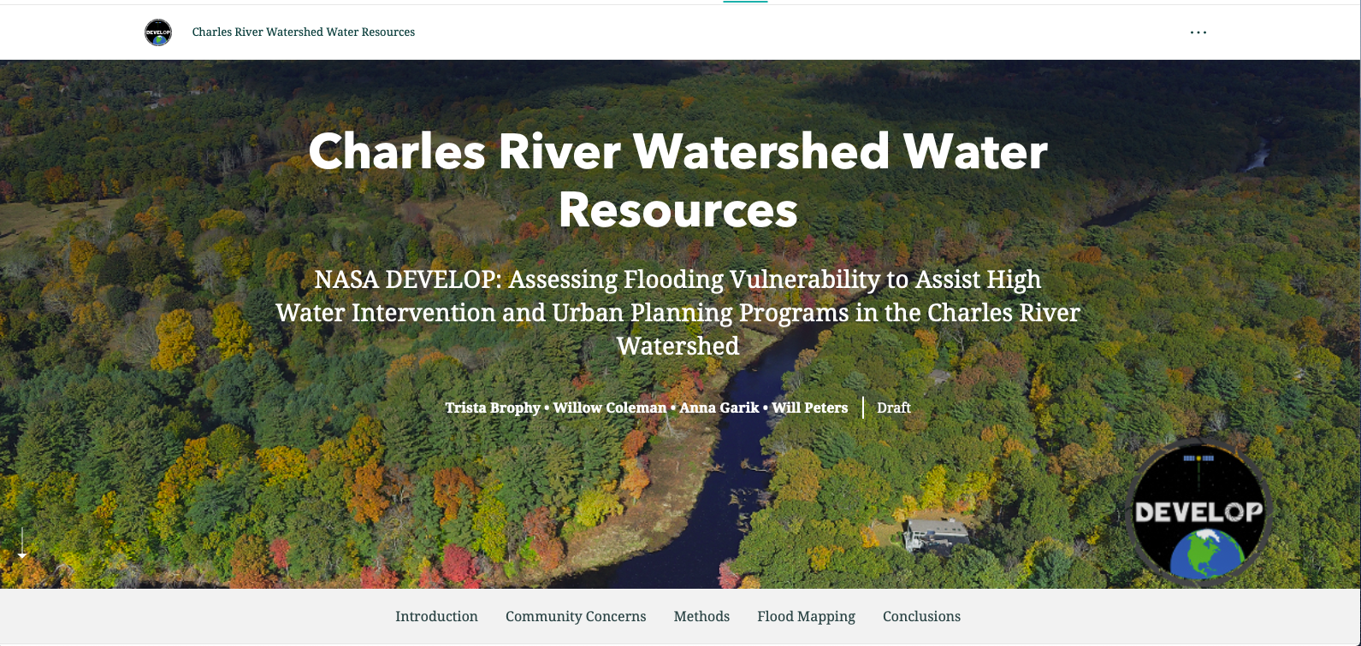
AGOL StoryMap
Notes:
To communicate the results of this project, the team produced a creative communication tool via the public facing StoryMap in ArcGIS Online.

Slide 37
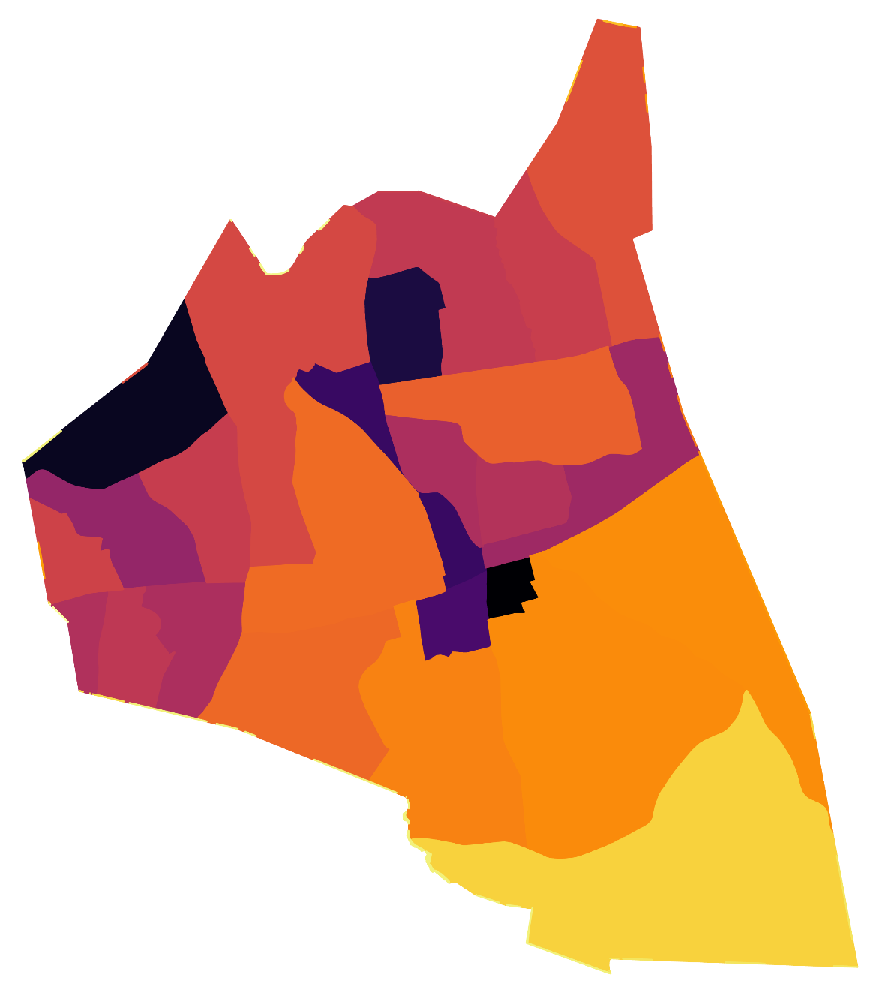
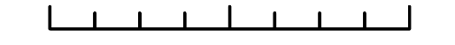
Town of Natick:
Impervious Surface Fraction
High impervious surface fraction
Increased potential for surface runoff
Flooding can occur
100%
Impervious surface
0%
0
1.5
3
km
Notes:
*Note: This slide is specifically for the Natick Select Board presentation.
The team calculated the impervious surface fraction per census block group across the Charles River watershed and Natick using the 1 m land cover map provided by MassGIS.
In Natick, we found that the impervious surface fraction per census block group is highest in the northern half of Natick and the lowest in the southern portion of Natick. The large impervious section in the upper left portion of the map is the area around the Natick Mall. The section in the upper center portion of the map is North Natick at the intersection of Highways 27 and 9. This areas has several large commercial developments. The third area in the center is downtown Natick.
These findings are relevant to the map of watershed degradation because high impervious surface fraction increases the potential for surface runoff and flooding.
Census block groups with an impervious surface fraction of greater than 10% are likely to experience some form of watershed degradation or modification due to surface runoff.

Slide 38
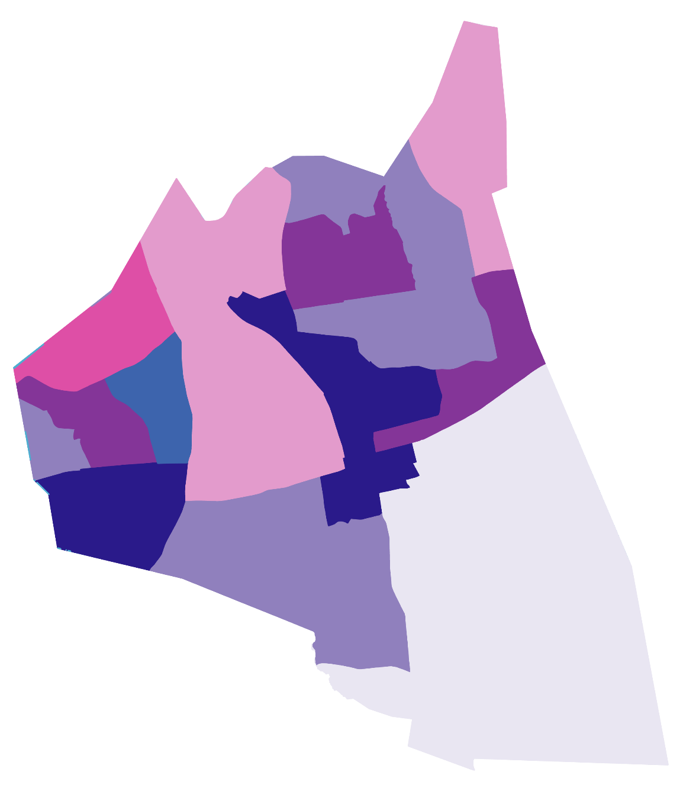
Town of Natick:
Watershed Degradation Potential
0
1.5
km
3
High
Impervious fraction
Low
High
Population density
High population density
+
High impervious surface fraction
=
Potential for severe watershed degradation
Notes:
*Note: This slide is specifically for the Natick Select Board presentation.
The team developed a bivariate map of population density and impervious surface fraction to map the potential for watershed degradation in Natick. Areas with both high population density and high impervious surface fraction are most likely to experience severe watershed degradation.
While much of south Natick has both low impervious fraction and low population density, the northern half of Natick has moderate to high impervious surface fraction and moderate to high population density, suggesting that there could be watershed degradation occurring in these locations. This is particularly true for downtown Natick and the portion of West Natick between Speen Street and Central Street.

Slide 39
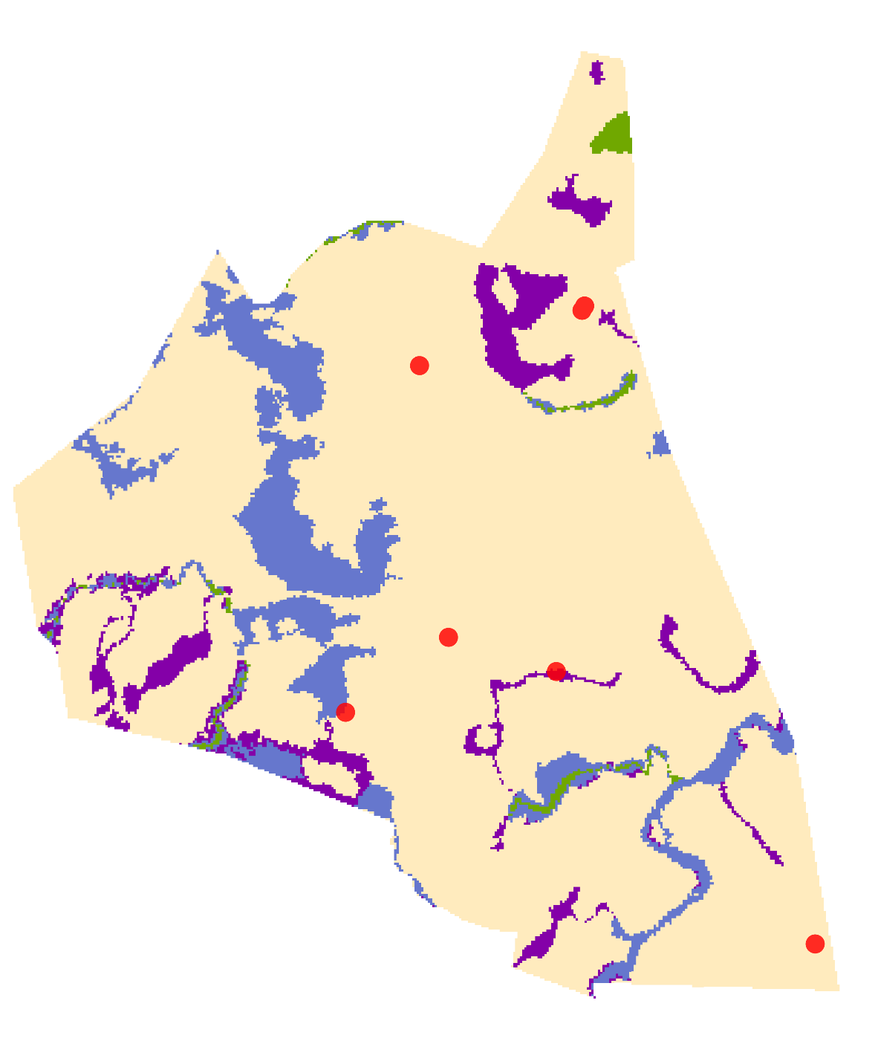
Town of Natick:
FEMA National Flood Hazard Map
Only 2/7 of reported flood events occur in FEMA 100-year or 500-year floodplains
FEMA National Flood Hazard Layer
100-year floodplain
Regulatory floodway
500-year floodplain
Minimal flood hazard
0
1.5
km
3
Reported flood events
Notes:
*Note: This slide is specifically for the Natick Select Board presentation.
This slide shows the FEMA National Flood Hazard layer for Natick. The 100-year floodplain follows waterbodies closely. The black dots represent the 7 flood events reported in the NOAA Storm events database from 2000-2020. It is interesting to note that 5 of these reported floods occurred outside of the FEMA 100-year and 500-year floodplains while only 2 occurred within the floodplains.

Slide 40

Town of Natick:
Flood Susceptibility Mapping
5/7 of recorded flood events occur in or are directly adjacent to areas classified as susceptible to flooding
Flood Susceptibility Map
Susceptible to flooding
Minimal flood susceptibility
0
1.5
km
3
Reported flood events
Notes:
*Note: This slide is specifically for the Natick Select Board presentation.
This slide shows the susceptibility map created by the team using the selected flood conditioning factors, with the areas susceptible to flooding shown in blue. The team then overlaid the NOAA Storm Events Database with susceptibility map. The team's map captured 5 of the 7 reported storm events, whereas the FEMA flood map only captured 2 of the reported flood events.

Slide 41
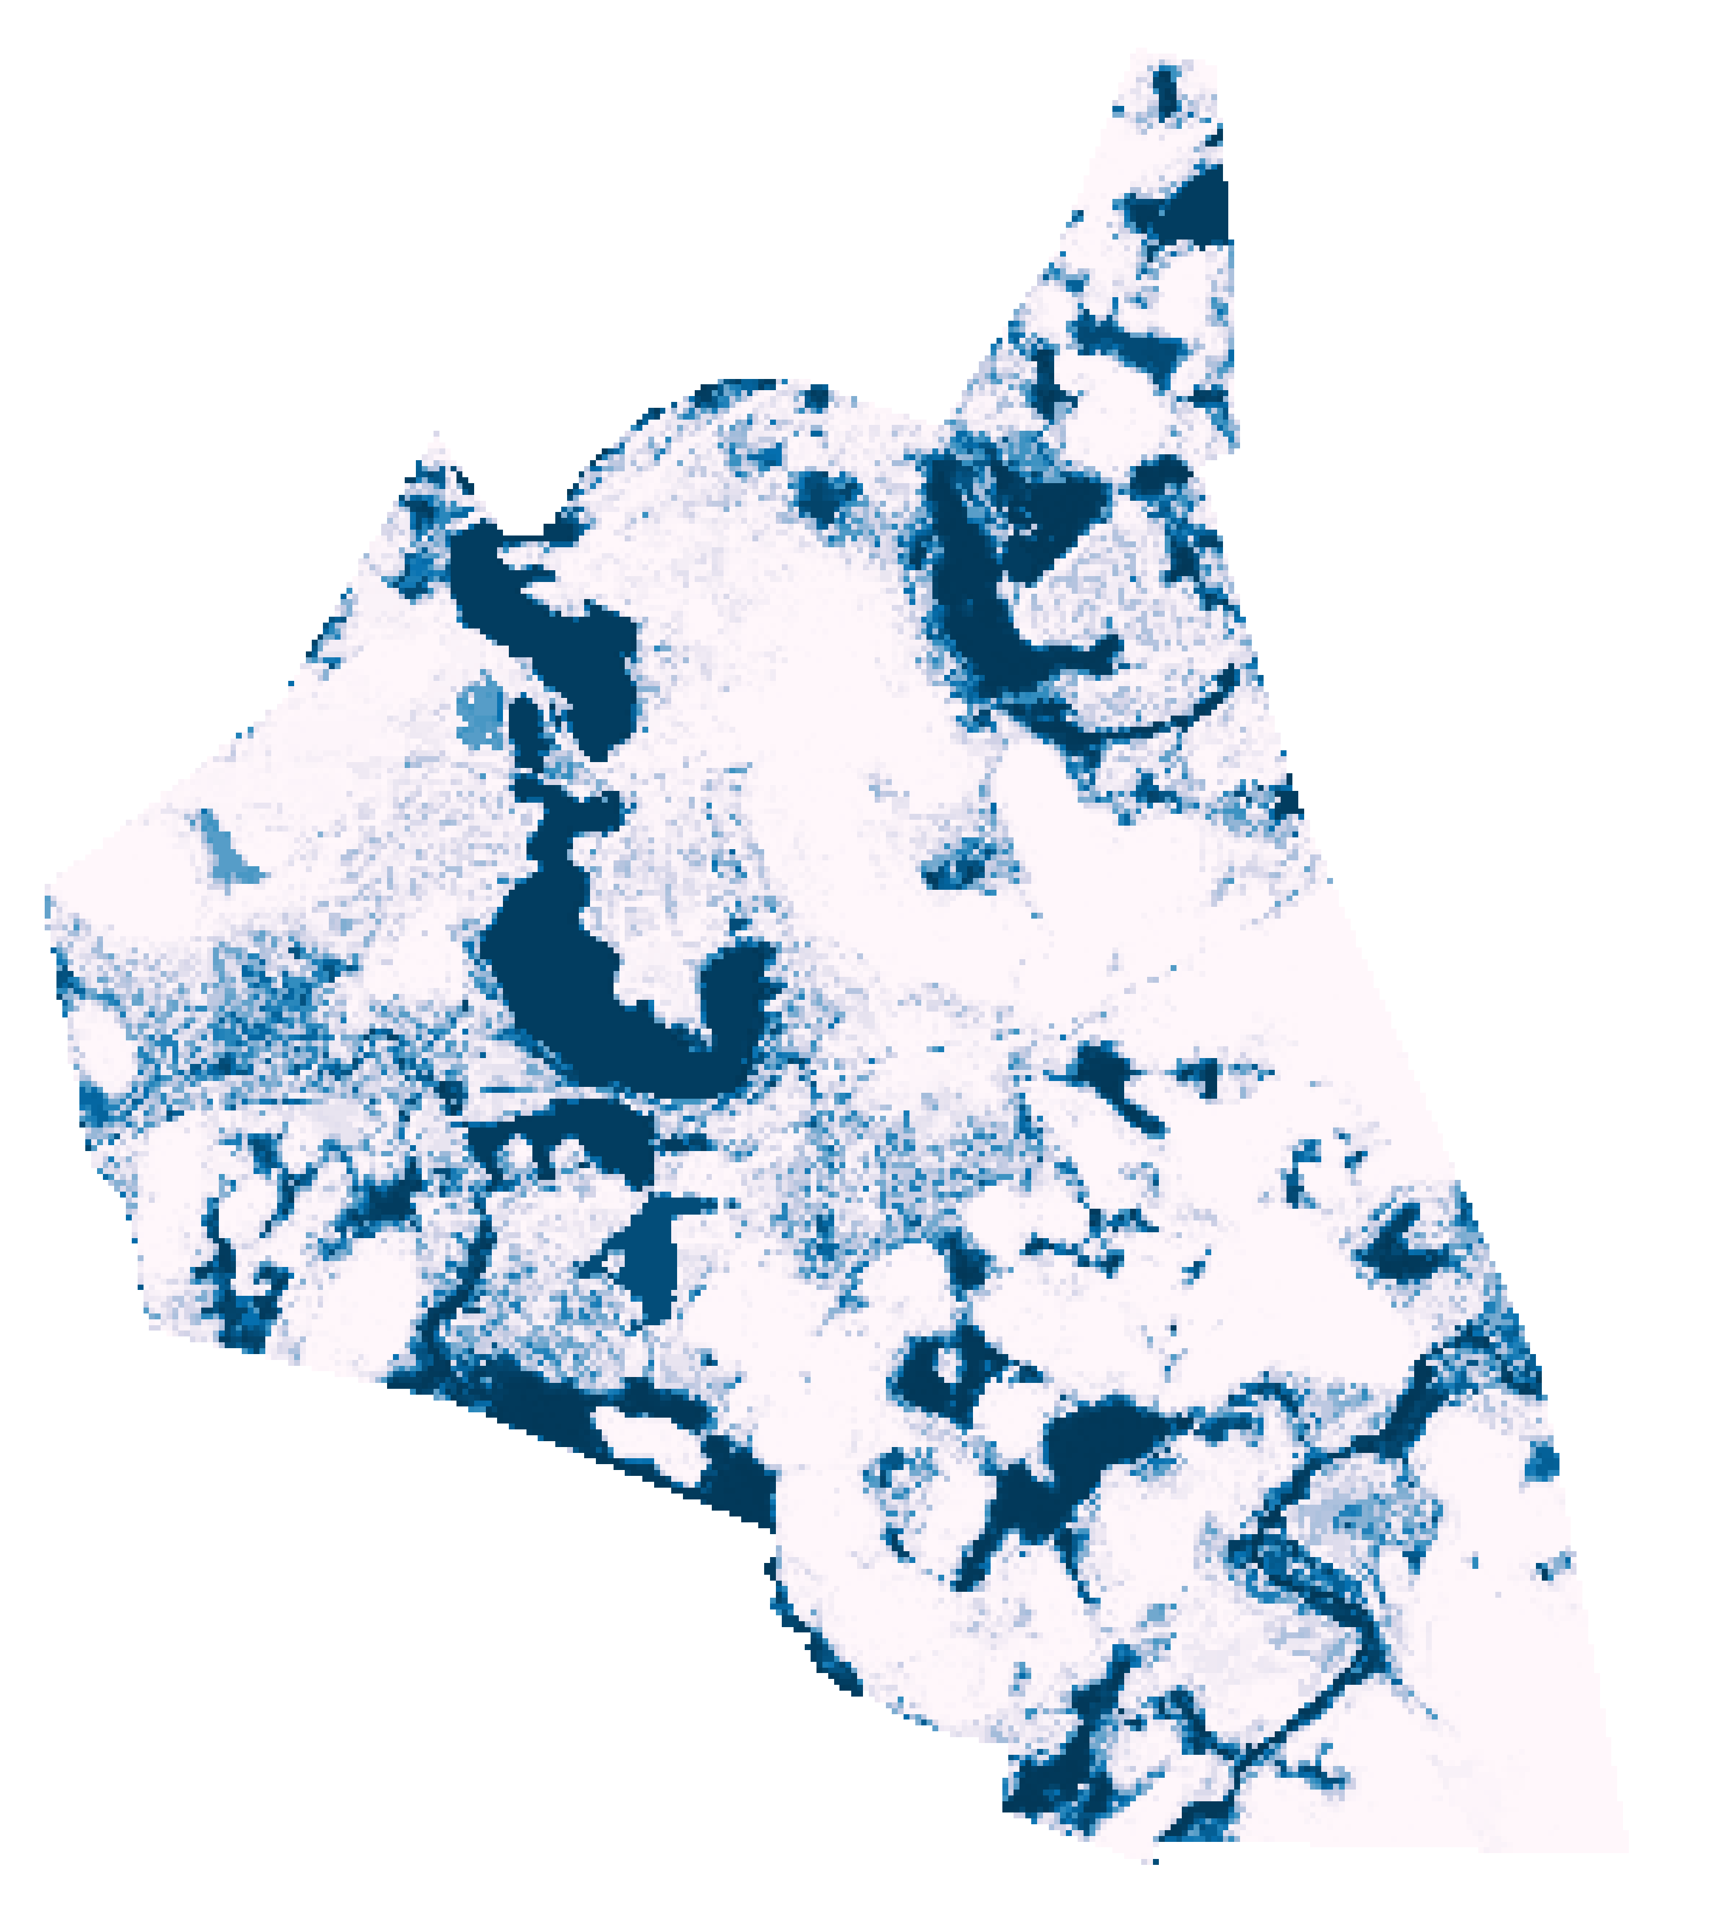
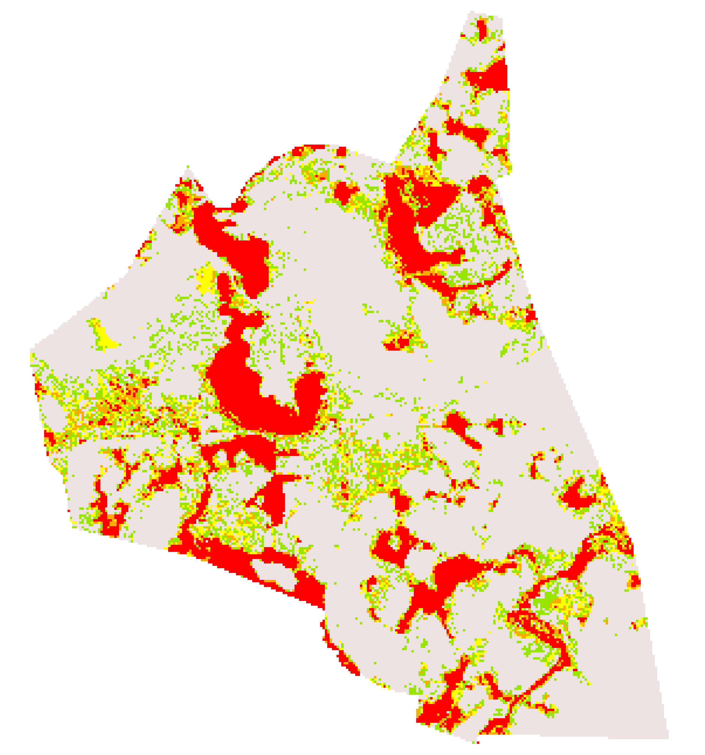

Town of Natick:
Flood Susceptibility Mapping
1
Flood Susceptibility
Very low
Probability of flooding
Low
Moderate
0
High
Very high
0
1.5
3
km
0
1.5
3
km
Notes:
Logistic regression outputs the probability of flooding in a pixel given the values of the flood conditioning factors. The team ran a multivariate logistic regression, which focuses on the relationship between flood conditioning factors. To calculate flood susceptibility, the team split this probability of flooding into five quantiles that represent different susceptibility zones.

Slide 42

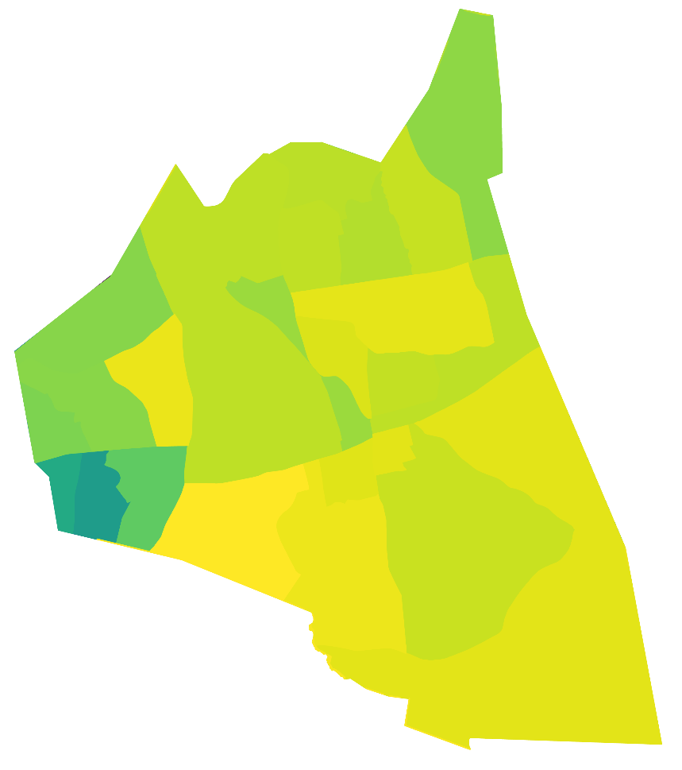
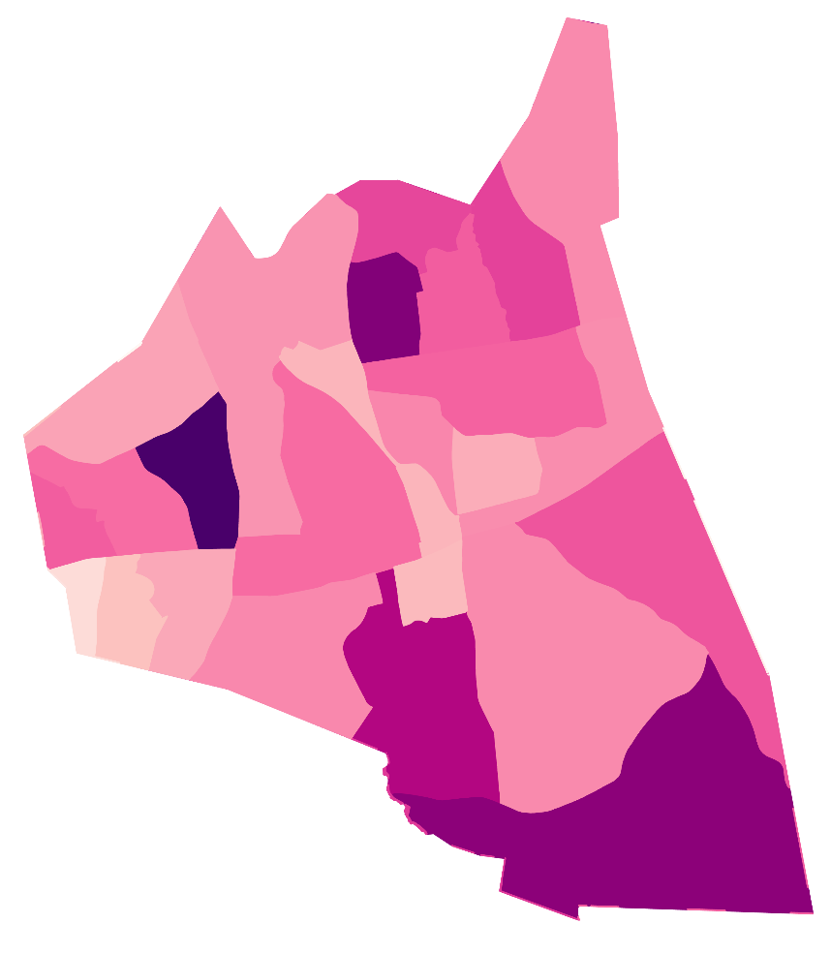
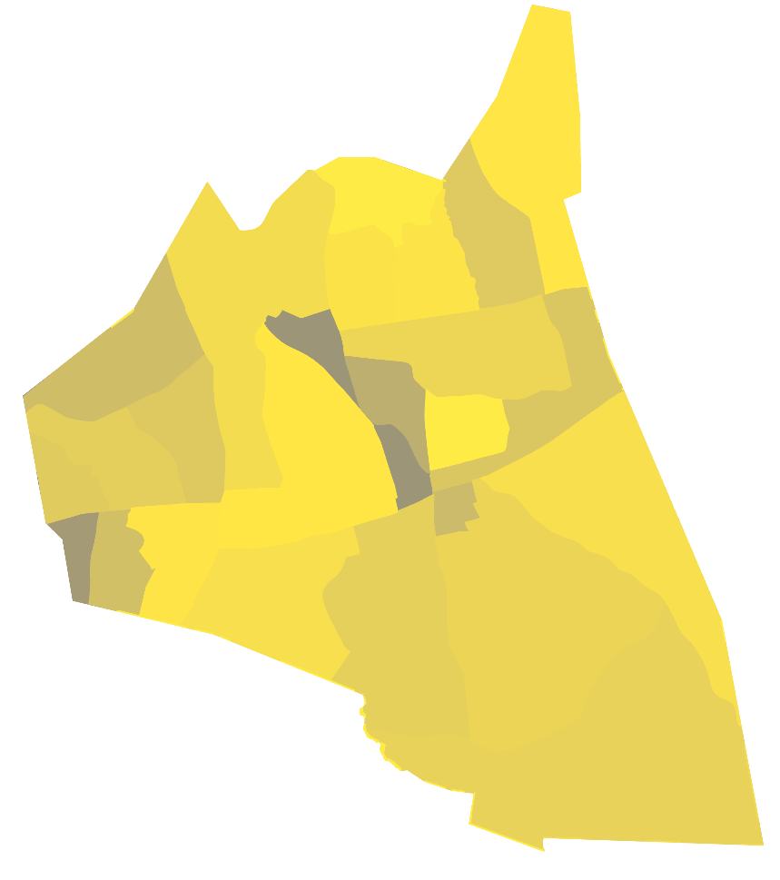
0
1.5
3
km
Town of Natick:
Flood Vulnerability Factors
70%
35%
25%
Non-White Population
Elderly Population
Population in poverty
0%
0%
0%
Notes:
*Note: This slide is specifically for the Natick Select Board presentation.
This slide shows maps of the three selected vulnerable groups. The non-white population is concentrated in a small pocket in West Natick. The elderly population appears greatest in the a pocket of West Natick and in the southern portion of Natick. The population in poverty is greatest in Central Natick and a pocket in West Natick.

Slide 43
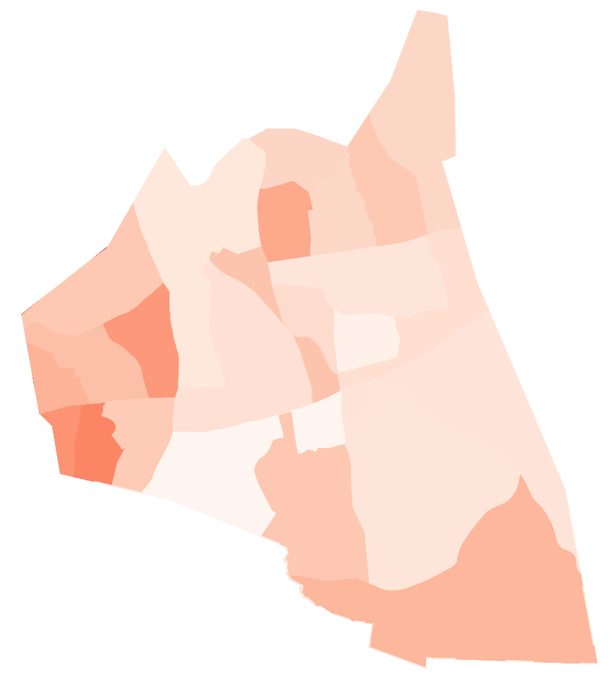
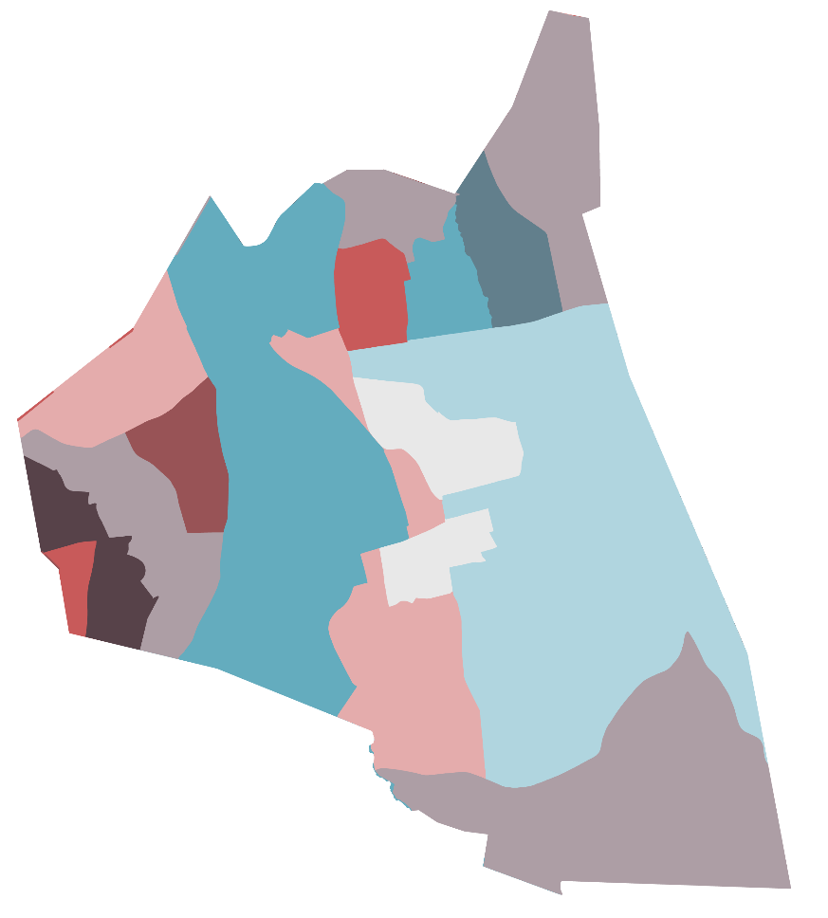
Town of Natick:
Flood Vulnerability Mapping
High
0.9
% in Susceptible Flood Area
Vulnerability Index
Low
High
0
Vulnerability Index
0
1.5
3
km
0
1.5
3
km
Notes:
*Note: This slide is specifically for the Natick Select Board presentation.
The team developed a bivariate map using the susceptibility map and the vulnerability index, as seen here. For each of the census block groups, the team calculated what percent of the pixels in each census block group fell within the flood susceptibility zone. This was mapped with the aggregated vulnerability index. Areas with a high percent of pixels in the flood susceptibility zone and high vulnerability index are the most vulnerable to flood events. According to this map, flood vulnerability is greatest in the western most pocket of Natick.

