Slide 1
Cranial Dynamical Parameters with NASA’s Pulsed Phase-locked Loop Technologies
Tom Yost
NASA-Langley Research Center

Slide 2
Presentation Outline
Introduction
Linear transcranial mechanical dynamics
  Transcranial displacement l
  Transcranial Acceleration, a
  Transcranial acceleration’s relation to intracranial pressure for patient in sitting position (graphs)
Interferometric measurements of ultrasonic waves
Transcranial changes from three consecutive heartbeats from data
Observations from the data that might lead to refinements in hypotheses and further discussions. Further questions, comments, and discussions
Notes:
What I did to get ready for this : Your interest appears to be what we can measure that will give you insights to skull expansion, especially as it pertains to migraines and other possible conditions. Specifically, we can not only measure transcranial distance, but also the time derivatives of these. We can measure the acceleration of the transcranial distance. This is very significant because of Newton’s second law, in that acceleration always is caused by unbalanced forces at the area of the skull that is being interrogated. Therefore the acceleration tells us something about the net pressure conditions in skull expansion and contraction at one location. These changes can be related to data obtained by ventricle pressure measurements, which have been well-studied and related to coarse outlines of valve closures, heart ventricle contractions, and other causes which influence ICP and hence skull expansions and contractions from pressure probes inserted into a ventricle within the brain. The purpose of this discussion is to explore the effects of small changes in ICP from three adjacent heart beats that are caused by beginnings of inspiration. The data shows that in one patient, and at one brief time interval, our instrument gives small but measurable changes that occur, and an indication of how an hypothesis for further study may be formed. Keep in mind that this information is by no means anything other than an exploration of an instrument’s capability.

Slide 3
1. Introduction
Our instrument yields information about some mechanical dynamics associated with cranial expansion.
For illustration, data on a patient is examined for three consecutive heartbeats during inspiration shows measurable changes in cranial dynamics, even for small changes in ICP.

Slide 4
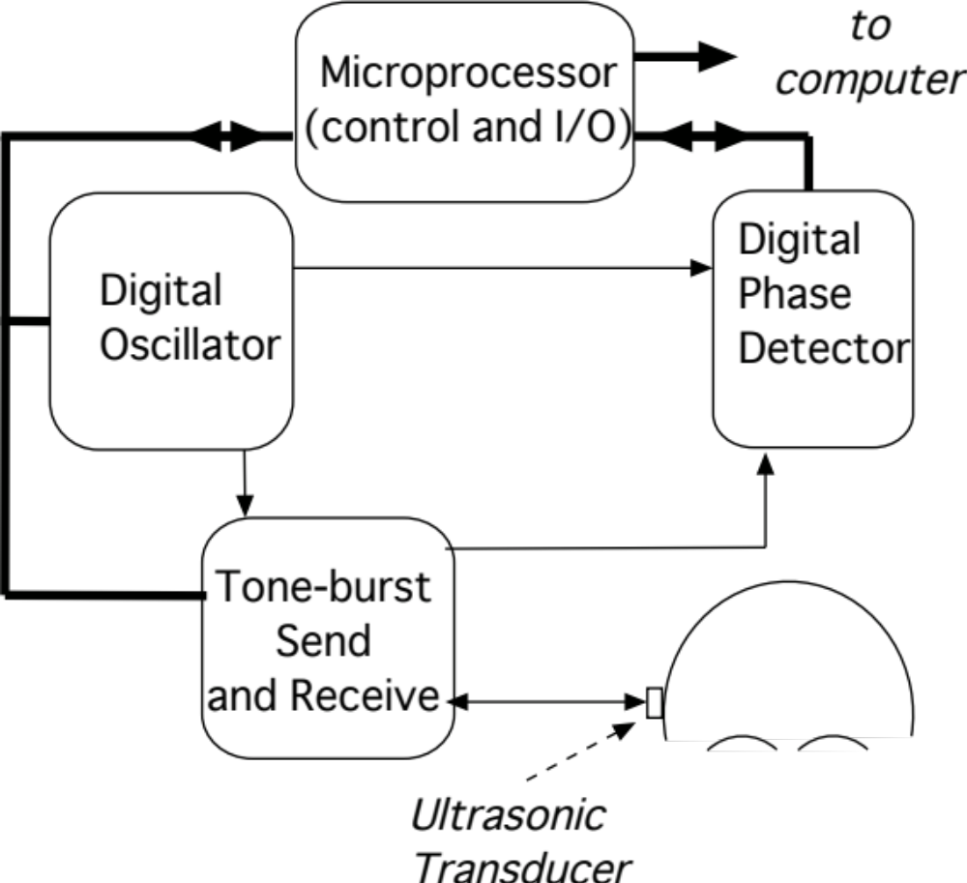
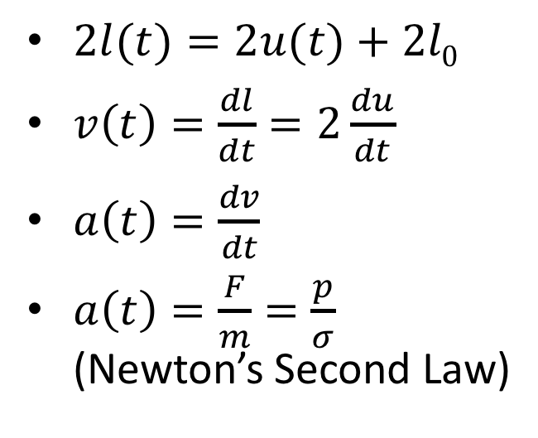
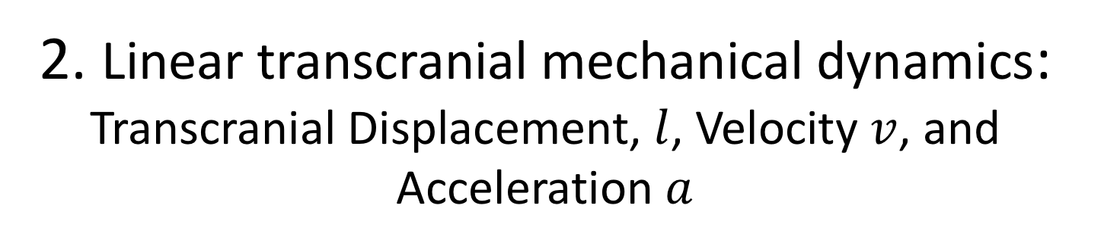
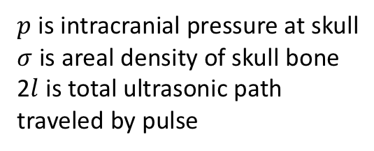
2. Linear transcranial mechanical dynamics: Transcranial Displacement, $l$, Velocity $v$, and Acceleration $a$
Ultrasonic Transducer
$2l(t)=2u(t)+2l\text{0}$
$v\left(t\right)=\frac{dl}{dt}=2\frac{du}{dt}$
$a\left(t\right)=\frac{dv}{dt}$
$a\left(t\right)=\frac{F}{m}=\frac{p}{σ}$ (Newton’s Second Law)
Reflecting
area
l₀
u(t)
u(t)
$p$ is intracranial pressure at skull
$σ$ is areal density of skull bone
2$l$ is total ultrasonic path traveled by pulse

Slide 5
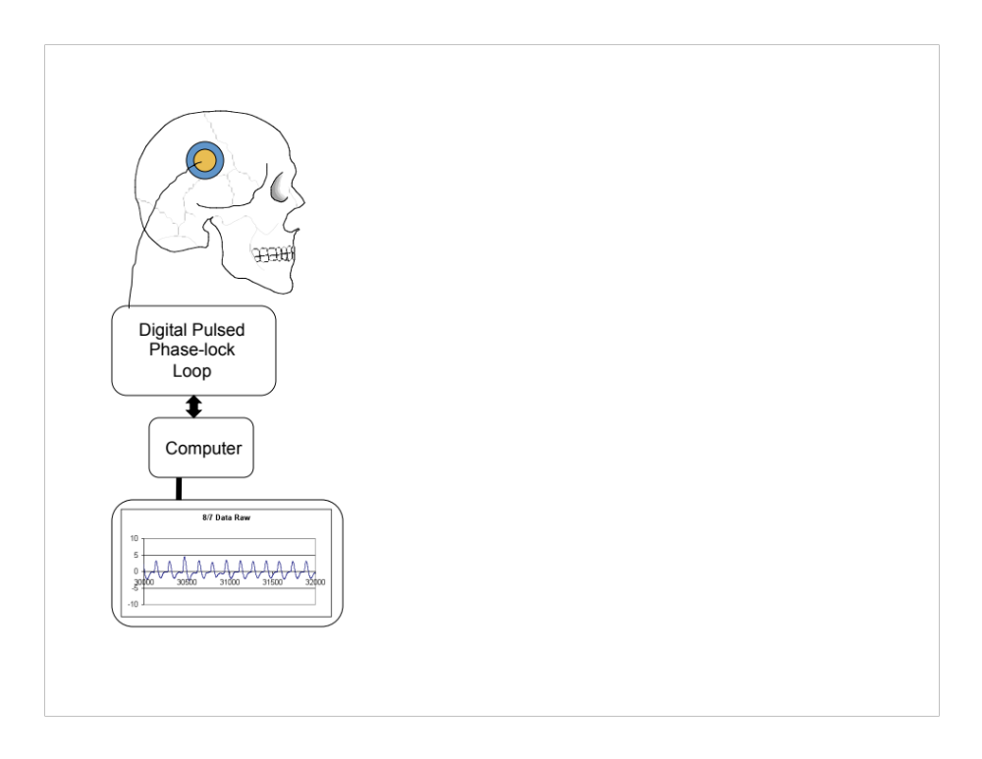
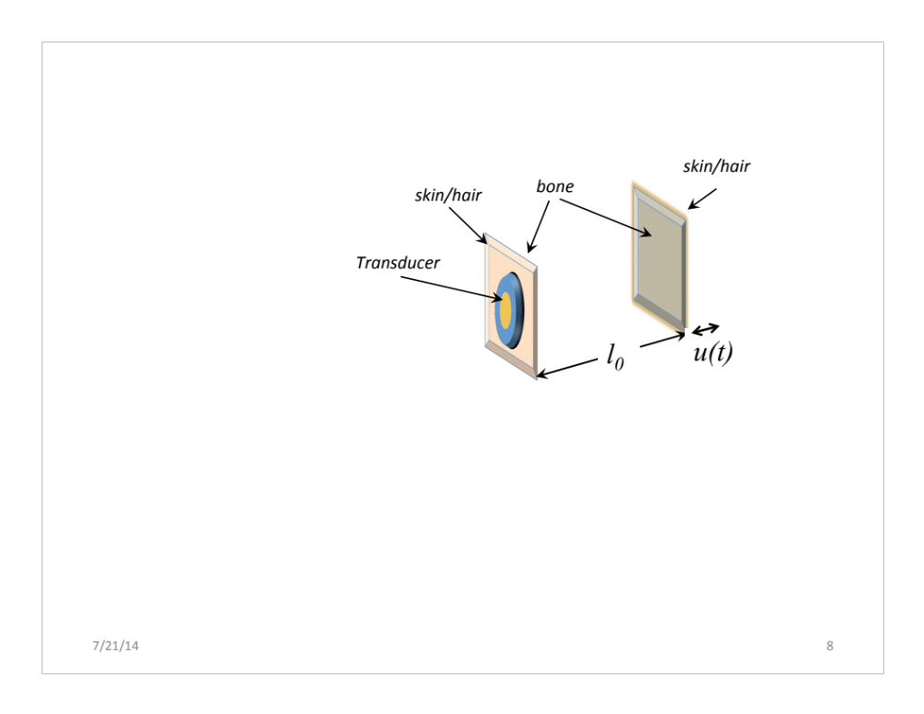
3. Interferometric measurements of ultrasonic waves: Cranial Distances
Skull Section—
opposite side
(Reflectection)
Skull Section--
with Transducer
(Transmit & Receive)
Δθ
Reference
Continuous Wave
Reflected
Toneburst Wave
(received by transducer)
Δθ = phase difference between reflected toneburst and reference

Slide 6
Comparison of pulsatile cycles at the beginning of inspiration
4. Transcranial changes from three consecutive heartbeats from data
The first slide shows the three consecutive heartbeat cycles for three functions, (1) arterial blood pressure, (2) cranial expansion, and (3) cranial acceleration. Displacement related dimensions are in are arbitrary units. Throughout the slides,
Arterial blood pressure is in mmHg
Transcranial displacement, u(t), is change from initial displacement u(t=0)=0 at initial setup.
Transcranial acceleration is d²u(t)/dt²
By using Newton’s second law, transcranial acceleration is directly related to net intracranial pressure changes.
The second slide is an expansion of the third cycle for improved clarity of the relationships among those three functions

Slide 7
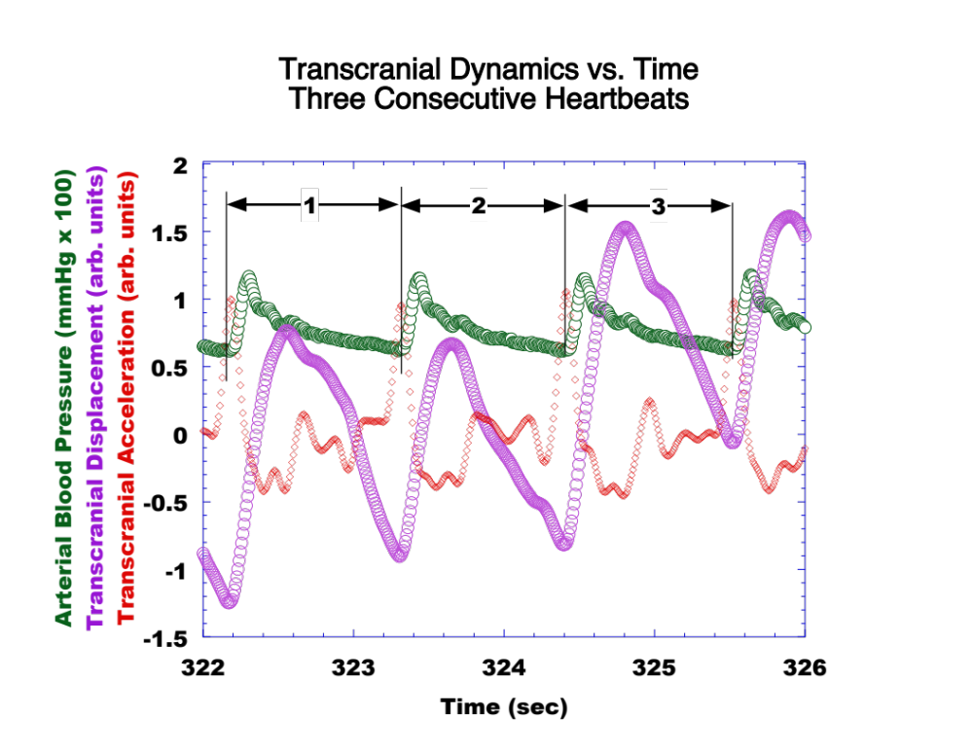
4.

Slide 8
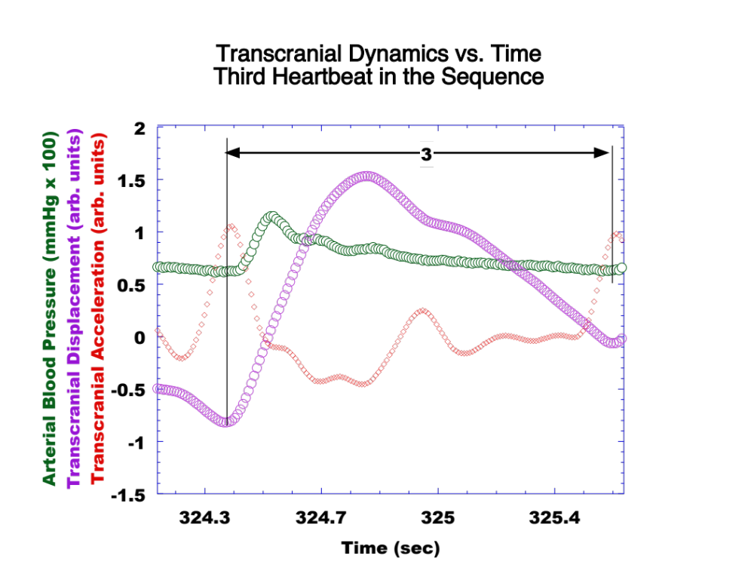
Detail—Third Heart beat
4.

Slide 9
Observations about Temporal-based Waveforms
4.
The arterial pressure waveform appears out of sync with transcranial distance waveform.
  Latency.
  Peaks don’t align in time
Within the cycle, transcranial acceleration
  shows that the skull does not equilibrate instantly to ICP changes especially at arterial pulsation (systole)
  several peaks occur, which include indications of
    Possible several damped oscillatory motions in the acceleration waveform.
    sensitive to equilibrium conditions (at timing when the transcranial acceleration is in the vicinity of zero)
    small changes in ICP, brought about by breathing (only some peak strengths).

Slide 10
Cumulative Cranial Expansions vs. transcranial acceleration:
3 consecutive waveforms
4.
Examination of each pulsatile waveform shows a contribution to cranial expansion on inspiration
The next three slides show the expansion at each cycle, and the cumulative effect from the preceding cycles.
Δl_{ι} is the net transcranial expansion for the i^{th} cycle, i=1,2,or 3
where the net transcranial expansion is plotted.

Slide 11
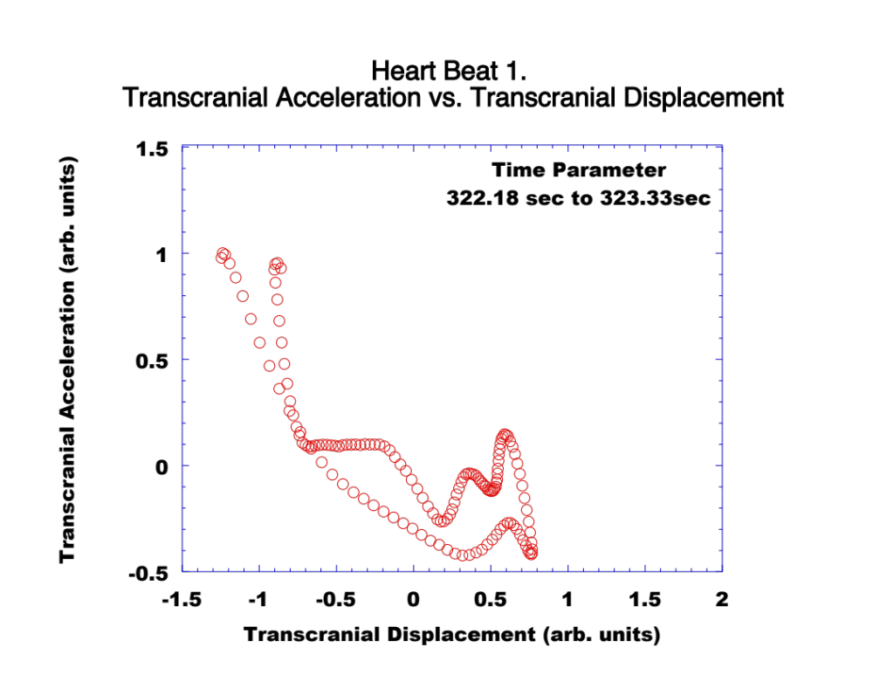
4.
∆l₁
∆l₁= 0.34 a.u.
Cycle swing = 1.94 a.u.
Equilibrium line

Slide 12
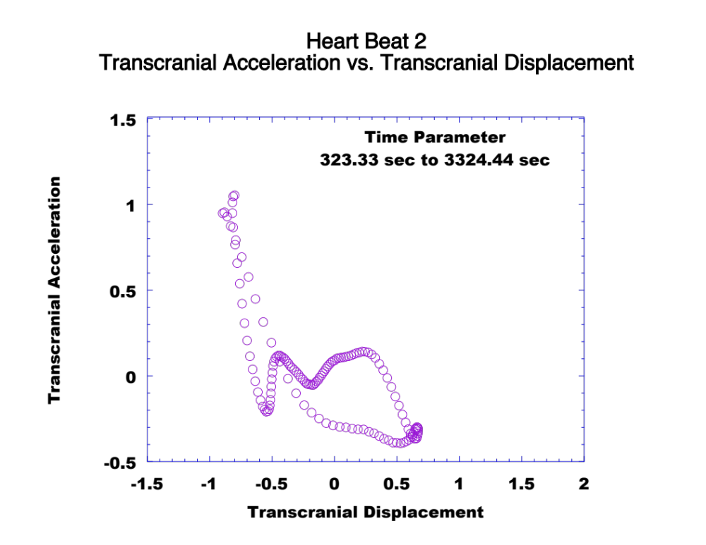
4.
∆l₂
∆l₁
∆l₂= 0.08 a.u.
Cycle swing = 1.16 a.u.
Equilibrium line

Slide 13
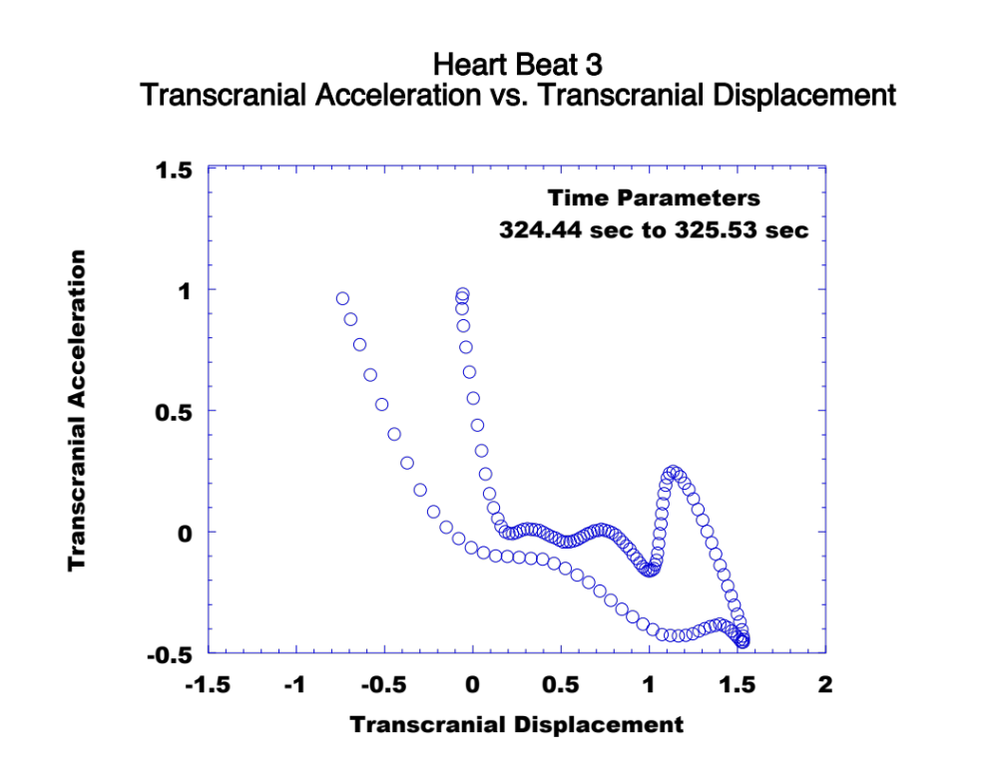
4.
∆l₂
∆l₃
∆l₁
∆l₃= 0.71 a.u.
Cycle swing = 2.20 a.u.
Equilibrium line

Slide 14
5. Calculations and their relationships with your maladies of Interest
Time-plots
Acceleration vs. Displacement plots
Potential timing and phase relationships with waves: percussion(P1), tidal (P2), and dichrotic (P3)
Oscillation frequencies in transcranial acceleration plots around P1, P2, and P3
Relative changes in amplitudes during inspiration
Transfer functions between ABP and TD, TA
Zero crossings of accelerations
Acceleration amplitudes (+ and -)
Inflection points; slope changes on each side
Δl_{ι} for all ι
Hysteresis in each cycle
Displacement width in each cycle
Zero-crossings of Acceleration and relationships to TD displacements
Acceleration amplitudes (+ and -)

Slide 15
Questions, Observations, and Comments?

