Slide 1
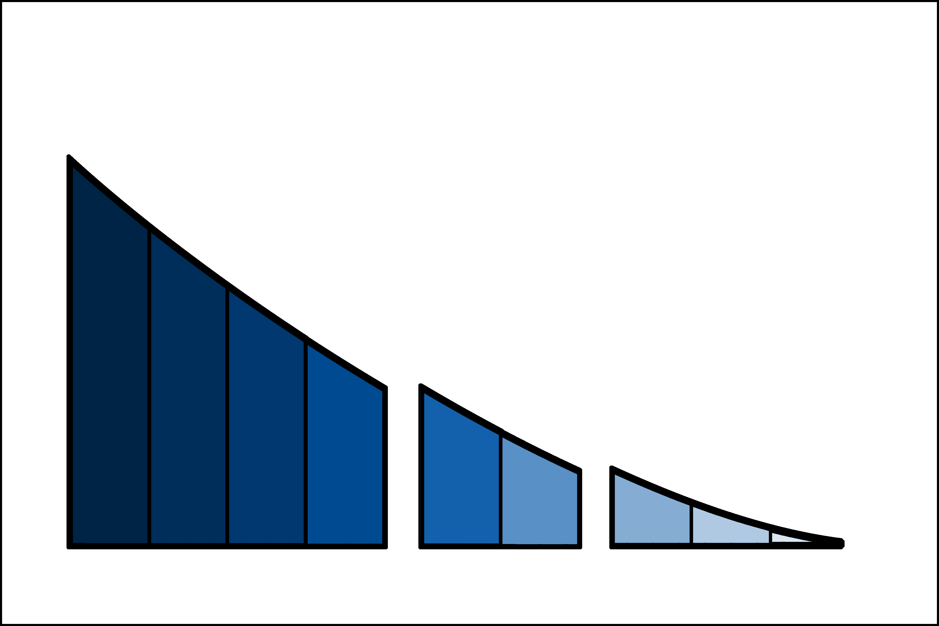
LESSONS LEARNED
Investment by TRL
Primarily Government
Internal IRAD
Angel Investors
Philanthropists
HIGH
Primarily Private Investors
Enabling Govt Support
Government as Customer
Primarily Government
Some Private Investors
Technology Valley of Death
Cold Atom Lab
Mighty Mice
GeneLab
Crystals
Private Investment Risk
Transition to Application
Transition to Manufacturing
3D Printing in Space
3-D
Tissues
ZBLAN
SiC
LOW
LOW
TRL 1
Basic principles observed
TRL 2
Technology application formulated
TRL 3
Laboratory Proof of Concept
TRL 4
Component/ breadboard tested in lab
TRL 5
Component/ breadboard validated in relevant environment
TRL 6
System prototype
Demo in relevant environment
TRL 7
System prototype
Demo in operational environment
TRL 8
Actual system completed and qualified by demo
TRL 9
Actual system proven through successful real world applications
NASA SBIR, ISS National Lab, ISS NRA, STMD Flight Opportunities
COMMERCIAL DEVELOPMENT
BASIC and APPLIED RESEARCH
NASA Biological and Physical Sciences, ISS National Lab
COMMERCIAL PROOF OF CONCEPT

