Slide 1
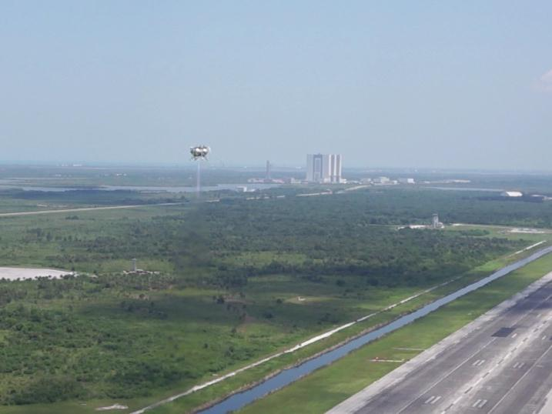

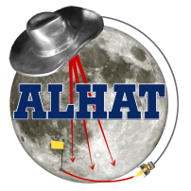
AES FY14 Review
Jon Olansen, Morpheus Project Manager
Chirold Epp, ALHAT Project Manager
22 September 2014

Slide 2

Morpheus Introduction
Morpheus is a Full Scale Robotic Lander (500kg payload) built as a risk reduction test article
  Morpheus system includes the vehicle, ground systems, operations
  Developed, tested and operated in-house at Johnson Space Center and KSC
Technologies:
  Liquid oxygen/methane propulsion (cryogenic, green, safe for ground handling and crew)
  Precision landing and hazard detection Sensors
  Leverages GSFC’s modular, reusable Core Flight Software
  Technology incubator for advanced development efforts
Tests complete: 12 hot fire, 34 tethered, and 14 free flights to date
Lean Development Approach
Forward Leaning towards Human Spaceflight
While technologies offer promise, capabilities offer potential solutions with application for future human exploration beyond LEO. Morpheus provides a bridge for evolving these technologies into capable systems that can be demonstrated and tested – in a relevant flight environment.

Slide 3
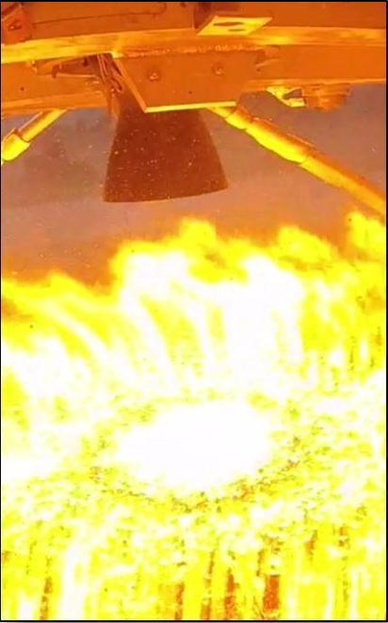
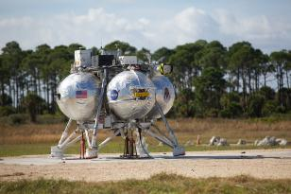
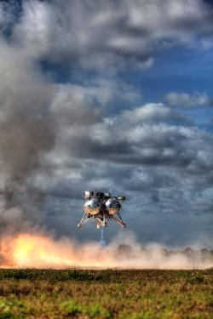
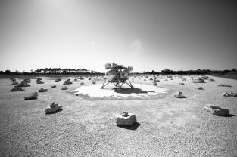
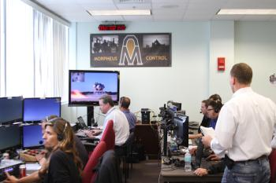
Morpheus Project Goals
Technology Advancement
  Liquid oxygen/liquid methane propulsion system
  Precision landing and hazard avoidance
Lean Development
  In-house design & build focus
  Test early, test often
Innovative Partnerships
  Collaborations with other NASA centers
  In-kind agreements with commercial partners
Education/Outreach
  Student involvement at every level
  Social media use to depict engineering development process

Slide 4






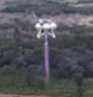



Morpheus Timeline
2010 2011 2012 2013 2014
Project M
Morpheus 1.5A Development
Pixel
Testing
Morpheus 1.0 Development
Testing
Morpheus 1.5B Development
JSC Testing
KSC Testing
Reliability upgrades
Stable hover
Precision translation
Ground takeoff and landing under tether
Engine stability
Precision landing
Free flights
ALHAT flights
HDP 1 trajectory
Built and operated by Armadillo Aerospace manual control
Proof of concept
LOX/Methane engine
APU redesign
HD4 engine
Addition of ALHAT
Stable hover under tether
Methane roll jets
JSC built & operated
Autonomous vehicle
48” tanks
HD3 engine

Slide 5
FY14 Plan & Milestones
FY14
Oct | Nov | Dec | Jan | Feb | Mar | Apr | May | Jun | Jul | Aug | Sep
KSC Flight Tests
Notional
JSC Flight Tests
KSC Flight Tests
KSC Flight Test Reports
ALHAT Enhancements & RPM Support Modifications
C0: TT & FF Hops
C1: FF Envelope Expansion
C2: HDP & ALHAT Open Loop
C3: HDP ALHAT Closed Loop
ALHAT
Closed Loop
VTB 1.5C build & testing
3/1
9/30
FY14 CR Mark supports planned KSC Testing completion in January Additional funds required for Q3 & Q4
Milestone | Date
Complete KSC flight tests of ALHAT on Morpheus lander to demonstrate closed-loop control of vehicle and autonomous Hazard Detection and Avoidance (HDA) | 2014-Mar-01
Complete Morpheus/ALHAT/RPM Free Flight tests at KSC (Notional) | 2014-Sep-30
Center | Interaction/Collaboration
JPL & LaRC | ALHAT
KSC | Test Flights, RESOLVE
GSFC | Flight & Ground Software
SSC | Engine Testing
MSFC | Propulsion Development, DMSL nozzle testing, Lander Partnership
ARC | Resource Prospector Mission
ALHAT flight tests
HQ Tracked
Milestones

Slide 6
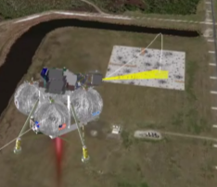
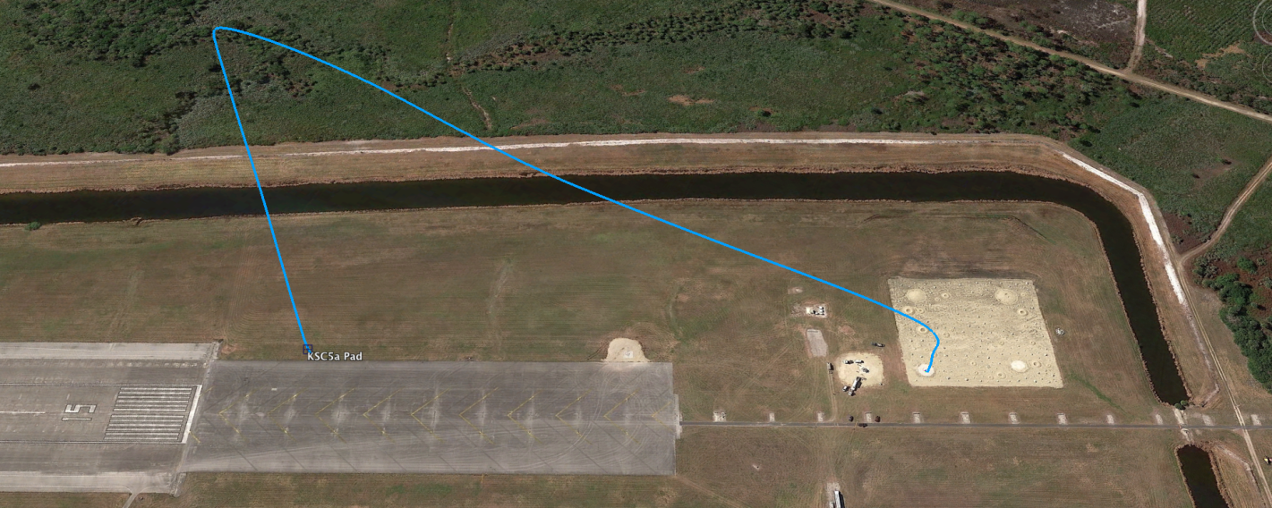


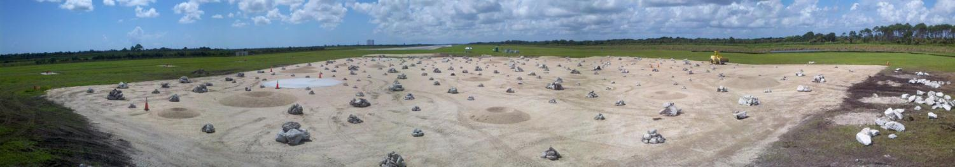
KSC Testing Objective:
Hazard Detection Phase (HDP) Trajectory
Simulated lunar approach profile that exercises ALHAT sensors and navigation, GOAL: Closed-Loop ALHAT Navigation
ALHAT Landing Site Selection
Approx. 450 m slant range
30 degree glideslope
Land in 100m x 100 m hazard field
Launch from “flame trench” pad
Shuttle Landing Facility at KSC with Simulated Lunar terrain

Slide 7



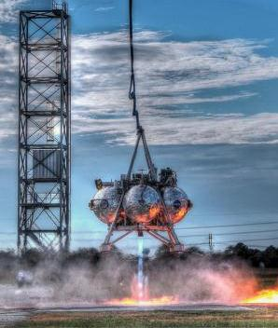
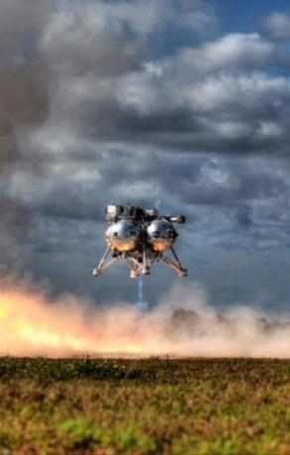
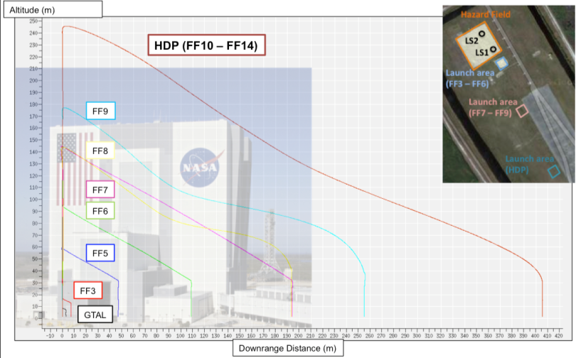
Summary of Morpheus 1.5B Testing
Tether tests
Ground Take-off
and Landing (GTAL)
JSC
Testing
Hot fire
(static engine tests,
ground interaction)
Free-Flight Envelope Expansion
Free-Flight Tests
KSC
Testing
Free flights

Slide 8

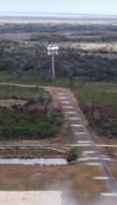

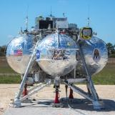
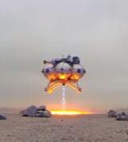
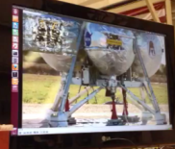


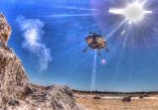
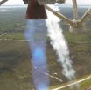
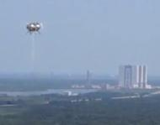
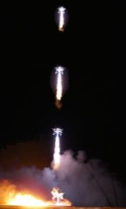



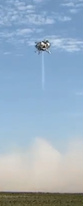
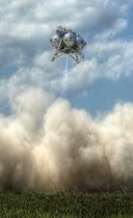
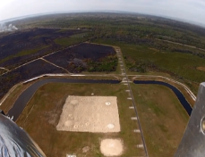
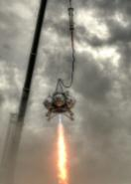
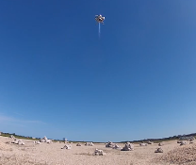
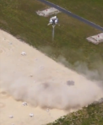
Morpheus 1.5B Testing - KSC
Started Dec 6, 2013
Morpheus 1.5B (2013-2014)
Tether 33
Dec 6
54 sec
FF3
Dec 10
54 sec
15 m x 7 m
FF4
Dec 17
82 sec
50 m x 47 m
Free Flight 5
Jan 16
57 sec
57 m x 47 m
Free Flight 6
Jan 21
64 sec
93 m x 109 m
Free Flight 7
Feb 10
68 sec
144 m x 194 m
Hot Fire12
Feb 14
RCS Only
Hot Fire13
March 3
RCS Only
FF8
March 5
82 sec
144 m x 194 m
>300,000 views
FF 9
March 11
83 sec
177m x 255 m
Tether 34
March 27
ALHAT
FF10
April 2
96 sec
ALHAT OL
245 m x 406 m
FF11
April 24
98 sec
ALHAT OL
245 m x 406 m
FF12
April 30
94 sec
ALHAT OL
245 m x 406 m
FF13
May 22
95 sec
ALHAT CL
245 m x 406 m
FF14
May 28
98 sec
ALHAT CL
245 m x 406 m

Slide 9
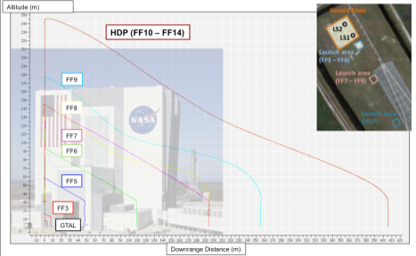
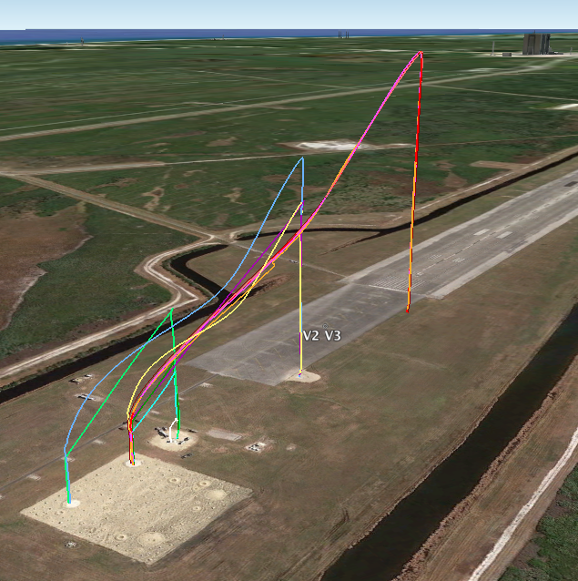
Flight Test Highlights
Completed 12
tremendously awesome
free-flight tests, including
5 full HDP Trajectories
Max speed:
36 mph vertical (15.9 m/s)
30 mph horizontal (13.4 m/s, FF9)
Total vertical height:
1905 m (6250 ft, 1.2 miles)
Total horizontal distance:
2883 m (9450 ft, 1.8 miles)

Slide 10

Project Success Criteria
AES Objectives | Project Success Criteria | Met? | Description
Rapid development and demonstration of prototype systems | Did the project complete its annual milestones? |  | Completed ambitious KSC FF test milestone schedule
Pioneer innovative approaches to improve affordability | Did the project implement innovative approaches to improve affordability? |  | MS SharePoint electronic documentation for PM, SE&I, T&V, CM, etc. Using expensive HW from other Programs (e.g., Orion SIGIs) Used low-cost vendors on MFG.com for some structural elements Low-cost COTS components bought online & locally with P-Cards
Create opportunities for the NASA workforce to gain hands-on experience and learn new skills | Was most of the work performed in-house by civil servants instead of being outsourced to contractors? Did people learn new skills? |  | 73 FTE (85%) in FY12 and 55 FTE (68%) in FY13 performed most work Team members learned many new skills with hands-on design, manufacturing and flight test experience, e.g., SE&I and T&V; wiring; design, manufacturing, testing and operation of rocket engines and Vertical Test Beds (VTB), and Flash LIDAR & Doppler LIDAR sensors
Multi-disciplinary, highly-collaborative project teams working across organizational lines | Did the project interact with other AES projects? Did the project involve multiple NASA centers? |  | See “Collaborative Partnerships” and “FY14 Plan, Milestones & Interactions” slides Interaction with RESOLVE, SRP and other AES projects 8 NASA centers involved in Morpheus vehicles, ALHAT sensors, and ground and flight testing
Infuse new technologies and capabilities into exploration missions | Did the project incorporate new technologies? Has the project identified a customer or end user? |  | New technologies include first known flight test of integrated LOX/methane RCS and main engine propulsion systems, and autonomous landing with hazard detection and avoidance (ALHAT) Customers include all projects with lunar/planetary landers
Leverage partnerships to amplify investments | Did the project establish partnerships with external organizations or other NASA programs? |  | See “Collaborative Partnerships” slide External partnerships with commercial aerospace (Armadillo, Masten), universities (Marquette, Purdue, UT), ESA, ULA, etc.
Outreach | Did the project engage the public through outreach activities? |  | Morpheus web site includes blog, videos, live streaming, & links to… Twitter (“Vehicle” Tweets during tests), Facebook page & YouTube ch. FF8 had > 450K views; most since FF2 Morpheus & ALHAT personnel visit schools for outreach Morpheus is VERY popular with co-ops and interns for work tours!

Slide 11


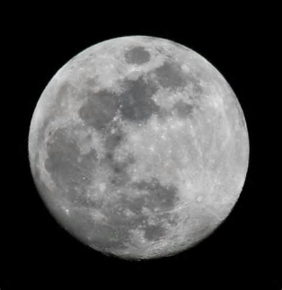
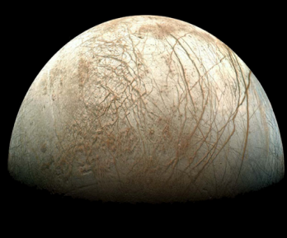
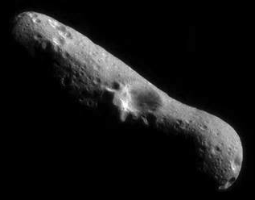
Mission-Enabling Capabilities
The mission of the ALHAT team is to develop, demonstrate, and infuse autonomous, real-time, 3-D terrain mapping and surface-relative navigation technologies promoting safe, precision landings on any solid planetary body under any lighting conditions.
Mars
Rocky terrain
Canyons
Enceladus
Geysers
Asteroids
Moon
Dark poles
Craters with ice
Redirect
Mission
Europa
Ice sheets
Rendevous &
Sample Return

Slide 12
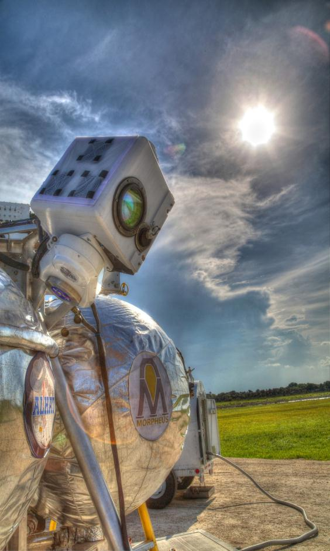
Fundamental ALHAT Functions
Terrain Relative Navigation (TRN) – Global Navigation
  TRN function compares onboard reconnaissance data with real-time terrain imaging data to update the onboard navigation state.
  Enables early and efficient elimination of major trajectory errors and delivers the lander into close proximity to the pre-defined landing area
Hazard Detection and Avoidance (HDA)
  ALHAT Hazard Detection System (HDS) generates a high-resolution, 3-D terrain map in real-time during the descent and landing trajectory. The HDS ranks the safe landing aim points and delivers the safe site list to the lander GN&C system.
  The landing vehicle must possess sufficient propulsive divert capability to reach the selected safe site.
Hazard Relative Navigation (HRN) – Local Navigation
  HRN function compares the high-resolution onboard terrain map developed by the HDS during the descent and landing trajectory with subsequent real-time terrain imaging data to update the onboard navigation state as the vehicle approaches the landing site. HRN accurately positions the lander above the safe landing site.
Inertial Navigation to Avoid the Dust Problem During Terminal Descent
  Lidar sensors initialize the lander navigation system with precise ground-relative measurements before the lander engine kicks up dust. Inertial navigation can then be used to very accurately dead reckon to the safe landing site.

Slide 13
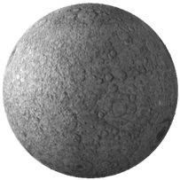


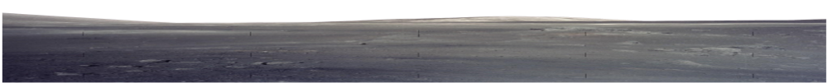

ALHAT for Lunar Landing
100 km
Deorbit maneuver
Powered Descent Initiation (PDI)
Transfer Orbit Phase (coast)
Powered Descent Phase
~1 hr
Braking Phase (TRN)
1.5 – 3 min
Efficiently reduce velocity from orbital speeds
Pitch-up Maneuver
Hazard Detection
Short pitch-up and throttle-down maneuver
Human Interaction
Approach Phase (HDA, HRN)
Hazard Avoidance
~15 km
View landing site while approaching at a low throttle and relatively constant attitude
Terminal Descent Phase
~50 m
Vertical descent to surface
Touchdown
NOTE –
Not to scale
300-600 km (8-10 min)

Slide 14



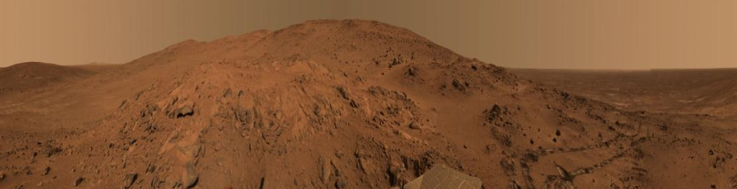
ALHAT for Mars Landing
(
Entry Interface
(
Entry
Chute Deploy
(
Aeroshell Separation
Begin Sensing
Terrain
Relative
Navigation
Initiate
Powered Descent
Illustrative Only
- Not to Scale -
Chute
Release
Continue TRN
Early divert
to remove entry dispersions
Hazard Detection Phase
~ 6 km
Detect Hazards
Rapidly divert to identified safe
landing site
Accurate and
controlled landing
~ 1 km

Slide 15
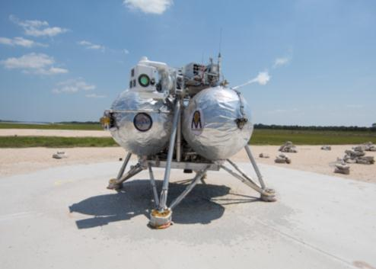
ALHAT Free Flight Performance
The objective of the Morpheus-ALHAT free flights was to demonstrate real-time hazard detection with safe site selection and accurate surface-relative navigation to land within 3 m of the selected safe site
FF10 was the first terrestrial flight demonstration of the ALHAT real-time hazard detection and avoidance system fully integrated with the Morpheus VTB
The first three flights were flown open loop with the vehicle navigated by the Morpheus navigation filter which used GPS, the SIGI IMU, and a COTS Acuity altimeter
The last two free flights were flown closed loop using the ALHAT Nav filter with the SIGI IMU, flash lidar for hazard detection and safe site selection, and the NDL and the LAlt to maintain a good surface-relative state

Slide 16
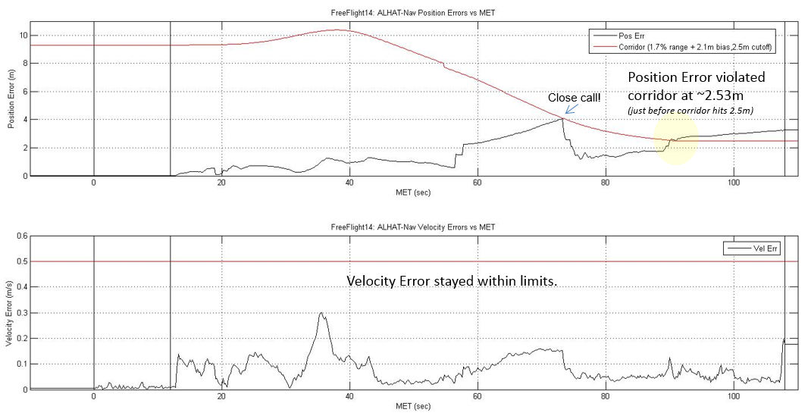
ALHAT Free Flight Performance
A navigation corridor was established that defined the acceptable limits on the position and velocity differences between the ALHAT state and the Morpheus state to ensure a safe and controlled landing of the vehicle
On FF13, the corridor position limit was exceeded during the HRN phase and AFM moded to VTB Nav and for FF14, the corridor limit was exceeded late in the trajectory, approximately 25 m before touchdown.

Slide 17
ALHAT Performance Summary
In general, the ALHAT System worked very well with just a few exceptions. In particular induced environmental effects were not adequately anticipated
  Liftoff dust cloud that drifted between the vehicle and the hazard field affected flash lidar data, particularly during HRN
  Hot, turbulent air from the engine plume caused major drop outs of Doppler lidar data, and three beam data was very limited
  This was the first time that the ALHAT navigation filter was fully integrated with ALHAT sensors in a dynamic flight environment and there was insufficient time to fully understand and resolve software integration and formulation issues during the free flight campaigns

Slide 18
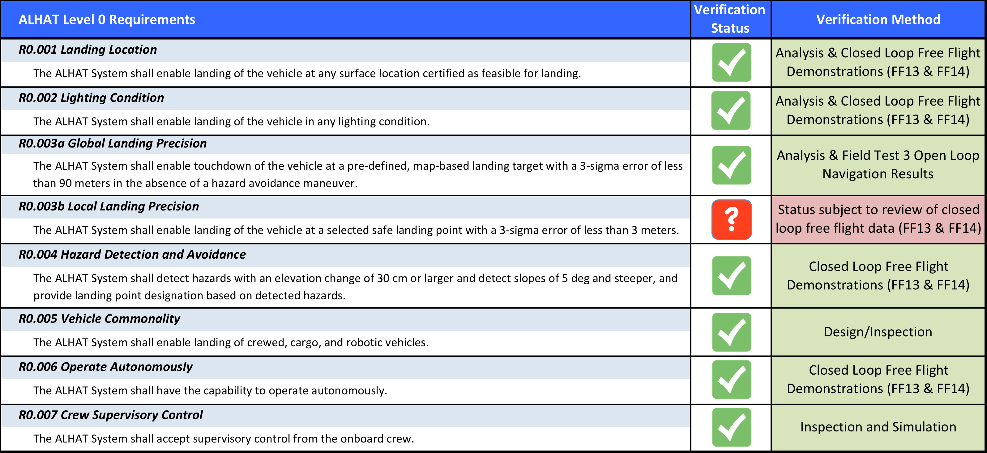
VERIFICATION OF
ALHAT LEVEL 0 REQUIREMENTS
Verification of R0.003b via closed loop flight demonstration was prevented by:
ALHAT lidar sensor interactions with the induced flight environment
Lack of flight experience with the ALHAT navigation filter
Violations of imposed free flight corridor safety constraints relative to VTB nav

Slide 19
FY15 Options

Slide 20



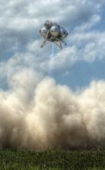
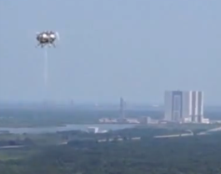

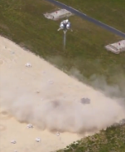
Purpose of Additional Morpheus/ALHAT Flights
The Morpheus/ALHAT project declared success after five fully integrated free flights at KSC, with three precision open-loop and two closed-loop flight tests
However, there are some objectives yet to be demonstrated fully:
  Engine plume prevented Doppler Lidar from collecting 3-beam data through much of flight
  ALHAT nav did not correctly process Hazard Relative Navigation (HRN)
  Vehicle transitioned from ALHAT nav back to VTB nav just before final descent
Additional flight testing will provide the opportunity to:
  Demonstrate completion of objective to fly full trajectory on ALHAT Nav with
  HRN and safe site selection by HDS
  Better demonstrate capability of Doppler Lidar in new mounting location without plume interference
Tether 34
Mar 27, ALHAT
FF10
Apri2, 96 s
FF11
Apr 24,98 s
FF12
Apr 30, 94 s
FF13
May 22, 95 s
FF14
May 28, 98 s

Slide 21
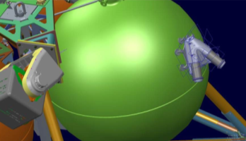
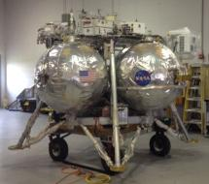
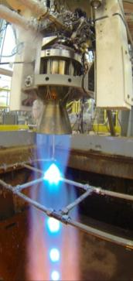
Factors to Consider for Flying Again
Team has worked nav analysis to increase likelihood of
meeting objectives for next flight
  Replay and sim show marked performance improvement
  Also planning to relocate Doppler Lidar to reduce plume interference
Required personnel need to be available for KSC test campaigns
  This may get tougher the longer we delay
As long as the vehicle is at KSC we have to continue paying
maintenance costs
Engine life is a concern
  The propulsion team has continued to monitor crack growth on the injector face oxygen orifices after each flight
  The current engine (HD4A) has over 3000 seconds of run time; but it is expected to be good for at least one more free flight, and quite possibly more
    Failure not expected to be a risk to flight; if cracks grow further, engine needs to be swapped for spare
  The HD4B engine has already been tested at Stennis, but needs a couple more tests to finalize the performance data needed for flight
    Swapping engines requires a tether test prior to resuming free flights
    Testing could be performed using the nearly finished C vehicle instead of at Stennis
Alternate DL location on +Z tank
Bravo in storage at KSC
Morpheus main engine test at SSC-E3

Slide 22
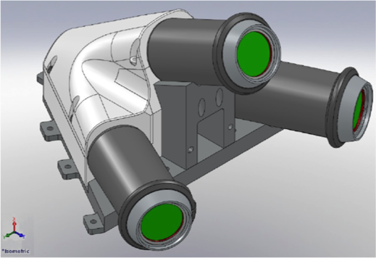
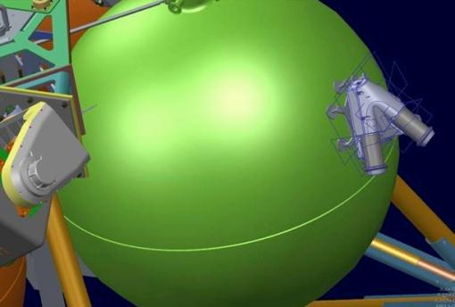
ALHAT/Morpheus FF15 Forward Work
  The Morpheus/ALHAT Projects are ready to perform two more free flights at KSC with the updates listed below:
  Flight placard to mitigate dust cloud impact
  HDS: reintegration of HDS LN200, FL pixel checks, ground functional checkouts
  LAlt: laser repair and replacement, calibration, reintegration onto vehicle, ground functional checks
  NDL: fabrication of new optic head and mounting bracket, beam alignment, reintegration onto vehicle, on-vehicle metrology, ground functional checks
  Checkout updated navigation filter I-loads and update the Morpheus flight software with the updated navigation filter software.

Slide 23
Morpheus/ALHAT Advances

Slide 24


SE&I - Project Scale of Rigor
May or may not use guidelines
Learn as you go
May only implement processes after failure
Research & Development
Human Space Flight
NASA guidelines:
NPR 7120.5d, 7123.1, 7120.2, etc.
Low cost project
Low consequence of failure
Easily replaceable hardware
Little schedule pressure
Under the radar
Process Rigor
CM, Requirements, Data Management, Formal Documentation, etc.
Technical Rigor
Factors of safety
Quality control
Amount of testing,
etc.
More documentation, rigor, discipline, record-keeping, planning, etc
High dollar project
High reliability required
Crew safety
Mission critical
Expensive payloads
High visibility
Schedule constraints
Costly replacement
Paying customer
1.5A
1.5B
Technology
Development / R&D
Morpheus
ALHAT
Shuttle, ISS, Orion
The scale of project rigor should always be adapted to the needs and scope of the project. Some attributes will drive rigor but not equally for all processes.

Slide 25
SE&I - Maintaining Data Relationships
What have we tested? What are the results?
How will we test and verify it does what it should?
Verification may be by testing
Testing results in discrepancies
Test Log
What should our system / subsystems do?
Requirements get verified
What discrepancies have occurred? Are they fixed?
Verification List
Requirements
Changes need to be verified
Discrepancies are linked to MEL items
Discrepancies
Design changes may be needed to meet requirements
Design changes may be needed to address discrepancies
Discrepancy fixes lead to actions
What are the actions? Who’s assigned and when are they due? Are they complete?
Design Changes
Action Items
What design changes are proposed and why? Have they been vetted and integrated impacts accepted?
Design changes lead to actions
Design changes lead sys config changes
Master Equipment List
Individual databases or spreadsheet products typically do not allow ways to link data without intermediate applications.
What are the hardware items and their properties?

Slide 26
Technology Advancement – ALHAT Sensors
ALHAT project developed, refined, and demonstrated closed loop operation of three advanced lidar sensors in a relevant flight environment
Laser Altimeter combines extended operational range, high repetition rate, and very high accuracy and precision
Three beam Doppler Lidar provides extraordinary surface-relative velocity accuracy and precision and can also provide simultaneous line-of-sight range measurements
Flash lidar uses TigerEye Sensor Engine, a custom-built laser, and real-time gain control and calibration algorithms to achieve long distance operation with improved 3-D image quality compared to prior art
  ALHAT invested considerable resources on NIR detector and Read-Out Integrated Circuit (ROIC) technologies to further increase sensitivity, improve range measurement accuracy and precision, and reduce noise
  These investments are being leveraged in the ARM BAA sensor suite development efforts
The recent closed loop Morpheus/ALHAT free flights has advanced the ALHAT sensor hardware and software to TRL 6

Slide 27
Technology Advancement – ALHAT TSAR Software
ALHAT project developed, refined, and demonstrated closed loop operation of two advanced terrain sensing and recognition software functions in a relevant flight environment
Hazard Detection & Avoidance (HDA) generates a terrain DEM, parses it for slope and roughness hazards, and generates a ranked list of safe landing sites (TRL 6)
Hazard Relative Navigation (HRN) compares the high-resolution terrain DEM generated during the descent and landing trajectory with subsequent real-time terrain imaging data to update the onboard navigation state as the vehicle approaches the landing site
  Processing of HRN measurements by the onboard ALHAT navigation filter was not fully successful during the recent Morpheus/ALHAT free flights
  HRN is deemed to be TRL 5 pending a fully successful end-to-end demonstration
ALHAT project developed, refined, and thoroughly tested multiple Terrain Relative Navigation (TRN) software algorithms for lidar and passive optical sensors in open loop flight on a fixed-wing aircraft over a variety of terrains, operational altitudes, and lighting conditions (TRL 5+)

Slide 28
Technology Advancement – ALHAT Navigation Filter
ALHAT project developed an extended Kalman navigation filter for safe, precision landing and matured it in cooperation with the Morpheus project
ALHAT Nav filter uses a dual-state inertial/surface relative approach to rendezvous the spacecraft with the selected landing target
ALHAT Nav filter performance was reasonably successful during the closed loop Morpheus/ALHAT free flights
  Completed most of FF13 and nearly all of FF14 using ALHAT Nav despite the tight navigation corridor constraint relavtive to VTB Nav
  Processing issues with respect to ALHAT HRN and NDL measurements resulted in sufficient divergence from VTB Nav to violate the trajectory corridor boundary
  Playback and simulation results from recent revisions to the ALHAT Nav filter appear promising for future free flights, but the ALHAT Nav filter is deemed to be TRL 5+ pending a fully successful end-to-end demonstration

Slide 29
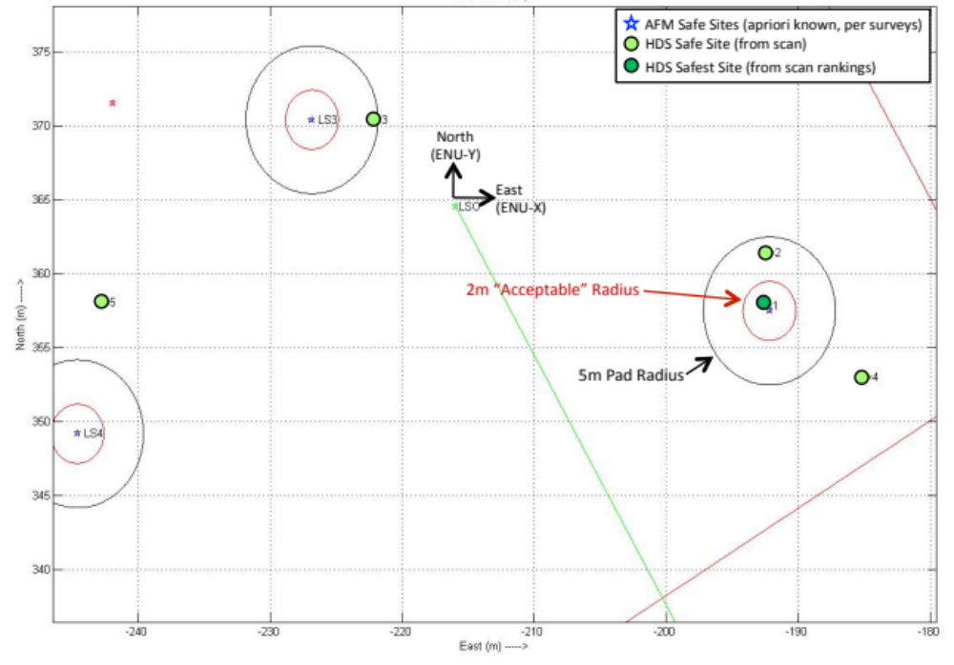
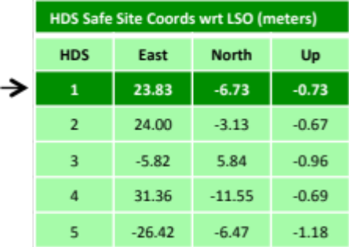

ALHAT Landing Site Evaluation
Landing Site Designation
  Designates landing site location based on HDS scan data (cross-checked with apriori-known safe site locations it maintains) and commands offset “divert” coordinates to Guidance, accordingly.
  Maintains a safe site for flying a Designated Abort safely into the Hazard Zone, in case of ALHAT-Fail.
FF13 Data
Landing Site Evaluation Overview Page:
(several links from this page)
https://oasis.jsc.nasa.gov/projects/ProjectM/GNC/Morpheus%20Flight%20Dynamics%20Wiki/1.2.13.6%20Landing%20Site%20Designation%20and%20Abort%20Zones.aspx

Slide 30




Technological Advances - Propulsion
Engines
In-house designed and built ~5300 lb thrust LOX/Methane main engine
  Demonstrated reliable performance in relevant flight environment
  >3000 sec of run time
  Identified design considerations that influence engine stability
Integrated LOX/Methane RCS engines for roll control
Feed System and Tanks
Propulsion subsystem maturation including feed system and startup conditions for engine stability
Propellant management with multiple tanks in quad tank lander design
Tested and demonstrated aluminum tanks with cryogenic propellants

Slide 31

Technological Advances - Propulsion
System Level Operations
Conducted 12 Hot-Fire Tests, 34 Tether Flights, 12 Free-Flights
System Level Flight Operational Experience Gained
  Prop System Turnaround measured in hours
  No major issues working with LNG and Lox
    ie. No hardstarts/No purge run for RCS in-flight, no corrosion, little to no soot, safed quickly with GN2 post flight
Low Cost of development, fabrication, and operations
  Developed and Built 3 vehicles for ~500K per year procurement $90K in FY2014, + 6-7 FTE
High Vapor Pressure & clean propellants is good for engines and operations
All Hardware common between O2 and CH4
Parallel Tank Differential Draining – Prop Manag.
Capacitance probe in each tank
Demonstrated propellant balance during free flight
Demonstrated self-correcting behavior (passive, no liquid control valves)
Propellant Slosh Control
Demonstrated damping of Lo2/Methane propellants
Four RCS jets x 20 lbf(max)
Demonstrated GNC control using Lox/LNG RCS engines
40msec to 30+sec pulses
Operated in blowdown from 350 psig to 160 psig
Operated over range of Inlet Conditions in flight
    Gas-gas , gas-liq ., liq.-liq.
Reliable engine and ignition obtained after a few modifications
  Spark extend, Pc tube locations, plug mods
Integrated Main Engine and RCS, Tank & Feedsystem
Blowdown Pressurization
RCS feedsystem mounted to tanks and TVS operated in flight
Cryo RCS worked even in Texas and Flordia summer environment
    Venting seen in videos is the initial chill-in from gas to liquid temps
Tanks used purged aerogel blankets ( non-flammable)
Gimbaled, Throttled Main Engine
~5400 lbf engine
>4:1 throttle capability with simple ball valve mechanism
>2500 sec operations, > 120 starts
Excellent stability during main stage
Start is stable with cold Lox and warm methane gas. Possibly unstable if liquid methane

Slide 32




Technological Advances – Precision Landing
GN&C
  Core G&C design for thrust vector control with gimbaled, throttling engine and roll control jets
  Multi-sensor precision navigation, including vibration isolation of IMUs
  Autonomous flight manager architecture
  Demonstrates capability for autonomous GN&C during final approach of lunar descent and landing
PA1 SIGI in Vibe Isolation Cage
ALHAT
  Integrated ALHAT hardware with vehicle and operations
  Autonomous hazard detection and trajectory re-planning
  Precision landing using only inertial and surface relative navigation
Hazard Field at SLF
ALHAT Flash Lidar mounted on Morpheus
HDP Launch Pad

Slide 33

ALHAT HDP Profile

Slide 34

Summary of Flight Test Results:
Landing Accuracy

Slide 35

Advances – Flight Software
Software
  GSFC’s Core Flight Software on-board; incorporated reusable AFM and GNC algorithms
  GSFC’s ITOS for ground software and displays; updates fro near real-time usage
  Flight and ground software architecture matured; core services and executive complete; timing and avionics data management; designed for FDIR
Simulation
  Uses JSC’s Trick environment
  (C++)
  EDGE graphics for situational
  awareness during flight and
  for ops team training
  Matches flight data well…
  All trajectories closely matched prediction from ops team sim the day before;
FF7 depicted
Simulation
Flight

Slide 36
Morpheus 1.5B Flight Software Architecture
GNC Sensors
Prop EMAs, HW, Valves, Sensors
Wireless
Framed CCSDS
57.6Kbps / 100Mbps
C&T Hardware,
Serial Radio and/or
Hard-line Ethernet
4 video cameras
HDS/ALHAT Sensors
PWM FW
Doppler Lidar
Ethernet
Doppler
IO
Video Switch
5 Hz
232
Telemetry
Output
Command
Ingest
House-
keeping
Scheduler
CFDP
File
Manager
Laser Alt.
Ethernet
Lalt
IO
A I/O
D IO
MTV
10 Hz
10 Hz
10 Hz
100 Hz
5 Hz
100 Hz
100 Hz
HDS
Ethernet
HDS
IO
50 Hz
Mass
Storage
SSR
SIGI
SIGI,
1553
IO
50 Hz
1553
GNC-N Apps
PPS
Javad
GPS
5 Hz
Nav – KF (Kalman Filter)
(VTB & ALHAT)
Nav Fast
Propagate
(VTB & ALHAT)
Nav
UPP
232
GPS IO
Nav - IMU
Preprocessor
Data
50 Hz
5 Hz
50 Hz
50 Hz
Storage
Acuity Alt.
5 Hz
Bkground
232
Alt IO
Inter-task Message Router (SW Bus – Publish/Subscribe)
Health &
Safety
Manager
1 Hz
1 Hz
AHRS
AHRS
IO
1 Hz
232
50 Hz
Automated
Flight
Manager
(AFM)
GNC-G
Application
GNC-C
Application
Prop
Application
SDI500 IMU
Software
Bus
Time
Executive
Event
Table
SDIO
DFI
5Hz
Services
Services
Services
Services
232
5 Hz
25Hz
100 Hz
cFE Core Services
Mission Specific I/O Apps
Ramp On
CFS Configurable Applications
Mission Specific Apps
1.5B Additions
36

Slide 37




Advances - GNC Simulation and Analysis
FSW Development
Trajectory Design
Operations Training
Pre-Flight Vehicle Checkouts
Pre-Flight Certification Runs (“Monte Carlo”)
  Nominal Runs
  Soft-Abort Cases
Day-of-Flight
  Propellant Loading
  Wind Placards
Post-Flight Reconstruction

Slide 38


Morpheus ITOS Displays
GNC Examples for ALHAT Flight
System/Sensor Health
Nav Differences
Trajectory
Flight Segment Transitions

Slide 39



Accomplishments – Integrated Vehicle
  Core vehicle components:
  60 Flight tests completed
  Welded aluminum structure
  Flight avionics with path to space flight hardware (including valve controller boards, CPU, I/O, command/telemetry)
  Power management and power distribution
  Integrated system challenges:
  Mass management
  Environments
  Thermal
  EMI
  Vibro-acoustics
  Vehicle instrumentation
  FDIR
  Flame trench design and ablative
Top deck unisolated accelerometer vibration attenuation by flame trench compared to landing on concrete pad

Slide 40




Ground Systems and Operations
Developed operator workstations, ground software and displays, plus communications capability from vehicle to control center (and to remote NASA centers)
Conducted safe and efficient propellant loading and launch operations
Managed flight-to-flight turnaround of vehicle – maintenance and R&R
Moved JSC operations team across country to Florida to support operations on ~2-week intervals
Engineers serving as operators improves design, operability and sustainability

Slide 41



Morpheus Vehicles
1.5A
1.5B
1.5C
“Alpha” Vehicle
June 2010-Aug 2012
5 Hot fires
20 Tether tests
2 Free flight attempts at KSC
HD4A Engine
LOV August 8, 2012
“Bravo” Vehicle
June 2012-Aug 2014+
7 Hot fires
14 Tether tests
1 GTAL
12 Free flights at KSC
~70 upgrades from Alpha
HD4A-LT Engine (refurbished)
“Charlie” Vehicle
Sept 2012-Aug 2014+
Structure 90% complete
Prop system 90% complete and low-pressure leak checked
Needs wiring and avionics installed (already have parts)
HD4B engine tested at SSC

Slide 42
Achievements: Schedule
Over four years, the project has spanned a total project life cycle from concept of operations through flight operations and sustaining engineering, with multiple prototypes and iterative design and development. In this time, the Morpheus project has built 2.75 nearly identical prototype vehicles, and conducted 60 flight tests over 37 months: 12 static hot fires, 34 tether tests, and 14 free flights. The final five free flights at KSC successfully reached an altitude of 245 m and traveled 800 m downrange to a land safely in the hazard field with the ALHAT components integrated on board.
Project moved seamlessly from design cycles to component test to flight testing phases (and repeated the transitions after the crash of 1.5A) by modifying processes as needed for effectiveness
Rapid pace of project life cycle enabled by the SE approach:
  Rapid decision-making enabled by daily interaction of PM and SE&I management with the technical team
  High level of forward momentum by daily management of team tasks during critical periods of the project
  Pace set with intermediate milestones to force progress
  Use of collaborative environment provided the whole team with immediate access to the “authoritative source” of project information
  Flat organizational structure with less boards and panels meant less time vetting presentation material before bringing forward to management
  After the crash of the 1.5A vehicle in August 2012, the Bravo vehicle was ready to fly just 8 months later. This demonstrated the quality of relevant design documentation, which allowed Bravo to be nearly identical other than the ~70 design upgrades that were incorporated.
  Flight-to-flight maintenance was scrupulously managed using a maintenance list in the collaborative environment which allowed a quick turnaround between flights

Slide 43





Morpheus Outreach and Education
Representative academic grants and partnerships :
  University of Washington (wind tunnel testing)
  Marquette University (GNC algorithm development)
  Purdue University (Pintle engine design, build and test)
  UTEP (RCS engine development/test)
Morpheus team has hosted >60 co-op and intern tours
Effective social media presence: NASA Morpheus website, Facebook page, Twitter, YouTube channel
Live streaming video during most flight tests
Real-time broadcast available on-site at JSC, KSC & HQ
Team members conduct tours and visit schools
Frequent student workshops at Space Center Houston

Slide 44
LESSONS

Slide 45

Lessons Learned
Vibro-acoustics matter
  Lean teams, by definition, cannot be deep in every area.
  Rapid prototyping development won’t generate prototypes with longevity.
Interfaces matter: Personnel and/or hardware
Risk trades matter
  Assess risk of LOV (or system losses) vs. rapid development
    Depending upon risk/reward, schedule pressure may be OK
    Test articles must not be too precious to test!
  Carefully balance project-level risk acceptance and appropriate team risk culture
    “The vehicle is largely single string, so what’s one more single point failure?!”
Communications matter
  Pre-declared test failure as a non-mishap
  Repeatedly inform agency management
  Manage expectations of team, management and public

Slide 46




Lean Development Lessons
Small focused team with in-house development enables rapid spiral development with dedicated personnel and little overhead
  Streamlined, electronic documentation
  Specific content can be scaled and applied across the agency
We talk a lot about lean processes, but it is also about the people
  Creating an environment that:
    empowers
    has a sense of urgency
    respectfully questions the past methods and techniques
    they know you will forgive them
    is inclusive of all orgs
  Invaluable hands-on technology development and testing experience for Morpheus team members will benefit NASA for decades with know-how and motivation

Slide 47



Lean Development Lessons
Prototyping leading requirements development
  Rapid, iterative prototype development and testing at a much lower cost than traditional NASA projects
    Lean/agile development with “Home Depot” engineering
  Testing enables rapid advancement, albeit with higher project risk, especially with aggressive Morpheus testing schedule
    Example: inexpensive electrical connectors and components can have higher failure rates leading to operational delays => learning where to selectively target more expensive procurements to balance cost with operational risk
  HF and TT tests have uncovered several issues not seen in simulations that would have prevented successful FF tests => frequent, iterative testing reduces risk of rapid development

