Slide 1
Overview of the Layered and Extensible Aircraft Performance System (LEAPS)
Erik D. Olson, PhD
NASA-Langley Research Center
November 19, 2020

Slide 2
Outline
Background
Motivation and Goals
Software Design
Challenge Problems
Recent Developments
FY21-22 Plans

Slide 3
Transformational Tools and Technologies Project
The Transformational Tools & Technologies (T³) Project operates within the Transformative Aeronautics Concepts Program (TACP) in NASA’s Aeronautics Research Mission Directorate (ARMD).
T³ enables fast, efficient design & analysis of advanced aviation systems from first principles by developing physics-based tools & methods and cross-cutting technologies; provides new multi-disciplinary analysis and optimization and systems analysis tools and supports exploratory research with the potential to result in breakthroughs.
T³ comprises both discipline-based and transdisciplinary system-level integration research that is foundational and cross-cutting. The tools and technologies developed support and enable the missions of the other ARMD projects and support all six ARMD Strategic Thrusts.

Slide 4
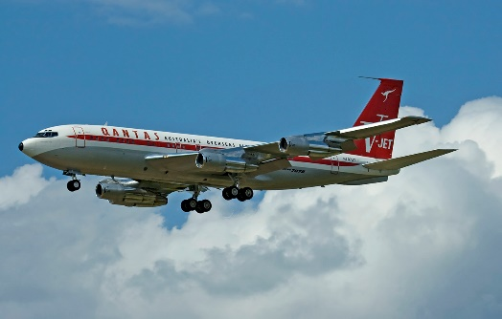
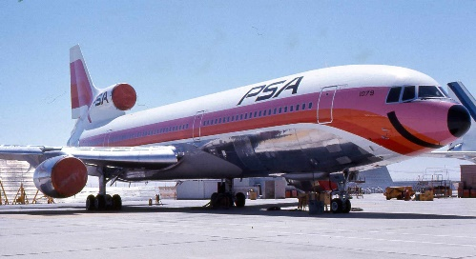
Background: Current In-House Aircraft Analysis Capability
Flight Optimization System (FLOPS)
  Legacy sizing and synthesis tool for aircraft conceptual design and analysis
  Monolithic FORTRAN code continuously developed from 1980’s to 2011
  FLOPS 9.0 released to public in 2016
Contributions to the FLOPS Longevity
  Extremely versatile – nearly every component can be tuned
  User has large ability to perform design space exploration, model validation, and sensitivity and trade studies
  Same tool can analyze tube-and-wing and blended-wing-body subsonic transports, supersonic transports, and fighter aircraft
  Detailed performance analysis beyond Breguet range equation allowing optimization of mission trajectory
  Used in industry, academia, and government organizations
Lockheed L-1011
Credit: Piergiuliano Chesi
Licensed under CC BY 3.0
https://commons.wikimedia.org/wiki/File:Pacific_Southwest_Airlines_L-1011_N1079.jpg
Boeing 707
Credit: Phinalanji
Licensed under CC BY 2.0
https://commons.wikimedia.org/wiki/File:Boeing_707-138B_Qantas_Jett_Clipper_Johnny_N707JT.jpg
Notes:
FLOPS has been around for a while, but now it is officially available through a formal request

Slide 5
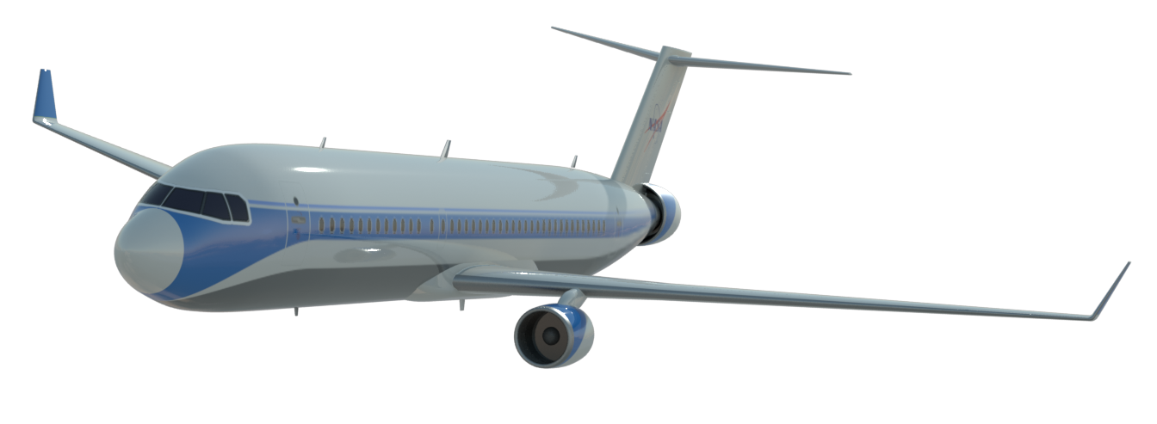
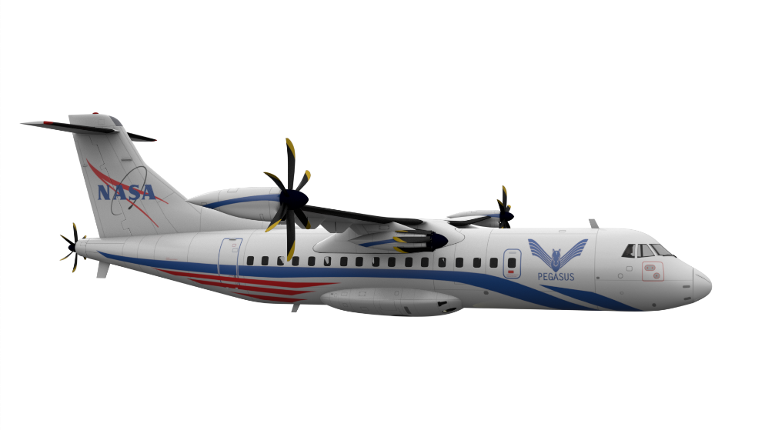
Background: Current NASA Advanced Concepts
Current portfolio of advanced concepts being explored by NASA pushes the limits of FLOPS
  Electric/hybrid-electric aircraft
  Highly coupled propulsion-airframe integration such as boundary layer ingestion
  Non-traditional configurations and structures (double-bubble, truss-braced wing, Prandtl wing)
  Does not include disciplines such as stability and control beyond a simple tail sizing

Slide 6
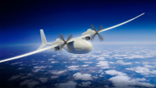
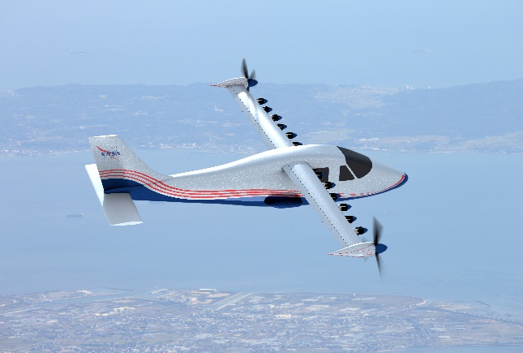
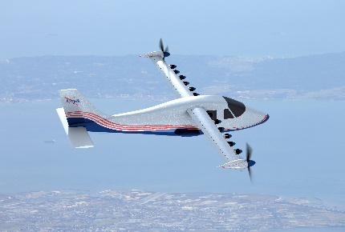
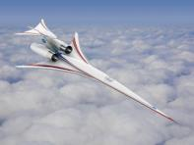
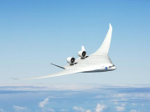
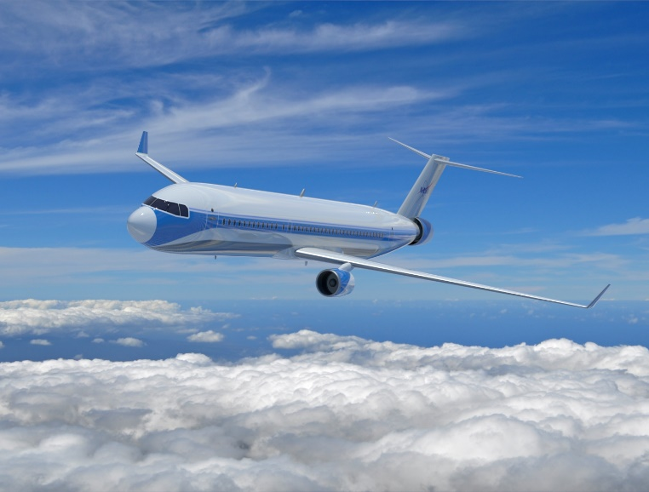
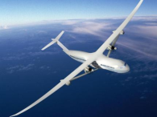
Background: Limitations and Gaps of Legacy Capability
Difficult to analyze unconventional/emerging power sources
  Ex: Electric/hybrid electric, fuel cells, structural batteries, solar power
Limited unconventional configuration analysis capability
  Challenges with distributed propulsion, truss-braced wing, vertical/short takeoff and landing, double bubble, high altitude long endurance
Restrained to conventional, linear flight profiles
  Ill-suited for station keeping, turning flight profiles, energy harvesting
Simplified aerodynamic analysis, functions of Mach, altitude, and lift coefficient only
  Difficult to capture propulsion-airframe integration, aeroelastic tailoring, morphing wing technologies
Several components rarely used/out of date, unnecessarily complicating the tool

Slide 7
Summary of LEAPS
The Layered and Extensible Aircraft Performance System (LEAPS)
  Sizing and synthesis tool being developed for the Aeronautics Systems Analysis Branch at NASA Langley Research Center
  A multi-disciplinary, multi-fidelity aircraft sizing and analysis tool
  Intended to work well with state-of-the-art optimization techniques and frameworks such as ModelCenter and OpenMDAO
  A set of (soon to be) publicly available Python modules that can be used a la carte should the user desire
LEAPS is NOT:
  A framework
  An optimizer or an optimization tool
  A push to higher-fidelity tools

Slide 8
Outline
Background
Motivation and Goals
Software Design
Challenge Problems
Recent Developments
FY21-22 Plans

Slide 9
Motivation for LEAPS Development
A lack of tools that meet internal customer needs for the analysis of advanced aircraft concepts and propulsion architectures using multidisciplinary and multi-fidelity analyses
A desire to collaborate on aircraft concepts and analysis methods in the public domain
The lack of software with robust error checking, informative exception messages, and complete user and theory documentation
The inability to modify, enhance, or extend analyses as new technologies and computational capabilities are developed
Notes:
Verbally say that we looked at a broad range of tools and leave it at that

Slide 10
LEAPS High Level Goals
Develop a modular, multidisciplinary, multi-fidelity aircraft design and performance software
  Not intended to drive high-fidelity to all aspects of aircraft conceptual and preliminary design
  Enable the right analysis for the right job at the right time
Create an aircraft design and analysis tool of exceptional quality and performance
  LEAPS is a proactive tool development rather than reactive
  Software and aerospace engineers working closely together
  High-capability software while controlling the learning curve for new users
Enable ease of distribution to the aeronautics community
  Foster collaboration within the aircraft design community
  NASA open source initiative placed emphasis on distributing tools and capabilities to research community
  LEAPS to be publicly released when completed

Slide 11
Goals and Objectives
Goal 1:
Develop a modular, multidisciplinary, multi-fidelity aircraft design and performance software
  Not intended to drive high-fidelity to all aspects of aircraft conceptual and preliminary design
  Enable the right analysis for the right job at the right time
Supporting Objectives:
Support analysis of a broad range of aircraft, including: transports to fighters, tube-and-wing to blended-wing-body, and jet fuel to all electric propulsion
Incorporate an energy agnostic framework allowing the analysis of a broad range of traditional and future power systems, energy storage systems, and energy harvesting systems
Support multi-fidelity, fully coupled analysis and simulation built centrally around a mission performance core
Be capable of providing the relevant information to support the latest tools for optimization, sensitivity analysis, and design of experiments

Slide 12
Goals and Objectives
Goal 2:
Create an aircraft design and analysis tool of exceptional quality and performance
  LEAPS is a proactive tool develop rather than reactive
  Software and aerospace engineers working closely together
  High-capability software while controlling the learning curve for new users
Supporting Objectives:
Develop LEAPS using standard software engineering development practices
Be of a modular design with a flexible architecture
Provide an exceptional user experience in terms of stability, reliability, and informed exception messages

Slide 13
Goals and Objectives
Goal 3:
Enable ease of distribution to the aeronautics community
  Foster collaboration within the aircraft design community
  NASA open source initiative placed emphasis on distributing tools and capabilities to research community
  LEAPS to be publicly released when completed
Supporting Objective
Develop LEAPS with procedures and practices that enable easy distribution of methods and software to the aeronautics community

Slide 14
Outline
Background
Motivation and Goals
Software Design
Challenge Problems
Recent Developments
FY21-22 Plans

Slide 15
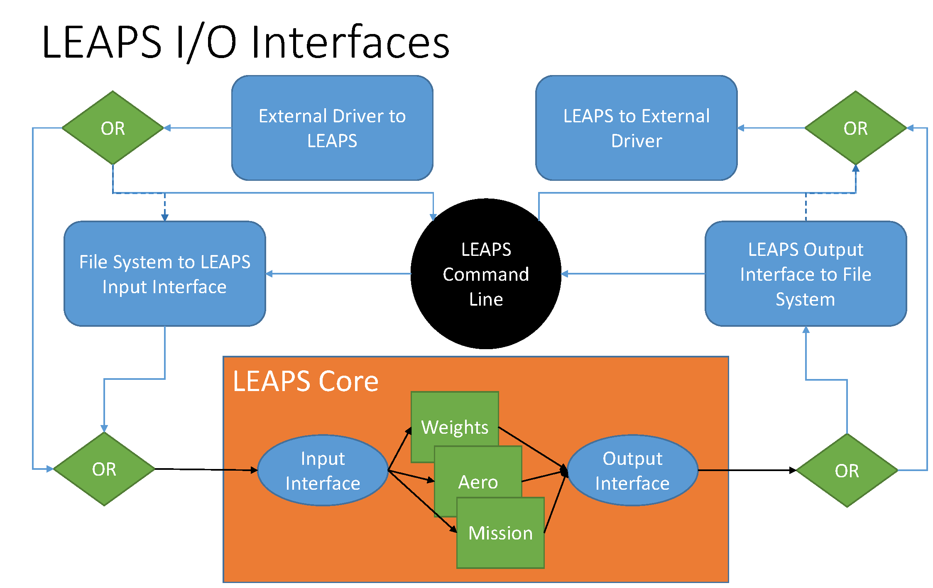
Software Architecture Design
Extensible
  Model package interface for adding/replacing analysis models
  Set of required functions implemented by the client model or package
  Client model can inherit functionality from a native LEAPS model
  User does not have to modify source code to extend LEAPS
Command line interface
  General options for help, versioning, and verbose output
  Specify input file path
  Output to command line or specified file
Externally driven LEAPS analysis
  Allows user to pull components or all of LEAPS into their analysis model
  Optimization performed through an external driver
Notes:
Give example of extending the analysis to use Raymer equations instead of internal L0 weights equations.

Slide 16
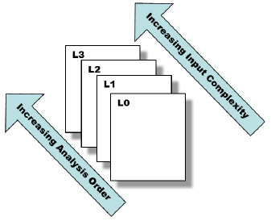
Software Architecture Design
Written in Python 3.7
  Ease of use and development
  Cross platform capability
  Input file utilizes configuration file format to leverage Python’s native parsing functionality
Modular design
  Data exchange: “Aircraft” object parameter
  Analysis models (Layers) specified by input file at runtime
    Default Level 0 models implement legacy methodologies
    Higher level models implement more complex methodologies

Slide 17
Outline
Background
Motivation and Goals
Software Design
Challenge Problems
Recent Developments
FY21-22 Plans

Slide 18

Description of Identified Challenge Problems
Conventional tube-and-wing
  Analysis of Boeing 737-800 aircraft
  Show LEAPS has replicated current analysis capability
Conventional tube-and-wing with coupled aero-elastic analysis
  Highly flexible wing structure as seen on state-of-the-art Boeing 787 aircraft
  Requires coupled, physics-based analysis of aerodynamics and structures
Parallel Electric-Gas Architecture with Synergistic Utilization Scheme (PEGASUS)
  Hybrid-electric vehicle that has onboard fuel and batteries
  Individual propulsors should be throttled independently to identify best ConOps for a given objective
X-57 Maxwell all-electric manned research aircraft
  All-electric configuration requires new mission analysis capability
  Vehicle aerodynamics are highly dependent on the propulsion system
Supersonic vehicle with coupled boom signature analysis
  Requires extensible analysis for boom signature (sBOOM)
  Custom trajectory objective function for minimize boom signature
https://www.transportation.gov/sites/dot.gov/files/AVIATION_FEATUREITEM_2_REGS_10.JPG

Slide 19
Challenge Problem
Parallel Electric-Gas Architecture with Synergistic Utilization Scheme (PEGASUS)
  Hybrid-electric vehicle that has onboard fuel and batteries
  Individual propulsors should be throttled independently to identify best ConOps for a given objective

Slide 20
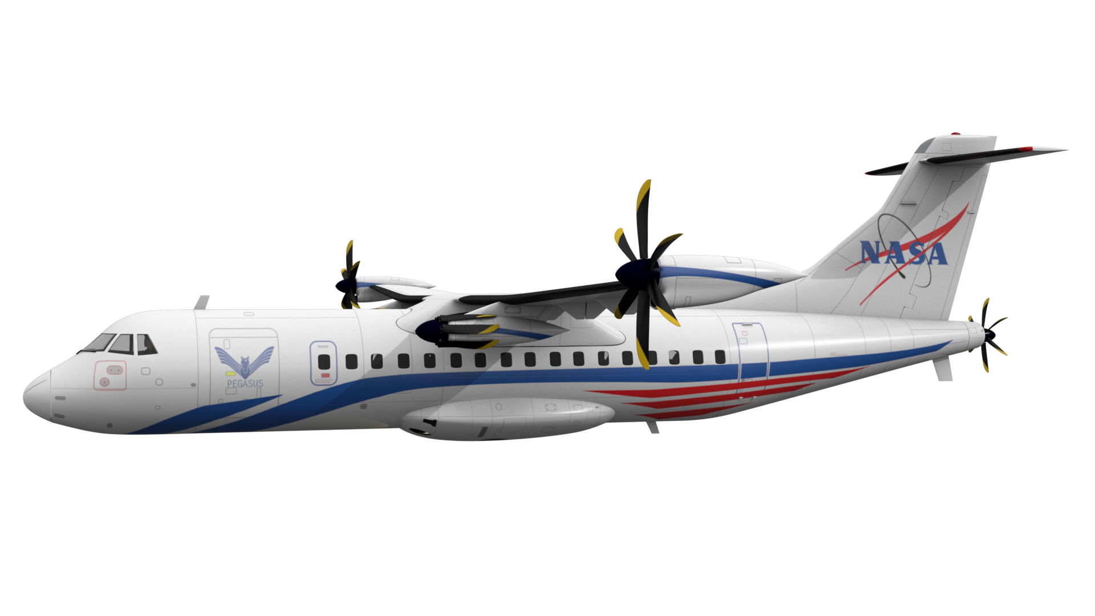
PEGASUS
Wingtip: Parallel Hybrid Electric
Propellers operating opposite to that of the wing tip vortical flow
Inboard: All Electric
BLI: All Electric
Ingests the fuselage boundary layer to reaccelerate the flow
Folded at cruise to reduce lift losses due to propeller swirl
Provides extra thrust during takeoff and climb

Slide 21
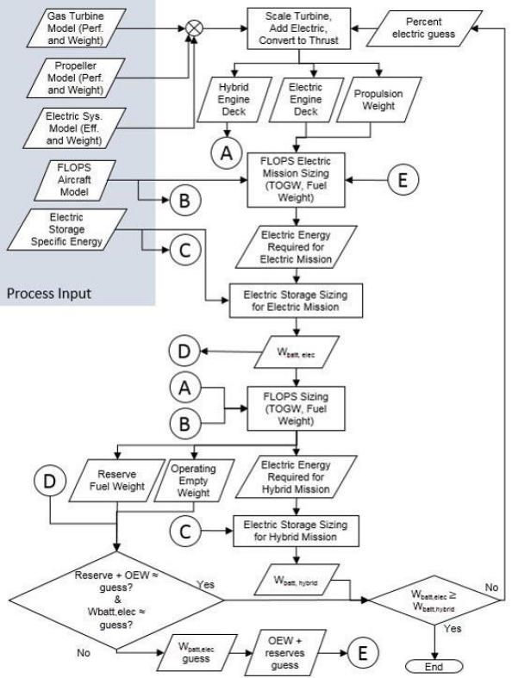
How Do We Model PEGASUS with FLOPS?
All propulsor classes modeled as one
Battery weight computed externally
Trajectory designed for fuel-powered aircraft

Slide 22
What Are the Differences in Mission Analysis Methodologies?
 | FLOPS | LEAPS L0 Approach
Equations | Point mass/Energy Method | Point mass/Energy Method
Energy | Consumable fuel | Consumable fuel, electric, hybrid-electric
Engine data sets per segment | One | Multiple
Throttle parameter | One for all propulsors | One or two per propulsor class
Cost function | Multiple | User-defined

Slide 23
Outline
Background
Motivation and Goals
Software Design
Challenge Problems
Recent Developments
FY21-22 Plans

Slide 24
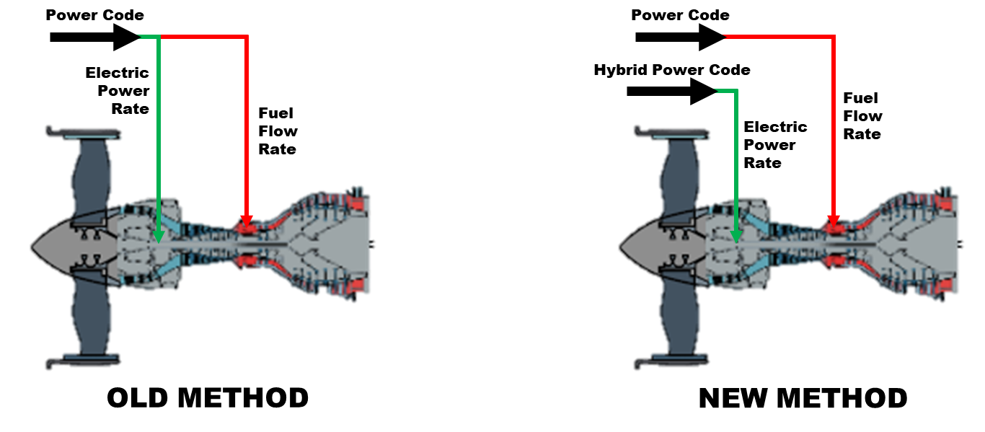
LEAPS Hybrid-Electric Methodology
Parallel-hybrid propulsion systems have two ways to control power
  Fuel flow rate and electric power are independent
“Hybrid Power Code” (HPC) was introduced to control electric power – requires engine model to contain additional points for each flight condition at various HPC levels
HPC behavior is set per mission segment, either at a constant value or optimized at each timestep

Slide 25
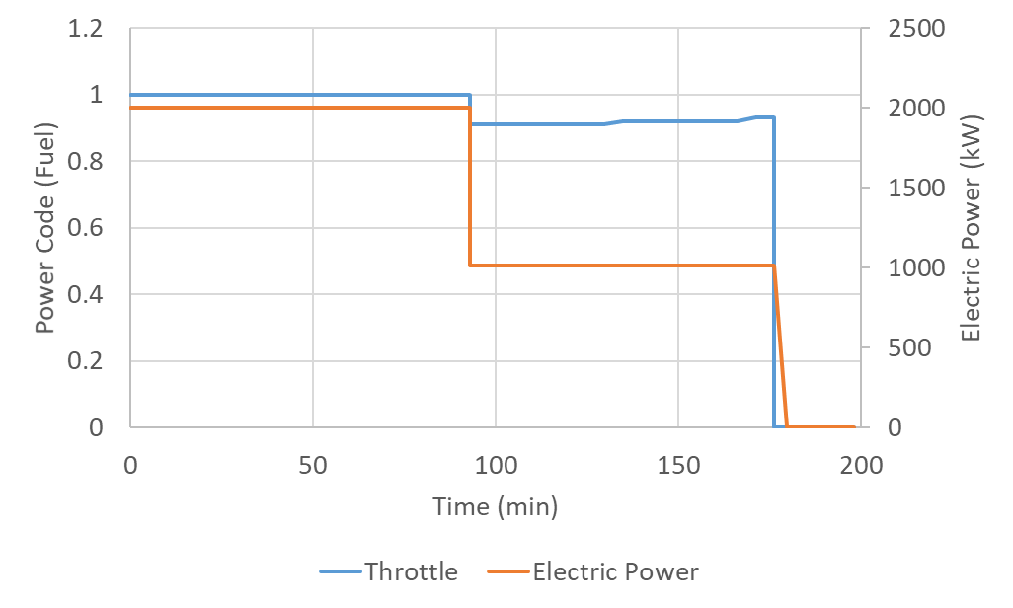
Applications of Methodology
Previously battery size was a fallout of mission analysis, could not be changed without changing vehicle or mission
  New method can adjust electric energy to match target battery size
Electric power can be optimized for minimal block energy, fuel, or other metrics
  Electric power lowered to match battery’s energy capacity
  Fuel throttle remains high to meet thrust requirements
Example of notional 737-like hybrid vehicle sized with a fixed battery

Slide 26
Inertia Relief for Multiple Wing-Mounted Propulsors
Task Lead: Bryce Horvath
Objective:
  Evaluate effectiveness of LEAPS wing inertia relief method for aircraft with large numbers of engines
  Extend LEAPS wing inertia relief methodology to account for dissimilar engines and validate method with higher order structural analysis tool
Status:
  Current LEAPS method determined to be effective for aircraft with distributed engines
  Extension to allow for dissimilar engine sets developed
  Extension compared against results generated with the SUITCASE structural analysis tool
  Implementation of extension in LEAPS is in progress

Slide 27
Evaluation of Current LEAPS Inertia Relief Method
Midsize transport aircraft evaluated with increasing numbers of wing mounted engines
Results show largely similar trends between SUITCASE and LEAPS

Slide 28
Selected Results – Evaluation of Proposed Method
Set 2:
32 Distributed Engines
Blending of Both Engine Sets
Set 1:
2 Engines
Large Commercial Transport evaluated with two engines sets.
  Set 1: Two engines
  Set 2: 32 Distributed engines
Weight shifted between both engines sets, while maintaining constant engine weight
Resulting configurations evaluated with LEAPS and SUITCASE

Slide 29
Results – All Evaluated Cases
Chart includes all evaluated configurations with LEAPS and SUITCASE
X axis is LEAPS calculated inertia relief factor – a representation of the benefit provided by the engines.
  1.0 = No benefit
  0.84 = Maximum benefit
Average Error: 2%
Trend of LEAPS providing slight under prediction of wing weight compared to SUITCASE

Slide 30
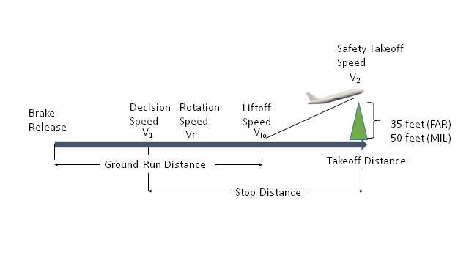
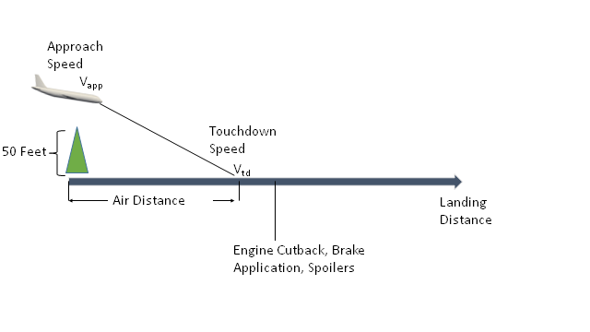
Takeoff and Landing Analysis
The simplified equations used in LEAPS are the same ones from FLOPS, which were curve fits of typical transport aircraft, adjusted to match the detailed takeoff and landing.
For LEAPS detailed takeoff and landing, equations of motion solved with SciPy solve_ivp
  With solve_ivp, events can be specified, eliminating much of the complexity in the FLOPS code
  Events include V1, Vr, V@engine failure, liftoff, obstacle height, landing flare height, touchdown, and stop

Slide 31
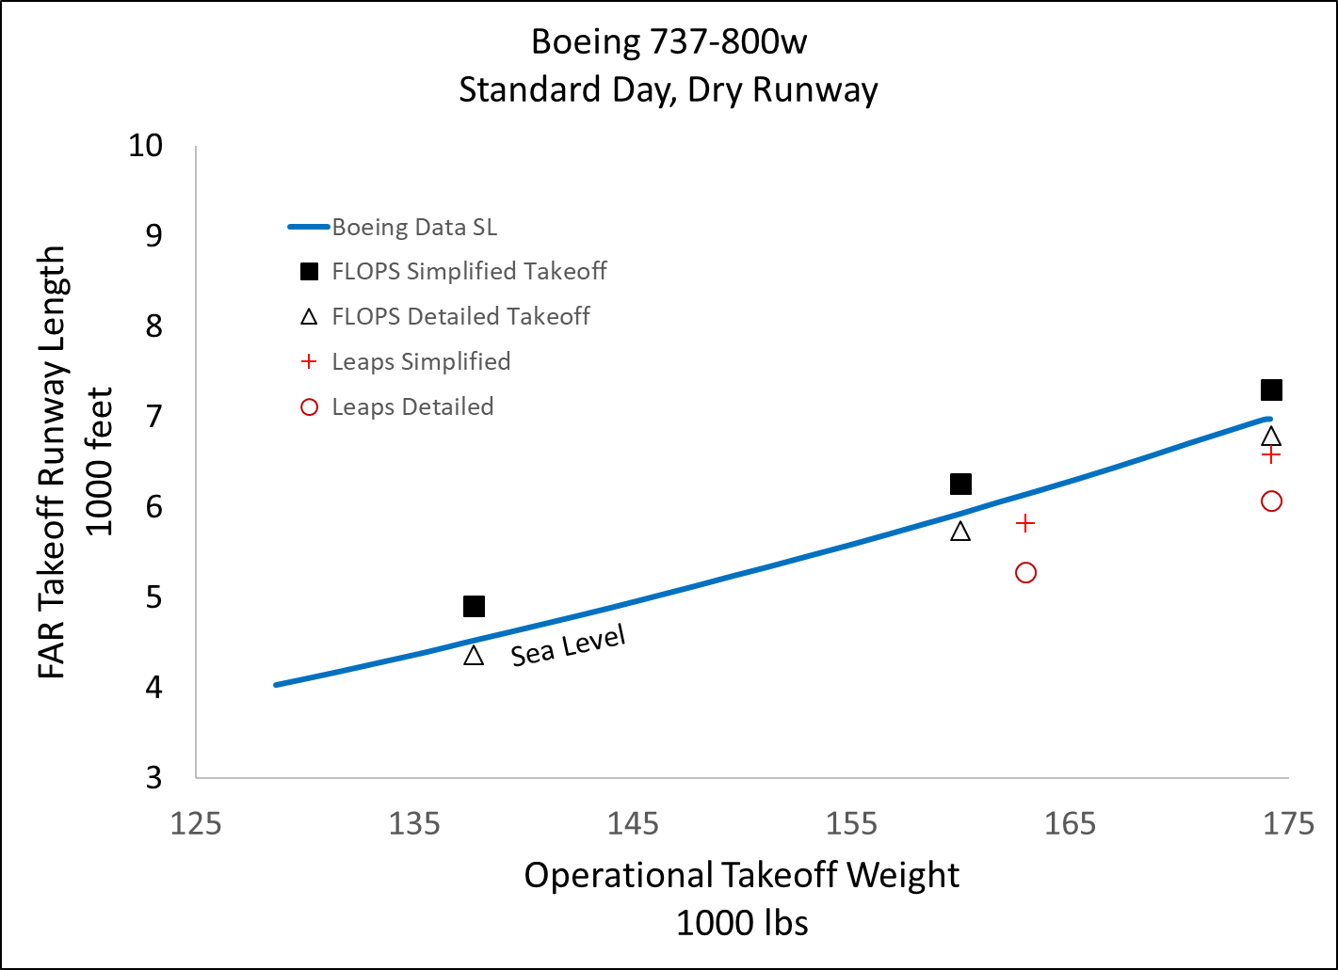
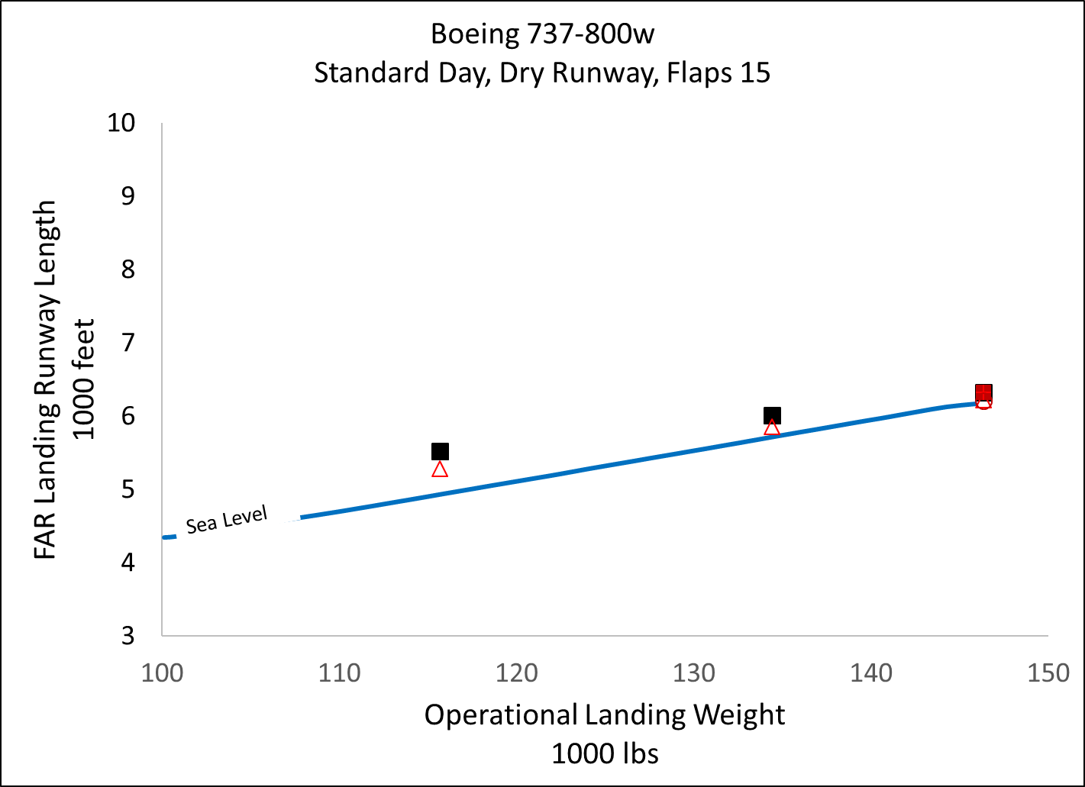
Takeoff and Landing Comparisons (Preliminary)

Slide 32
Outline
Background
Motivation and Goals
Software Design
Challenge Problems
Recent Developments
FY21-22 Plans

Slide 33
FY21-22 Plans
Integration of finite-element analysis
Off-design mission analysis, payload-range diagrams
Integration of low-order flutter analysis
Graphical user interface (GUI)
Initial plug-ins for CREATE-AV ADAPT
Throttle-dependent aerodynamics

Slide 34
Acknowledgements
This research was funded by both the Transformational Tools and Technologies (TTT) Project, part of the Transformative Aeronautics Concepts Program (TACP), and the Advanced Air Transport Technologies (AATT) Project, part of the Advanced Air Vehicles Program (AAVP) within the NASA Aeronautics Mission Directorate (ARMD).

