Slide 1
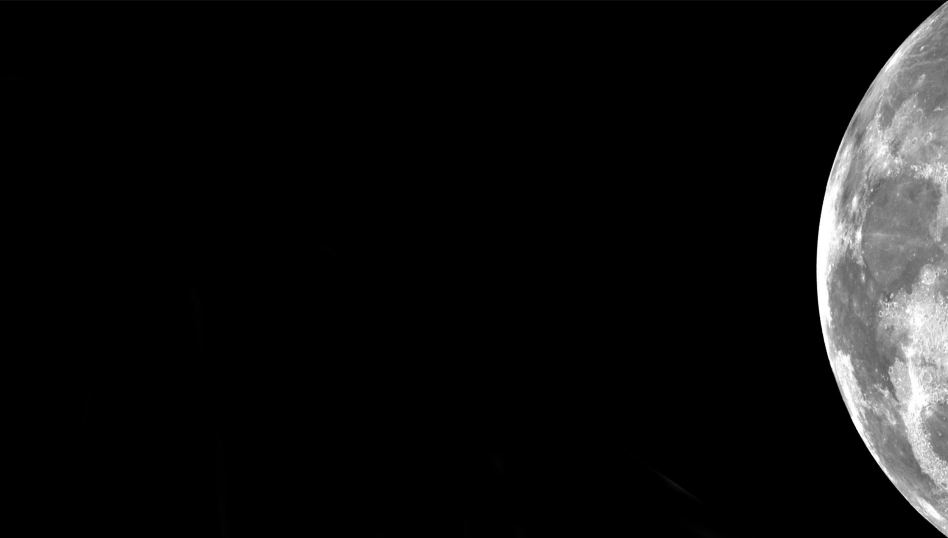

Electrodynamic Dust Shield
Carlos I. Calle, Ph.D.
Electrostatics and Surface Physics Laboratory
Swamp Works
NASA Kennedy Space Center

Slide 2
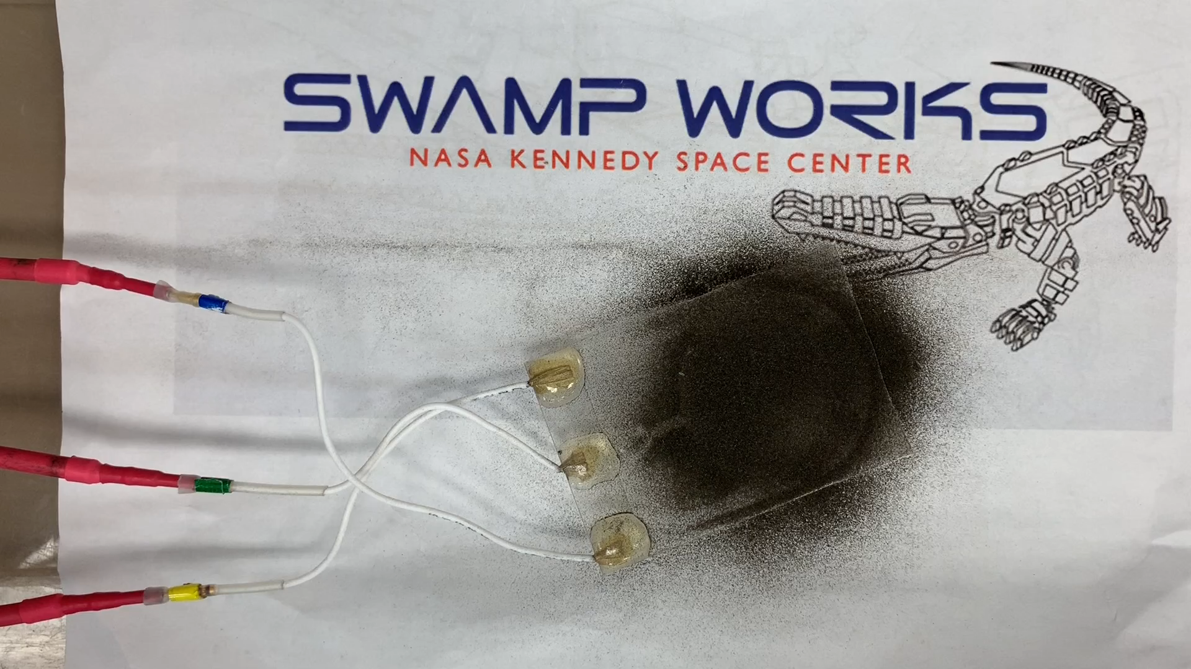
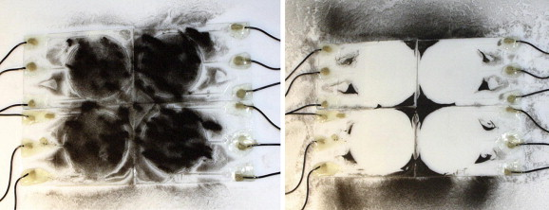
The EDS Technology
The Electrodynamic Dust Shield (EDS) is an active dust mitigation/transport system for NASA’s Exploration missions.
Uses dynamic electric fields to remove dust from surfaces.
dust particle motion
+
1
2
3

Slide 3
The Technology: Development History
NASA Research Opportunities in Space Science – Mars Exploration Program (ROSS 2003) Award: Development of an Electrodynamic Screen for Dust Particle Removal from Solar Panels on Mars - 2003-2006
NASA Exploration Technology Development Program – Dust Management Project: Development of the EDS for lunar exploration – 2006-2009
NASA IPP with the Florida Solar Energy Center: Solar Panel Dust Mitigation – 2009
ISS Exploration Research and Technology: MISSE-X NASA Payloads – 2010-2013 – Canceled in 2013
ISS Exploration Flight Project (X-Project): EDS Experiment on MISSE-11 – 2017-present
ISS Exploration Flight Project (X-Project): EDS Experiment on MISSE-15 – 2021
CIF with GRC: Electrodynamic Dust Shield for Solar Panels -2021
IR&TD: Electrodynamic Dust Shield-Next Steps—RASSOR stereo cameras and EDS on Astronaut Visor (with JSC)
STMD/SMD CLPS 19D: EDS Demonstration Payload — 2020-2023

Slide 4
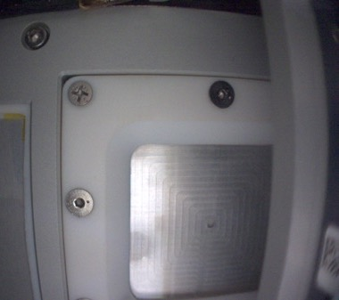
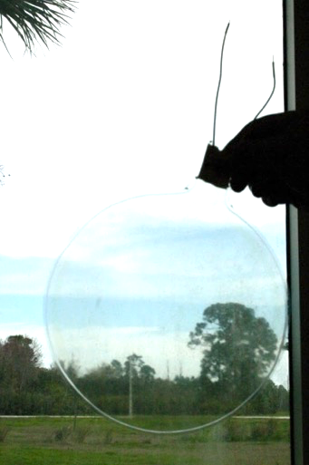
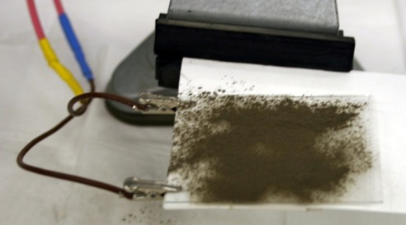
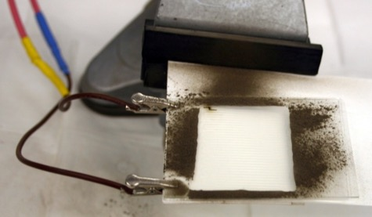
EDS Implementations: Optical Systems & Viewports
Works well in conjunction with passive dust mitigation methods/coatings
Multiple phases (single-phase, 2-phase, 3-phase)
Can be made transparent, flexible, applied to metals
Uses include:
  Camera lenses, optical instruments
  Viewports, visors
  Solar panels, solar cells
  Curved surfaces such as solar concentrators
  Thermal radiators, thermal painted surfaces
  Flexible materials, fabrics
Glass EDS in space
9”diameter ITO/PET EDS Tested at Desert RATS.
ITO electrodes
Dielectric
Glass
Glass EDS at vacuum
RASSOR EDS Mount

Slide 5
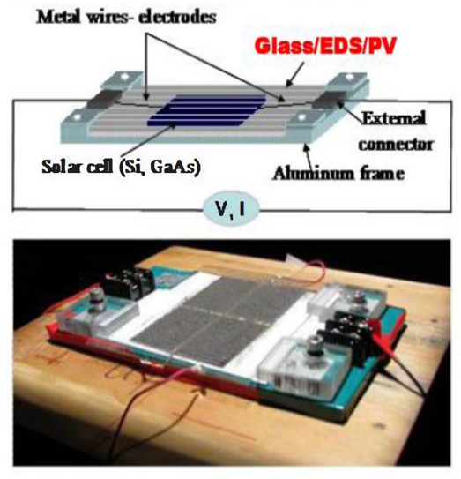
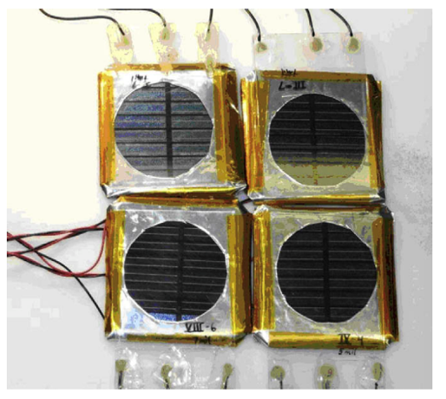
EDS Implementations: Solar Panels
Kapton EDS in space
Solar panel response to 50–75 mm JSC-1A dust deposition and removal under high vacuum conditions with a 3-phase ITO-glass EDS with four different electrode spacings.**
Glass EDS/PV and PV setup with JSC-1A lunar stimulant.
Original efficiency: 9.02%
Efficiency after depositing and removing dust: 8.15%
RASSOR EDS Mount

Slide 6
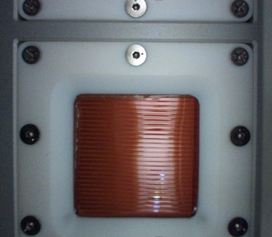
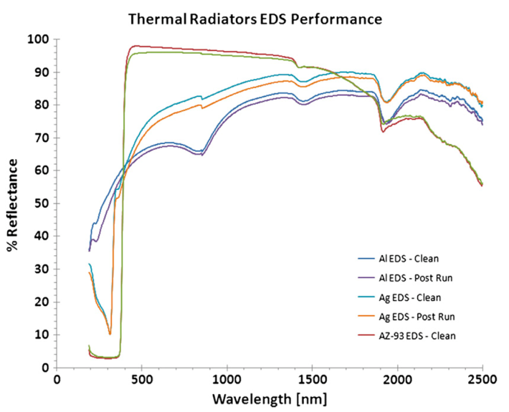
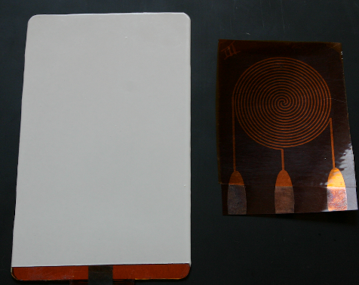
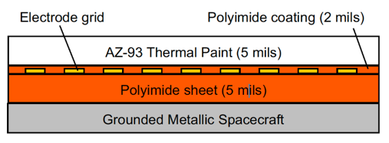
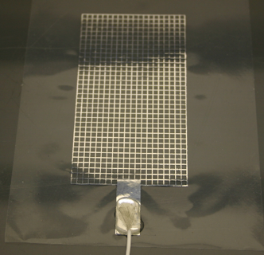
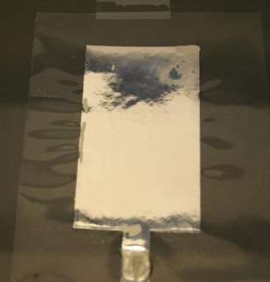
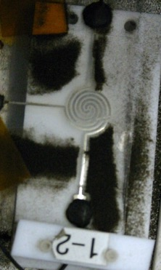
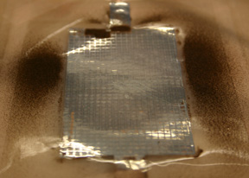
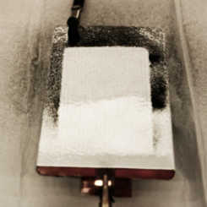
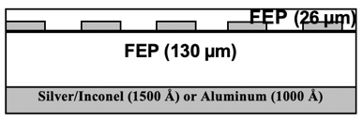
EDS Implementations: Thermal Radiators
Kapton EDS in space
Cu-Kapton EDS on Al with AZ-93 Thermal Paint
Kapton EDS in space
Reflectance spectra for three types of 3-phase EDS panels for thermal radiators (Al-FEP, Silver-Inconel-FEP, and Cu-Kapton with AZ-93 thermal paint) before dust deposition and after dust clearing. Experiments were performed at 5 x 10⁶ kPa.*
One-Phase Al-FEP EDS
Three-phase Ag-FEP vacuum test
One-phase Cu-Kapton-AZ-93 EDS
*Calle, C.I., C.R. Buhler, M.R. Johansen, M.D. Hogue, and S.J. Snyder, “Active dust mitigation technology for lunar and Martian exploration, Acta Astronautica, 69, 1082-1088 (2011)
One-phase Al-FEP
RASSOR EDS Mount

Slide 7
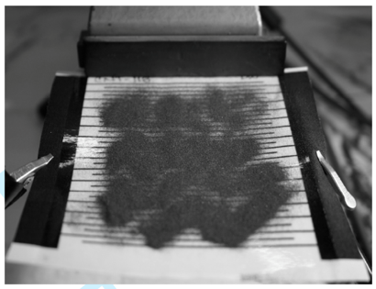
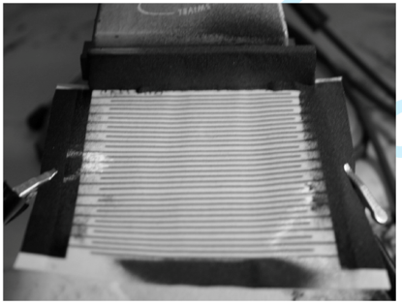
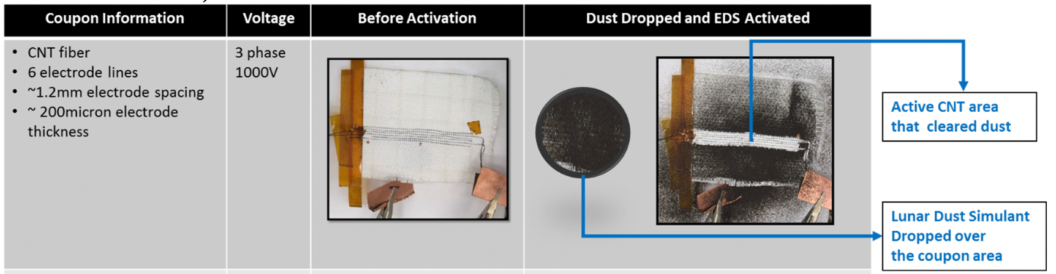
EDS Implementations: Fabrics (Low TRL)
*Trigwell, S., S.J. Snyder, A.S. Biris, C.R. Fortier, and C.I. Calle, “Application of conductive carbon nanotube ink electrodynamic screens for dust mitigation of spacesuits during lunar exploration missions”, Particulate Science and Technology, 2012
50-75 µm simulant on 2-phase CNT-cotton fabric EDS, 1500 V, 10 Hz, <10 s, air test.*
Dust removal experiments with EDS with CNT thread electrodes on Ortho-Fabric material.**
**Manyapu, K.K., et al., Investigating the Feasibility of Utilizing Carbon Nanotube Fibers for Spacesuit Dust Mitigation, International Conference on Environmental Systems, 182, 10-14 July 2016, Vienna, Austria

Slide 8
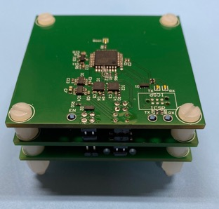
EDS Electronics
Size: Power supply: 5 cm x 5 cm x 2 cm
Power: EDS shields → ~ mW to remove dust
EDS Power supply → 2-4 W maximum
Modes of Operation:
EDS can be operated continually for surfaces needed to be free of dust that are highly sensitive (optics, lenses, etc.)
EDS can be operated momentarily to remove settled dust for less susceptible systems (solar panels, radiators, etc.)
Power Signal:
  EDS operates between ~900-1200 volts in air, but could operate up to 4 kV in vacuum with efforts at minimizing that potential underway
      Signals are 10 Hz square wave with fast rise times (still being optimized for vacuum)
High voltage power supply
(50 mm x 50 mm x 25 mm)
Mass: 58 g
Glass EDS Vacuum test
Kapton EDS Vacuum test
RASSOR EDS Mount

Slide 9
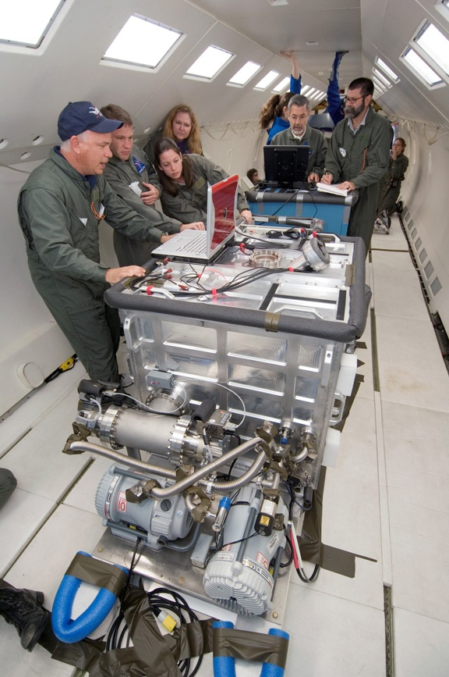
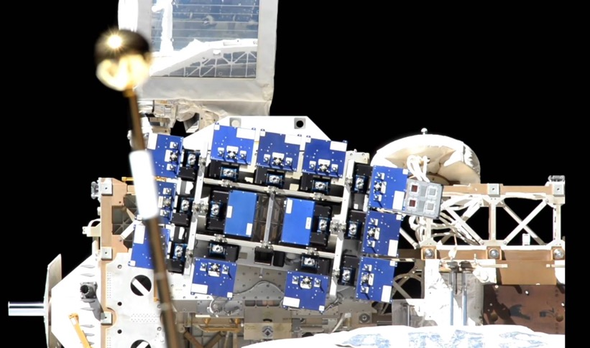
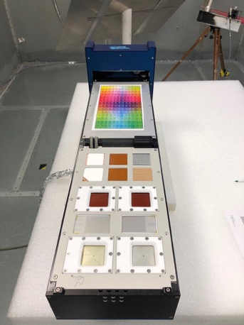
RGF and ISS Experiments
Tested with Apollo samples on Reduced Gravity Flights
Flying as a payload for the Materials ISS Experiment (MISSE) 11 and 15
Developing payload for NASA’s Commercial Lunar Payload Services Lander (CLPS) program
  Reduced Gravity Flight (RGF) Experiments were performed under lunar and Martian gravity
  MISSE 11 and 15: to test materials and construction of the EDS subassemblies to evaluate impact of exposure to the space environment
Electronics control unit
Video recording computer
Vacuum chamber

Slide 10
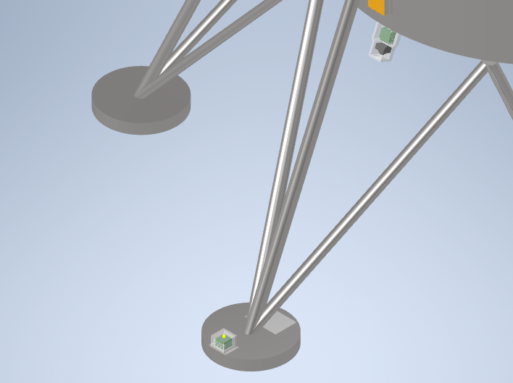
EDS demonstration on a CLPS Mission
Launch date: June 2023
The main objective is to demonstrate the operation of two EDS Systems on the lunar surface:
  EDS for a small camera to be located under the lander’s deck
  EDS on a white aluminum panel to be located on a lander’s footpad
The camera EDS will consist of indium tin oxide electrodes on a glass panel coated with a space-rated dielectric.
The Footpad EDS will consist of thin copper electrodes on polyimide film with a white polyimide dielectric cover. This multilayer film will be affixed to an aluminum panel.
The EDS panels will be activated and controlled with compact high voltage power supplies co-located with each EDS.
A Digital Storage Unit (DSU) will provide power, data communications, and data storage for EDS and camera operations.
DSU
HVPS-1
Camera EDS Assembly
Footpad EDS
HVPS-2

Slide 11
Questions?

Slide 12
Back Up

Slide 13
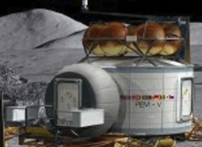
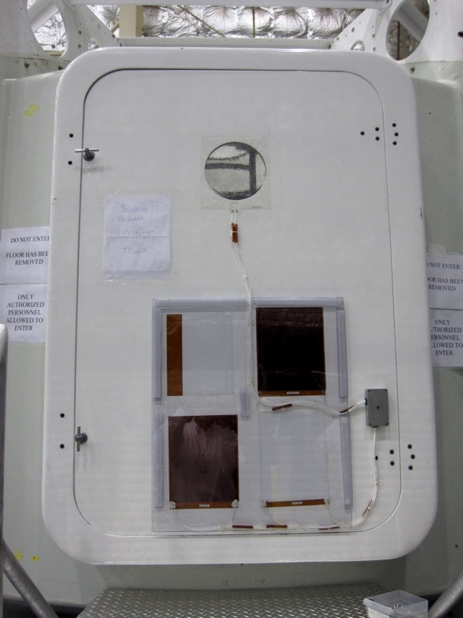
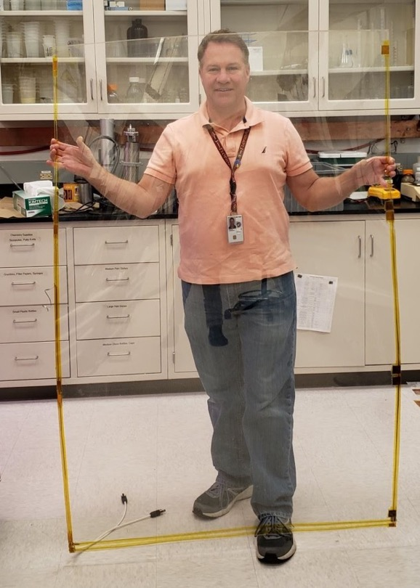
Clear 9”-diameter EDS on Viewport, 14” x 17” Cu/Kapton EDS for thermal radiators installed on lunar habitat prototype at Desert Research and Technology Studies (Desert RATS).
Prototype 60” x 40” ITO on clear polymer (Poly Adaptive, LLC)

Slide 14

EDS on a Reduced Gravity Flight
10-micron dust simulant removal on Reduced Gravity Flight at vacuum

