Slide 1


Empowering Knowledge with
NASA Aeronautics
Tiffany Smith
December 2020
Aeronautics Research Mission Directorate

Slide 2
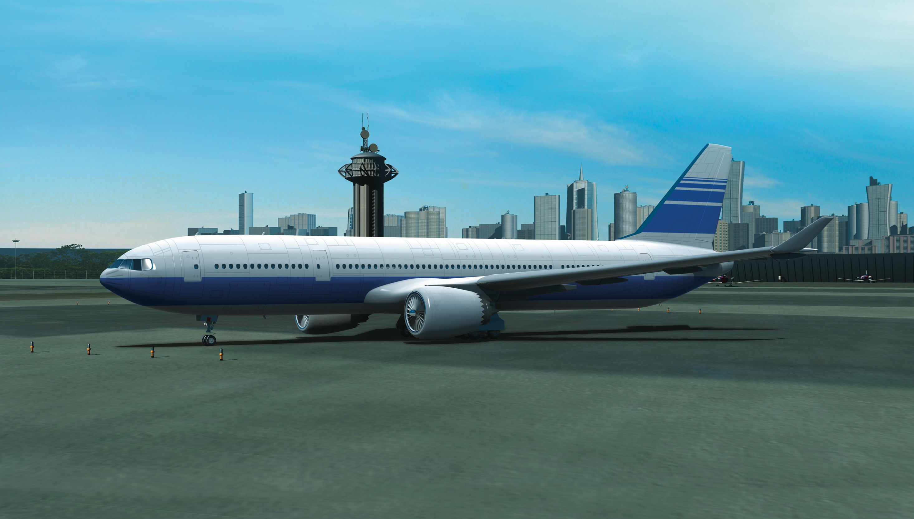

NASA has made decades of contributions to aviation
NASA-developed technology is on board every U.S. commercial aircraft and control tower.
+ COMPUTATIONAL FLUID DYNAMICS (CFD)
+ AIR TRAFFIC MANAGEMENT
• Center TRACON Automation System (CTAS) – 1990s
• Traffic Management Advisor (TMA) – 1990s
• Surface Management System (SMS) – 2000s
• Future Air Traffic Management Concepts Evaluation Tool (FACET) – 2000s
+ NASA STRUCTURAL ANALYSIS (NASTRAN)
+ AIRBORNE WIND SHEAR DETECTION
+ COMPOSITE STRUCTURES
+ TURBO AE
+ LIGHTNING PROTECTION STANDARDS
+ DIGITAL FLY-BY-WIRE
+ WINGLETS
+ SUPERCRITICAL AIRFOIL
+ AREA RULE
+ GLASS COCKPIT
+ ICING DETECTION
+ JET ENGINE
COMBUSTORS
+ ENGINE NOZZLE CHEVRONS
+ DAMAGE-TOLERANT FAN CASING
+ RUNWAY GROOVES
+ WIND TUNNELS

Slide 3
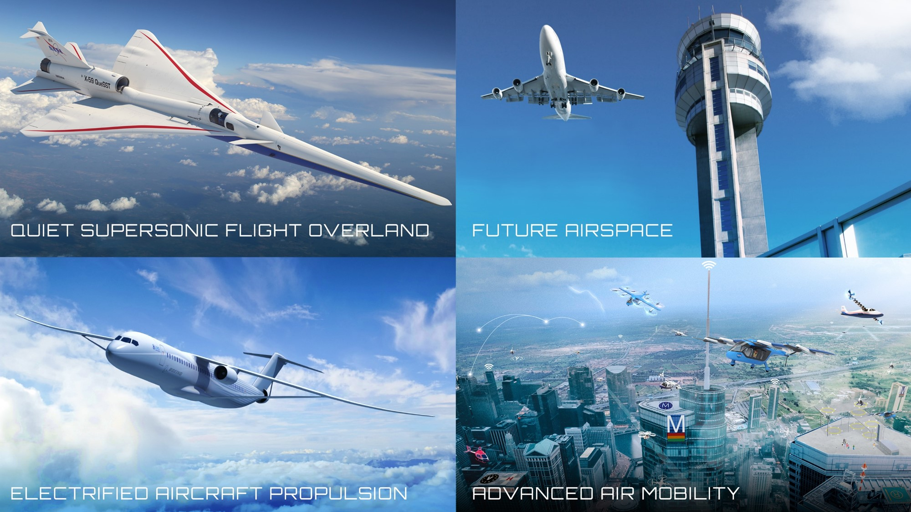


Slide 4
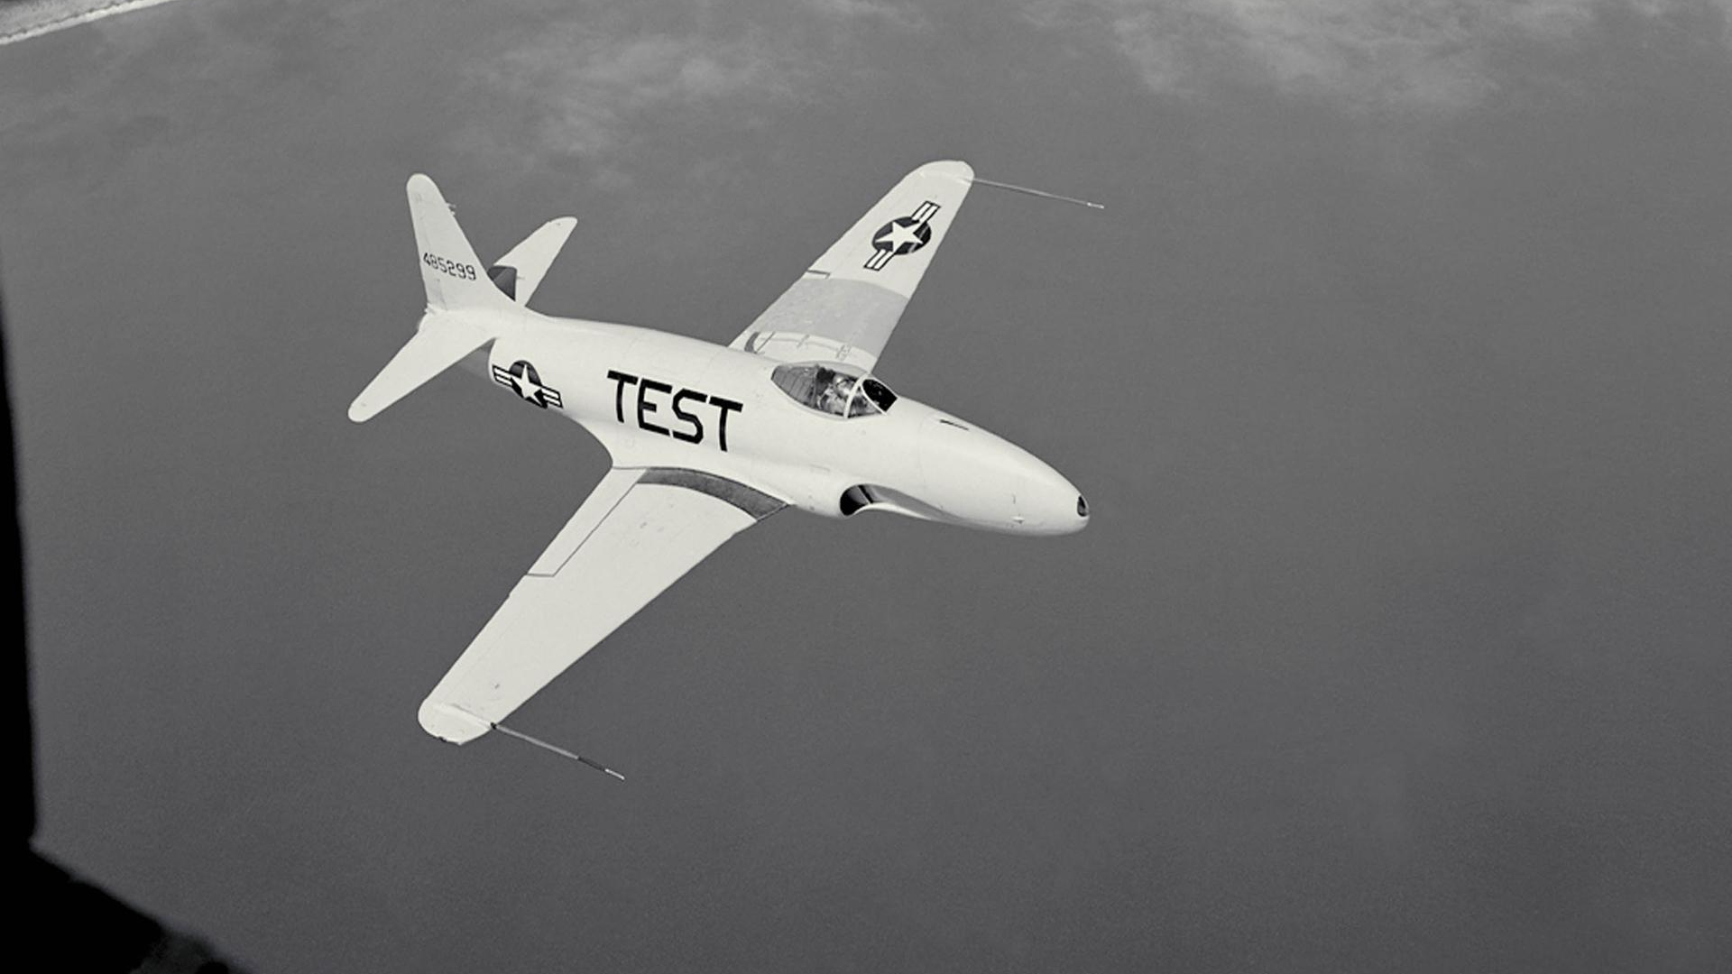
Knowledge Has Enduring Value

Slide 5
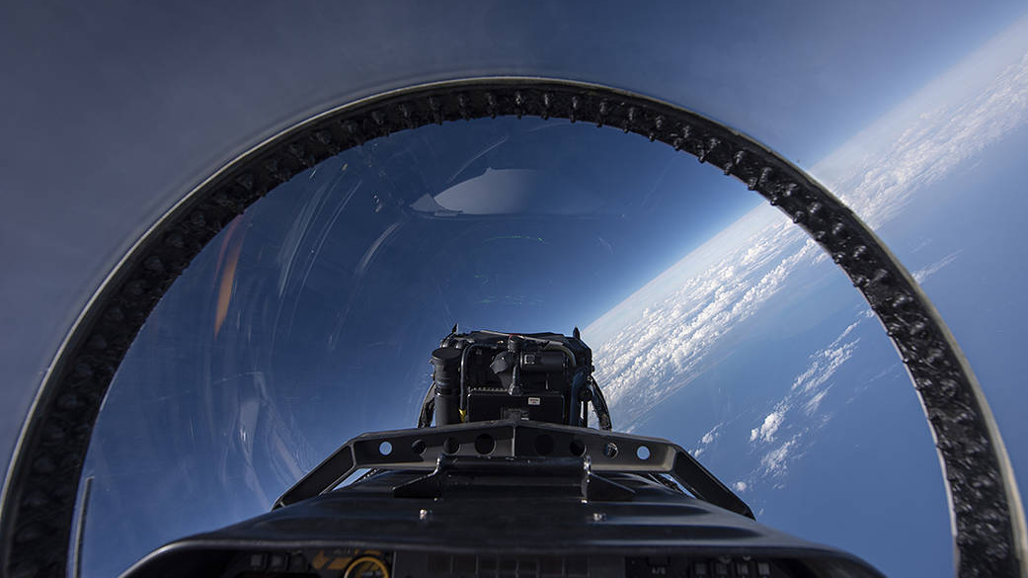
Mission First

Slide 6

Consider Your Environment

Slide 7
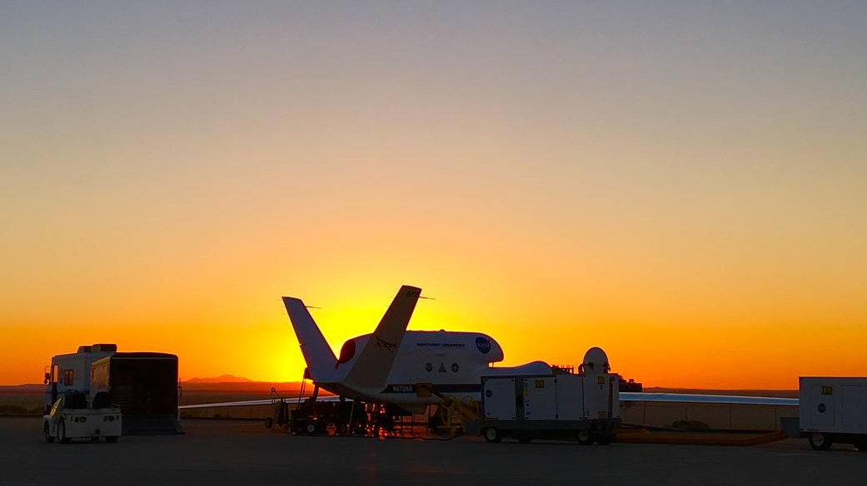
Identify Knowledge Priorities

Slide 8
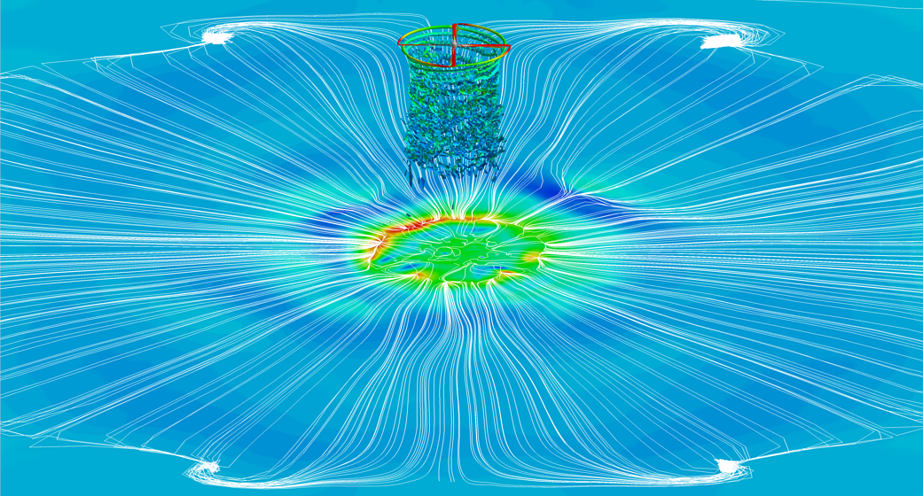
Locate
Knowledge Flows

Slide 9
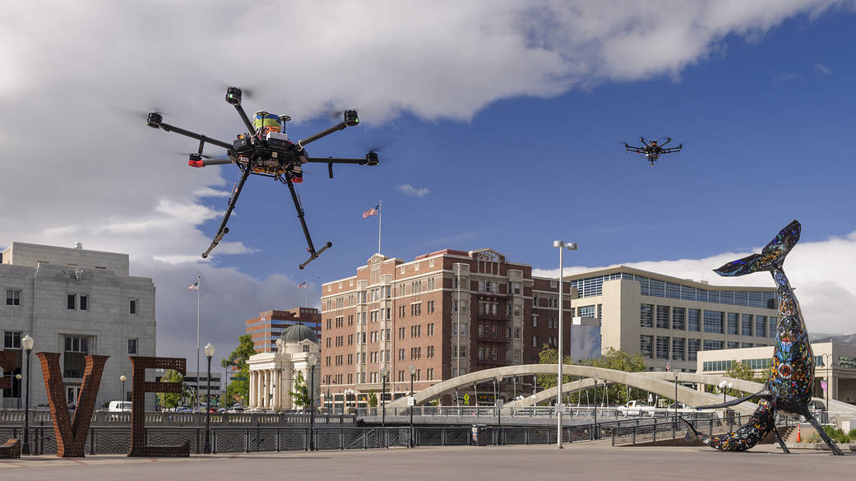
Engage Stakeholders

Slide 10
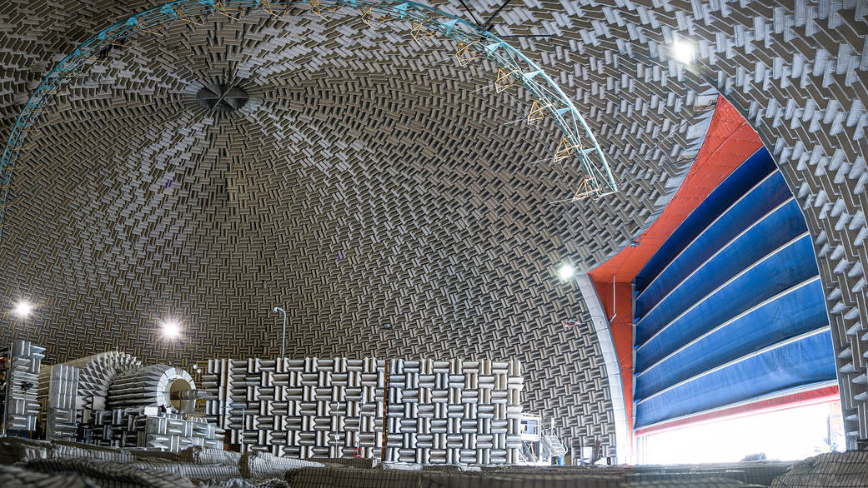
Build a Framework

Slide 11
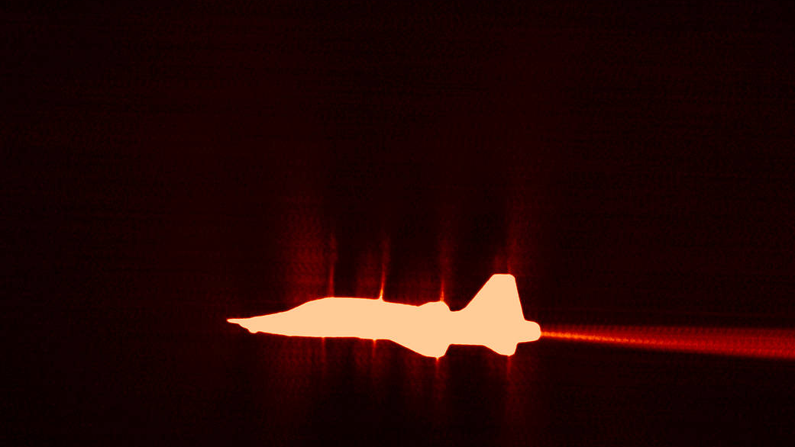
Be Intentional, Stay Strategic

Slide 12
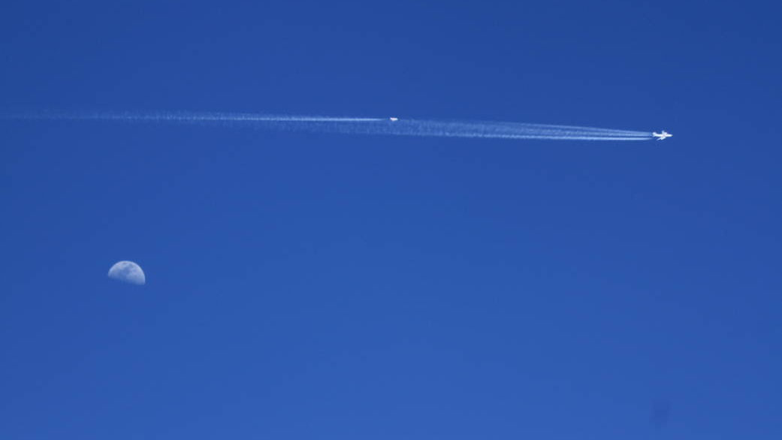
Provide Meaning and Context

Slide 13
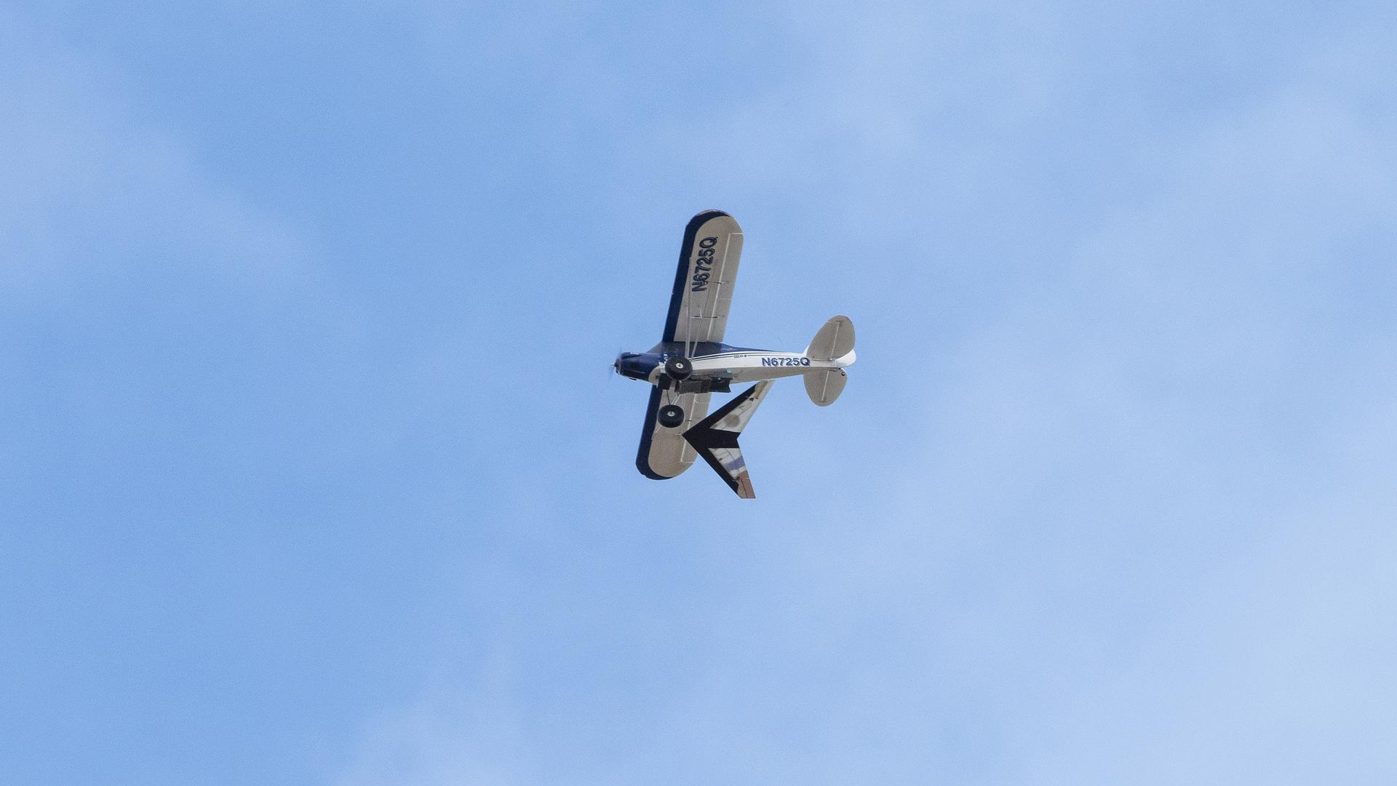
Develop Partnerships That Matter

Slide 14
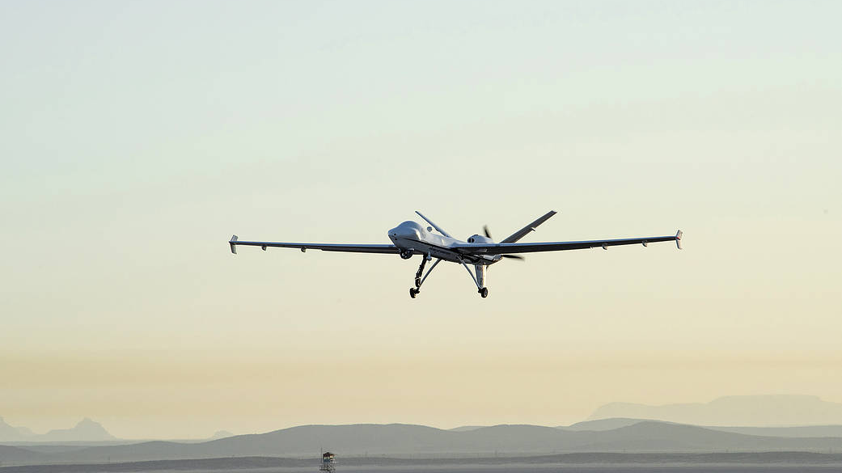
Look to the Horizon

Slide 15

Help Knowledge Endure

Slide 16
All images used in this presentation available at http://www.nasa.gov/flight

