Slide 1
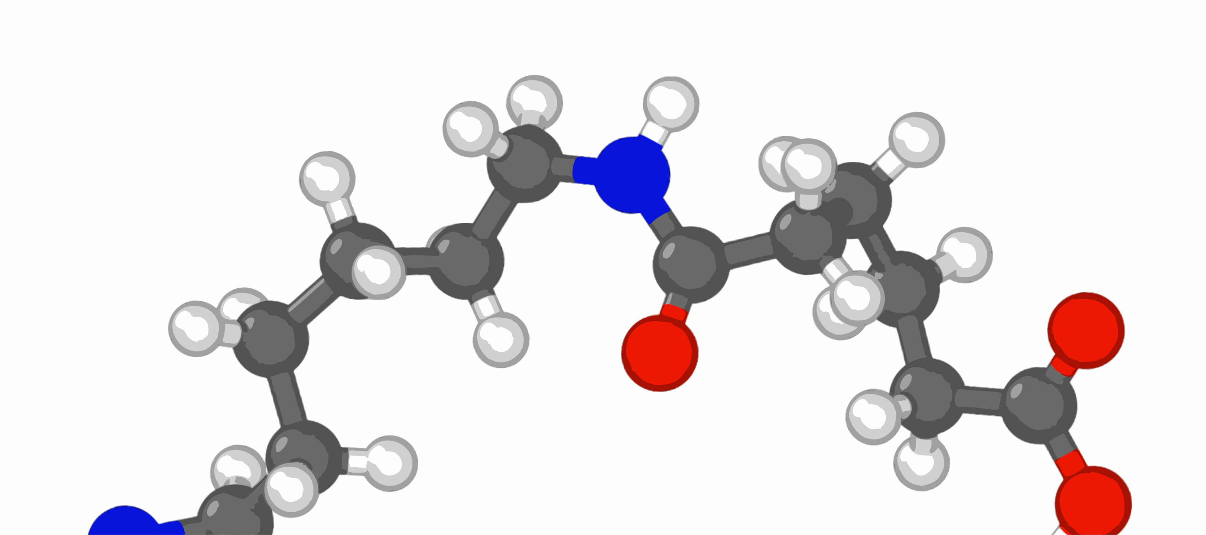



REACTER—A Heuristic Method
for Reactive Molecular Dynamics
Jacob Gissinger, Benjamin Jensen, Kristopher Wise
NASA Langley Research Center
MRS Fall 2020
Nov. 27 – Dec. 4
F.MT04.03.07
jacob.gissinger@nasa.gov
newly polymerized

Slide 2
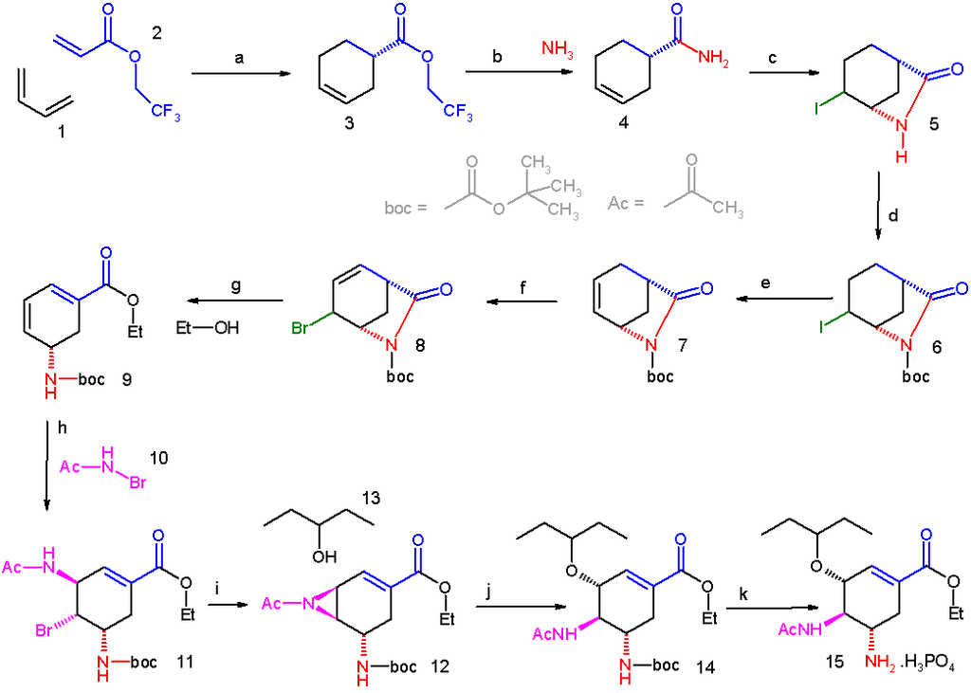
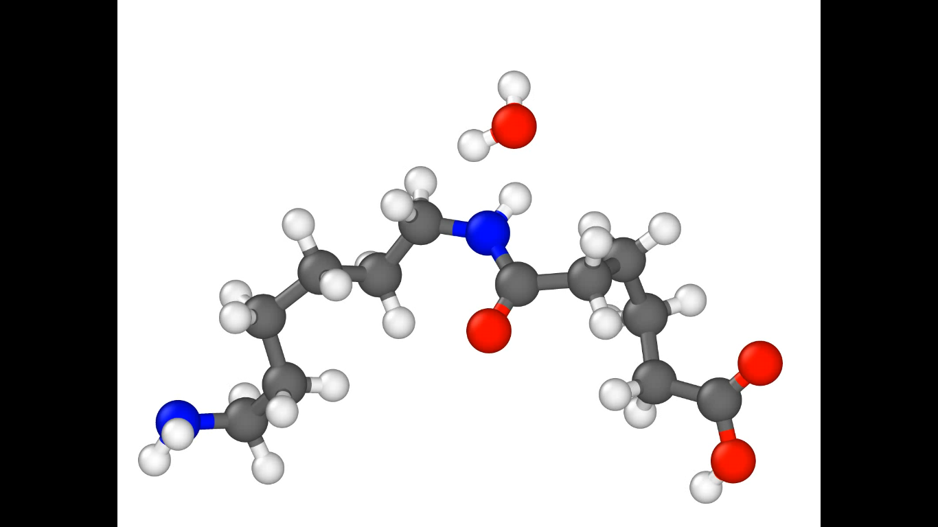
What is REACTER?
A protocol for adjusting topology during classical MD
  Add/remove specific bonds, angles, dihedrals, and impropers
  Modify all force field types as well as atomic charges
  Supports any fixed-valence force field (PCFF, OPLS, etc.)
  Reaction stabilization
Parallel implementation in LAMMPS as fix bond/react
  User inputs: molecule templates of pre- and post-reaction topology
  A map file relating atoms before and after the reaction
REACTER: A Heuristic Method for Reactive Molecular Dynamics.
Gissinger, Jensen & Wise. Macromolecules. 2020 (in press).
www.reacter.org

Slide 3
REACTER: Standard Features
REACTER supports:
  Arbitrary reactions, any classical force field, on-the-fly minimization
Useful capabilities:
  Support for coarse-grained systems
  Limit total occurrences of a given reaction
    Use case: Stop reactions after a certain percentage of crosslinking
  Use variables for inputs (reaction cutoff, probability and frequency)
    Use case: define reaction cutoff as a function of extent of reaction
Additional options:
  Reaction constraints
  Delete user-specified atoms, based on topology

Slide 4
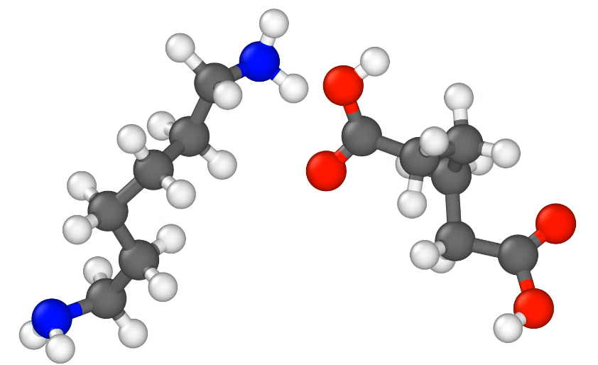
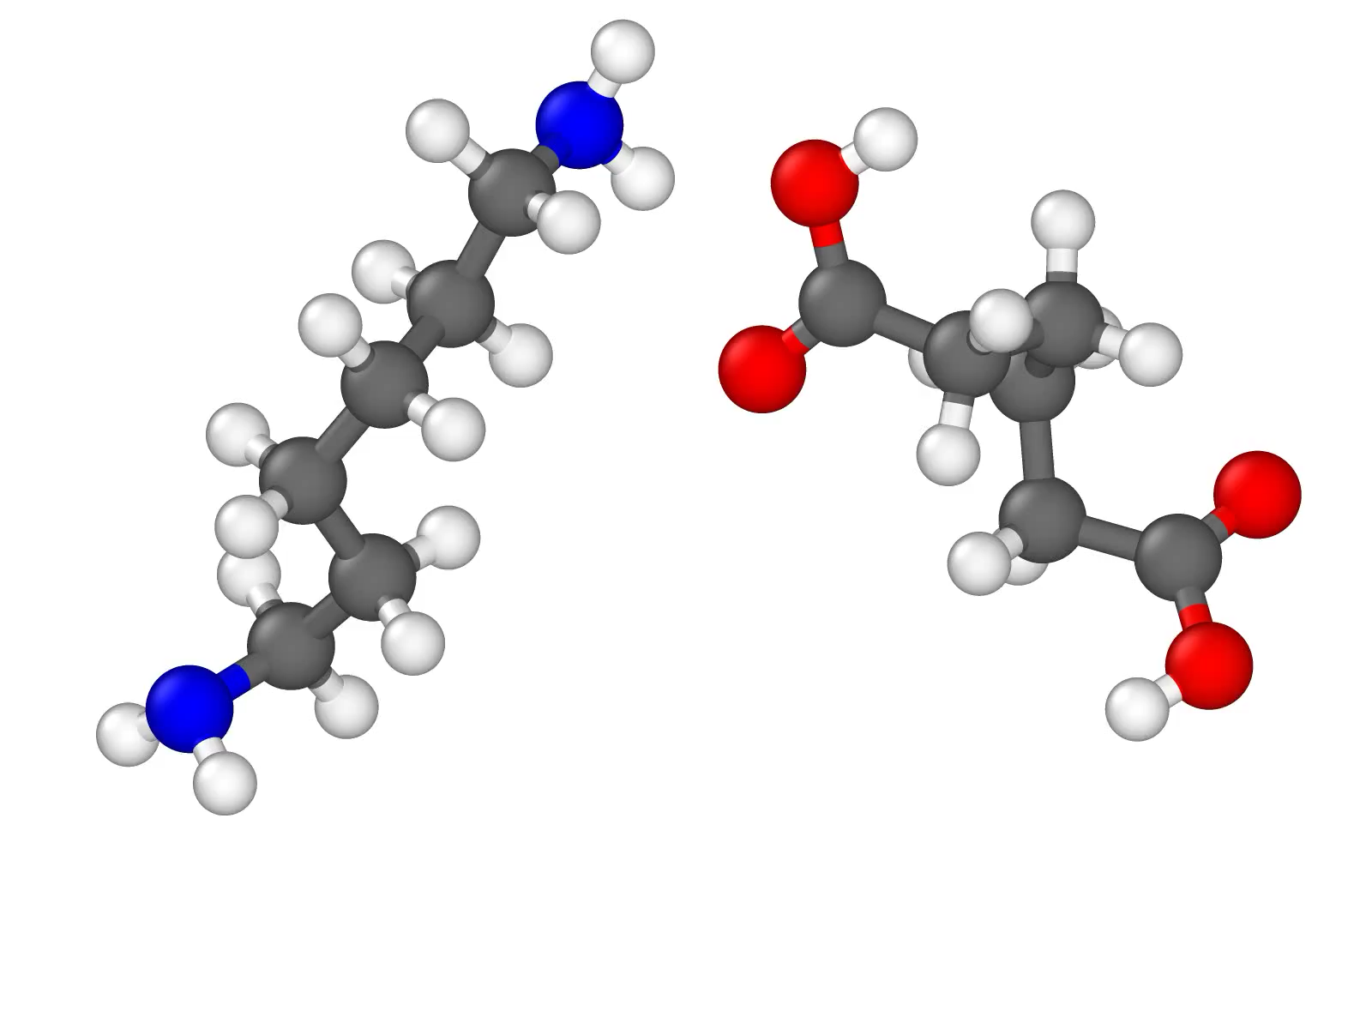
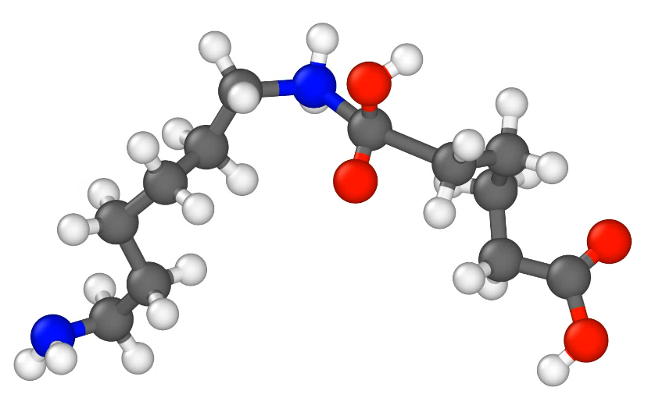
Delete Atoms Based on Topology
1) Delete unwanted reaction by-products
2) Remove specific molecules based on topology (such as small rings)
deletion of condensed water molecule
nylon polycondensation

Slide 5
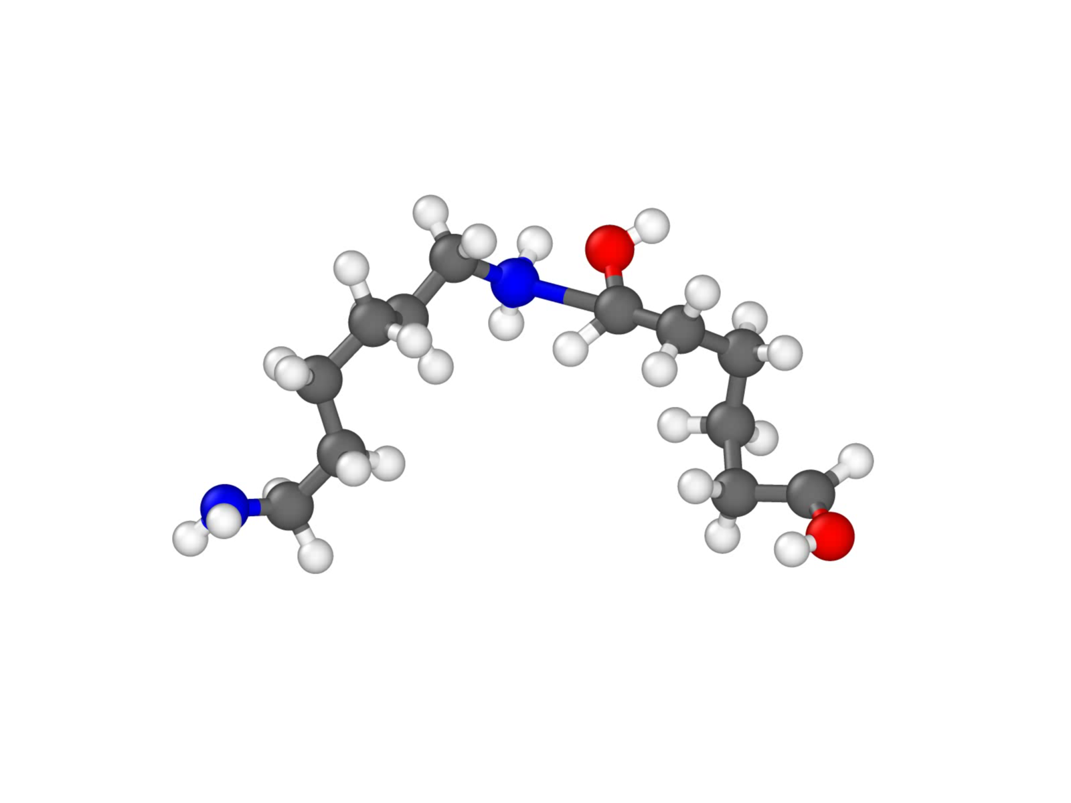
Bond-Breaking Reaction Trigger
Simple criterion for mechanically-induced chain scission

Slide 6
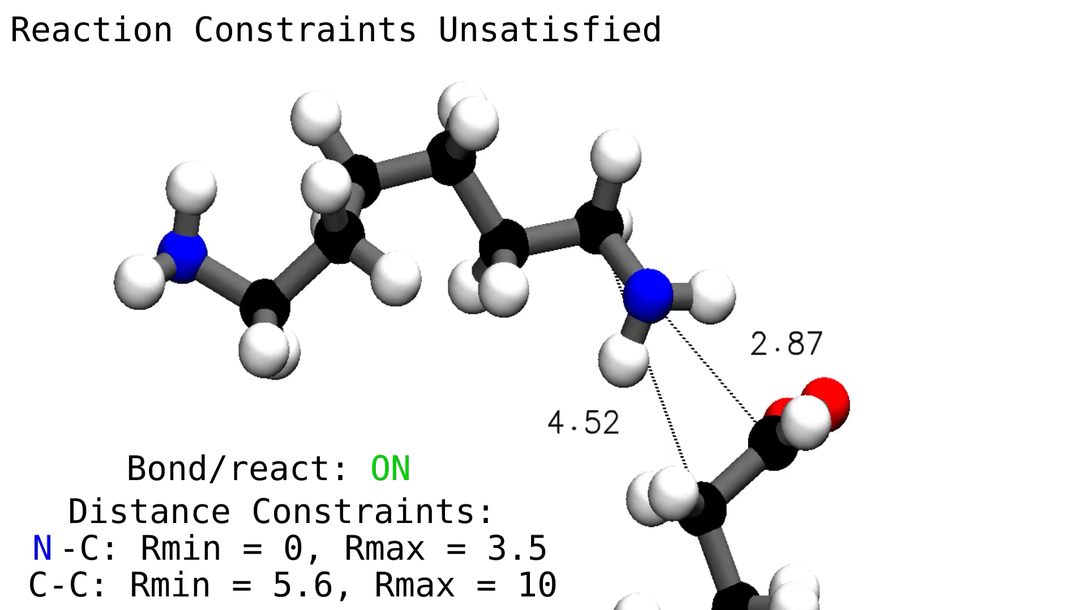
Reaction Constraints
Currently five constraints: Arrhenius, RMSD, distance, angle, dihedral
  Can be used to enforce a relative orientation between reacting molecules
Demo: two distance constraints enforce a certain molecular orientation

Slide 7
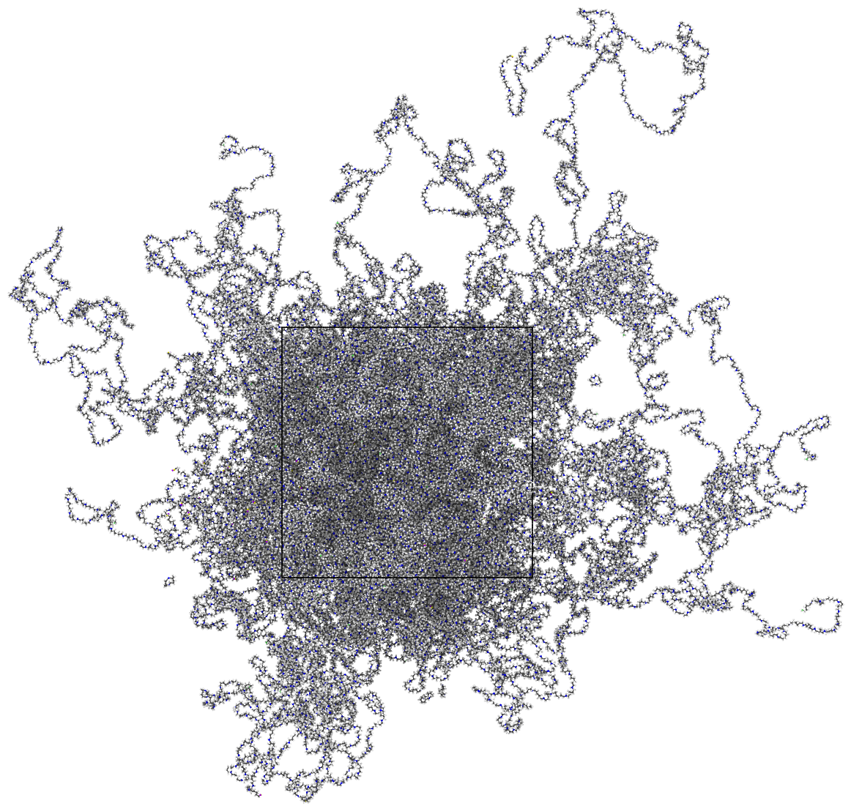
Large-scale Nylon 6,6 Demo
Setup: 5,000x adipic acid
5,000x hexamethylenediamine
220,000 atoms
Temperature: 530 K
(actual synthesis temp)
Final density: 0.9 g/cm³
Side length: 13.3 nm
3-5 Å reaction cutoff
>99% polymerized
condensed water molecules removed

Slide 8
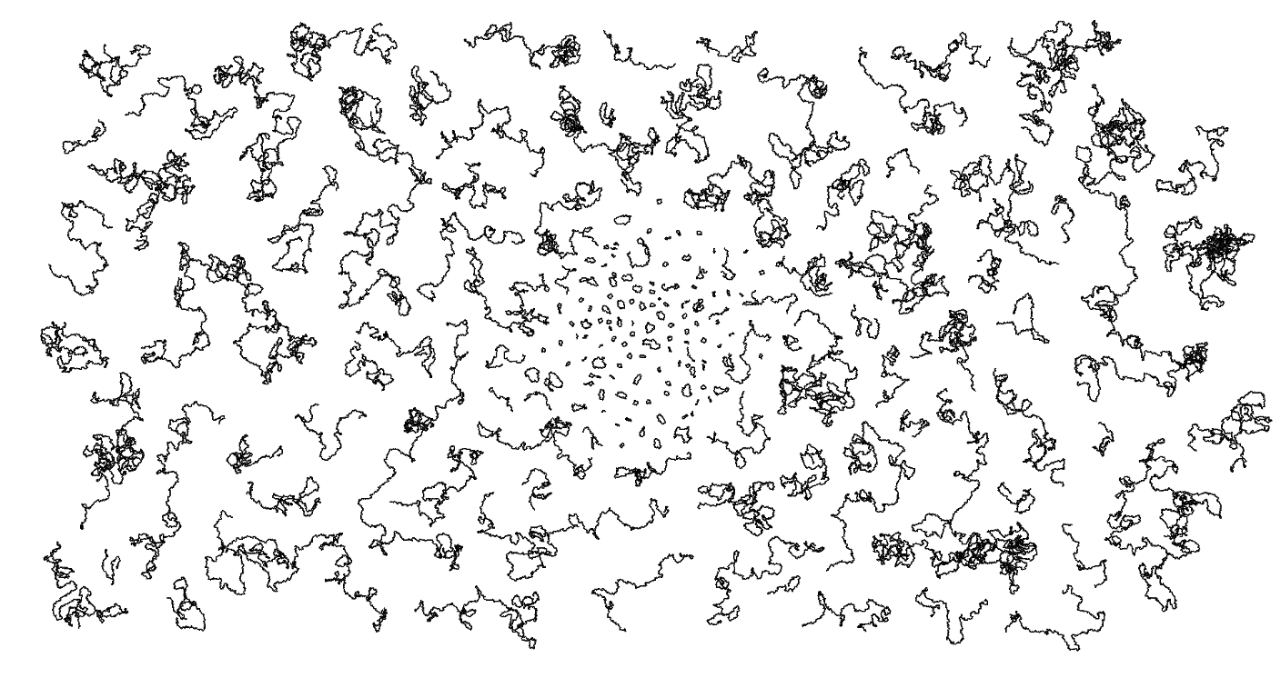
Chain PDI ≈ 2 Overall PDI (with cycles) ≈ 3.9*
(nylon 6,6)
265 repeat units
>7,400 backbone
atoms
only backbone atoms shown
*Experimental PDI ≈ 4.
Solid-state modification of polyamide-6,6. Jeyakumar, A. Eindhoven: Technische Universiteit Eindhoven. 2012.

Slide 9
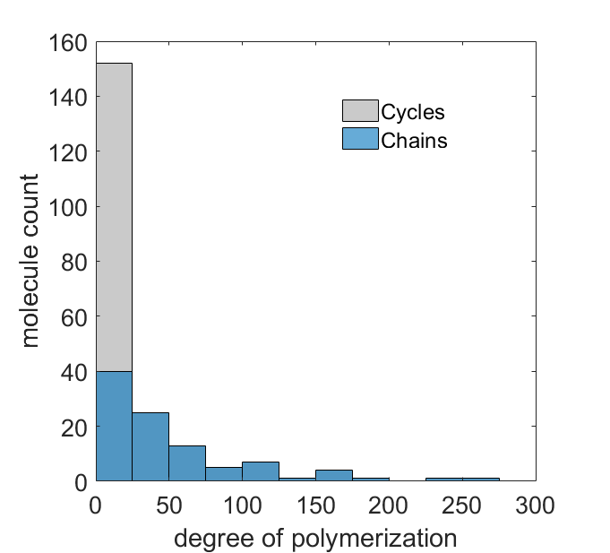
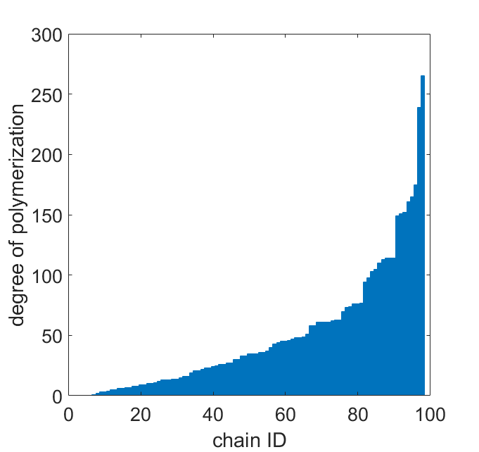
>99% Polymerized Nylon 6,6: Chains vs. Cycles
Cycles
Chains
>250 repeat units
(>500 reactant molecules)
weight % cycles:
simulation: 3.7%
experiment: 1-5%¹
molecule count
degree of polymerization
degree of polymerization
chain ID
¹Endgroup-based separation and quantitation of polyamide-6,6 by means of critical chromatography. Mengerinka, et al. Journal of Chromatography A 949, 337. 2002.

Slide 10
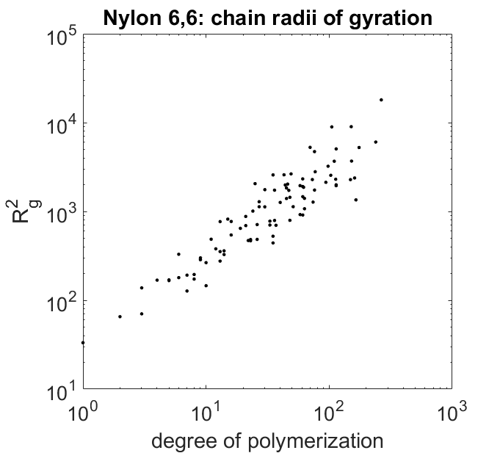
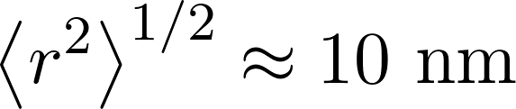
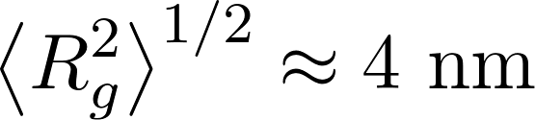
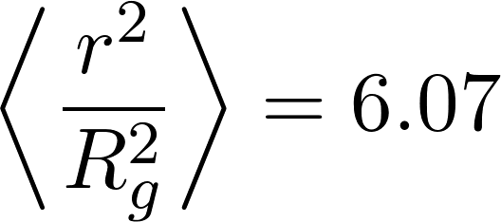
Nylon 6,6: Chain Morphology
Nylon 6,6: chain radii of gyration
end-to-end distance
R_{g}² ~ N^{1.1}
# repeat units
(Å)
radius of gyration
Value for a Gaussian chain:
degree of polymerization

Slide 11
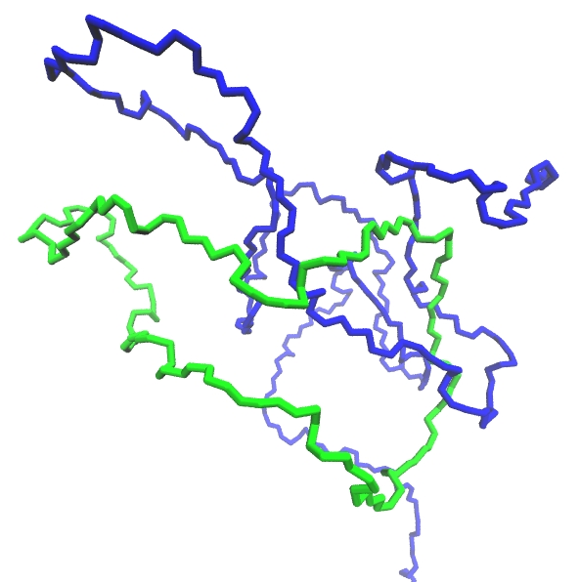
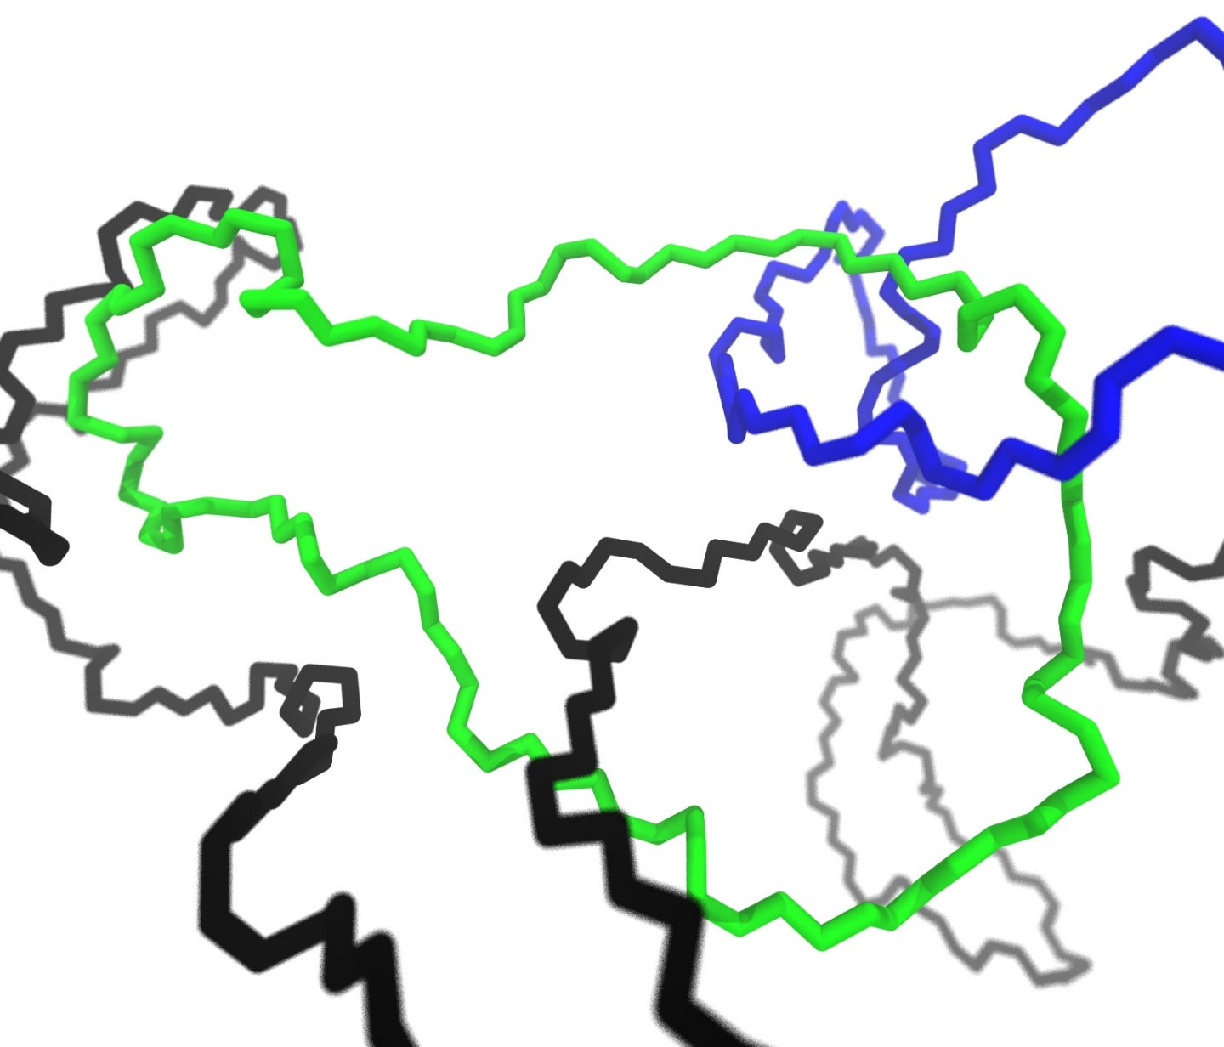
Chain Growth vs. Ring Formation
Nylon 6,6
cycle
cycle
single topologically-constrained cycle
cycle constraining two chains:
physical ‘slip-link’

Slide 12
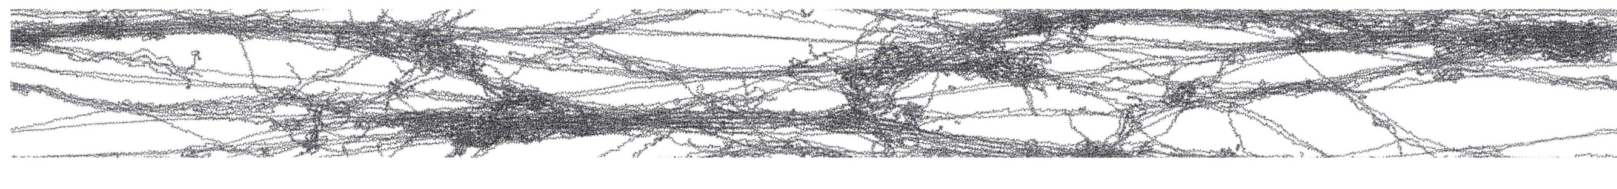
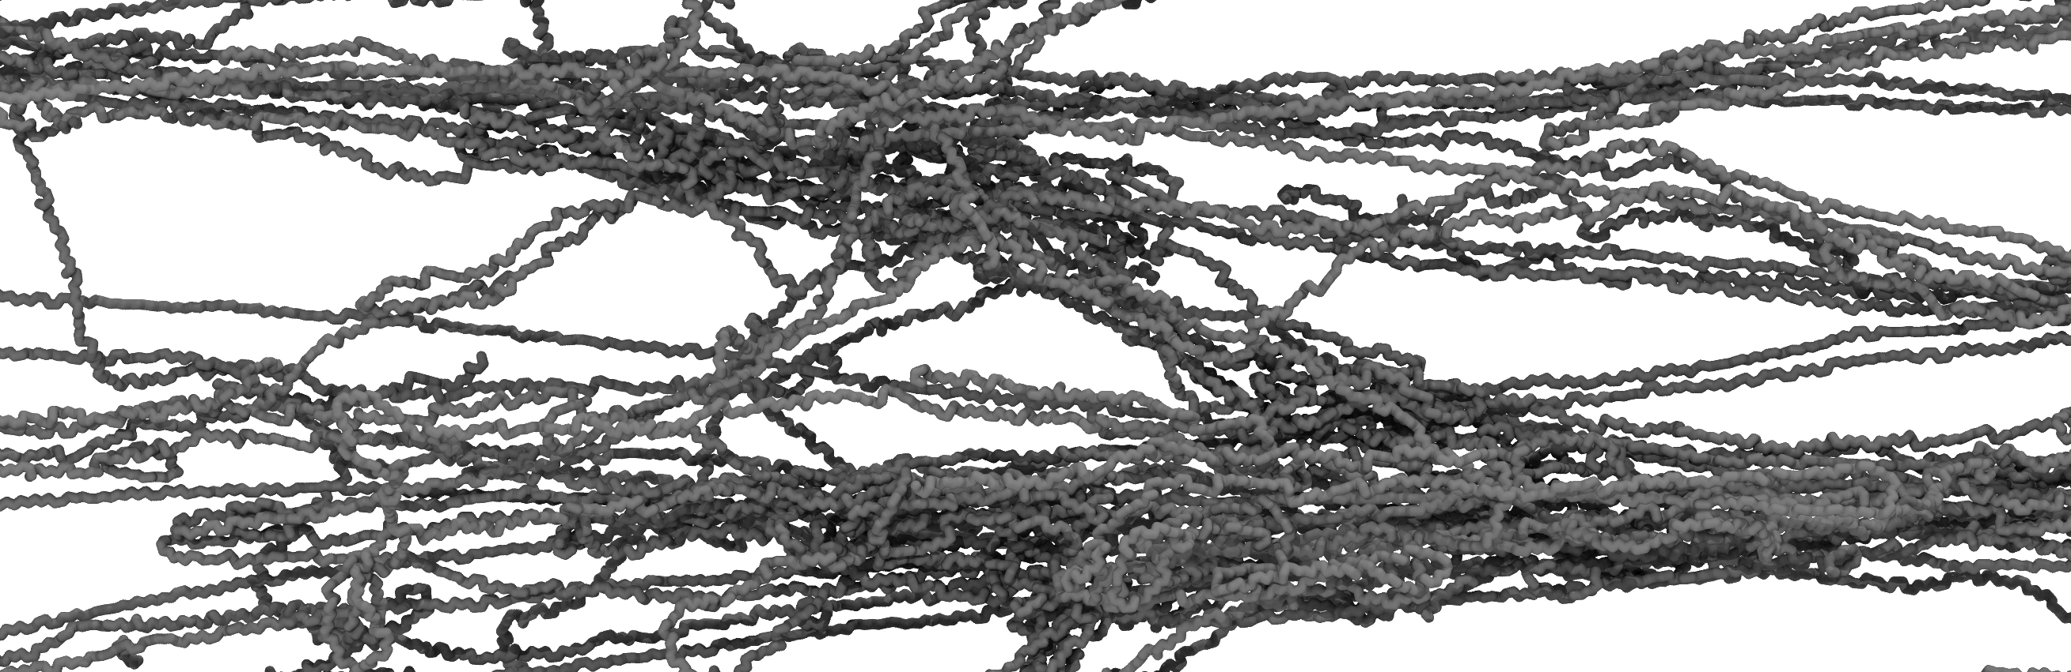
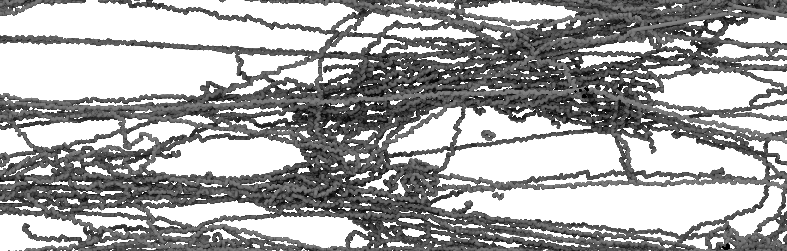
Uniaxial Extension with Chain Scission
130 Å
(nylon 6,6)
1435 Å (~11:1 aspect ratio)
Uniaxial strain
  Highly entangled system
  Craze formation
Chain scission reaction
  Relieve topological constraints
  Activated if C-N bond > 1.67Å
    Chosen empirically
  Only 6 chain scissions occurred

Slide 13
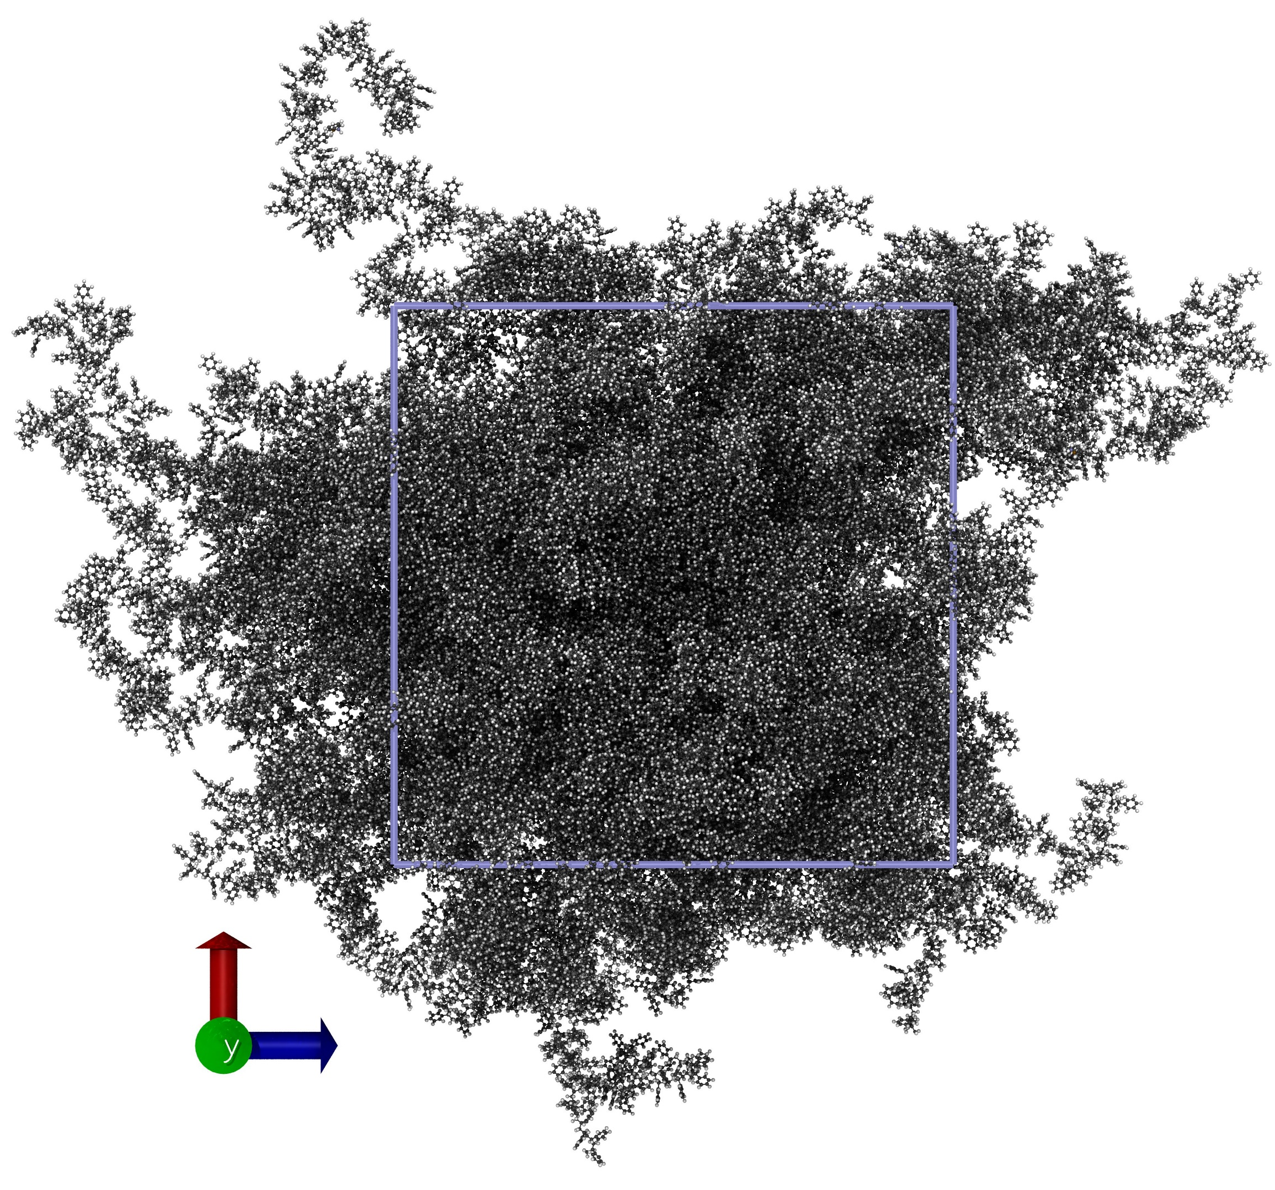
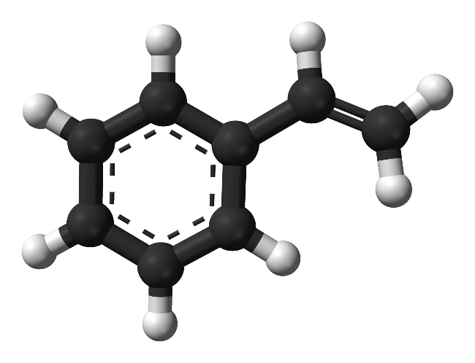
Polystyrene Demo
>99% polymerized polystyrene
200,000 atoms (12,500x styrene)
>98.5% polymerized with 3.0 Å distance cutoff, before switching to 3.5 Å
Conclusion: REACTER can handle small monomers with bulky side groups
530 K
13.7 nm box
REACTER: A Heuristic Method for Reactive Molecular Dynamics.
Gissinger, Jensen & Wise. Macromolecules. 2020 (in press).

Slide 14
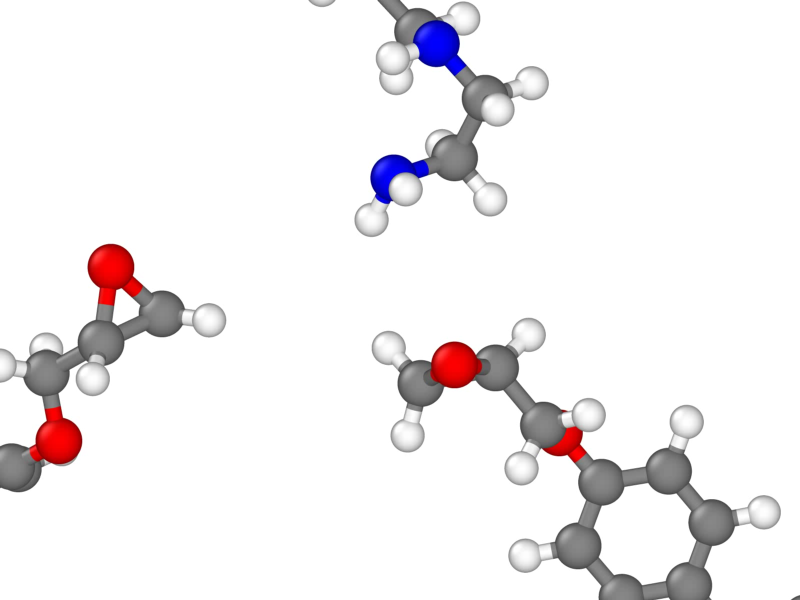
Epoxy Crosslinking
Simple cross-linking mechanism of an amine to two epoxy molecules

Slide 15
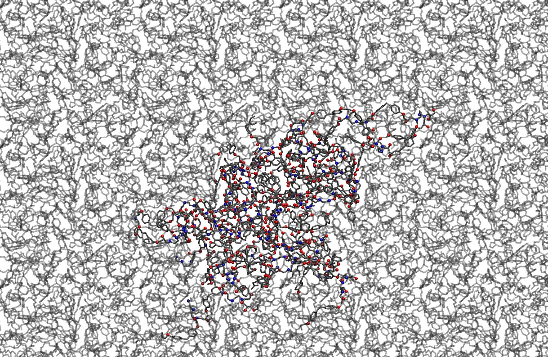
Final Epoxy Morphology
96% cross-linked
Distance cutoffs:
rxn 1: 3.5 Å, rxn 2: 5.0 Å
100 diepoxy molecules,
50 diamine molecules
Run: 200 ps at 800 K
Modeling chemical reactions in classical molecular dynamics simulations. Gissinger, Jensen & Wise. Polymer 128, 211-217. 2017.

Slide 16
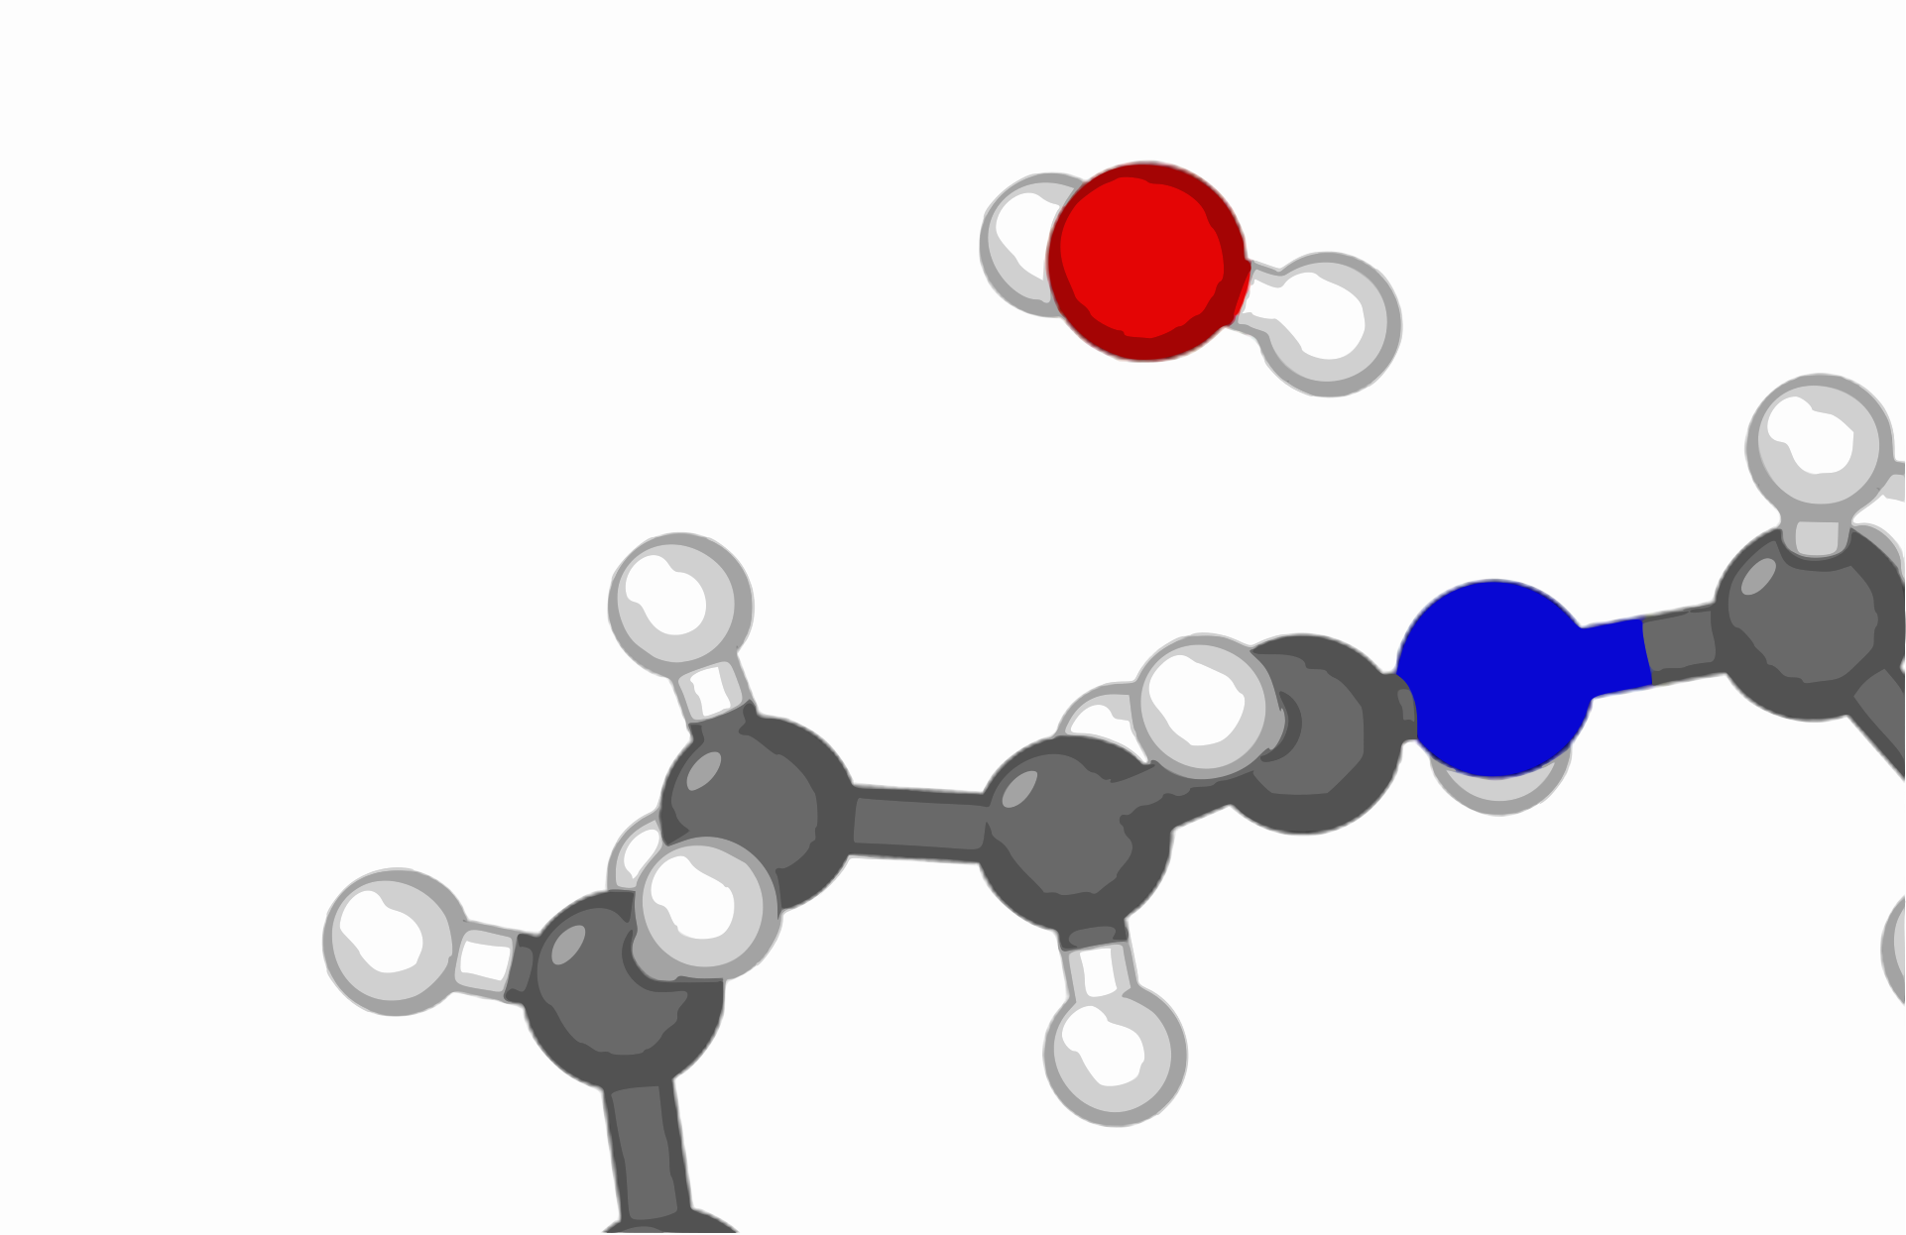
Summary and Outlook
REACTER is a useful tool for building complex morphologies
The REACTER protocol scales well
  10,000 nylon precursors true temp. (≈260 C)
  12,500 styrene molecules low cutoff 3-5 Å
Correctly predicts cyclic content, polydispersity and chain morphology
What’s next?
  More predictive reaction constraints
    Potential energy surfaces?
  Features in progress
    Additional reaction constraints
    Option to insert atoms
>99% polymerization

Slide 17
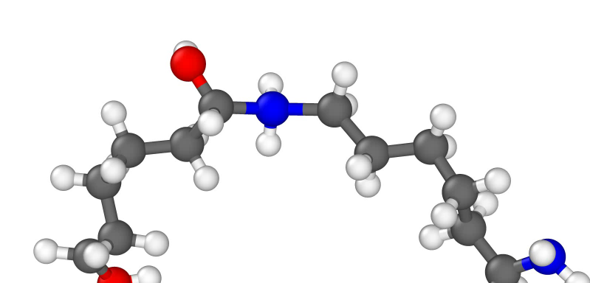

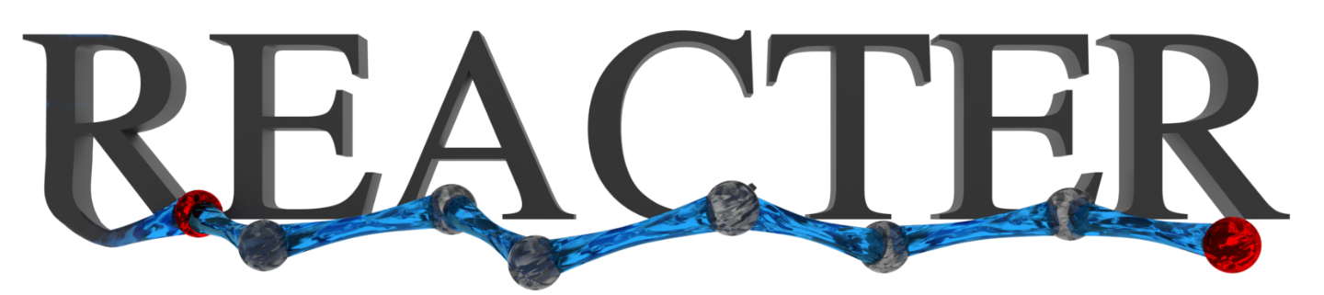
Thank You!
www.reacter.org

