Slide 1
Linear System Assembly on GPU for an Inviscid Flux Miniapp
Daniel Steinberg – University of Illinois at Urbana-Champaign
Jeffrey Hill – NASA
Joey Schulz – AMA
NASA ARC-TS Intern Presentations, August 28, 2020

Slide 2
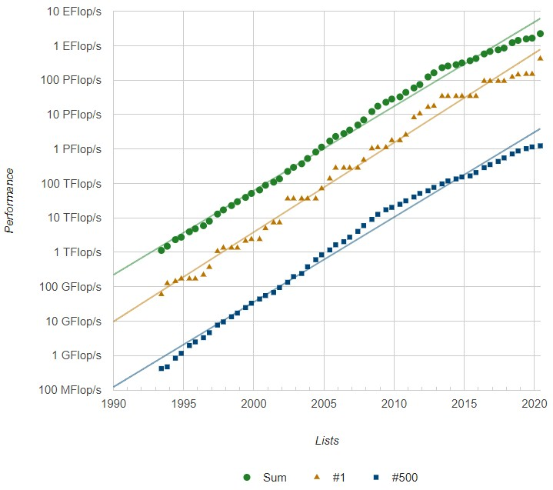
Trends in Computing
More high- power computing (HPC) devices built, more computing power demanded
Allows for larger and more complex problems
Refinements made to existing CFD codes
More advanced physical models
Top 500 computers of various architecture:
Top computer (Fugaku, RIKEN, Japan) still runs on CPU (central processor)
Increasing number of GPU-based cores (graphics processor)
Heterogeneous architecture: CPU and GPU working in tandem within a system
To allow for use in more HPC systems, code necessary to be implementable on GPU
Performance of HPCs over time (nextplatform.com)

Slide 3
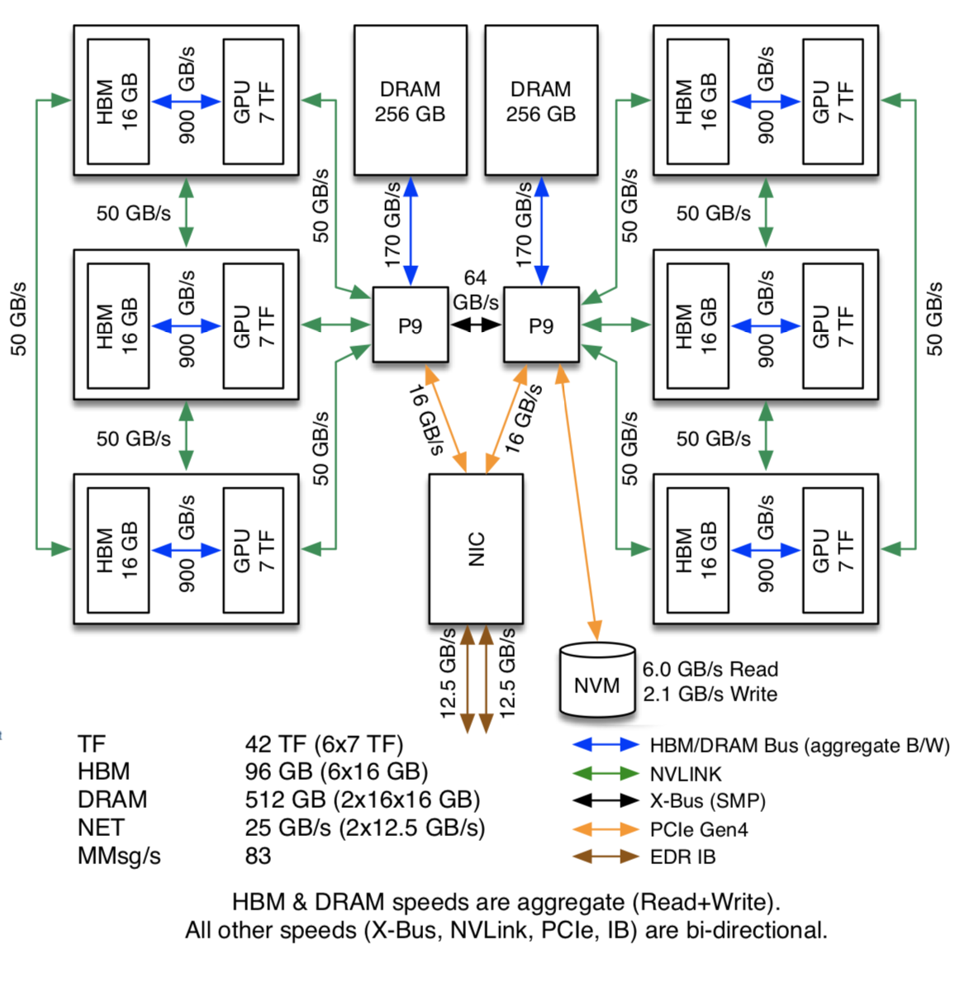
Why GPU?
CPU (Central Processing Unit)
GPU (Graphics Processing Unit)
More adept at serial processing
Lower latency
Few complex cores
More adept at massive-parallel processing
Higher throughput
Multiple simple compute elements
Lower power and cost requirements
High temperature, multi-species gas physics codes are one such massively-parallel routine
Typically run on large domains
Requires flux computation across multiple faces simultaneously
Single Summit node
Modern HPC machines are evolving rapidly; how can we write code to also leverage the GPU?

Slide 4
Project Goals
DPLR: Current implementation of high-temperature, reacting Navier-Stokes gas physics routine
Inviscid routine represents greatest bottleneck
Can we turn that implementation into a performant GPU miniapp?
Miniapp (mini-application): tool to simulate section of larger code
Represents area of significant time consumption
Is the GPU more performant for these flow routines than CPU, by how much?

Slide 5
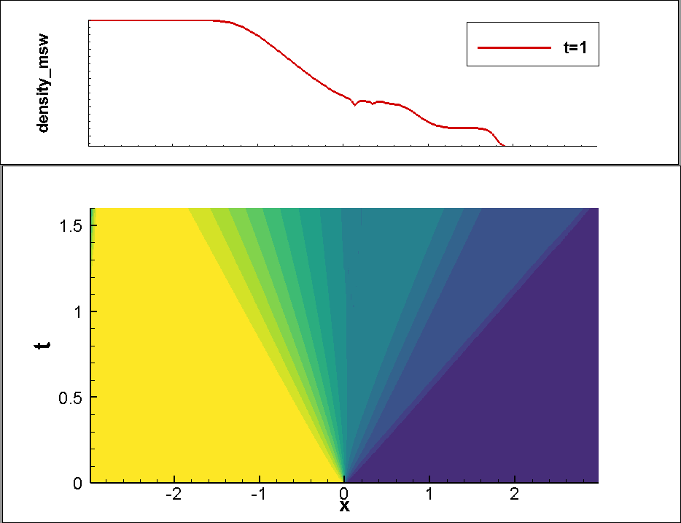
Inviscid Flow Solver: 1D
Motivation for creating multi-dimensional flow solver:
Reacting gases can contain multiple species (e.g. N₂, NO⁺)
Exist at multiple spatial temperatures (translational, vibro-electronic)
Reentry flow structures like conical shocks need multiple spatial dimensions to be described
Start with simple, 1D, perfect gas code
Goal: take shock tube code, implement in C++, modified Steger-Warming
Modified Steger-Warming used in DPLR
Algorithm:
$F=\frac{∂F}{∂Q}Q=JQ=(LΛR)Q$
$Λ=Λ_{+}+Λ_{−}, Λ_{+}=\frac{1}{2}\left(Λ+\left|Λ\right|\right), Λ_{−}=…$
$F^{+}=J_{i+\frac{1}{2}}^{+}Q_{i},F^{−}=J_{i+\frac{1}{2}}^{−}Q_{i+1},F=F^{+}+F^{−}$
Verified with standard shock tube problem; shock and rarefaction structures behave as expected
Contact
Fan
Shock
Toro test 1: $P_{1}=8P_{2},ρ_{1}=10ρ_{2},u_{1}=u_{2}=0$

Slide 6
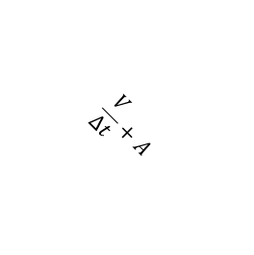
Inviscid Flow Solver: 3D
Analytical form of flux Jacobian (two temperature model):
$F=\left(\begin{matrix}ρ_{s}U \\ ρUu+p\hat{n} \\ \begin{aligned}ρUe_{v} \\ ρUH\end{aligned}\end{matrix}\right),U=u⋅\hat{n},H=e_{v}+e_{t}+\frac{u⋅u}{2}+\frac{p}{ρ}$
Jacobian computed directly from eigenvalues and eigenvectors, flux using modified Steger-Warming
Algorithm for computing inviscid flux kernel:
Septadiagonal (3D), block-banded linear system
$res\left(i,j,k\right)=\left(\frac{V}{Δt}+A\right)⋅du+A_{i−1}du_{i−1}+A_{i+1}du_{i+1}+…$
Compute flux between cell $Q_{i,j,k}$ and each of its six spatial neighbors in parallel (Kokkos)
Sum all fluxes for total flux, store to residual vector
$$. . .$$
$$B_{j+\frac{1}{2}}$$
$$\frac{V}{Δt}+A$$
$$A_{i+\frac{1}{2}}$$
$$A_{i−\frac{1}{2}}$$
$$B_{j−\frac{1}{2}}$$
$$. . .$$
2D representation of block-banded system

Slide 7
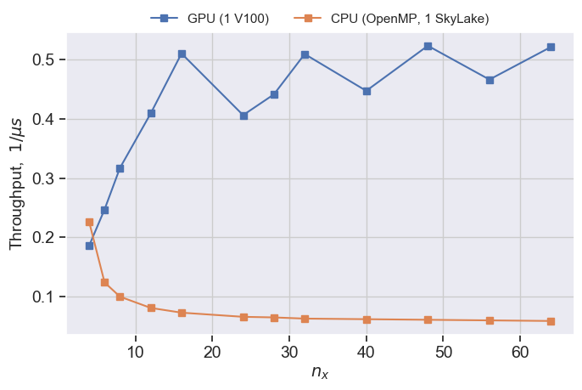
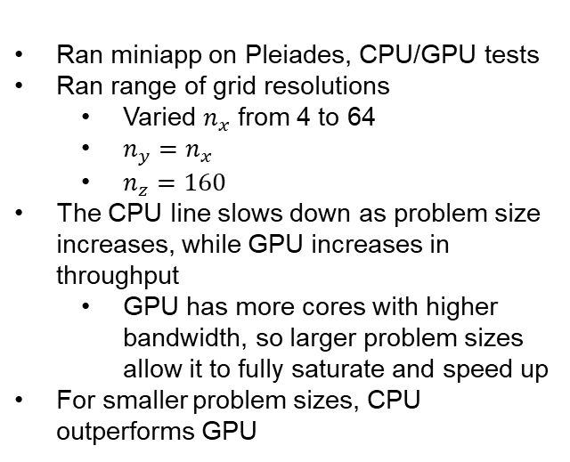
Results: CUDA vs OpenMP
Ran miniapp on Pleiades, CPU/GPU tests
Ran range of grid resolutions
Varied $n_{x}$ from 4 to 64
$n_{y}=n_{x}$
$n_{z}=160$
The CPU line slows down as problem size increases, while GPU increases in throughput
GPU has more cores with higher bandwidth, so larger problem sizes allow it to fully saturate and speed up
For smaller problem sizes, CPU outperforms GPU
Saturation
Throughput vs spatial resolution for CPU and GPU

Slide 8
Conclusions and Future Work
Conclusions:
GPU implementation is viable, can perform better than CPU for large problems
CPU can dominate for smaller problem sizes
Only naïve implementation, room for refinement and sizeable margin of error
Future work:
Investigate different CPU and GPU implementations
Can they be further optimized?
Does this result hold up as we optimize CPU?

Slide 9
QUESTIONS?

Slide 10
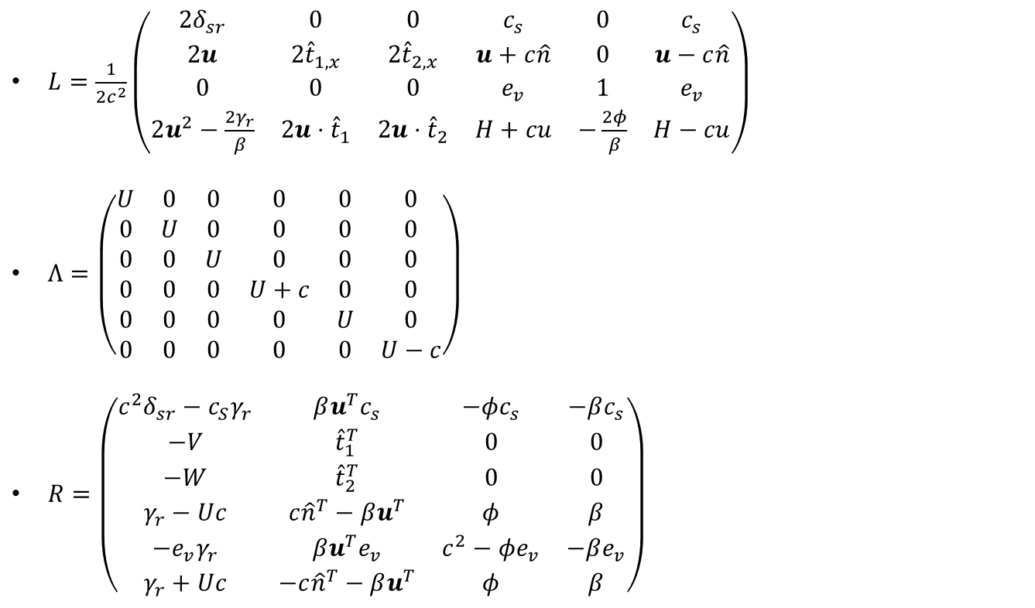
Eigenvalues and Eigenvectors
$L=\frac{1}{{2c}^{2}}\left(\begin{matrix}{2δ}_{sr} & 0 & 0 & c_{s} & 0 & c_{s} \\ 2u & {2\hat{t}}_{1,x} & {2\hat{t}}_{2,x} & u+c\hat{n} & 0 & u−c\hat{n} \\ 0 & 0 & 0 & e_{v} & 1 & e_{v} \\ 2u^{2}−\frac{{2γ}_{r}}{β} & 2u⋅{\hat{t}}_{1} & 2u⋅{\hat{t}}_{2} & H+cu & −\frac{2φ}{β} & H−cu\end{matrix}\right)$
$Λ=\left(\begin{matrix}U & 0 & 0 & 0 & 0 & 0 \\ 0 & U & 0 & 0 & 0 & 0 \\ 0 & 0 & U & 0 & 0 & 0 \\ 0 & 0 & 0 & U+c & 0 & 0 \\ 0 & 0 & 0 & 0 & U & 0 \\ 0 & 0 & 0 & 0 & 0 & U−c\end{matrix}\right)$
$R=\left(\begin{matrix}c^{2}δ_{sr}−c_{S}γ_{r} & βu^{T}c_{s} & −φc_{s} & −βc_{s} \\ −V & {\hat{t}}_{1}^{T} & 0 & 0 \\ −W & {\hat{t}}_{2}^{T} & 0 & 0 \\ γ_{r}−Uc & c{\hat{n}}^{T}−βu^{T} & φ & β \\ −e_{v}γ_{r} & βu^{T}e_{v} & c^{2}−φe_{v} & −βe_{v} \\ γ_{r}+Uc & −c{\hat{n}}^{T}−βu^{T} & φ & β\end{matrix}\right)$

Slide 11
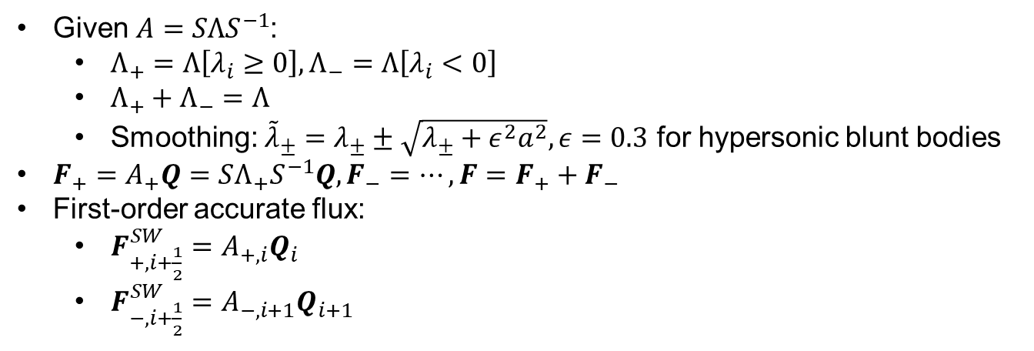
Steger-Warming Algorithm
Given $A=SΛS^{−1}$:
$Λ_{+}=Λ\left[λ_{i}≥0\right],Λ_{−}=Λ\left[λ_{i}<0\right]$
$Λ_{+}+Λ_{−}=Λ$
Smoothing: ${\tilde{λ}}_{±}=λ_{±}±\sqrt{λ_{±}+ε^{2}a^{2}},ε=0.3$ for hypersonic blunt bodies
$F_{+}=A_{+}Q=SΛ_{+}S^{−1}Q,F_{−}=…,F=F_{+}+F_{−}$
First-order accurate flux:
$F_{+,i+\frac{1}{2}}^{SW}=A_{+,i}Q_{i}$
$F_{−,i+\frac{1}{2}}^{SW}=A_{−,i+1}Q_{i+1}$

Slide 12
Modified Steger-Warming Algorithm
Evaluate split Jacobians at the same index (first-order accurate):
$F_{+,i+\frac{1}{2}}^{mod. SW}=A_{+,i+\frac{1}{2}}Q_{i}$
$F_{−,i+\frac{1}{2}}^{mod. SW}=A_{−,i+\frac{1}{2}}Q_{i+1}$
Half-indices indicate average of states
For second-order accuracy, improve $Q$ with projections:
$F_{+,i+\frac{1}{2}}^{mod. SW}=A_{+,i+\frac{1}{2}}Q_{i+\frac{1}{2}}^{L}$
$F_{−,i+\frac{1}{2}}^{mod. SW}=A_{−,i+\frac{1}{2}}Q_{i+\frac{1}{2}}^{R}$
$Q_{i+\frac{1}{2}}^{L}=\frac{3}{2}Q_{i}−\frac{1}{2}Q_{i−1},Q_{i+\frac{1}{2}}^{R}=\frac{3}{2}Q_{i+1}−\frac{1}{2}Q_{i+2}$
MUSCL for improved accuracy:
$Q_{i+\frac{1}{2}}^{L}=Q_{i}+\frac{1}{6}\left(Q_{i}−Q_{i−1}\right)+\frac{1}{3}\left(Q_{i+1}−Q_{i}\right)$
$Q_{i+\frac{1}{2}}^{R}=Q_{i+1}−\frac{1}{6}\left(Q_{i+2}−Q_{i+1}\right)−\frac{1}{3}\left(Q_{i+1}−Q_{i}\right)$

Slide 13
Miniapp outputs:
Domain size ($n_{x}×n_{y}×n_{z}$)
Density residual
Elapsed time ($t$)
Throughput $\left(\frac{n_{x}n_{y}n_{z}}{t}\right)$
Backup:
Working theory: for $n_{x}≥12$, CPU memory saturates

